Slide 1

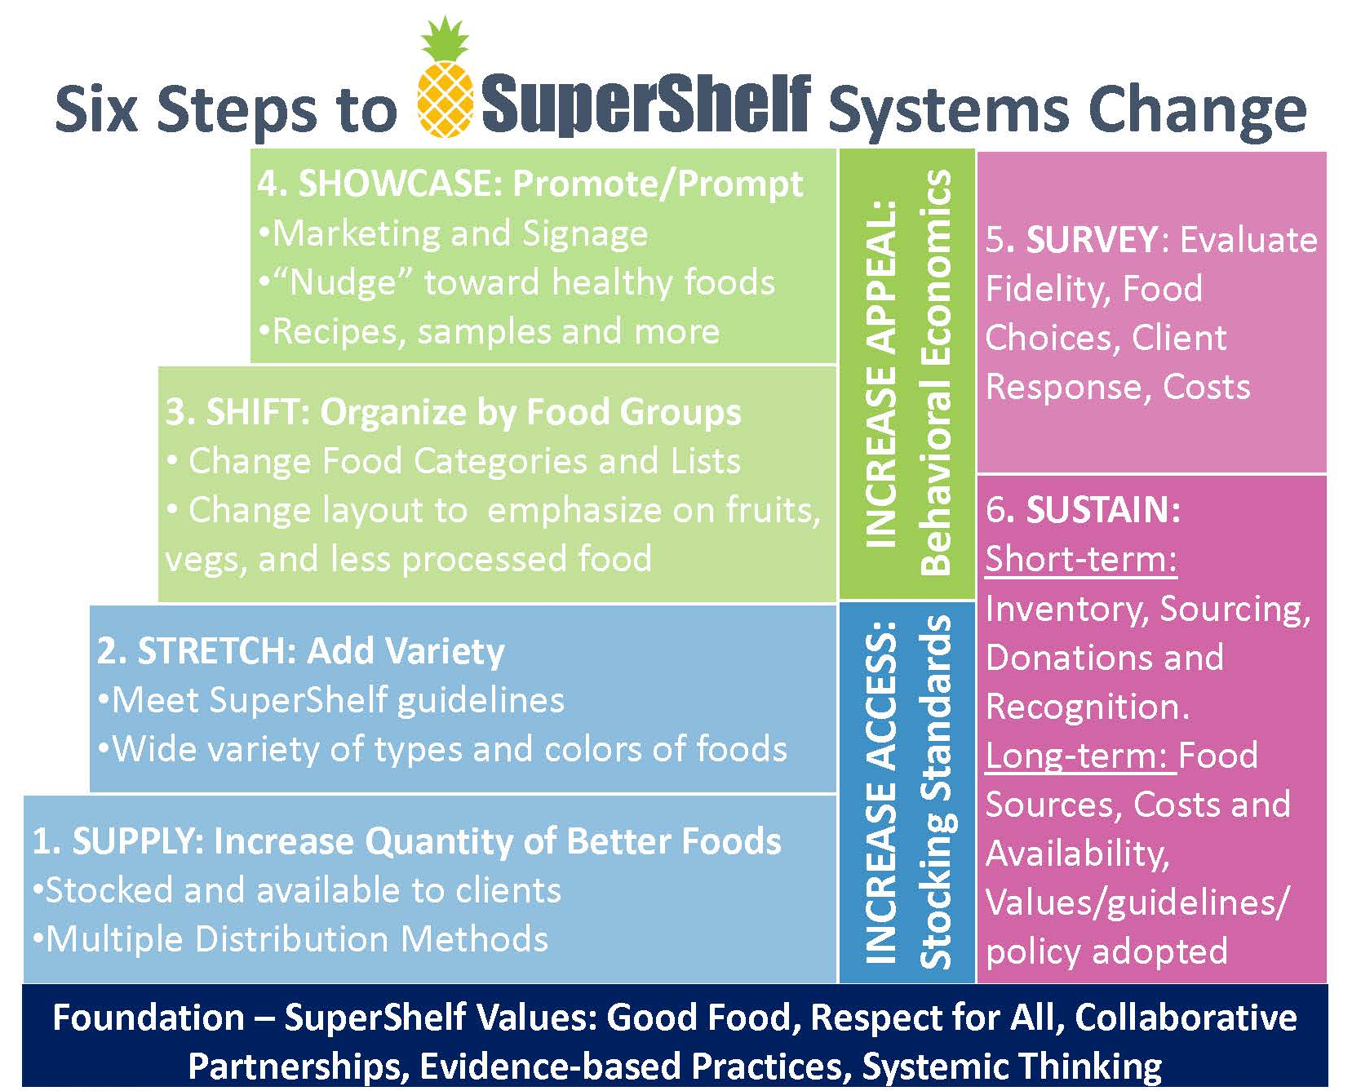
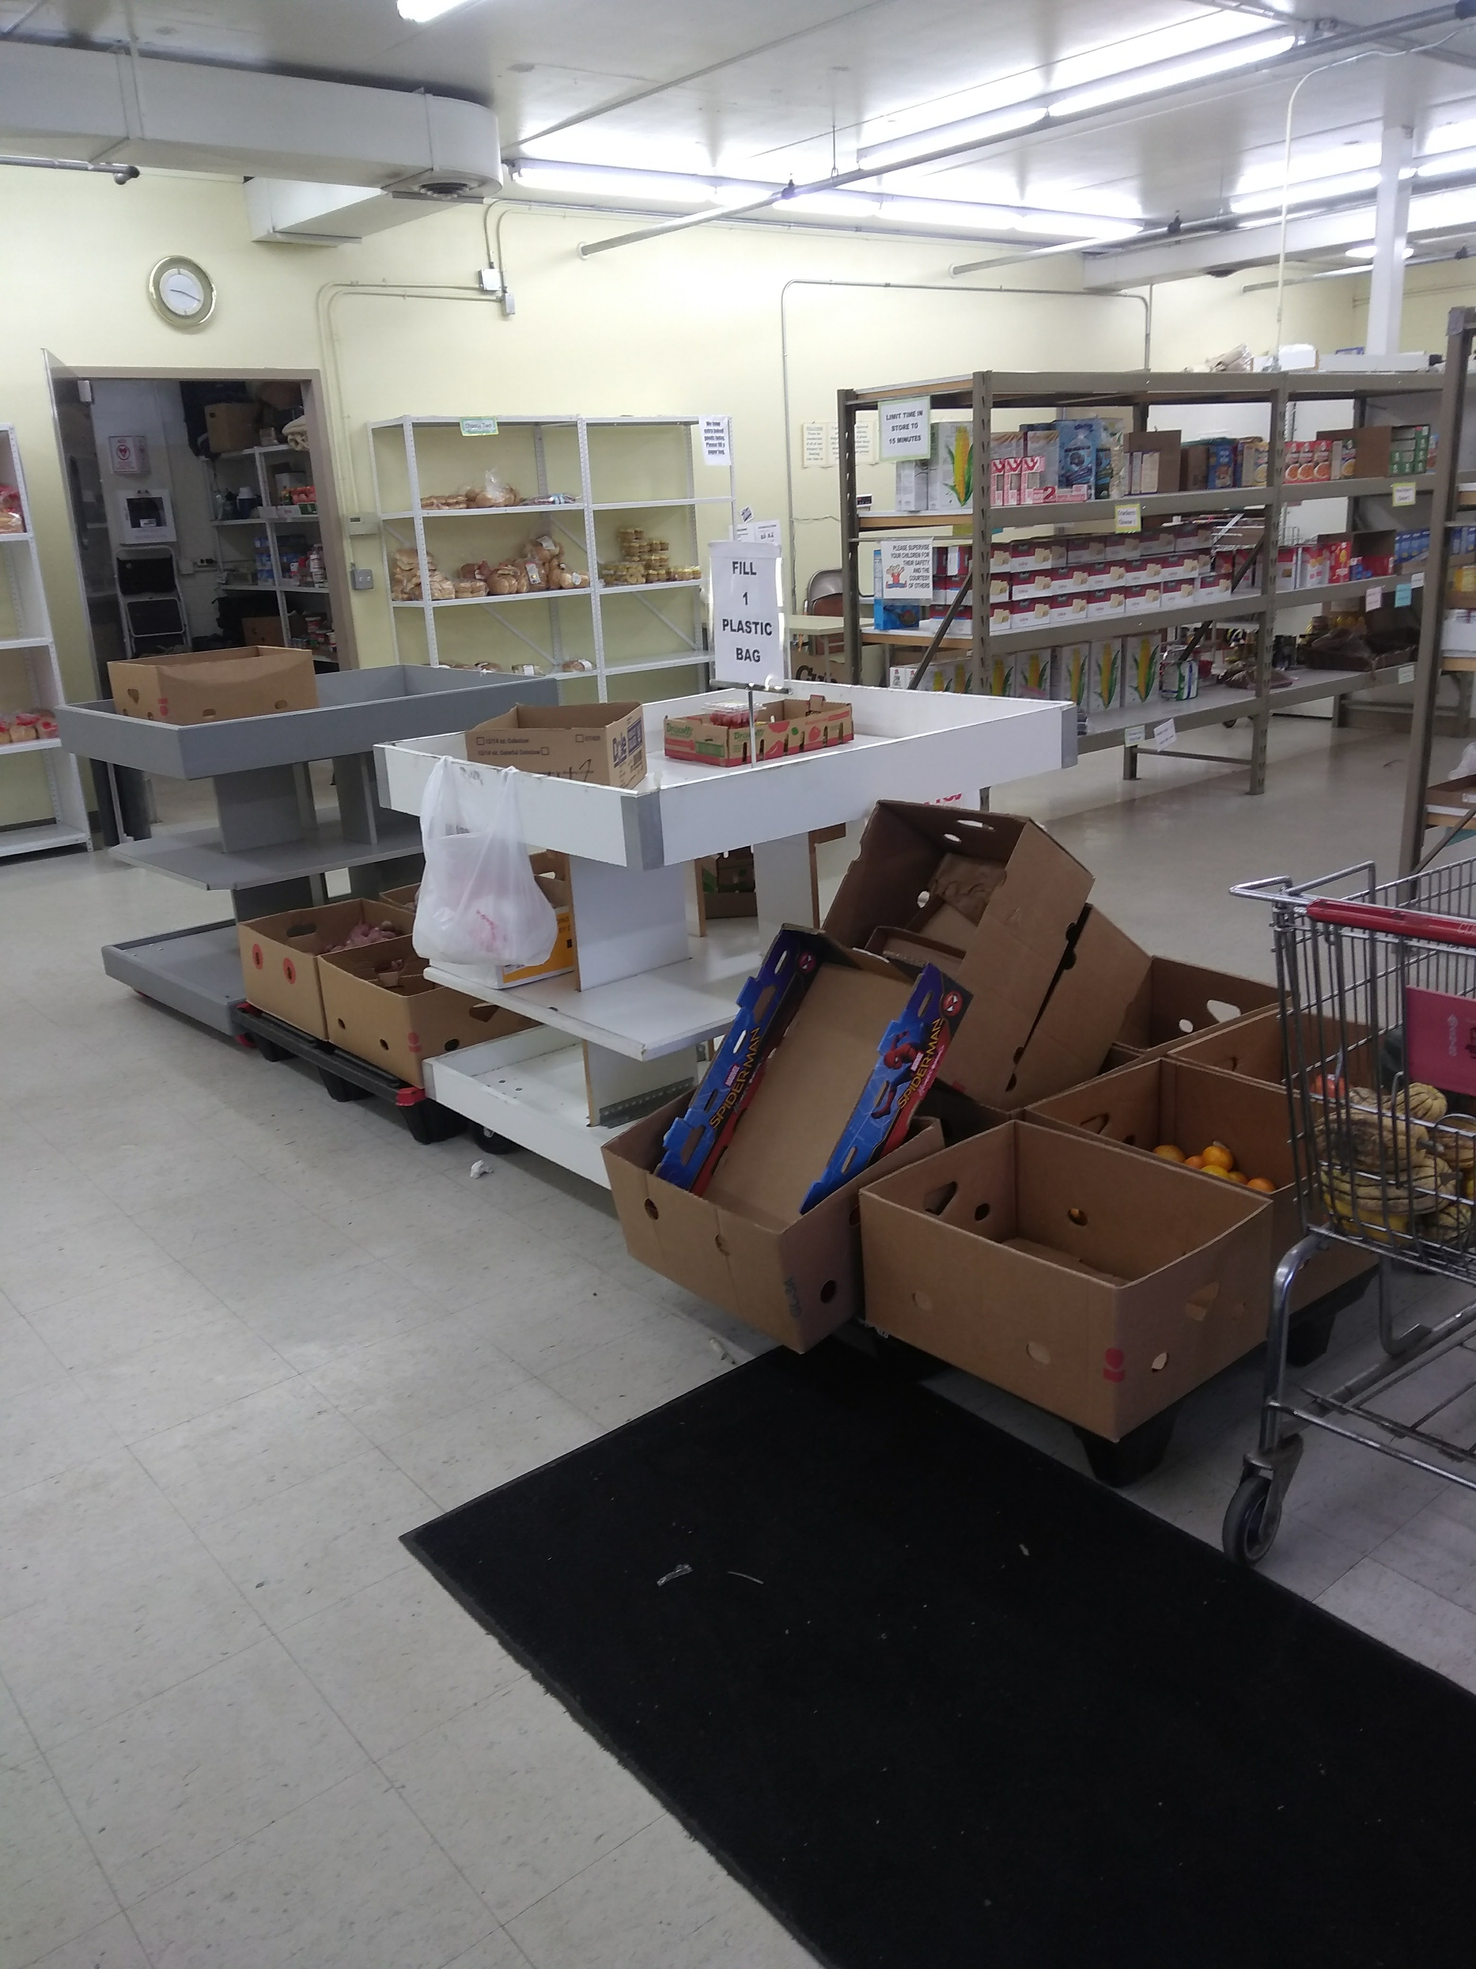
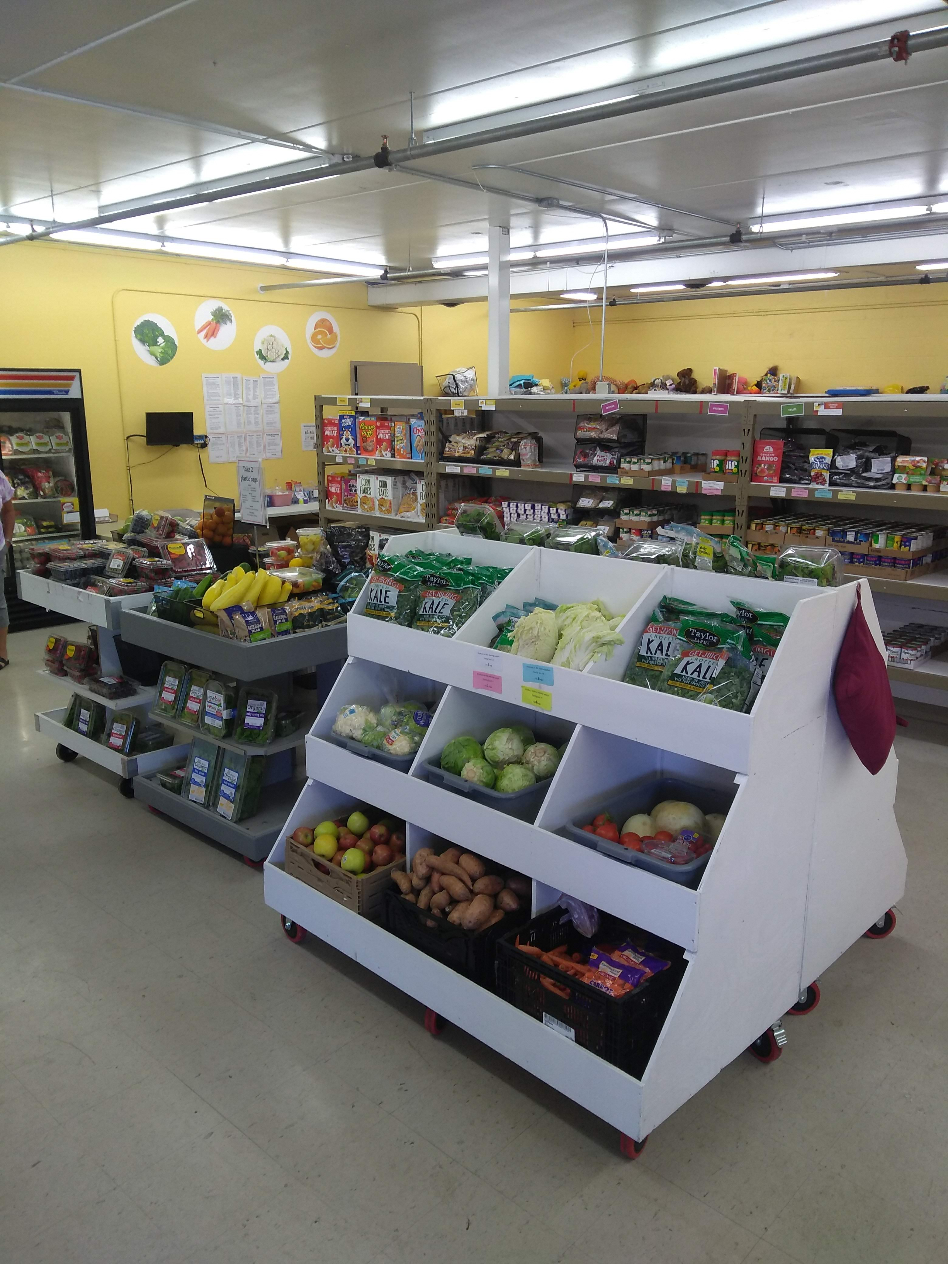
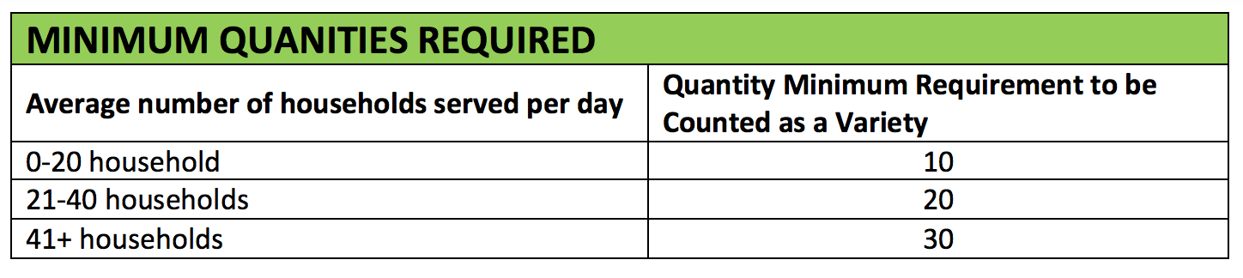
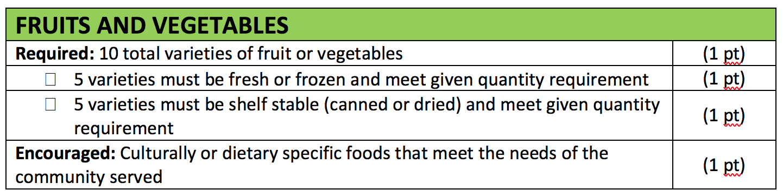


A Tool to measure implementation of food pantry transformations
Marna Canterbury, MS, RD¹; Laura Bohen, MPH²; Nora Gordon, MPH³; Katherine Grannon, MPH, RD³; Nathan Hesse²; Jamie Bain², MPH; Sarah Schmidt⁴; Elizabeth Riley, MPP, MSW⁵; Caitlin Caspi, ScD³
TRANSFORMED TO BRING GOOD FOOD TO ALL
1. HealthPartners 2. University of Minnesota Extension 3. University of Minnesota Department of Family Medicine and Community Health 4. The Food Group 5. Valley Outreach
WHAT IS SUPERSHELF?
A partnership of organizations working together to create multi-level engagement where evidence-based evaluation, on the ground transformational work and growing engagement by leaders in the hunger sector come together around a shared vision of a transformed food system where all people thrive.
METHODS
The evaluation tool measures compliance with the SuperShelf Six Steps Methods. A overall environment measure was developed during a pilot evaluation of SuperShelf to healthy food availability (specific food stocking standards), and healthy food appeal (behavioral economic strategies). The tool was then used to measure the transformation of a food shelf in the larger evaluation.
Results
100
56
FIDELITY EXAMPLE QUESTIONS AND SCORING
QUESTION | RESPONSE OPTIONS (points)
Aesthetics and Layout (28 points)
Are colorful signs (larger than 11x8.5) displayed that show appealing foods | - More than 3 (2pts) - 1-3 (1 pt) - None (1 pt)
The layout impedes the flow of clients. (e.g., they back track, get lodged in tights spots, etc.) | - Yes, I observed this (0 pts) - Yes, I observed this to some extent (.5 pts) - No, I did not observe this (1 pt)
Healthy food prominence and appeal (21 points)
Are fruits and vegetables the first item clients can select? | - Yes (2 pts) - No (0 pts)
Select the strategies that are being used to display fruits and vegetables displayed in an appealing manner? (select all that apply) | - In colored bins (1 pt) - Sorted/organized (1 pt) - Not bruised or moldy (1 pt) - Stocked abundantly (1 pt) - Other ( 1pt if < 4 selected) - None (0 pts)
Unhealthy food placement and competition (22 points)
Is Hamburger Helper displayed for selection after F/V, WG, and beans? | - Yes (2 pts) -Yes, but out of stock (1 pt) - No not stocked at all (2 pts) - No, not displayed after F/V (0 pts)
Is Hamburger Helper grouped with other products? (if stocked) | - Yes (2pts) - No (0 pts)
Stocking Standards (29 points)
Are there 10 total fruits and veggie varieties? | - Yes (1 pt) - No (0 pts)
Are there 8 total protein varieties? | - Yes (1 pt) - No (0 pts)
FOOD PANTRY TRANSFORMATIONS
SuperShelf works with food pantries to:
Create a food pantry environment that is client centered, promoting and respecting individual choice
Increase access to a variety of healthy, culturally appropriate food
Apply behavioral economic principles to promote healthy food choices
Create an appealing environment by transforming the physical space
Meet specific SuperShelf standards, methods, and values
Make the healthiest choice the easiest choice for all
Before
After
Discussion
This tool can be used to measure whether food pantries meet standards of healthfulness and client-centeredness. While specific to the SuperShelf initiative, the tool can inform the evaluation procedures of other initiatives in food pantries.
www.supershelfmn.org
Acknowledgements:
This study was funded by the National Heart, Lung, and Blood Institute
PI: Caitlin E. Caspi, Grant Number: 5R01HL136640-02

