Slide 1


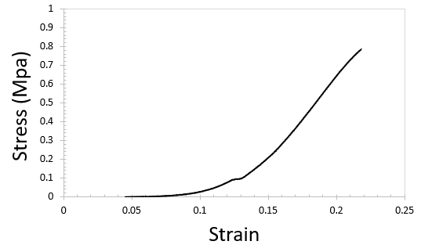
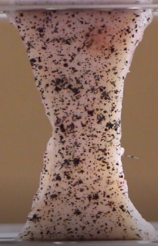
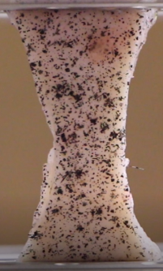
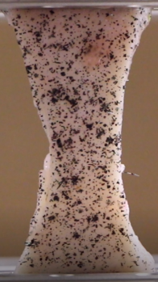
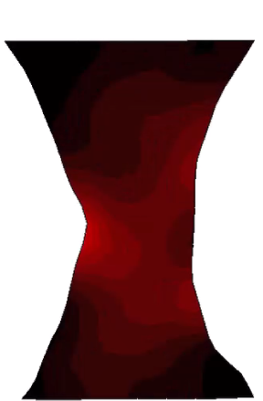
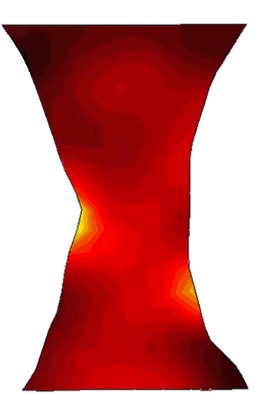
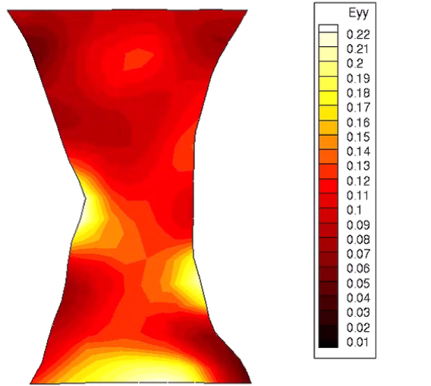
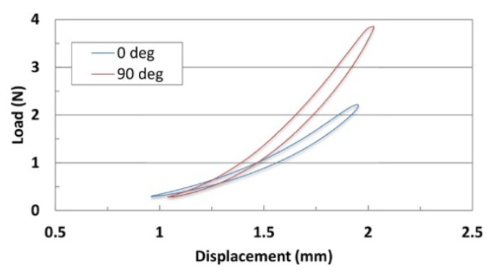
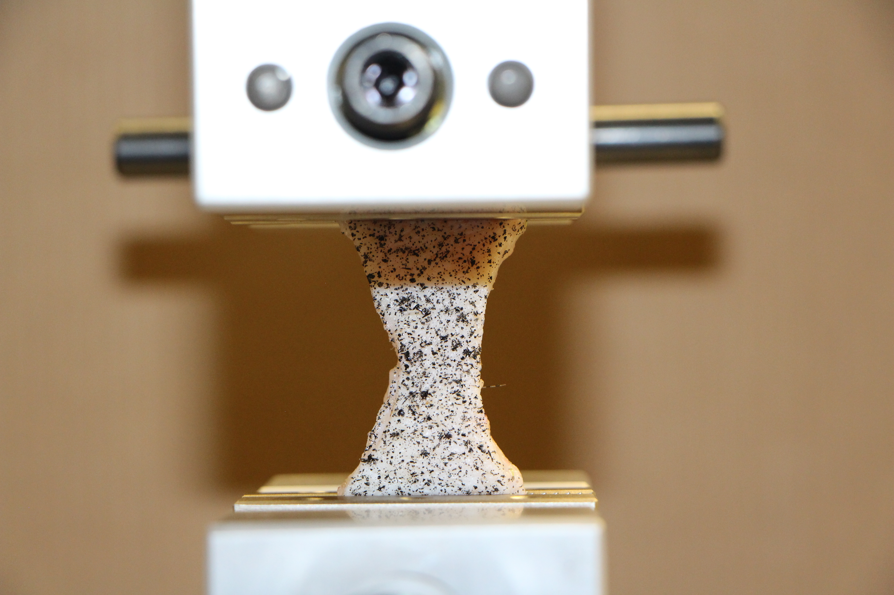
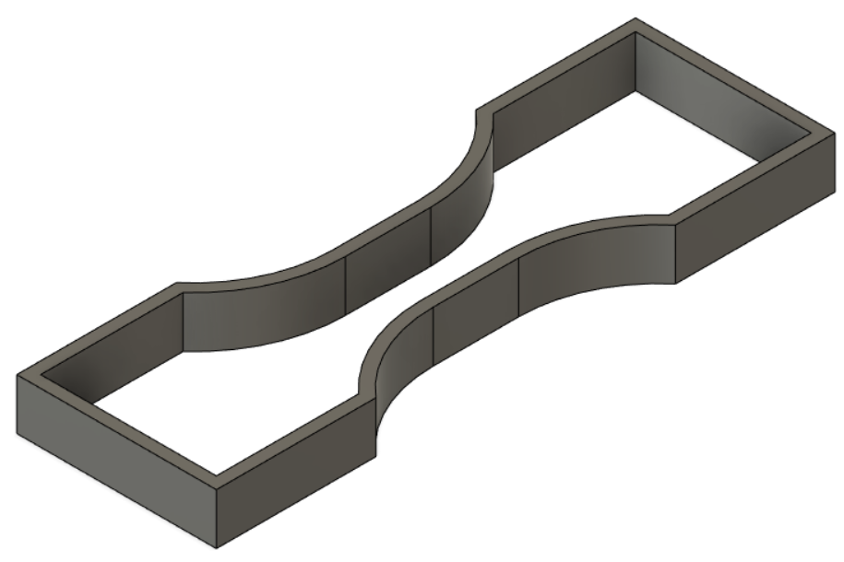
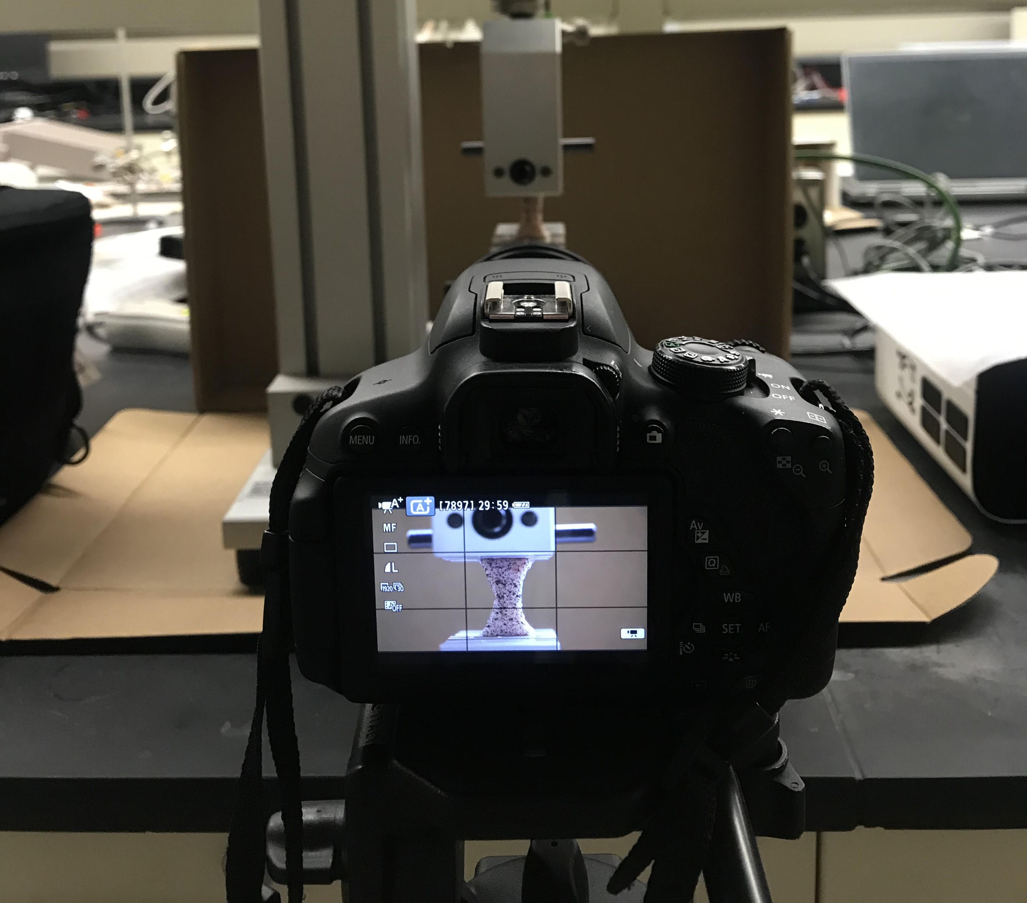
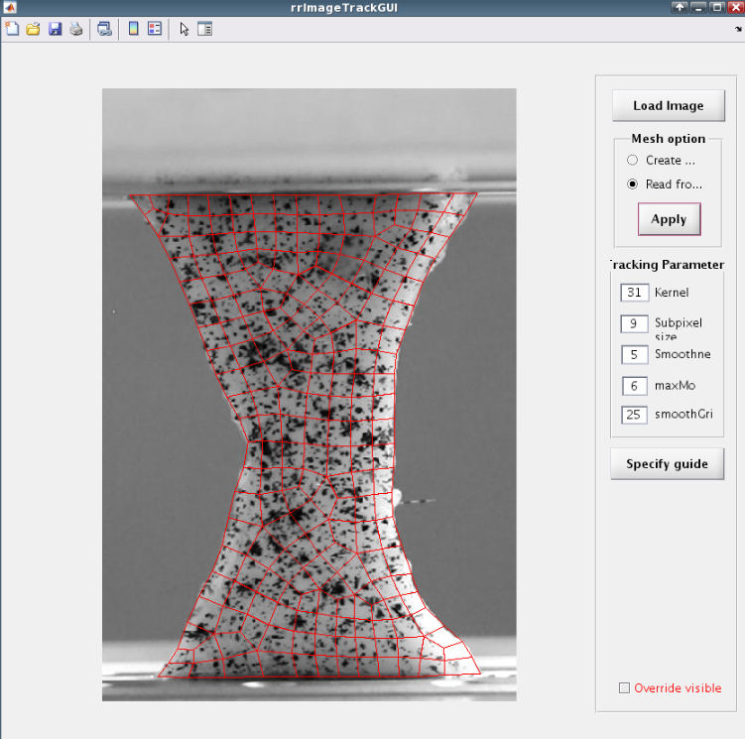
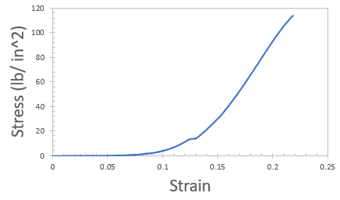
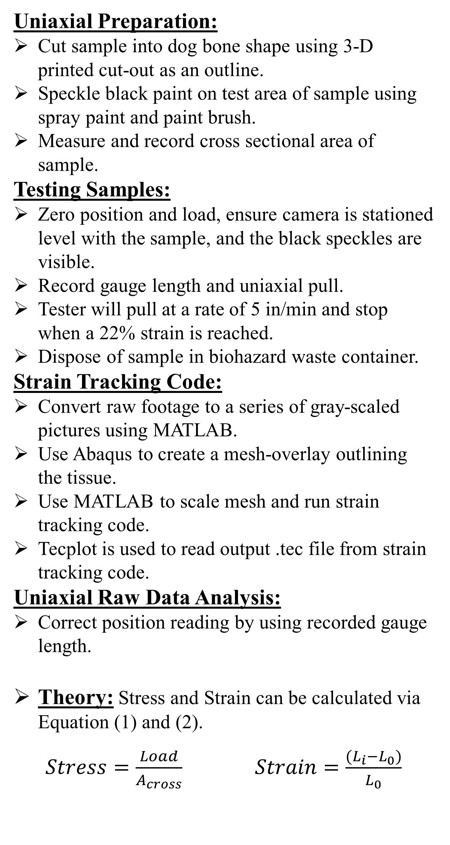
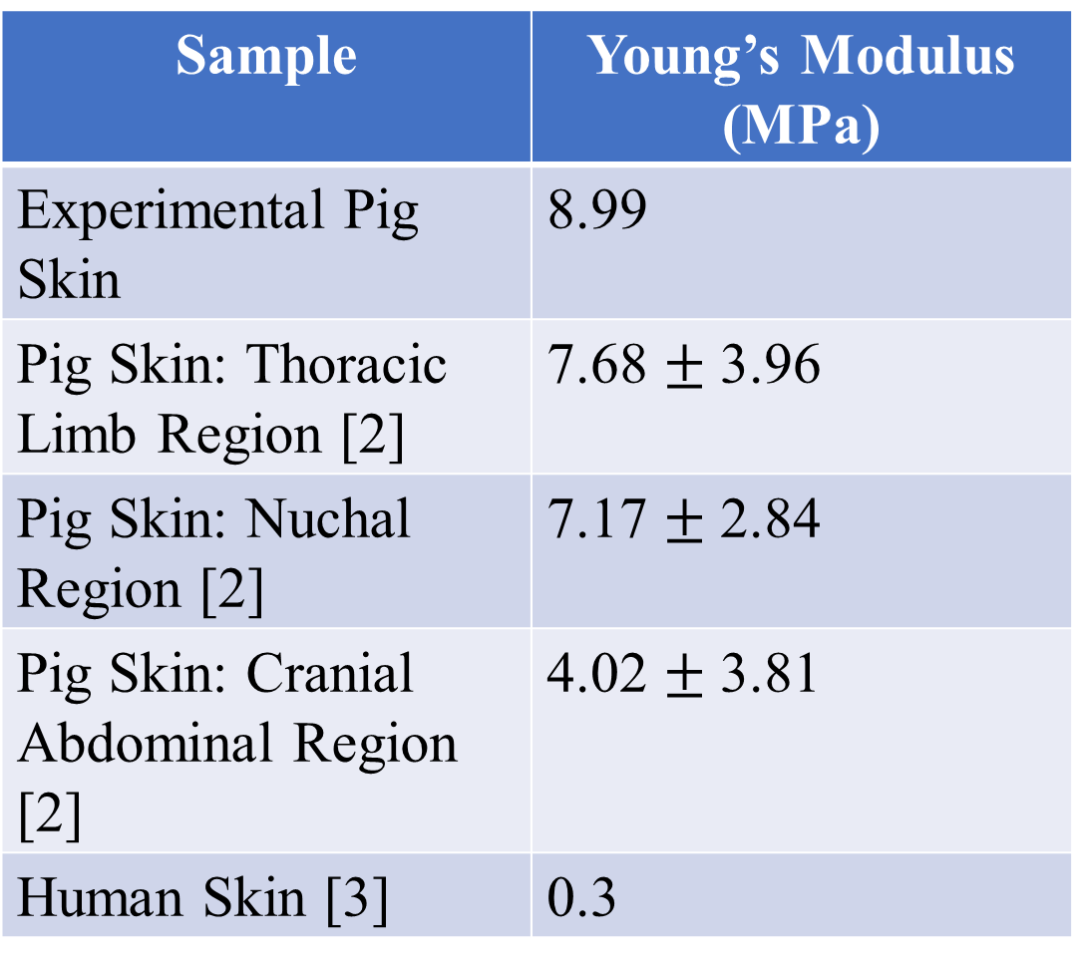
Characterizing the Mechanical Properties of Biological Tissues
Niko Wallace, Victor Lai
INTRODUCTION
RESULTS
Heart Disease therapies are transitioning from traditional open heart surgery procedures to less evasive, transcatheter, procedures. Physicians have been using organ models made of hard plastics or rubber-like materials like polylactic acid and thermoplastic polyurethane which do not resemble the actual properties of biological tissue. As a result, a demand for more accurate heart models has arisen. This UROP aims to gather research regarding the physiological and mechanical aspects of diseased heart tissue by use of a biaxial and uniaxial tester and a set of specialized MATLAB code to track strain. The strain tracking code allows the strain to be measured at each point of the sample is important in determining the individual strains of the tissue due to it’s anisotropic nature [1]. The individual strain mappings are needed before tissue can be matched with specific silicone bulking agent ratios and used to 3D-print diseased heart models resembling the mechanical properties of biological tissue.
Objective: Measure physiological and mechanical properties of biological tissue using a TestResources uniaxial and biaxial tester and custom strain tracking code.
Individual Strain at 7.3 seconds
Individual Strain at 10 seconds
Individual Strain at 4.68 seconds
Sample | Young’s Modulus (MPa)
Experimental Pig Skin | 8.99
Pig Skin: Thoracic Limb Region [2] | 7.68 $±$ 3.96
Pig Skin: Nuchal Region [2] | 7.17 $±$ 2.84
Pig Skin: Cranial Abdominal Region [2] | 4.02 $±$ 3.81
Human Skin [3] | 0.3
Figure (1) graphically describes anisotropic nature of tissue [4]
METHODS
Uniaxial Preparation:
Cut sample into dog bone shape using 3-D printed cut-out as an outline.
Speckle black paint on test area of sample using spray paint and paint brush.
Measure and record cross sectional area of sample.
Testing Samples:
Zero position and load, ensure camera is stationed level with the sample, and the black speckles are visible.
Record gauge length and uniaxial pull.
Tester will pull at a rate of 5 in/min and stop when a 22% strain is reached.
Dispose of sample in biohazard waste container.
Strain Tracking Code:
Convert raw footage to a series of gray-scaled pictures using MATLAB.
Use Abaqus to create a mesh-overlay outlining the tissue.
Use MATLAB to scale mesh and run strain tracking code.
Tecplot is used to read output .tec file from strain tracking code.
Uniaxial Raw Data Analysis:
Correct position reading by using recorded gauge length.
Theory: Stress and Strain can be calculated via Equation (1) and (2).
$Stress=\frac{Load}{A_{cross}}$ $Strain=\frac{{(L}_{i}−L_{0})}{L_{0}}$
DISCUSSION
Pig Skin Analysis:
Due to uniaxial test, strain in the Y-direction will be equal to the overall strain. As a result, the accuracy of the tracking code can be confirmed via the raw data from the uniaxial tester.
Pig skin yields little stress before reaching 10% strain. Once 10% has been reached, stress is dramatically increased before the 20% strain marker.
Slight differences in planar strain as seen in the strain maps is most likely due to the skin being thicker on certain areas of the dog bone.
Young’s Modulus Comparison:
The Young’s modulus found in literature corresponds well to the Young’s modulus calculated from the uniaxial tester’s raw data.
Differences in values primarily results from the skins originating from a different age pigs and different parts of the body [2].
Future Work:
Aim to test anisotropy of pig skin and compare to literature results.
Create new fixture or endo grips to better secure tissue samples and prevent slippage during test.
Write test method using TestResources’ software for the Biaxial Tester.
ACKNOWLEDGEMENTS
Liz Gacek (PhD graduate student in Biomedical Engineering in the Barocas Lab at University of Minnesota – Twin Citties): for help with the strain tracking code.
Financial Support for this research is provided by the UROP program.
Analysis Software is provided by Minnesota Supercomputing Institute (MSI) at the University of Minnesota
REFERENCES
[1] Chanda, Arnab, and Christian Callaway. “Tissue Anisotropy Modeling Using Soft Composite Materials.” Hindawi, Department of Bioengineering, University of Pittsburgh, www.hindawi.com/journals/abb/2018/4838157/. [2] MAŁGORZATA ŻAK, et al. “Determination of the Mechanical Properties of the Skin of Pig Foetuses with Respect to Its Structure.” ResearchGate, ResearchGate, Jan. 2011, www.researchgate.net/publication/51495139_Determination_of_the_mechanical_properties_of_the_
skin_of_pig_foetuses_with_respect_to_its_structure. [3] Shergold, Oliver A, et al. “The Uniaxial Stress versus Strain Response of Pig Skin and Silicone Rubber at Low and High Strain Rates.” ELSEVIER, International Journal of Impact Engineering, 2006, www-mech.eng.cam.ac.uk/profiles/fleck/papers/191.pdf. [4] TA Instruments Jan. “Characterizing Anisotropic Material Behavior with the Planar Biaxial TestBench System.” AZoM.com, 31 July 2019, www.azom.com/article.aspx?ArticleID=11656.

