Slide 1

Temporary Event Training: Licensing
Notes:
Temporary Event Training: Licensing

Slide 2
Training Objectives
Determine if you need a license
Submit application & payment to City Clerk
Obtain your license
Notes:
In this training session you will learn how to obtain a temporary event license. Objective 1: determine if you need a license. Objective 2: Submit an application and payment to the City Clerk Licensing Division. Objective 3: obtain your license.

Slide 3
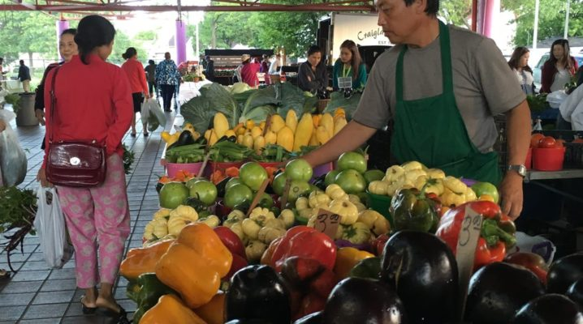
What is a Temporary Event?
Fair
Fundraiser
Festival
Carnival
Circus
Public exhibition
Anniversary sale/promotion
At a fixed location for not more than
14 consecutive days
Notes:
What is a temporary event? A temporary event is an event such as a fair festival, fundraiser, carnival, circus, public exhibition, anniversary sales or occasional sales promotion that is held at a fixed location for not more than 14 consecutive days.

Slide 4

Do I Need a License?
1
Notes:
Do I need a license? A license is REQUIRED for any person or business selling and or serving food at a temporary event but there are some exemptions.

Slide 5
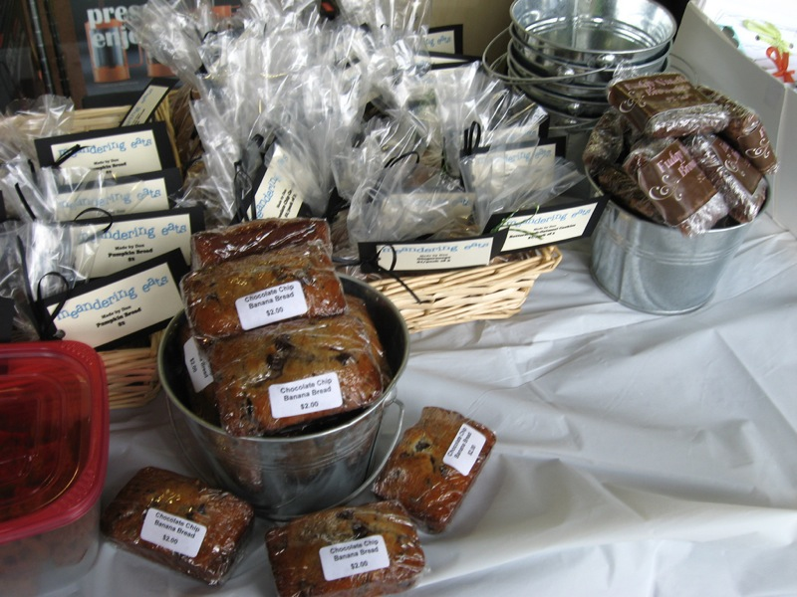
Licensing Exemptions
Notes:
Before we explore how to obtain a license, we will first explore scenarios where licensing exemptions exist.

Slide 6
A license is not require for:
Canned or bottled non-alcohol drinks that do not require refrigeration
Raw agriculture including:
Cottage food products such as non-potentially hazardous bakery
uncut produce, honey, cider,
sorghum, maple syrup
Notes:
A license is not required for the following scenarios: If an individual or business is selling or giving away. Canned or bottled non-alcohol drinks that do not require refrigeration. Raw agriculture including: uncut produce, honey, cider, sorghum, maple syrup. Cottage food products such as non hazardous baked goods.

Slide 7
A license is not require for:
Naturally acidic or acidified canned products if:
Pre-packaged foods that do not require temperature control.
Sample size portions which are 2oz or less
pH is ≤ 4.6.
Direct sales no more than $5,000 per year
Notes:
Canned fruits and vegetables that are naturally acidic or acidified by pickling or fermenting, with equilibrium pH less than or equal to 4.6, sales are direct from producer to consumer, and no mor than $5,000 in sales per year with required labeling and signs. Pre-packaged foods that do not require temperature control such as chips or candy. Sample size portions which are 2 oz or less liquid/solid or combination.

Slide 8
A license is not require for:
Licensed food peddlers or food trucks operating within their license limits
Licensed food dealers who have obtained a temporary extension of their food premise
Block parties which are not open to the general public
Special organizations serving meals
Notes:
Licensed food peddlers or food trucks operating within their license limits. Licensed food dealers who have obtained a temporary extension of their food premise. Block parties which are not open to the general public. And special organizations servicing meals.

Slide 9





What is a “Special Organization Serving Meals”
Churches
Religious, fraternal, youth,
or patriotic organizations
Service clubs
Civic organizations
Non-profit organization
Sports team
Notes:
What is a “Special Organization Serving Meals”? Churches, Religious, fraternal, youth, or patriotic organizations, Service clubs, Civic organizations, non-profit organization, or sports team that prepare, serve, or sell meals to transients or the general public for 4 days but no more than 12 days in a licensing year.

Slide 10

For all other Scenarios:
A license is REQUIRED for any person or business selling and/or serving food at a temporary event
Notes:
For all other Scenarios: A license is REQUIRED for any person or business selling and/or serving food at a temporary event

Slide 11
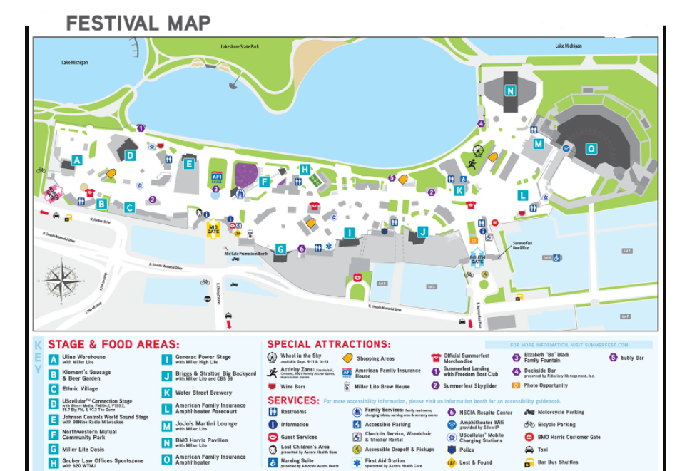
Notes:
Remember, if you have multiple booths and they are not adjacent or next to each other, you will need multiple temporary event licenses.
For example, On the map, we see that an operator has booth space at in the ‘A’ area and the ‘L’ area, as seen within the red circle. This operator would require two licenses. The next example, as seen as the solid purple stars, shows one booth located in the ethnic village, and smaller stands located throughout the grounds, this operator would require 3 licenses.

Slide 12

Application Submittal
2
Notes:
Application Submittal

Slide 13

License application can be completed:
Online at: milwaukee.gov/tempfood
In Person: 200 E Wells, Room 105
Milwaukee, WI 53202
By Phone: (414) 286-2238
Notes:
A temporary event license application can be completed by submitting the application online at the link on the screen, In person at City Hall, 200 E wells, room 105 Milwaukee 53202
Or by calling the licensing division at 414-286-2238

Slide 14
Please Note:
If your application was submitted online,
a secured payment link will be sent to you after your application is processed
Notes:
Please Note. If your application was submitted online. A secured payment link will be sent to you after your application is processed.

Slide 15

Obtain Your License
3
Notes:
Objective 3: obtain your license

Slide 16
Paper license will be provided to you if you pay in-person
License will be emailed if paid online
License will be mailed if paid over the phone
A license is valid for ONE YEAR from the date of issue
Notes:
A paper license will be provided to you if you pay in-person. A license will be emailed if paid online. And if you paid over the phone, the license will be mailed to you. A license is valid for one year from the date it was issued.

Slide 17
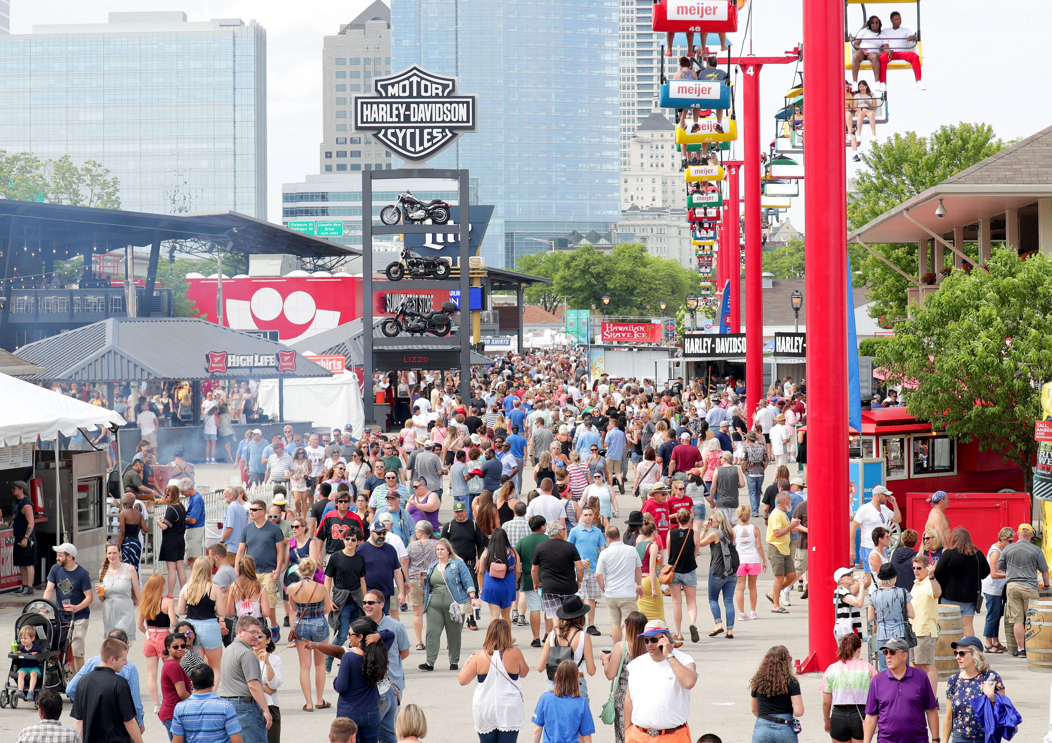
You must have a physical paper copy of your license on hand at every event
Notes:
Regardless of how you obtain your license, you must have a physical paper copy on hand at your event for inspection purposes.

Slide 18

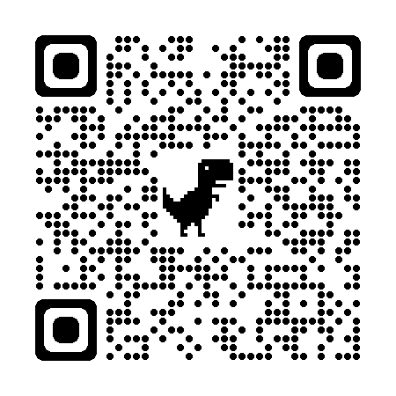
Licensing Division:
414-286-2238
Notes:
If you have any questions if you are in need of obtaining a temporary event license for your operation, please reach out to the licensing division at 414-286-2238. For food specific questions, you can find additional information on the City of Milwaukee Health Department Website, or by scanning the QR code located on the screen.

