Slide 1
Sustaining Open Research:
Funding Agencies and the Desirable Characteristics: Background and U.S. DOT Implementation
Leighton L Christiansen https://orcid.org/0000-0002-0543-4268
Data Curator, National Transportation Library (NTL),
leighton.christiansen@dot.gov
Presented to: Data Curation Network (DCN) Sustaining Open Research: Virtual Learning Series, on 2023-07-12
Notes:
Slide Title: Sustaining Open Research: Funding Agencies and the Desirable Characteristics: Background and U.S. DOT Implementation
[Speaker Script]
Thank you for the kind introduction. It is an honor to be asked to lead off the Sustaining Open Research: Virtual Learning Series.
[00:09; 00:09]
[Next slide]
Slide Text not read:
Leighton Christiansen https://orcid.org/0000-0002-0543-4268
Data Curator, National Transportation Library (NTL),
leighton.christiansen@dot.gov
Presented to: Data Curation Network (DCN) Sustaining Open Research: Virtual Learning Series, on 2023-07-12

Slide 2
Introduction
Notes:
Slide Title: Introduction
[Speaker Script]
None: Division slide only
[Next slide]

Slide 3
Disclaimer & Accessibility Note
Opinions expressed by me during this presentation, the discussion period, or at other times during the session are mine alone, and do NOT necessarily represent the opinions, practices, polices, and/or laws of the National Transportation Library, the Bureau of Transportation Statistics, the U.S. Department of Transportation, the Office of Science and Technology Policy, the Subcommittee on Open Science, or other bodies of the United States government.
Typographic errors are also mine.
This presentation has been made as accessible as possible for persons with disabilities who use screen readers and adaptive technologies. This includes adding alt text to images, and checking color choices and contrast. Also, the entire scripted text is included in the Slides Notes feature, so folks may read along at their own pace. However, ad libs are not recorded. My apologies.
Because NTL is committed to making all of our presentations accessible to the widest possible audience, suggested improvements are welcome.
The Slide Notes section may also include text that I did not have time to read, and which contains more useful information. This text is easier to locate on the “Handout” version of these slides which can be shared with you.
Notes:
Slide Title: Disclaimer & Accessibility Note
[Speaker Script]:
Opinions expressed by me during this presentation, the discussion period, or at other times during the session are mine alone, and do NOT necessarily represent the opinions, practices, polices, and/or laws of the National Transportation Library, the Bureau of Transportation Statistics, the U.S. Department of Transportation, the Office of Science and Technology Policy, the Subcommittee on Open Science, or other bodies of the United States government.
Typographic errors are also mine.
This presentation has been made as accessible as possible for persons with disabilities who use screen readers and adaptive technologies. This includes adding alt text to images, and checking color choices and contrast. Also, the entire scripted text is included in the Slides Notes feature, so folks may read along at their own pace. However, ad libs are not recorded. My apologies.
Because NTL is committed to making all of our presentations accessible to the widest possible audience, suggested improvements are welcome.
The Slide Notes section may also include text that I did not have time to read, and which contains more useful information. This text is easier to locate on the “Handout” version of these slides which can be shared with you.
[01:10 ; 01:18]
[Next Slide]

Slide 4
Personal Introduction
Leighton L Christiansen (They/Them) https://orcid.org/0000-0002-0543-4268
Data Curator at the National Transportation Library at U.S. DOT, as well as part of the Implementation Team for the U.S. DOT Public Access Policy (2016 to present)
Librarian/Library Director at the Iowa DOT Library (2012 to 2016)
Graduate School of Library and Information Science, University of Illinois at Urbana-Champaign, Masters of Library and Information Science (MLIS), Certificate of Study in Data Curation (2009 to 2012)
  Undergrad Major in English, Minor in Computer Science at Kirkwood Community College, Blackhawk Community College, and the University of Iowa
Logged 1.5 Million miles as a school bus driver, and short-haul, intermodal, livestock, regional, and long-haul truck driver (1990 to 2008)
Important Links
ORCID https://orcid.org/0000-0002-0543-4268
LinkedIn https://www.linkedin.com/in/leightonchristiansen
Notes:
Slide Title: Personal Introduction
Leighton L Christiansen, pronouns They/Them
[00:17 ; 01:36]
[Next Slide]
[Slide Text not read]:
Again, my name is Leighton L Christiansen (They/Them) https://orcid.org/0000-0002-0543-4268, and I will take just a moment or two to introduce myself and my relationship to the topic at hand.
Data Curator at the National Transportation Library at U.S. DOT, as well as part of the Implementation Team for the U.S. DOT Public Access Policy (2016 to present)
Librarian/Library Director at the Iowa DOT Library (2012 to 2016)
Graduate School of Library and Information Science, University of Illinois at Urbana-Champaign, Masters of Library and Information Science (MLIS), Certificate of Study in Data Curation (2009 to 2012)
Undergrad Major in English, Minor in Computer Science at Kirkwood Community College, Blackhawk Community College, and the University of Iowa
Logged 1.5 Million miles as a school bus driver, and short-haul, intermodal, livestock, regional, and long-haul truck driver (1990 to 2008)
Important Links
If you would like to see other things I have worked on, please visit my ORCID page https://orcid.org/0000-0002-0543-4268
Or connect on LinkedIn https://www.linkedin.com/in/leightonchristiansen

Slide 5
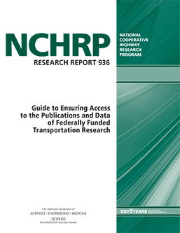
NCHRP 936: Guide to Ensuring Access to the Publications and Data of Federally Funded Transportation Research
Table of Contents
Ch. 1: What are We Trying to Accomplish?
Ch. 2: Understanding Essential Requirements
Ch. 3: Going Beyond the Minimum in an Evolving Landscape
Ch. 4: Developing Strategies and Policies
Ch. 5: Roles & Responsibilities
Ch. 6: Managing Research Publications
Ch. 7: Managing Research Data
Ch. 8: Data Management Plans
Ch. 9: Building Blocks of the Solution
Ch. 10: Learning and Training
Ch. 11: Estimating and Managing Costs
Ch. 12: Assessing and Managing Progress
Ch. 13: Putting it all Together
Important Links
NCHRP 936: https://www.trb.org/Publications/Blurbs/180230.aspx
Notes:
Slide Title: NCHRP 936: Guide to Ensuring Access to the Publications and Data of Federally Funded Transportation Research
I will stop on this slide just long enough to say I was the lead proposer on the research project that led Jake Carlson to be a co-author on the NCHRP Report 936: Guide to Ensuring Access to the Publications and Data of Federally Funded Transportation Research.
And then I will wish you a…
[00:22 ; 01:58]
[Next slide]
[Text not read]:
As it happens, I was the lead author on the 2014 proposal that led to the National Cooperative Highway Research Program project 20-110, on which I was also a panel member. The authors of the guide were also kind enough to allow me to advise on, and edit drafts prior to the 2020 publication of NCHRP Report 936 “Guide to Ensuring Access to the Publications and Data of Federally Funded Transportation Research.” One of those authors was Jake Carlson.
The research proposal sought a step-by-step guide to assist state departments of transportation and other funded researchers to comply with the DOT public access plan. You can see from the table of contents that there are a number chapters on data management and data curation action. The other chapters are important for understanding the DOT public access plan, and for helping you to understand the broader public access and open science global movements.
Next, I would like to wish you a ….
[Next Slide]
[Text not read]
Table of Contents
Ch. 1: What are We Trying to Accomplish?
Ch. 2: Understanding Essential Requirements
Ch. 3: Going Beyond the Minimum in an Evolving Landscape
Ch. 4: Developing Strategies and Policies
Ch. 5: Roles & Responsibilities
Ch. 6: Managing Research Publications
Ch. 7: Managing Research Data
Ch. 8: Data Management Plans
Ch. 9: Building Blocks of the Solution
Ch. 10: Learning and Training
Ch. 11: Estimating and Managing Costs
Ch. 12: Assessing and Managing Progress
Ch. 13: Putting it all Together
Important Links
NCHRP 936: https://www.trb.org/Publications/Blurbs/180230.aspx

Slide 6
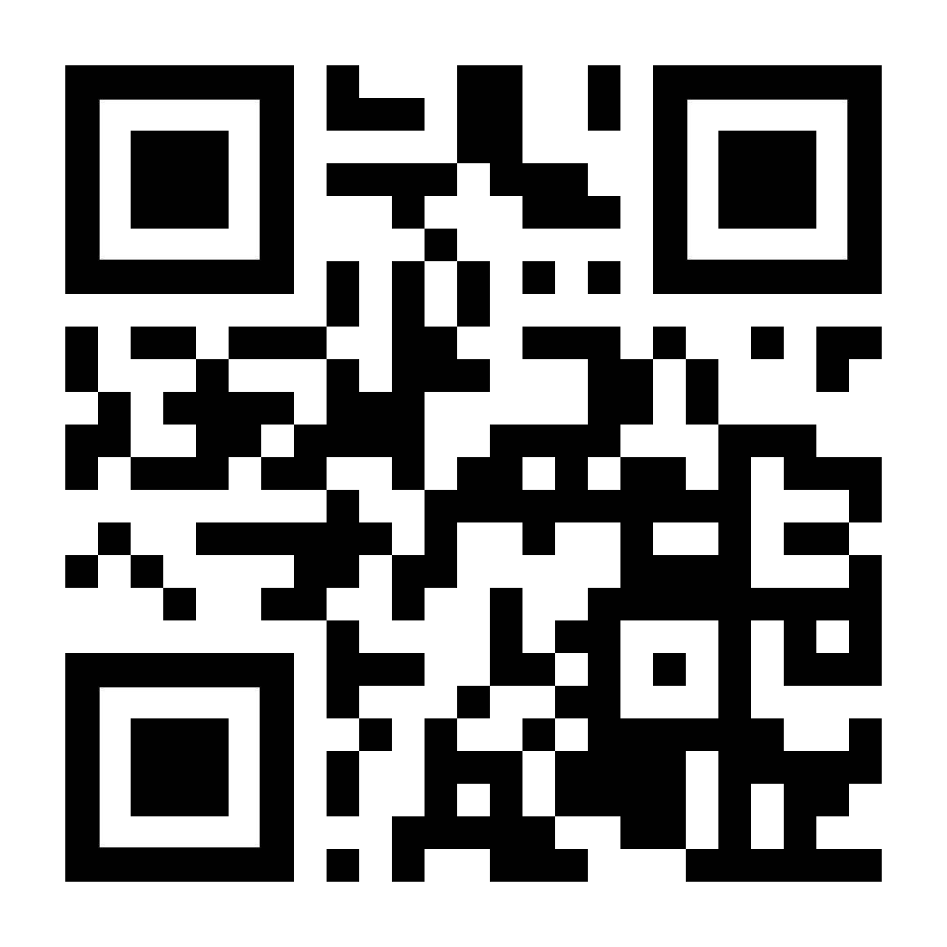
2023 Year of Open Science
The White House announces
The 2023 Year of Open Science
NASA ✦ NSF ✦ NOAA ✦ DOE ✦ GSA ✦ NEH ✦ NIH ✦ NIST ✦ USDA ✦ USGS ✦ DOT
CDC ✦ Commerce ✦ State ✦ Smithsonian ✦ EPA
Along with other organizations, including CENDI, voluntary collaboration among Federal managers, and HELIOS, a coalition of 80+ universities
A multi-agency initiative across the federal government to spark change and inspire open science engagement through events and activities that will advance adoption of open science.
Website: https://open.science.gov/
WH: https://www.whitehouse.gov/ostp/news-updates/
Nature: https://doi.org/10.1038/d41586-023-00019-y
Notes:
Slide Title: The 2023 Year of Open Science
[Speaker Script]:
…Happy Year of Open Science.
So let us get to the heart of the matter
[00:12 ; 02:10]
[Next Slide]
In January 2023, the White House, with support from many federal agencies and a coalition of universities, dedicated 2023 as a Year of Open Science. The effort is lead by a voluntary collaboration among Federal managers of scientific and technical information working together in the OSTP Subcommittee on Open Science, a committee on which I and others from NTL & DOT serve.
[Background Image Description: This slide contains a full-size background for the Year of Open Science. The background is varying shades of blue an contains an image of an open book as well as 8 icons representing different branches of science. The slide also holds a QR code leading to the Open Science.gov website at https://open.science.gov.
Slide text not read:
The White House announces
The 2023 Year of Open Science
NASA ✦ NSF ✦ NOAA ✦ DOE ✦ GSA ✦ NEH ✦ NIH ✦ NIST ✦ USDA ✦ USGS ✦ DOT ✦ CDC ✦ Commerce ✦ State ✦ Smithsonian ✦ EPA
Along with other organizations, including CENDI, voluntary collaboration among Federal managers, and HELIOS, a coalition of 80+ universities
A multi-agency initiative across the federal government to spark change and inspire open science engagement through events and activities that will advance adoption of open science.
Website: https://open.science.gov/
WH: https://www.whitehouse.gov/ostp/news-updates/
Nature: https://doi.org/10.1038/d41586-023-00019-y

Slide 7
Contents
Notes:
Slide Title: Contents
[Speaker Script] [None: Section Division Decorative Slide Only]
[Next slide]

Slide 8
Points to Cover
Development of the Desirable Characteristics
U.S. Department of Transportation Implementation
Notes:
Slide Title: Points to Cover
[Speaker Script]:
In this presentation I will touch on just two main points:
Development of the Desirable Characteristics
U.S. Department of Transportation Implementation
[00:14 ; 02:23]
[Next Slide]

Slide 9
Desirable Characteristics of Data Repositories for Federally Funded Research
Notes:
Slide Title: Desirable Characteristics of Data Repositories for Federally Funded Research
[Speaker Script] [None: Section Division Decorative Slide Only]
[Next slide]

Slide 10
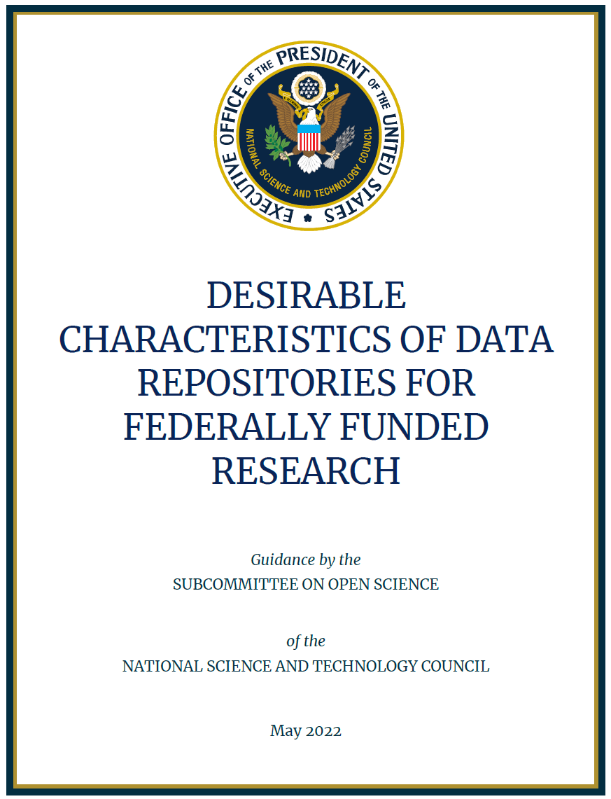
Desirable Characteristics
Thank you to Maryam Zaringhalam, Assistant Director for Public Access and Research Policy, White House Office of Science & Technology Policy, for the slide content that follows.
Notes:
Slide Title: Desirable Characteristics
[Speaker Script]:
I need to start by saying “Thank you” to Maryam Zaringhalam, Assistant Director for Public Access and Research Policy, White House Office of Science & Technology Policy, for the slide content on the Desirable Characteristics that follows.
[00:30 ; 02:55]
[Next Slide]

Slide 11
NSTC OSTP Subcommittee on Open Science
The NSTC Subcommittee on Open Science (SOS) advances Federal efforts to support open science by increasing access to, and use of, the results of Federally funded research and development, including, scholarly publications and digital data.
Among its responsibilities, the SOS aims to coordinate and improve implementation of policies to increase access to the results of Federally funded scientific research and to identify additional steps that Federal departments and agencies can take to enhance the preservation, discoverability, accessibility, quality, and utility of research outputs.
Notes:
Slide Title: OSTP NSTC Subcommittee on Open Science
[Speaker Script]:
So where did the Desirable Characteristics come from? They came from the Subcommittee on Open Science (SOS), under the White House National Science and Technology Council (NSTC) and Office of Science and Technology Policy (OSTP).
The SOS exists to advance Federal open science efforts, as well as to coordinate and harmonize public access and open science policy across the federal agencies.
Many of the outputs of the SOS are internal to the departments and agencies, to guide our implementation. Others, such as the Desirable Characteristics of Data Repositories for Federally Funded Research, are public documents, to fill specific needs expressed by the federally funded research community.
[00:46 ; 03:42]
[Next Slide]
[Full slide text]
The NSTC Subcommittee on Open Science (SOS) advances Federal efforts to support open science by increasing access to, and use of, the results of Federally funded research and development, including, scholarly publications and digital data.
Among its responsibilities, the SOS aims to coordinate and improve implementation of policies to increase access to the results of Federally funded scientific research and to identify additional steps that Federal departments and agencies can take to enhance the preservation, discoverability, accessibility, quality, and utility of research outputs.

Slide 12
Desirable Characteristics: Purposes
Improving consistency of repository selection guidance across Federal agencies
Promoting the FAIR data principles
Incorporating experiences and comments of agencies, and public and private sector organizations
Providing high-level characteristics, rather than an exhaustive set of design criteria, for data repositories
Allowing for implementation flexibility to vary across data repositories
Remaining nimble in the face of evolving technology and data sharing practices
Notes:
Slide Title: Desirable Characteristics: Purposes
[Speaker Script]:
The Purposes of the Desirable Characteristics include:
Improving consistency of repository selection guidance across Federal agencies
Promoting the FAIR data principles
Incorporating experiences and comments of agencies, and public and private sector organizations
Providing high-level characteristics, rather than an exhaustive set of design criteria, for data repositories
Allowing for implementation flexibility to vary across data repositories
Remaining nimble in the face of evolving technology and data sharing practices
A note about point 5: These characteristics aren’t themselves a certification process, though they are aligned to certification schemes like CoreTrustSeal. We do expect there to be a great deal of motivation, however, for repositories to demonstrate how they align to these criteria to make it easier for researchers, librarians, data curators, and other members of the research community to confidently select those repositories.
[01:02 ; 04:45]
[Next Slide]

Slide 13



Desirable Characteristics: Audiences
Researchers, Librarians, & Data Managers
Program Officers, Funders, & Policy Makers
Data Repositories & Repository Staff
Assisting Federally funded researchers in data repository selection under data management and sharing polices.
Identifying specific repositories that an agency might designate for use for particular data types.
Guiding development of agency-supported data repositories.
Informing the characteristics desired by an agency for sharing data resulting from Federally funded research
Notes:
Slide Title: Desirable Characteristics: Audiences
[Speaker Script]:
The SOS envisioned three broad audiences for these characteristics.
Researchers, Librarians, & Data Managers:
The SOS hopes to assist Federally funded researchers in selecting data repositories under data management and sharing polices.
Program Officers, Funders, & Policy Makers:
The SOS wanted to help Federal staff Identify specific repositories that an agency might designate for use for particular data types, and
Guide development of agency-supported data repositories.
Data Repositories & Repository Staff
The SOS wanted to help repository staff understand the characteristics desired by an agency for sharing data resulting from Federally funded research
In order to get input from these audiences, which we’re ultimately seeking to serve and align with, OSTP issued a request for comment in January 2020 to solicit feedback on the proposed set of characteristics.
[01:09 ; 05:53]
[Next Slide]

Slide 14
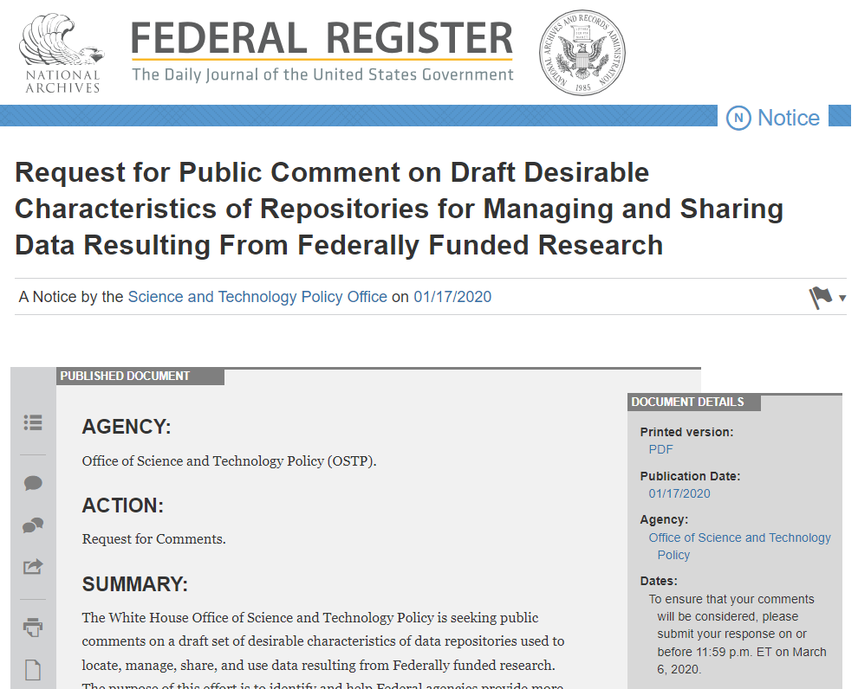
Desirable Characteristics: Request For Comment
Requesting Feedback On:
The proposed use and application of the desirable characteristics
The appropriateness of the characteristics for “All Data Repositories” (Section 1) and those “Repositories Storing Human Data (even if de-identified)” (Section 2)
Considerations for any other characteristics that should be included for unique data types (e.g., special or rare datasets)
The ability of existing repositories to meet the desirable characteristics
Consistency of the desirable characteristics with widely used criteria or certification schemes for certifying repositories
Any other topic that may be relevant to consider
https://www.federalregister.gov/documents/2020/01/17/2020-00689/request-for-public-comment-on-draft-desirable-characteristics-of-repositories-for-managing-and
Notes:
Slide Title: Desirable Characteristics: Request For Comment
[Speaker Script]:
As noted, In January 2020, OSTP Issued a Request for Comment (RFC) to solicit community feedback on:
The proposed use and application of the desirable characteristics
The appropriateness of the characteristics for “All Data Repositories” (Section 1) and those “Repositories Storing Human Data (even if de-identified)” (Section 2)
Considerations for any other characteristics that should be included for unique data types (e.g., special or rare datasets)
The ability of existing repositories to meet the desirable characteristics
Consistency of the desirable characteristics with widely used criteria or certification schemes for certifying repositories
Any other topic that may be relevant to consider
There have been more than 11,000 views of the RFC which netted 119 responses.
[00:46 ; 06:39]
[Next Slide]

Slide 15
Desirable Characteristics: 119 RFC Responses
Notes:
Slide Title: Desirable Characteristics: 119 RFC Responses
[Speaker Script]:
The central image of this slide is a pie chart, which groups the 119 public responses into 9 sectors, with academia (38 responses, shaded in dark blue), scientific societies (22 responses, shaded in dark green), and open access groups (16 responses, shaded in gold) being the top three categories of respondents, and comprising 76 of the 119 responses, or 63%.
National Laboratories/ Federal Funded Research and Development Centers (FFRDC) / University Affiliated Research Centers (UARC): 14 responses (shaded blue);
Non-profit organizations: 8 response, shaded light blue;
Industry; 6 responses, shaded burnt orange;
U.S. Government: 5 responses, shaded grey;
Publishers/Publishing Associations: 2 responses, shaded grey-green; and,
Individuals/ or Affiliation Unknown: 8 response, shaded pale yellow.
The comments were analyzed by the Science and Technology Policy Institute (STPI), looking for agreement with the characteristics, common comments, concerns that arose, areas for refinement and reorganization, and also for possible reorganizations of the characteristics.
[01:54 ; 08:33]
[Next Slide]
[Text not read]
Complete RFC Results by group in the pie chart:
University/Academia: 38 response, shaded dark blue;
Scientific Society/Association: 22 responses, shaded dark green;
Open Access Group: 16 responses, shaded gold;
National Laboratory/ Federal Funded Research and Development Centers (FFRDC) / University Affiliated Research Centers (UARC): 14 responses (shaded blue);
Non-profit organizations: 8 response, shaded light blue;
Industry; 6 responses, shaded burnt orange;
U.S. Government: 5 responses, shaded grey;
Publisher/Publishing Associations: 2 responses, shaded grey-green; and,
Individual/ or Affiliation Unknown: 8 response, shaded pale yellow.

Slide 16
Desirable Characteristics: Comment Themes
Overall agreement:
  With the approach taken by the SOS
  With the need for a common set of characteristics
  Minimally burdensome for existing repositories to meet criteria
Suggestions:
  To reorganize characteristics
  For clarifying language around characteristics
Concerns:
  May not yet be sufficient community standards around metadata and common formats in some
  Some of the characteristics could be costly and difficult to achieve in practice without additional funding
Desire for specifying best practices or policy prescriptions for repositories to meet these characteristics
Notes:
Slide Title: Desirable Characteristics: Comment Themes
[Speaker Script]:
The Science and Technology Policy Institute (STPI) analysis:
Showed Overall agreement:
With the approach taken by the SOS
With the need for a common set of characteristics
Minimally burdensome for existing repositories to meet criteria
Yielded Suggestions:
To reorganize characteristics
For clarifying language around characteristics
Surfaced some Concerns:
May not yet be sufficient community standards around metadata and common formats in some
Some of the characteristics could be costly and difficult to achieve in practice without additional funding
Illuminated a Desire for specifying best practices or policy prescriptions for repositories to meet these characteristics
[00:48 ; 09:22]
[Next Slide]

Slide 17
Desirable Characteristics: Publication!!!
May 2022
Approximately 50 authors and collaborators from 18 or more departments, agencies, or offices
Desirable Characteristics Goals:
Improving consistency across Federal departments and agencies for repository selection guidance
Identifying desirable characteristics for public access data repositories
Making federal research FAIR (findable, accessible, interoperable, and reusable)
Protecting privacy and security
The National Science and Technology Council, Desirable Characteristics of Data Repositories for Federally Funded Research, 2022, https://doi.org/10.5479/10088/113528
Notes:
Slide Title: Desirable Characteristics: Publication!!!
[Speaker Script]:
The Desirable Characteristics were published in May 2022 thanks to the work of more than 50 authors and collaborators from 18 or more departments, agencies, or offices.
The Goals of the Desirable Characteristics include:
Improving consistency across Federal departments and agencies for repository selection guidance
Identifying desirable characteristics for public access data repositories
Making federal research FAIR (findable, accessible, interoperable, and reusable)
Protecting privacy and security
The Desirable Characteristics can be cited as The National Science and Technology Council, Desirable Characteristics of Data Repositories for Federally Funded Research, 2022, https://doi.org/10.5479/10088/113528
Alright. I hope you get a good picture of the background. Now let me turn to implementation at DOT.
[Next Slide]

Slide 18
Desirable Characteristics Implementation at U.S. DOT
Notes:
Slide Title: Desirable Characteristics Implementation at U.S. DOT
[Speaker Script] [None: Section Division Decorative Slide Only]
[Next slide]

Slide 19
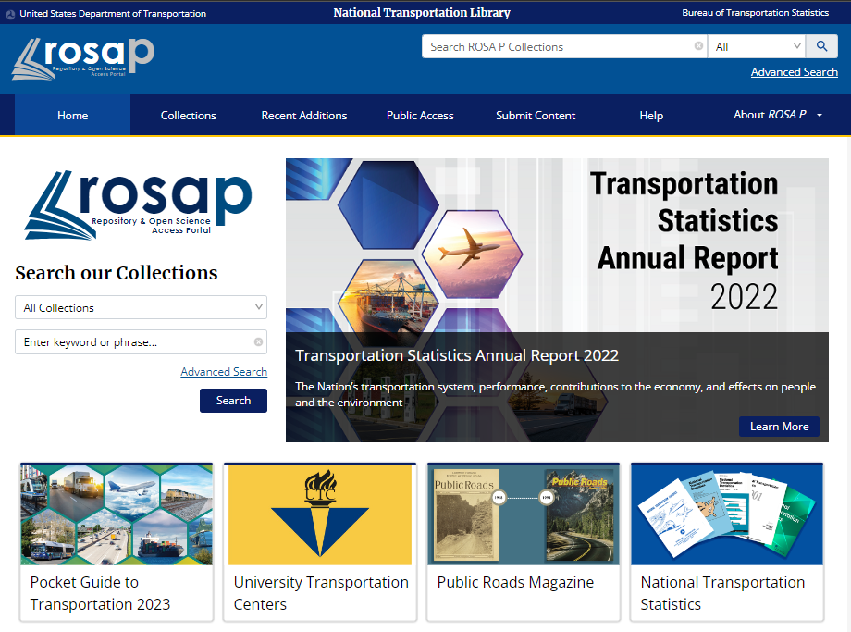
The Repository & Open Science Access Portal (ROSA P)
MAP-21 mandates NTL serve as central depository and clearinghouse for transportation research and data
More than 66, 000 records (July 2023)
Bookmark:
https://rosap.ntl.bts.gov/ or https://doi.org/10.21949/1398953
Notes:
Slide Title: The Repository & Open Science Access Portal (ROSA P)
[Speaker Script]:
Let me first introduce you to our Repository & Open Science Access Portal (ROSA P)
Since the signing of Moving Ahead for Progress in the 21st Century, or MAP-21, legislation in 2012, the National Transportation Library (NTL) has been mandated to “serve as a central depository for research results and technical publications” and “provide a central clearinghouse for transportation data and information of the Federal Government.” This is a big responsibility, and one we are happy to fulfill.
This MAP-21 mandate is specifically referenced in the current USDOT Public Access Plan. The Public Access Plan requires that an electronic copy of all DOT-funded research be submitted to the National Transportation Library’s digital repository, currently branded as the Repository & Open Science Access Portal, or ROSA P.
As of this month, ROSA P hosts more than 66,000 records of research results, statistical reports, datasets, briefs, presentation decks, videos, maps, data management plans, and other formats, most of which is funded, in whole or in part, by US DOT.
Be sure to Bookmark: https://rosap.ntl.bts.gov/ or https://doi.org/10.21949/1398953
I am going to let you know if NTL walks the Desirable Characteristics walk, or if we are all talk…
[01:21 ; 10:44]
[Next Slide]

Slide 20
ROSA P & the Desirable Characteristics: Organizational Infrastructure
Free and Easy Access
Clear Use Guidance
Risk Management
Retention Policy
Long-term Organizational Sustainability
ROSA P is free to use and no account is needed
Datasets are accompanied by as much documentation as researchers provide, and is supplement by NTL staff as needed
ROSA P is not supposed to house sensitive data; publicly sharable data only
Retention policy: In perpetuity
NTL is 1 of 5 national libraries; written into law by Congress in 1998
Notes:
Slide Title: ROSA P & the Desirable Characteristics: Organizational Infrastructure
[Speaker Script]:
Table 1 of the publication is called Desirable Characteristics of Repositories for Managing and Sharing Data Resulting from Federally Funded or Supported Research.
Table 1 has 3 sections:
Organizational Infrastructure;
Digital Object Management; and,
Technology
Each section has a number of characteristics and a short explanation or definition of that characteristic.
The characteristics under Organizational Infrastructure are:
Free and Easy Access
Clear Use Guidance
Risk Management
Retention Policy
Long-term Organizational Sustainability
How does ROSA P do?
Well I believe that we can mostly check these off:
ROSA P is free to use and no account is needed
Datasets are accompanied by as much documentation as researchers provide, and is supplement by NTL staff as needed
ROSA P is not supposed to house sensitive data; publicly sharable data only
Retention policy: In perpetuity
NTL is 1 of 5 national libraries; written into law by Congress in 1998
Those who were paying attention noticed I phrased it as “ROSA P is not supposed to house sensitive data.” Because we are only able to manually search for sensitive information at this time, I have concerns that we cannot make a strong claim on risk management.
What is next?
[01:54 ; 12:38]
[Next Slide]

Slide 21
ROSA P & the Desirable Characteristics:
Digital Object Management
Unique Persistent Identifiers
Metadata
Curation and Quality Assurance
Broad and Measured Reuse
Common Format
Provenance
Datasets are assigned DOIs & Public Access Policy requires ORCIDs
Dublin Core bibliographic & DCAT-US V1.1 (Project Open Data Metadata)
1 Fed and 2 Fellows with specific Data Curation training as part of MLIS & we are working the DCN CURATED workflow into our process for 2023-10-01
All DOT-produced data is in the Public Domain & we encourage researchers to get CC or appropriate licenses. Called out in metadata.
Push for submission of open formats, or documentation of proprietary formats.
Documentation includes version control; we will improve Provenance with CURATED
Notes:
Slide Title: ROSA P & the Desirable Characteristics: Digital Object Management
[Speaker Script]:
The characteristics for this part of Table 1 are:
Unique Persistent Identifiers
Metadata
Curation and Quality Assurance
Broad and Measured Reuse
Common Format
Provenance
How does NTL do here?
Very strongly!
Datasets are assigned DOIs & Public Access Policy requires ORCIDs
Dublin Core bibliographic & DCAT-US V1.1 (Project Open Data Metadata)
1 Fed and 2 Fellows with specific Data Curation training as part of MLIS & we are working the DCN CURATED workflow into our process for 2023-10-01
All DOT-produced data is in the Public Domain & we encourage researchers to get CC or appropriate licenses. Called out in metadata.
Push for submission of open formats, or documentation of proprietary formats.
Documentation includes version control; we will improve Provenance with CURATED
[01:12 ; 13:49]
Next?
[Next Slide]

Slide 22
ROSA P & the Desirable Characteristics:
Technology
Authentication
Long-term Technical Sustainability
Security and Integrity
All submissions are mediated by humans
We employ 3-2-1 Backups, and expect to be around for a while, but we could use a more explicit and documented plan.
Data in ROSA P is not supposed to be sensitive. We would benefit from more robust documentation. DOT has Secure Data Commons for more sensitive data.
Notes:
Slide Title: ROSA P & the Desirable Characteristics: Technology
[Speaker Script]:
The third portion of Table 1 is Technology, with these characteristics listed:
Authentication
Long-term Technical Sustainability
Security and Integrity
How does NTL rate here? Well, we are still very manual, and lack some documentation, which we will need to address before we go for our CoreTrustSeal certification:
All submissions are mediated by humans
We employ 3-2-1 Backups, and expect to be around for a while, but we could use a more explicit and documented plan.
Data in ROSA P is not supposed to be sensitive. We would benefit from more robust documentation. DOT has Secure Data Commons for more sensitive data.
Now remember what I mentioned before: The Desirable Characteristics are NOT a certification scheme. However, they certainly can help prioritize areas for improvement.
How about Table 2?
[01:20 ; 15:10]
[Next Slide]

Slide 23
ROSA P & the Desirable Characteristics:
Additional Considerations for Human Data
Fidelity to Consent
Security
Limited Use Compliant
Download Control
Request Review
Plan for Breach
Accountability
ROSA P is not designed to secure and share sensitive human subject data. DOT protects and provides that data through other means.
Notes:
Slide Title: ROSA P & the Desirable Characteristics; Additional Considerations for Human Data
[Speaker Script]:
Table 2 is entitled Additional Considerations for Repositories Storing Human Data and has these characteristics:
Fidelity to Consent
Security
Limited Use Compliant
Download Control
Request Review
Plan for Breach
Accountability
I did not score ROSA P against these characteristics, because ROSA P is not designed to secure and share sensitive human subject data. DOT protects and provides that data through other means.
What we may need to do is look at our other access points through the Desirable Characteristics lens.
So now we bring it home by showing how DOT is helping and is planning to help researchers implement the Desirable Characteristics, especially if they do not deposit their data in ROSA P, which is their right in the Public Access Plan.
[00:57 ; 16:07]
[Next Slide]

Slide 24
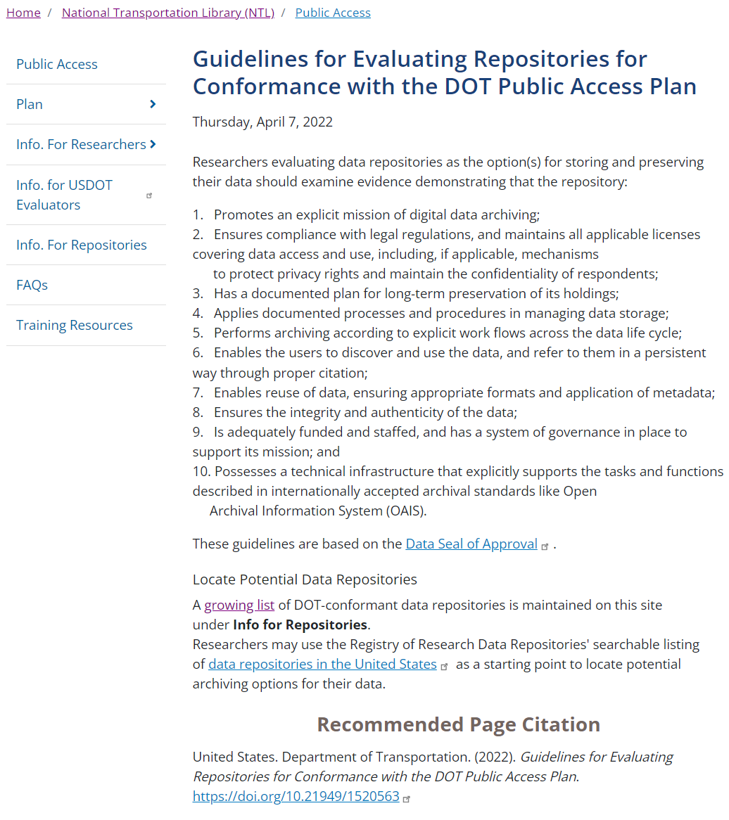
Helping DOT-funded Researchers:
Guidelines for Evaluating Repositories
Since 2016, hosted “Guidelines for Evaluating Repositories for Conformance with the DOT Public Access Plan” webpage
Based on the Data Seal of Approval criteria of the time
This will get updated to match the Desirable Characteristics
United States. Department of Transportation. (2022). Guidelines for Evaluating Repositories for Conformance with the DOT Public Access Plan. https://doi.org/10.21949/1520563
Notes:
Slide Title: Helping DOT-funded Researchers: Guidelines for Evaluating Repositories
[Speaker Script]:
When the DOT Public Access Plan went into effect in 2016, we also stood up a guidance website to help researchers implement the plan.
One of those pages is our “Guidelines for Evaluating Repositories for Conformance with the DOT Public Access Plan” webpage.
The characteristics we suggest researchers look for in a repository were based on the Data Seal of Approval criteria of the time.
This page will get updated to match the SOS Desirable Characteristics…..soon-ish.
[00:36 ; 16:43]
[Next Slide]
[Text not read] United States. Department of Transportation. (2022). Guidelines for Evaluating Repositories for Conformance with the DOT Public Access Plan. https://doi.org/10.21949/1520563

Slide 25
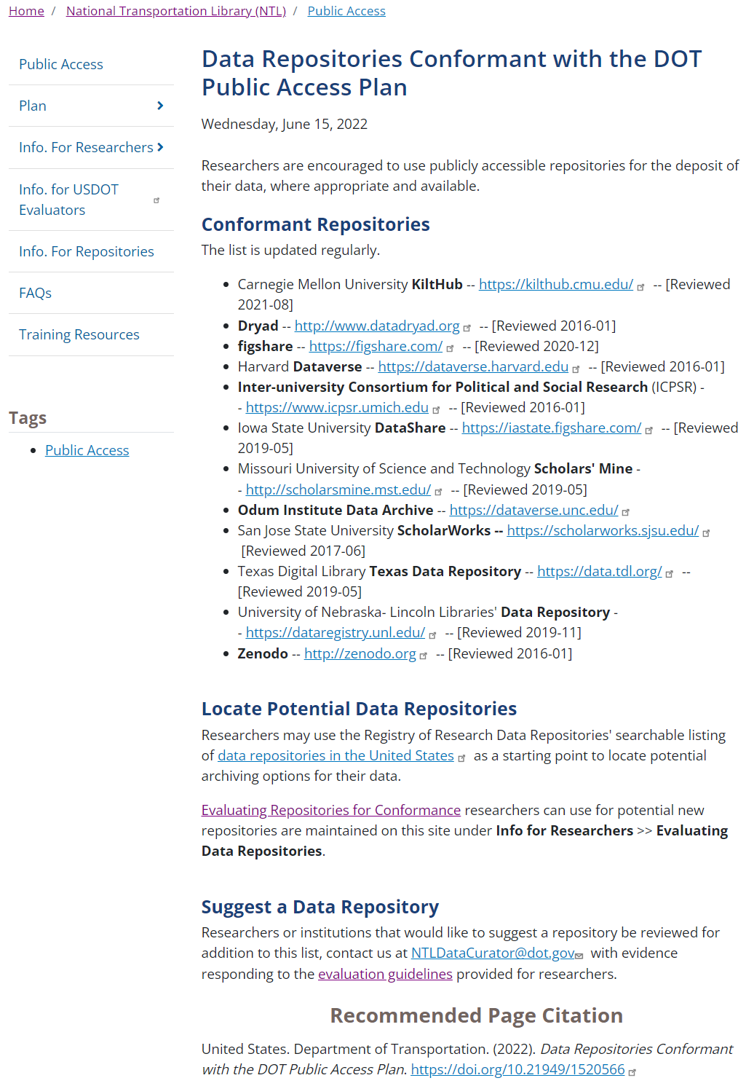
Helping DOT-funded Researchers:
List of Conformant Repositories
Since 2016, hosted “Data Repositories Conformant with the DOT Public Access Plan” webpage
NTL staff or researchers suggest repository
If willing to be included, repository provides its Data Seal of Approval, Core Trust Seal, or other certification; or fills out questionnaire based on Data Seal of Approval.
Questionnaire will change to reflect Desirable Characteristics
United States. Department of Transportation. (2022). Data Repositories Conformant with the DOT Public Access Plan. https://doi.org/10.21949/1520566
Notes:
Slide Title: Helping DOT-funded Researchers: List of Conformant Repositories
[Speaker Script]:
So, one of the things our Public Access Plan promised was that we would keep a list of “Data Repositories Conformant with the DOT Public Access Plan,” and we have since 2016.
Repositories are suggested by NTL staff or researchers.
If willing to be included, repository provides proof of its Data Seal of Approval, CoreTrustSeal, or other certification; or fills out a questionnaire based on Data Seal of Approval. Then, NTL staff reviews each questionnaire, and adds the repository to the list if satisfied. (So far no one rejected.)
The questionnaire will change to reflect Desirable Characteristics….soon-ish.
Why make all of these changes to our guidance documents?.....
[00:56 ; 17:40]
[Next Slide]
[Text not read] United States. Department of Transportation. (2022). Data Repositories Conformant with the DOT Public Access Plan. https://doi.org/10.21949/1520566

Slide 26
Desirable Characteristics Called Out in DOT Public Access Plan Update Draft
Section 3.b)iii. of “Ensuring Free, Immediate, and Equitable Access to Federally Funded Research” memo says: Federal agencies should also provide guidance to researchers that ensures the digital repositories used align, to the extent practicable, with the National Science and Technology Council document entitled “Desirable Characteristics of Data Repositories for Federally Funded Research.”
DOT Draft Update calls out Desirable Characteristics by name
The National Science and Technology Council, Desirable Characteristics of Data Repositories for Federally Funded Research, 2022, https://doi.org/10.5479/10088/113528
Notes:
Slide Title: Desirable Characteristics Called Out in DOT Public Access Plan Update Draft
[Speaker Script]:
All of our guidance needs to updated, because our Public Access Plan is undergoing review and update to satisfy the August 2022 OSTP memo “Ensuring Free, Immediate, and Equitable Access to Federally Funded Research.” Section 3.b)iii. of the memo says: Federal agencies should also provide guidance to researchers that ensures the digital repositories used align, to the extent practicable, with the National Science and Technology Council document entitled “Desirable Characteristics of Data Repositories for Federally Funded Research.”
DOT Draft Update calls out Desirable Characteristics by name. Now our guidance needs to align as well.
One last question I was asked to address…
[00:53 ; 18:33]
[Next Slide]

Slide 27
Funding U.S. DOT Research Data Curation? Yes
Plan to Increase Public Access to the Results of Federally-Funded Scientific Research
Version 1.1
December 15, 2015
Section 4.2 Data: states plainly: DOT will allow the inclusion of appropriate costs for data management and access in proposals for federal funding for Scientific Research.
U.S. DOT Public Access: Public Access Plan landing page: https://doi.org/10.21949/1520559
DOT Updated Public Access Plan due by
December 31, 2024
Draft Update?: Almost the exact same language.
But researchers have to include the expense in the proposal!!!
The most likely person or organization to reuse your data first is you and your team! Be good to your future self. Make sure you can find your data!!!
Notes:
Slide Title: Funding U.S. DOT Research Data Curation? Yes
[Speaker Script]:
Funding!
The Plan to Increase Public Access to the Results of Federally-Funded Scientific Research Version 1.1, or what we call the DOT Public Access Plan, went live on December 15, 2015.
Section 4.2 Data: states plainly: DOT will allow the inclusion of appropriate costs for data management and access in proposals for federal funding for Scientific Research.
U.S. DOT Public Access: Public Access Plan landing page: https://doi.org/10.21949/1520559
Our first plan recognized the importance of research outputs (publications, data, and others) to maintaining and improving our transportation access, equity, safety, and infrastructure. Further, the plan endorsed the tax-paying public’s right to access the research that they funded. Our updated plan will continue along those lines.
Like all federal agencies, we need to have our DOT Updated Public Access Plan completed by December 31, 2024.
The draft update has almost the exact same funding language.
But researchers have to include the expense request in their proposal!!!
Soapbox time: The most likely person or organization to reuse your data first is you and your team! Be good to your future self. Make sure you can find your data!!!
And with that….
[01:29 ; 20:03]
[Next Slide]

Slide 28
Thank You
Notes:
Slide Title: Thank you
Thank you for your time and attention.
[00:04 ; 20:06]
[Next Slide]

Slide 29
Contact
Leighton L Christiansen
Data Curator
National Transportation Library
leighton.christiansen@dot.gov
Notes:
Contact:
Leighton L Christiansen
Data Curator, National Transportation Library
leighton.christiansen@dot.gov

Slide 30
Resources
Notes:
Slide Title: Resources for Future Work
[Speaker Script] [None: Section Division Decorative Slide Only]
[Next slide]

Slide 31
DOT & NTL Resources for Public Access
Plan to Increase Public Access to the Results of Federally-Funded Scientific Research. (2015-12-16). United States Department of Transportation. https://doi.org/10.21949/1503646
U.S. DOT Public Access [Home page]. (2016 to 2022). United States. Department of Transportation. (2022) https://doi.org/10.21949/1503647
Repository & Open Science Access Portal (ROSA P). [Repository]. (2017 to present). United States. Department of Transportation. Bureau of Transportation Statistics. National Transportation Library. https://doi.org/10.21949/1398953
Repository and Open Science Access Portal. Collection: “Public Access Resources.” National Transportation Library. https://rosap.ntl.bts.gov/collection_par
Repository and Open Science Access Portal. Collection: “US DOT Public Access Data Management Plans.” National Transportation Library. https://rosap.ntl.bts.gov/collection_pa_dmp
Research Hub. [Database]. United States. Department of Transportation. Office of the Assistant Secretary for Research and Technology. https://researchhub.bts.gov/
A Deep Dive into Public Access for Research Data [Presentation to FAA]. Leighton Christiansen. 2021. https://doi.org/10.21949/1522407
Notes:
Slide Title: DOT & NTL Resources for Public Access
[Next slide]
Plan to Increase Public Access to the Results of Federally-Funded Scientific Research. (2015-12-16). United States Department of Transportation. https://doi.org/10.21949/1503646
U.S. DOT Public Access [Home page]. (2016 to 2022). United States. Department of Transportation. (2022) https://doi.org/10.21949/1503647
Repository & Open Science Access Portal (ROSA P). [Repository]. (2017 to present). United States. Department of Transportation. Bureau of Transportation Statistics. National Transportation Library. https://doi.org/10.21949/1398953
Repository and Open Science Access Portal. Collection: “Public Access Resources.” National Transportation Library. https://rosap.ntl.bts.gov/collection_par
Repository and Open Science Access Portal. Collection: “US DOT Public Access Data Management Plans.” National Transportation Library. https://rosap.ntl.bts.gov/collection_pa_dmp
Research Hub. [Database]. United States. Department of Transportation. Office of the Assistant Secretary for Research and Technology. https://researchhub.bts.gov/
A Deep Dive into Public Access for Research Data [Presentation to FAA]. Leighton Christiansen. 2021. https://doi.org/10.21949/1522407

Slide 32
Resources on Data Repositories & Data Retention
Desirable Characteristics of Data Repositories for Federally Funded Research. National Science and Technology Council (NSTC) Subcommittee on Open Science (SOS), 2022. https://rosap.ntl.bts.gov/view/dot/62310
“Guidelines for Evaluating Repositories for Conformance with the DOT Public Access Plan” from U.S. DOT Public Access Guidance website. (2016 to 2022). United States. Department of Transportation. (2022) https://doi.org/10.21949/1520563
“Data Repositories Conformant with the DOT Public Access Plan” from U.S. DOT Public Access Guidance website. (2016 to 2022). United States. Department of Transportation. (2022) https://doi.org/10.21949/1520566
Considerations on Data Retention: Presentation to the Open Mobility Foundation’s Privacy, Security, and Transparency Committee. Leighton Christiansen. 2022. https://doi.org/10.21949/1526875
Notes:
Slide Title: NLT Resources on Data Repositories & Data Retention
[Next slide]
Desirable Characteristics of Data Repositories for Federally Funded Research. National Science and Technology Council (NSTC) Subcommittee on Open Science (SOS), 2022. https://rosap.ntl.bts.gov/view/dot/62310
“Guidelines for Evaluating Repositories for Conformance with the DOT Public Access Plan” from U.S. DOT Public Access Guidance website. (2016 to 2022). United States. Department of Transportation. (2022) https://doi.org/10.21949/1520563
“Data Repositories Conformant with the DOT Public Access Plan” from U.S. DOT Public Access Guidance website. (2016 to 2022). United States. Department of Transportation. (2022) https://doi.org/10.21949/1520566
Considerations on Data Retention: Presentation to the Open Mobility Foundation’s Privacy, Security, and Transparency Committee. Leighton Christiansen. 2022. https://doi.org/10.21949/1526875

Slide 33
Federal & NTL Public Access & Open Science Resources
Increasing Access to the Results of Federally Funded Scientific Research. [Memorandum]. (2013-02-22) John P. Holdren, White House Office of Science and Technology Policy (OSTP). https://rosap.ntl.bts.gov/view/dot/34953
Ensuring Free, Immediate, and Equitable Access to Federally Funded Research. [Memorandum]. (2022-08-25) Dr. Alondra Nelson, White House Office of Science and Technology Policy (OSTP). https://www.whitehouse.gov/wp-content/uploads/2022/08/08-2022-OSTP-Public-Access-Memo.pdf
Desirable Characteristics of Data Repositories for Federally Funded Research. National Science and Technology Council (NSTC) Subcommittee on Open Science (SOS), 2022. https://rosap.ntl.bts.gov/view/dot/62310
Open.Science.gov. Office of Science and Technology Policy. https://open.science.gov/
U.S. Open Science Policy Perspectives & Transportation: Open Science in Transportation: Challenges and Opportunities in a COVID-19 Era. Presented at Transportation Research Board 2021 Annual Meeting Workshop 1467. Leighton L Christiansen. 2021. https://doi.org/10.21949/1520725
Notes:
Slide Title: Federal & NTL Public Access & Open Science Resources
[Next slide]
Increasing Access to the Results of Federally Funded Scientific Research. [Memorandum]. (2013-02-22) John P. Holdren, White House Office of Science and Technology Policy (OSTP). https://rosap.ntl.bts.gov/view/dot/34953
Ensuring Free, Immediate, and Equitable Access to Federally Funded Research. [Memorandum]. (2022-08-25) Dr. Alondra Nelson, White House Office of Science and Technology Policy (OSTP). https://www.whitehouse.gov/wp-content/uploads/2022/08/08-2022-OSTP-Public-Access-Memo.pdf
Desirable Characteristics of Data Repositories for Federally Funded Research. National Science and Technology Council (NSTC) Subcommittee on Open Science (SOS), 2022. https://rosap.ntl.bts.gov/view/dot/62310
Open.Science.gov. Office of Science and Technology Policy. https://open.science.gov/
U.S. Open Science Policy Perspectives & Transportation: Open Science in Transportation: Challenges and Opportunities in a COVID-19 Era. Presented at Transportation Research Board 2021 Annual Meeting Workshop 1467. Leighton L Christiansen. 2021. https://doi.org/10.21949/1520725

Slide 34
Sharing Federal Science Background
Notes:
Slide Title: Sharing Federal Science Background
[Speaker Script] [None: Section Division Decorative Slide Only]
[Next slide]

Slide 35
Sharing U.S. Government Research Before Public Access
U.S. Government Publishing Office (GPO)
https://www.gpo.gov/
Opens March 4, 1861 as Government Printing Office
Printing and binding for the Senate and House of Representatives, the Executive Branch, and the federal Judiciary.
Embraces digital future, and rebranded Government Publishing Office in 2014
GPO Style Manual: https://www.govinfo.gov/content/pkg/GPO-STYLEMANUAL-2016/pdf/GPO-STYLEMANUAL-2016.pdf
National Technical Information Service (NTIS)
https://www.ntis.gov/
Established by law on September 9, 1950, as “Publication Board”
Clearinghouse for the collection and dissemination of scientific, technical, and engineering information (STEI)
Federal agencies are required to send a copy of their STEI products to NTIS
NTIS catalogs, organizes, preserves and disseminates to public online through National Technical Reports Library (NTRL) https://ntrl.ntis.gov/NTRL/
Notes:
Slide Title: Sharing U.S. Government Research Before Public Access
[Speaker Script]:
The U.S. Government has been sharing publications and research outputs with the public, in an organized way, since President Lincoln’s administration in 1861.
There have been two bodies responsible for sharing federal research. Beginning in 1861 there was the U.S. Government Printing Office (GPO), which is now the Government Publications Office. Second, beginning in 1950, came the National Technical Information Service (NTIS), specifically created to share scientific, technical, and engineering information with the public.
[Next Slide]
[Text of slide not presented orally:
U.S. Government Publishing Office (GPO)
https://www.gpo.gov/
Opens March 4, 1961 as Government Printing Office
Printing and binding for the Senate and House of Representatives, the Executive Branch, and the federal Judiciary.
Embraces digital future, and rebranded Government Publishing Office in 2014
GPO Style Manual: https://www.govinfo.gov/content/pkg/GPO-STYLEMANUAL-2016/pdf/GPO-STYLEMANUAL-2016.pdf
National Technical Information Service (NTIS)
https://www.ntis.gov/
Established by law on September 9, 1950, as “Publication Board”
Clearinghouse for the collection and dissemination of scientific, technical, and engineering information (STEI)
Federal agencies are required to send a copy of their STEI products to NTIS
NTIS catalogs, organizes, preserves and disseminates to public online through National Technical Reports Library (NTRL) https://ntrl.ntis.gov/NTRL/ ]
[Expanded background text:
The U.S. Government has been sharing publications and research outputs with the public, in an organized way, since 1861. Two of the many bodies responsible for sharing information and research are the U.S. Government Publishing Office (GPO) and the National Technical Information Service (NTIS).
I won’t spend much time on these, except to point out that the 1950 law that established NTIS specifically calls for the sharing of scientific, technical, and engineering information (STEI) with the public.
NTIS holds millions of records and also distributes scanned copies of many of its holdings. These can be accessed through a number of NTIS interfaces, including the National Technical Reports Library (NTRL) https://ntrl.ntis.gov/NTRL/ ]

Slide 36
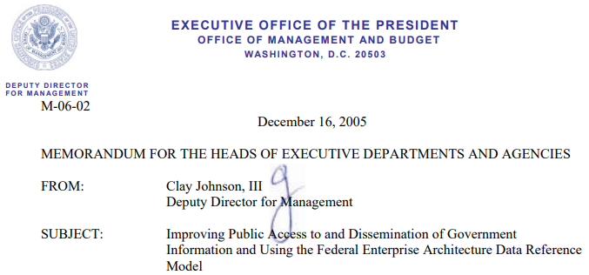
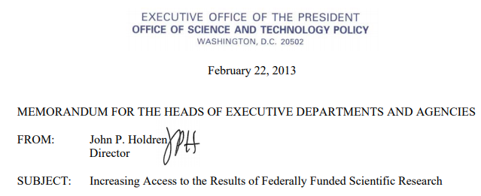
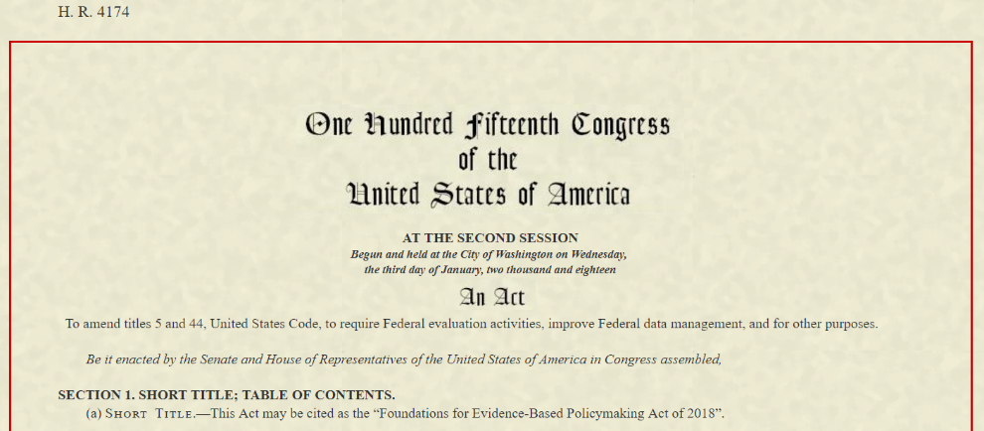
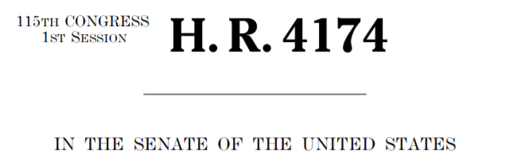
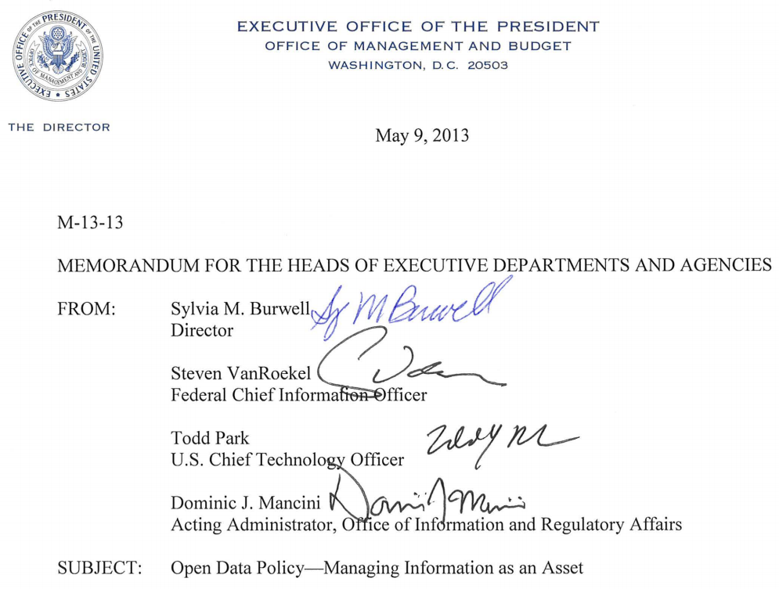
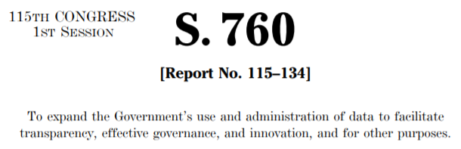
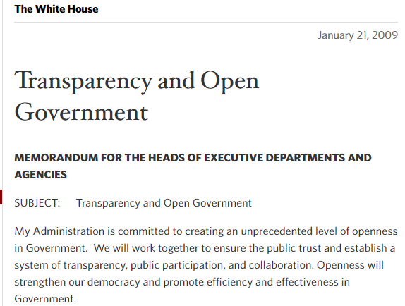
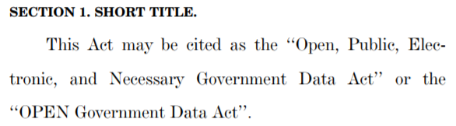
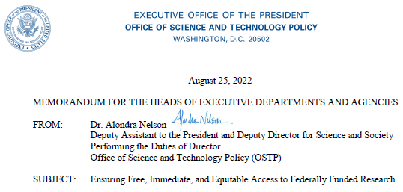
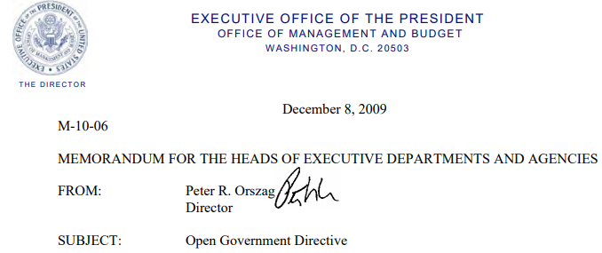
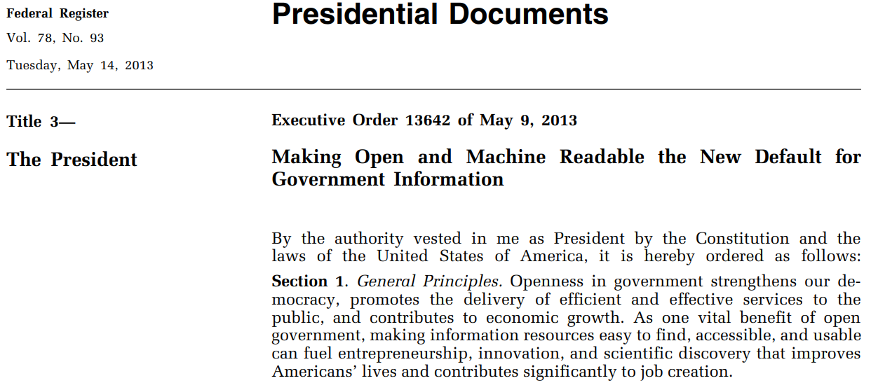
Opening U.S. Government-Funded Science: Polices 2005 to 2023
2005
2013
2017
2019
2009
2013
2018
2022
Notes:
Slide Title: Opening U.S. Government-Funded Science: Policies 2005 to 2023
[Speaker Script]:
As digital desktop publishing took off in the 1990s and early 2000s, distribution of federal scientific outputs has become distributed across all federal agencies.
Over the past 18 years we have seen many executive orders, policies, and laws, that seek to make our research outputs more available. These included directives for increased public access to federally funded publications and datasets. It is hoped that opening research outputs to broader public use will have social, economic, and research benefits, especially as data is re-used in novel ways.
A small sample of these include:
2009 “Transparency and Open Government”
2013 “Increasing Access to the Results of Federally Funded Scientific Research,” and,
2022 White House Office of Science and Technology Policy (OSTP) memo on “Ensuring Free, Immediate, and Equitable Access to Federally Funded Research.”
And let us no forget…
[Next slide]
[Text of slide not presented orally:
List of policies and memos picture on the screen:
Office of Management and Budget (OMB) Memo M-06-02, “Improving Public Access to and Dissemination of Government Information and Using the Federal Enterprise Architecture Data Reference Model,” December 16, 2005, https://www.whitehouse.gov/sites/whitehouse.gov/files/omb/memoranda/2006/m06-02.pdf
White House “Transparency and Open Government” memo, January 21, 2009, https://obamawhitehouse.archives.gov/the-press-office/transparency-and-open-government
Office OMB memo M-10-06, “Open Government Directive”, December 8, 2009, https://www.whitehouse.gov/sites/whitehouse.gov/files/omb/memoranda/2010/m10-06.pdf
White House Office of Science and Technology Policy (OSTP) memo “Increasing Access to the Results of Federally Funded Scientific Research,” also knows as “The Holdren Memo,” February 22, 2013, https://web.archive.org/web/20130308142014/https://www.whitehouse.gov/sites/default/files/microsites/ostp/ostp_public_access_memo_2013.pdf
OMB memo M-13-13, “Open Data Policy – Managing Information as an Asset,” May 9, 2013, https://www.whitehouse.gov/sites/whitehouse.gov/files/omb/memoranda/2013/m-13-13.pdf
White House Executive Order 13642 “Making Open and Machine Readable the New Default for Government Information,” May 9, 2013, https://www.govinfo.gov/content/pkg/FR-2013-05-14/pdf/2013-11533.pdf
House of Representatives bill H.R. 4174, “Foundations for Evidence-Based Policymaking Act of 2018,” introduced October 31, 2017, https://www.congress.gov/bill/115th-congress/house-bill/4174
U.S. Senate bill “S.760 - Open, Public, Electronic, and Necessary Government Data Act,” introduced March 29, 2017, https://www.congress.gov/bill/115th-congress/senate-bill/760/text , and,
Public Law No. 115-435 “Foundations for Evidence-Based Policymaking Act of 2018,” signed into law on January 14, 2019, https://www.congress.gov/115/plaws/publ435/PLAW-115publ435.pdf
[Expanded background text:
Over at least the past 15 years we have seen a number of White House executive orders, policies, and laws, that seek to make the operations of the government more transparent. This included executive orders calling for increased public access to federally funded publications, research, and data, so that citizens have as much access as possible to the products they fund through taxes. It is hoped that opening research outputs to broader public use may also have social, economic, and research benefits, especially as data is re-used in novel ways, perhaps not considered by the original researcher.
A non-exhaustive list of these order, memos, and laws include: (see list above)
Let us focus for a second on Public Law 115-435, the Foundations for Evidence-Based Policymaking Act of 2018 (HR 4174). Title II of the Act, includes the Open, Public, Electronic, and Necessary (OPEN) Government Data Act. The OPEN Government Data Act requires that non-restricted U.S. government data be available in machine-readable formats, and that each federal agency have a Chief Data Officer. This act is consistent with the spirit of the memos and policies that preceded it, including the U.S. DOT Public Access Plan. ]

