Slide 1

How to Setup a Temporary Booth
Part 3:
Employee Health & Hygiene
Notes:
How to setup a temporary booth: Part 3: Employee health & hygiene

Slide 2
Personal Hygiene
Employees must wear clean clothes and hair restraints
Smoking and eating are not allowed in food stands
Small children, friends, and visitors must not be allowed into food stands
Notes:
Personal hygiene requires food employees to wear clean clothes and hair restraints such a hat, visor, or bandana. Smoking and eating are not allowed in food stands. Small children, friends and visitors, and our four legged friends, must not be allowed into food stands.

Slide 3
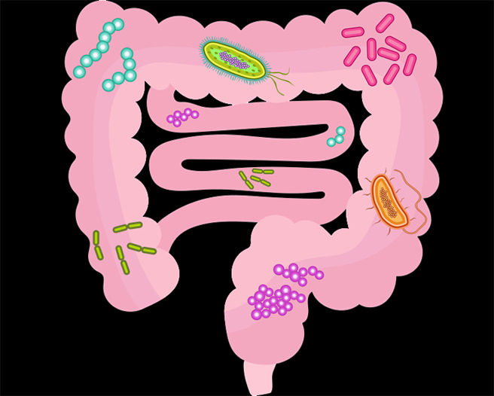
Employee Illness
This Photo by Unknown Author is licensed under CC BY-SA
Notes:
Employee illness. Screening employees experiencing symptoms is a required tool to maintain food safety.

Slide 4
Important Definitions:
Exclude prevent a person from working in a food establishment or entering a food establishment as an employee
Restrict limits the activities of a food employee so that there is no risk of transmitting a disease that is transmissible through food
Notes:
Some important definitions to know when looking at employee illness is exclusion and restriction. Exclusion prevents a person from working in a food establishment or entering a food establishment as an employee. Restriction limits the activities of a food employee so that there is no risk of transmitting a disease that is transmissible through food

Slide 5
Restrict Employee
Sore throat with fever
Open wound
Infected wound or boil
Notes:
If an employee is experience sore throat with a fever, they need to have medical documentation showing use of antibiotics or a negative culture to return to food preparation areas.
If any employee has a open wound, infected wound, or boil the employee should be restricted from food preparation until the wound is effectively covered or healed.

Slide 6
Exclude Employee
Vomiting
Diarrhea
Notes:
If an employee is experiencing vomiting or diarrhea, exclude that employee by sending them home until 24 hours without symptoms.

Slide 7
Exclude & Report
Jaundice
Salmonella typhi
Shigella
Norovirus
Hepatitis A
Shiga toxin-producing E.coli
Notes:
Exclude and report to the local health department if the employee has been diagnosed with jaundice, norovirus, Hepatitis A, Salmonella typhi, shigella, or Shiga toxin-producing E.coli.
If you are ever confused whether an employee should be restricted or excluded, reach out to your local health department, they will assist you in the proper procedures.

Slide 8


www.milwaukee.gov/health/tempfood
Notes:
Additional information, including printable guidance documents in English and Spanish can be found on the City of Milwaukee Health Department website, or by scanning the QR code located on the screen.

