Slide 1



Diversity and Cultures: Teaching and Learning Through Graphic Novels and Comics
Presenters:
David Beard and Kate Vo Thi
Education Minnesota Summer Seminar 2017
College of Saint Benedict

Slide 2

Pre-Session Setup
On the 3x5 Cards, please record:
2. Hand in your card to win prizes!
3. Grab a folder.
4. Make a pile of the readings for yourself, and begin to peruse.
Your name
Your email
What you teach (level and subject)
What graphic novels/comics, if any, you have used in the classroom

Slide 3
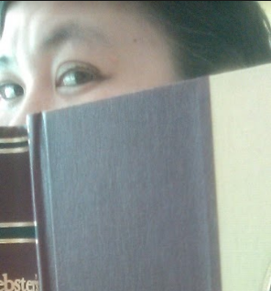
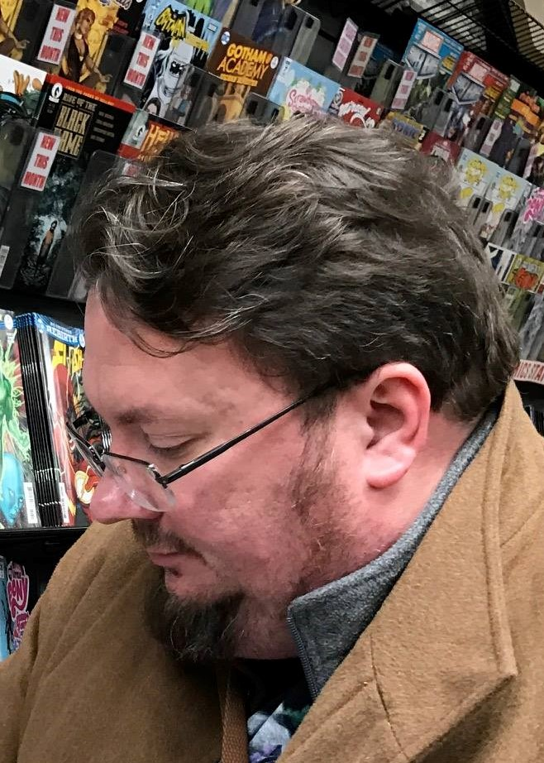
About Us
Kate is a librarian at Lake Superior College in Duluth, MN. She’s a past ALA Spectrum Scholar and enjoys reading and games.
David is a faculty member in rhetoric and writing at UMD, with a BA in English Ed. He’s co-editor of "Teaching History, Literacy, Tolerance," a curriculum for courses in History, Social Studies, Language Arts and Composition.

Slide 4
Overview of Session
The Wheel of Significant Learning
Probamon! (Large Group Reading, Large Group Discussion)
Graphic Novels & Diversity (Individual Reading, Small Group Discussion, Chalk Share)
Graphic Novels & STEAM (Individual Reading, Small Group Discussion, Chalk Share)
Closure

Slide 5
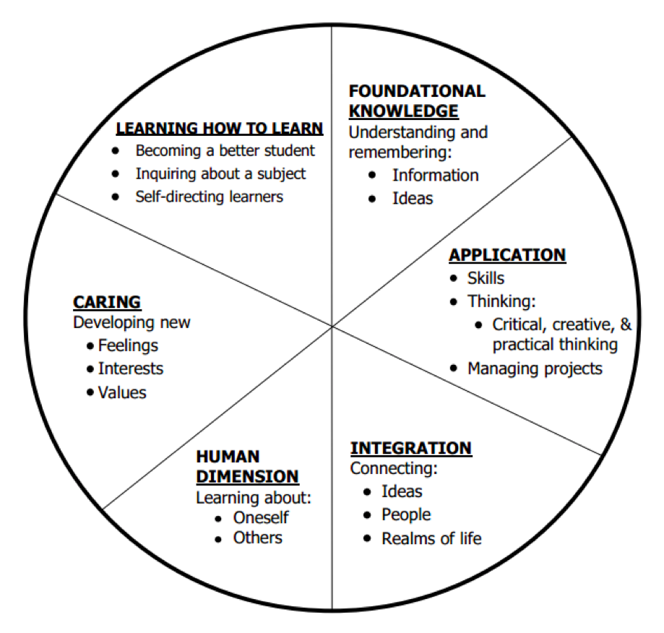
The Wheel
of
Significant
Learning
(Dee Fink)

Slide 6
Questions based in the Wheel
How might this graphic novel help students learn…
Foundational Knowledge?
...Application?
… ...Integration?
… … ...The Human Dimension (self and other)?
… … … ...Caring?
… … … … ...Learning How to Learn?

Slide 7
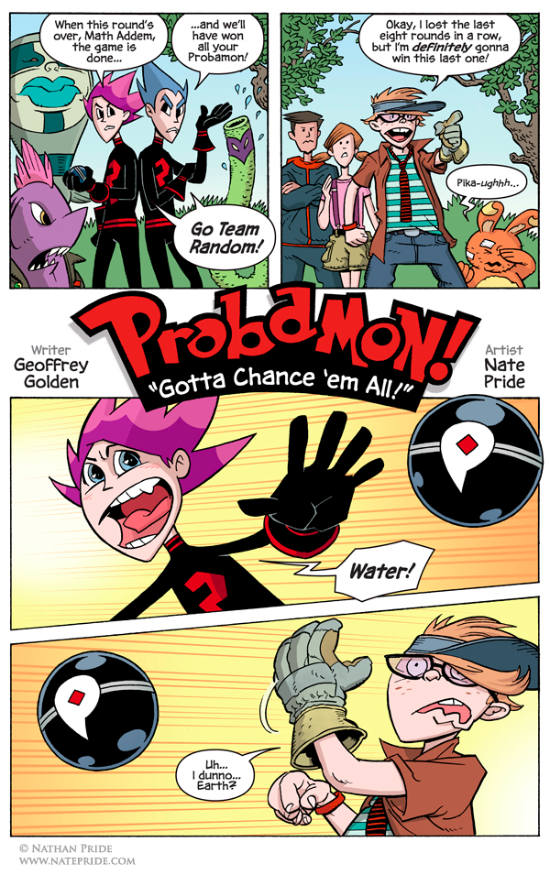
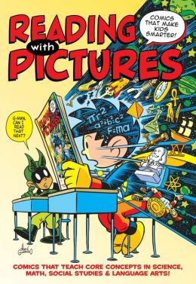
Probamon!
Large Group Reading,
Large Group Discussion
From Reading with Pictures: Comics That Make Kids Smarter
Josh Elder (editor)

Slide 8
Questions about Probamon! based in the Wheel
How might Probamon! help students learn…
Foundational Knowledge?
...Application?
… ...Integration?
… … ...The Human Dimension (self and other)?
… … … ...Caring?
… … … … ...Learning How to Learn?

Slide 9
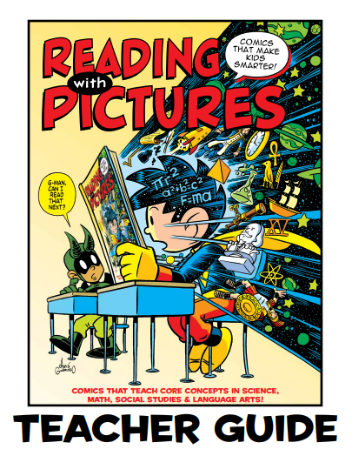
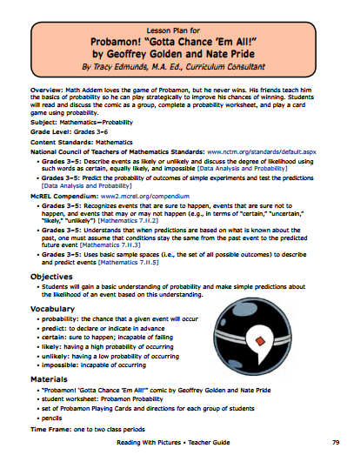

Slide 10
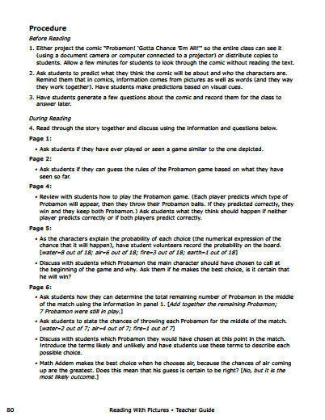
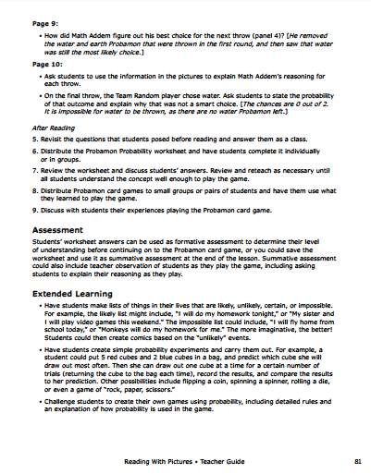

Slide 11
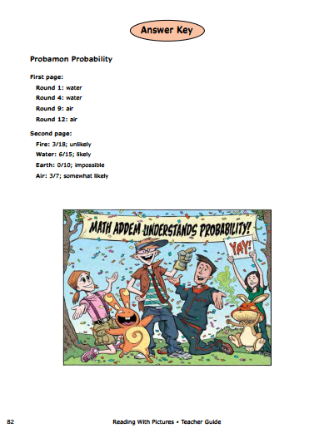
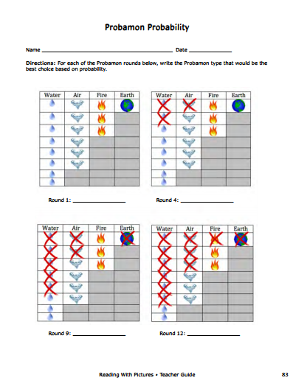

Slide 12
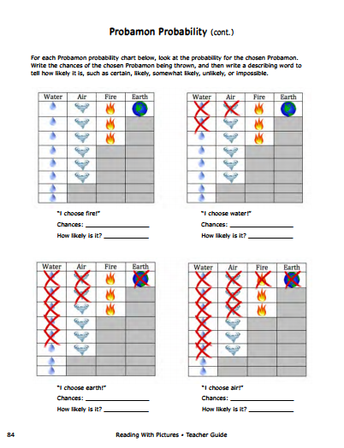
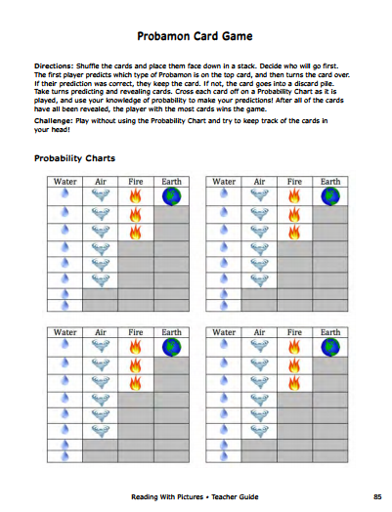

Slide 13
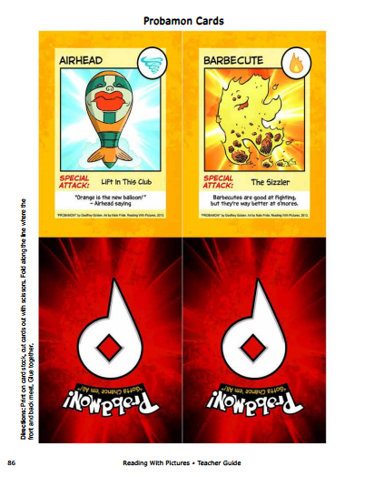
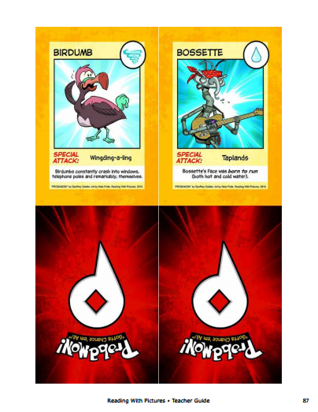

Slide 14
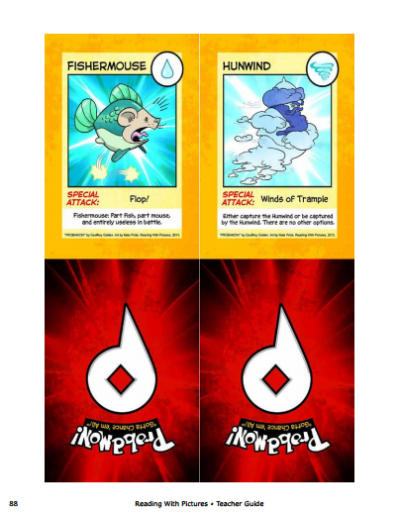
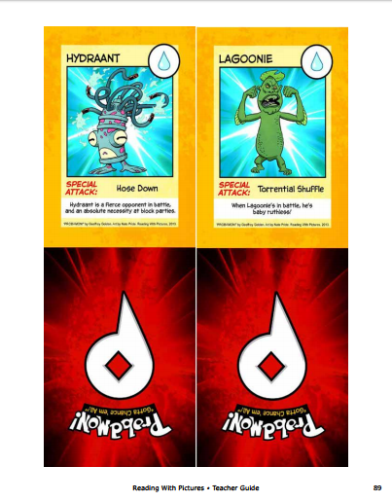

Slide 15
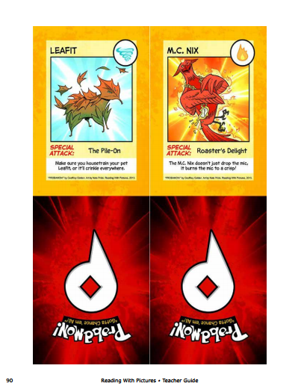
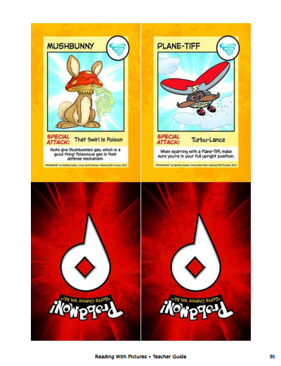

Slide 16
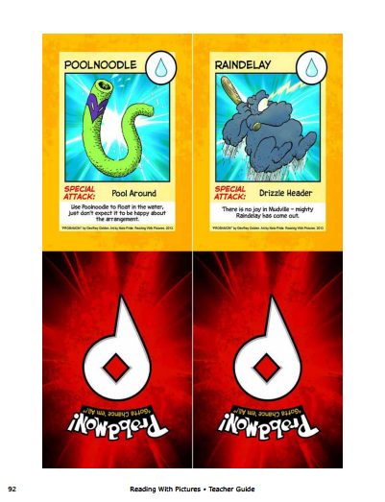
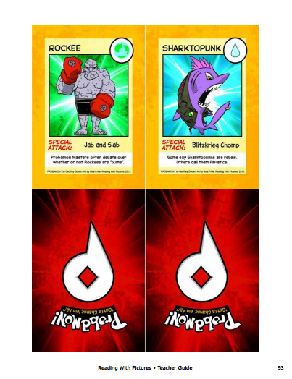

Slide 17
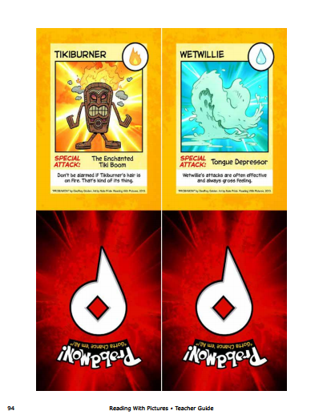

Slide 18


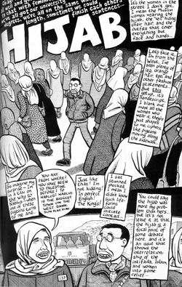


Graphic Novels & Diversity (Individual Reading, Small Group Discussion, Chalk Share)

Slide 19
Graphic Novels & Diversity (Individual Reading, Small Group Discussion, Chalk Share)
Form Groups:
Asian-American Comics
African-American Comics
Native American / First Nations in Comics
Israeli-Palestinians (in) Comics
Then, Answer Questions & Chalk Share

Slide 21
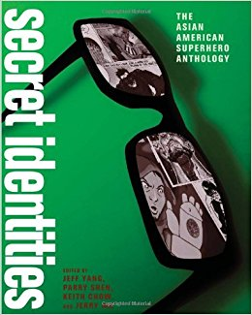

Slide 23


Slide 26
Questions based in the Wheel
How might this graphic novel help students learn…
Foundational Knowledge?
...Application?
… ...Integration?
… … ...The Human Dimension (self and other)?
… … … ...Caring?
… … … … ...Learning How to Learn?

Slide 27
Graphic Novels & STEAM
(Individual Reading, Small Group Discussion, Chalk Share)
Form Groups:
Constance & Nano & SWE
Dignifying Science: Stories About Women Scientists: Barbara McClintock
Then, Answer Questions & Chalk Share

Slide 28

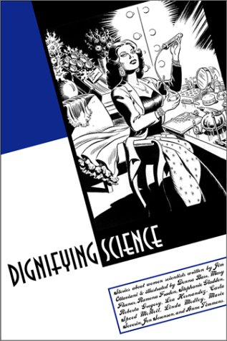
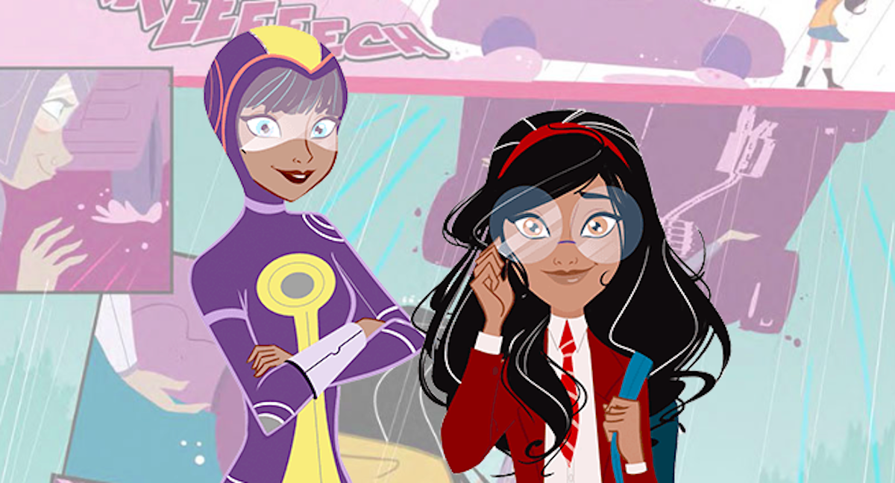
Graphic Novels &
(Individual Reading, Small Group Discussion, Chalk Share)

Slide 29
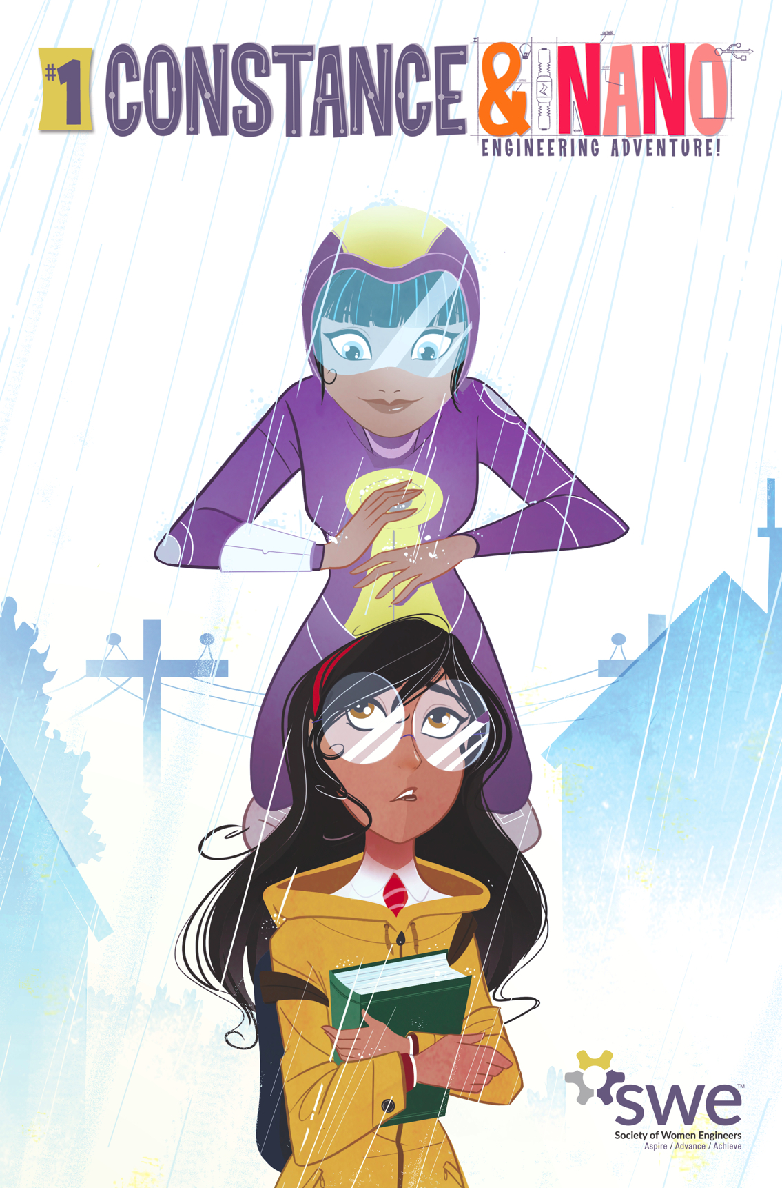

Slide 30
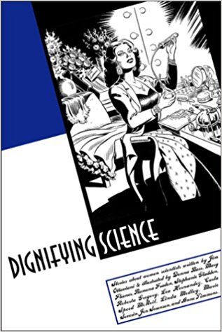

Slide 31
Questions based in the Wheel
How might this graphic novel help students learn…
Foundational Knowledge?
...Application?
… ...Integration?
… … ...The Human Dimension (self and other)?
… … … ...Caring?
… … … … ...Learning How to Learn?

Slide 32



Closure

