Slide 1


.
Notes:
Cole

Slide 2
WASTE MANAGEMENT AND SUSTAINABILITY
Cole Sherwin
Megan McCarty
Grace Wateland
David Voss
Riley Primus
EMSA
Team
Notes:
Cole
Everyone say their position

Slide 3
Our goal is to create a more sustainable campus
Notes:
Cole

Slide 4
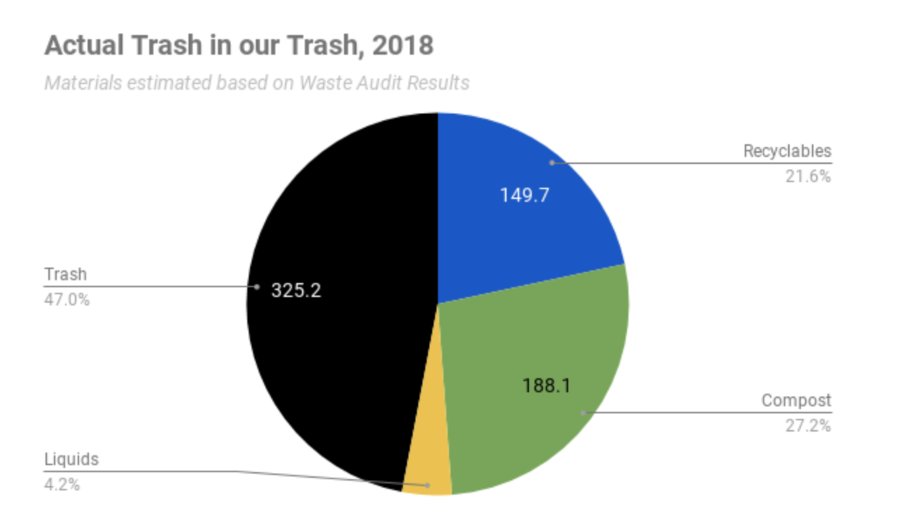
Notes:
Cole
From 2016-2018, approximately 933 pounds of trash have been sorted by UMD’s Office of Sustainability and volunteers. The sorting team found that less than half of items in the waste bins were actually waste
47% of items in the waste bins were actually waste
27.2% of items in the waste bins were compost
21.6% of items in the waste bins were recyclables
4.2% of items in the waste bins were liquids

Slide 5
SWOT ANALYSIS
Strengths | Weaknesses
Completed 2 and 1 in progress bin assessments. Which is a comprehensive inventory of the number/type/location of waste/recycle/compost bins across campus-- these assessments have helped streamline waste collection across campus, make bins more consistent, and reduce the overall number of trash bins present. Solid baseline data gathered over the last 2.5 year for all campus waste streams. | Poor media exposure Constant need to educate students/faculty and staff every year Takes time to see the impacts of those changes in data People are set in their old ways and are not wanting to learn new things.
Opportunities | Threats
Growth Removing garbage bins from all classrooms More items being able to be recycled | Budget cuts: fewer hands/hours to do the same amount of work Changes to what can be recycled can impact participation
Notes:
David

Slide 6
CONSUMER INSIGHTS
Majority of our target market is willing to learn more about sustainability and how they can help make campus more sustainable.
3 in-depth interviews and a survey with 77 responses.
In our survey we learned that 41 respondents have not heard about any of the sustainability campaigns found on campus.
27 respondents said “probably yes” and 18 respondents said “definitely yes” to listening to a 15 minute speech about changes you can make to become more sustainable.
57% of our respondents have definitely seen all three of the posters relating to waste, compost, and recycling.
Notes:
David

Slide 7

TARGET MARKET
Primary:
UMD Students
Secondary: UMD Staff & Faculty
Tertiary:
Other people on our Campus
Notes:
Grace

Slide 8
MARKETING COMMUNICATIONS OBJECTIVE #1
Short-Term Objective: By December of 2020, the amount of recyclables, compostable, and liquids found in the waste bins by will decrease by 5%.
Notes:
Grace
Group Notes:
To educate- create a behavioral switch
Measurable goal- 47% should be closer to 100%?
Give alternatives
Lowering how much recyclable and compostable goods are found in trash bins by 5%
Change behavior
Grace’s class notes:
-Goals are not measurable- more of a big picture level
-level of vision- ex. Our goal is to… create a more sustainable campus through waste management?
-Objectives are measurable and the ways that you get to your goal (subsection of goal) ex. Number such as lowering the amount of recyclables and compostables found in the trash bins by 5%
-As a result of this, the 47% should be closer to 100% trash in the trash bins
-By 2025, we hope to be at...
-Strategic initiatives are strategies (that are a subsection of objectives) ex. Awareness campaign (educating people)
-Tactics are a subsection of strategic initiatives (you can have as many tactics as you want- tactics are not limited) Tactics are how we do it- Ex. Advertising through visuals such as posters, videos, stickers, etc.
-Tactic executions
-Tactic #1: Ex. Direct marketing by interacting with UMD students and staff via email- by sending an informative waste management video? or broadcast media on UMD TV’s, or print media (ex of print media- infographs posted in the food court)
-Tactic #2:
-Tactic #3:

Slide 9
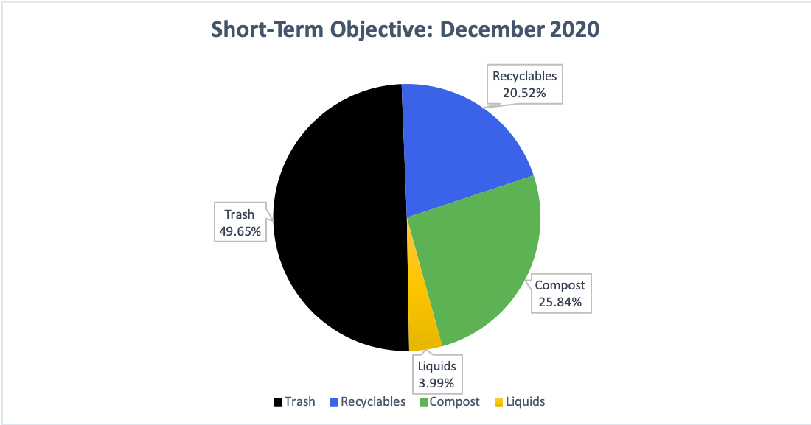
Notes:
Grace
Currently-
Trash: 47%
Recyclables: 21.6%
Compost: 27.2%
Liquids: 4.2%
December 2020 (Decrease in Recyclables, Compost, and Liquids by 5% each)
Recyclables: 21.6% * .05 = 1.08 > 21.6% - 1.08 = 20.52%
Compost: 27.2% * .05 = 1.36 > 27.2% - 1.36 = 25.84%
Liquids: 4.2% * .05 = .21 > 4.2% - .21 = 3.99%
20.52% + 25.84% + 3.99% = 50.35%
Trash= 100% - 50.35% = 49.65%

Slide 10
OBJECTIVE #1: STRATEGIC INITIATIVE
Strategic Initiative: Creating an awareness campaign to educate the University of Minnesota Duluth students, staff, faculty, and anyone else that is on campus.
Notes:
Grace

Slide 11
OBJECTIVE #1: TACTICS
Tactic #1: Creating visual aids such as stickers, posters, and videos to help enforce sustainable waste practices
Tactic #2: Creating a sense of urgency in order to save our resources on this planet.
Notes:
Grace

Slide 12
MARKETING COMMUNICATIONS OBJECTIVE #2
Long-Term Objective: Within 4 years of the initiation of our recommendations, the amount of recyclables in the waste bin will decrease to 17.28%, the amount of compost in waste will decrease to 16.96%, the amount of liquids in waste will decrease to 3.36%, and the amount of trash in waste bin will increase to 62.4%.
Notes:
Grace

Slide 13
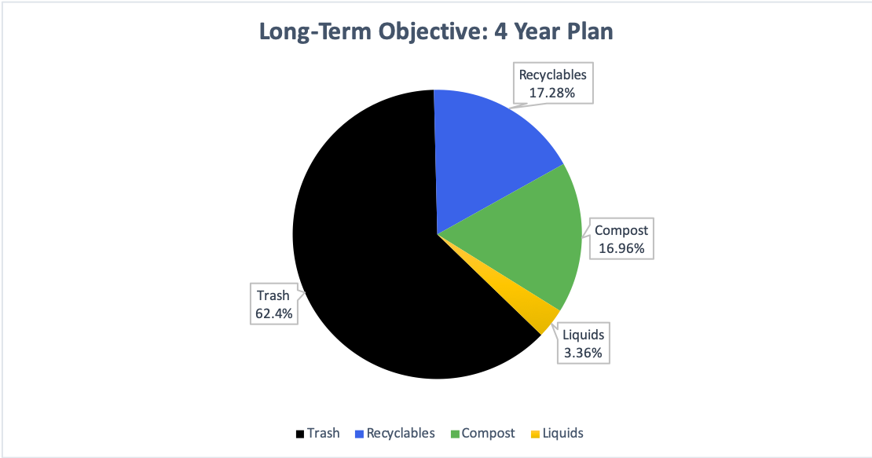
Notes:
Grace
Currently-
Trash: 47%
Recyclables: 21.6%
Compost: 27.2%
Liquids: 4.2%
4 Year Plan (Recyclables, Compost, and Liquids each decrease by 5% each year or a 20% decrease in 4 years)-
Recyclables: 21.6% * .2 = 4.32 > 21.6% - 4.32 = 17.28%
Compost: 27.2% * .2 = 4.24 > 21.2 - 4.24 = 16.96%
Liquids: 4.2% * .2 = .84 > 4.2 - .84 = 3.36%
17.28% + 16.96% + 3.36% = 37.6%
Trash = 100% - 37.6% = 62.4%

Slide 14
OBJECTIVE #2: STRATEGIC INITIATIVE
Strategic Initiative: Encouragement of proper waste sorting on campus long-term.
Notes:
Grace

Slide 15
OBJECTIVE #2: TACTICS
Tactic #1: Creating a 4 year rotational sustainability plan that involves a different focus each year to improve overall awareness of campus initiatives.
Tactic #2: Being consistent with the content that is posted and how it is displayed.
Notes:
Grace

Slide 16
MEDIA OUTLETS
KUMD Advertising
$15 per ad for 20 second spot
The Bark
$75 for print ad
$50 for online for a week
Social media→ $50 per post
Video→ 10 second is $100/video at the beginning as an ad before a longer video and $75 for at the end of the video.
Facebook
The minimum cost of a boosted facebook post is $1 per day.
Google ads
Based on an auction system
Average Cost Per Click in Google ads is between $1 and $2 on the search network
Most expensive keywords in Google ads and Bing ads cost $50 or more per click.
Ad for Sporting events
No associated cost for UMD approved groups
Rotary Bulletin/Regular (14’ x 48’)
Location I-35 at 19th Ave E
Price $1,800 - $3,900 in a 4 week period
Notes:
Riley and Megan
$1000 for outreach and promotional
KUMD Advertising
$15 per ad for 20 second spot
Seasonal factors and volume discount may vary price
Kevin at KUMD
The Bark
$75 for print ad
$50 for online for a week
Social media→ $50 per post
Video→ 10 second is $100/video at the beginning as an ad before a longer video and $75 for at the end of the video.
Order sheet needs to be filled out
Facebook
The minimum cost of a boosted facebook post is $1 per day.
Maining up to how ever much you want to spend on boosting ads
Set your budget and the duration of ad
Don’t boost multiple ads at the same time
https://undullify.com/boosting-posts-on-facebook-all-your-burning-questions-answered/
Google ads
Based on an auction system
Average Cost Per Click in Google ads is between $1 and $2 on the search network
Most expensive keywords in Google ads and Bing ads cost $50 or more per click. Generally highly competitive keywords in industries that have high customer lifetime values, like law and insurance.
Average small business using Google ads spends between $9,000 and $10,000 per month.
https://www.wordstream.com/blog/ws/2015/05/21/how-much-does-adwords-cost
Ad for Sporting events
Romano Gym, Amsoil Arena, & Malosky Stadium
No associated cost for UMD approved groups
Would require some effort and cost for some giveaway item
Rotary Bulletin/Regular (14’ x 48’)
Location I-35 at 19th Ave E
Impressions per week = 147,502
Price $1,800 - $3,900 in a 4 week period
https://www.lamar.com/Duluth/InventoryBrowser

Slide 17
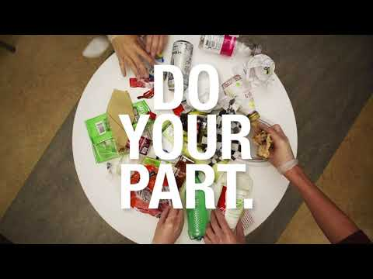
VIDEO
Notes:
Riley
This short video is to help drive visual appeals and bring wider awareness to campus through the use of TV monitors and the website. We thought that a short video would be more effective to communicate our message and reach more of our target audience.
Aim clear 3 to 5 seconds
Played around campus
Lsbe
Kirby
Athletics
Community Outreach

Slide 18

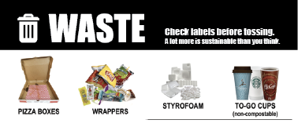


GARBAGE CAN STICKERS
Notes:
Riley
These stickers will have direct contact with each disposal bin in order to help people interact with each receptacle. The overall goal of these stickers is to help bring awareness to consumers of what items go where.

Slide 19
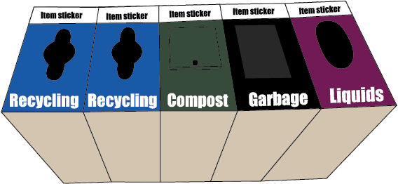
LIQUID DUMPING BINS
Notes:
Riley
Placing liquid dumping bins next to each set of disposal bins will reduce the amount of liquid that has to be diverted from the waste bins.

Slide 20

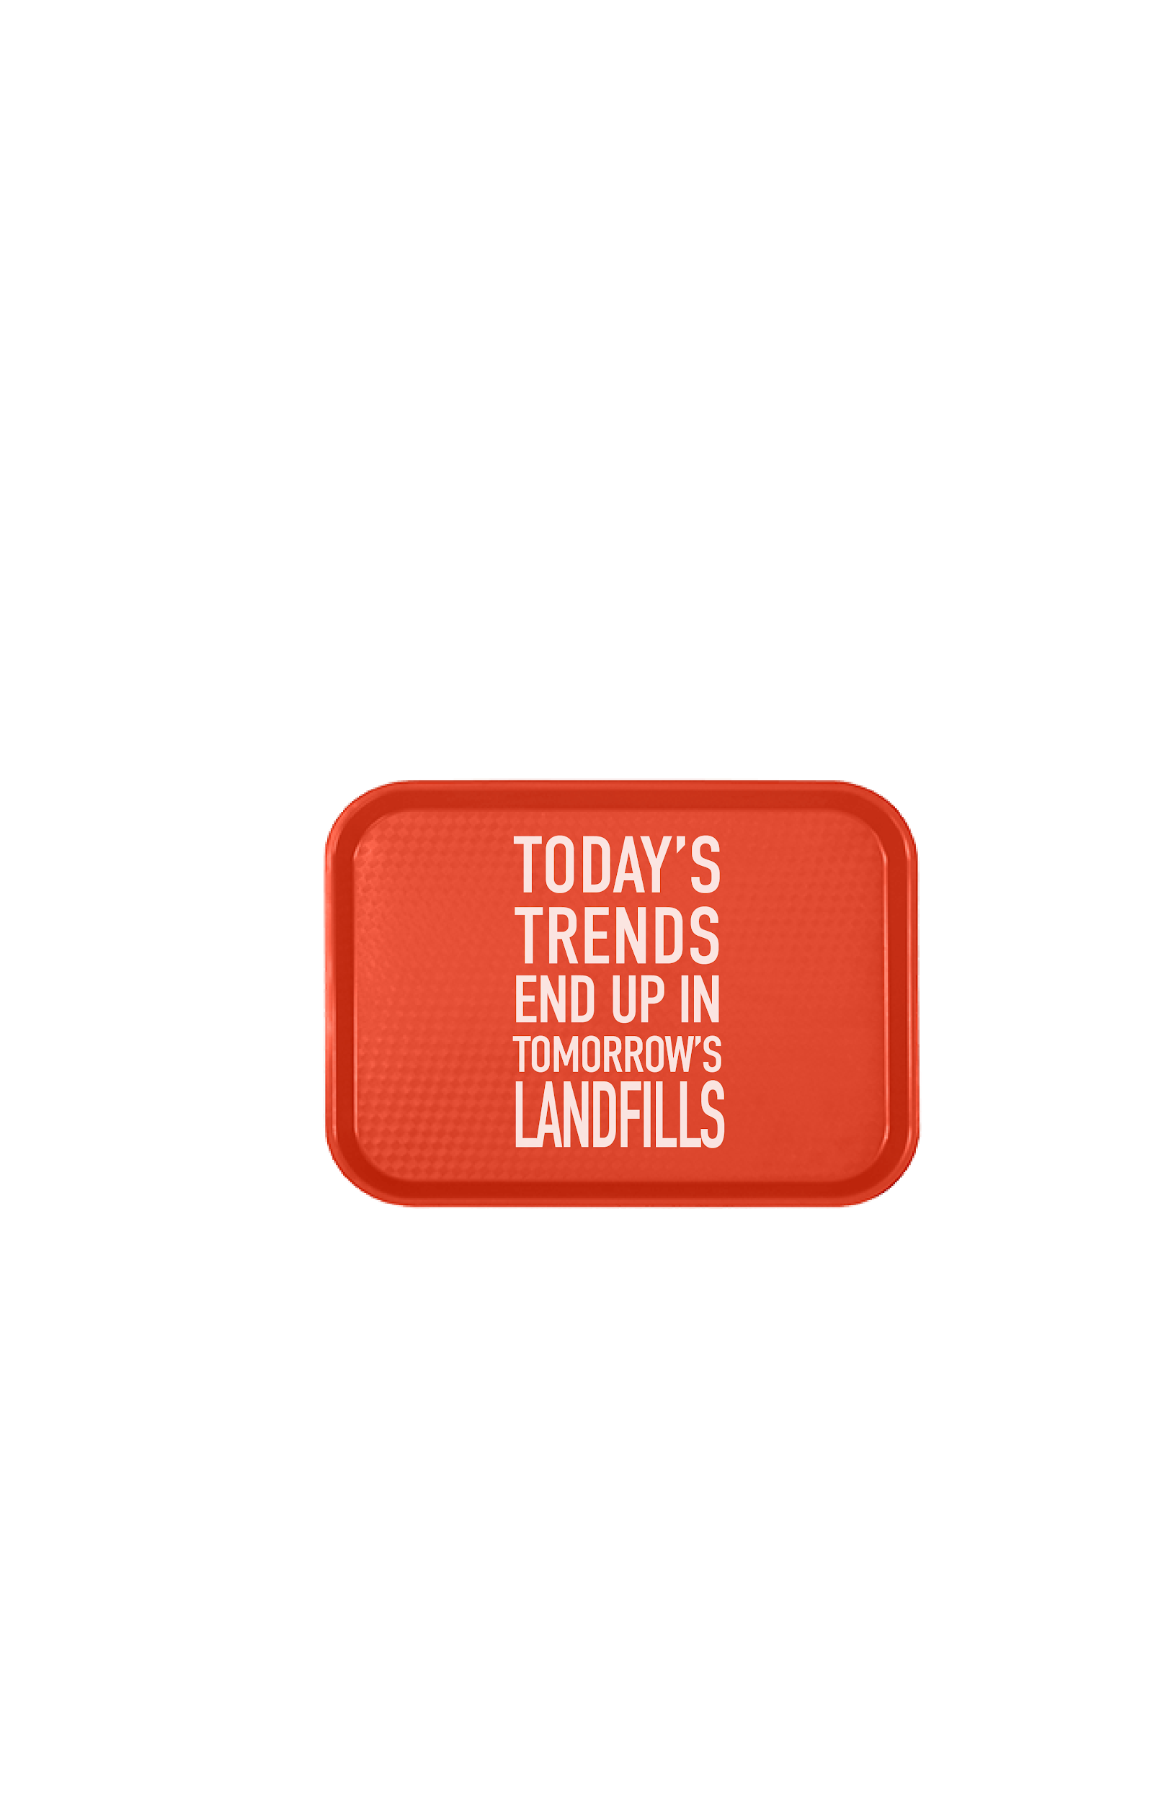
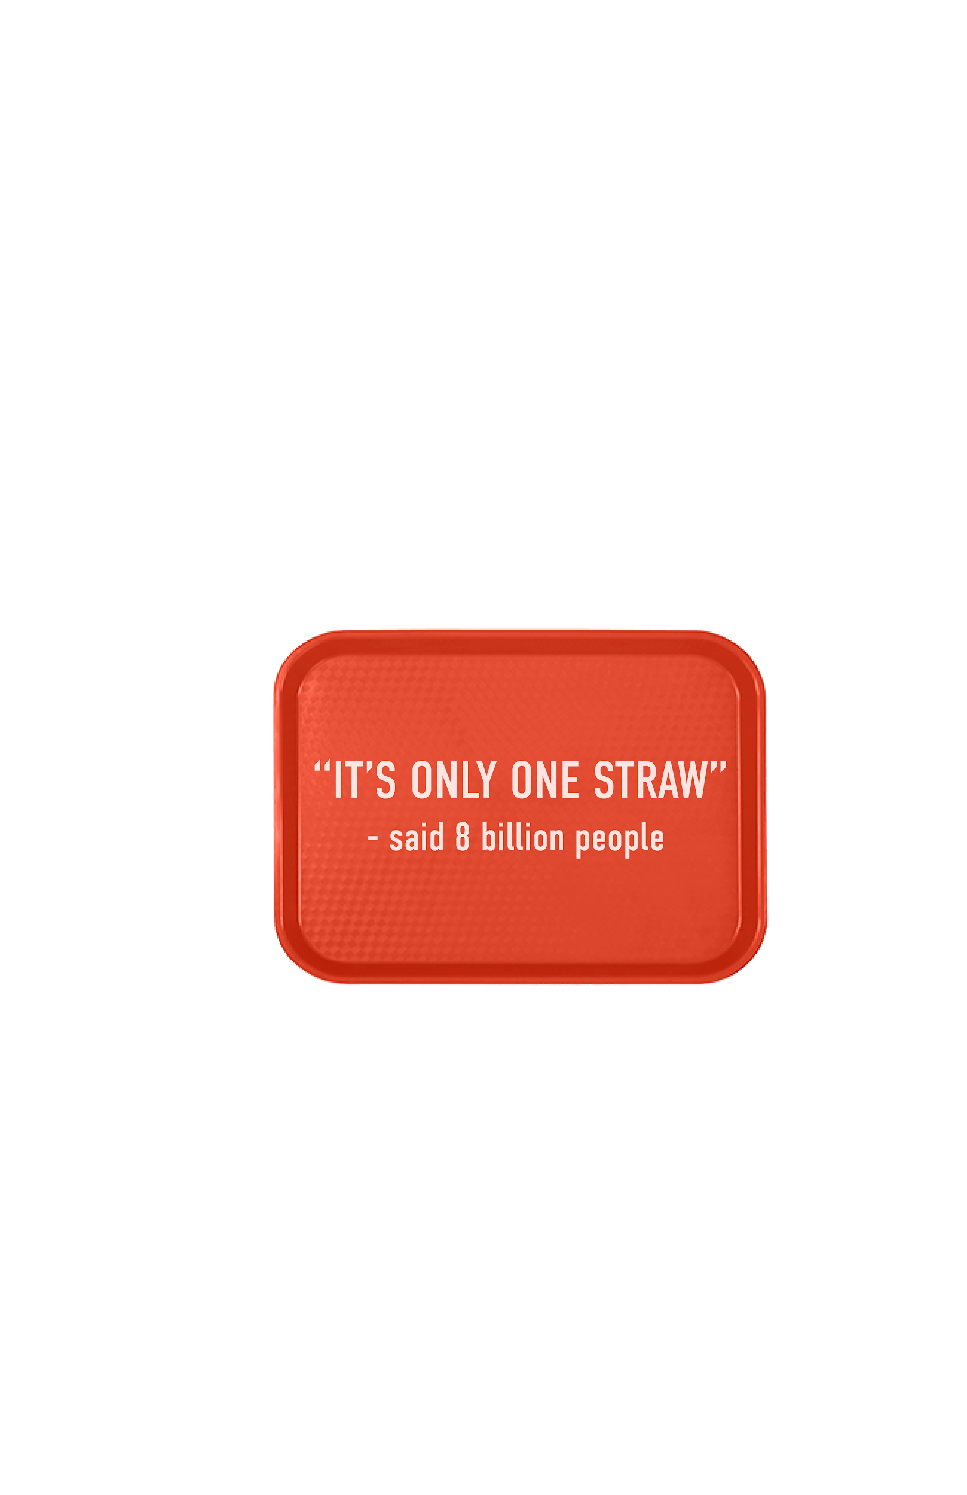
FOOD COURT TRAYS
Notes:
Riley
From our survey results, 74% of respondents said that the food court was the most frequent place they ate on campus. In addition, many people that eat at the food court are unaware that the majority of products found here are compostable. With this being said, we thought it would be smart to focus some of our efforts on the food court.

Slide 21
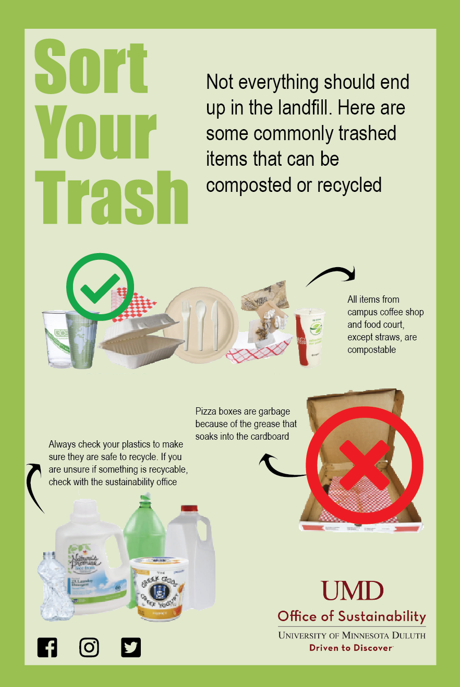
POSTER
Notes:
Megan
We have designed a poster that shows items that are commonly placed in the wrong bins. We will use our biannual survey for asking students if they have seen the posters and if they have used them to assist in their waste sorting.

Slide 22
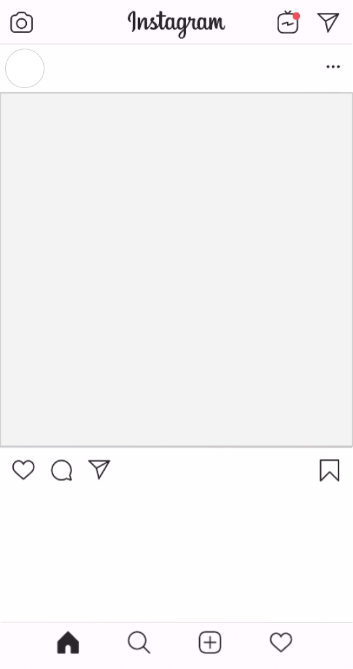

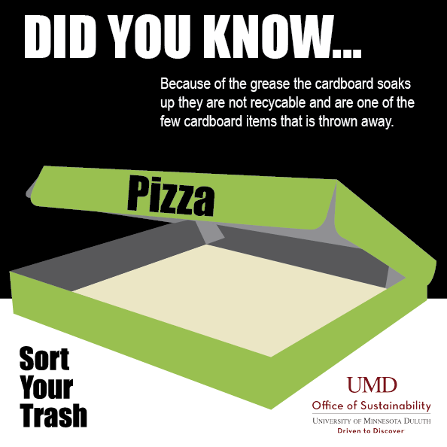
SOCIAL MEDIA
Notes:
Megan
Social media is a vital way to connect with college students and create a two-way conversation
Live in a horizontal world
Currently not engaging students in a conversation
Need to provide relevant information
Weekly posts from UMD sustainability social media accounts can advertise visual aids pertaining to waste reduction and sustainable practices. These can be evaluated by checking click rates, likes, shares, retweets, and etc. We can measure the amount of consumers coming into contact with our ads. This then will be surveyed to see if these ads have made direct impacts on consumer behavior.

Slide 23
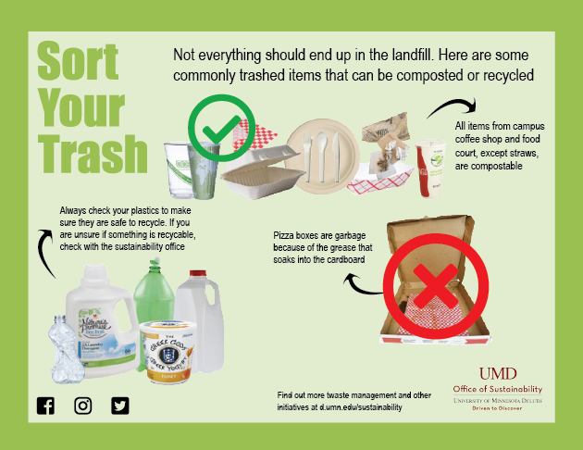
KUMD AND THE BARK
“Did you know that over 50% of UMD’s waste actually belongs in either the recycling or compost. We need your help to make UMD a more sustainable campus. We have designated bins all around campus to help you sort your waste correctly. Make sure to take 30 seconds to check the posters to see where your items belong. This ad is brought to you by the Sustainability Office located on the campus of The University of Minnesota Duluth. If you have any questions
email us at sustain@d.umn.edu or
call us at (218) 726-8198.”
Notes:
Megan
The Bark, KUMD, and Bulldog Athletics are all routes we have chosen to advertise our campaign around campus. These will be the best methods of reaching our target audience of University of Minnesota Duluth’s (UMD) students, faculty, and staff. We can test how well these ads have reach our consumers by including questions in our biannual survey. We are able to collect data on consumers feelings, insite, additude, and education level that our ads created.

Slide 24
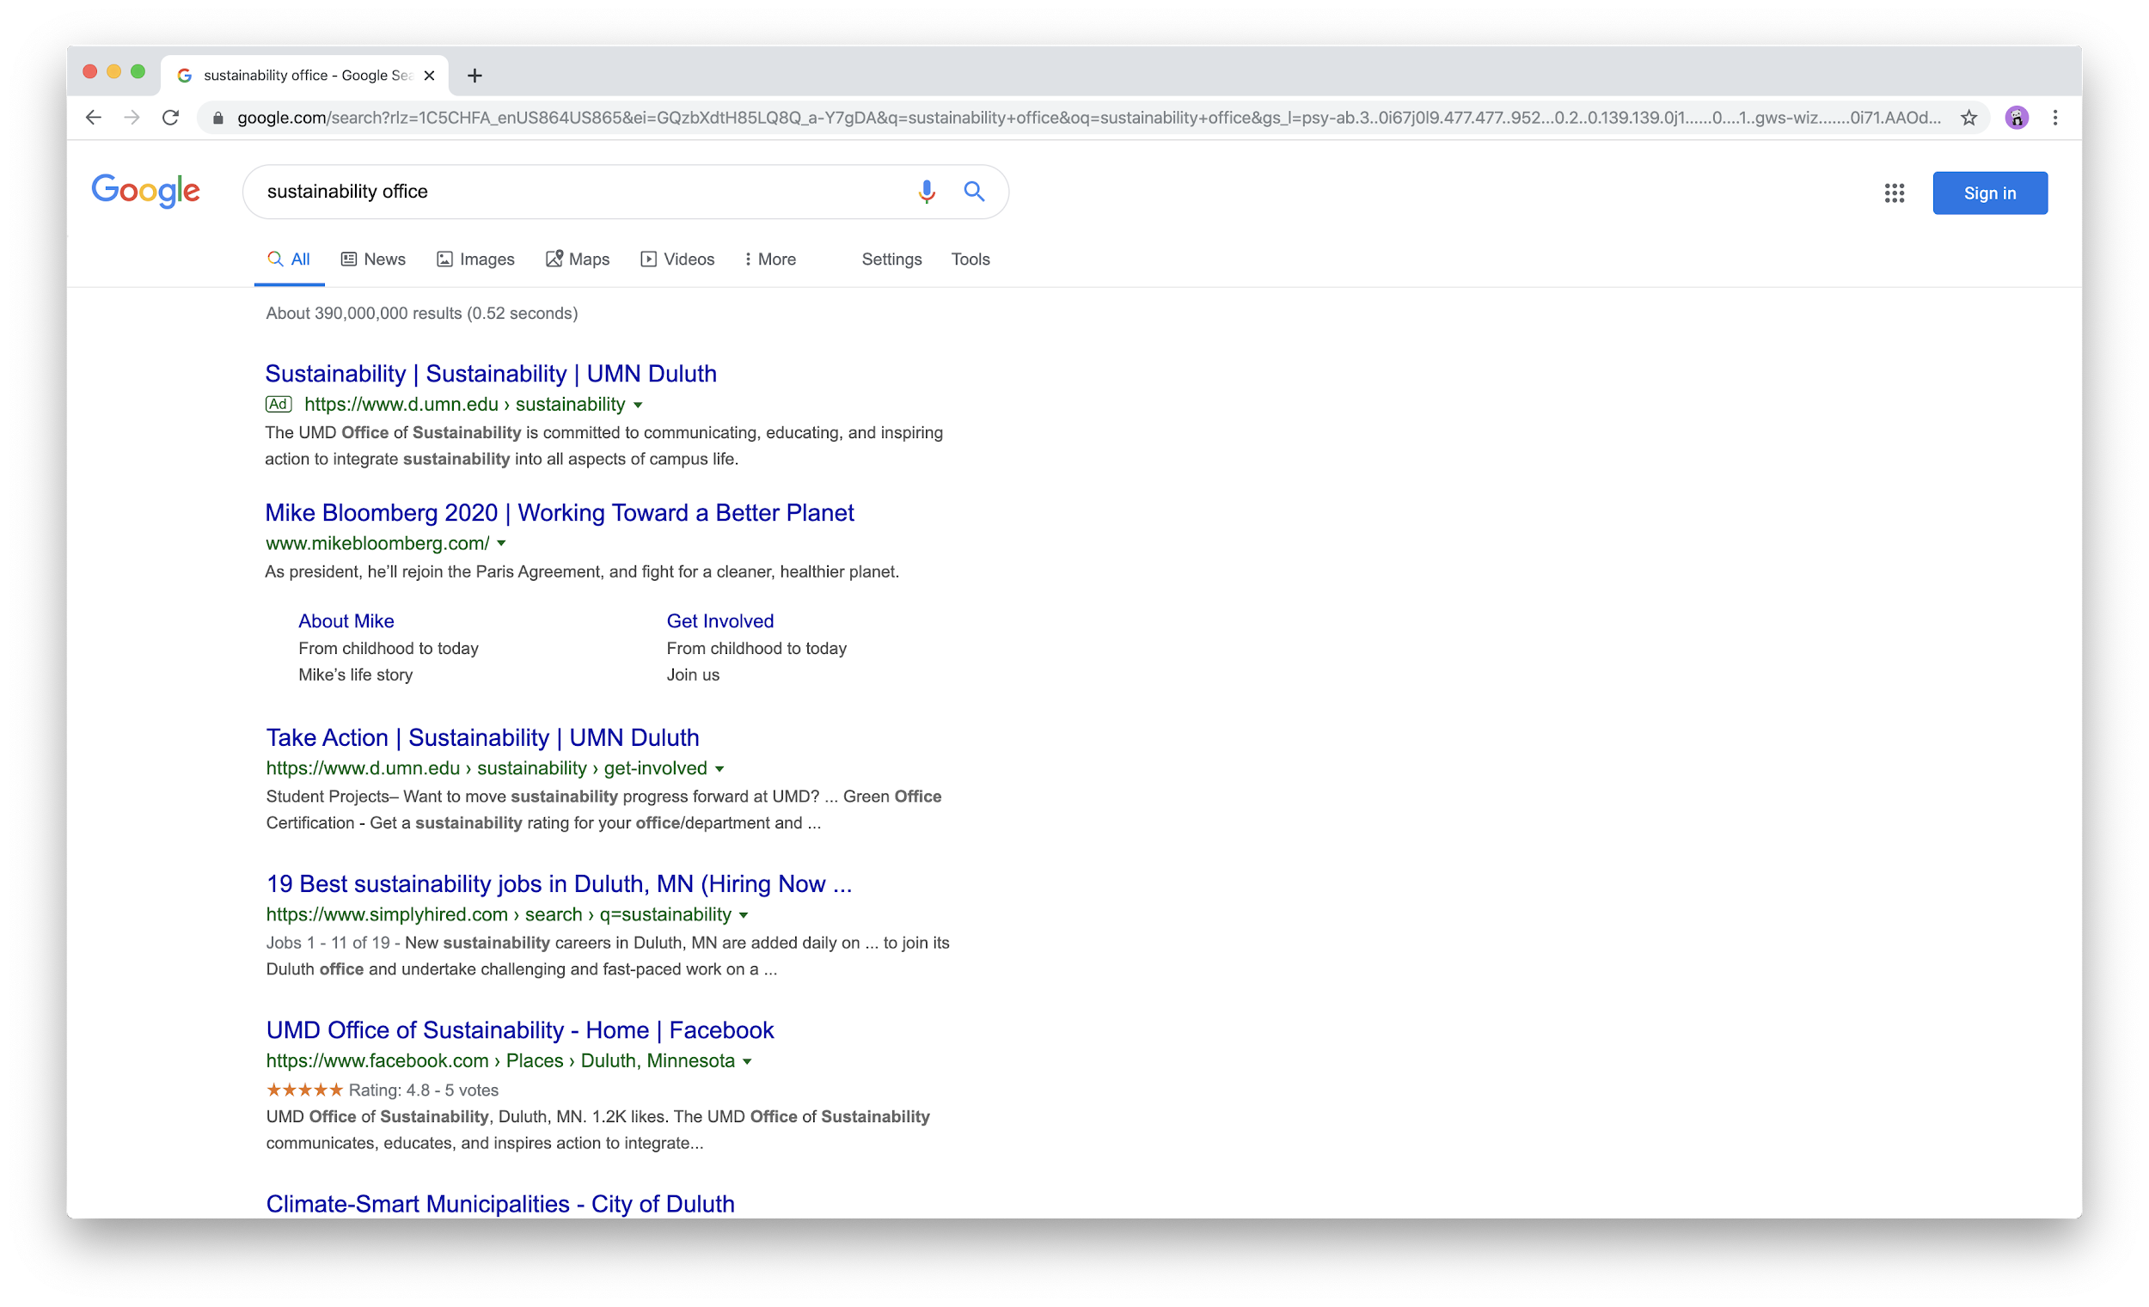
GOOGLE ADS
Notes:
David

Slide 25
KEYWORD LIST TO BID ON
Positive
EMSA (Environmental Management Systems Agency)
Environmental Issues
Global Warming
Renewable Energy
EPA
Pollution
Climate Change
Sustainability
Environmental Pollution
Recycling
Waste
Compostable
Negative
Landfill
Not Real (for people who don’t believe in global warming)
Conspiracy (for those searching for global warming conspiracies)
Noise (to eliminate searches for noise pollution)
Light (to eliminate searches for light pollution)
Notes:
David

Slide 26
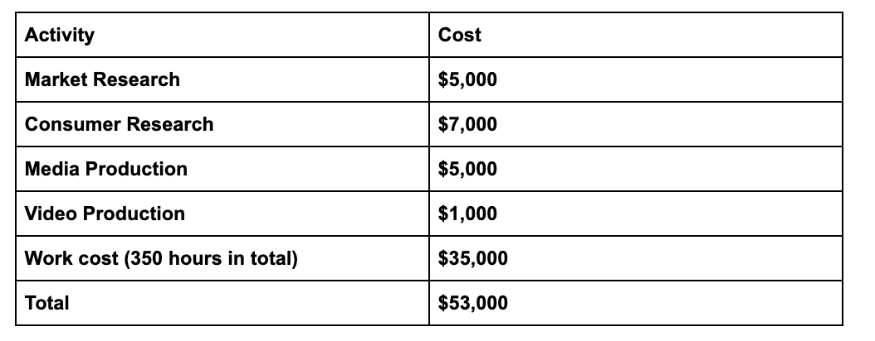
FINANCIAL PERSPECTIVE
Cost
Notes:
Cole

Slide 27
4-YEAR PLAN
1. SORT YOUR WASTE
2. SHARE A RIDE
3. CONSERVE YOUR ENERGY
4. SAVE YOUR WATER
.
Notes:
Megan

Slide 28
QUESTIONS?
Notes:
-At the end of the final paper, add ONLY the interview questions that gave us unique insight/stuck out

