Slide 1
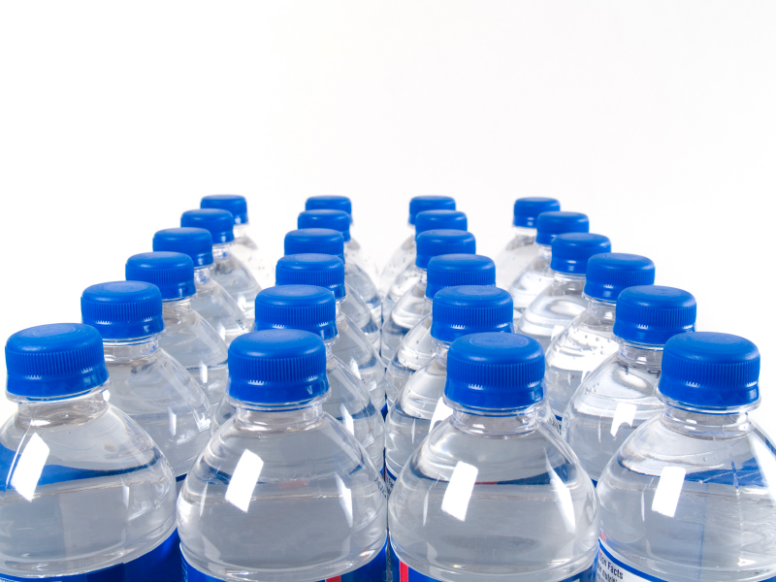
UMD’S
Bottled Water Blues

Slide 2

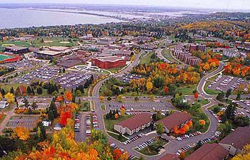
Objectives
Reduce
Educate
Encourage Alternatives

Slide 3
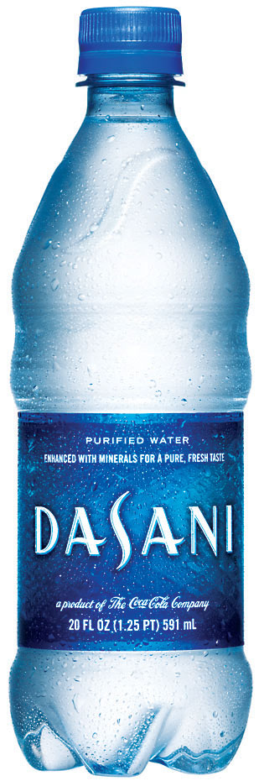
The Issues
Bottled Water is Unsustainable
Misconceptions about tap water
Insufficient Alternatives

Slide 4
Bottlemania

Slide 5
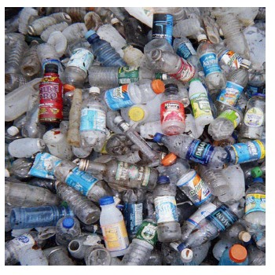
The Facts
Consumption Doubled 2000-2008
Detrimental to Environment
Often bottled from tap sources.

Slide 6


V.S.

Slide 7

Bottled Water & UMD
According to Auxiliary Services….
3.4 Mega-joules per bottle…..

Slide 8
Survey Says….

Slide 9
Promising…..

Slide 10
Room for Improvement

Slide 11
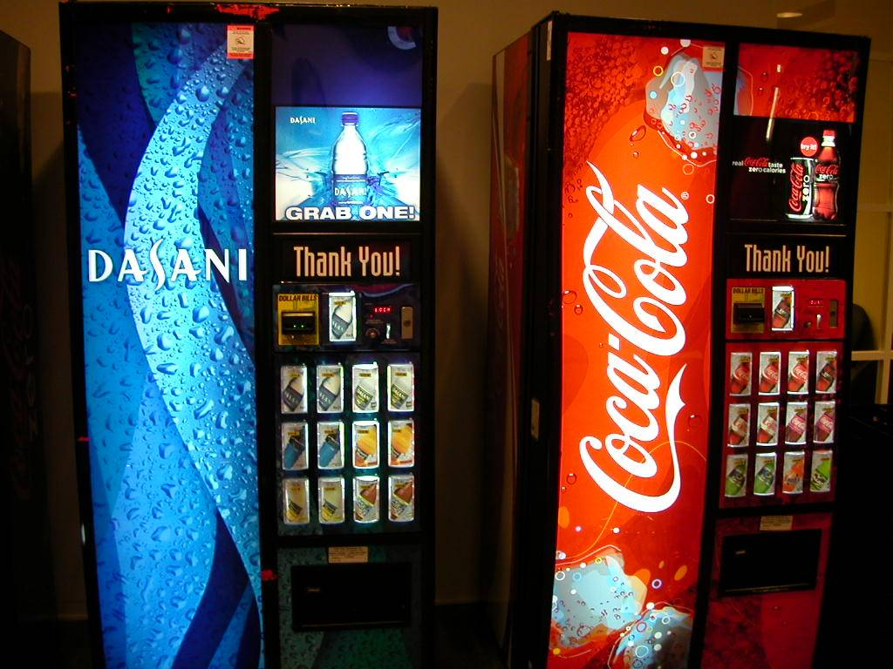
John Brostrom
Auxiliary Services

Slide 12
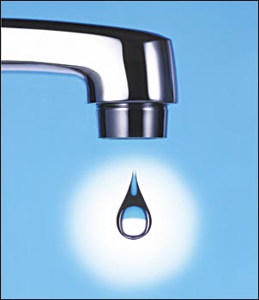
Other Universities……
University of Maryland
University of Minnesota-Morris
St. Cloud State

Slide 13
Possibilities….
Spigots
Freshman education/water bottles
Food Court refills
Hydration Station.

