Slide 1

How Data and Publishing Intersect for Public Health Researchers
A Conversation Around Broad Definitions of Dissemination
Shanda hunt + Caitlin bakker

Slide 2
Ithaka S + R Study
Seven Participating Institutions
      Johns Hopkins University
      University of Alabama
      University of Arizona
      University of Illinois
      University of Iowa
      University of Minnesota
      University of Washington

Slide 3
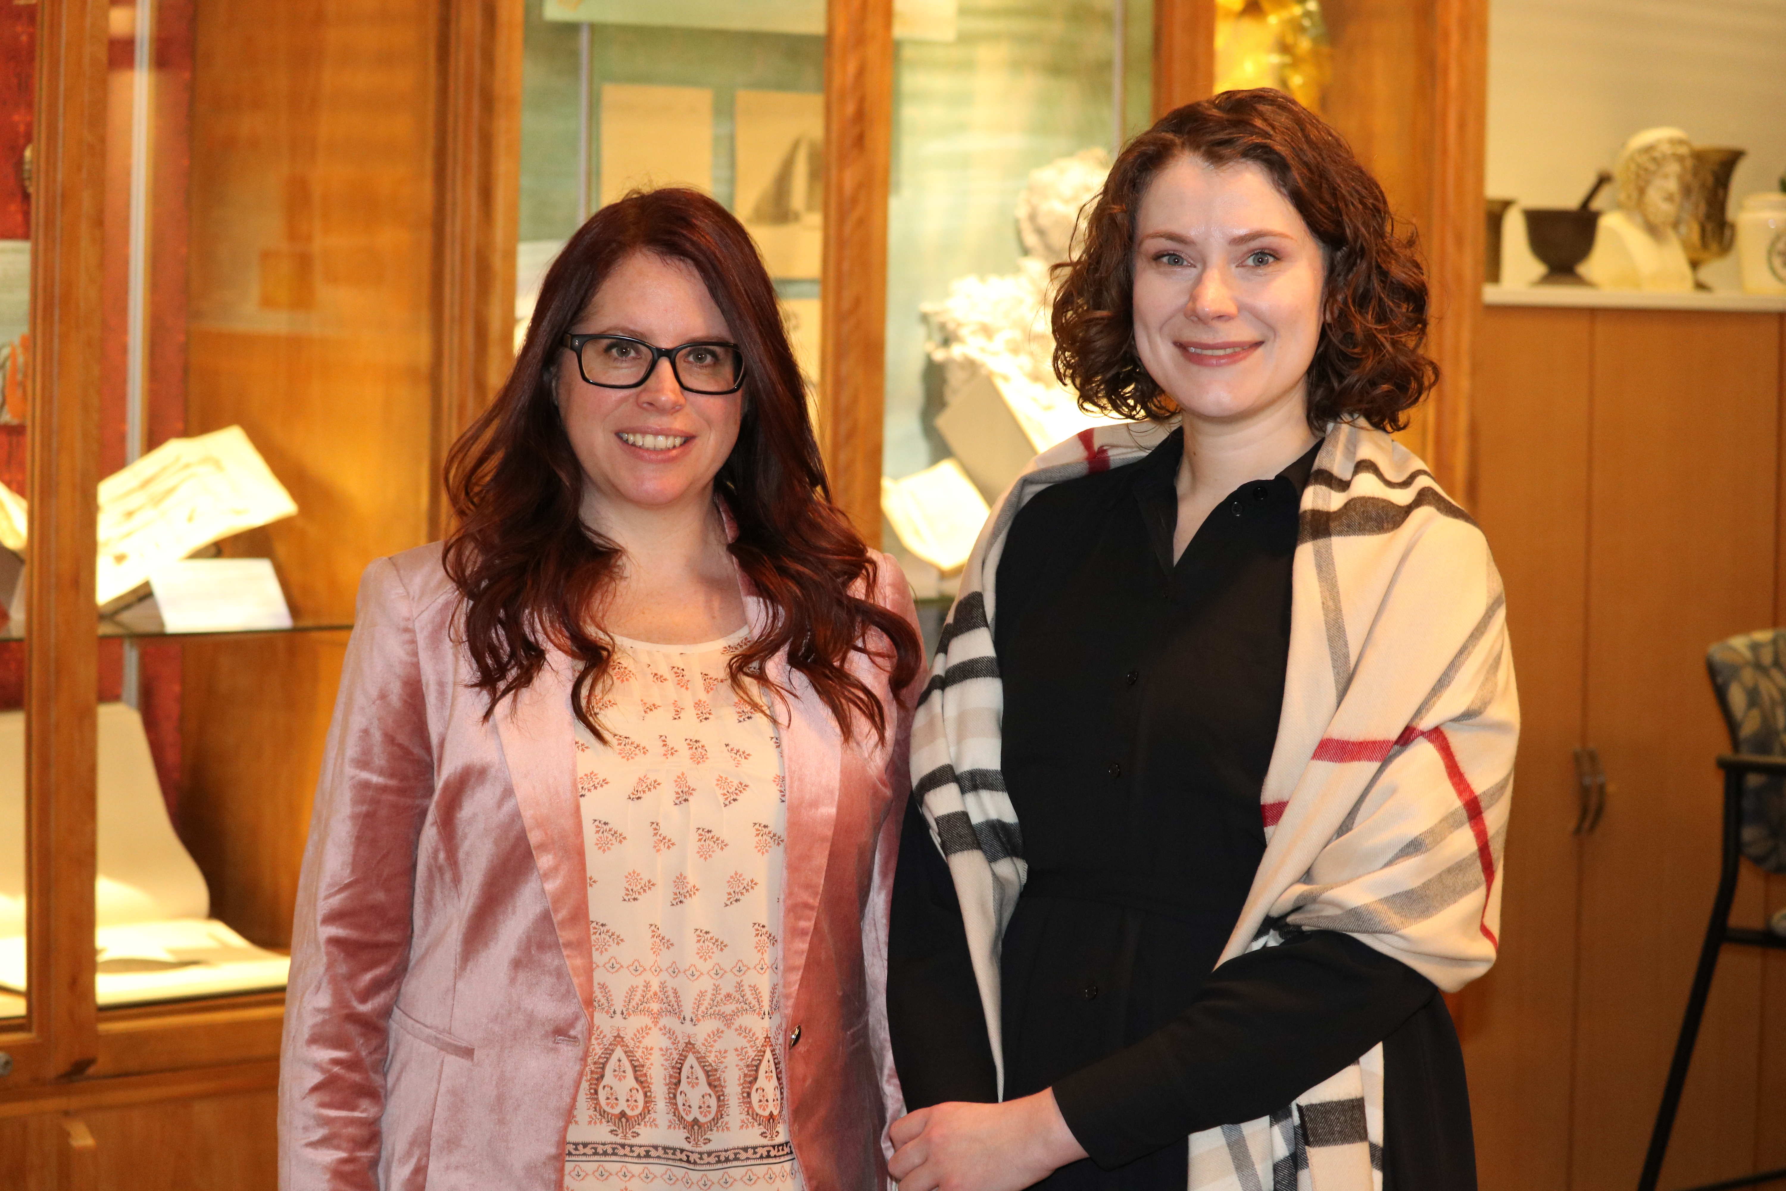
University of Minnesota Team
Shanda Hunt, MPH
Public Health Librarian
Data Curation Specialist
Caitlin Bakker,
MLIS
Research Services Librarian
Medical School Librarian

Slide 4
Public Health
“The combination of science, skill and beliefs that is directed to the maintenance and improvement of the health of all people through collective and social action.”
Inherently Interdisciplinary
Last JM, Spasoff RA, Harris SS. A dictionary of epidemiology. 4th ed. New York: Oxford University Press; 2001.

Slide 5
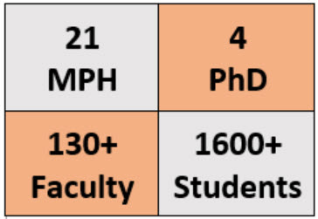
UMN School of Public Health
One of the first public health programs offered in the United States
Ranked 8th in the nation
Four divisions:
Biostatistics
Environmental Health Sciences
Epidemiology & Community Health
Health Policy & Management

Slide 6
Recruitment
Obtained list of faculty from SPH website
Sort: Division + Alphabetical
Email script
First 20 on each division’s list (80 invites)
24 participants

Slide 7
Analysis
Transcripts created by VerbalInk
NVivo 11 Pro
Independently coded by 2 coders
Grounded theory approach

Slide 8
Findings
Data management was an afterthought
Some misunderstanding of the publication industry
Dissemination in many forms highly valued
Communicating public health to the public was becoming more recognized as a priority

Slide 9
Data Management was an Afterthought
“Cause I've looked at, say, my old codes for data analysis, and I had a lot of comments on there, ‘This is what this line does,’ and so on and so forth. But even still, when I go through it, it was just, I don't know what I did.”
“[I]t's very hard to keep up with where those datasets are and whether you've shared them with people who might still have them. And even if it's requested to get it back, did they respond to your email? Did you follow up?”
Notes:
Several “data fail” stories shared with us
Data inaccessible bc stored on zip or floppy discs
Not sure how to re-run old analysis due to poor annotation
Unsure of who the data was shared with and if it was returned
Lack of forethought and organization leading to frustration/unpreparedness
In-house data managers becoming a thing of the past
Current confusion around NIH's definition of clinical trials introduces new data management requirements for researchers who previously haven’t engaged with this topic
Attitudes toward data sharing:
Understand that may be mandated in some cases - human subjects and privacy
Often led by another member of the team who is more devoted to the concept
Historical researcher fear (“data parasites”) vs thoughtfulness around population being studied
Concerns centered on:
Data ownership in a collaborative (especially international work and policy affecting)
Public harm - misinterpretation of data, exposure of vulnerable populations (e.g., indigenous communities)
Recognizing change in expectations around data management
Showed a strong desire to learn more
“...people are looking for efficiencies and methods that will be the best, good business practice so that you won’t lose things, so that the things that you need to interpret will be in the dataset…”

Slide 10
Misunderstanding of the Publication Industry
“[W]hen journals start charging you to publish your work, I just feel like there’s a commercialism aspect to it that I feel runs counter to...the system in which we do research. Almost all of our research is externally funded…. And I don’t like it if people suddenly start trying to make money off that. I don’t know that it’s a good use of taxpayer money, to be able to pay publishers to put my work out there when there are options to not do that.”
Notes:
Equated open access publishing with predatory practices in a lot of cases
Almost all had published open access, but it was due to a colleague decision
Deterred by article processing charges (APCs), describing them as “insulting” and “hilarious”
Another participant - societies journals make their money from membership fees
P and T a huge consideration
Menial work involved in the publishing process
Formatting
Lengthy turnaround times
Concerns about documenting data for sharing sometimes reflected a similar tone

Slide 11
Dissemination in Many Forms Highly Valued
"We write reports for community members that are readable by community members all the time, and interviews with local American Indian-based periodicals, and other media, radio. [These are] identified by community members, by our community partners. I do feel it’s really important to have those outlets because that’s one important way for the information to get out to community members."
Notes:
Because the end goal of public health research is to better the health of the public, they were experienced in disseminating results in a variety of ways and to many audiences.
Wanted to move beyond dissemination to knowledge mobilization.
This particular quote was from a researcher who did CBPR
Most spoke about disseminating to other researchers at conferences and seminars
Identified three emerging avenues through which to disseminate their work to broader audiences:
Data sharing
Social media
Data visualization
Data Sharing:
Tentative curiosity
Looking for ways to tackle their fears in this area – i.e., maintain some form of control
Social Media:
Thought of social media as self promotion = distasteful
Did not think of it as research dissemination
Still intrigued, worried about who might manage such a campaign
Data Visualization:
Participants wanted to be able to “tell a story” in a few images
Easily understood and interpreted
Spectrum of comfort with this concept
Worried about misinterpretation and loss of meaning
Concern about the necessary expertise (e.g., graphic design) and the number of tools potentially involved

Slide 12
Communicating Public Health to the Public was Becoming More Recognized as a Priority
“I think we could be more intentional about how we engage with members of the community, broadly defined – not just individuals and families, but organizations, nonprofit organizations, departments of health, industries – in how we set research agendas, so that what we're doing is going to actually be viewed as valuable by stakeholders within the broader community.”
Notes:
Feel public health is misunderstood (manifests as an absence of illness)
Barrier to uptake of evidence-based recommendations, interventions, and policies
Feel it is their responsibility to change that
Barriers:
Cost
Lack of clear communication mechanism
Lack of training in knowledge translation activities
Potential for misinterpretation
Opportunities:
Educate the public on how research agendas are set
Highlight the cost effectiveness of research
Include community members as active participants in research

Slide 13
Summary
Creative population in terms of dissemination
Open to new platforms for dissemination
Clear opportunities for education
Data and publishing intersect in many ways, but particularly when researchers are looking for ways to communicate their work to the public

Slide 14
Recommendations for Library Science
Better their data management skills to improve incidents of data reuse or sharing
Reframe datasets as a research output which can be cited and considered in the P&T process
Articulate the complexity of the publishing industry to highlight the necessity of open science

Slide 15
Recommendations for Library Science
Encourage open access publishing as one strategy for communicating with the public, which includes public health practitioners
Encourage them to leverage social media and data visualizations – as publishing alternatives or enhancements – to communicate with the public
Ensure they know how to maintain control over their outputs through embargoes, restricted access, and licensing

Slide 16
Research Outputs
“A Qualitative Analysis of the Information Science Needs of Public Health Researchers in an Academic Setting” – Manuscript to be published in the Journal of the Medical Library Association, April 2018
“Supporting the Changing Research Practices of Public Health Scholars” - Ithaka S+R multi-institutional report, December 2017

Slide 17

Thank You
Shanda Hunt
hunt0081@umn.edu
UMN Experts Profile
Caitlin Bakker
cjbakker@umn.edu
UMN Experts Profile

