Slide 1
A Public health assessment of the north st. paul living streets plan
University of Minnesota
School of public health
Division of environmental health sciences
In partnership with the resilient communities project
ELIZABETH NARTEN | TEEGAN WYDRA | EMILY YANG

Slide 2

The city of north st. paul
Located in eastern Ramsey County
20 year Capital Improvement Plan to upgrade major infrastructure
  Living Streets Plan

Slide 3

Vision of living streets plan
Directly responds to concerns
  Stormwater runoff
  Modes of transportation
  Active living
Living Streets and Public Health

Slide 4
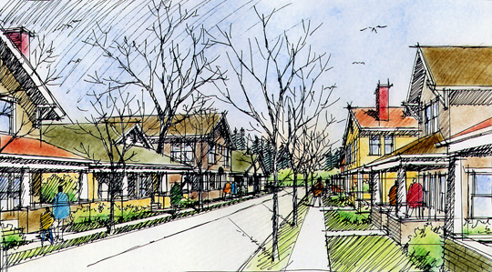
Urban communities
Projected to rise from 46.6% to 69.6% between 2000 and 2050
Concerns
  Increased percentage of stormwater runoff
  Dependence on motor vehicles
  Physical inactivity and sedentary lifestyles

Slide 5
Sustainable solutions
Goal of Public Health Assessment
  Manage Stormwater
  Enhance Urban Green Space
  Accommodate Pedestrian Movement
  Promote Active Living

Slide 6
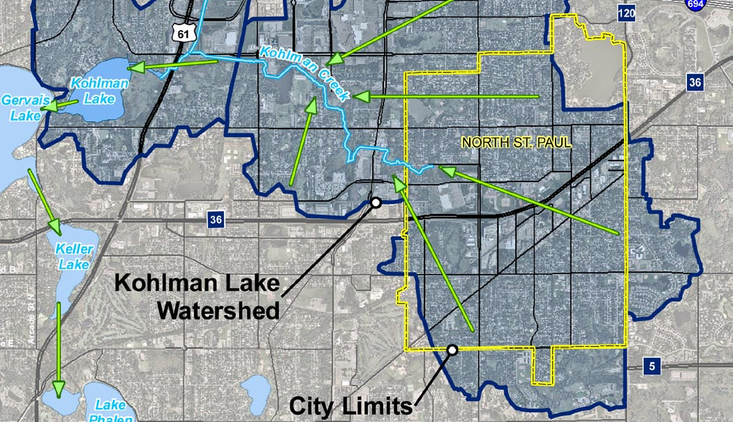
Notes:
The city of North St. Paul works with the Minnesota Pollution Control Agency to continually update a plan on how to best manage the discharge of stormwater. The main focus is to reduce sediment and pollutants that enter surface water and flow into storm sewer systems. Currently, Kohlman Lake is a lake fed by the North St. Paul watershed which has been placed on the Minnesota Pollution Control Agencies Impaired Waters List. Much of the water that falls on North St. Paul is transported over impervious surfaces such as lawns, pavement, roads, and roofs, and eventually flows into Kohlman Creek which then flows into Kohlman Lake.

Slide 7
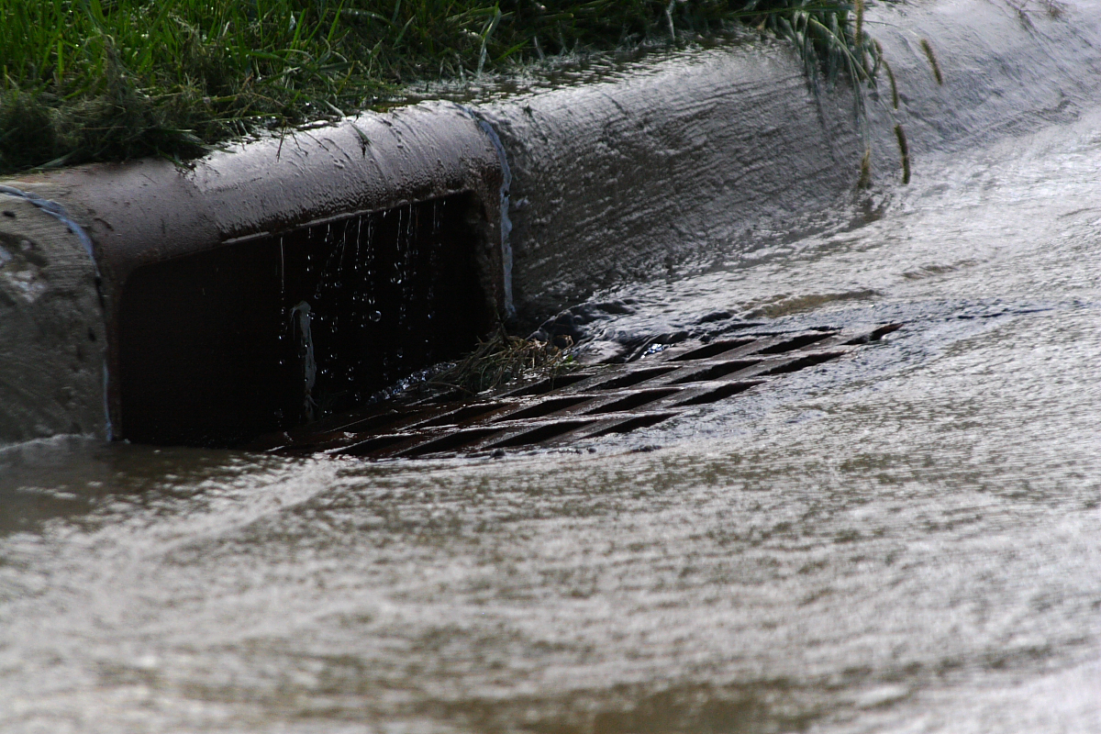
Notes:
These impervious surfaces cause a large amount of runoff. Traditional methods to divert stormwater runoff are accomplished through an underground network of pipes which are then diverted to holding ponds or discharged directly into surface waters. This is an effective way to quickly deal with excess stormwater, but does little to treat the runoff before it is released into the environment. This causes a rise in water temperature, an increase in pollutants and nutrients, decreases water clarity and has negative effects on biota. Imperviousness also increases flooding and channel instability.

Slide 8
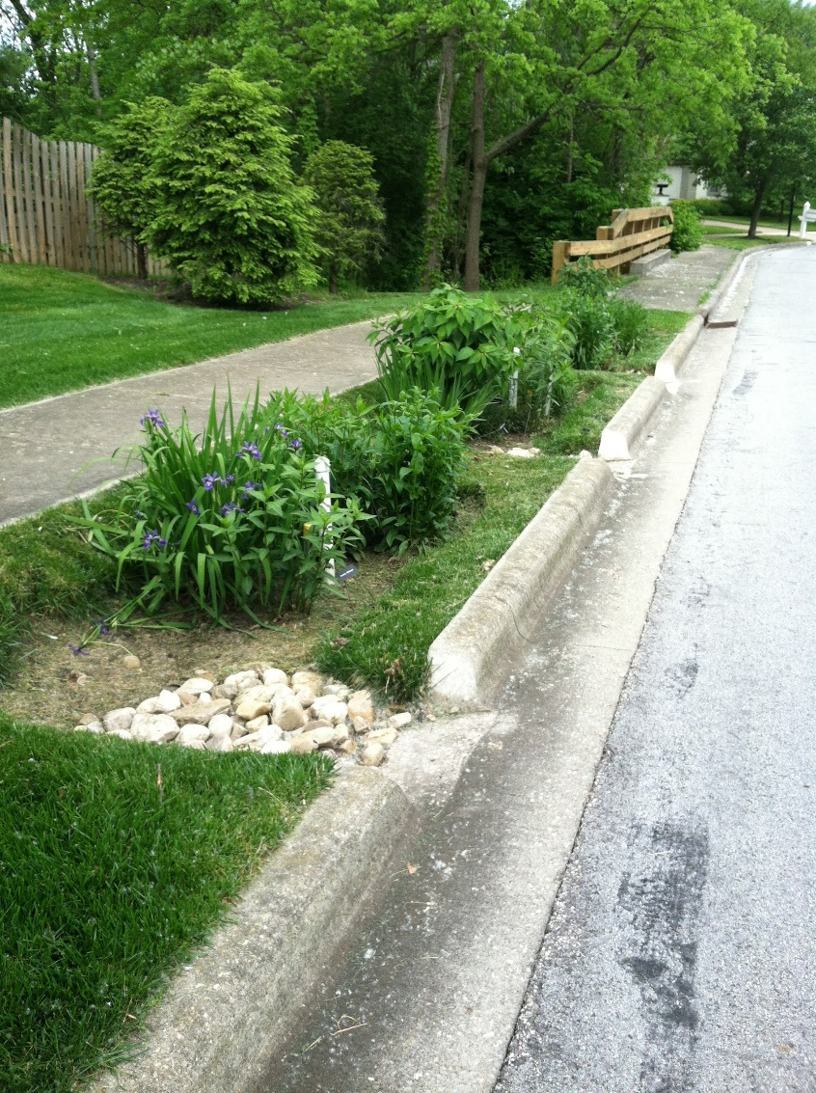
Reducing stormwater
Rain gardens/bioretention areas
Increasing green space
Increasing pervious surfaces
Reducing imperviousness
Notes:
Rain gardens or bioretention areas, increasing green space, and increasing pervious surfaces by narrowing roadways are a few options discussed in the North St. Paul Living Streets Plan. But we wanted to find out, how effective are these methods?

Slide 9
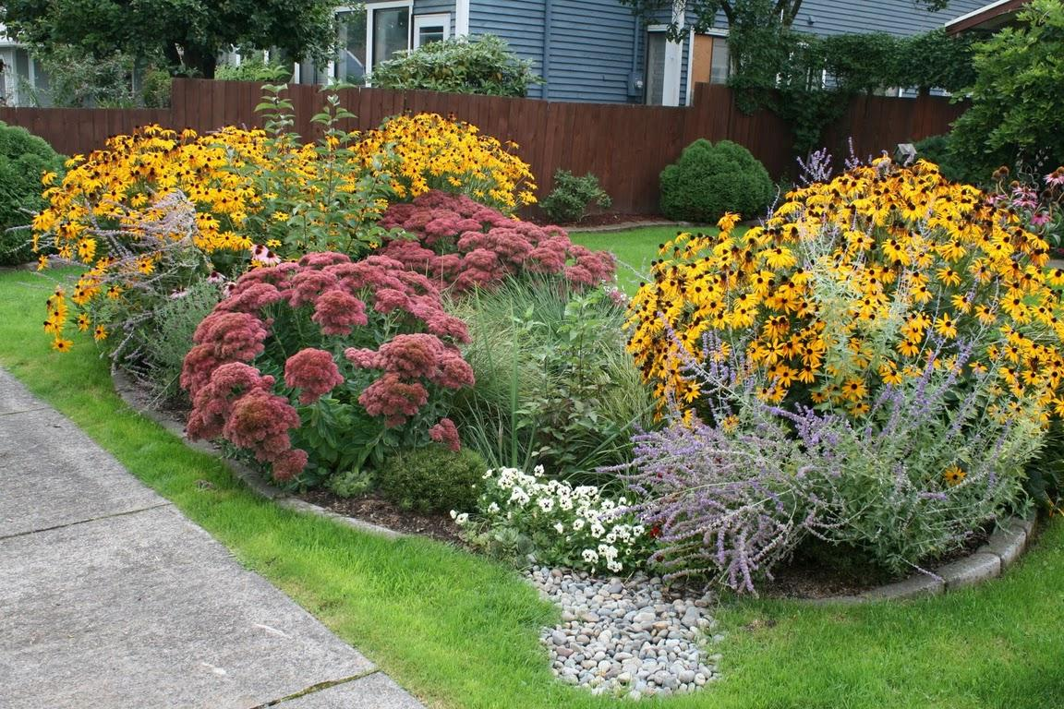
Notes:
Rain gardens are one proposed way to reduce the negative effects from imperviousness.
Because they are able to retain and hold water, allowing it to infiltrate into the soil, they have the effect of counteracting impervious surfaces. Native plants and nearby trees and shrubs benefit from this, allowing roots to grow deep into the soil, infiltrating nutrients into the ground. Beyond localized benefits, rain gardens recharge local and regional aquifers, protect against flooding, and protect streams and lakes from harmful pollutants such as fertilizers, pesticides and oil. In fact, they allow about 30% more water to soak into the ground compared to a patch of traditional lawn

Slide 10
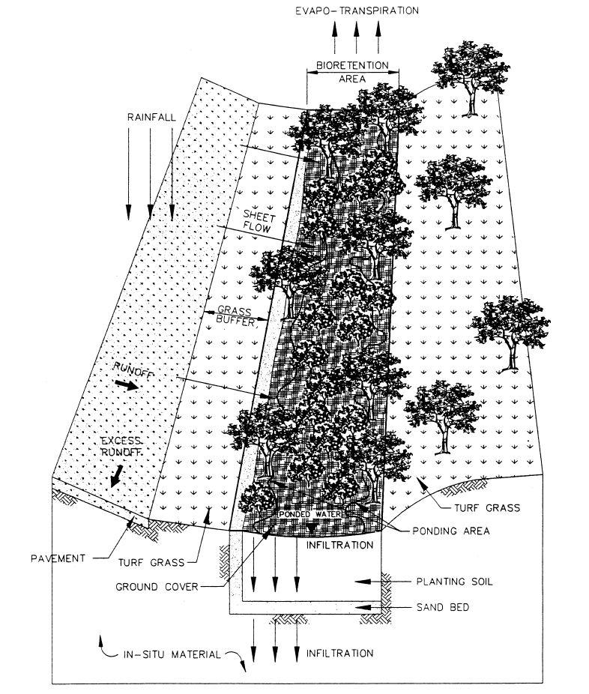
tion Design
Bioretention Design
  Mimics natural retention areas that existed before development.
Notes:
This figure diagrams the main concept behind rain garden design, originally called a bioretention area. The concept behind the design was to mimic a water retention area that existed before development. The Prince George's County Department of Environmental Resources in Maryland was the first to incorporate this idea in a residential neighborhood for the purpose of stormwater management, and was highly successful.

Slide 11
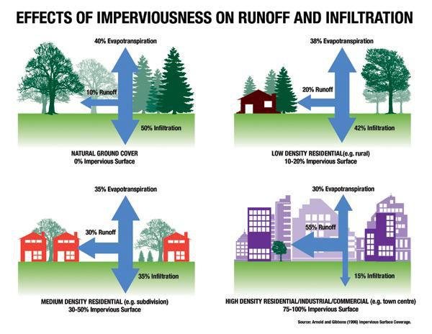
Notes:
Several studies have focused on imperviousness and the effect this has on water quality. This diagram compares imperviousness in natural ground cover, low density residential or rural, medium density residential, and high density or industrial. Increased imperviousness causes more severe and frequent flooding, and the increased flow causes stream and river banks to widen or down-cut stream beds. This type of channel instability can increase erosion and habitat destruction. Research in many different areas have come to a similar conclusion: that there is a threshold for stability at around 10% imperviousness. This highlights the potentially large impact a pervious surface has on water quality. Though It is generally not feasible to keep imperviousness under 10%, it is possible to manage water quality considering already existing infrastructure.

Slide 12
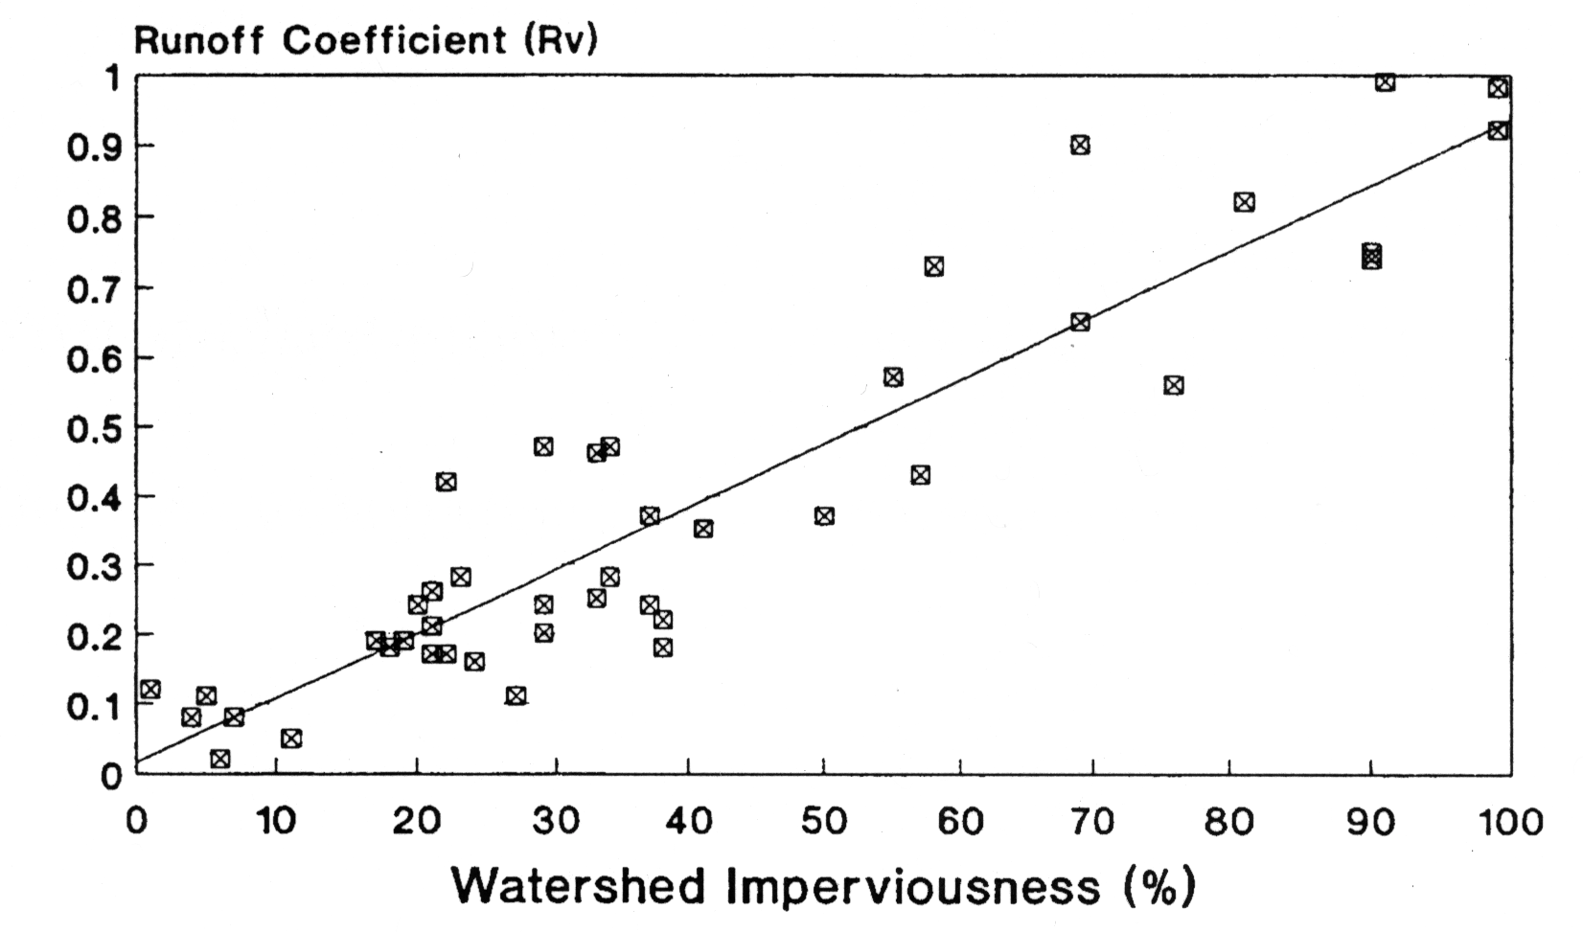
Notes:
This scatterplot shows the increase in the site runoff coefficient as a result of site impervious cover, developed from over 40 runoff monitoring sites across the nation. The runoff coefficient ranges from zero to one and expresses the fraction of rainfall volume that is actually converted into storm runoff volume.
This study found that the total runoff volume for a one-acre parking lot is 16 times the amount produced by an undeveloped meadow. To visualize this.. if there was a one-inch rainstorm, the total runoff from the one-acre meadow would fill a standard size office to a depth of about two feet. If that same acre was completely paved, a one-inch rainstorm would completely fill the office, as well as the two next to it”

Slide 13
Effects of pollutants
Oxygen Depletion
Eutrophication
Species Stress
Toxicity
Algal Blooms
Impact Recreational Use
Lowered Aesthetic Value
Notes:
This is a short list of effects due to pollutants. Many studies have consistently shown that urban pollutants in waterways are directly related to the amount of impervious surfaces in watersheds. In fact, imperviousness was found to be the most predictive variable when studying pollutant loads found in waterways. A large source of these pollutants are from non-point sources, such as stormwater runoff, which is difficult to measure and regulate.

Slide 14
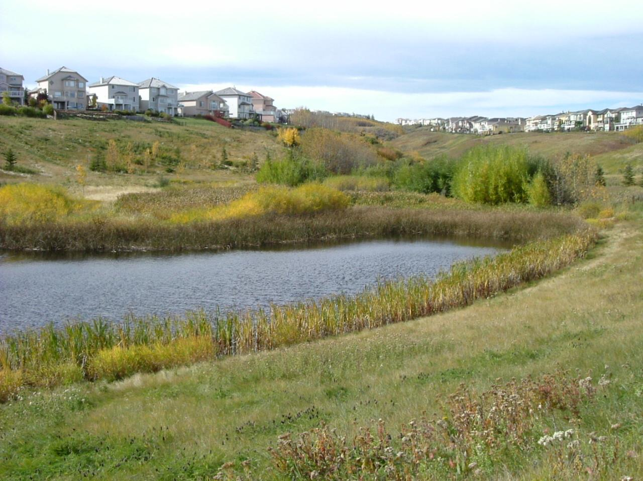
Notes:
Not all pollutants are directly carried into open water bodies, some stormwater is able to infiltrate into soils, such as in stormwater detention ponds and wetlands. Not only do they enable some control over peak stormwater flows, but they actively remove and filter water pollutants. This observation has let to their application in stormwater runoff treatment.

Slide 15
Studies on pollution removal
Metal removal:
  90% of lead
  80% of copper
  50-70% of zinc
Organic nitrogen, ammonia, ammonium reduction:
  38-57% in upper ports
  68-75% in middle and lower ports
Notes:
One study wanted to test the ability of soils to treat stormwater, specifically by mimicking rain gardens using boxes with exiting water ports. They found that adsorption was over 90% for lead, over 80% for copper and between about 50% and 70% for zinc. They also found that there was an overall removal of organic nitrogen, ammonia and ammonium, and that depth was an important factor in the amount observed. In the upper ports, effluent showed a reduction of 38% to 57% and at middle and lower ports there was a reduction of 68% to 75%.

Slide 16
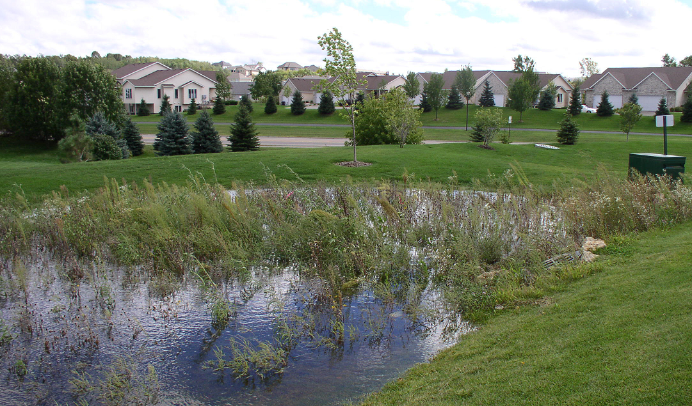
Notes:
Unfortunately, study on actual rain gardens has not been a widely researched topic. The U.S. geological Survey conducted a study during 2002-04 to address this lack of information. Surface and subsurface water was measured in five rain gardens in the Minneapolis-St. Paul metropolitan area to evaluate their effect on water quality.

Slide 17
Findings from usgs study:
Size and design of rain gardens important
Soil properties a contributing factor
Other important factors:
  drainage area
  frequency and duration of storm events
  capacity of rain garden
  vegetation types
  materials in construction of base
Notes:
Size and design of the rain gardens was found to be a very important aspect of their effectiveness at reducing overflow and proper infiltration of runoff.
Differing soil properties was found to be a contributing factor to rain garden effectiveness. Clay soils caused more water to flow over the rain gardens whereas sandy or gravelly soils encouraged infiltration.
Other important factors contributing to effectiveness included contributing drainage area, frequency and duration of storm events, capacity to store runoff and increase infiltration before overflow occurs, vegetation type, and materials used in the construction of the base of the rain garden.

Slide 18
Findings from usgs study (cont) :
Suspended solids including nutrients were lower
Reduction of chlorine
Reduction of nitrite and nitrate
High variability between gardens
Recommended further studies
Notes:
The study found that suspended solids, including nutrients, were measured at much lower levels in outflow as compared to inflow.
There was a general reduction of chlorine and nitrite plus nitrate nitrogen concentrations compared to background conditions in one of the rain gardens
Overall, the study found that there was some reduction of certain contaminants but there was also high variability between rain gardens.
This study was done with some newly established rain gardens, so further study on rain gardens as they mature may shed some light on long term benefits of rain garden use.

Slide 19
Increased water temperatures effect
Biological productivity
Stream metabolism
Contaminant toxicity
Aquatic biodiversity
Notes:
Impervious surfaces, especially dark colored ones such as pavement, absorb and reflect heat from the sun. In warmer times of the year, areas near impervious surfaces can have an air temperature 10 to 12 degrees warmer than the original green spaces they replaced. As water flows over these areas, receiving waters see an increase of temperature. These increased water temperatures can have several negative effects on aquatic ecosystem processes like biological productivity, stream metabolism, contaminant toxicity, and the loss of aquatic biodiversity.
A six month study of 5 different streams with different levels of impervious cover had average temperatures that were higher than a forested reference stream. The temperature increase of the streams were directly related to the size of the impervious areas in the source watersheds.
Additionally, several studies have shown a correlation between impervious surfaces and impaired aquatic biodiversity

Slide 20
Benefits of rain gardens
Lower stormwater loads
Natural pollution removal
Lower maintenance than equal area of turf grass
More cost-effective when compared to a system of curbs and gutters
Increased biodiversity
Aesthetic beauty
Notes:
I know I have focused heavily on rain gardens, but that is because they have shown to be a highly effective way to combat imperviousness. Impervious surfaces in urban areas will always exist, though the amount of impervious surface can always be managed and controlled. The choice to include added green space, increased tree cover, and features like rain gardens will only benefit the quality of water running into our lakes and streams.
In particular, the implementation of rain gardens is an incredibly efficient use of space creating not only a method for water retention and treatment, but also added biodiversity and aesthetic beauty

Slide 21
Other considerations
Maintenance required
Off-season aesthetics
Vegetation matters
Plant competition with weeds
Notes:
Initially, the installation of a rain garden will be more work than a similar sized area of lawn, but maintenance is low after the plants mature. They require some weeding and watering in the first two years, and may require some thinning in later years as plants mature.
Plants will die in the winter months, rain gardens don't always look like people may want them to, but the dead and dormant plants can be left over winter. They should be cut back in the spring to allow new shoots to emerge.
You can't plant just anything in a rain garden and expect it to thrive, but the addition of grasses, sedges, and rushes with the flowering species can create diversity of root growth and depth.
These varied types of roots contribute to healthy plant competition which in turn allows the plants to outgrow and out-compete other species such as weeds

Slide 22
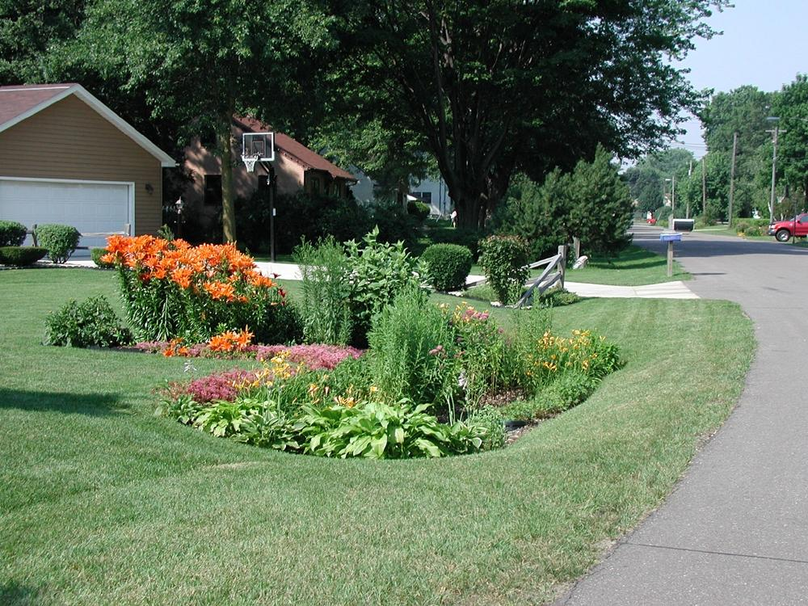
Notes:
The listed benefits of rain gardens such as increased neighborhood insect and plant diversity and added aesthetic beauty are direct and observable. The unseen benefits of rain gardens are more far-reaching and valuable to the future of our water resources A rain garden has the potential to mimic a natural wetland; allowing added infiltration and filtration of numerous contaminants. When constructed properly, rain gardens can be one good solution to a growing problem.

Slide 23

SUCCESSFUL RAIN GARDEN PROGRAMS - BLOOMINGTON
Project created to address impaired Minnesota River
  Partially funded by Clean Water Land and Legacy Amendment
Curb-cut rain gardens and pervious pavement
Voluntary participation, ~50 gardens planted since 2009
Captured annually:
  1.5 tons sediment, 15 pounds phosphorus, 18 ac-ft stormwater volume

Slide 24
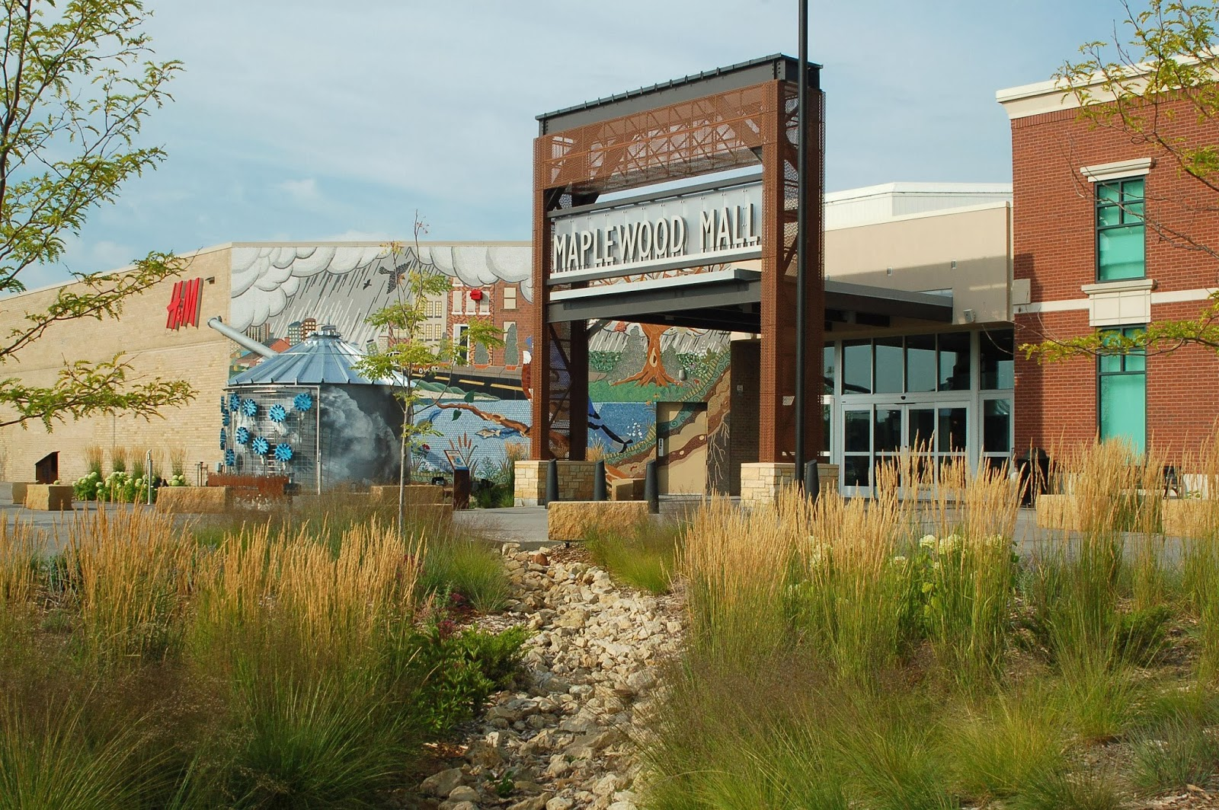
SUCCESSFUL RAIN GARDEN PROGRAMS - MAPLEWOOD
Program in place since 1996
  Supported by Environmental Utility Fund fee
Over 700 home and 60 city rain gardens have been installed in conjunction with street reconstruction
Voluntary participation with incentives
Maintenance not an issue
  City inspections
  ~95% compliance

Slide 25
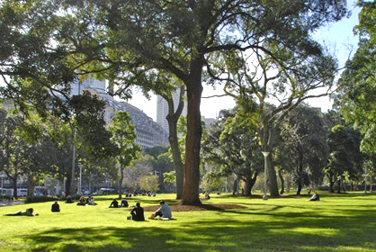
Urban green space
Living Streets Plan Objective: Enhance the Urban Forest
  Urban parks, street trees, landscaped boulevards, public gardens, wetlands, etc.
green space = health
Benefits to health:
  Environmental
  Physical
  Mental

Slide 26
Benefits of Street trees
Environmental Health
Community-Wide
Lower air temperature
Reduce stormwater
Prevent erosion
Move water to groundwater table
Filter the air we breathe
Absorb traffic noise
Increase privacy
Enhance safety
Reduce crime
Increase property value
Increase revenue at shops

Slide 27
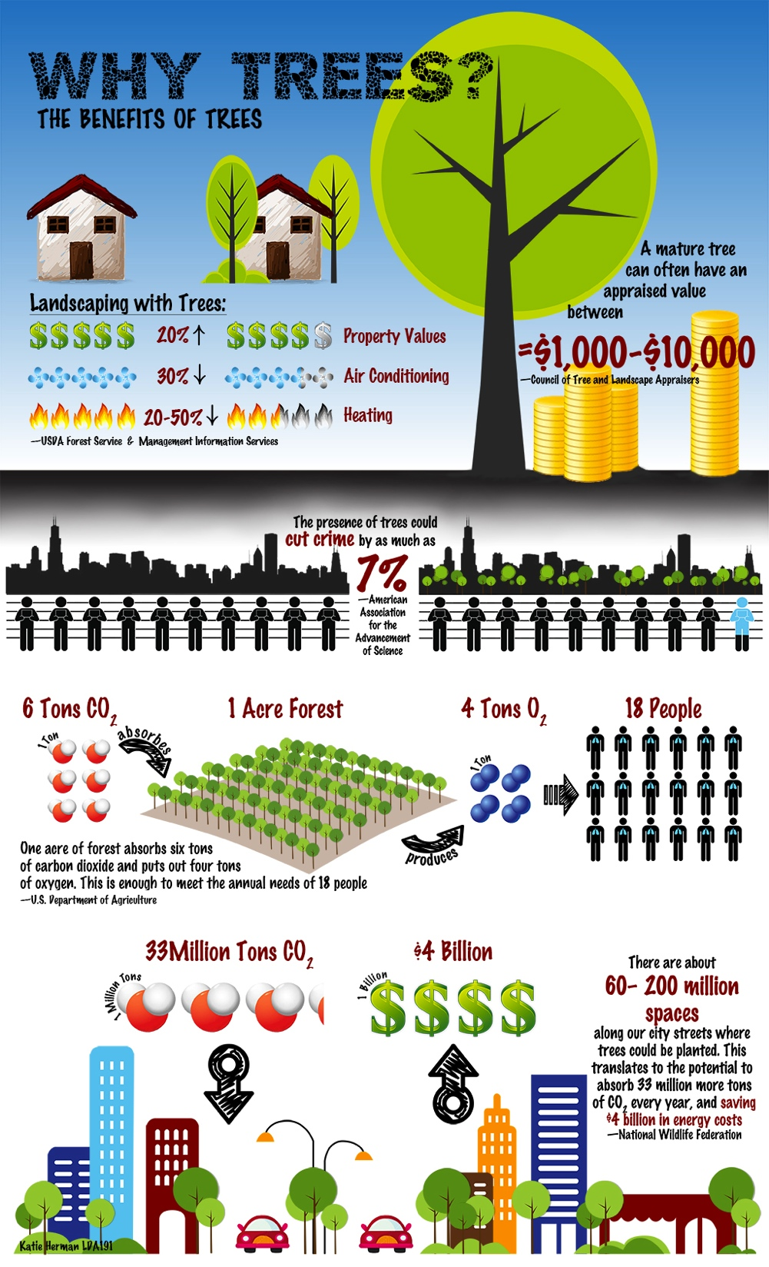
Value of mature tree =
$1000 - $10,000
Increase in property value
Reduction in heating/cooling costs
Presence of trees cuts crime by 7%
1 acre of forest
6 tons of CO2
4 tons of O2
18 people
60 – 200 million spaces available to plant trees along U.S. streets

Slide 28
Neighborhood greenness
Inspires physical activity
  People want to get out and enjoy nature
  Walking distances judged to be less on streets with trees, more trips on foot (Tilt et al., 2006)
Makes you feel better about your health
  People living in greener environments have better self-perceived health (Maas et al., 2006)
Improves mental health
  Restorative, relaxing, heightens focus
  Moving to greener areas shows sustained mental health improvements (Alcock et al., 2013)

Slide 29
Urban forestry challenges
Relationship between health and natural green space is complex
  “Just because you build it, doesn’t mean they will come”
  Community outreach and education initiatives
Management and maintenance issues
  Invasive species
  Pollution

Slide 30

North st. Paul – A greenstep city
Joined in 2012
Voluntary, free, continuous improvement program
Complete action items from a list of 28 sustainability and quality-of-life “best practices”
  Many directly relate to objectives of Living Streets Plan

Slide 31
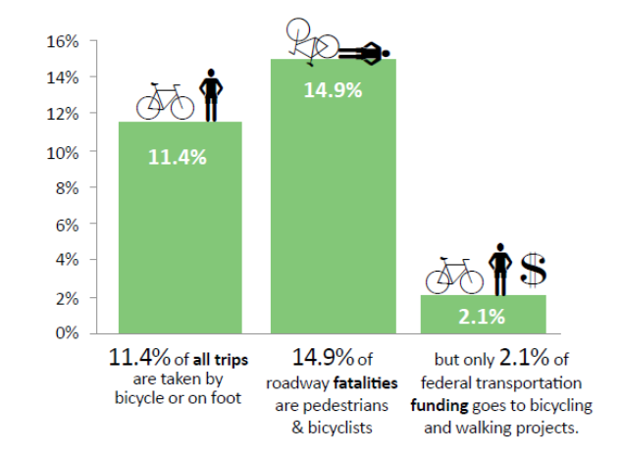
Pedestrian movement
Bicycling and walking account for:
  11.4% of trips
  14.9% of roadway fatalities
  2.1% of federal funding
27% of pedestrians are under 16 years of age or over 65

Slide 32


Minnesota pedestrian movement
40% do not drive
  Children, elderly, and individuals with a disability
16% increase in walking
Pedestrian movement campaigns

Slide 33
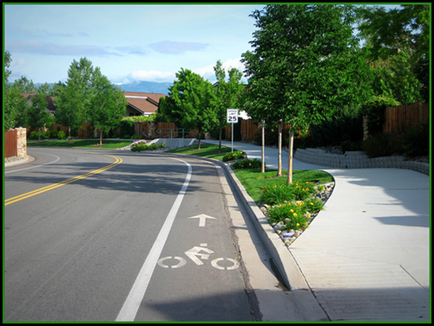
Pedestrian-friendly communities : Sidewalks
Proven safeguard
Connects the community
Use of green space and landscape
Safe Routes to School

Slide 34
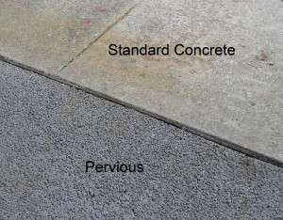
Pervious concrete
Reduce impervious surfaces
Drawbacks of pervious concrete
  Test pilot projects
Cost

Slide 35
Active travel to school
Decline in rate of children walking and bicycling to school
  1977 – 48%
  2007 – 16%
2011 survey revealed lack of sidewalks as a barrier
Built environment influence on physical activity

Slide 36

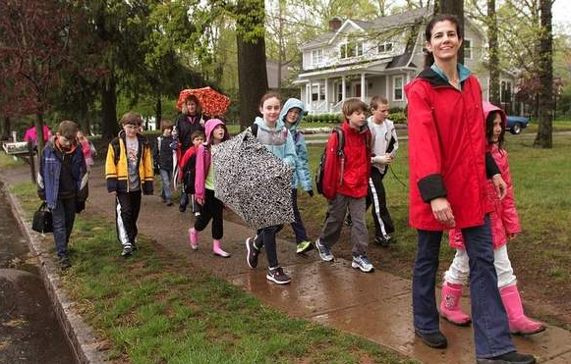
Safe routes to school (SRTS)
Walking remains risky mode of travel
Initiative began in Denmark
National initiatives to increase Safe Routes to School

Slide 37


SRTS Initiatives
Funding for SRTS in 1998
  Marin County, CA
2005 Federal Bill
  Allocated funds to states for SRTS
Health People 2020
  Increase proportion of trips made to school by walking

Slide 38


Minnesota safe routes to school
101 communities participating since 2006
Funds infrastructure and non-infrastructure improvement projects
Work in partnership with State agencies

Slide 39
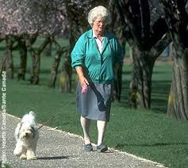
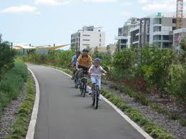
The active living movement
Create and promote environments that make it safe, accessible, and efficient for everyone to integrate physical activity into their daily lives
Opportunity for North St. Paul = infrastructure improvements + health promotion
Why this movement is so important to public health:
  Rise in sedentary lifestyles
  Decrease in physical activity

Slide 40
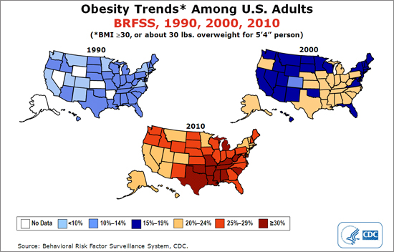

Slide 41
Active Living research
Physical activity offers numerous health benefits to people of all ages
Research shows Active Living:
  Improves physical and mental health
  Decreases risk of chronic disease and associated medical costs
  Reduces transportation costs
  Improves air quality
  Builds stronger, safer communities
  Improves quality of life

Slide 42


Slide 43
10 things your city can do to promote active living
1. Join Let’s Move Cities and Towns, a campaign to engage municipal leaders to help end childhood obesity.
2. Adopt a Complete Streets policy, ensuring access and connectivity to multimodal transportation for all users.
3. Convert vacant or paved lots into playgrounds, parks or community gardens.
4. Form partnerships with local schools to develop Safe Routes to School programs and/or joint-use agreements for community access to recreational facilities.
5. Conduct an inventory of parks, open space, vacant land, sidewalks and recreational facilities; engage residents and area stakeholders to identify needs and opportunities to create, expand or enhance these areas.
6. Create a welcoming, safe, and attractive environment — beautify streets, parks, and trails by ensuring adequate tree canopy, lighting, attractive landscaping, art, benches and safety features.
7. Implement appropriate and attractive traffic-calming design features.
8. Create policy to evaluate the health impacts of all new development.
9. Support community programming such as festivals, charity walks/runs and entertainment in parks.
10. Develop public education campaigns to encourage active living.

Slide 44
Metro area living streets policies
Edina, Minnesota – policy adopted in 2013
Maplewood, Minnesota – policy adopted in 2013
Minnesota Complete Streets Cities
  Many shared objectives with North St. Paul Living Streets Plan
  2010 statewide legislation
  25 participating cities

Slide 45
Conclusion & recommendations
Public health benefits
Initiatives and Community Engagement
  Strengthen citizen support
City of North St. Paul as an Urban Ecosystem

Slide 46
Further work and studies
Cost and benefit analysis of pervious surfaces for roads, sidewalks, and parking lots
Road salt application without overuse and possible alternatives
Use of high phosphorus and nitrogen fertilizers
The long term effectiveness of rain garden soil treatments.
Studies on mature rain gardens.
Impacts of active transportation on energy consumption
Addition or enhancement of marked pedestrian crosswalks
Long-term sustainability of a newly developed urban forest
Notes:
An in depth look at the cost and benefit analysis of pervious surfaces for roads, sidewalks, and parking lots as a method to reduce impervious surfaces.
Maximizing effectiveness of road salt application without overuse and possible alternatives is another area of study we recommend to explore.
Analyzing the use of high phosphorus and nitrogen fertilizers and the effectiveness of limiting their use in urban environments.
The long term effectiveness of rain garden soil treatments.
Studies on rain gardens as they mature because this may shed light on long term benefits of rain gardens.
The influence of active transportation on energy consumption and its impact on carbon emission, air quality, and climate change.
Addition or enhancement of marked pedestrian crosswalks

Slide 47
Frequently asked questions and concerns
Tool for City staff
Addresses specific concerns
  Rain gardens
  Sidewalks
  Active living

Slide 48
acknowledgements
Elizabeth Wattenberg Ph.D. – Project Advisor, School of Public Health, University of Minnesota
Matt Simcik Ph.D. – Project Advisor, School of Public Health, University of Minnesota
Petrona Lee Ph.D. – Project Advisor, School of Public Health, University of Minnesota
Mike Greco – Resilient Communities Project, Program Manager
Cliff Aichinger – Ramsey-Washington Metro Watershed District, Administrator
Sage Passi – Ramsey-Washington Metro Watershed District, Watershed Education Specialist
Shelly Pederson – City of Bloomington, City Engineer
Steven Segar – City of Bloomington, Civil Engineer
Bryan Gruidl – City of Bloomington, Senior Water Resources Manager
Mark Nolan – City of Edina, Transportation Planner
Ross Bintner – City of Edina, Environmental Engineer
Michael Thompson – City of Maplewood, Director of Public Works/City Engineer
Steve Love – City of Maplewood, Assistant City Engineer

