Slide 1

Creativity, Foresight, Innovation
Advancing the American Nurses Association Innovation Enterprise
Daniel J Pesut PhD RN FAAN
Chair, National Advisory Board ANA
Innovation Enterprise

Slide 2

Outcomes
Discuss the proposition that creative thinking is essential to support innovations in nursing and health care.
Define the concept of foresight leadership to advance the development of innovation in nursing and health care.
Describe a set of resources to activate a community of practice and learning related to creativity, foresight, and innovation in nursing and health care.

Slide 3
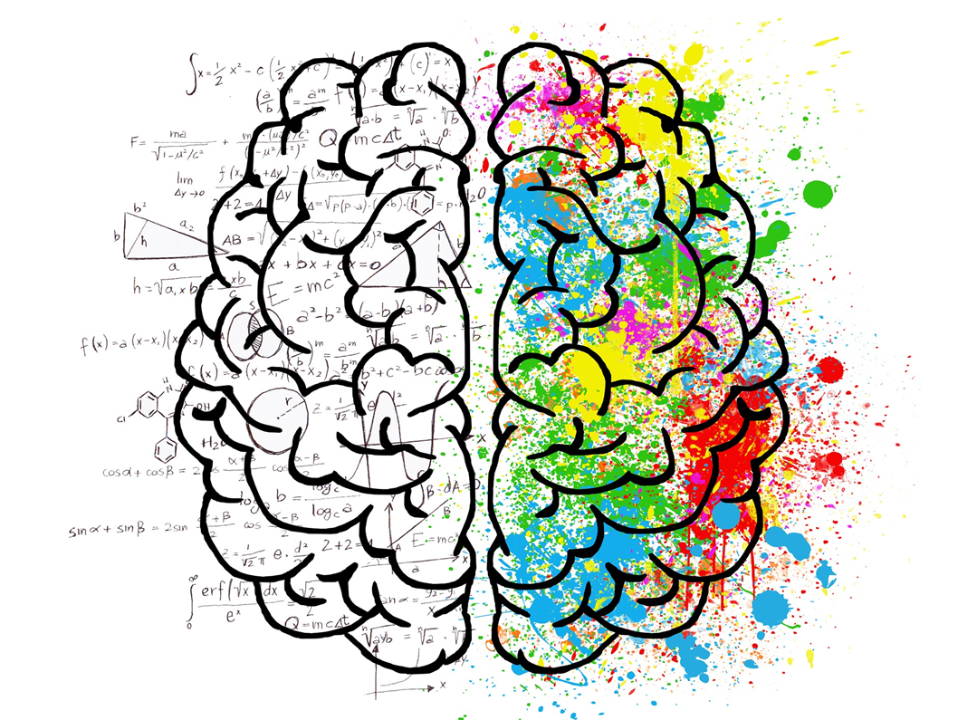
Dimensions of Creative Process
Person
Process
Product
Environment
Bessemer, S. & Treffinger, D. (1981). Analysis of creative products: Review and synthesis.
Journal of Creative Behavior. 15(3), 158-178.

Slide 4

Creative Individuals
A person who regularly solves problems, fashions products, or defines new questions in a domain in a way that is initially considered novel but that ultimately becomes accepted in a particular cultural setting.
Gardner, H. (1993). Creating minds. Harper-Collins: New York.

Slide 5
Creative Person
Intrinsic Motivation
Excited by Work
Enjoys Challenge
Risk Orientation
Talent
Expertise
Experience

Slide 6
Creative Person
Persistence
Curiosity
Energetic
Intellectually Honest
Rapport With Others
Broad Minded

Slide 7
Mental Locks
The Right Answer
That’s Not Logical
Follow the Rules
Be Practical
Avoid Ambiguity
Von Oech, R. (1983). A whack on the side of the head. Warner Books: New York.

Slide 8
Mental Locks
To Err Is Wrong
Play is Frivolous
That’s Not My Area
Don’t Be Foolish
I’m Not Creative
Von Oech, R. (1983). A whack on the side of the head. Warner Books: New York.

Slide 9

Creative Thinking: A Meta-Skill
A metacognitive process of generating novel and useful associations, attributes, elements, images, abstract relations or sets of operations -- that better solves a problem, produces a plan or results in an outcome, pattern, structure or product not clearly present before.
Pesut, D. (1985). Toward a new definition of creativity (editorial), Nurse Educator,10(1), 5.
Pesut, D. J. (1990). Creative Thinking a Self‐Regulatory Metacognitive Process‐A Model for Education, Training and Further Research. The Journal of Creative Behavior, 24(2), 105-110.

Slide 10
Disney Creativity Strategy
Dreamer
Realist
Critic
Dreamer, Realist, Critic?
Dilts, R. (1990). Walt Disney the dreamer, realist and the critic. Dynamic Learning Publications.
P.O. Box 1112 Ben Loman California, 995005. Tel 408-336-3457.

Slide 11
VALUE PATTERNS RELATED TO DREAMERS, REALISTS AND CRITICS
 | DREAMER | REALIST | CRITIC
Orientation | What | How | Why
Representation Preference Approach Time Frame Time Orientation Reference | Vision Toward Long Term Future Internal-Self | Action Toward Short Term Present External- Environment | Logic Away Long/Short Term Past/Future External- Others
Dilts, R., Epstein, T., Dilts, R.W. (1991). Tools for dreamers: Strategies for creativity and the
structure of innovation. Meta Publications: Cupertino, California.

Slide 12

Alpha Leadership:
Anticipate, Align, Act

Slide 13

Future Blind

Slide 14

Future Blind
Lost and trapped in yesterday’s decisions, choices and consequences –become risk aversive.
Betrayed by expectations -must negotiate the expectations of youth with the experience of life.
Social systems once protective are destabilizing.
Hudson, Frederic (1999). The Adult Years: Mastering the art of self-renewal. Jossey-Bass: San Francisco, CA.
Notes:
People become future blind when they become Lost and trapped in yesterday’s decisions, choices and consequences this results in many of us becoming risk averse. Second some us feel betrayed by expectations when we realize we have to negotiate the expectations of our youth with the realities and experience of life. Another factor that contributes to future blindness is the fact that social systems once protective are destabilizing. Additionally, people today are often overwhelmed with information and decisions and sometimes we become bewildered by change, complexity and discontinuities. As a result Dr. Hudson observes that many people develop a discourse of regret versus hope. It is the job of a leader to shift the nature of discourse in an organization to one of hope, inspiration, aspiration and vision. Creating a vision of the future that touches, moves and inspires people in an organization involves the develop of foresight leadership. Foresight is the antidote to being future blind. The development of foresight pre-supposes that leaders develop actively develop and master the art and science of anticipation that is associated with the development of future literacy skills. There are a number of resources available to help leaders activate and develop their foresight leadership skills.

Slide 15

Future Blind
Overwhelmed with information and decisions.
Bewildered by change, complexity and discontinuities.
Develop discourse of regret versus hope.
Hudson, Frederic (1999). The Adult Years: Mastering the art of self-renewal. Jossey-Bass: San Francisco, CA.
Notes:
People become future blind when they become Lost and trapped in yesterday’s decisions, choices and consequences this results in many of us becoming risk averse. Second some us feel betrayed by expectations when we realize we have to negotiate the expectations of our youth with the realities and experience of life. Another factor that contributes to future blindness is the fact that social systems once protective are destabilizing. Additionally people today are often overwhelmed with information and decisions and sometimes we become bewildered by change, complexity and discontinuities. As a result Dr. Hudson observes that many people develop a discourse of regret versus hope. It is the job of a leader to shift the nature of discourse in an organization to one of hope, inspiration, aspiration and vision. Creating a vision of the future that touches, moves and inspires people in an organization involves the develop of foresight leadership. Foresight is the antidote to being future blind. The development of foresight pre-supposes that leaders develop actively develop and master the art and science of anticipation that is associated with the development of future literacy skills. There are a number of resources available to help leaders activate and develop their foresight leadership skills.

Slide 16
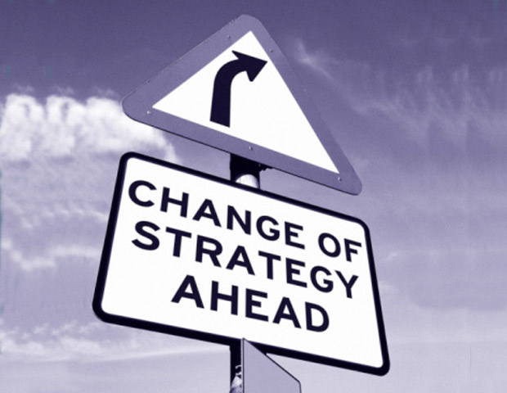

Future Studies
The purpose of future studies is not to predict the future, but to envision desirable futures and avoid or prevent catastrophic ones.

Slide 17
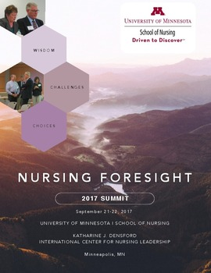

Foresight Leadership
Wisdom Challenges and Choices:
Nursing Foresight 2017 Summit Harvest Document

Slide 18

Future Consciousness
Time perspective: understanding of the past, present and future and the value of long-term thinking.
Agency beliefs: trust in ability to influence future events.
Ahvenharju, S., Minkkinen, M., & Lalot, F. (2018). The five dimensions of futures
consciousness. Futures, 104, 1-13.

Slide 19

Future Consciousness
Openness: critical questioning of established truths and seeing possibilities of change.
Systems perspective: ability to see interconnectedness between human and natural systems and complex consequences of decisions.
Concern: for other’s aspirations for a better world for everyone.
Ahvenharju, S., Minkkinen, M., & Lalot, F. (2018). The five dimensions of futures
consciousness. Futures, 104, 1-13.

Slide 20

Nursing Foresight Leadership
Nursing foresight is the ability and act of forecasting what will be needed in the future considering emergent health care trends which have consequences for population and planetary health, as well as the profession’s purpose, definition, professional scope, and standards of practice.

Slide 21
Develop Foresight Leadership
Know your personal, and your organization’s orientation toward time.
Develop future fluency and literacy skills.
Appreciate the value of innovation, design, and hybrid thinking to support foresight leadership.
Pesut, D. (2000). Looking forward: Being and becoming a futurist. Nurses Taking the Lead. Personal Qualities of Effective Leadership. Pennsylvania, PA: WB Saunders Company, 39-65.
Notes:
Over time, I have come to believe the following principles are essential to the develop of foresight leadership:
Know your personal, and your organization’s orientation toward time.
Appreciate the value of innovation and design thinking to support foresight leadership.
Develop future fluency and future literacy skills.
Actively monitor industry trends, forecasts, disruptions.
Discern logical consequences of trends using futures thinking tools and techniques.

Slide 22
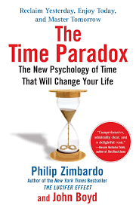
Time Perspectives
Past-negative
Past-positive
Present fatalistic
Present hedonistic
Future
Transcendental future
The time paradox survey
Bluedorn, A. C., & Denhardt, R. B. (1988). Time and organizations.
Journal of management, 14(2), 299-320.
Slawinski, N., & Bansal, P. (2017). The paradoxes of time in organizations. The Oxford Handbook of Organizational Paradox, 373.
Notes:
Check out the resources and links on this slide. Of particulate interest is the Your Tube video by Dr. Philip Zimbardo titled the Secret Powers of Time – Zimbardo and his colleagues believe people operate in one of six-time perspectives past, Past-negative Past-positive
Present fatalistic,
Present hedonistic
Future
Transcendental future
If want to understand more deeply your time perspective I invite you to take the time paradox survey and reflect on how your assessed time perspective influences your foresight leadership development.
Slawinski and Bansal note
Organizations that focus on the present over the future prioritize efficiency over learning and exploitation over exploration organizations that tend to focus on the past over the future tend to favor tradition over innovation

Slide 23
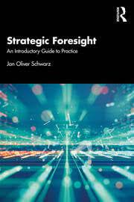
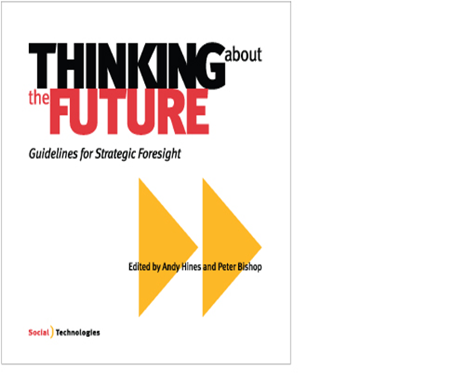


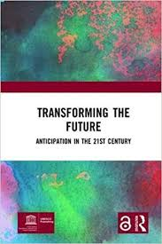
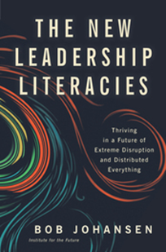
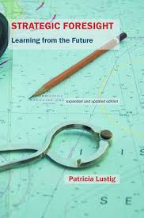

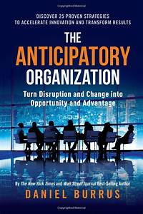
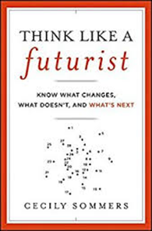
Develop Foresight Leadership Skills
Notes:
For example, Click on the hyperlink in this slide and learn what the United Nations Education and Scientific Organizations are doing to help people round the world develop a future thinking orientation. Check out the references and resources at the end of this lecture to learn more about future literacy and how to develop knowledge, skills, and abilities to become more future literate. The University of Minnesota School of Nursing has been a pace setter in many areas and has always had a future time orientation. The School of Nursing is a leader in the development of knowledge, learning, and service activities that push the envelope in terms of research, education and practice. In particular the work of the Katherine J Densford International Center of Nursing Leadership has stimulated dialogues and discussions about the value, and importance and impact of nursing knowledge and wisdom work. Past projects include sharing the knowledge of nursing leaders with the Summit of Sages Initiative and the development of the Densford Center Library of Nursing Leaders. In the Fall of 2018 under my leadership the Center turned its attention to the issue of nursing foresight.. The School of Nursing and the Densford Center hosted an invitational summit to explore and develop the idea nursing foresight leadership.

Slide 24
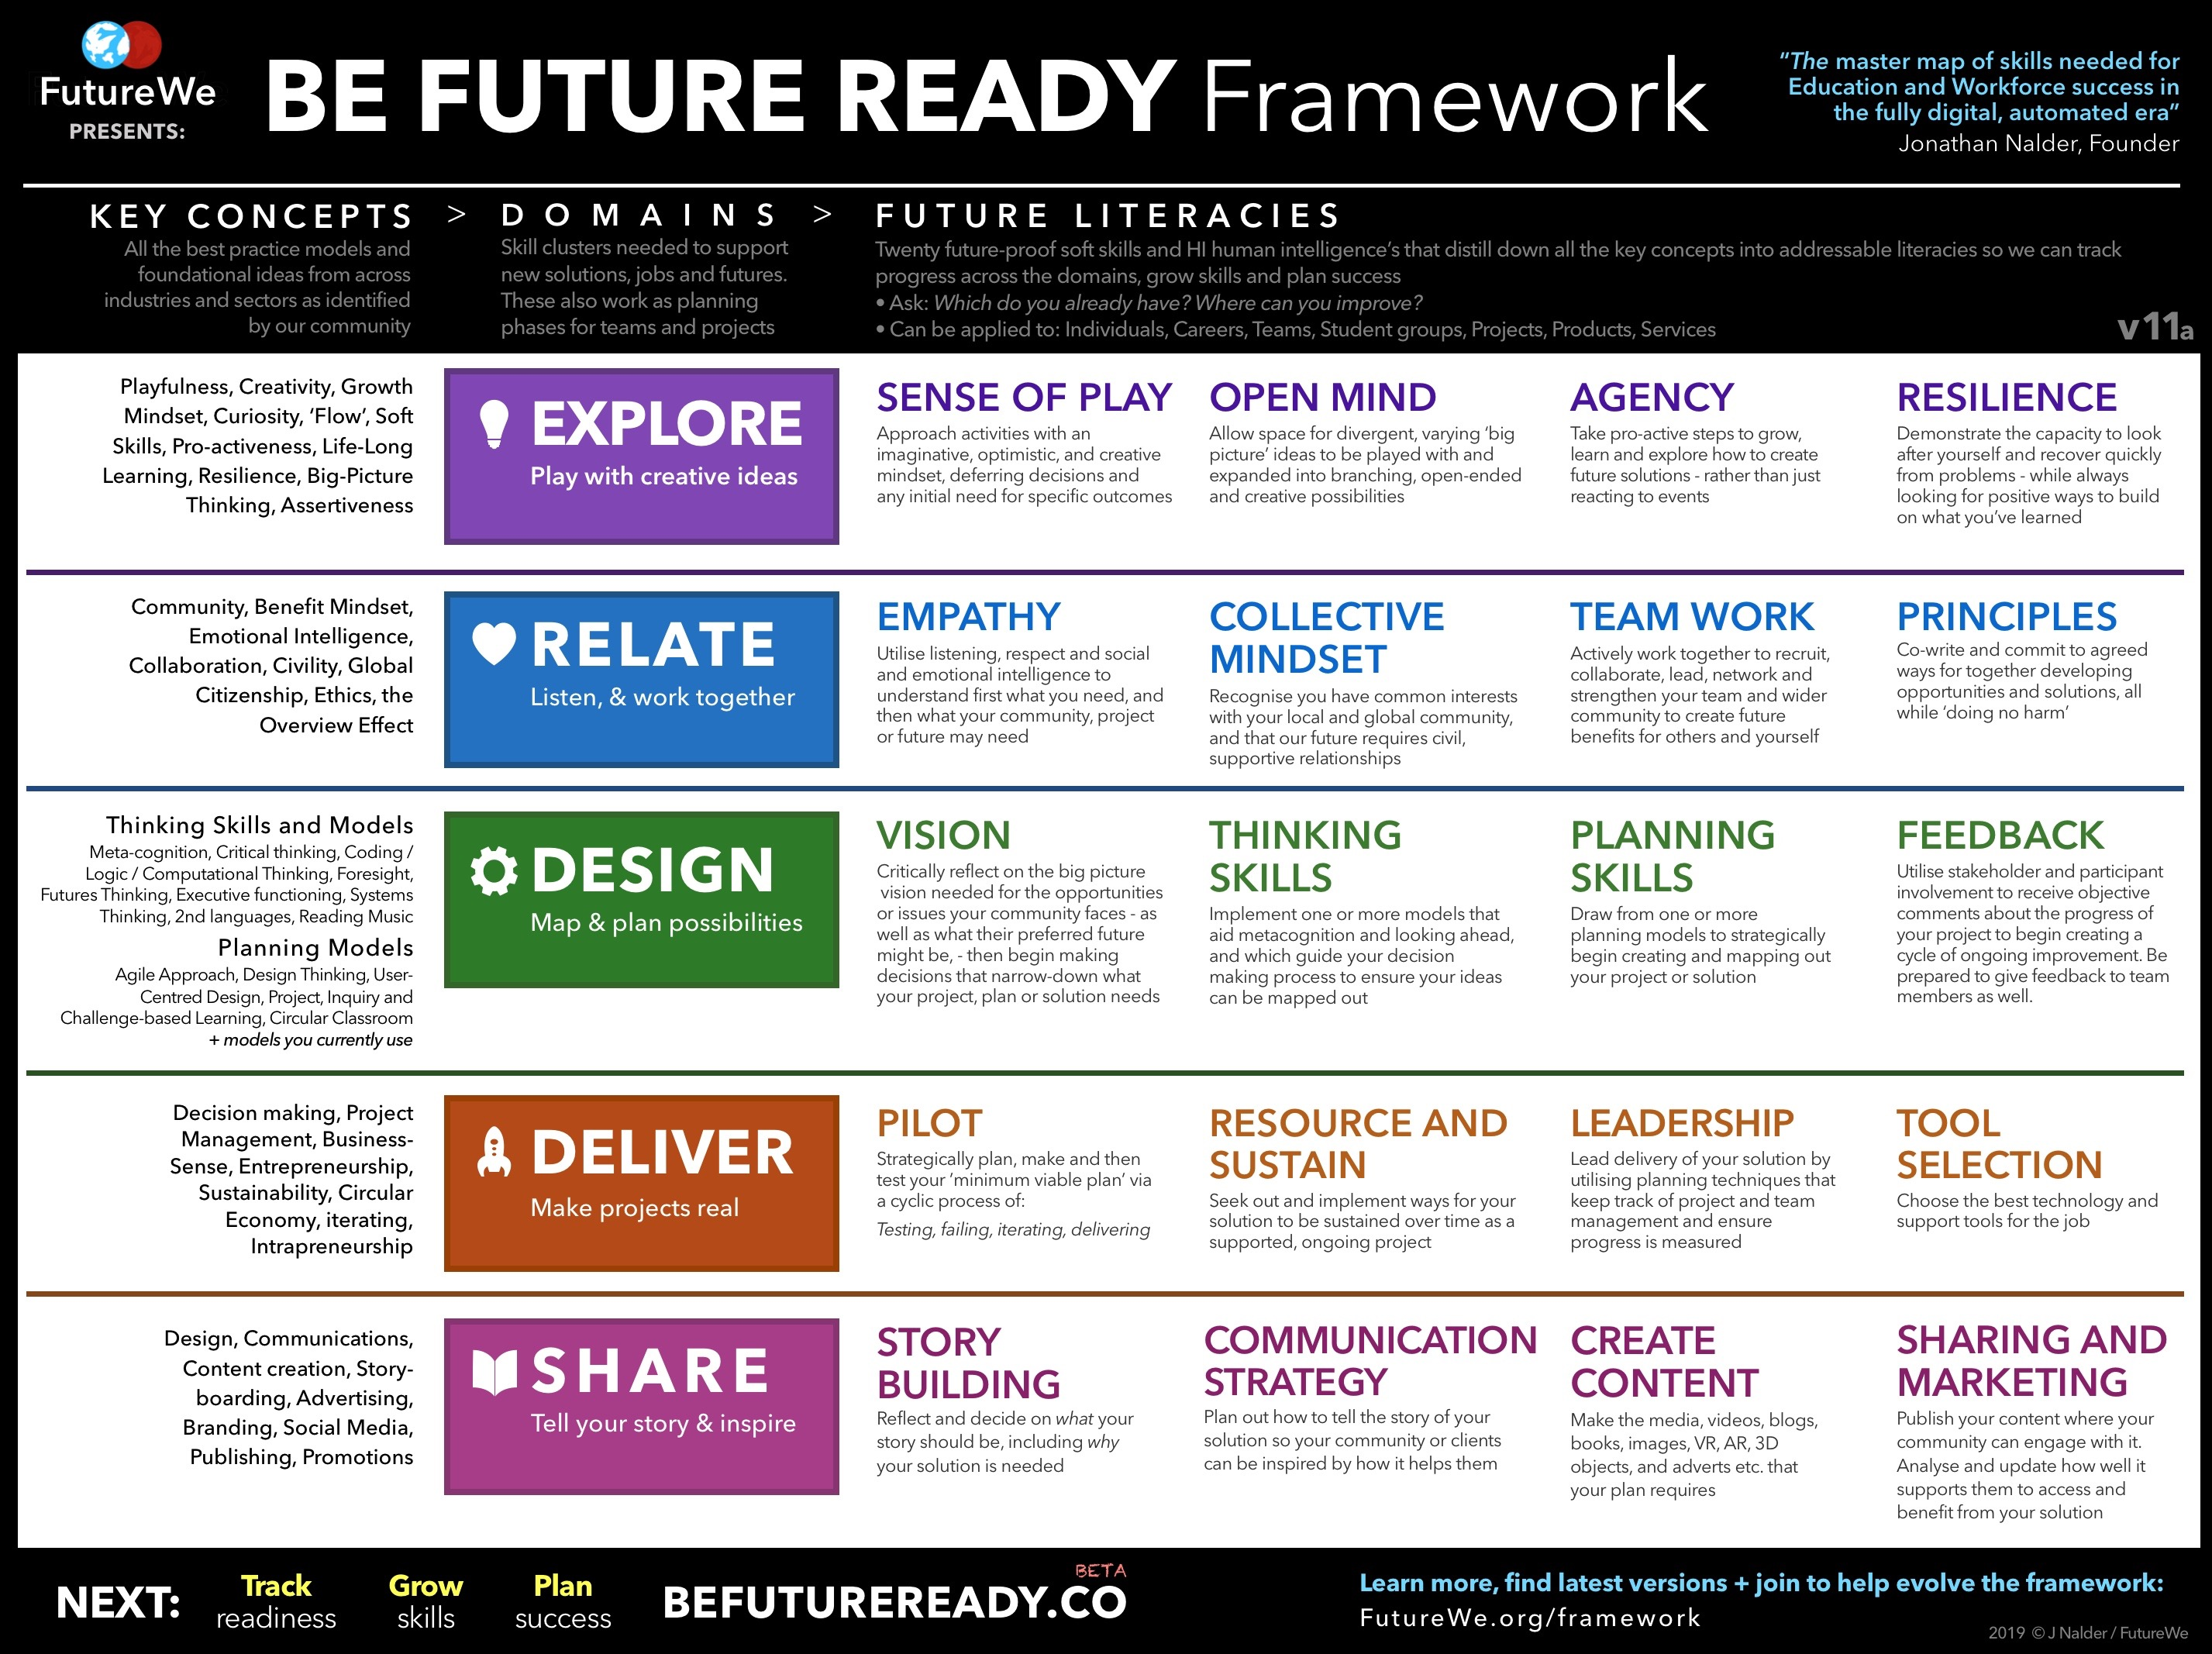
http://futurewe.org/framework/
Used with permission
Notes:
The five competencies of explore, relate, design, deliver and share are essential to a nursing foresight leadership skill set. As a leader you must play with new ideas, work together in community , map out solutions, make solutions real through piloting and rapid prototyping of projects an ideas and then inspire and share the learning through story telling, and communication strategies that help people understand and appreciate the consequences and impacts of emerging trends. There is also a survey https://docs.google.com/forms/d/e/1FAIpQLSeGW__0tqUKGCN9rJnrbno-VnOEtpQK7qboTFrj5LSXAys_Gw/viewform one can take to gauge and assess your future ready skills

Slide 25

Appreciate the value of design, and hybrid thinking, to support the Novation Dynamic
Notes:
Creating the future depends on appreciating the value of innovation and design thinking. Recall Chris Mc Goff’s words from the Change versus Transformation Prime…. Transformation is a creation and not a fix. Crafting a vision of a desired future requires design thinking and creativity and appreciation of the value of innovation in action. Links associated with this slide will lead you to resources about the complexity and dynamics of design required in a health eco-system. Supporting creativity and innovation in an organization requires appreciation of creativity with a well defined purpose in mind. The future we model in the next slide outlines the competencies and skills leaders need to create to support a foresight leadership agenda

Slide 26
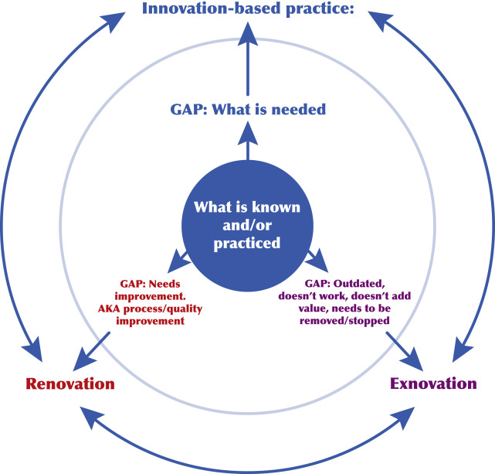
The Novation Dynamic
Ackerman, M. H., Giuliano, K. K., & Malloch, K. (2020). The Novation Dynamic:
Clarifying the Work of Change, Disruption, and Innovation. Nurse Leader, 18(3), 232-236.

Slide 27
Elements of an Innovation Culture
Risk taking
Resources
Information
Targets
Funding
Wide scope search
What, but now how
Emotional support
Specific call for innovation
Balanced assessment
Time
Uncensored, unfiltered, unsummarized
Tie to strategic plan
Learning from “failure” rather than punishing
Trying new things
Authority to act
Free-
flowing
“Stretch”
Clear case for need
Culture for Innovation
Aligned with organizational goals
Honoring everyone’s input
Flexibility
Deliberate process
Values-based
Diversity
Training
Intrinsic motivation
Trusting, open environment
Encouragement for skills development
Team based work
Individualized
Tools
Recognition
Relationships
© 2005 Plsek, Maher & Bevan reproduced with permission

Slide 28
Design Thinking : Theory and Practice
2022 ANA Social Policy Statement, Standards of Practice, Code of Ethics
Innovation Enterprise
2015
Tim Brown and Roger Martin
Design for Action
2008
Tim Brown (IDEO)
Design Thinking
2006
David Dunne & Roger Martin
Design Thinking & How it
will change management education
Practice based discoursed
2001
Tom Kelley (IDEO)
The art of Innovation
1960’s
1970’s
1980’s
1990’s
2000’s
1969
Herbert Simon
Science of the Artificial
1992
Richard Buchanan
Wicked Problems in Design Thinking
1987
Peter G. Rowe
Design Thinking
Scholarly discourse
investigating how
designers think & work
1983
Donald Schön
The reflective Practitioner
2001
Nigel Cross
Designerly Ways of Knowing
1980
Brian Lawson
How Designers Think
JWoodilla and Çetinkaya (2014)
Notes:
In 2008 Tim Brown, IDEO published the article that became the most cited article till today in HBR, entitled Design Thinking.
Martin and Brown went on to publish books in 2008 and 2009 which featured case studies and references to each other.
Both others met through working with P&G … Martin claimed to have suggested the label “design thinking” for IDEO’s practices … check Financial Times India article by Martin.

Slide 29
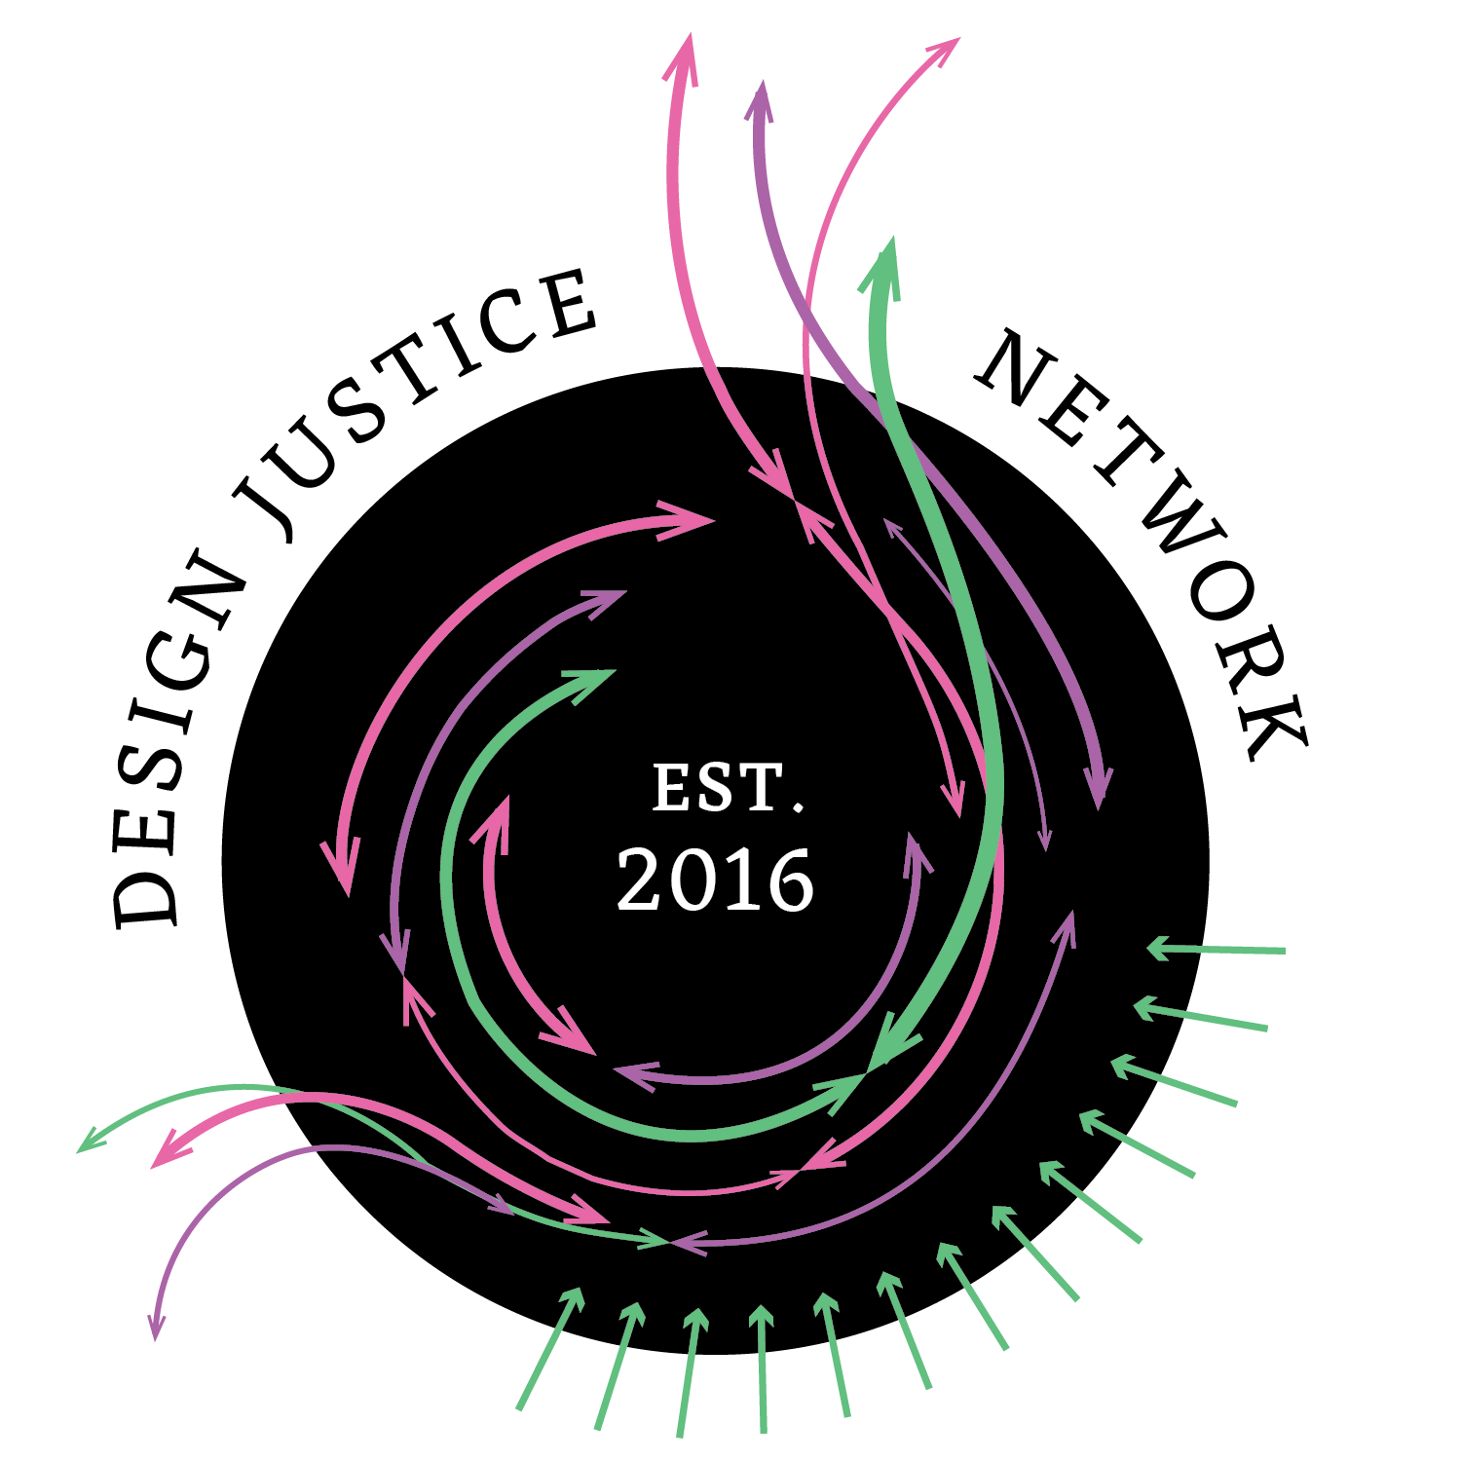
Design Justice Principles
Use design to sustain, heal, and empower our communities, as well as to seek liberation from exploitative and oppressive systems.
Center the voices of those who are directly impacted by the outcomes of the design process.
Prioritize design’s impact on the community over the intentions of the designer.
View change as emergent from an accountable, accessible, and collaborative process, rather than as a point at the end of a process.
See the role of the designer as a facilitator rather than an expert.
Believe that everyone is an expert based on their own lived experience, and that we all have unique and brilliant contributions to bring to a design process.
Share design knowledge and tools with our communities.
Work towards sustainable, community-led and controlled outcomes.
Work towards non-exploitative solutions that reconnect us to the earth and to each other.
Before seeking new design solutions, look for what is already working at the community level. Honor and uplift traditional, indigenous, and local knowledge and practices.

Slide 30
Develop Foresight Leadership
Appreciate the use of vision-based scenarios.
Stimulate strategic conversations about espoused visions looking backwards from the future.
Navigate change efforts with the creative power of Appreciation, Influence and Control.
Be clear and intentional about a professional and/ or an organizational leadership legacy.
Notes:
Appreciate the use of vision-based scenarios.
Stimulate strategic conversations about espoused visions looking backwards from the future.
Navigate change efforts with the creative power of Appreciation, Influence and Control.
Be clear and intentional about a professional nursing leadership legacy.
Some years ago I studied with Philip and Mikela Tarlow.. They wrote a fascinating book, referenced at the end of this presentation titled Navigating the Future: A personal guide to achieving success in the New Millennium. In this work they note what the future holds for you depends on what you hold for the future. So in essence as you become more clear about what you want the future to be, that future will be realized through you conscious intentions to create it. Unfortunately many of us are become victims of what developmental psychologist Frederick Hudson calls future blindness. Hudson studies adult development and discovered many adults become future blind for the following reasons.

Slide 31

Actively Monitor Industry Trends, Forecasts, Disruptions
Notes:
A key of course to the foresight process is the active monitoring of industry trends, forecasts and the anticipation of disruptive innovations. Many organizations do not have process in place to actively gather information about what is next in the industry.
Authors Deering ,Dilts, & Russell, J. (2002) in their book . Alpha leadership: Tools for business leaders who want more from life. John Wiley, NY. Ask the question is your organization more frog or bat?

Slide 32
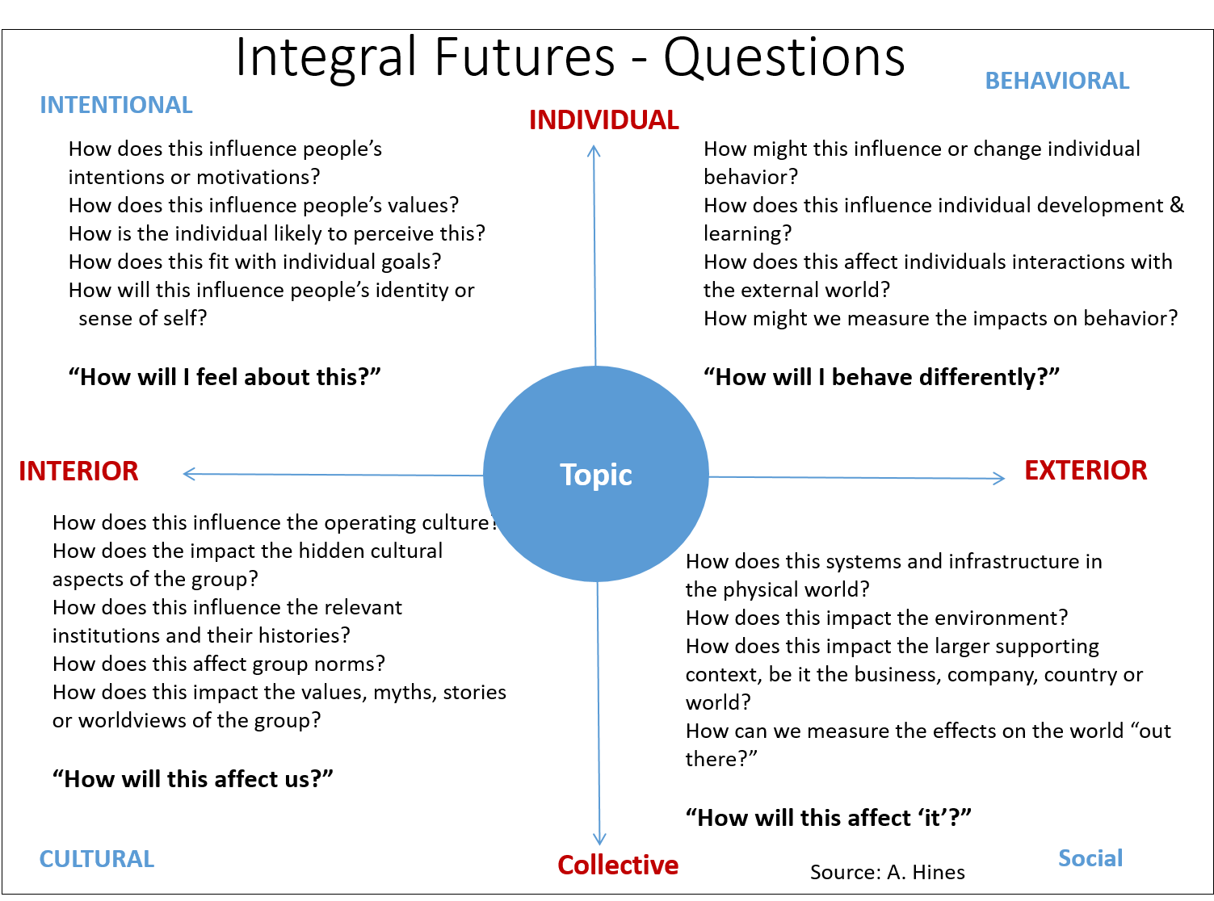
Notes:
An integral approach to considering the future involves attention to four dimensions, the personal, the cultural, the behavioral and the social. Think of an emerging topic related to the future of nursing and health like data science, genetics, artificial intelligence, climate change…. How can you use the questions to unpack and make explicit some of the consequences of these topics in terms of the future?

Slide 33

Appreciate the Use of Vision Based Scenarios
A scenario is a method for telling a story about the future. It can be based on reliable or speculative data.
Notes:
Trends come alive through the creation of scenarios…A scenario is a method for telling a story about the future. It can be based on reliable or speculative data. For example the Robert Wood Johnson Foundation commissioned the Institute for Alternative Future to create and develop scenarios about the Future of Health in 2032. The next slide has a hyper links to the final report. Click on it and read the scenarios…which one resonates the most with you Which one do you think is most likely to emerge? Which one do you want to emerge?

Slide 34
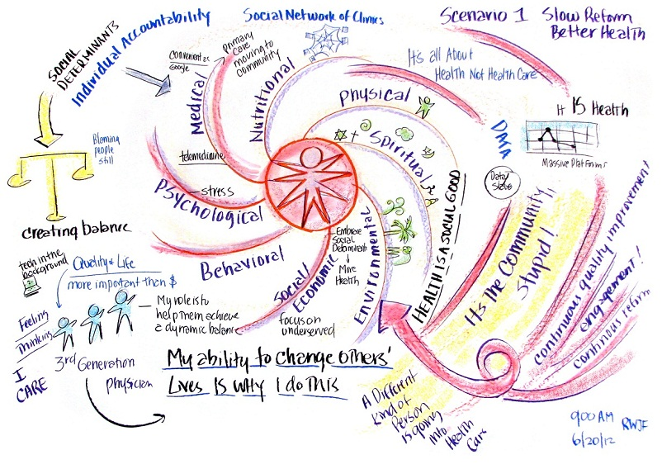
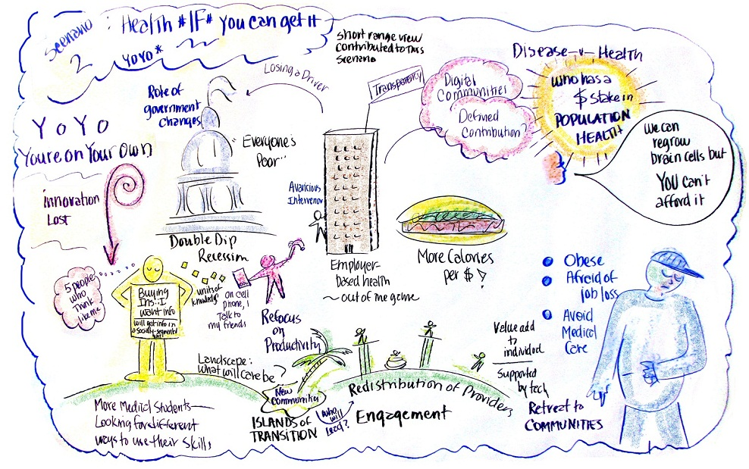
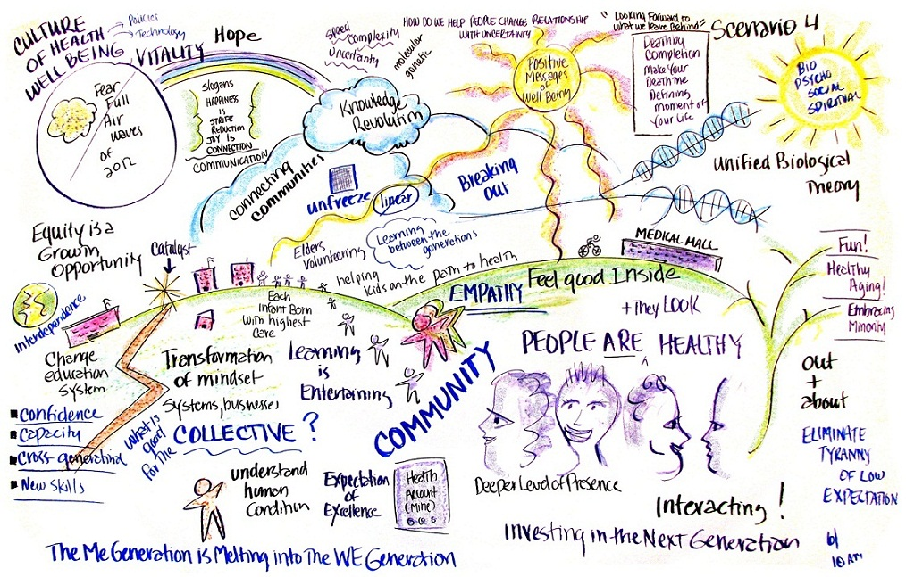
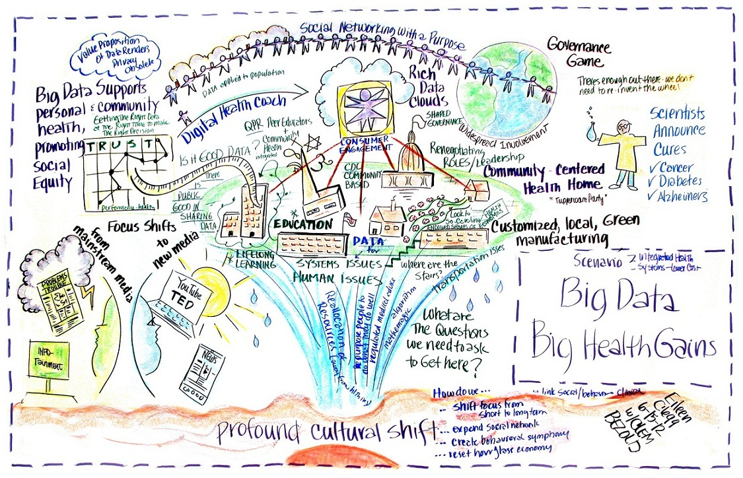
Health and Health Care 2032
Notes:
In addition to the Four Scenarios about Health and Health Care in 2032 The IAF has other scenarios about health care int the future as well as the future of human services in year 2035

Slide 35

Human Service 2035
Scenario 1: Reductions and Rebounds (Expectable) - Assumes a period of likely human service cuts during the 2017- 2021as well as the evolution of human service delivery, automation and the use of intelligent agents in all sectors of the economy along with expectable job loss.
Scenario 2: Navigating Unending Challenges (Challenging) considers some key things that “could go wrong” (including another great recession, funding cuts).
Scenario 3: Building Human Potential (Visionary) - Explores human progress in attitudes; technology including “abundance advances,” and policy.
Scenario 4: Thriving Communities (Visionary) --successful changes in attitudes, technology including job loss to automation, policy transformations, and the “abundance advances”.
Notes:
Read and reflect on these four Human Service Scenarios for the year 2035 what are the implications of each of these for the future of nursing and health? Strategic conversations about scenarios like this should be organized around the following questions

Slide 36

Stimulate Strategic Conversations Looking Backwards from the Future
How plausible does the scenario seem?
What thoughts does it suggest?
What feelings does it generate?
Notes:
How plausible does the scenario seem?
What thoughts does it bring to mind?
What feelings does it generate?

Slide 37
Strategic Conversations
What are the implications for society, healthcare and the health care professions?
If parts of the scenario are desirable what actions need to be taken to increase the chances of it happening?
If parts are undesirable what actions need to be taken to prevent them from happening?
Notes:
What are the implications for society, healthcare and health care professions especially nursing?
If parts of the scenario are desirable what actions need to be taken to increase the chances of it happening?
If parts are undesirable what actions need to be taken to prevent them from happening?

Slide 38
Develop Foresight Leadership
Navigate change efforts with the creative power of Appreciation, Influence and Control.
Be clear and intentional about a professional and/ or an organizational leadership legacy.
Make a pledge to future generations.
Explore the ANA Innovation Enterprise resources and spread the word about your innovation contributions.
Notes:
Appreciate the use of vision-based scenarios.
Stimulate strategic conversations about espoused visions looking backwards from the future.
Navigate change efforts with the creative power of Appreciation, Influence and Control.
Be clear and intentional about a professional nursing leadership legacy.
Some years ago I studied with Philip and Mikela Tarlow.. They wrote a fascinating book, referenced at the end of this presentation titled Navigating the Future: A personal guide to achieving success in the New Millennium. In this work they note what the future holds for you depends on what you hold for the future. So in essence as you become more clear about what you want the future to be, that future will be realized through you conscious intentions to create it. Unfortunately many of us are become victims of what developmental psychologist Frederick Hudson calls future blindness. Hudson studies adult development and discovered many adults become future blind for the following reasons.

Slide 39
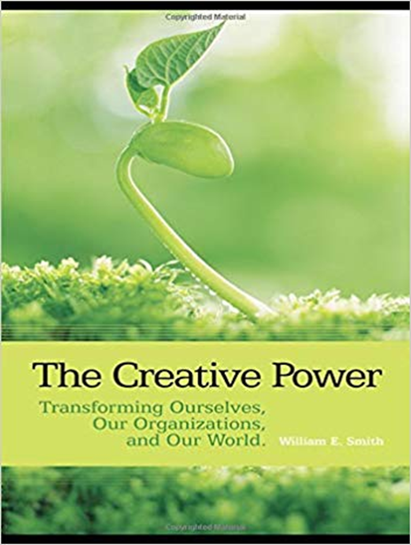
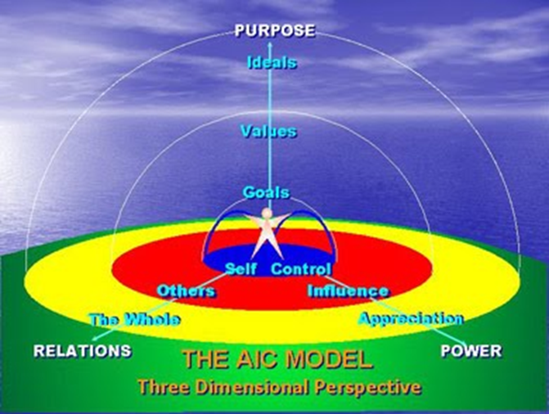
Navigate Change With Appreciation, Influence and Control
The Simplicity Beyond Complexity
The Creative Power of AIC
Notes:
Once a direction or decision has been made about pursuit of a desired future, Leaders must navigate change with the appreciation, influence and control. The AIC model of leadership developed by William Smith is simple, elegant and powerful. Smith observes once a purpose is determined it sets up energies related to ideals, values and goals. And success is achieved with degrees of appreciation, influence and control. A leader's task is to help people compare and contrast the ideal with the reality, and discern who is going to support or not support the vision into action, and then one is challenged to decide what to do about it. Successful foresight initiatives have equal amounts of appreciation, influence and control factors. I invite you to learn more about the AIC model and consider how you can incorporate this model in your own leadership skill set.

Slide 40

Pledge to Future Generations
Create a Community of Practice with Creativity,
Foresight, and Innovation in Mind
ANA INNOVATION GUIDE

Slide 41
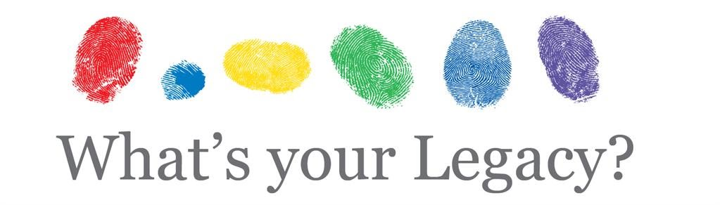
O’Connor, L. (2019). Career Legacy Cartography Portfolio for Advanced Practice Nursing. Scholarship, a Career Legacy Map and Advanced Practice
Hinds, P. S., Britton, D. R., Coleman, L., Engh, E., Humbel, T. K., Keller, S., & Walczak, D. (2015). Creating a career legacy map to help assure meaningful work in nursing. Nursing outlook, 63(2), 211-218.
Secretan, L. (2010). The spark, the flame, and the torch: Inspire self. Inspire others. Inspire the world. Secretan Center, Incorporated.
Why ~ Be ~ Do
Beaudet, O., Pesut, D., & Lemberger, O. (2023). The ANA Innovation Engine: Activating Innovation Through Education and Communities of Practice| OJIN: The Online Journal of Issues in Nursing. Online Journal of Issues in Nursing, 28(2).
Notes:
So this brings us to the issue of a personal and or professional leadership legacy. As you consider the future considering your personal and or professional past – what difference do you want to make in the world of nursing and health? What do you want to be known for? What stories will people tell after you leave your organization? What contributions will be most remembered when you are ready to retire? Create a career legacy map with a desired future in mind and begin to exercise your foresight leadership to make a positive difference in the world of nursing and health…
I hope you continue to learn more about foresight and futures literacy. Check out some of the references and resources in the next slide.. Visit the Foresight Leadership Future of Nursing and Health Web resource at www.foresight-leadership .org Join the Foresight leadership Future of Nursing and Health learning community on Linked in. Add your voice to the conversations about trends, impacts, consequences and developments likely to influence the future of nursing, health, and the planet… explore, learn and contribute because you are the next generation nursing leaders responsible for creating the professional future of nursing and health,

Slide 42

Reflections
What concepts, ideas, or resources are most interesting or useful?
How can the knowledge be used ?
Why is the knowledge important?
Why care about the knowledge or information?

Slide 43
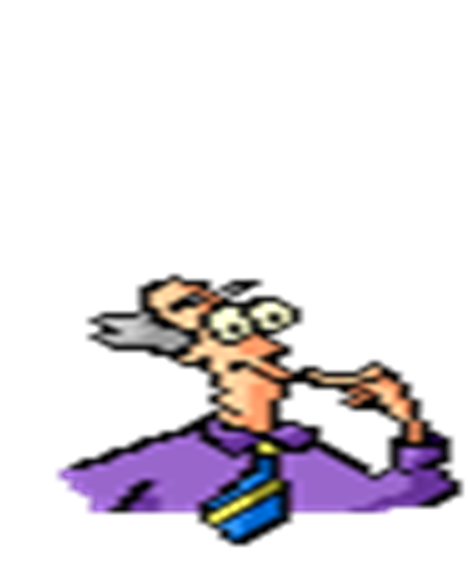
Dialogue
What did you appreciate?
How did the information presented influence your thinking and feeling?
What if any commitment to action will you make based on what you learned?

