Slide 2
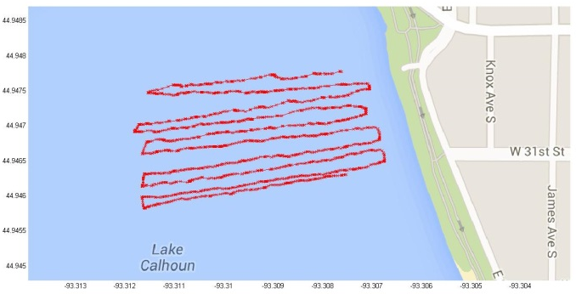
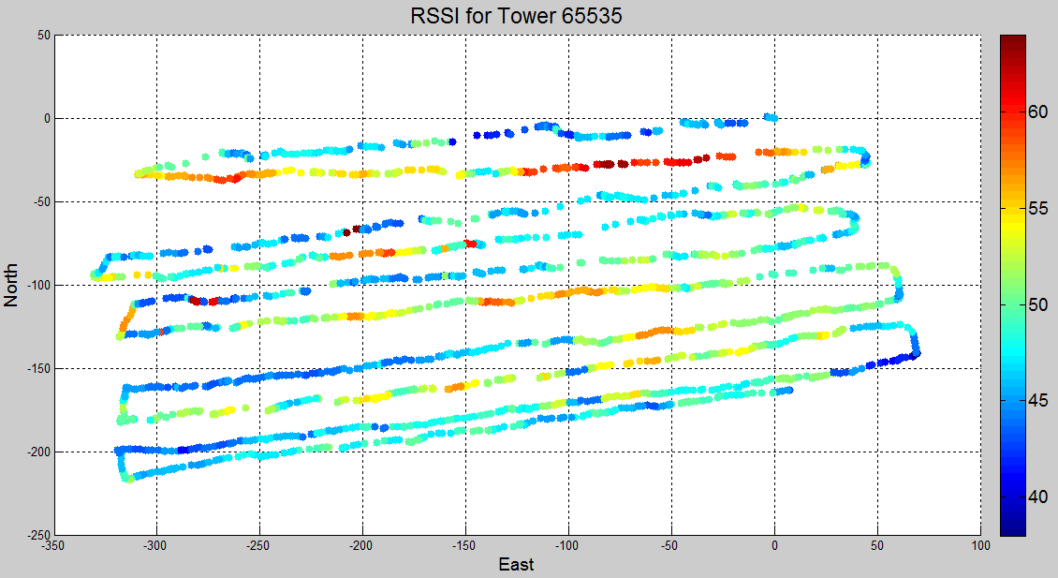
Lake Calhoun RSSI Test
Walking test with Multi-Tech rCell Wireless Modem Receiver
Planned to use data for estimation algorithm over a similar sized area that a SUAV may operate.
Walked a rectangular grid 250m x 350m

Slide 3
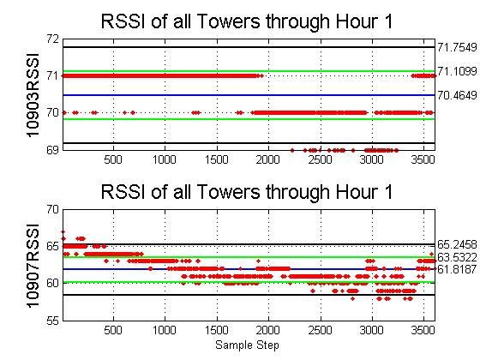
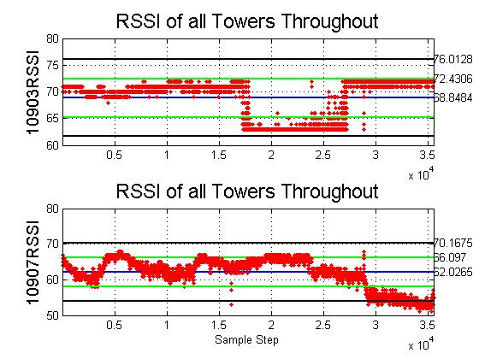
Static Received Signal Strength Indication (RSSI) Test
Static test with Multi-Tech rCell Wireless Modem Receiver
Set up the receiver and antennas in parking
9:00AM 1 February 2014 – 7:00PM 1 February 2014 at 2:00AM (10 hours)
Cell Tower ID (y-axis label) RSSI vs sample step obtained by receiver (roughly 0.5 Hz)

Slide 4

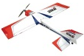

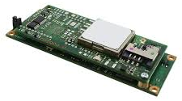
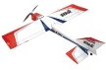
Timing Advance Solution
Purchased Multi-Tech 2G cell phone modem capable of outputting cell ID, RSSI, and timing advance data on the main cell tower and neighboring cell towers.
Plan to use aircraft (cell modem) GNSS position (when available) to estimate locations of cell towers using the timing advance information
When GNSS is lost, use estimated locations of cell towers to then reverse the problem and estimate location of aircraft by triangulation.
TA=2
~1100m
TA=1
~550m

Slide 5
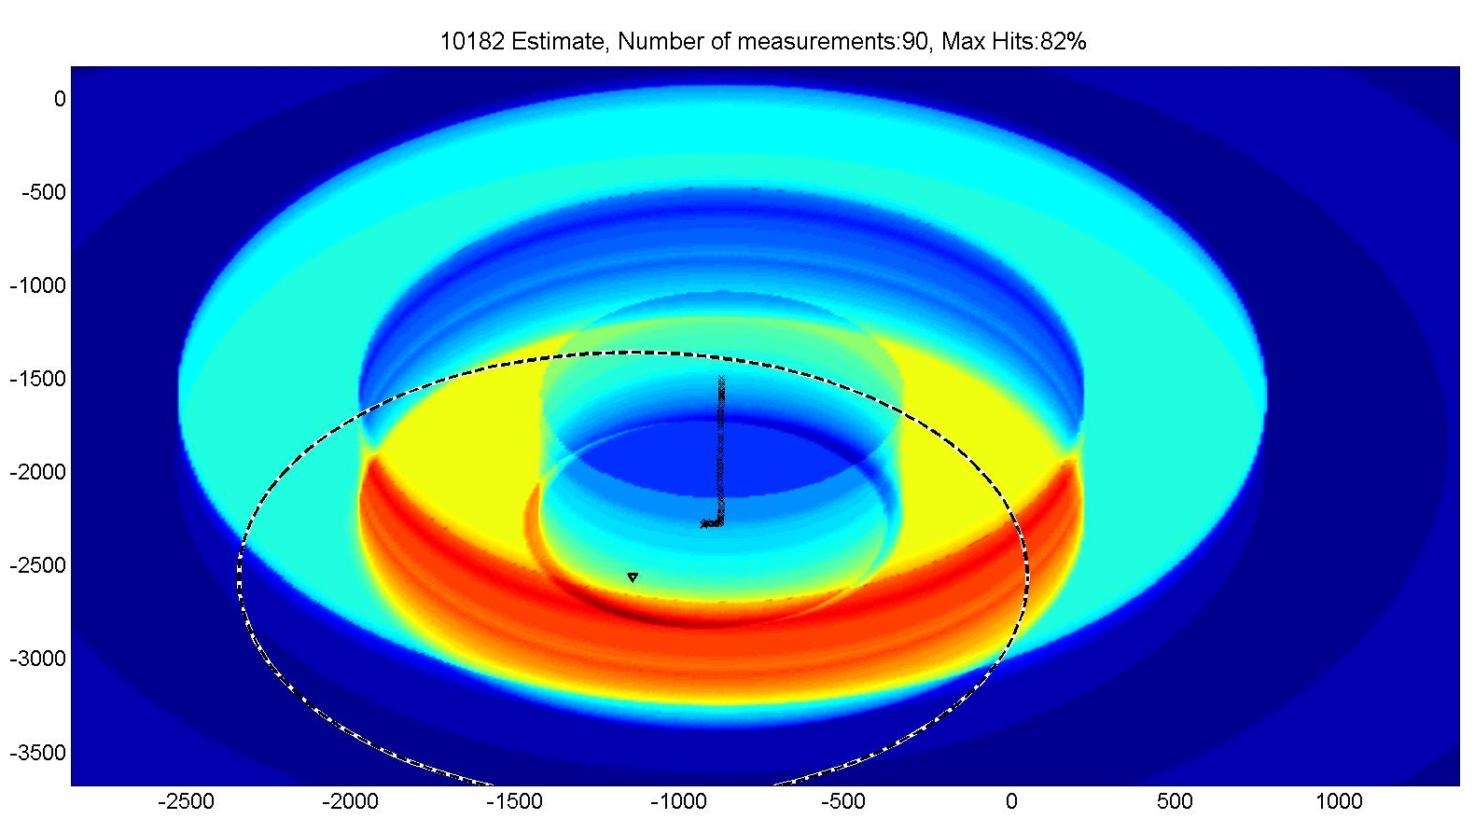
Timing Advance Data

Slide 6
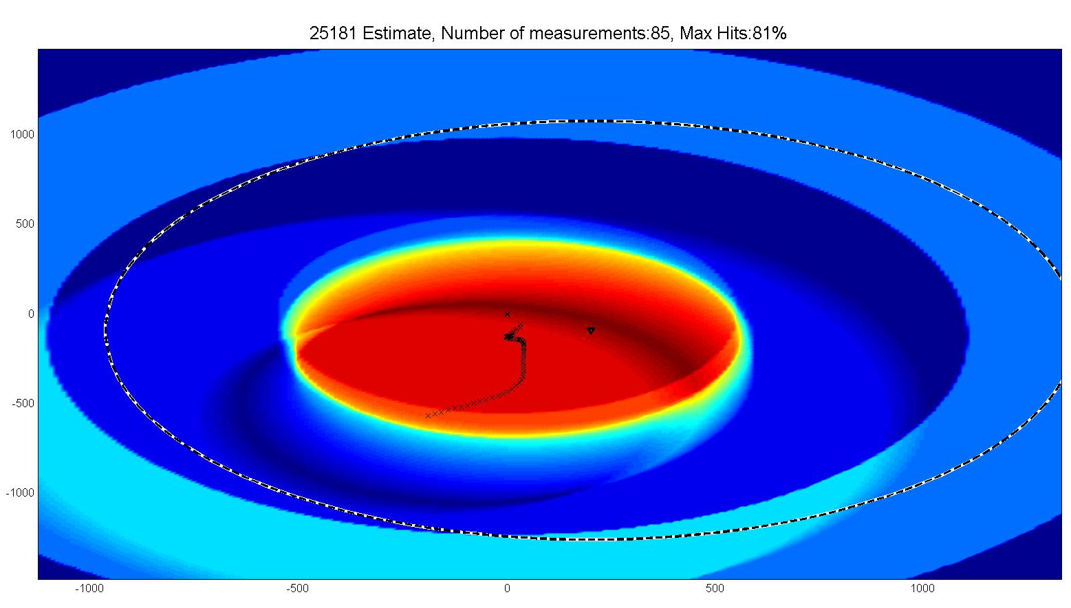
Timing Advance Data

Slide 7
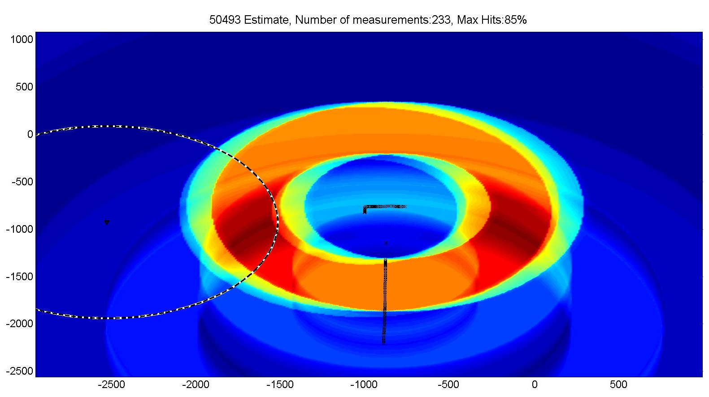
Timing Advance Data

Slide 8

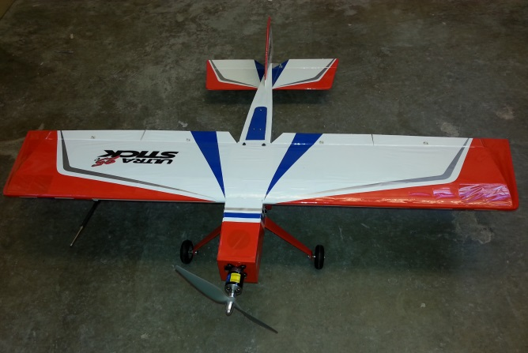
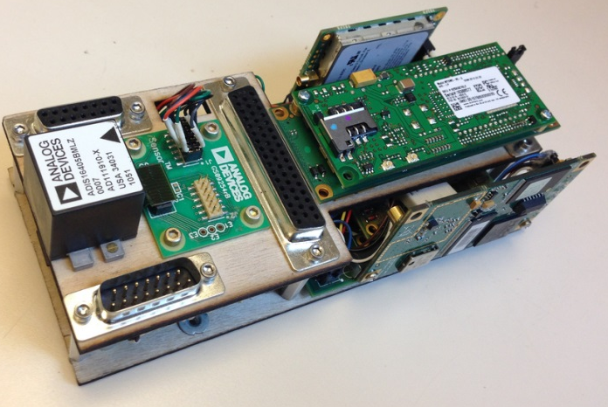
Tyr

Slide 9
Extra

