Slide 1
Information Literacy of Online Health Consumers in Minnesota
Georgia International Conference on Information Literacy
September 27 - 29, 2018
Savannah, GA
Slides: z.umn.edu/GICOIL-onlinehealth

Slide 2
SHANDA HUNT, MPH
Public health librarian & data curation specialist
NICOLE THEIS-MAHON, MLIS
Dental librarian & health collections coordinator
KATHERINE CHEW, MLS
Research/outreach services librarian & mortuary science liaison
UNIVERSITY OF MINNESOTA
Health Sciences Libraries
Minneapolis, MN
Template from SlidesCarnival

Slide 3
OVERVIEW
Background
Setting
Methods
Results
Recommendations

Slide 4
BACKGROUND
1
Minnesota Electronic Health Library

Slide 5

MeHL
Data Collection
More Information
Minnesota Electronic Health Library
Studies of civilians, pharmacists, physicians
https://hsl.lib.umn.edu/about/mehl
Notes:
The Minnesota Electronic Health Library (MeHL) would bring 24/7 health information to all Minnesotans to create a healthier Minnesota. MeHL would benefit providers, patients, students, and caregivers. The health information in MeHL would include:
Evidence-based research
Point-of-care tools
Full-text medical and nursing books
Full-text medical and nursing journals
Prescription drug references
The Health Sciences Libraries at the UMN have been collecting data to inform the MeHL project. Several teams of librarians have conducted four studies: one on the health literacy of Minnesotans, two on information resource access among pharmacists and physicians, and one on how Minnesotans find and evaluate online health information - the final provided the data for this presentation.

Slide 6
SETTING
2
Minnesota State Fair

Slide 7


MINNESOTA STATE FAIR
Two
Million in
Attendance
Image: https://www.mnstatefair.org/
Notes:
Participants were recruited using a convenience sample at the 2016 Minnesota State Fair, which had nearly two million people in attendance. A convenience sample is not a randomized selection of participants; it is exactly as it sounds: you recruit people who are convenient to recruit. It is often used in exploratory studies and for populations that are difficult to reach. In addition to the convenience sample available at the State Fair, another advantage is that people come from all over the state, allowing us to reach a rural population we likely would not have reached otherwise.

Slide 8


Driven2Discover
WANT BIG IMPACT?
Use big image.
Image: http://d2d.umn.edu/
Notes:
The UMN owns a research building at the State Fair called the Driven2Discover building (D2D). The goal is for researchers to connect with the public - Minnesotans get to see what research the UMN is conducting and be a part of that, making the UMN more accessible. Each year, UMN researchers have an opportunity to apply for space in this building to recruit fair attendees for their research studies. A D2D committee reviews all applications and selects the research projects that will be included. This beautiful facility did not exist when we conducted our study; instead, we were in the old “Spam” building that the UMN had just purchased.

Slide 9
METHODS
3
Mixed Methods

Slide 10
THE RESEARCH QUESTIONS
What online sources do Minnesotans use to answer their health questions?
How do Minnesotans use the online health information they find?
How confident are Minnesotans’ in their ability to evaluate the quality of online health information?
What do Minnesotans feel is missing from online sources of health information that are currently available?
Notes:
With these questions, we were hoping to get a sense of the online health seeking beliefs and behaviors of participants.

Slide 11
THE SURVEY
Sample of surveys we used:
Patient Activation Measure - 13
eHealth Literacy Scale
Indicators of Accuracy of Consumer Health Information on the Internet
We created additional questions on navigation of websites, demographics, and the “perfect” online health source.
Notes:
The survey instrument was adapted from several assessments of online health information (OHI). We found several surveys that looked at parts of our research questions, but not one that fit our needs perfectly - so we took parts of existing surveys or adapted the questions to meet our needs.
The Patient Activation Measure 13 assesses patient knowledge, skill, and confidence for self-management. The eHEALS is an 8-item measure of eHealth literacy developed to measure consumers’ combined knowledge, comfort, and perceived skills at finding, evaluating, and applying electronic health information to health problems. Indicators of Accuracy of Consumer Health Information on the Internet was the survey used in a study that examined how health consumers evaluate the information they find on the Internet. Finally, we created some of our own questions that asked about demographics, how consumers navigate health websites, and two qualitative questions around the “perfect” online health source and what they feel is missing from existing sources.
The 43-item survey was administered via REDCap on iPads. Analysis of descriptive statistics was conducted using RStudio to explore relationships between variables, and a qualitative analysis of two survey items were conducted using Nvivo 11 Pro.

Slide 12
LIMITATIONS
Convenience sample
Response bias
Limitations are a part of every study, and are often balanced out by other considerations.
Anonymity
Benign topics
Natural behavior
Data collection on attitudes
Notes:
This study utilized a convenience sample and, thus, results are not representative of all Minnesotans. The survey was also self-reported and self-administered by individuals who took time from a fair to participate in research studies. There is potential for response bias in this situation as this population may have been unique, underestimated or exaggerated responses, or provided responses they perceived as desirable.
At the same time, the anonymous nature of the survey, coupled with the benign topic (e.g., no questions on sensitive subjects such as sexual health or drug use), make it more likely that participants answered truthfully. And while it is possible to collect primary data on website navigation, participants may alter their behavior in a lab environment, knowing that they are being recorded for a research study. Finally, attitudes, which provide context around research results, can only be collected via self-report methods.

Slide 13
RESULTS
4
Online health consumer beliefs and behavior

Slide 14
255 PARTICIPANTS
74%
Female
72%
Highly
Educated
19%
Worked in
Healthcare
Notes:
The survey was completed by 284 participants; 29 were excluded due to missing or out-of-state zip codes, leaving us with a sample of 255 participants. The sample is skewed in that it is heavily female -- 74% compared to Minnesota’s 50%, highly educated -- 72% compared to Minnesota’s 34%, and experienced in health care -- 19% compared to Minnesota’s 10%. The sample appeared to be skewed white (84%), but was on par with Minnesota’s population (85%). Again, this means that the study results are not generalizable to the state of Minnesota, but they do provide an important baseline for future work in this area.

Slide 15
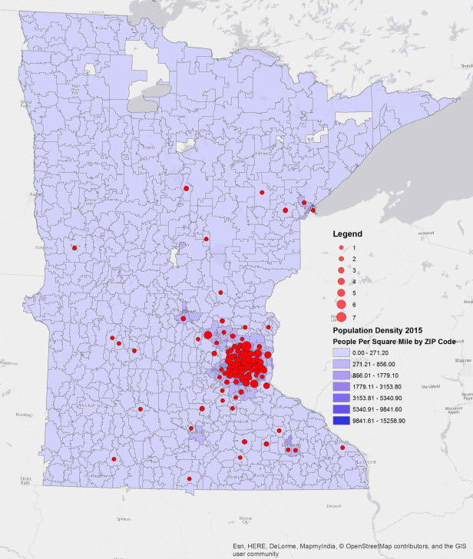
POPULATION DENSITY OF PARTICIPANTS
Notes:
29% of our sample came from rural areas. Approximately 25% of State Fair attendees are from rural areas, so we captured more than expected.

Slide 16
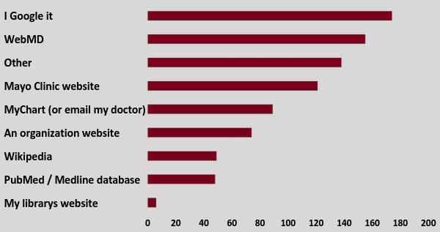
NAVIGATIONAL BEHAVIORS
Notes:
Participants felt that having access to health information online was important. Most began looking for health information with a search engine; Google, in particular. This is consistent with other literature that found it is common for consumers to start with broad searches versus going directly to known websites. WebMD was second and the Mayo Clinic was third. [“Other” was most often not specified by participants.] While the Mayo Clinic is a national organization, it is perhaps more heavily used by Minnesotans due to familiarity - the clinic originated in Rochester, MN. Approximately 50 participants looked to MEDLINE which is a robust database of peer-reviewed health and medical literature that you need a subscription to access the full article. This result is a reflection of the high number of health care providers who participated in the study. Indeed, Health care providers were significantly more likely than non-health care providers to use Medline databases (p<0.001), a mobile app (p=0.006), and the Minnesota Department of Health or Department of Health and Human Services websites (p=0.04).

Slide 17
USE OF INFORMATION
78% discussed the information with a health professional
76% shared the information with a friend or family member
74% used the information to decide when to see a health professional
Notes:
Participants used the information they found for a variety of reasons. The results point toward a desire to have a more interactive relationship with providers, to engage in caretaking, and to advocate for oneself.

Slide 18
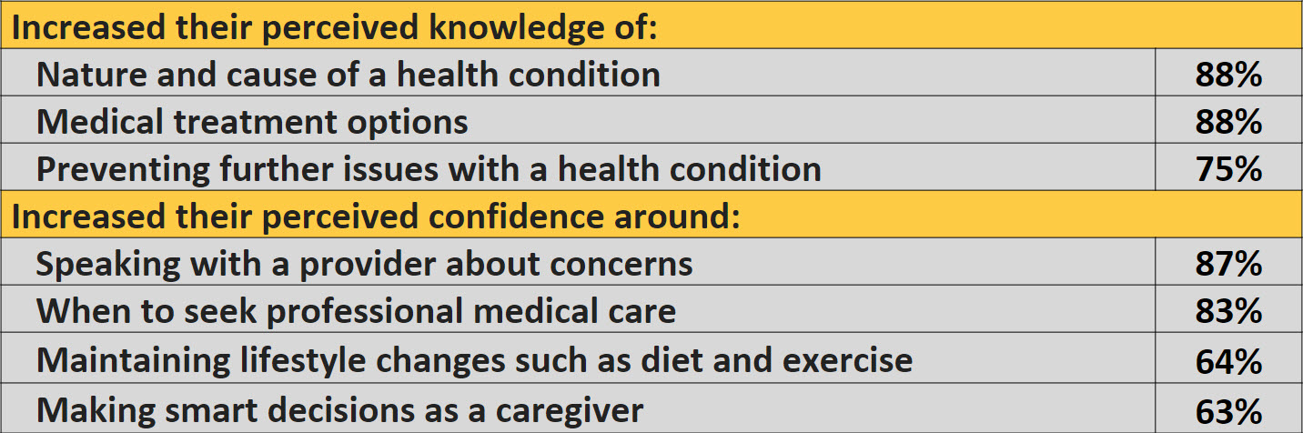
SELF PERCEPTIONS
Notes:
As you can see, participants believed that having access to health information online increased their knowledge on health issues and increased their confidence in their ability to execute certain health behaviors.

Slide 19
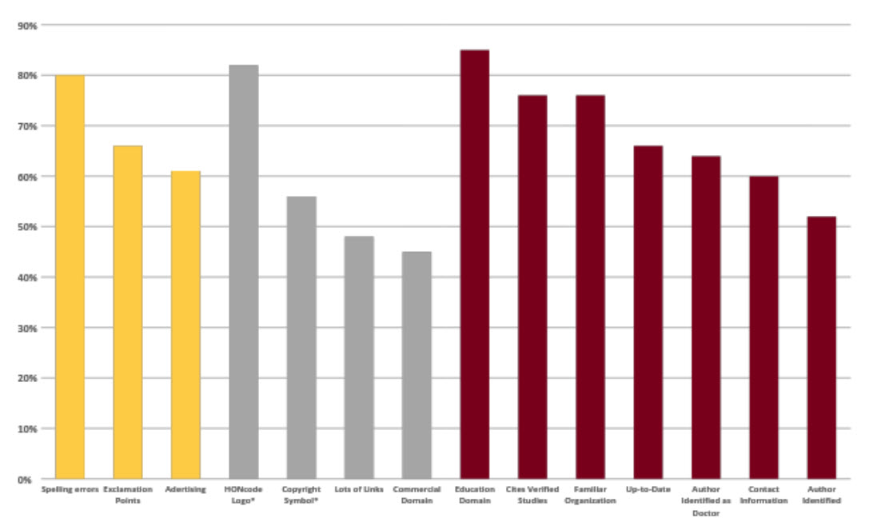
PERCEIVED INDICATORS OF WEBSITE QUALITY
Notes:
Participants felt that spelling errors, exclamation points in the text, and advertising were indicators of low quality websites. They were unsure about websites from commercial domains, websites with a lot of “linking out”, and websites that displayed a copyright symbol or HONcode logo. Copyright symbols and HONcode logos are verified indicators of website quality - to display a HONcode logo, a website must apply for certification and adhere to eight ethical principles: authorship, complementarity, privacy, attribution, justifiability, transparency, financial disclosure, and advertising policy. Finally, participants believed that indicators of high quality were educational domain, citations of peer-reviewed studies, familiar organizations, up-to-date information, author identified as a doctor or simply author identified, and contact information.
Given that copyright and HONcode are proven indicators, we compared participants who chose those as high quality indicators to those who did not on several variables. We found that those who selected copyright or HONcode were more confident in their knowledge of online health information resources. They were also significantly more likely to “always” find the health information they were looking for.
Another thing to note is the variety of indicators that participants felt were high quality. If you think back to the HONcode criteria that I just explained, these indicators align very well. A number of studies have found that these criterion combined do provide insight into the overall quality of a health website. Thus, while our participants were unsure about the copyright symbol and HONcode logo, they still displayed a savviness in how they evaluate quality.

Slide 20
QUALITATIVE THEMES
Trusted versus Distrusted Sources
Characteristics of the Ideal Source
Notes:
Participants were given the opportunity to report in an open-ended question what they desire from an OHI source, as well as what they feel is missing. Two main themes emerged from our analysis: 1) Trusted versus Distrusted Sources, and 2) Characteristics of the Perfect Source.

Slide 21
Online health information should come from “...an unbiased source that provides information without trying to sell you something. Company websites are okay; government or educational sites are better.”
Notes:
Participants identified two specific sources - WebMD and The Mayo Clinic - as trusted sources of OHI. Participants looked at a website’s domain to identify whether or not the source was trustworthy; they specifically looked for .gov or .edu sites. They felt trusted sources were non-profit or non-industry, were authored by a doctor or professional, and cited sources of information. Participants also stated that trusted sources were easy to access, understand, and navigate. In contrast, information provided that was alarmist and catastrophizing was the primary reason given for distrusting a source of OHI. Participants distrusted sources that had advertisements, charged money, or provided conflicting information.
Recall that a distrust of advertisements also came up in the quantitative results, but that WebMD, a site that relies heavily on advertising, was the second place consumers went to look for health information online. This is contradictory behavior.

Slide 22
“Clear linkage to clinical study data or summary, or if none exists, then a standard statement saying so.”
Notes:
Most of the responses to the qualitative question also provided a description of what the ideal OHI source might look like. Participants desired more detailed information as well as personalized functionality. Nearly one-third of the data around the theme of an ideal source focused on the desire for a source of OHI that was evidence-based. Participants wanted a source that was clearly linked to research, subject experts, data, and supporting publications. Many participants expressed that the sources of OHI currently available were not valid, reliable, and/or credible. They also called for transparency as demonstrated in this quote.
Recall that a distrust of advertisements also came up in the quantitative results, but that WebMD, a site that relies heavily on advertising, was the second place consumers went to look for health information online. This is contradictory behavior.

Slide 23
RECOMMENDATIONS
5
Applying results in education

Slide 24
STRATEGIES FOR EDUCATION
Navigate
Direct students to the most efficient route to online health information and show them how to personalize their experience.
Assess
Give students the skills they need to accurately assess the value, trustworthiness, and relevancy of a health website.
Partner
Look to your fellow teachers, including public and academic librarians, for opportunities for mass education.
Notes:
I’m going to propose 3 ways to take our study results and apply them to education around health literacy.

Slide 25
Teach Personalization in Navigation
The “one-stop-shop” doesn’t safely exist, so show health consumers how to personalize what is available to them.
Notes:
First and foremost, we need to teach health consumers about best practices for navigating the Internet. Educators should encourage health consumers to begin their search at verified, reliable, reputable health websites such as PubMed or MedlinePlus. PubMed allows consumers to read the abstracts of peer-reviewed literature and will direct them to free full-text articles if they’re available. MedlinePlus is the National Institutes of Health's Web site for patients and their families and friends. Produced by the National Library of Medicine, the world’s largest medical library it offers summarized medical information to consumers. If students feel they must begin with a search engine, instruct them how to quickly weed through the results. You can teach them about Search Engine Optimization (SEOs) and paid advertisements so they understand why certain websites rise to the top of a Google search.You can teach them about structuring their question so that their search words retrieve the most relevant websites.
You heard in our results that participants desired a site that knew their medical history, their unique characteristics, and provided them with tailored health information. Google actually attempted to do this. They launched Google Health Record in 2008, but the uptake was less than they expected and they shut it down in 2011. What it did was allow consumers to input their personal medical records into Google Health Record, and then Google would search for relevant health information to add to the consumers’ record. They claimed that they did not need to comply with HIPAA rules, but it’s unclear if the idea was not successful because people were concerned about their privacy and confidentiality. Other services, one from Microsoft, have entered the picture since then, but more as health record management systems rather than personalized health information tools.
Thus, given that the desired “one-stop-shop” does not exist, educators need to teach consumers how to navigate health information on the Internet, as I previously mentioned, but also how to find information that is as individualized as possible.

Slide 26
Tailored to language needs
MedlinePlus
Made for the average consumer
Providing fewer language sources
Direct translations
Many languages
Audio/visual
Health Reach
Health information in many languages
MedlinePlus is referring to Health Reach
Family planning & some refugee info removed
Multicultural & Multilingual Health Information
UMN Health Sciences Libraries
Notes:
MedlinePlus is health information from the National Library of Medicine. It was created for the average health consumer (versus healthcare providers) and visually resembles WebMD, making it easy to navigate for consumers. The site offers direct translations of web pages at a 5th-6th grade reading level. Medline Plus has the capacity to offer many language options and audio/visual materials. But unfortunately, like other government pages, some information in other languages has been removed and no new translated materials are being added.
Health Reach is also from the National Library of Medicine; it was formerly called Refugee Health Source. Medline Plus refers online health consumers to Health Reach. It does not offer direct translations, but rather summaries of info from other vetted sources. While we can’t be certain that it was done intentionally, family planning and some refugee information has recently been inaccessible on the site.
The UMN Health Sciences Libraries maintains a list of additional health sources in many languages. Some are specific to Minnesota, but there are national websites as well. You may want to research options that are specific to your own states as well.
As you can see, the last link includes materials on multicultural sources. This includes African American Health, American Indian and Alaska Native Health, and Multicultural Resources for Health Information. Some of these are sponsored by the National Library of Medicine and some are not. This is a good segue into the next slide.

Slide 27
Tailored to specific characteristics
NIH Senior Health
Retired in 2017
Referring people to
Medline Plus
National Institute on Aging
Go4Life
Eunice Kennedy Shriver National Institute on Child Health & Human Development
Larger mission
A - Z health topics
Women’s health (maternal health?)
Office on Women’s Health
More info on National Institute on Aging
Notes:
There were existing personalized sites that were not on the individual level, but on more of a characteristic level - in the last 2 years these have been folded into megasites, making them less personalized. For example, NIH’s Senior Health was retired in 2017, but there is still a landing page that points consumers to three other health websites.
The Eunice Kennedy Shriver National Institute on Child Health is not necessarily a source of health information for consumers, but they do have an A - Z health search. They also offer a section on “women’s health”, which is focused on maternal issues.
There is an Office on Women’s Health run by DHHS. But again, there is more information on women’s health on other sites as well, such as the National Institute on Aging.

Slide 28
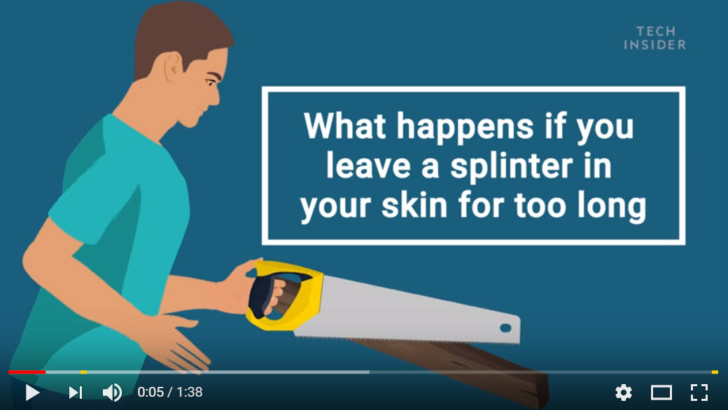
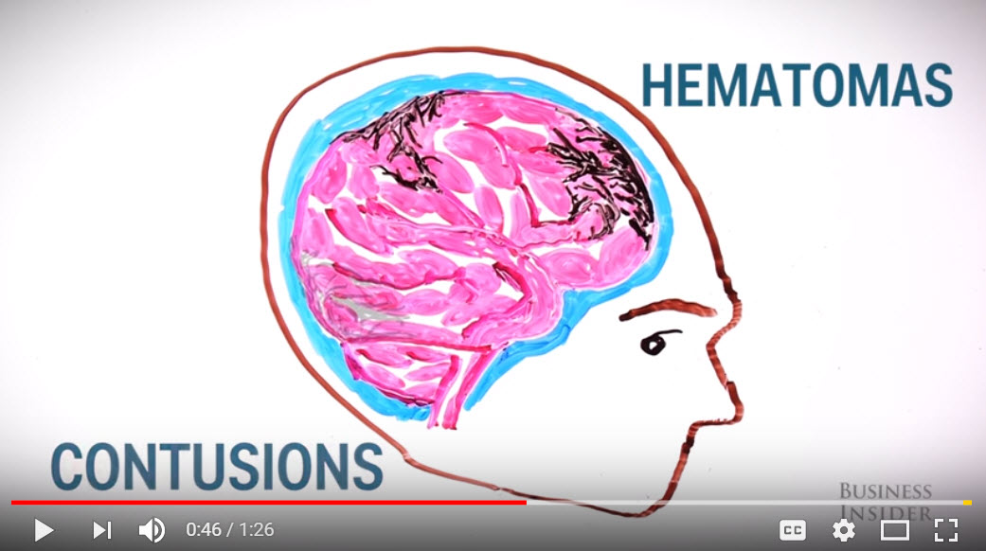
Tailored to learning style
https://www.youtube.com/watch?v=25HLKjIZA2Y
https://www.youtube.com/watch?v=MboxdG2EZA0
Notes:
Health consumers may have different preferences for how to receive and learn information. Some may prefer visual representations of information. YouTube has numerous health channels, including one by NIH Senior Health which I’ve previously mentioned. Here I have two examples: one as simple as removing a splinter and another that breaks down what happens to the brain when you have a concussion. As educators of online health information, keep in mind that educational health videos should last only 2 - 4 minutes for maximum retention of information.

Slide 29
Teach How to Assess Quality of Health Websites
A set of criteria versus one or two indicators is the best strategy according to the evidence available.
Notes:
Our study found that participants were unsure whether the HONcode logo and copyright symbol were reliable indicators of website quality, and instead used a variety of criterion such as educational domain, supporting evidence, brand familiarity, sponsorship, and readability. This points to consumer savvy when it comes to evaluating websites; they considered many factors when determining the trustworthiness of OHI. But again, consider the fact that our sample was highly educated with a large proportion of healthcare providers. It is same to assume that the average online health consumer would need more guidance.

Slide 30
List of criteria
Who is sponsoring the information?
Who is authoring the information?
Is there reliable contact information?
Does the information appear biased?
Can you verify that the information is accurate?
Has the website been reviewed by qualified professionals?
Is the information up to date?
Are there sufficient privacy protections in place?
Does the website encourage medical advice from a professional?
Notes:
There is a relatively standard set of criteria that consumers should consider in their search for online health information.

Slide 31
Evaluation templates & resources
Online Health Information Scorecard
Tutorial: Evaluating Internet Health Information (16 min)
Finding & Evaluation Online Resources
Trust It or Trash It?
Notes:
The Online Health Information Scorecard helps consumers move through the criteria on the previous slide, asking them to answer specific questions and score the criteria. It was developed by the Pacific Northwest NNLM and the University of Washington.
The tutorial is a 16 minute video from MedlinePlus.
Finding & Evaluating Online Resources is a series of considerations when consulting online information, and there is a specific section on evaluating health information.
The final resource is also a series of considerations, but the site is interactive - potentially capturing the consumer’s attention better. This is produced by Genetic Alliance.

Slide 32
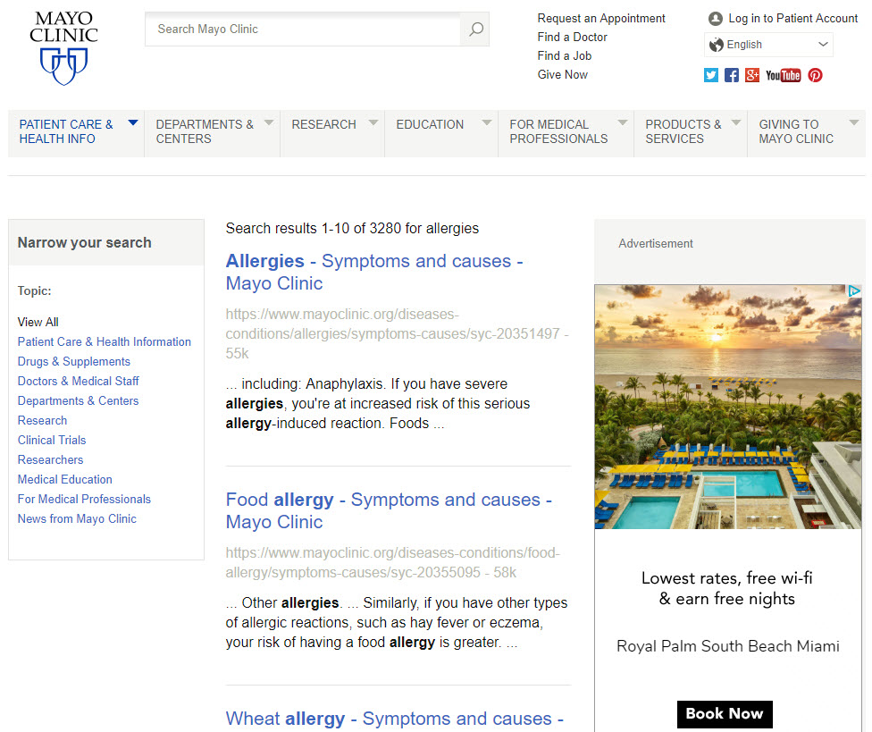
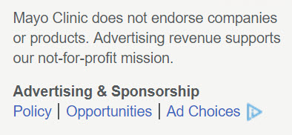
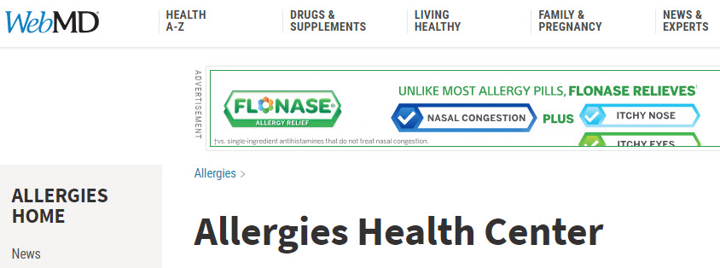
Address the issue of advertisements
Notes:
A majority of study participants identified the presence of advertisements as indicators of low quality online health information; however, a majority also used WebMD, a site with advertisements. This conflicting result could be attributed to the familiarity of advertisements on websites. It is possible that while participants identified advertisements as an indicator of poor quality, they may not judge them as good or bad when viewing health information online. It is also possible that the type of advertisement may influence whether a user deems health information as high or low quality. One study found that consumers specifically distrusted sites with pop-up or banner advertisements. Librarians who educate the public could focus on evaluation elements that address distrust around advertisements. For example, librarians can educate consumers on how to identify sponsorship information – and critically examine how it influences site content – rather than outright dismissing sites with advertisements. Here is an example from the Mayo Clinic, which makes a clear statement about the need for ads to fund the site, displays ads that are not related to the page content, and offers transparent information about their advertising policy and selection process. In contrast at the bottom, you see a screenshot of the WebMD Allergies Health Center with a Flonase ad at the top. There were two other Flonase ads on the page, and at the very bottom of the site was a small link for Ad Choices. While WebMD is a trusted site, displaying the HONcode logo as well as other indicators of quality, the choice and placement of advertisements might mislead some health consumers. Teaching consumers to be cognizant of how ads are displayed will help them make more informed choices.

Slide 33
Partner with Experts to Maximize Education Efforts
Widespread education is the best way to impart knowledge to online health consumers, preventing the spread of incorrect and dangerous information.

Slide 34

Potential partnerships
NNLM Public Libraries Training
Schools + Public Libraries
Public + Academic Libraries
Schools + Academic Libraries
Community Outreach
Notes:
We can teach health literacy on the Internet in a variety of ways with the support of each other. Health science librarians at academic institutions, public librarians, and school educators are ideal partners in efforts to educate students and the public about best practices for retrieving and using health information online.

Slide 35
PUBLICATION
“Online Health Information Use, Assessment, and Gaps Identified by Minnesotans”
Journal of Consumer Behavior on the Internet
Nicole Theis-Mahon, Shanda L Hunt, Nora Forbes
Notes:
If you are interested in the full results and analysis of this study, look for our publication coming out soon in the Journal of Consumer Behavior on the Internet.

Slide 36
Thanks!
THANK YOU
Contact:
Shanda Hunt, MPH
hunt0081@umn.edu
Experts@Minnesota
LinkedIn

