Slide 1


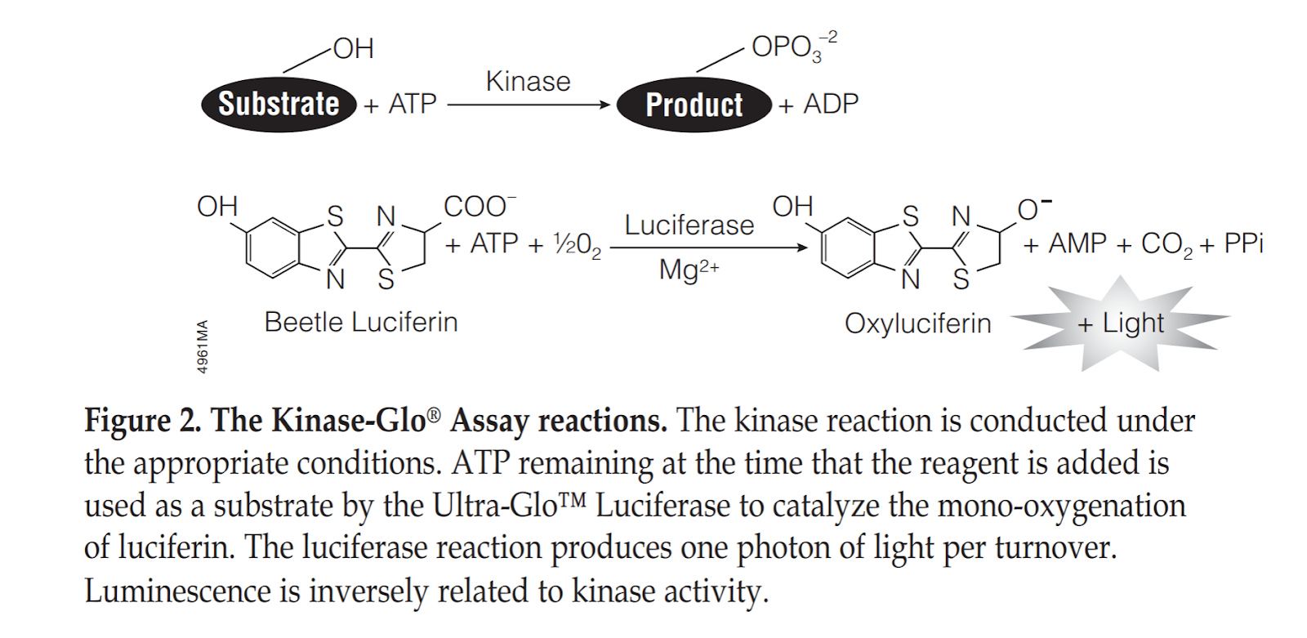
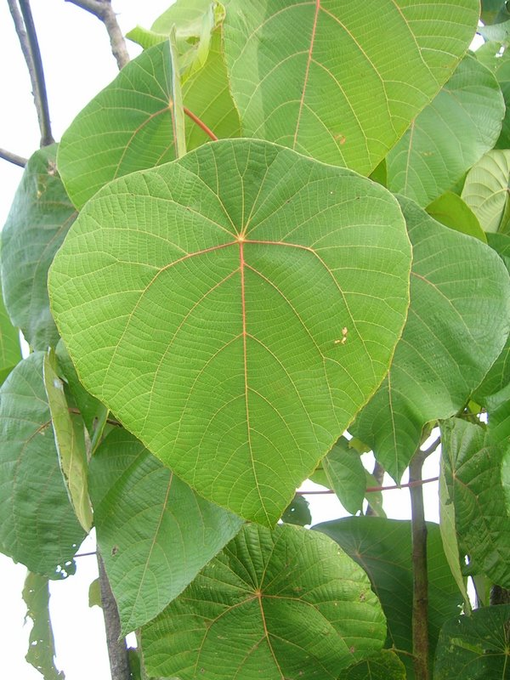
Inhibition of Kinases by extracts of Macaranga genus
Aryan Abazari & Dr. Venugopal Mukku
Department of math, science, and technology, University of Minnesota Crookston
Introduction
Methodology Continued
Discussion
Previous Studies
There have been findings regarding the presence of the Kinase enzyme in cell transformation, tumor initiation, survival, and proliferation of cancer. Several scientists worldwide were able to discover the plants or medicine that inhibited the action of different enzymes in the body.
Natural products research has come full circle. Of the 174 anticancer drugs approved by the FDA from 1981 to 2014, more than 50% are either natural products or derivatives thereof. (Newman and Cragg, 2016).
The role of the Kinase enzyme has been essential in the metastasis of cancerous cells. A typical cell in the human body requires glucose consumption to gain enough energy to function, while the cancerous cells can function without the use of energy from glucose. The cancerous cell has a unique characteristic that makes them resistant to glucose starvation, and thus it gives them the ability to divide and spread without energy.
The FDA has approved 37 kinase inhibitors since 1980(Wu, Nielsen, and Clausen, 2015; Bhullar et al., 2018).
Studies suggest that the resistance to glucose starvation is due to activation of the pathway involving PKA, and there is a critical need to identify inhibitors of this activation (Palorini et al., 2016)
Our goals from this research are to explore the ability of M. occidentalis, M. monanadra and M. schweinfurthii to inhibit protein kinases B and C.
To use our result for further discovery of a chemical or a drug that inhibit the spread of cancer cells.
The chemical inhibiting the action of the kinase enzyme may inhibit other activity of the cells
There are already 37 approved kinase inhibitors.
Herbal plants are not used commonly for treatment by modern physician and scientists
Performing the assay:
References
Bailon-Moscoso, N., Cevallos-Solorzano, G., Romero-Benavides, J.C., Ramirez Orellana, M.I. 2017. Natural Compounds as Modulators of Cell Cycle Arrest: Application for Anticancer Chemotherapies. Curr Genomics. 18:106-131.
Bhullar, K.S., Lagarón, N.O., McGowan, E.M., Parmar, I.P., Jha, A., Hubbard, B.P., and Rupasinghe, H.P.V. 2018. Kinase targeted cancer therapies: Progress, challenges and future direction.Mol. Cancer. 17:48.
Harvey, A.L., Edrada-Ebel, R., and Quinn, R.J. 2015. The re-emergence of natural products for drug discovery in the genomics era. Nat. Rev. Drug Discov. 14:111-129.
Heffernan-Stroud, L.A., and Obeid, L.M. 2013. Sphingosine Kinase 1 in Cancer. Adv Cancer Res. 117:201-235.
Newman, D.J., and Cragg, G.M. 2016. Natural products as sources of new drugs from 1981 to 2014. J. Nat. Prod. 79: 629-661.
Palorini, R., Votta, G., Pirola, Y., De Vitto, H. et al. 2016. Protein kinase A activation promotes cancer cell resistance to glucose starvation and anoikis. PLoS Genet. 12:e1005931.
Piotrowska, H., Kucinska, M., and Murias, M. 2012. Biological activity of piceatannol: leaving the shadow of resveratrol. Mutat. Res. 750:60-82.
Saslis-Lagoudakis, C.H., Savolainen, V. Williamson, E.M., Forest, F., Wagstaff, S.J., Baral, S.R., Watson, M.F., Pendry, C.A., and Hawkins, J.A. 2012. Phylogenies reveal predictive power of traditional medicine in bioprospecting. PNAS, 109: 15835-15840.
Wheeler, D.L., Iida, M., and Dunn, E.F. 2009. The role of Src in solid tumors. Oncologist. 14:667-678.
Wu. P., Nielsen, T.E., and Clausen, M.S. 2015. FDA-approved small-molecule kinase inhibitors.Trends in Pharmacol. Sci. 36: 422-439.
Zinda, M.J., Johnson, M.A., Paul, J.D., Horn, C., Konicke, B.W., Lu, Z., H., Sandusky, G., Thomas, J.E., Neubauer, B.L., Lai, M.T., Graff, J.R. 2001. AKT-1, -2, and -3 are Expressed in Both Normal and Tumor Tissues of the Lung, Breast, Prostate, and Colon. Clinical Cancer Research. 7:2475-2479.
Intended Results
Methodology
Extracts/fractions/compounds
All the extracts were collected and weighted in vials ready for the experiment.
Plant extracts were dissolved in DMSO (5 mg/mL) and then diluted to 1/5 using DMSO to achieve 1 mg of extract in 20% DMSO. The negative control is 20% DMSO. Positive control was H-89 (1 mg in 20% DMSO)
ATP solution and kinase buffer were prepared as discussed in the summary. However, the protocol could not be completed due to problems with lab renovation and instrument failures.
The intended results were supposed to duplicate the data shown bellow with protein kinases B and C.
The following figure shows the inhibition of protein kinase A by The controls and Macaranga occidentalis extracts.
Well ID | Name | Well | Conc/Dil | Lum | Mean inhibition | % inhibition (Sample/positive control)
CTL1 | Negative Control (DMSO) | G4 |  | 3683 | 3,863.67 | 0.69
 | Negative Control (DMSO) | G5 |  | 3544
 | Negative Control (DMSO) | G6 |  | 4364
CTL2 | Positive Control (H-89) | G1 |  | 559112 | 561,737.00 | 100.00
 | Positive Control (H-89) | G2 |  | 565543
 | Positive Control (H-89) | G3 |  | 560556
SPL1 | M. occidentalis (leaves) | A1 |  | 280839 | 283,726.00 | 50.51
 | M. occidentalis (leaves) | A2 |  | 267027
 | M. occidentalis (leaves) | A3 |  | 303312
Table 1.
Acknowledgements
This project was supported by the University of Minnesota's Undergraduate Research Opportunities Program.
Special thank you to Dr. Venugopal Mukku for his support and mentorship as the faculty research supervisor and co-author for this project

