Slide 1
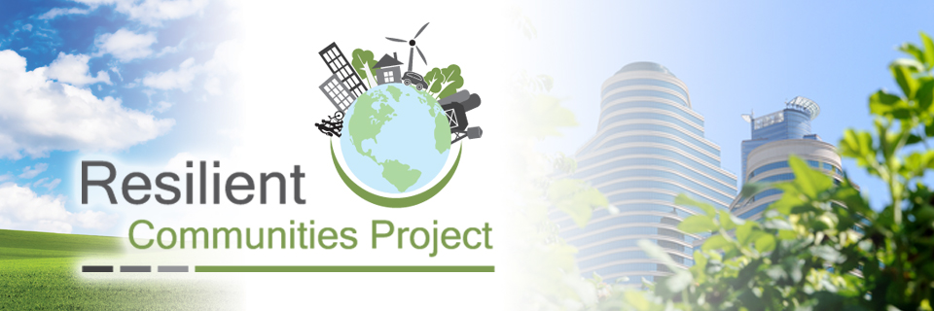
Southwood Nature Preserve
Image from rcp.umn.edu
University of Minnesota Duluth
EnEd 5325: Sustainability Issues Investigation
March 28th, 2014
Bryan Bongey, Amy Hughes, Geneva Martin, Kristen Reich
Notes:
Hi!
Who are we? Background? Relevance to project? What it means?

Slide 2

Sustainability Investigation Issues
Master’s certificate program in Environmental Education
Study an actual sustainability issue
  Have appropriate scope for the time period of this course (fifteen weeks)
Study the issue through the point of making recommendations that will actually influence the resolution of the issue
Continue research from UMD student’s suggested Management Plan for Southwood Nature Preserve

Slide 3
2013: Long Range Management Plan
Reconsider the mission statement of the SNP Task Force
Monitor visiting usage
Incorporate nearby, unprotected Holloway Marsh
Eradicate invasive species
Improve interpretive visuals for nonformal EE
Increase winter recreational use
Erect a shelter

Slide 4

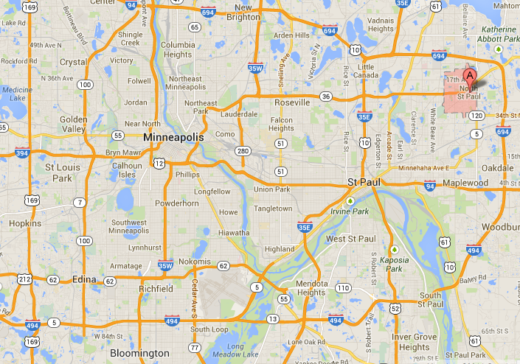
Image from rcp.umn.edu
2013-2014 Community Partner
North Saint Paul
Image from google.maps.com
Notes:
What is the RCP? Why NSP?

Slide 5

North Saint Paul Initiatives
U of MN Departments
Live/work housing
Living streets and capital improvements
Green energy initiative
Neighborhood identities
Fiber optic network development
Community identity and branding
Downtown revitalization strategies
Civic engagement and communication
Environmental education
Redevelopment-ready community
Public art and public history
Master redevelopment plan
Silver Lake trail connection
Community gardens and local food
Staff development and retention
Development of underutilized parcels
Aging in place
Energy conservation initiative
Emerald Ash Borer Management Plan
Bulk Waste Pick-Up Program Evaluation
Documenting the RCP-North Saint Paul Partnership
Stormwater Management
Housing Studies
Civil Engineering
Law School
Communication Studies
Graphic Design
Marketing
Gerontology
Journalism
Architecture
Organizational Leadership, Policy, and Development
Urban and Regional Planning
Public Policy
Environmental Education (UMD)
Design
Environmental Science, Policy, and Management
Forestry
Public Health
Human Resources and Industrial Relations
Social Work
Image from blog.htc.ca
Notes:
Multiple initiative, our focus

Slide 6
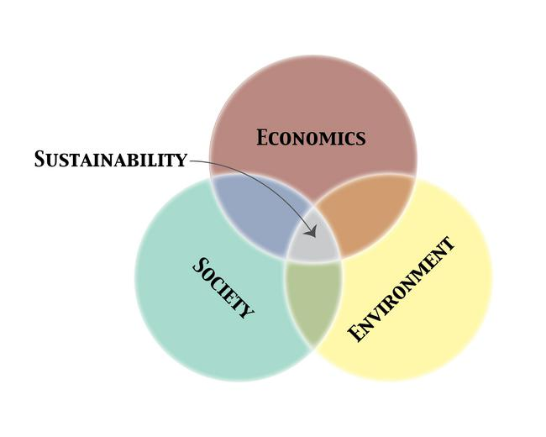
Sustainability
“…development that meets the needs of the present without compromising the ability of future generations to meet their own needs.”
Image from http://serc.carleton.edu/details/images/35878.html
World Commission on Environment and Development (1987) Our Common Future, Oxford University Press, Oxford,

Slide 7
Sustainability
“Sustainability is the goal of sustainable development – an unending quest to improve the quality of peoples’ lives and surroundings, and to prosper without destroying the life-supporting systems on which current and future generations of humans depend. Like other important concepts, such as equity and justice, sustainability can be thought of as both a destination and a journey.”
Parliamentary Commissioner for the Environment (2004) See Change: Learning and Education for Stability. New Zealand Government

Slide 8

Resiliency
“The ability to become strong, healthy, or successful again after something bad happens” and “the ability of something to return to its original shape after it has been pulled, stretched, pressed, bent, etc.”
Merriam-Webster, 2014
Image from youthsectorblog.wordpress.com

Slide 9
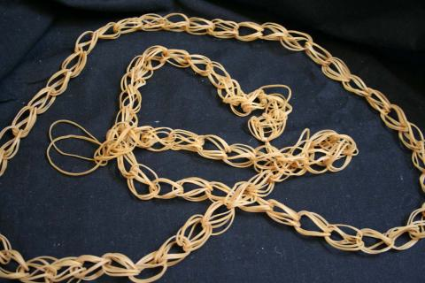
Resilient Community
“He’s a million rubber bands
in his resilience.”
–Alan K. Simpson
“The ability of community members to take meaningful, deliberate, collective action to remedy the impact of a problem, including the ability to interpret the environment, intervene, and move on.”
Community and Regional Resilience Institute, 2013
Image from kathlynn-diary.blogspot.com

Slide 10
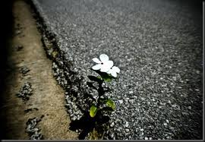
Sustainability & Resiliency
Interconnected and interdependent
Long-term perspective
Adaptive & responsive
Flexible
Collaborative
Image from jennyfinn.com

Slide 11
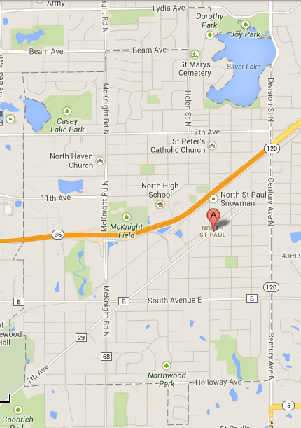
North Saint Paul, Minnesota
Size: 3 square miles
Population: 11,460
Small town feel, proximity to urban development
Rooted in values of community and simplicity
  Open to progress

Slide 12
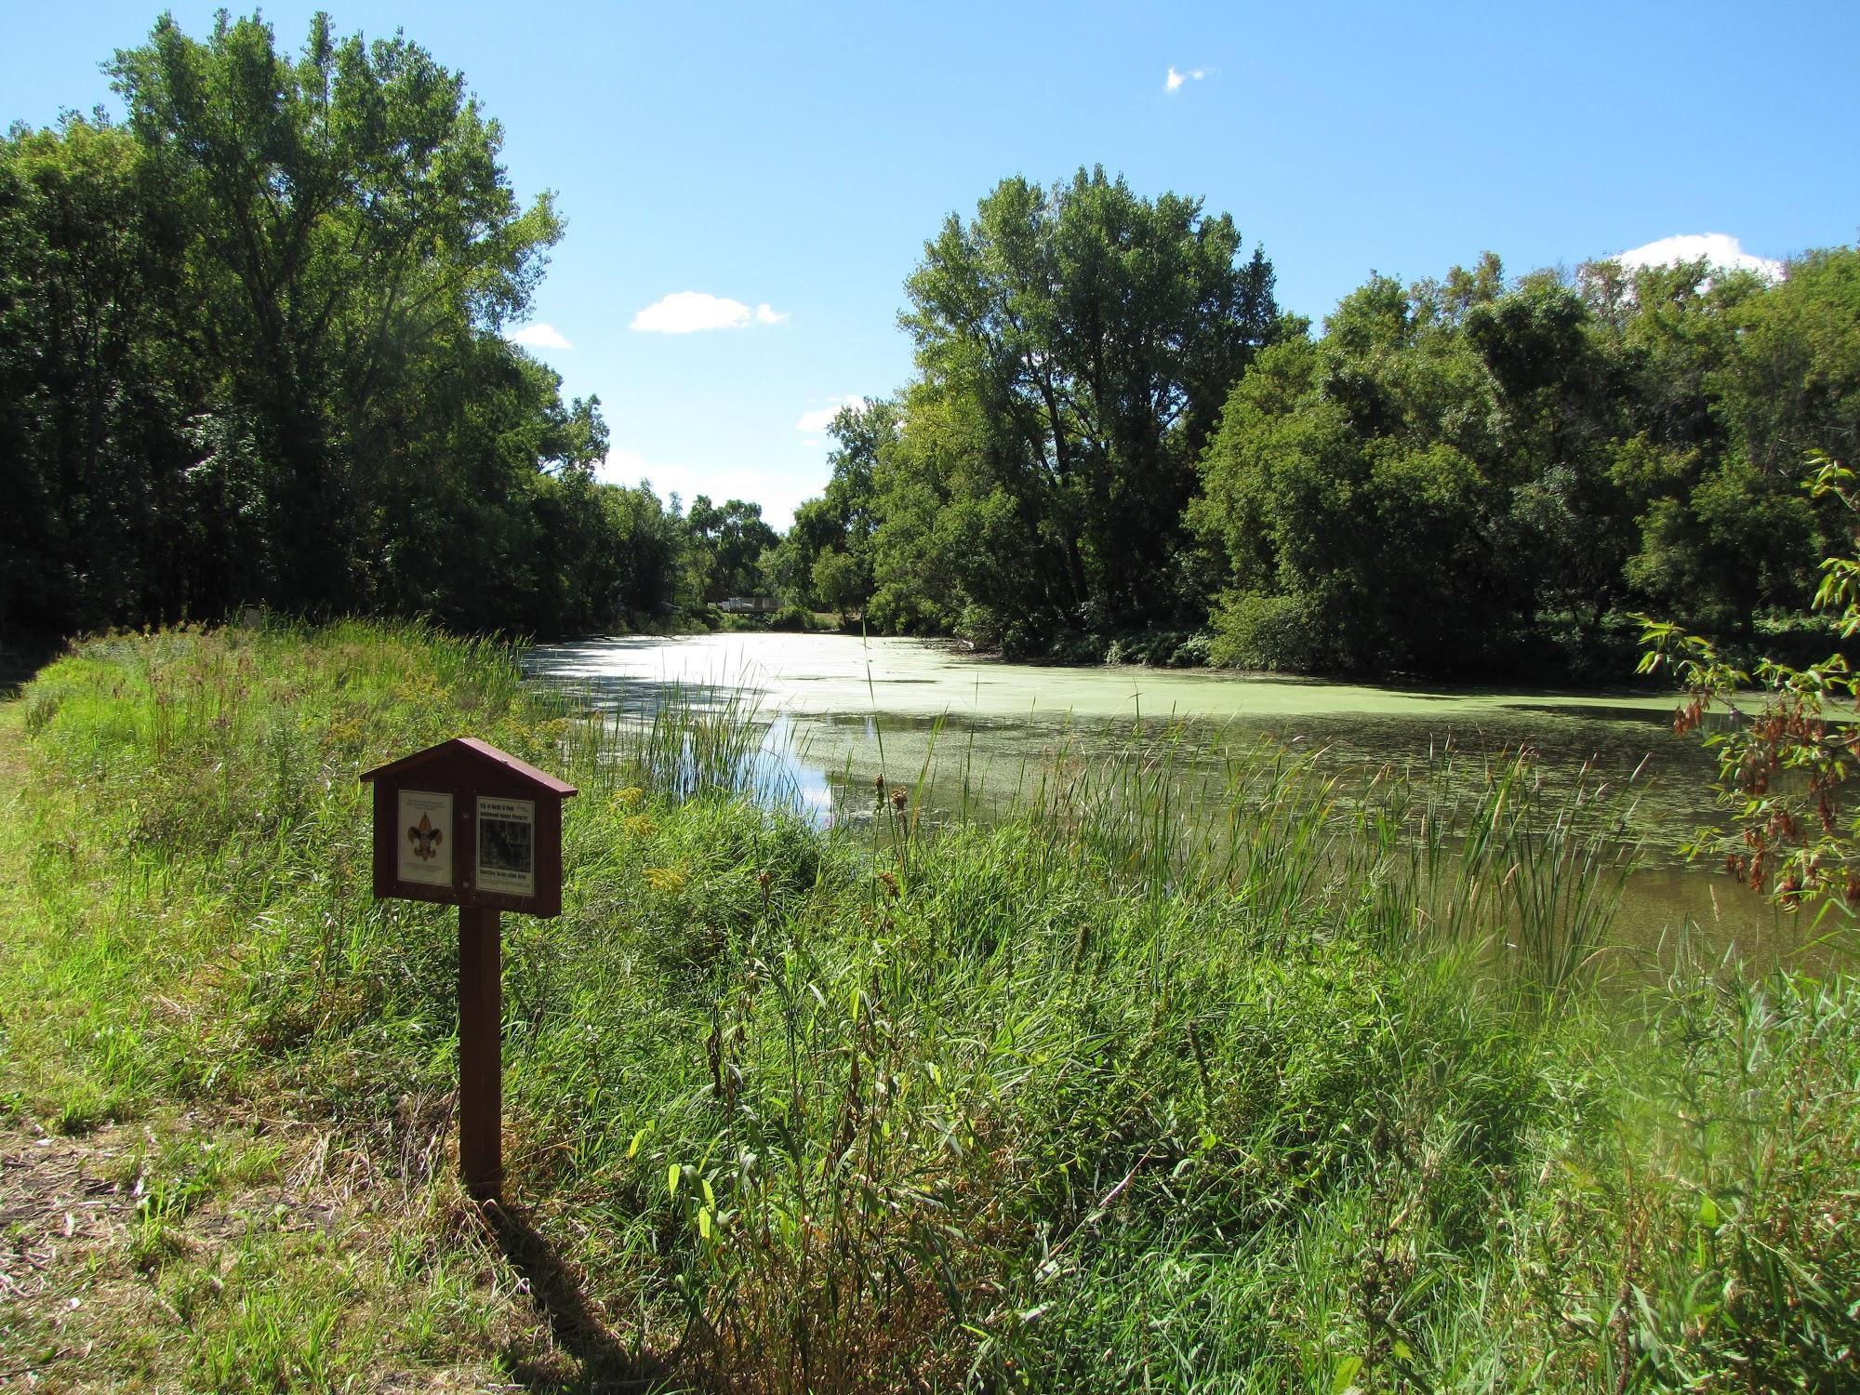
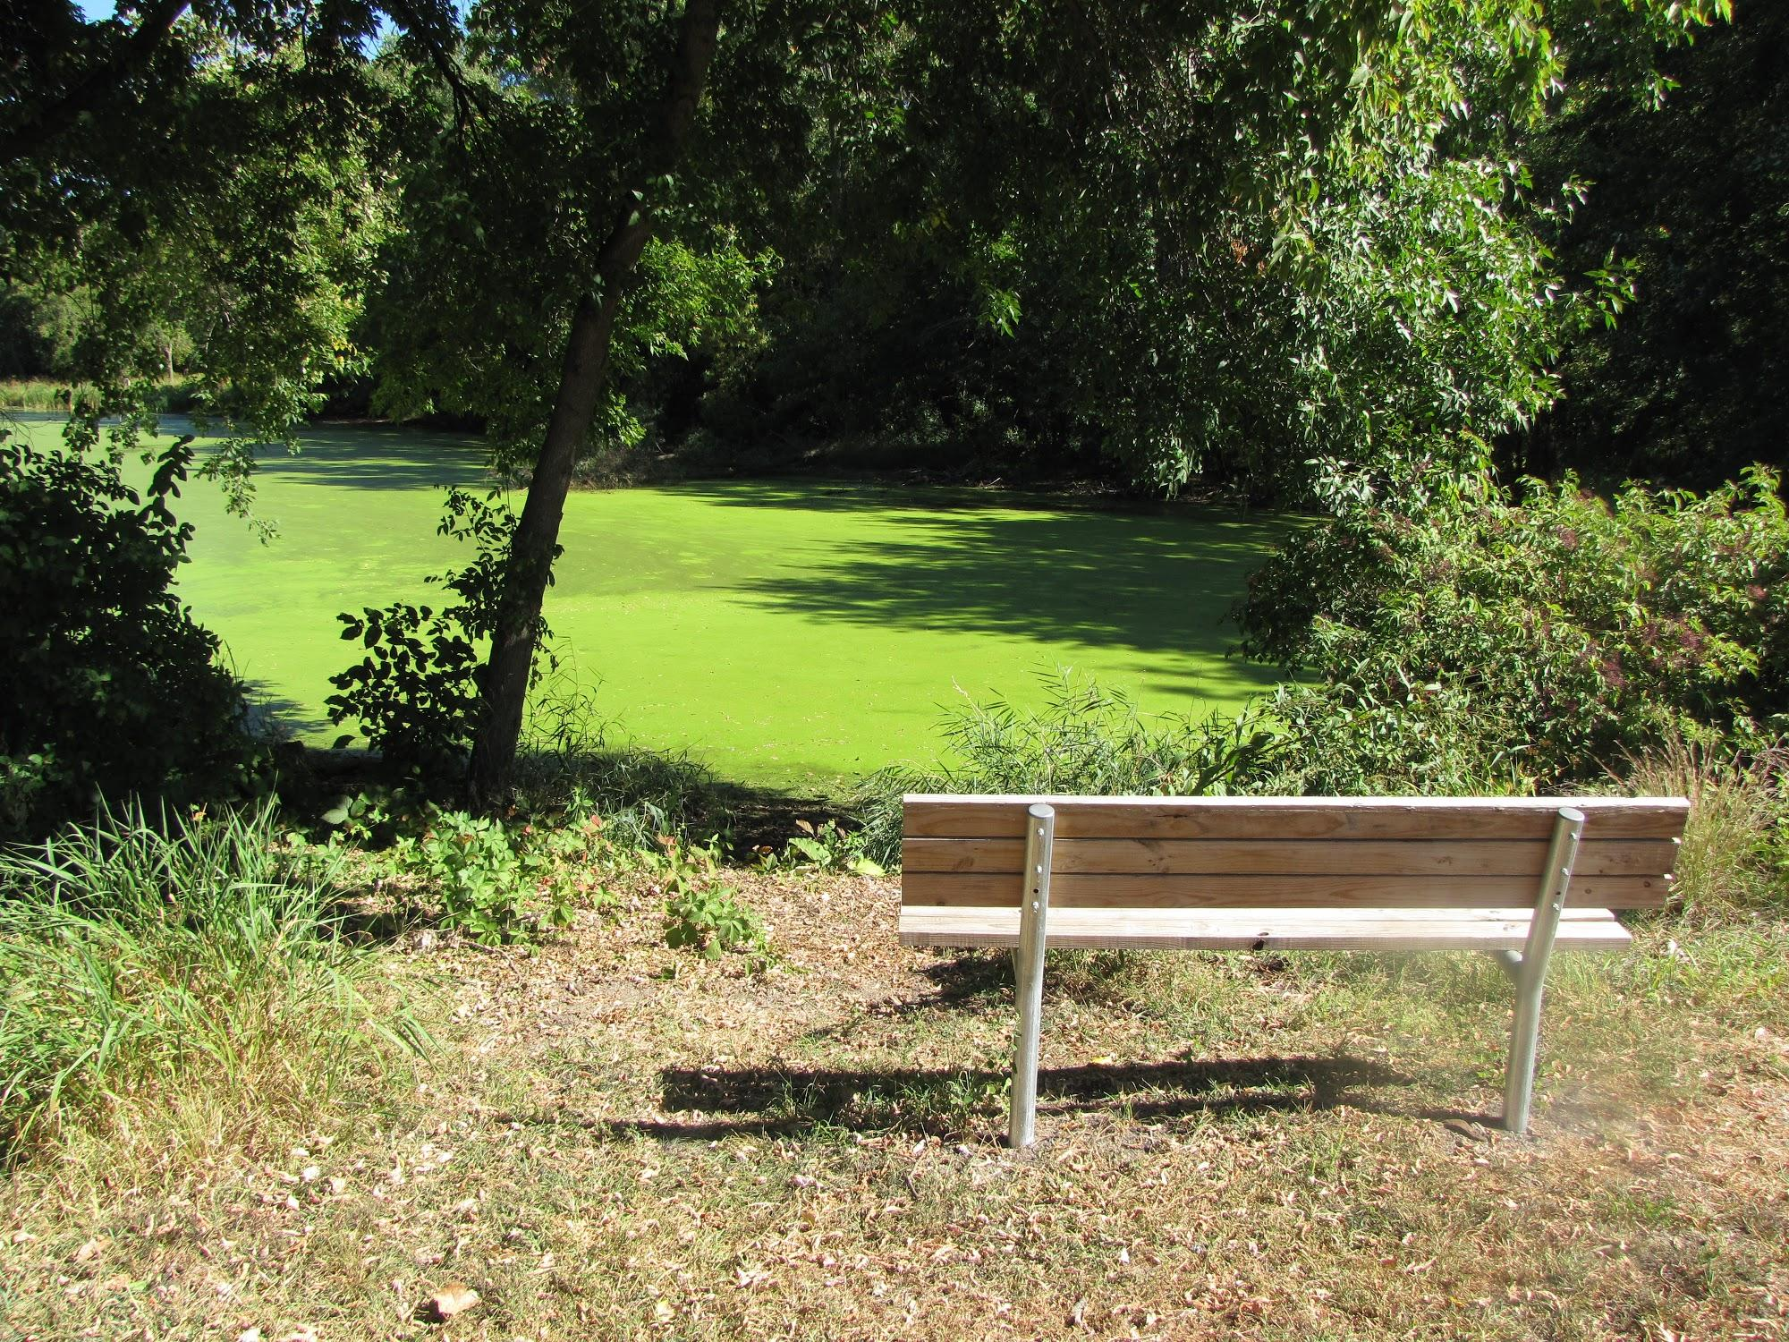
Southwood Nature Preserve:
Environmental Education Initiative
29-acre natural area
  Managed by Parks and Rec Dept.
Habitats
  Wetland
  Restored oak savannah
Visitor Use
  1.5-mile trail system
  Interpretive signs
  Infrequent use by nearby schools
Images from SNP Long-Range Management Plan, 2013

Slide 13
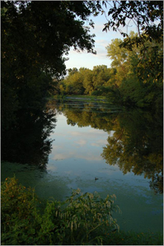
Identification of Issue
Southwood Nature Preserve is a natural, usable space for guests of all ages, but lacks the infrastructure and personnel to support its potential for addressing the environmental concerns through educational pieces.
Image from invasiveplantnews.com

Slide 14
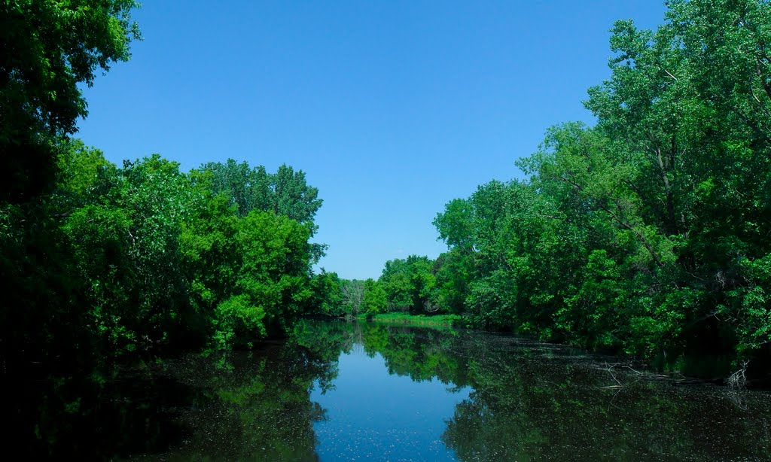
Statement of Purpose
The purpose of this project is to investigate and recommend the best means of education that can enhance the visitor experience, and lead to a sustainable management of the Southwood Nature Preserve.
Image from usa.ugo.cn

Slide 15
Purpose: To create education pieces that…
  Instill a sense of place
  Educate and empower visitors, especially locals, to actively participate in the preserve’s multiple uses.
Foster curiosity, concern
  Illustrate local environmental concerns in nonformal and outdoor education programming.
Share outdoor learning space
  Outreach to more nearby schools, programming will allow students to have ownership and act as stewards of preserve.

Slide 16
Methods and Data Collection
Methods of Obtaining Data
  Literature Review
  Case Study
  Interviews
Methods for Creating Resiliency at SNP
  Community Development
  Education
  Environment
  Recreation

Slide 17
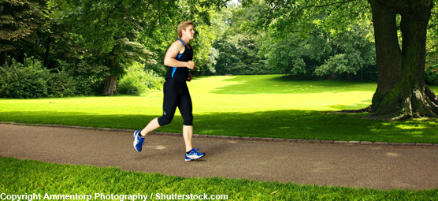
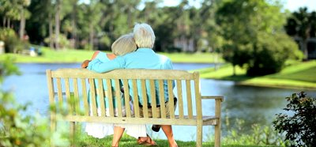
Data Collection
Literature Review
  Enhancing Green Spaces, UK, 2011
Well-managed parks foster:
  More community involvement.
  Better relationships within the community and local councils.
  Citizens that are involved with local green spaces and take pride in them.
Image from economicdevelopment.org
Image from footage.shuttershock.com
Notes:
Enhancing Green Spaces, 2011
Research shows that well managed parks and green spaces have
more community involvement which leads to better relationships within the community and with local councils.
Citizens who were more involved with local green spaces took more pride in the area where they live.
Acts of improving, renewing or even saving a park can build extraordinary levels in a neighborhood
Investigating the impact of interpretive signs, 2011
Qualitative study on how visitors interact with and use interpretive signage.
Visitors voluntarily inquire information at their own pace
Different motivators for reading signs

Slide 18
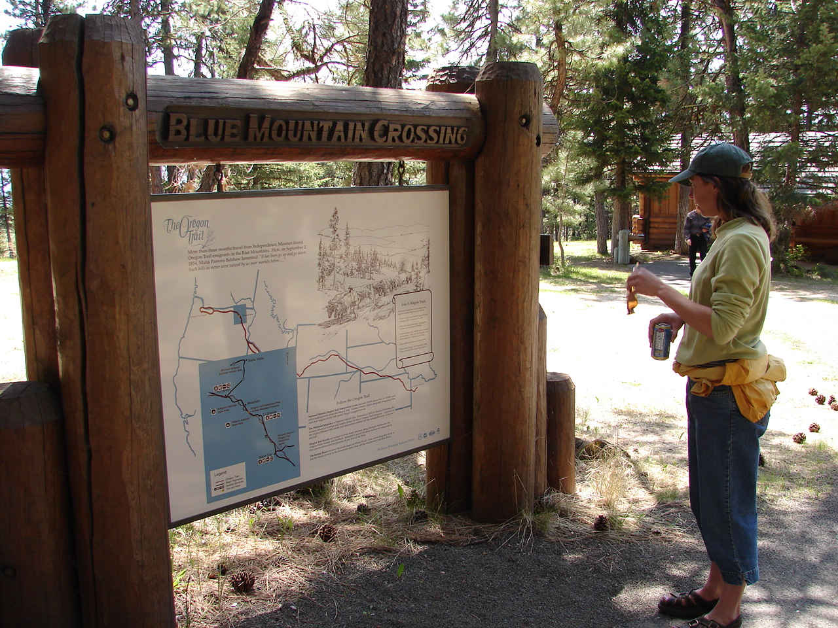
Data Collection
Literature Review
  Investigating the impact of interpretive signs, Colorado, 2006
Visitors are more likely to interact with interpretive signs that:
  Are placed at a resting spot.
  Include sensory, interactive information.
  Reflect the natural environment that is present.
Image from fs.usda.gov
Notes:
Enhancing Green Spaces, 2011
Research shows that well managed parks and green spaces have
more community involvement which leads to better relationships within the community and with local councils.
Citizens who were more involved with local green spaces took more pride in the area where they live.
Acts of improving, renewing or even saving a park can build extraordinary levels in a neighborhood
Investigating the impact of interpretive signs, 2011
Qualitative study on how visitors interact with and use interpretive signage.
Visitors voluntarily inquire information at their own pace
Different motivators for reading signs

Slide 19
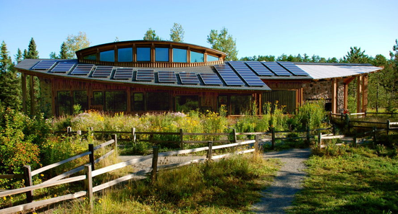
Data Collection
Case Study
  Hartley Nature Center, Duluth, MN
    660 acres; 20,000 visitors each year
Outreach to public with:
  Advertising of space in prominent public spaces.
    flyers, radio, local news
  Online presence with contact network.
    Direct mail, newsletters
Image from mix108.com

Slide 20
Data Collection
Interviews
  Mike Greco, Project Manager, RCP
  Jon Fure, City Project Lead, North St. Paul
  Cathy Troendle, Community member
  Chuck Ericksen, Community development

Slide 21
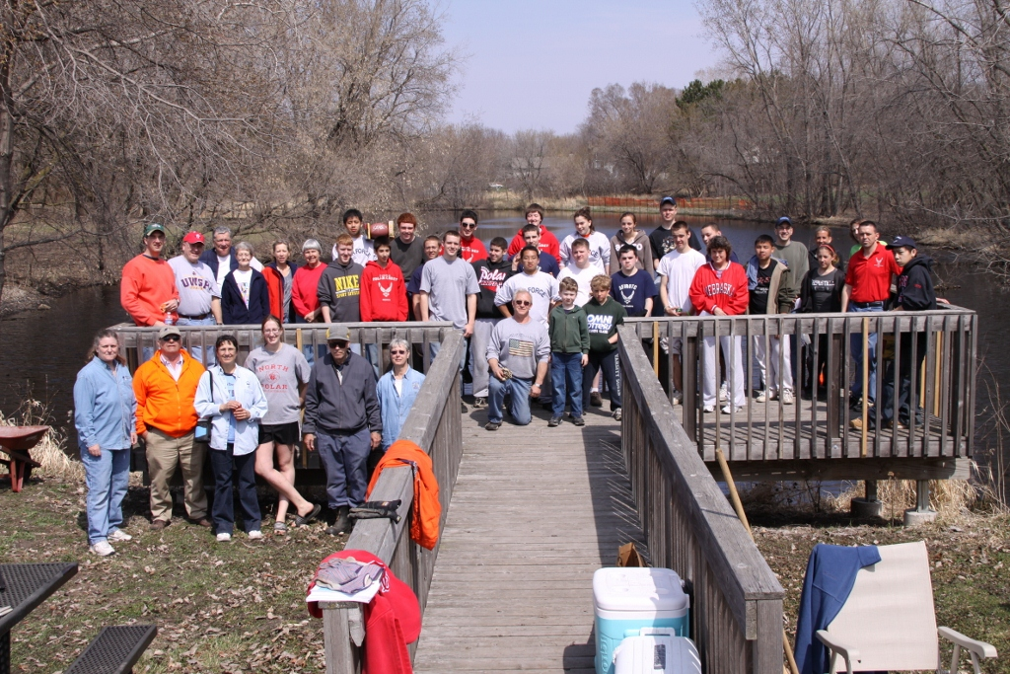
Recommendations for Creating Resiliency for the Southwood Nature Preserve
Education
Community Development
Recreation
Environment
Image from invasiveplantnews.com

Slide 22
Short-Term Recommendations
As we combine and collaborate our findings, we have come up with several recommendations for establishing resilience for the Southwood Nature Preserve. As our focus is environmental education, we hope to incorporate more passive educational methods that visitors can engage with.

Slide 23
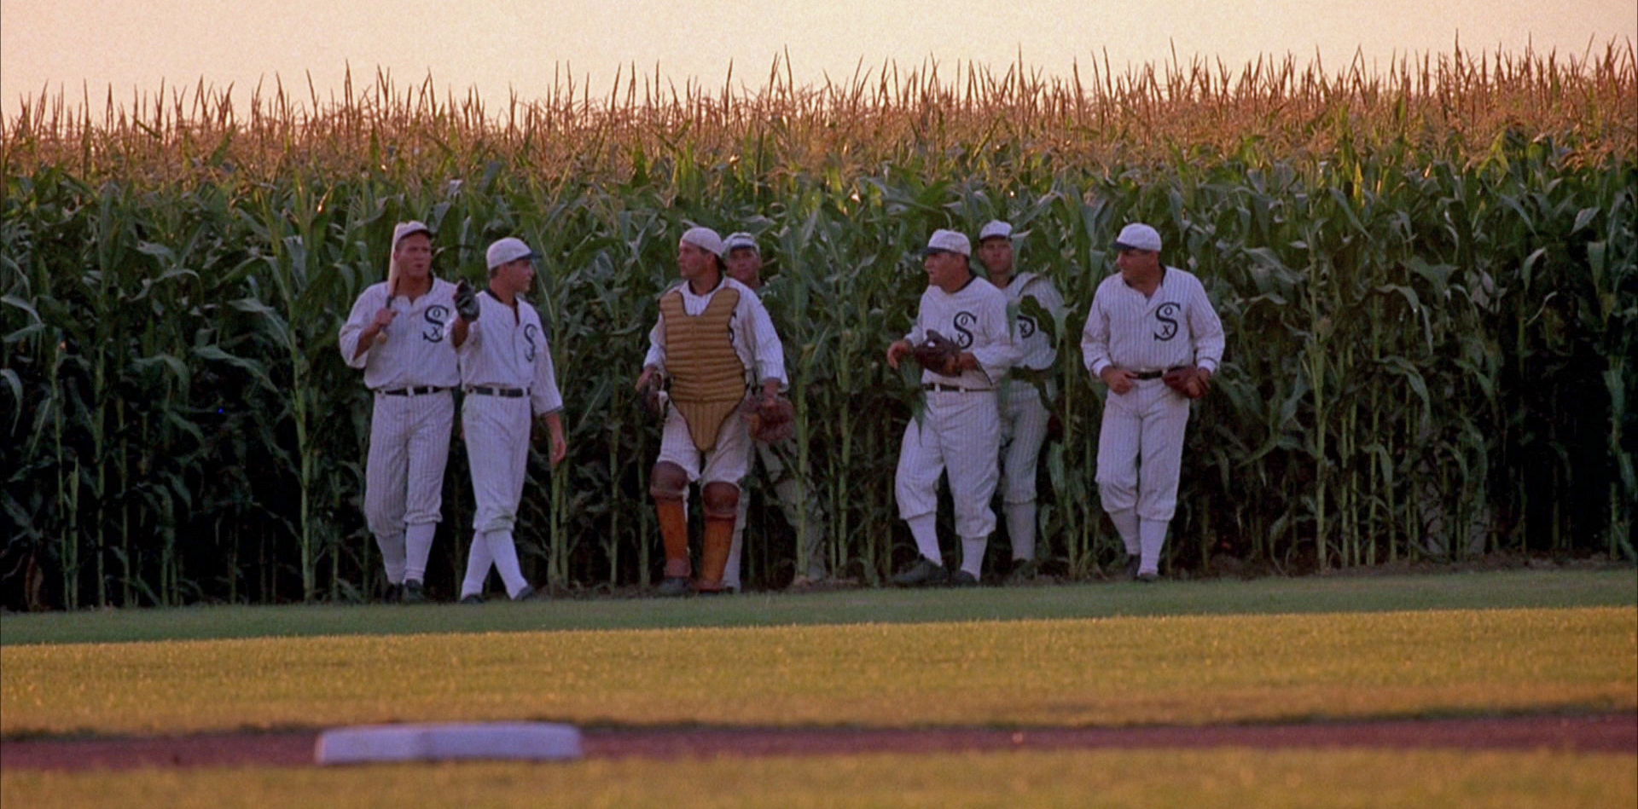
“If you build it,
...he will come.”
Image from divahound.com

Slide 24
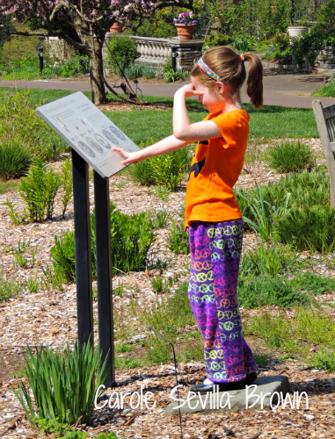
Education is the foundation of resiliency.

Slide 25
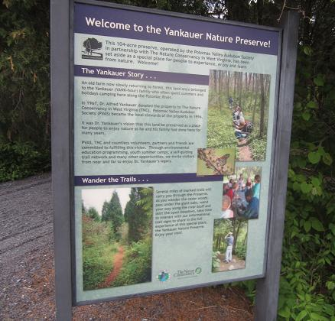
Short-Term Recommendations
Construct a permanent, professional informational kiosk
  Welcome message
  Map
  Information
    History: geologic, cultural
    Habitat
    Wildlife
Image from olddominionwildlife.org

Slide 26
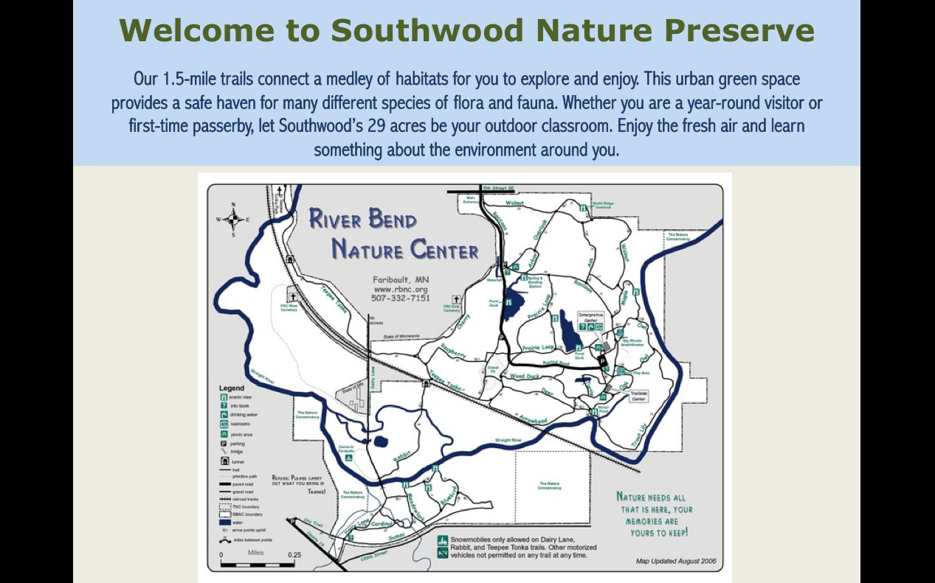

Slide 27
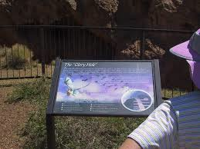
Short-Term Recommendations
Construct interpretive signage at resting places
Informative
  Relevant to surrounding habitat
Interactive, sensory
Easy to approach, read
  Size of sign, font, images
  Accessible
Near benches
Image from olt.org

Slide 28
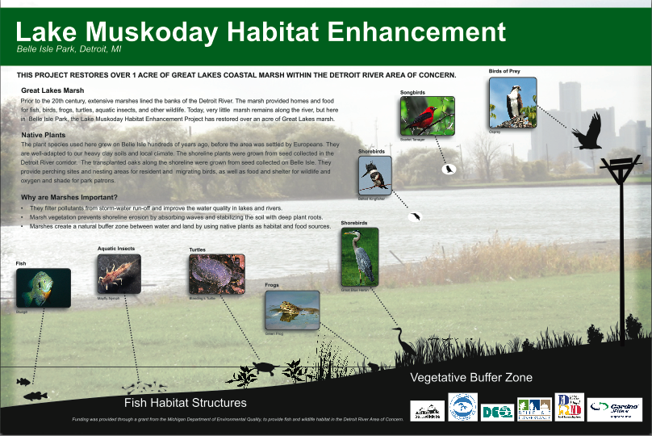
Notes:
Signs can highlight different features of habitat... Flora, fauna

Slide 29
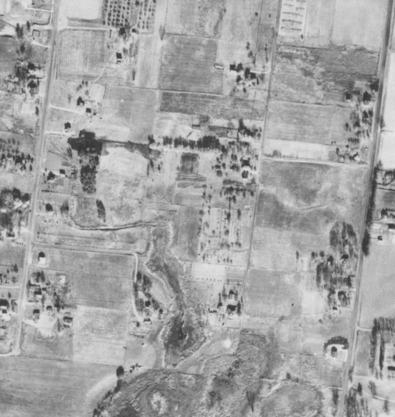
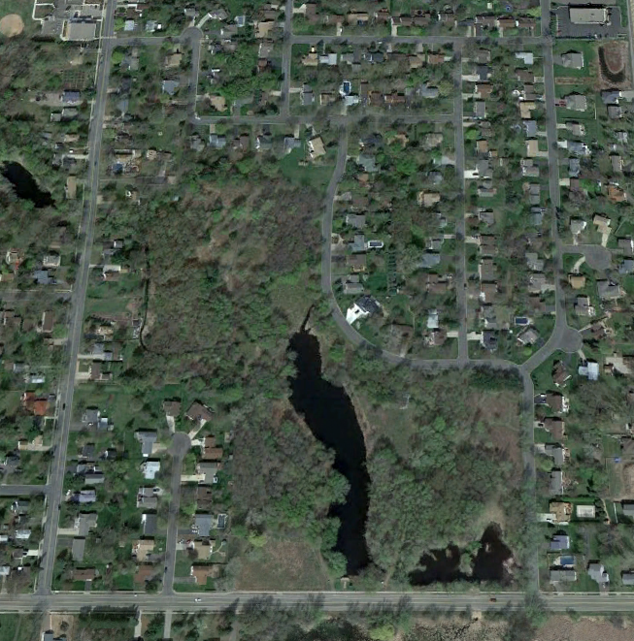
A History of Use
The land that Southwood sits on has a long history. Prior to the establishment of SNP the land itself served as homes to families as well as a dumping ground for the Berwald Roofing Company and the Allan homestead in the early 1960s. On August 16, 1968, a letter to the Berwald Roofing Company and Allan’s family stated that they were no longer allowed to use the land as a dumping site because the city was striving to mitigate water quality problems.
In the 1960s, the 29 acres of Southwood were twelve separate parcels of land, each owned by a different family. In 1969, nine of the parcels were bought through eminent domain, while three of the families refused to sell. Through eminent domain, the government had the right to seize private property for public use with payment or compensation to the land owner.
In the fall of 1970 the remaining three parcels were condemned and acquired for park use.
The funds used to purchase these parcels came from a few different sources including the State of MN Natural Resource Fund Grant, the Federal HUD Grant, and a few other state and federal grants.
1953
2012
Through the last 50 years, a lot has changed at the site of Southwood Nature Preserve. It now provides green space for the local community, learning opportunities for surrounding schools, habitat for the local wildlife, and recreational trails for hiking and observing nature. Enjoy what history has brought us.

Slide 30
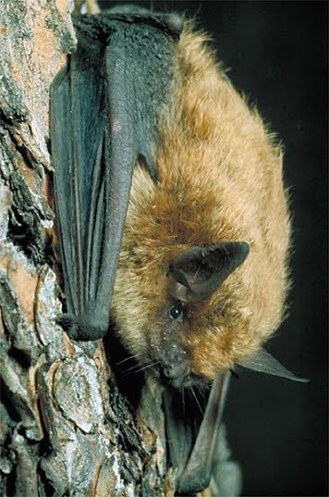
Bats: Nature’s Bug Zappers
Busting Bat Myths!
Bats are not blind; they are not rodents; they do not get caught in people’s hair; no species in North America drink blood; and if left alone, they are completely harmless and highly beneficial to humans. Busted.
Bat Facts
Bats are the most important predators of night-flying insects. A single little brown bat can eat 500 mosquito-sized insects in an hour. Pregnant and nursing bats may eat their own weight in insects each night.
Many of the insects bats eat are major pests. U.S. farmers save an estimated $23 billion per year thanks to the insect control services of bats.
Bat species that hibernate in caves are severely threatened by White-Nose Syndrome (WNS), a fungal disease that has killed over 5.7 million bats.
If you ever find a bat, DO NOT touch it. Follow this rule, and you have very little chance of catching rabies from bats.
By installing bat houses like this one here, you can keep bats out of your home and provide valuable roosts for these useful and fascinating animals.
For more information, visit www.batcon.org and www.whitenosesyndrome.org

Slide 31
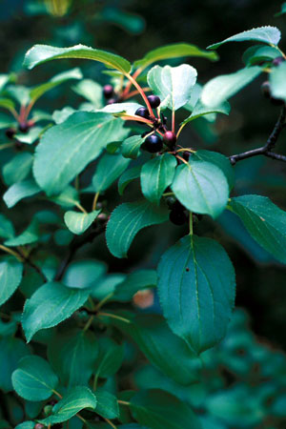
Wanted Dead, Not Alive
Invasive Species: Common Buckthorn & Glossy Buckthorn
Rhamnus cathartica
Frangula alnus
Buckthorn was first brought to Minnesota from Europe as an ornamental shrub and hedge plant in the mid-1800s. It has since become a serious threat to native ecosystems. Now, this invasive species threatens the success of native species because it...
  Creates dense shade that prevents other plants from growing and contributes to erosion by out-competing native plants that stabilize the soil.
  Is extremely hardy and difficult to exterminate. If a stem is cut, new stems will sprout from the stump.
  Releases chemicals into the soil that are toxic to other plants.
No native insects or plant diseases are adapted to attack buckthorn, so there is nothing to curb its growth or stop it from spreading. Also, seeds may remain dormant for up to 7 years before sprouting; areas where buckthorn has been removed must be monitored afterward to ensure that buckthorn does not regrow.

Slide 32
Short-Term Recommendations
Distribute a site-specific educational field guide
  For local schools to use in guided, instructional field trips to the SNP
  Follow the SNP trail systems
  Age-appropriate information with an example activity at designated areas
  Examples – Audubon Center of the North Woods and Camp Widjiwagon
Contract temporary naturalist(s) from other local park districts

Slide 33
Recommendations for Creating Resilience at Southwood Nature Preserve
Once these small scope recommendations are met and implemented, we hope that the directors of the Southwood Nature Preserve continue to evaluate and address the park’s current status and its future capabilities in order to evolve with and sustain community resiliency.
Notes:
G

Slide 34
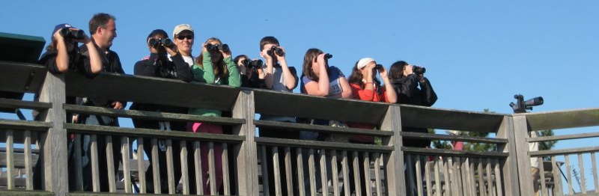
Education: Long-Term Recommendations
Create nonformal education events
Hire Staff
  Help with school and community events
Image from cmboviewfromthecape.blogspot.com
Notes:
Evaluate by
Implement two monthly evening or weekend educational hikes at Southwood.
Hired staff facilitate and lead weekend education programming.

Slide 35
Community Development:
Long-Term Recommendations
Expand partnerships
  Increase schools’ use of the SNP
  Incorporate other Park Districts
  Collaborate with U of M Naturalist Program
Work with the North St. Paul Commissions
  Create measurable objectives in context to the Parks and Recreation Department
Create an online presence
Neighbor outreach
  Distribute survey to locals about knowledge and usage of the park
  Offer mailing and “comments” sections at kiosk for visitors to voluntarily engage
Notes:
Evaluate by
Increase to 4 schools that use SNP as outdoor classroom
Create community partnerships
Create 3 volunteer educator positions for University of Minnesota Master Naturalists to fill
Facebook presence
Increase park use across the seasons by 25%.

Slide 36
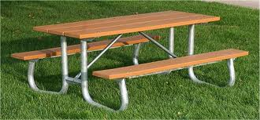
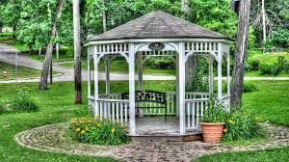
Recreation: Long-Term Recommendations
Increase number of leisure structures
Assess seasonal recreation and trail maintenance
Image from abundantearth.com
Image from panoramio.com
Notes:
Evaluate by
Construct 5 new benches.
Construct 1 gazebo that overlooks the pond, opposite to the viewing deck.
Picnic areas host at least 2 events per month.

Slide 37
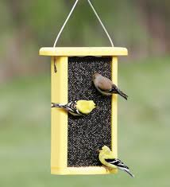
Environment: Long-Term Recommendations
Monitor the presence and disturbance of invasive species
Monitor the water quality
Address and implement pet policy
Build more trash and recycling receptacles
Construct feeders for wildlife
Image from duncraft.com
Notes:
Evaluate by
Treat 50% of areas affected by invasive species
Monthly water quality testing
Little to no guest comments about presence of litter and pet droppings
Guest at SNP comment that birding is main motivation for visiting in guest book

Slide 38
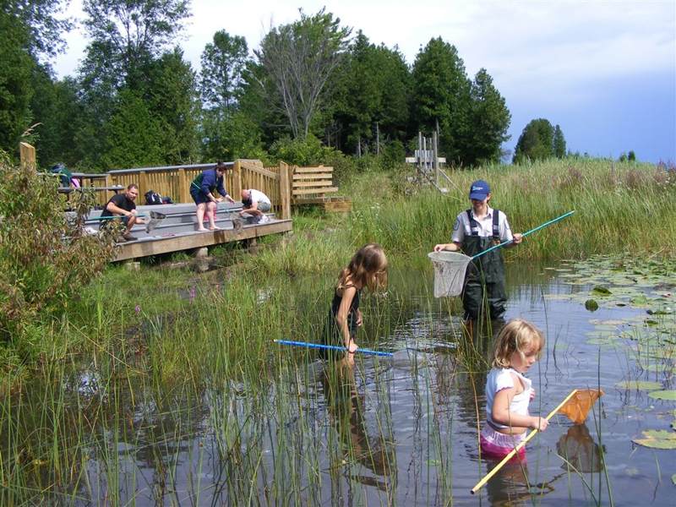
“Come forth into the light of things, let nature be your teacher.”
-William Wordsworth
“People underestimate their capacity for change There is never a right time to do a difficult thing. A leader’s job is to help people have a vision of their potential.” – John Porter
“Never doubt that a small group of thoughtful, committed citizens can change the world. Indeed, it is the only thing that ever has.” –Margaret Mead
Image from parkreports.com

Slide 39


Image from rcp.umn.edu
Thank You!
Image from rcp.umn.edu
Image from d.umn.edu
Notes:
City of North Saint Paul & Resilient Communities Project
Mike Greco, Project Manager, RCP
Jon Fure, City Project Lead, North St. Paul
Ken Gilbertson, University of Minnesota Duluth
YOU!

Slide 40
Southwood Nature Preserve
Image from rcp.umn.edu
University of Minnesota Duluth
EnEd 5325: Issues and Investigation
March 28th, 2014
Bryan Bongey, Amy Hughes, Geneva Martin, Kristen Reich
Notes:
Hi!
Who are we? Background? Relevance to project? What it means?

