Slide 1

Zero-Commute Futures: Opportunities for Live/Work Housing in North Saint Paul
May 2014 Final Report
Compiled by
Erin Olson and Michael Urness
Notes:
Michael

Slide 2
A Profile of Live/Work Housing
Live/Work Types | Description | Unit Size | Lot Size for Development | Compatible Districts
Live-With | Residential and workspace are one and the same | 800 - 1,500 square feet | 25,000 - 700,000 square feet | Central Business District; Diversified District
Live-Near | Residential and workspace separated by wall or ceiling | 800 – 3,000 square feet | 35,000 – 700,000 square feet | Diversified District
Live-Nearby | Residential and workspace in separate structures on same lot | 800 – 3,000 square feet | 35,000 – 700,000 square feet | Diversified District
Notes:
Erin

Slide 3
Selling Points of Live/Work
It is affordable
It saves time
It matches the needs of changing demographics
It matches popular urban design features
It is flexible
It is environmentally responsible
It fosters economic development and diversifies local economies
It brings vacant and underutilized spaces back onto tax rolls
It creates positive externalities in the community
Notes:
Michael

Slide 4
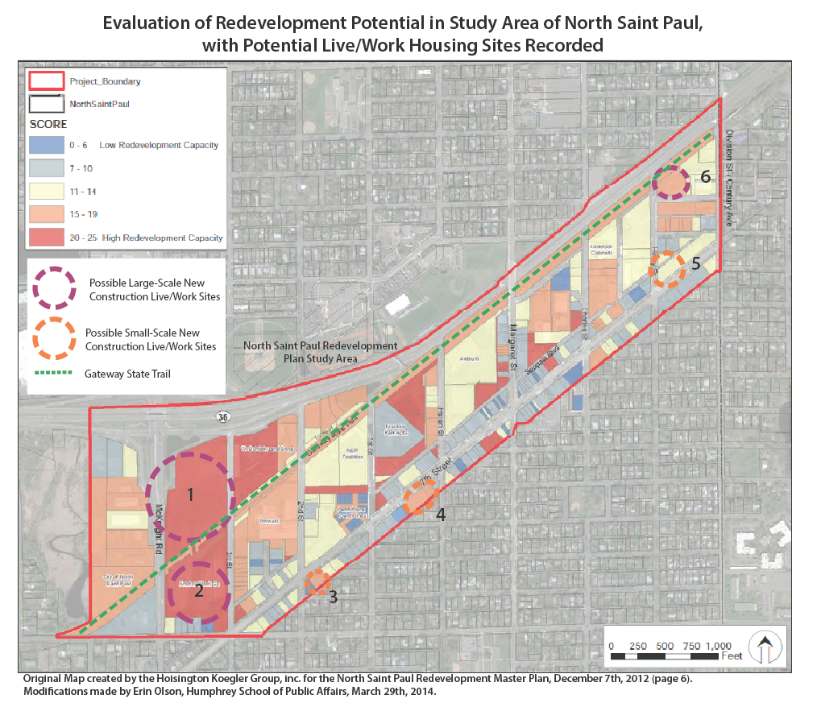
Selecting an Appropriate Site
Notes:
Erin

Slide 5
Case Studies
The Arcade, Providence, RI
Park East Enterprise Lofts, Milwaukee, WI
Greenpoint Manufacturing and Design Center, New York, NY
Schmidt Artist Lofts, Saint Paul, MN
Pinetree Studios, Oakland, CA
The Lofts at Habersham, Beaufort, SC
The Elgin, Elgin, IL
Jackson Flats, Minneapolis, MN
Franklin Arts Center, Brainerd, MN
653 Galtier Lofts, Saint Paul, MN
Chicago Ave Fire Arts Center, Minneapolis, MN
Notes:
Michael

Slide 6
Case Studies
The Arcade
(pg. 20)
  Tenants: 48 residential, 25 commercial
  Reclaimed underutilized structure
  Low-cost live-near housing in the heart of the city
Park East Enterprise Lofts (pg. 21)
  Tenants: Mix of low-income and market rate, business owner and strictly tenant
    85 total units, 28 live/work
    Live-Near lofts
  Brought foot traffic and commercial to blighted area
Notes:
Michael

Slide 7
Case Studies
The Lofts at Habersham (pg. 25-26)
  Tenants: 33 Market rate rental and owner-occupied
  Flexhouse live-near model on a mainstreet
  Adaptability of use in changing economic climates
The Elgin
(pg. 27-29)
  Tenants: Low-Income Artists (100% LIHTC), 55 live-with units
  “Shining star” development in small community outside of Chicago
  Significant support from the City made the development possible
Notes:
Erin

Slide 8
Case Studies
Jackson Flats (pg. 30)
  Tenants: Low-Income Artists (100% LIHTC), 35 Live-With Units
  Municipal buy-in can make or break the success of live/work development
  The most promising opportunities are still prone to unforeseen challenges
Franklin Arts Center (pg. 31)
  Tenants: Low-income artists (100% LIHTC) and mixed-income artists studios
    25 units (plus 25 working studios), Live-With and Live-Near
  Strong community support and diverse, local funding partners make for strong projects
Notes:
Erin

Slide 9
Funding and Financing Live/Work Housing
Most often it is municipalities that approach developers to build live/work housing
Funding Sources
  Low-Income Housing Tax Credits
  Minnesota Housing Finance Agency
  Local Redevelopment Authorities
  Tax-Exempt Bonds
  Non-Profits
Notes:
Erin

Slide 10
Zoning Requirements for Live/Work Housing
Diversified District and CBD well-suited for live/work housing
Examples of potential revisions:
  Give preference to less restrictive when residential and commercial codes in conflict
  Exempt sleep spaces in lofts from emergency egress requirements
  Higher densities in live/work developments
  Exemptions to fee structures (permitting, pre-development contract, PILOT) or reduce acquisition price
Notes:
Michael

Slide 11
General Considerations Regarding Live/Work Housing
Affordable, stable space
  Physically appropriate for intended businesses
Governance structure
  Exists to encourage involvement and manage potential conflicts
Active internal communities
  Driven by key leaders
Building features
  Anchor tenants and programs that tie the buildings to the community
Geographic connectivity
  Relationships with community amenities that complement the live/work lifestyle
Notes:
Erin

Slide 12
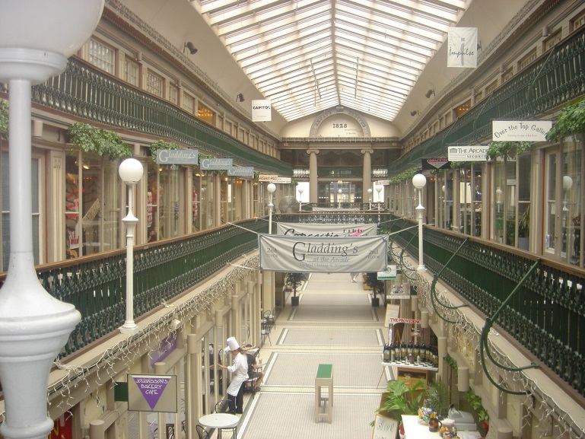
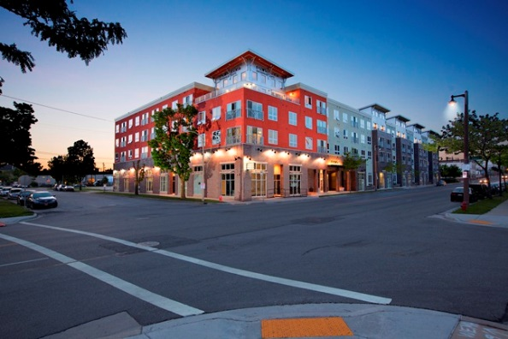
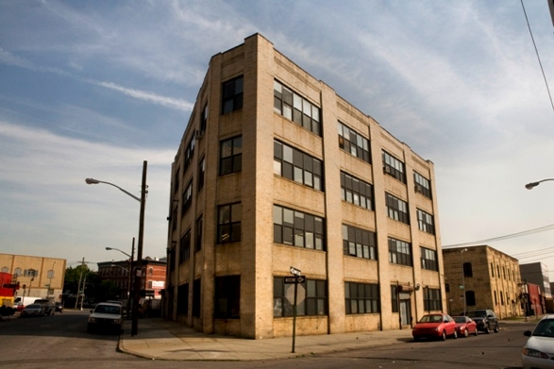
Conclusion
Comments
Questions
Discussion
Notes:
Michael

