Slide 1

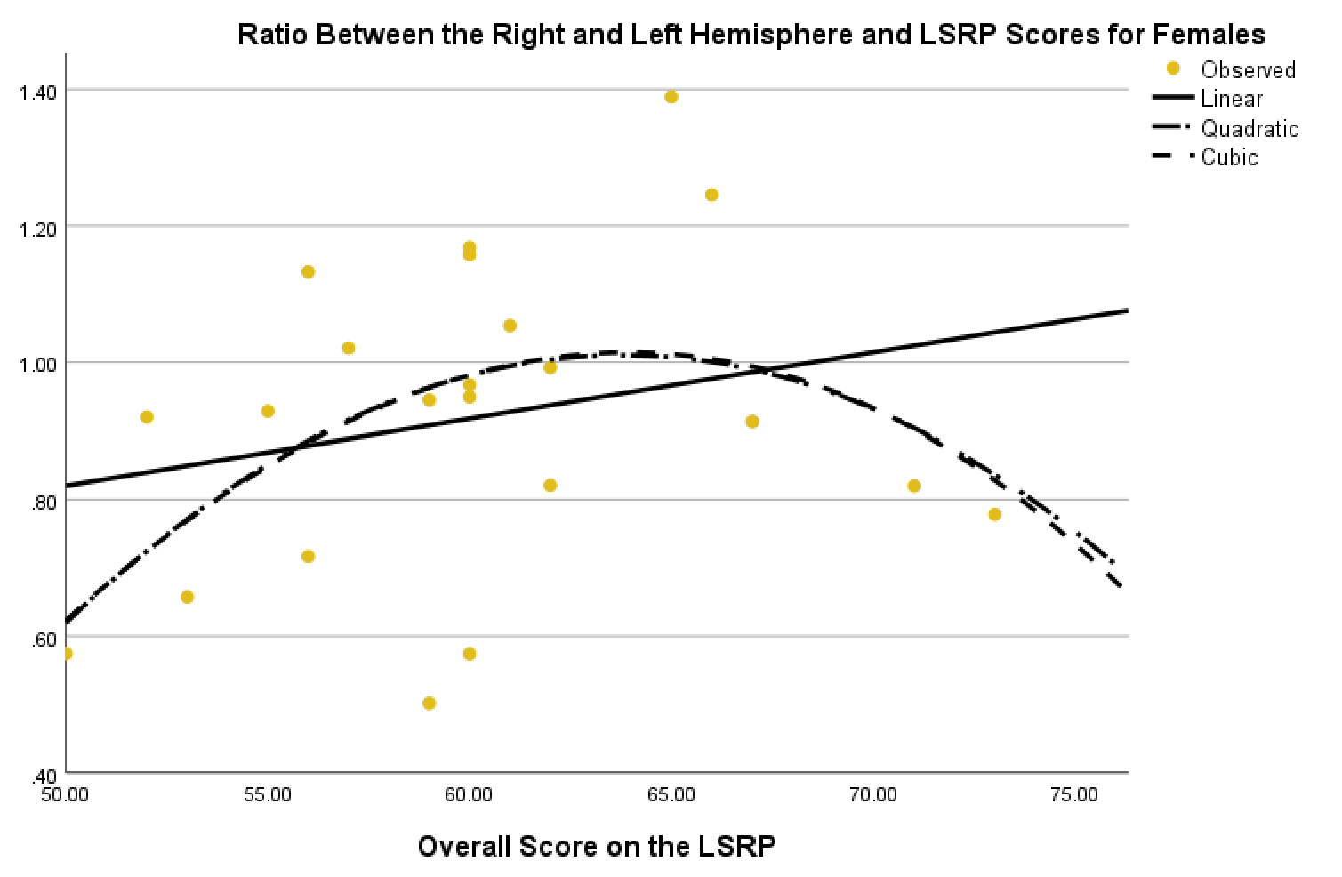
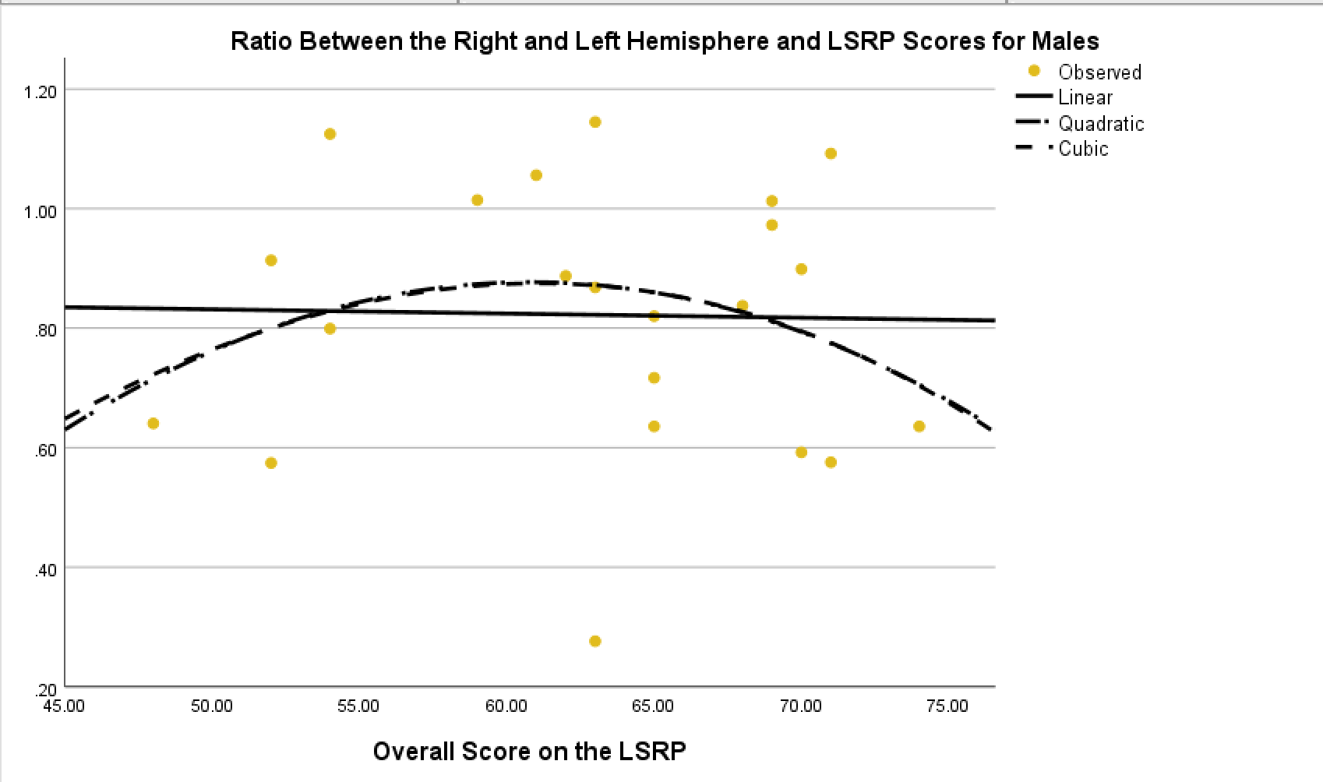
Sex Differences in the Relationship Between Psychopathy and Cerebral Lateralization During Empathic Challenge.
Gavrielle J. Gunther, Robert. L. Lloyd Ph.D., Ryan J. Hjelle M.A.
Department of Psychology, University of Minnesota Duluth
Introduction
Hypothesis
Results
The right hemisphere has been associated with feelings of disgust and negative affect while the left hemisphere is involved in happiness and other positive emotional responses (Robinson and Price, 1982).
Asymmetry in frontal cortex activity in response to emotionally-valanced stimuli has been interpreted as reflecting hemispheric specialization for processing positive and negative emotions: Left, positive affect; Right negative affect (Davidson et al, 1990).
Hemispheric specialization for processing positive and negative emotions:
Left, positive affect; Right negative affect
It is suggested that each hemisphere undergoes contralateral inhibition from the other hemisphere in the regulation of affect and that damage to or inhibition of one hemisphere results in a release from contralateral inhibition leading to exaggerated affective states.
Davidson et. al. (1990) reported that there is a bias toward right-sided anterior temporal activation in over 70 percent of participants when subjected to films displaying disgust, compared to films portraying a positive condition.
Papousek et al. (2019) report that high trait positive affect was associated with left lateralization during a simulated examination, whereas low positive trait affect was associated with right lateralization. Since the examination was oral in nature, there may be a social factor involved in these relationships.
Low positive trait affect was associated with right lateralization
De Pascalis et al. (2013) report that dispositional optimism and behavioral activation positively relate to anterior left hemisphere bias. But dispositional optimism was associated with a right bias in the dorsal posterior cingulate cortex.
Under a simulated examination task, lateralization was related to trait-positive affect (Papousek et al., 2019).
Scores on the Levenson Self-Report Psychopathy scale will be negatively correlated with the left-to-right alpha ratio, during exposure to the video, indicating less distress to the video as psychopathy scores increase.
I further hypothesize that this relationship will be strong and significant in female participants, but weak and non-significant in male participants, thus demonstrating a difference in processing social/emotional stimuli in males and females.
The correlation between LSRP scores and the left to right hemisphere ratio was not significant in females (p = .394 [-.199, .623]).
The correlation between LSRP scores and the left to right hemisphere ratio was not significant in males, p = .919 [-.432, .337].
There was a non-significant relationship that showed females had a stronger LSRP and left-to-right alpha ratio (R² = 0.060, linear; R² =0.207, quadratic., see figure 1) compared to males R² = 0.001, linear; R² =0.052, quadratic., see figure 2), but significance was not reached.
Measures
EEG cap
Places onto the participant’s scalp for recording from areas F3 and F4.
Grass 122 AC amplifiers (3-30hz bandpass) were used to acquire the electrophysiological signals.
EKG and EOG
Heart rate and eye movement were recorded and used to detect artifacts in the EEG.
BioPac MP150
Digitized at a rate of 1,000 samples/sec per channel using a BioPac MP150 analog-to-digital converter.
Demographics Questionnaire
Items on the demographics questionnaire included age, gender identity, sex assigned at birth, race, major, and average GPA.
Levenson Self-Report Psychopathy Scale
Participants completed the 26-point scale which was comprised of two separate portions. Averages were then computed for both females and males.
Procedures
Baseline cortical activity was recorded for five minutes while the participant was seated in a chair.
Subsequent recordings were taken while the participant watched a four-minute, 47-second video of a traumatic arm amputation on a 15.5-inch LCD monitor approximately 60 inches from the subject.
For treatment recordings, spectral analysis was computed for each of the ten thirty-second consecutive epochs and the amount of alpha activity in each epoch was summed across the ten epochs.
The ratio of alpha activity in the left and right hemispheres was calculated for both the treatment condition.
Figure 1
Figure 2
Reject Hypothesis One, No significance between LSRP scores
and left-to-right alpha ratio.
Reject Hypothesis Two, No significance between males and females.
Participants
Discussion
Participants consisted of 23 females, 22 males and one individual who did not indicate sex assigned at birth, who were recruited via SONA at the University of Minnesota Duluth.
Eighty-nine percent of the participants indicated they were Caucasian.
Two percent indicated they were black or African American. Another
Two percent indicated that they identified as two or more races.
Six percent indicated they were another race not indicated on the survey.
Furthermore, we were unable to support our hypotheses asserting a negative correlation between LSRP and left-to-right alpha ratio. Furthermore, unable to statistically detect a significant relationship between the variables among females. However, a strong quadratic effect, while non-significant, replicates a similar strong quadratic, yet non-significant, effect detected in an earlier study.
To alleviate this problem this study will plan on combining participants from this study (n = 46) with a previously done study that collected the same data and then re-evaluate the data and re-run the regression analysis (quadratic and linear).

