Slide 1
Engagement:
Outreach librarianship and connecting with your community
Katherine Chew
Research/Outreach Services Librarian
Health Sciences Libraries
University of Minnesota
Notes:
Outreach librarian University of Minnesota

Slide 2
Agenda
Defining “outreach”
Why Do Outreach
Different Flavors of Outreach
Planning for Outreach
Evaluation / Assessment

Slide 3
what is “outreach”?
Notes:
What is Outreach?

Slide 4
What is “Outreach”?
out·reach
noun
noun: outreach
1. the extent or length of reaching out.
an organization's involvement with or activity in the community, especially in the context of social welfare.
  "her goal is to increase educational outreach"
verb
verb: outreach; 3rd person present: outreaches; past tense: outreached; past participle: outreached; gerund or present participle: outreaching
1. reach further than.
Notes:
Dictionary definition of outreach
Wikipedia
Outreach is an activity of providing services to any populations who might not otherwise have access to those services. A key component of outreach is that the groups providing it are not stationary, but mobile; in other words they are meeting those in need of outreach services at the locations where those in need are. In addition to delivering services, outreach has an educational role, raising the awareness of existing services.

Slide 5

What Is “Outreach”?
Notes:
Library centric definition of outreach
“Draw a circle around the central or main library building–every library service, program, or library-related endeavor taking place outside that circle is outreach.”
-Scott Pointon (Public Libraries, 2009)
“Generally, an outreach librarian is responsible for ‘reaching out’ to a library’s clientele to actively educate them as to the services a library may offer, as opposed to passively waiting for them to come to the library.”
-Mitch Fontenot (College & Research Libraries News, 2013)
Hennepin County: Outreach services
Outreach services bring the library to anyone facing barriers, strengthening individuals and families, improving quality of life, creating community, and increasing understanding of library resources.
Outreach is not limited to a library setting, instead outreach tends to be defined by the specific activities undertaken by librarians and others vested in the public’s social and health well being as they attempt to reach beyond the boundaries of their traditional onsite services and address the problems or needs of a targeted clientele.
Marketing: Promotion of library programs & services; a one-way message
Outreach: Providing library programs & services outside the building(s) in the place & manner that works best for the community; a two-way interaction
Community Partnerships: Creating programs or services collaboratively with a partner to further mutual goals; a rich, ongoing relationship
Community Engagement: All of the above

Slide 6
What Is “Outreach”?
Extending services to support local groups, such as veterans or homeless
Creating a information web portal
Exhibiting at a local community fair
Targeting programs to senior citizens
Partnering with a local public school
Partnering with a specialty library
Community Outreach
Notes:
[Community outreach]
People use the word outreach to describe a wide range of activities, from actual delivery of services to dissemination of information.
Outreach is most often designed to accomplish one of the following (or some combination):
Community outreach describes services to users external to the institution – for example the homeless, veterans, community groups. Reaching out to community members (internal or external) to meet an information need and/or promote the library’s resources, services or existence, with the intent of developing a long-term relationship with those community members.
Outreach is most often designed to accomplish one of the following (or some combination):
What opportunities support the mission and vision of your institution/library?
Understanding what outreach means is the first critical step in a successful outreach program. All parties involved need to have a clear understanding of what outreach means to that institution/library.

Slide 7
What Is “Outreach”?
Office hours off-site or in the academic unit
Teamwork with another librarian in an overlapping subject discipline
Be embedded in courses or provide input into curriculum development
Supporting college/department special events
Sit on college/departmental communities
Co-teaching, teaching a departmental credit course
Liaison Outreach
Notes:
Outreach services may also be provided to those within an academic library’s home institution, whether students, faculty, staff administrators, laboratory researchers, or clinicians.
What opportunities support the mission and vision of your institution?
The exercise of carefully considering goals and objectives and using this knowledge to craft a definition of outreach for a library is a valuable one. A thoughtful definition clarifies the focus and simplifies the selection of activities.
A library’s definition of outreach should be the basis of a strategic plan for outreach. A comprehensive outreach plan should include detailed goals and objectives, assessment and evaluation methods and a marketing strategy.
Critical that the librarians conducting outreach are clear about the library’s outreach definition and that they ensure that the outreach efforts are consistent with the goals of the library’s outreach program and the mission of the library.

Slide 8
WHY DO OUTREACH?

Slide 9
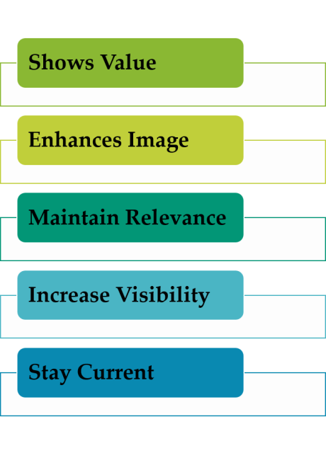
Why Do outreach?
Notes:
Mission statement of the institution / the audience that the outreach would be targeted to …
What are some common reasons for outreach?

Slide 10
Why do outreach?
Goals of an Outreach Program
Outreach should help to reduce …..
Outreach should help to establish the library as …
Outreach should ……
Outreach to increase access for users – enhance a person’s ability to use, acquire or employ your service, product or practice
Outreach to expand peoples’ willingness to use your service or product
Outreach to increase awareness of your service among potential users or those who will refer them.
Notes:
Goals of An Outreach Program
Outreach should help to reduce …..
Outreach should help to establish the library as …
Outreach should ……
[American Library Association]
In libraries, outreach is often described as services for those who are infrequent users or nonusers or as services for those who are traditionally underserved. Outreach librarians strive to provide equitable delivery of library services to all people through the development of programs, policies, practices, and behaviors which make the library available to all people.
What kinds of people do Outreach librarians serve?
Outreach librarians serve a wide range of people. They serve a variety of people based on the environment and the population which their library seeks to serve. Most often, outreach librarians are focused on the traditionally underserved, including poor and homeless people, ethnically diverse people, older adults, adult new and non-readers, incarcerated people and ex-offenders, people with disabilities, GLBT populations, and rural and geographically isolated communities.
When is outreach needed
Outreach to increase access for uses (enhance a person's ability to use, acquire or employ your service, product, or practice).
Outreach to expand peoples' willingness to use your service or resource.
Outreach to increase awareness of your service or resource among potential users or those who will refer them.
One reason to offer outreach in your community is that in today's complex information environment, we have a greater responsibility to communicate the resources and expertise that exist in our communities. Libraries, community centers, and faith based organizations are often heavily utilized when someone has a question on just about any topic. They are often the “starting points” for information seeking on a variety of topics.
It is necessary to market community centers, libraries and faith based organizations in way that community members know what resources are available to them locally. It makes sense that if a library is constantly marketing it’s services, it will remain current in the types of services and resources that they provide. No one wants to promote outdated information. Also, by marketing your library you will help to maintain relevance to your users, increase visibility and inevitably show your overall value. The same can be said for community and faith based organizations.

Slide 11
DIFFERENT FLAVORS OF OUTREACH

Slide 12
Different flavors of outreach
Outreach to Institutional Faculty, Staff and Students (Liaison Model)
Outreach to the Local Community

Slide 13
Different flavors of outreach
Collection based outreach
Instruction & services based outreach
“Whole person” outreach
Just for fun outreach
Partnerships and community focused outreach
Multi-pronged themed events and programming
Notes:
Collection based outreach
Linked to a library’s collection or parts of a library’s collection.
Library led book clubs, author talks, scavenger hunts
Summer reading programs, community read programs
Book exhibits, pop-up libraries
Instruction & services based outreach
Presentations & public guidance regarding library services
Workshops/classes
Whole person outreach
Primarily concerned with helping people on an individual level & help them make personal progress in some aspect of their life
Health-based activities such as health screenings, crisis support
Stress reduction programs
Homework help, job search, tax preparation
Just for fun outreach
Focus on providing a friendly or welcoming experience
Arts & crafts activities, concerts, games/puzzles
Partnerships and community focused outreach
Focused on creating partnerships and working with community groups
Promoting library collections/services at community focused groups
Providing space for external groups
Expanding library’s reach for non-library or underserved populations
Improving access to health information
Multi-pronged themed events and programming
Large scale and usually involved numerous activities and levels of support over several days
Combination of collection based outreach, instruction and events that are just for fun

Slide 14
Different flavors of outreach: liaison librarian
Campus Engagement
Seeking participation in departmental, college and campus committees.
Attending and presenting at departmental meetings, seminars, and colloquia
Forming and working with library advisory committees.
Seeks opportunities to collaborate and establish partnerships with affiliates, including the creation of digital content and services.
Community Engagement
Seeking speaking engagements and other opportunities to address community groups to inform them of resources available to them.
Seeking opportunities to address local, regional, and state government agencies, to foster better communication and understanding of each other's programs and services
Pursuing partnerships with other organizations (e.g., libraries, library organizations, business community, etc.).
Developing, maintaining and promoting services and resources that will benefit the broader community.
Notes:
Liaison librarian programs
Personal connection
Additional populations
Basic science graduate students
Research postdoctoral associates
Clinical & translational sciences researchers/institutes
Outreach to committees, task forces and work groups
Offices of research, research compliance, conflict of interest and similar venues

Slide 15
Different flavors of outreach: Community Engagement
Community engagement was given a working definition by the Center for Disease Control and Prevention (CDC) when its first edition of Principles of Community Engagement was published in 1997. The organization agreed that community engagement was:
…the process of working collaboratively with and through groups of people affiliated by geographic proximity, special interest, or similar situations to address issues affecting the wellbeing of those people. It is a powerful vehicle for bringing about environmental and behavioral changes that will improve the health of the community and its members. It often involves partnerships and coalitions that help mobilize resources and influence systems, change relationships among partners, and serve as catalysts for changing policies, programs, and practices (CDC, 1997, p. 9).
Notes:
Community collaboration requires long-term commitment on the part of the engaging organization and its partners. To earn public trust and the trust of your partners:
Be clear – people want direction
Be concise – too much information is a barrier to understanding
Be correct – check facts, update frequently
Be connected – know the people to reach in key communities and build relationships
Be confident – but don’t confuse confidence with control. People trust the confidence shown by real leaders, not the control tactics of authority figures
Be transparent – make your goals, values and priorities evident
Be a role model – practice these principles as a model for your partners

Slide 16
Different flavors of outreach: Community Engagement
Community engagement is the process of working collaboratively with community members — be they library customers, residents, faculty, students or partner organizations— to address issues for the betterment of the community.
As champions of lifelong learning, libraries are a place to quench curiosity, access technology, and explore new ideas, hobbies, and careers. Increasingly, libraries also offer patrons a welcoming space to meet their neighbors to discuss and resolve important issues.
http://www.ala.org/tools/librariestransform/libraries-transforming-communities/engagement

Slide 17
PLANNING A OUTREACH PROGRAM
Notes:
The development of an outreach project must be based on the needs of the individuals involved in the outreach initiative. Strategic planning of the project is necessary step to ensure success. Ensuring their goals and objectives are consistent with the goals and objectives of the library are another step in the outreach process as well as to match the audience with the project.
Measuring the Difference (2001)
Booklet series: Planning and Evaluating health Information Outreach Projects.

Slide 18
7 Key Questions
Who?
What?
When?
Where?
Why?
How?
How Much?
Notes:
In order to think through the development of your activity, there are 7 key questions you can ask yourself. These questions are all multifaceted but will help you recognize what pieces you have in place and where you will need to fill in the gaps.
Who? Think about who your target population will be? Who in your organization can assist? Who in your community might be an expert or might know an expert? Who are potential partners for this outreach event?
What? What type of outreach activity do you wish to provide? Will you provide information or will you offer a program with a speaker? What resources are available from other agencies that you can use? What are the community health needs and what evidence of this do you have?
When? When will you offer your program? When will be the best time based on your target population and availability of staff?
Where? Where will the program be held? Do you have the space in your library or organization or based on your target population will it be best to take the program directly to another location?
Why? Why do you want to offer this outreach activity? Why will this be beneficial to your library/organization’s chosen target population?
How? How will you market the program? Are there specific locations where your target population frequents? How will you locate speakers if you are unaware of any?
How much? This question involves looking at how much time you and other staff will have to invest in the activity and also how much money will it cost?

Slide 19
Characteristics of a successful outreach program
Alignment of goals/Institutional Mission
Needs assessment/Environmental Scan
Relationship building/Partnerships
Evaluation/Assessment
Mobility
[Skills]
Notes:
Alignment of goals
Align strategic goals of the library and the mission of the institution
Keeps library focused on the essentials
Bring in key stakeholders at the planning stage
Needs assessment
Essential to understand the needs of the community to which outreach is targeted.
Needs assessment needs to be relevant
Client centered approach to services & programming rather than library –centered approach
Relationship building
Trusted professional relationships can lead to client buy-in, increased usage of services, champions who can influence others and collaboration
Evaluation
Essential to identifying whether an intervention has been successful, for understanding what attributes contributed to this success or failure and for informing planning of future outreach endeavors.
Mobility
Visibility is an important key to successful outreach
Ability to go where the clients are
[Skills]

Slide 20
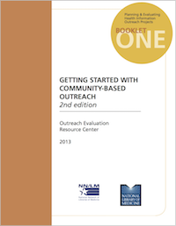
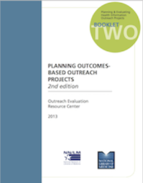

Planning Guides:
NNLM Evaluation Office
Booklet 1: Getting Started with Community-Based Outreach
Booklet 2: Planning Outcomes-Based Outreach Projects
Booklet 3: Collecting and Analyzing Evaluation Data
https://nnlm.gov/neo/professional-development/guides
Notes:
(free)

Slide 21
ENVIRONMENTAL SCAN

Slide 22
7 Key Questions (redux)
Who?
What?
When?
Where?
Why?
How?
Notes:
Outreach Goals
COMMUNITY NEEDS ASSESSMENT
■ Identify the most significant needs or problems
▪ Who (vulnerable people, e.g)?
▪ What ()?
▪ Where underserved areas, counties/zip codes)?
▪ Why (access barriers)?
■ The “How” = Implementation Strategy: identify potential program and
collaboration opportunities that have a measurable impact

Slide 23
The 6 Ds of Needs Assessment
DEFICIT
DEVELOP
DESCRIBE
DESIRES
DUPLICATION
DEMAND
Kylie Hutchinson, Community Solutions Planning and Evaluation http://communitysolutions.ca/web/
Notes:
Deficit – what is the need for …
Develop – what strengths exist in the community that can support your project. This includes meeting space, partners, etc.
Describe – What are the important demographic variables of the population?
Desires – How would participants prefer to have services provided to them?
Duplication – Is anyone else providing this service? Are you duplicating an existing program?
Demand – Will participants attend your training?

Slide 24
Needs assessment
Form a picture of your target community
Identifying the people or groups of people in your community who are most affected by or involved in problems …. related to … use …
Assessing individual and community needs and aspirations
Identifying the factors (individual, physical, socio-environmental) that create barriers to …
Identifying the level of resources and the community readiness to address the needs
Obtaining data that can support the need for your project and provide a baseline description of the community that will allow you to monitor your progress.
Notes:
Identifying the people or groups of people in your community who are most affected by or involved in problems related to information or service use
Assessing individual and community needs and aspirations
Identifying the factors (individual, physical, socio-environmental) that create barriers to information or service use
Identifying the level of resources and the community readiness to address the needs
Obtaining data that can support the need for your project and provide a baseline description of the community that will allow you to monitor your progress.

Slide 25
Needs assessment
Step 1 - Get organized
  Identify team of advisors
  Conduct literature review
  Take an inventory of what you already know
  Develop evaluation questions
Notes:
Step 1 - Get organized: In this phase, you identify the boundaries of your target community, find a team of advisors to guide the community assessment project, and determine the scope needed for a community assessment. With the help of your team of advisors, you take an inventory of what you already know, and identify the additional information needed, and put together a data collection plan.

Slide 26
Needs assessment
Step 2 - Gather information
  Interviews
  Focus group interviews
  Questionnaires
  Observations
  Site visits
  Online discussions
Notes:
Step 2 - Gather information: Once organized, you collect data identified in Step 1 as necessary to gaining a full understanding of the community.
Interviews and Focus Groups
Engaging with people in your community through interviews or focus groups builds relationships by communicating to community members that you value their opinions and insights. It’s an opportunity to get to know people personally and to hear more nuance around what they aspire to for themselves, their families and the community.
Stakeholder meetings/group interviews bring groups of people together to discuss community issues. They are usually guided by a structure of pre-determined questions to elicit insights. Groups might consist of key gatekeepers or decision-makers in your community, or they might be an assembly of “ordinary citizens.” Tailor the interview questions or meeting agenda to the topic and the individuals involved.
Topical focus groups are more targeted than group interviews in that they gather small groups of key individuals who could contribute to activating, programming, designing or reaching out to the people you want to attract to your library space. For example, the library might conduct focus groups with teens to inform the design and programming for a teen active learning space
Intercept Surveys are questionnaires that are administered verbally, in person and are designed to get the perspectives of individuals in the community. You could approach a variety of community members or you could target individuals from a specific audience you want to work with. These “verbal surveys” are best conducted in the context and environment in which these individuals live, work or play. So, get out of the library and go to playfields, shopping centers, churches, etc.
Happy hour brainstorming is a more casual approach to eliciting insights from groups of people. Provide a welcoming space for the event, including food and drink, if appropriate; make it a party. Have one-on-one conversations with people. Encourage personal stories and anecdotes by leading with something like, “tell me about a time when…”

Slide 27
Needs assessment
Step 3 - Assemble, interpret, and act
Notes:
Step 3 - Assemble, interpret, and act: At this stage, you compile your information and decide whether to move forward with outreach in your target community. If you believe you can effectively work with a community and have a positive impact on members' information or service use, you will then build a project plan (described in Booklet 2 Planning Outcomes-Based Outreach Projects [18] of this series) using your community assessment findings as your foundation.

Slide 28
Academic community Needs
Learn about the uniqueness of each academic unit: its culture, academic cycles, major assignments, communication styles and specific issues
Join disciplinary electronic discussion lists
Become familiar with individual faculty research interests
Search course syllabi to evaluate and identify the need for specific guides to library resources and to respond to course and discipline needs
Sit in on classes for greater familiarity with demands of the course
Become aware of college/departmental activities such as journal clubs, research priorities and needs, departmental policies, seminars, table/exhibit for research days and special events and participate

Slide 29
DEVELOPING AN OUTREACH PROGRAM

Slide 30
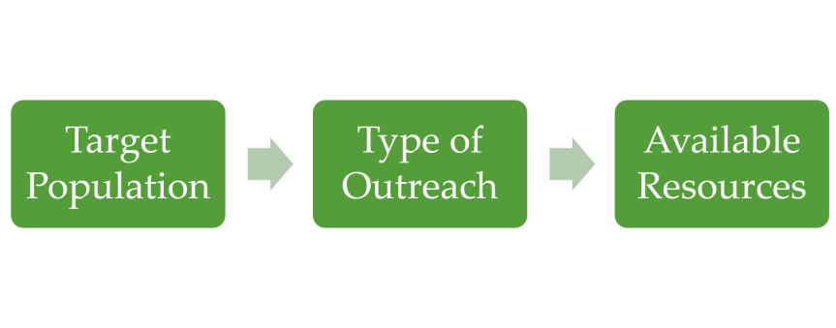
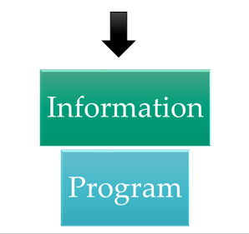
Develop a plan
Notes:
Once you’ve had a chance to review your community information/service needs, where do you even begin? You will need to develop a plan. It is often helpful to identify, your target population, the type of outreach that you want to do (provision of resources or a full fledged program) and then determine what resources you already have available to continue with this plan. It is also helpful to think about the various resources that you can refer individuals to, a staff member who is an excellent public speaker, or a connection to a local agency that can provide a program on a given topic.
Remember, outreach does not mean that you have to provide a one hour program with a speaker and activities. Think about your library/organization and what a manageable and meaningful outreach activity might look like based on your staff, physical space and other factors.

Slide 31
Develop a plan
Begin with the results you’re seeking
Figure out what you have to do
Then identify what you need

Slide 32
Logic models
Inputs
Activities
Outcomes
What we invest
What we do
Why we do it
Intended
Results
Planned Activities
Notes:
The logic model is designed to help you link your resources and activities to your outcomes.
Work backwards

Slide 33
Logic models
Column Examples:
Inputs
Activities
Reach
Outcomes
Money
Staff
Volunteers
Partners
Supplies
Technology
Equipment
Teaching
Outreach activities
Online resource development
Service delivery
Users
Staff
Decision-makers
Learning & skill development
Affective change
Behavior change
Environmental change
Notes:
As complicated as logic models may sound, they can be easy to use and very helpful from program idea to evaluation. Think of the inputs as the resources that will be used to support the activity or program you wish to conduct.
The activities are the main things the project will do/provide.
Finally outcomes are the how many and what sort of observable/tangible results will be achieved?

Slide 34
Logic models
Think of achieving outcomes in stages
Inputs | Activities/ reach | Outcomes
 |  | Short | Intermediate | Long
Notes:
The short term focuses on what will occur as a direct result of the activity (such as changes in knowledge, skills or attitudes).
Don’t forget about assumptions and external factors:
The assumptions are the beliefs about the environment and community. External factors include the positive and negative influences, the culture, economics, politics and demographics of the community. Both assumptions and external factors should be confirmed before implementing the program.

Slide 35
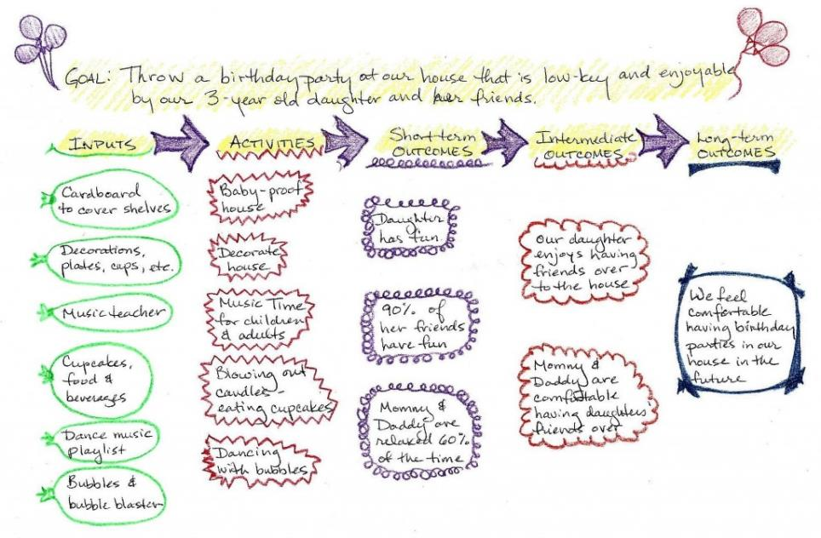
7 Key Questions
https://nnlm.gov/evaluation/blog/2016/02/04/logic-model-for-a-birthday-party/
Notes:
Logic models don’t have to be scary or complex ….
Here is an example of a logic model for a child’s birthday party. This is a fun way to show how logic models can be useful and don’t always have to be daunting.

Slide 36
Stakeholders
Key stakeholders for outreach programs fall into three major groups:
Those involved in program operations: Management, program staff, partners, funding agencies, and coalition members.
Those served or affected by the program: Community members, advocacy groups, and elected officials.
Those who are intended users of the evaluation findings: Persons in a position to make decisions about the program, such as partners, funding agencies, coalition members, and the general public or taxpayers.
Notes:
Engage Stakeholders
Stakeholders are people or organizations invested in the program, interested in the results of the evaluation, and/or with a stake in what will be done with the results of the evaluation. Representing their needs and interests throughout the process is fundamental to good program evaluation.
Key stakeholders for evaluations of programs fall into three major groups:
▪ Those involved in program operations: Management, program staff, partners, funding agencies, and coalition members.
▪ Those served or affected by the program: community members, and elected officials.
▪ Those who are intended users of the evaluation findings: Persons in a position to make decisions about the program, such as partners, funding agencies, coalition members, and the general public or taxpayers.
Give priority to those stakeholders who
▪ Can increase the credibility of your efforts or your evaluation
▪ Are responsible for day-to-day implementation of the activities that are part of the program
▪ Will advocate for or authorize changes to the program that the evaluation may recommend
▪ Will fund or authorize the continuation or expansion of the program.

Slide 37

funding
Notes:
Internal
External

Slide 38
Funding Opportunities
Institute for Museum and Library Services
https://www.imls.gov/grants/apply-grant/available-grants
Minnesota Grantwatch: Literacy Grants
https://minnesota.grantwatch.com/cat/22/literacy-grants.html
Legacy Minnesota
https://www.legacy.mn.gov/opportunities-funding
Greater Midwest Region National Network of Libraries of Medicine
https://nnlm.gov/gmr/funding

Slide 39
PROGRAMMING RESOURCES

Slide 40
Programming resources
Programming Librarian (ALA) http://www.programminglibrarian.org/
Public Library Association: Community Engagement & Outreach http://www.ala.org/pla/resources/tools/community-engagement-outreach
  Public Libraries Online http://publiclibrariesonline.org/tag/library-outreach/
Demco Ideas & Inspirations: Library Outreach https://ideas.demco.com/tag/library-outreach/
Notes:
“ProgrammingLibrarian.org is a place for library professionals to share, learn and be inspired to present excellent programming for their communities. Through resources, ideas and professional development opportunities, we seek to help libraries fill their role as cultural and civic hubs in their communities.
ProgrammingLibrarian.org is run by the American Library Association (ALA) Public Programs Office, which promotes cultural and community programming as an essential part of library service. Through professional development activities, programming resources, model programs and grant opportunities, the Public Programs Office supports libraries as they fill their role as community cultural centers — places of cultural and civic engagement where people of all backgrounds gather for reflection, discovery, participation and growth. “ ALA Programming Librarian
Resources devoted to helping increase community engagement and outreach, including: the ALA Libraries Transform campaign, outreach strategies, information on bookmobiles, how to work with community groups, universal access, and much more.

Slide 41
PROGRAM
IDEAS / EXAMPLES

Slide 42
Types of proGRAMS: Examples
Services to At Home patrons
Correctional Services
Homeless Services
Refugee/Immigrant Services
Services for Older Adults
Services for Veterans
Notes:
At Home Reader
Services to corrections
Services to senior housing
Homeless Services
Immigrant Services
Services for Older Adults
Immigrant Services
The Library helps non-English speaking and other immigrants understand and interact with the culture, government, and educational system of the United States. Read More ›
Correctional Services
NYPL's Correctional Services offers reliable, sustainable, and quality library services to justice-involved people and their families in and around New York. Read More ›
Services for Veterans
The Library supports veterans, military service members, and their families with free programs, classes, and resources. Read More ›
Services for Adults and Young Adults
The New York Public Library provides information and assistance to those seeking to obtain government ID, filing income taxes, and enrolling in a health insurance plan through the Health Insurance Marketplace. Read More ›
Services for 50+ Adults
As the average age increases with the aging of the Baby Boom generation—generally accepted as those born from 1946 to 1964—the Library has added programs targeting those 50 years of age and older. Read More ›
Community Oral History Project
NYPL's Community Oral History Project celebrates New York City's unique neighborhoods and diverse people. It preserves and documents history by collecting the stories of those who have experienced it. Read More ›

Slide 43
Types of programs: liaisons
Training: delivering instruction
Consultation/research
Marketing: increasing the library’s visibility
Technical expertise: contributing expertise to help other groups with technical projects
Liaison: assigning library representatives to specific departments in the home institution to facilitate services and communication between the library and respective departments
Web: creating a library-sponsored website for a particular purpose or audience
Hosting exhibits & events

Slide 44
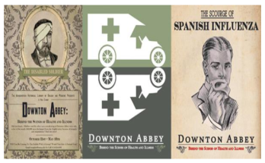
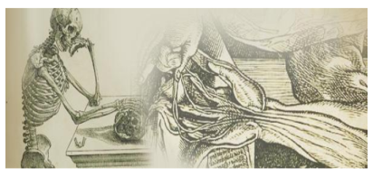


In-House Exhibits & events
Wangensteen History of Medicine Library Exhibits
Visualizing the Body: Celebrating 500 Years of Andreas Vesalius, Renaissance Art and Medical Revolution
Downton Abbey: Behind the Scenes of Health and Wellness
Medical Exchanges: Mapping the Human Body in Japan and China
Bodies and Spirits: Health and the History of Fermentation and Distillation
Notes:
Bring people into the library
Engage the interest of primary user base and others on campus
Incorporate and highlight interests of the community and the library
Be an active and innovative partner of the campus community
Change or broaden the perception of the library among user base

Slide 45




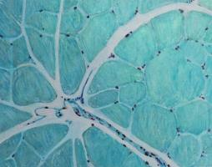






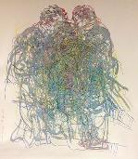

Bringing people in:
Art exhibits

Slide 46

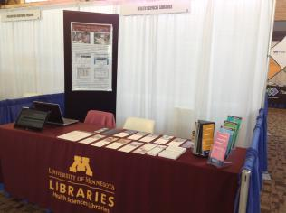
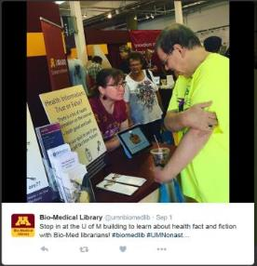
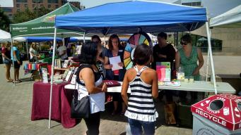
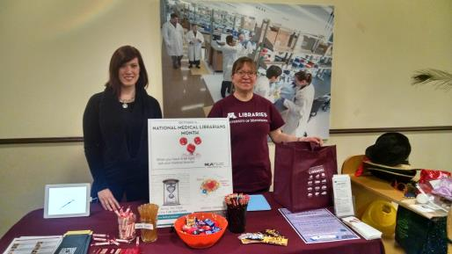
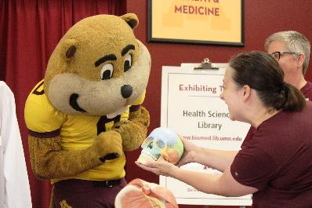
Event Tabling/Exhibiting
Notes:
Pop up tabling

Slide 47
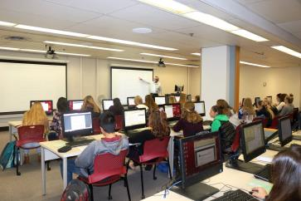
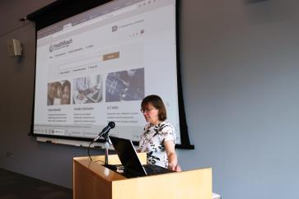
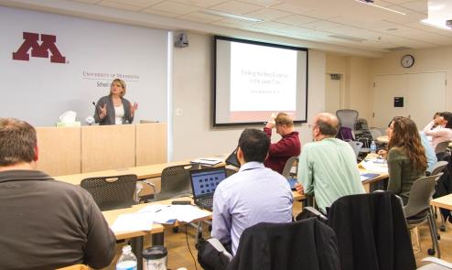
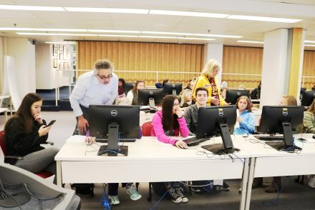
Workshops: On & Off-site

Slide 48
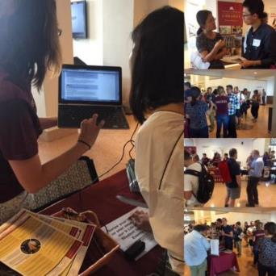
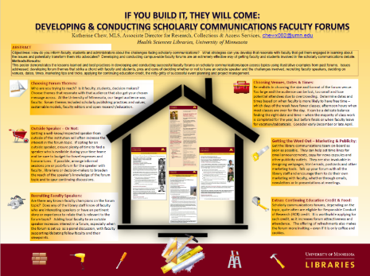
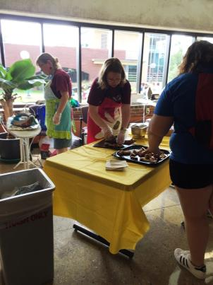
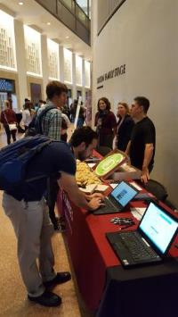
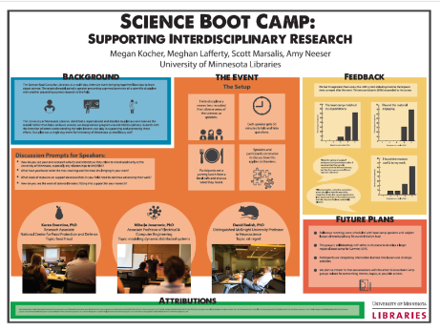
LIAISON OUTREACH

Slide 49
MARKETING & PROMOTION
Notes:
Once you have determined your target population and type of activity, it is never to early to think about how you will market/promote the health outreach activity.
What agencies in the community does your target population frequent? What areas of your organization are your target population most likely to be in? It can sometimes be a process of trial and error to determine what marketing strategies work best for your particular community. Some ideas include the traditional use of fliers, newspaper ads or signage on bulletin boards and in windows of local businesses. Additionally, many organizations have an increased web presence, so information can be listed on web site calendars, press releases on news feeds and the use of social media sites.
Remember marketing doesn’t mean you have to be restricted to the walls of your library. Place bookmarks in local doctors offices, have fliers about upcoming lecture series or database searching classes in grocery stores, hair and nail salons, childcare centers, and community and faith based organizations in your neighborhoods.
Marketing ideas don’t have to cost money, to create webinars, or 5 minute videos there are open source software available, also think about the resources that your library or community partners already have. Tap into what already exists and build upon that.

Slide 50
Understanding The Differences Between Marketing, PR and Sales
If the circus is coming to town and you paint a sign saying ‘Circus coming to the Fairground Saturday’, that’s advertising.
If you put the sign on the back of an elephant and walk it into town, that’s promotion.
If the elephant walks through the mayor’s flower bed, that’s publicity.
And if you get the mayor to laugh about it, that’s public relations.
If you did all of this on purpose, that’s marketing.
If the town’s citizens go to the circus, you show them the entertainment booths, explain how much fun they’ll have spending money at the booths, answer their questions and ultimately, they spend a lot at the circus, that’s sales.
Notes:
The following quote is attributed to M. Booth and Associates, Inc. as taken from a Reader’s Digest story called, Promoting Issues and Ideas.

Slide 51


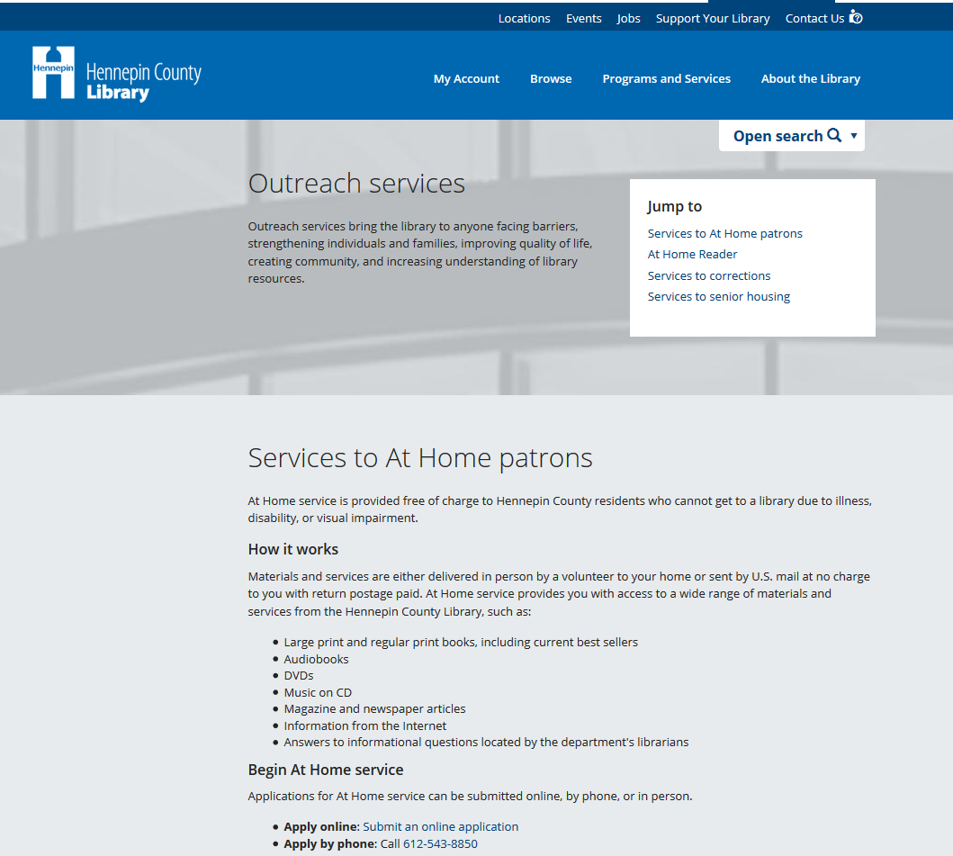
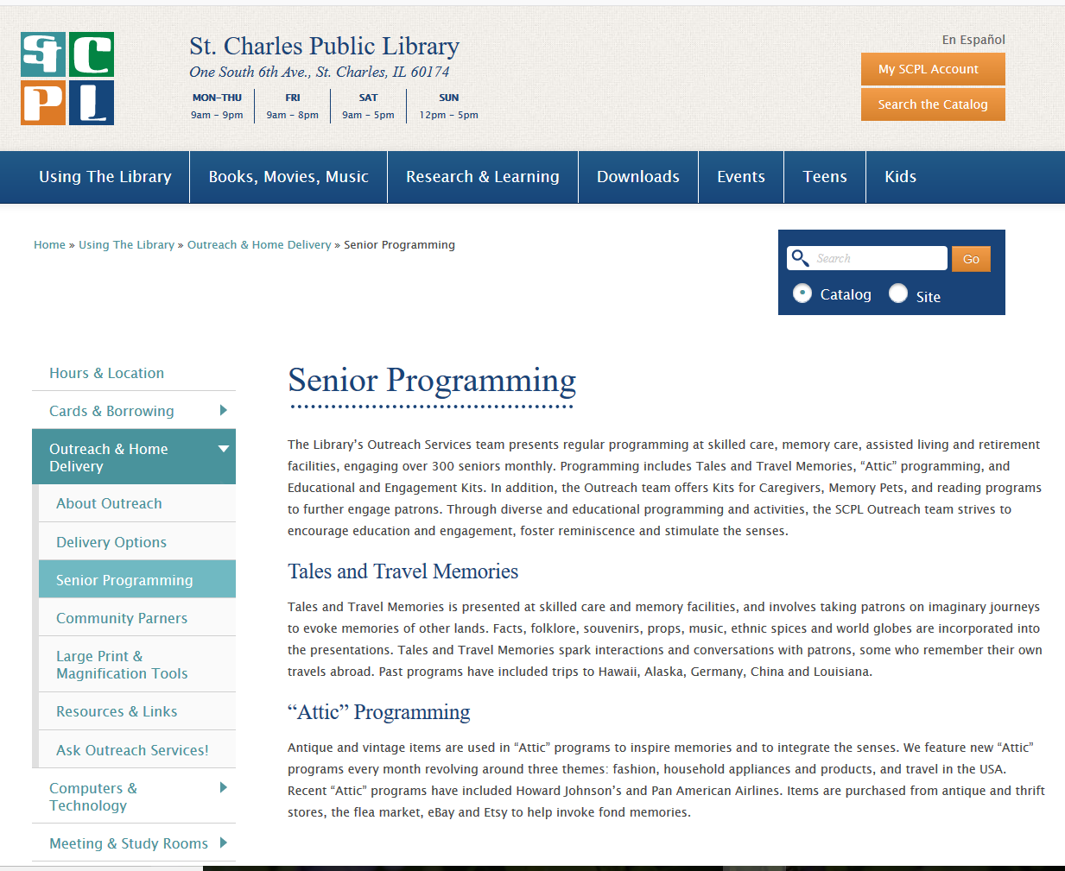
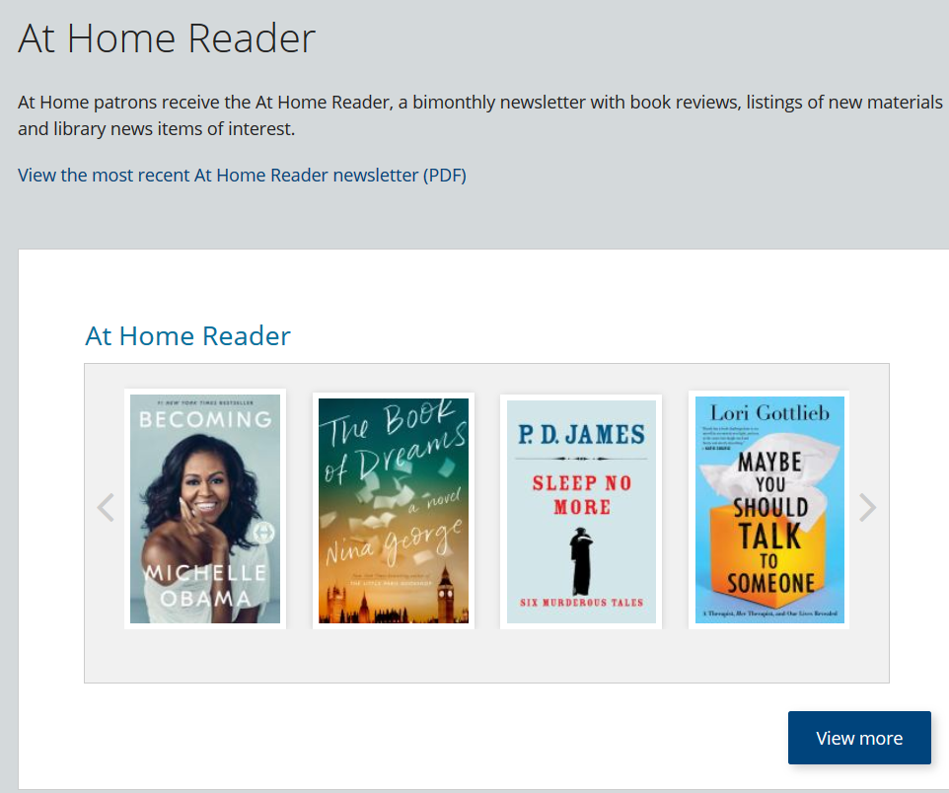
Personal Health
Web portals

Slide 52
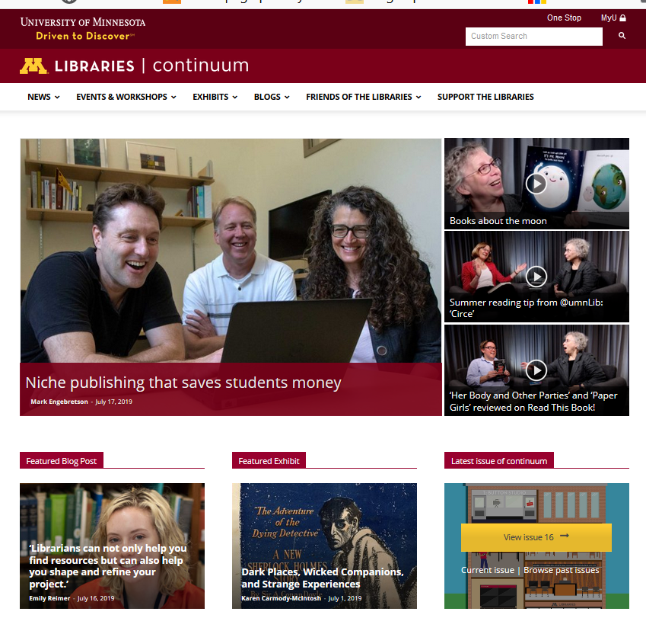
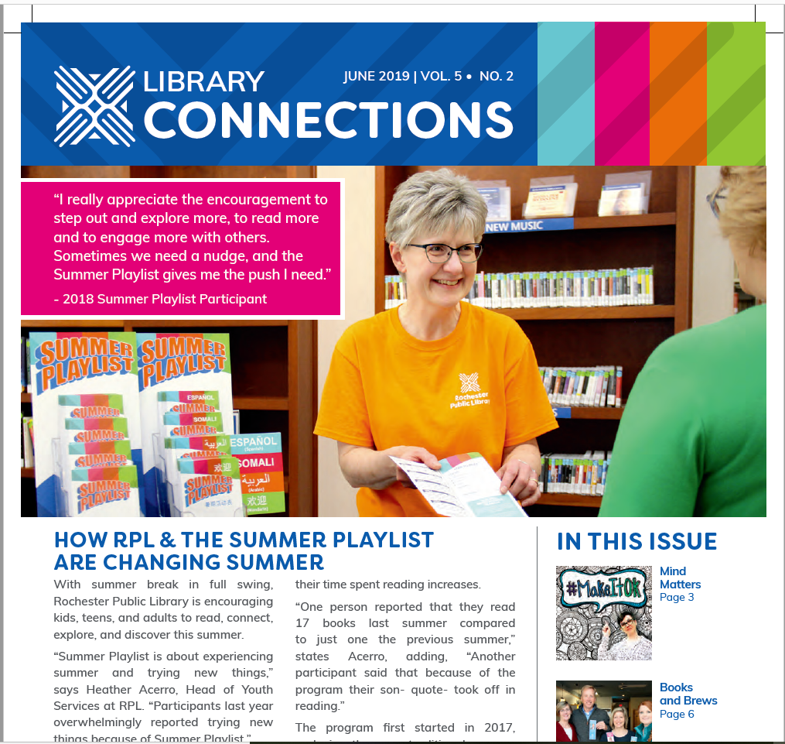
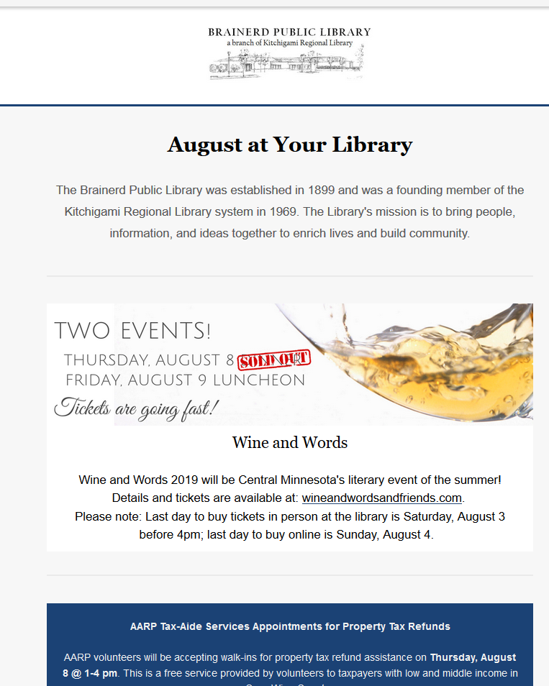
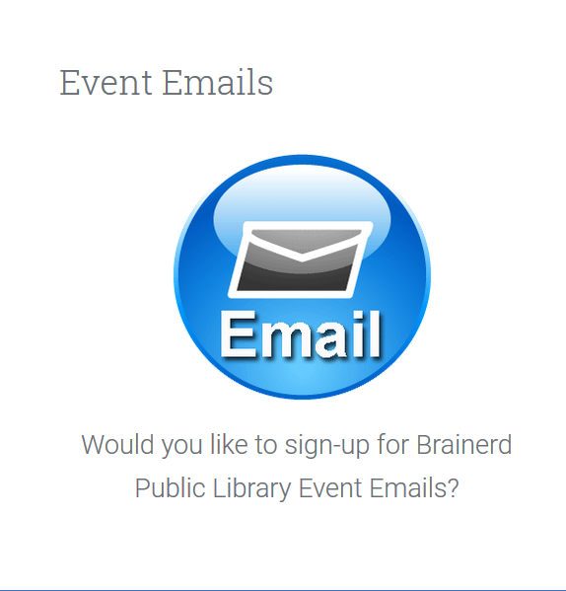
Marketing: newsletters

Slide 53

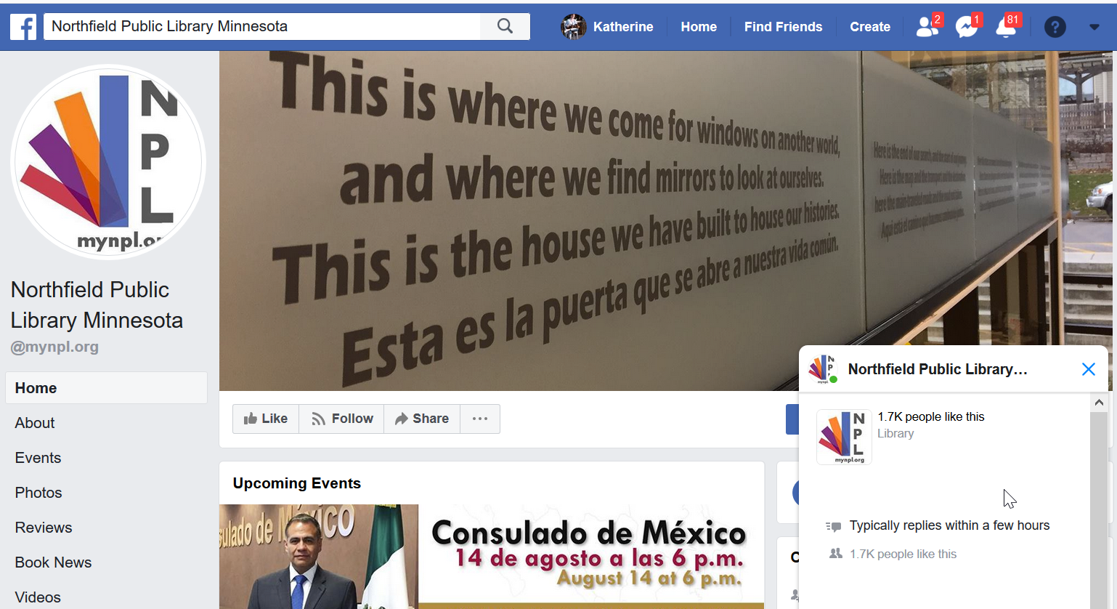
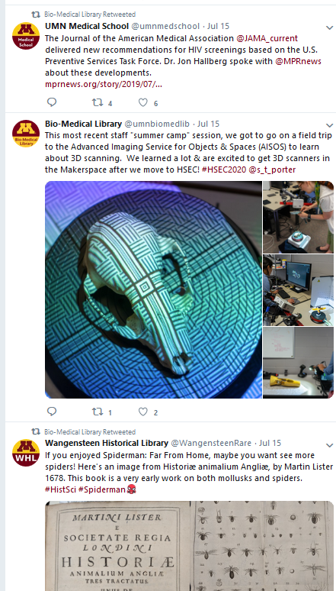
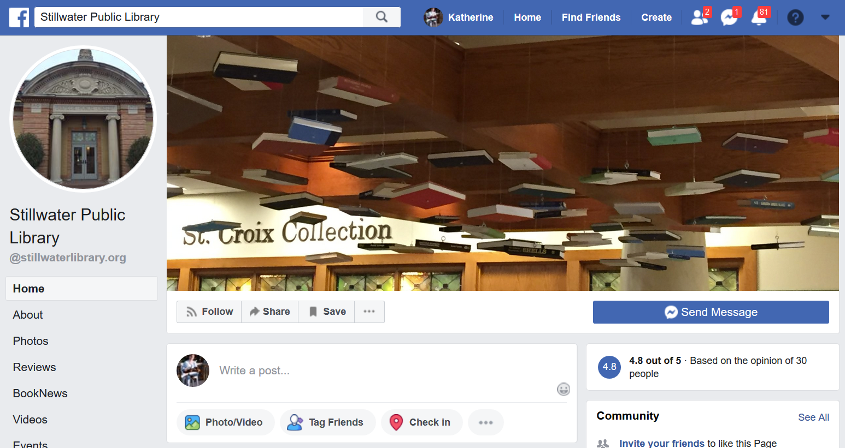
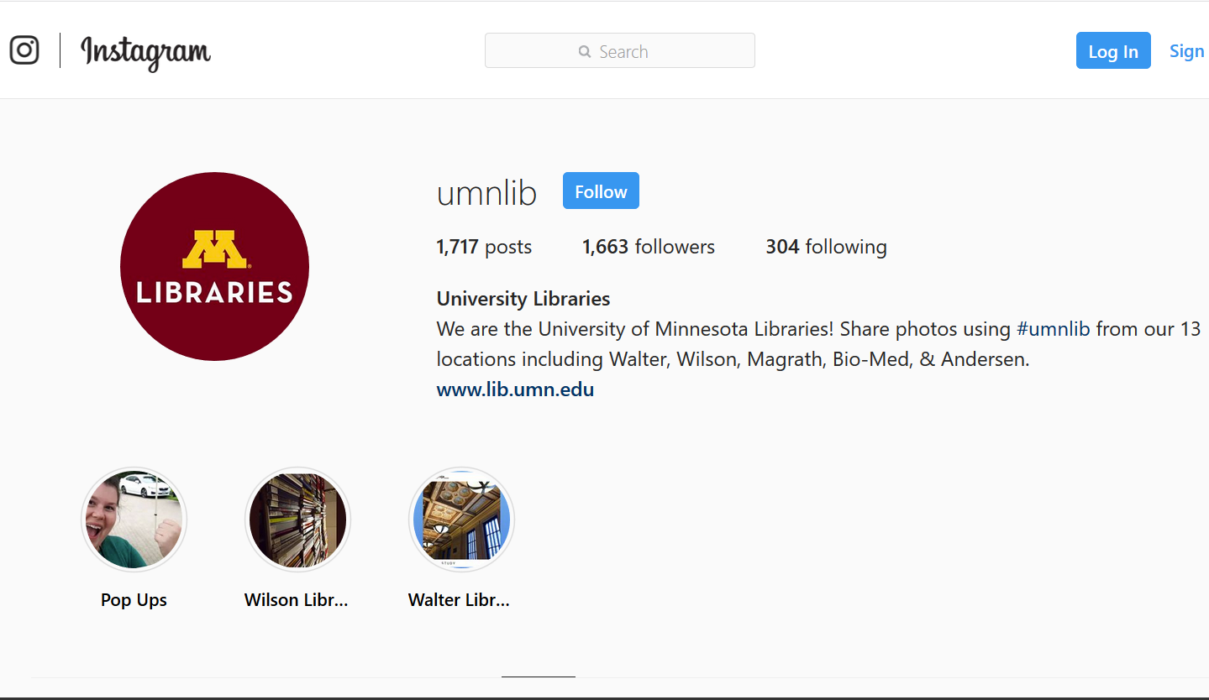
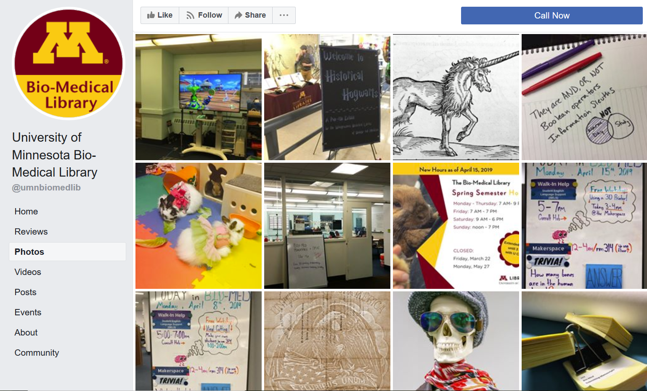
Marketing: social media

Slide 54
PARTNERSHIPS
Notes:
Internal partners
External partners
look around your community and locate agencies and organizations that you could potentially partner with to offer outreach activities.
Think about the types of people that live in your community. What types of services and resources do they need? Also, what agencies exist in your community? This could be community and faith based organizations. Is there a YMCA/YWCA or Boys and Girls Club near you? Are there Boy and Girl Scout Troops?
Are there individuals from local organizations that use your library for space and convenient parking. Consider partnering with them and other types of libraries such as academic, public, school and even hospital libraries in your area. Area Agencies , Gardening Clubs, Video Game stores, Museums and Art Institutes (even those at local colleges and universities).
A combined community effort is going to enhance any program you can think of doing and lend itself to improved sustainability with everyone providing resources to assist the community at large.
The bottom line is that you won’t know until you ask and I’m sure each of you can think about some agency in your community that is a potential partner.

Slide 55
Choosing a partner
Audience: Do you need help in attracting certain target audiences to your program or to the library in general?
Publicity: Do you need help publicizing your program?
Funding: Do you need additional funds to present your program?
People: Do you need additional people to help you plan and present your program?
Space: Is your event too large for the library?
Ideas and know-how: Has another agency hosted a similar event?
Presenters and performers: Are there local talents?
Think inside the library: Do library staff have connections?
CA Summer Reading Program Working with Community Partners (California Library Association) http://www.cla-net.org/?100
Notes:
Before choosing a community partner, it can be helpful to refer back to your logic model and the 7 Key questions. “For example: What are your program goals? What do you need to achieve your goals? Which of your needs can be met by the library? How can a partner help you meet these needs and achieve your goals?
This process will help you evaluate your existing resources and prioritize your remaining needs, thus helping you to choose the most effective potential partners to assist you.”
Here are some questions to ask to help evaluate your needs:
Audience: Do you need help in attracting certain target audiences to your program or to the library in general?
Consider a community partner that has connections or influence with your target audience. Think about community leaders.
Publicity: Do you need help publicizing your program?
Approach people with PR and publicity skills who can create press releases/flyers/posters etc.
Get acquainted with your local reporters and media sources. If you have a cordial and established relationship, they are more likely to help out. Find out who has the "library beat" at your local media outlets â€“ who is responsible for covering events at the library? Find out if your local paper will run a public service ad or article for free.
Funding: Do you need additional funds to present your program?
Offer local businesses the opportunity to sponsor your program. Businesses often set aside funds for community projects since it gives them the chance, and the PR value, to support local causes.
At big events, consider offering local vendors or community groups a chance to have a booth at the event (with a percentage of their profit going to your library). Think about bookstores (chains and local) as well as local specialty stores.
Could a partner raise funds for the program or for the library?
People: Do you need additional people to help you plan and present your program?
Everyone is a potential volunteer! Examples include local businesses with employee volunteer programs; seniors; the library's teen group, or high school teens who need community service hours; parents who want to become involved in the community; civic groups; your friends group; colleges with community involvement programs; family, friends and the neighborhood dog.
Overestimate how many volunteers you need â€” it pays to have too many.
Think about the skills your volunteers might need. Do you need creative people to help decorate the library? People who are detail-oriented? Tech-savvy? Develop an ongoing list of reliable volunteers - they are a valuable and constantly needed resource.
Space: Is your event too large for the library?
Could a partner donate space to hold part, or all, of your event? If not, could your partner assist you in renting more space if needed? Assess your space and staffing needs realistically to see if this is something you need help with.
Try developing ongoing relationships with local theaters or business centers - these relationships can prove useful in many ways, beyond offering potential space.
Ideas and know-how
Perhaps a community partner has organized an event similar to the one you are planning and could provide ideas and tell you about potential pitfalls.
They might also be able to put you in touch with partners and resources that they used for their event.
Presenters and performers
Utilize your pool of local talent. Everyone is or knows potential talent. Scan the media and keep a list of groups or individuals who appeal to you for future reference.
Build contacts with the local Screen Actors Guild office, school drama departments, and art groups, local authors or celebrities, local dignitaries, media personalities etc. The worst they can do is say no, but quite often they are happy to help libraries, or can point you in the direction of someone who can. Make sure to compile a list of contact names, numbers, and emails for future program use. They might not be able to help with this program, but maybe they can help with another in the future.
Think inside the library
You don't always have to come up with new and different people to partner with. Look at the partners you currently have to see how you might develop those relationships further.
When considering your choices for community partners, get input from other staff members and groups, such as your teen advisory group or Friends of the Library board members. This can help you to get different perspectives and ensure support from your colleagues and staff.

Slide 56
Community partners (tips)
Approaching Your Community Partner
Be clear about what you want from your partner
Think about how the partnership will benefit your community partner
Be prepared
Working With a Partner
Communicate
Agreements
Be Prepared
Follow-up
Thank partner publicly and privately
Keep in Touch
Plan for Future Events
Notes:
Be clear about what you want from your partner
For example, do you need your partner to be actively involved in the planning and/or presentation of the program? Or do you want to develop the program and need them to help provide funds or materials, or to help you promote the event?
Think about how the partnership will benefit your community partner
What's in it for them? A successful partnership will benefit both parties, and a partner is more likely to come on board if they can see those benefits. The PR value of being listed as a sponsor can often mean a heightened local media profile for your partner, and this can make it worth their time and effort to become involved. A successful partnership can also ensure their interest in future projects.
In addition, you can build contacts by offering your library's resources to other community organizations. Meet local PTA/PTO members by volunteering to attend Back to School Nights, or offer your meeting rooms and plan programs to appeal to local college groups and professors.
Be prepared
Have information about your program and the library ready to give to the potential partner.
Be sure to research potential partners and be informed about them. When evaluating a potential partner, it can be helpful to talk to people who may have worked with them before. This may help you decide if they are the right partner for you. You might also find that you have a colleague or friend in common, which can give you more credibility with the potential partner as well.

Slide 57
EVALUATION / ASSESSMENT
Notes:
Return on investment

Slide 58
Why assessment
Program Improvement
  Program staff may want to see a dashboard report of selected indicators and receive brief, regular verbal updates at meetings to learn what midcourse adjustments to make to improve program operations and activities
Program Effectiveness
  A funding agency may ask for a detailed, comprehensive report to demonstrate whether program components are contributing to expected outcomes for accountability purposes

Slide 59
Common evaluation purposes
To gain insight
Assess feasibility or practicality of a new approach for broader implementation
To change practice or make improvements
Describe what a program has done and to what extent
Enhance program operations by improving quality, effectiveness, and efficiency of activities
Monitor activities for program management or routine reporting
To determine or assess effects
Understand the relationship between program activities and certain effects or outcomes
Demonstrate accountability to funder or partners
Judge the value or worth of a program
To affect participants involved in the evaluation
Generate a positive influence on stakeholders or participants (to reinforce program messages, empower participants, or facilitate social transformation)
Centers for Disease Control and Prevention. Evaluation Reporting: A Guide to Help Ensure Use of Evaluation Findings. Atlanta, GA: US Dept of Health and Human Services; 2013 https://www.cdc.gov/dhdsp/docs/Evaluation-Reporting-Guide.pdf

Slide 60
Six Steps of Program Evaluation
Step 1: Define your stakeholders
Step 2: Describe the program
Step 3: Focus the design of your evaluation
Step 4: Gather evidence
Step 5: Draw conclusions
Step 6: Present findings and ensure use
Notes:
Step 1: Define your stakeholders
Your stakeholders are supporters, implementers, recipients, and decision-makers related to your program. Getting them involved early on will help you get different perspectives on the program and establish common expectations. This helps to clarify goals and objectives of the program you’ll evaluate, so everyone understands its purpose.
Step 2: Describe the program
Taking the time to articulate what your program does and what you want to accomplish is essential to establishing your evaluation plan. Your descriptions should answer questions like: What is the goal of our program? Which activities will we pursue to reach our goal? How will we do it? What are our resources? How many people do we expect to serve?
Articulating the answers to those questions will not only help with accountability and quality improvement, but it will also help you promote the program to its beneficiaries.
Step 3: Focus the design of your evaluation
Evaluations can focus on process, means, resources, activities, and outputs. They can focus on outcomes or how well you achieved your goal. You may also choose to evaluate both process and outcomes.
As you begin formulating your evaluation, think about the specific purpose of the evaluation—what questions are you trying to answer? How will the information be used? What information-gathering methods are best suited for collecting what our organization needs to know?
Step 4: Gather evidence
Qualitative and quantitative data are the two main forms of data you may collect.
Qualitative data offers descriptive information that may capture experience, behavior, opinion, value, feeling, knowledge, sensory response, or observable phenomena. Three commonly used methods used for gathering qualitative evaluation data are: key informant interviews, focus groups, and participant observation.
Quantitative methods refer to information that may be measured by numbers or tallies. Methods for collecting quantitative data include counting systems, surveys, and questionnaires.
Step 5: Draw conclusions
This is the step where you answer the bottom-line question: Are we getting better, getting worse, or staying the same? Data comparisons show trends, gaps, strengths, weaknesses. You can compare evaluation data with targets set for the program, against standards established by your stakeholders or funders, or make comparisons with other programs
Step 6: Present findings and ensure use
It is important that all the work you put into program evaluation gets used for quality improvement. When you present your findings and recommendations, it is important to know the values, beliefs, and perceptions of your group; build on the group’s background and build on common ground; and state the underlying purpose for your recommendations before you get to the details.

Slide 61
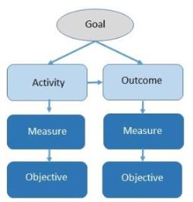
Goals – outcomes - objectives
Goals, outcomes, and objectives: these may be among the most confusing terms in the evaluation lexicon. They often are used synonymously. They are different concepts, but they are connected.
A goal is a broad visionary statement that is abstract. Usually several activities and outcomes will contribute toward a goal. An outcome defines an observable result that supports the goal. You should be able to directly link an activity to an outcome. An objective builds details into the outcome so that it can be evaluated. An objective has three key elements:
  An observable measure that will allow you to provide tangible evidence of program implementation or an outcome.
  A target, which is the threshold the outcome must exceed for you to consider the activity worthy of resources used.
  A timeline stating when that target will be met.
https://nnlm.gov/sites/default/files/neo/files/tips/neo-tip-sheet-align-mission-obj-c.docx.
Notes:
Assessment strategies
Keep in mind what you want to learn:
Number of people who attend
Demographics
Participant satisfaction
Establish program metrics that reflect your goals and objectives.
Each program objective should link to an overall program goal and include specific measurable target and timeline.
Activity metrics;
Participation metrics

Slide 62
Assessment Strategy Questions
Outreach Goal
  Assessment strategy for each goal
    Time: Is the assessment strategy time intensive, requires considerable amount of time or …
    Manpower: how much manpower/staff time is involved
    Data: is the data collected quantitative, qualitative or both
    Limitations: what is the limitations of the assessment strategy chosen? What does it not measure? Are there budget constrains? Does it require compliance on the part of participants?
Notes:
Assessment Strategy Questions to ask for each event goal

Slide 63
Assessment questions
Did you get there?
Did you do everything you planned?
What unexpected things happened?
Would you go there again?
What advice do you have for others?
What would you do differently next time?
Notes:
Outcomes assessment is guided by the “intended results’ columns

Slide 64
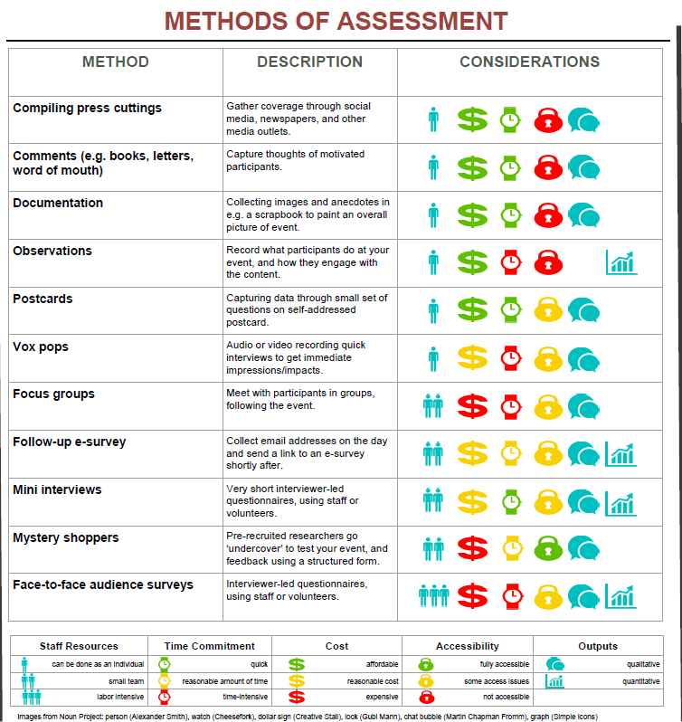
Methods of assessment
Table from: Shannon Farrell & Kristen Mastel. BEYOND BUTTS IN SEATS: Creating Campus and Community Partnerships Through Meaningful Outreach. http://hdl.handle.net/11299/174632

Slide 65
Questions?
Katherine Chew
Research/Outreach Services
Health Sciences Libraries
chewx002@umn.edu
612-6267-3017

