Slide 1
CAN DESIGN THINKING HELP US BREAK THE “IRON TRIANGLE?”
Revisiting tensions that call for new ways of thinking in higher education
David J. Weerts, October 11, 2014

Slide 2
UNDERSTANDING THE CURRENT HIGHER ED CONTEXT…
Economic: Financial challenges to remain for higher education.
Demographic: Baby boomer needs will dominate in future decades. Yet, growing population of post-traditional learners (Soares, 2013).
Political: Increasingly polarized government, focus on institutional performance (graduation rates/degree production)
Public opinion: Higher education can do more with less (Public Agenda, 2010).
Technology/Innovation: Advances in service, process, business-model innovation (MOOCS, learning validation, etc.)

Slide 3
Quality
Prevailing tensions in higher education….
Access
Affordability
The Iron Triangle: College presidents talk about costs, access, and quality. (2008) National Center for Public Policy and Higher Education: San Jose, CA

Slide 4
COMMON GROUND? COMPETING NARRATIVES THAT COMPLICATE THE ISSUE…
How do we think about Quality/Outcomes?
  Prestige maximization (Bowen’s Law).
  Market forces: Power of rankings (U.S News and World Report, etc.)
  Public officials/public: Degree completion most salient. Educated workforce (human capital), economic growth, economic mobility (private good)
  “Quality” inked with discussions about accountability, outcomes, selectivity, costs.

Slide 5
COMMON GROUND? COMPETING NARRATIVES THAT COMPLICATE THE ISSUE…
The complicated Access puzzle.
  Blame shifting: K-12, parents, higher education?
  College readiness as an imperative.
  Institutional transformation? Assets-building view as opposed to deficit thinking.
  Financial link: Affordability as a barrier to access.
  Tension: Quality often coupled with selectivity, limiting access. Yet, access is seen as national imperative.

Slide 6
COMMON GROUND? COMPETING NARRATIVES THAT COMPLICATE THE ISSUE…
An even more complicated Affordability puzzle?
  Institutions: “decline in state support causes tuition to rise. Quality costs money.”
  Public officials: “institutions are unaccountable, can’t control costs.”
  Free market view: “not a problem, students are still coming”
  Larger forces to blame: “have to spend more on prisons, health care.
Mumper, M. (2001) The paradox of college prices: Five stories with no clear lesson, In Heller, D. E., (ed). The States and Public Higher Education Policy: Affordability, Access, and Accountability. Baltimore: Johns Hopkins Press.

Slide 7
SOME TRADITIONAL APPROACHES TO ADDRESSING THESE ISSUES
Scholarly Research
  Theory testing and generation (disciplinary knowledge). Empirically-based.
  “What explains early departure among college students?”
Policy Analysis
  Problem focused, aimed to generate solutions based on a set of criteria, weighing alternatives, etc.
  What can be done to bring up low graduation rates?”

Slide 8
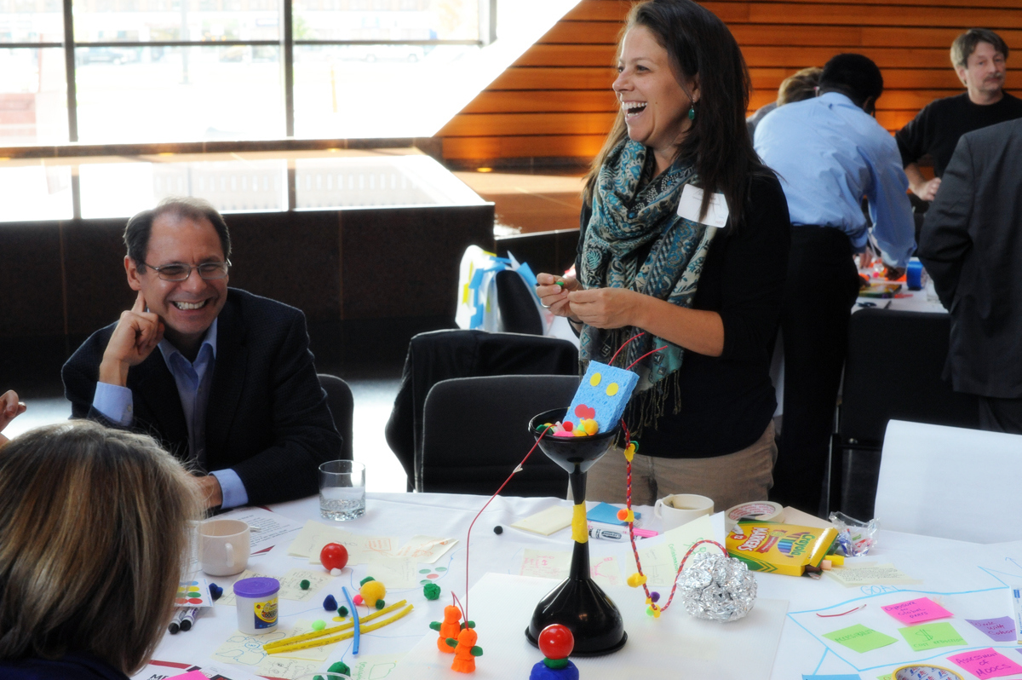
PERSISTENT CHALLENGES REQUIRE NEW TOOLS, NEW WAYS OF THINKING
Design thinking
  Focus on user experiences related to set of specific challenges in the field. Prototype development.
  “How can we ensure that Sally earns a degree given various constraints?” (costs, location, etc.)
“Our College makes stuff.”
-Tom Fisher, Dean, College of Design,
University of Minnesota

Slide 9

WANTED: CREATIVE ASSOCIATES WHO CAN HELP US “MAKE STUFF.”
(ADDRESSING BIG ISSUES IN HIGHER EDUCATION AND SOCIETY!)

Slide 10
Thank You!

