Slide 1

How to Setup a Temporary Booth
Part 4:
Cleaning and Sanitation
Notes:
How to setup a temporary booth: Part 4: cleaning and sanitation

Slide 2
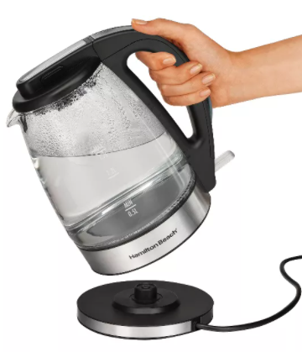
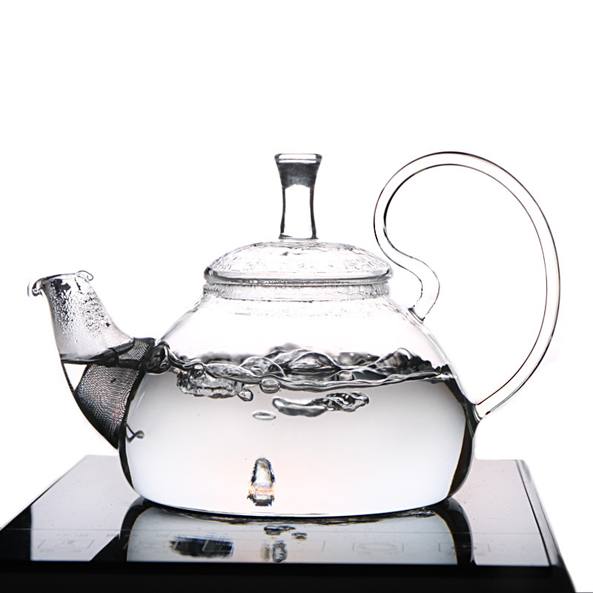
Hot Water
Provide a means of heating water such as:
Coffee Maker
Heated on a grill or stove
Hotpots
Teapots
Notes:
Hot Water: If hot water under pressure is not available, you must provide a means of heating the water. Some quick and easy ways to heat water at your event include: using a coffee maker, or heat the water in a pot on a grill or stove you are using. hot pots and tea pots also work great.

Slide 3
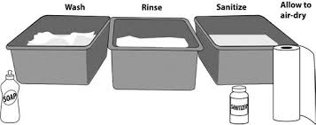
Proper Warewashing Procedures
Notes:
Proper warewashing procedures. When water under pressure is not available on site, basins large enough to immerse utensils may be set-up for warewashing. Label the basins (wash-rinse-sanitize) Wash in hot soapy water. Rinse in clear water. Then sanitize using an approved chemical sanitizer . Then allow all dishes and utensils to air dry.

Slide 4
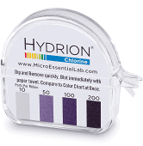
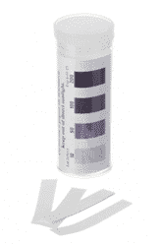
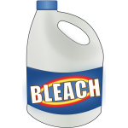
Sanitizer Solutions
Sanitizing solution can be made using 1-1/2 tsp. bleach to 1 gallon water
Chlorine (Bleach) Concentration: 50-100 ppm
Notes:
Sanitizer solutions. Only an approved sanitizer may be used. Bleach is a common, widely used chlorine sanitizer. A chlorine solution can be made using 1-1/2 tsp bleach to 1 gallon of water. The chlorine concentration should be between 50-100 parts per million. Remember, for concentration levels of your sanitizer: too little will result in inadequate sanitization. Too much can be toxic. Always have your chemical test strips available to check concentration levels.

Slide 5
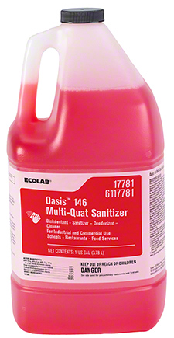
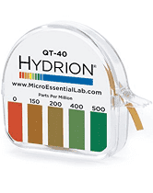
Sanitizer Solutions
Notes:
Quaternary ammonium, also known as multi-quat or simply quat, is another common sanitizer. Always use per manufacturers instructions. A common concentration is between 200-400 parts per million.

Slide 6
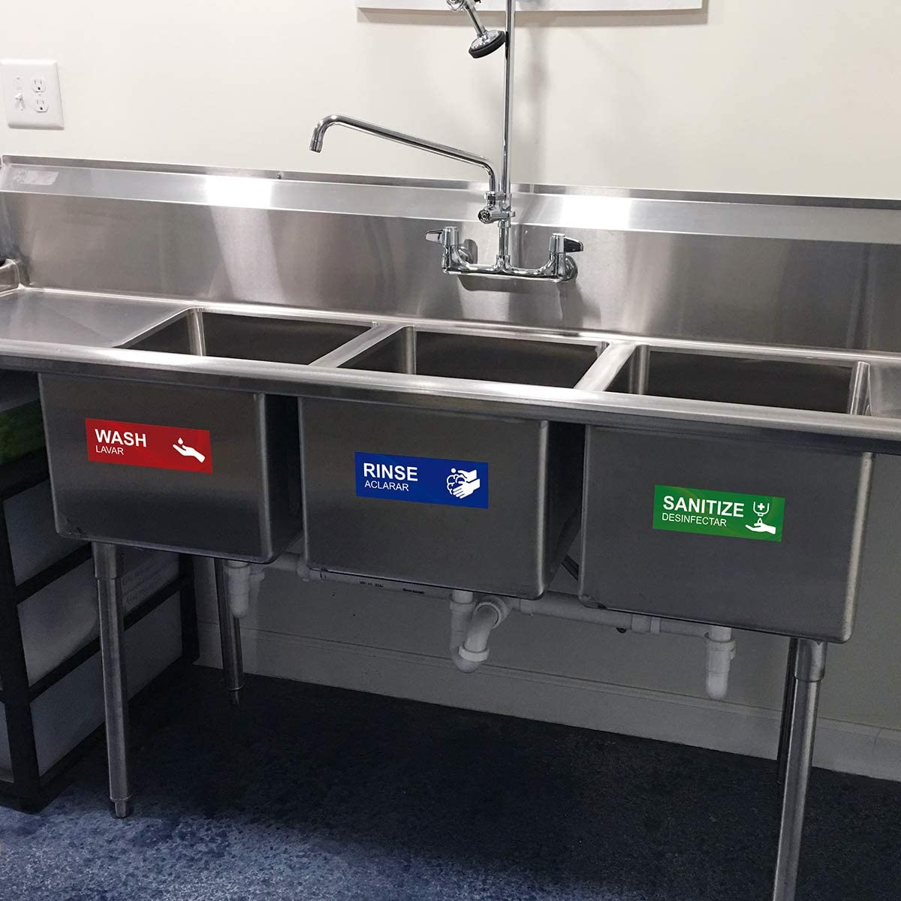
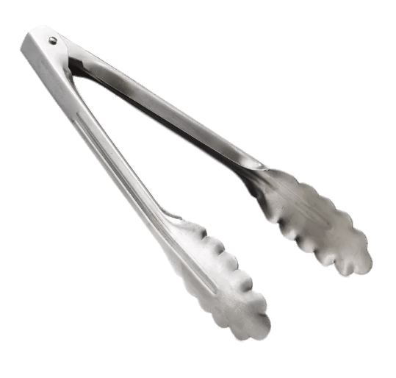
Alternatives to Warewashing On-site
Have multiple utensils available
Take soiled utensils to commercial kitchen for washing, rinsing, sanitizing
Notes:
Alternatives to warewashing on-site. If you have limited food activiy at your booth, you can bring extra utensils to avoid warewashing onsite. You must take the equipment and utensils back to an approved facility or your commercial kitchen at the end of each day for warewashing. Remember, utensils such as tongs or scoops must be replaced with clean utensils at least every four hours, so always bring extras!

Slide 7
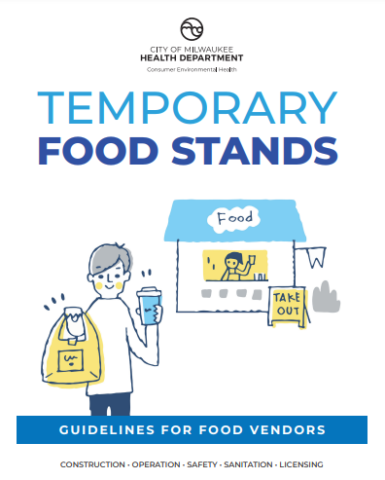
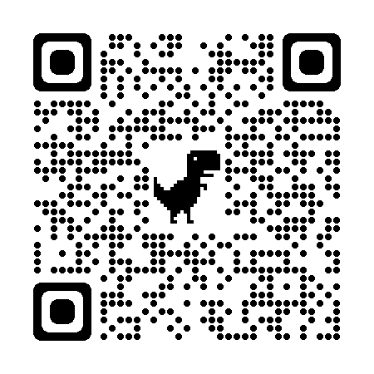
www.milwaukee.gov/health/tempfood
Notes:
Additional information, including printable guidance documents in English and Spanish can be found on the City of Milwaukee Health Department website, or by scanning the QR code located on the screen.

