Slide 1
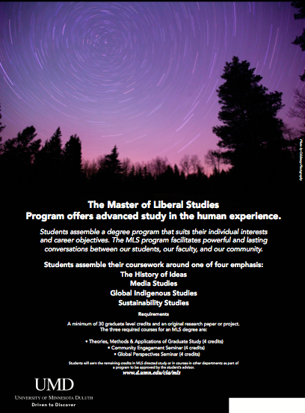
Internationalizing the Curriculum
in the Master of Liberal Studies Program
on the Duluth Campus
By David Beard,
Director of Graduate Studies, MLS
& Past Cohort Member and Mentor, Internationalizing Teaching and Learning
dbeard@d.umn.edu
Context
MLS is an interdisciplinary graduate program primarily for part time students.
MLS is located outside any academic department, with faculty released (for example) from Criminology, Journalism, Communication, and English to teach three required courses.
MLS 8001 Introduction to Interdisciplinary Graduate Study
MLS 8051 Seminar in Community Engagement
MLS 8052 Seminar in International Perspectives
Students assemble the remainder of their coursework from existing options in other units.
Project
To internationalize this graduate curriculum!!
Constraints
The course must be internationalized without defining “international” within any one discipline’s methods or objects of study. A criminologist and a literary critic must both be able to teach the class.
The university curriculum committee and the university graduate council must see the class as well-defined and rigorous.
Students, meanwhile, with hyperlocal and hyperpractical interests must see the course as an organic part of their curriculum, not a hoop to pass through. Part time graduate students will simply reject a curriculum with hoops.
Solutions
The DGS integrated the literature on international
education learned in the Internationalizing Teaching &
Learning workshops (organized through GPSA) with
the literature on interdisciplinarity (especially Julie
Thompson Klein) to develop a course proposal sharp
enough to pass administration and yet be taught by a
rhetorician as well as a specialist in Korean film.
Visit us at z.umn.edu/umdmls to learn more.

