Slide 1
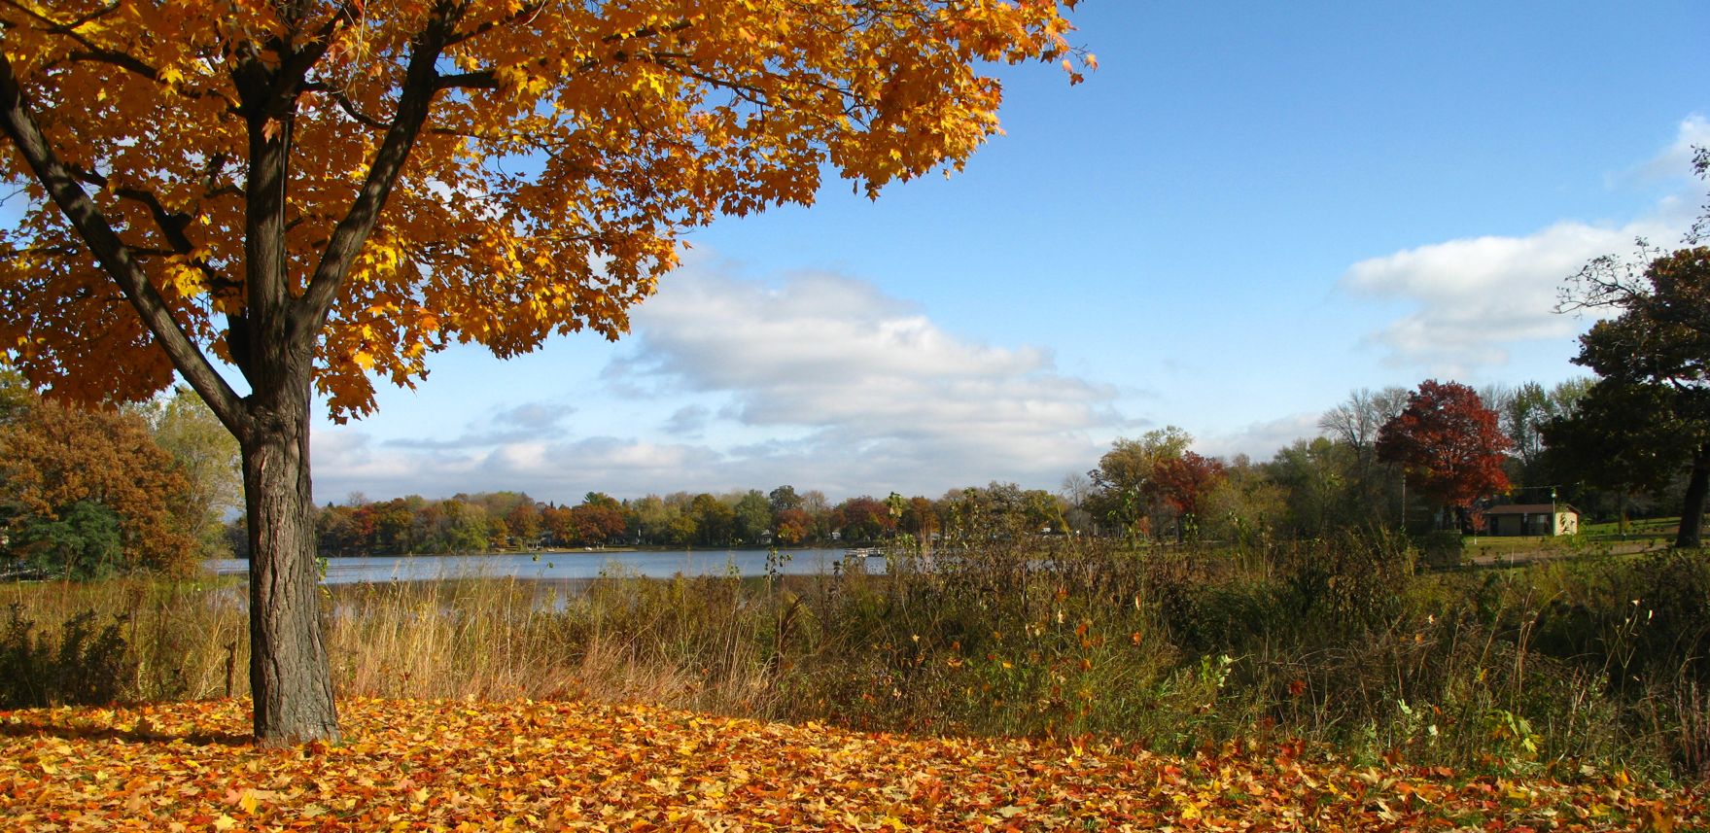

NORTH SAINT PAUL
EMERALD ASH BORER MANAGEMENT PLAN
Created by: Ricardo Braun, William Butler, Jeff Carroll,
Mario Fagundes, Brandon Hull, Luke Midura, Lauren Stufft, and Zhezi Yang

Slide 2
About us
University of Minnesota Students FNRM 4501 Urban Forest Management: Managing Greenspaces for People Urban Forestry Capstone Class
City of North Saint Paul contacted the Department of Forest Resources requesting assistance creating an Emerald ash borer management plan
Our class worked with City of North Saint Paul staff to obtain information needed for tree inventory analysis to produce and compare several management models

Slide 3
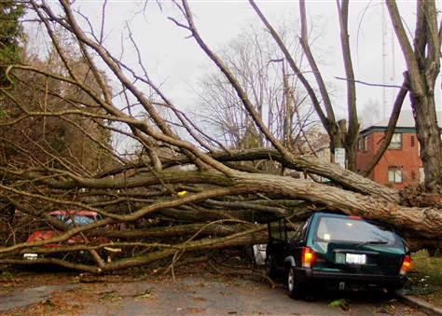
Cause for Concern
Photo Courtesy of NBC News

Slide 4
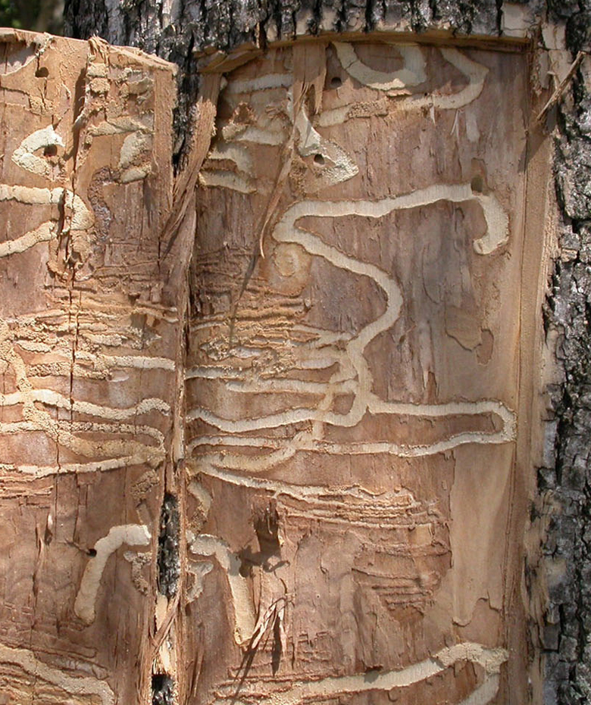
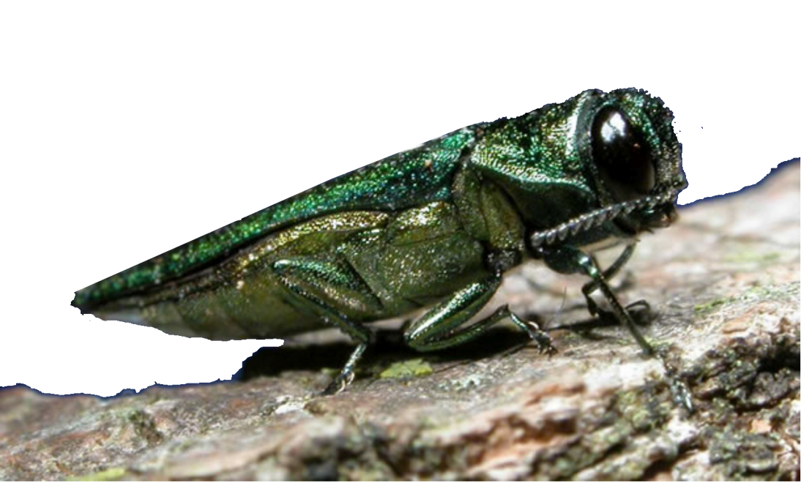
Background Information
EAB kills virtually all established ash trees in its path
Approximately one-third (32%) of public trees in North Saint Paul are ash
Infested ash trees will die from EAB in about three years
EAB is on your doorstep… confirmed infestations within 5.5 miles of North Saint Paul (in Shoreview and St. Paul)
Photo Courtesy of The Nature Conservancy
Photo courtesy www.emeraldashborer.info

Slide 5
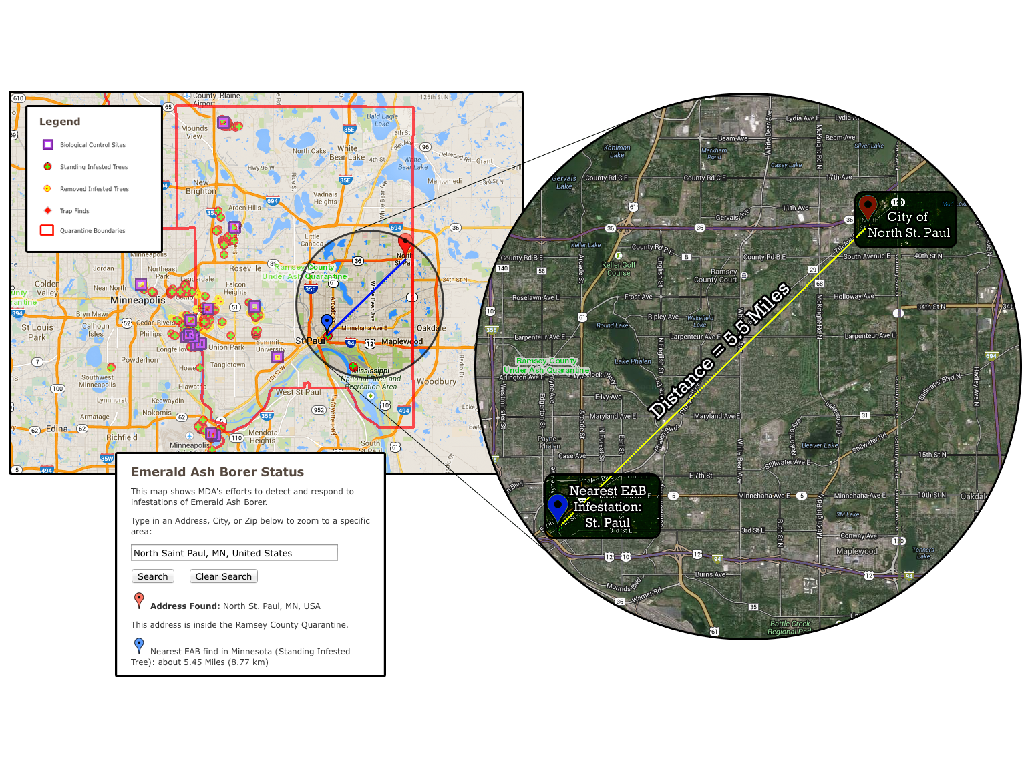
Neighboring EAB Infestations

Slide 6
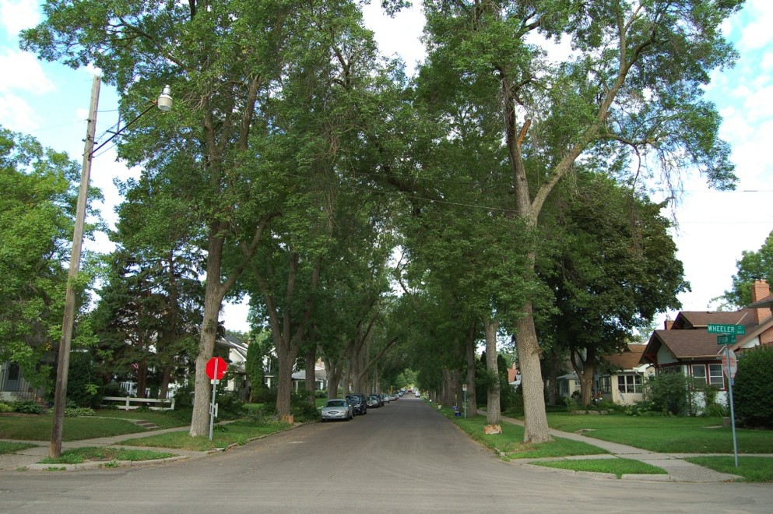
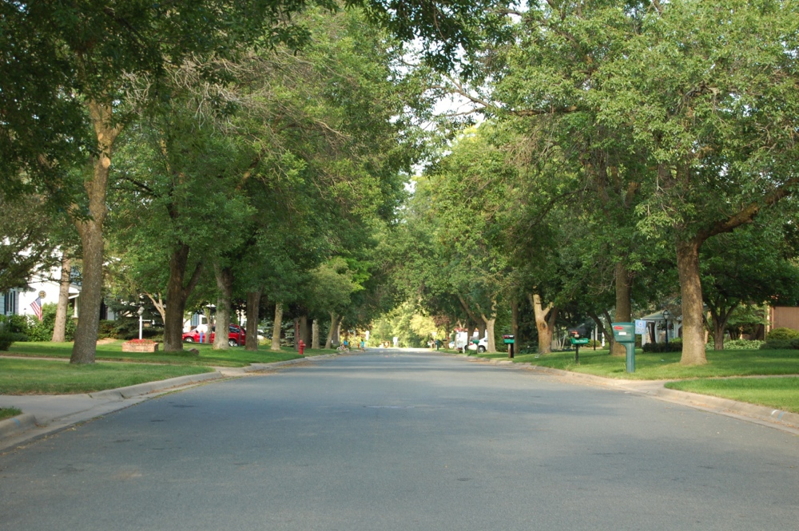
Ash Tree Dependence
Ash trees have been planted heavily relied on since Dutch elm disease destroyed elm populations
Overplanting of ash has occurred because of its desirable growth characteristics, tolerance of urban conditions and the tree’s abundant availability
Saint Paul Neighborhood
Shoreview Neighborhood
Photos Courtesy of Gary Johnson

Slide 7
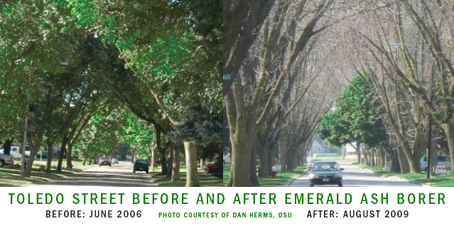
What’s the worst that can happen?
The cost of choosing not to implement an EAB management plan can be extremely expensive
  Trees killed by EAB can deteriorate within a couple years, and tend to fall over at the base
  Price of removals will rise as EAB spreads regionally due to widespread increases in demand for services

Slide 8
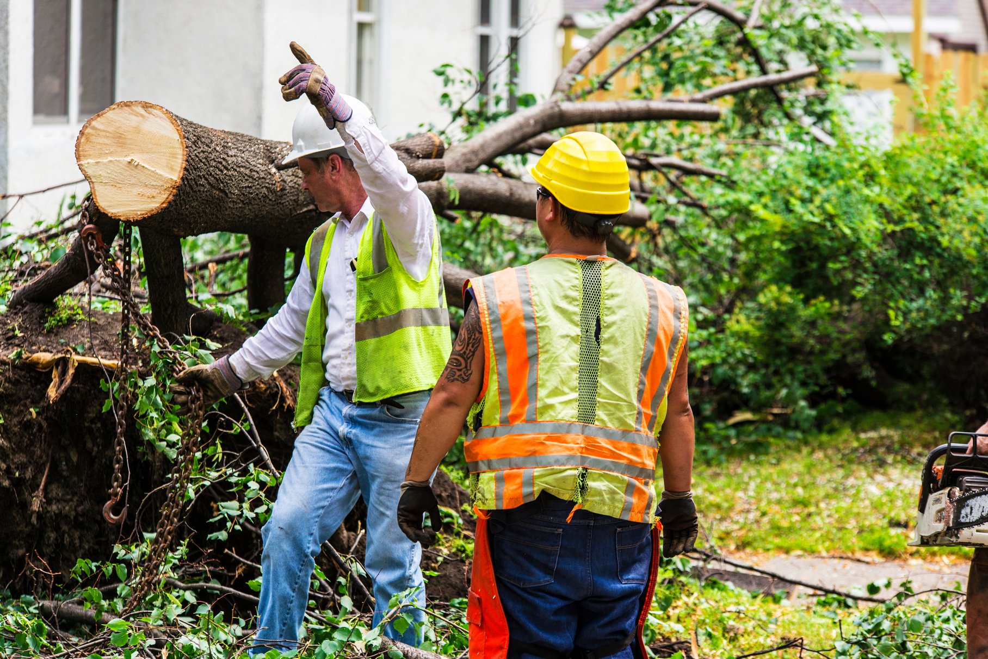
Avoid Burdens on City Resources
Image courtesy www.wilmingtonnc.gov

Slide 9
Reasons for a
Management Plan
Maximize the financial resources of North Saint Paul
Mitigate future epidemics by improving tree diversity
  Insect and disease problems should be expected and planned for
  Manage plantings so as not to exceed 10% of a single species
Maintain the character of the city’s urban forest
Preserve the benefits (economic, environmental, and cultural) provided by North St. Paul’s public trees

Slide 10
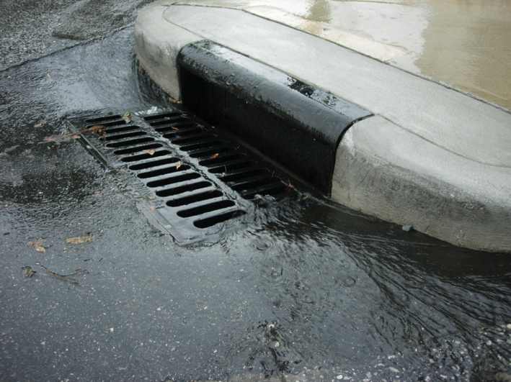
Environmental
& Community Benefits
Improved air quality
  Reduction of carbon dioxide released into the atmosphere
  (1,228,455 lbs. = 112 cars running annually)
Improved water quality
  Less storm water runoff into
  Ramsey/Washington County
  watershed (3,441,802 gallons)
Photos Courtesy of www.wilmingtonnc.gov

Slide 11
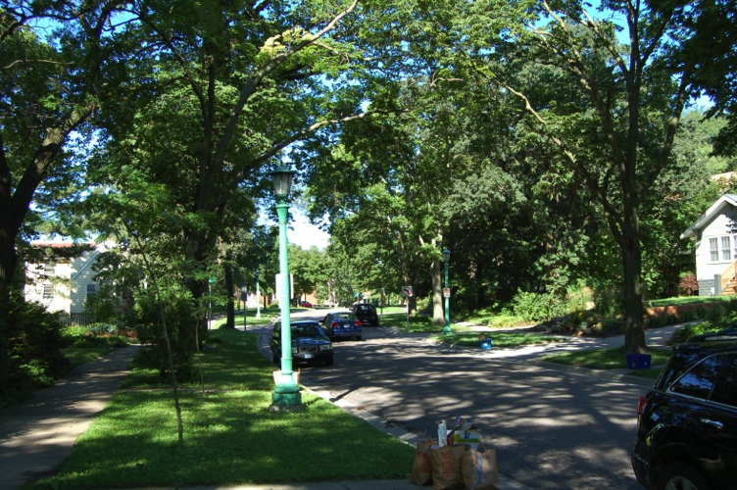
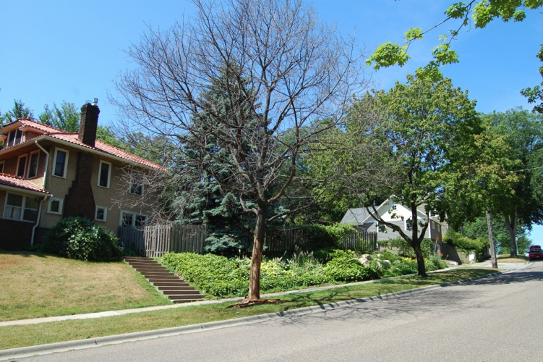
Economic Benefits of Public Ash Trees
  Annual economic savings to the City of North Saint Paul:
  Reduced energy (325,035 kilowatts/hr) and natural gas (42,912 therms) consumption
    Trees shade homes, reducing energy consumption for air conditioning
    Trees block winter winds, reducing energy use for heating homes
  Public trees save the city of North Saint Paul about $200,000 annually!
Photos Courtesy of Gary Johnson

Slide 12
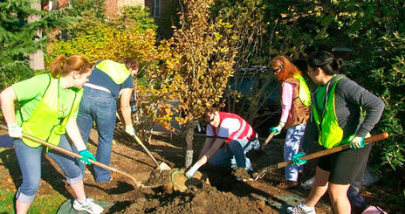
Cultural Benefits of Trees
Trees can improve sense of community
Healthy trees that are well-cared for make citizens feel safer and more comfortable
Tree planting and management can provide numerous community education and volunteer opportunities
Photos Courtesy of American University

Slide 13
Management Options
Remove and replace all public ash trees killed by EAB
Replace public ash trees that are young or in critical/poor condition and treat public ash trees that are mature or fair/good condition with insecticide to protect them from EAB
Staged removal of all ash trees at 10% per year

Slide 14
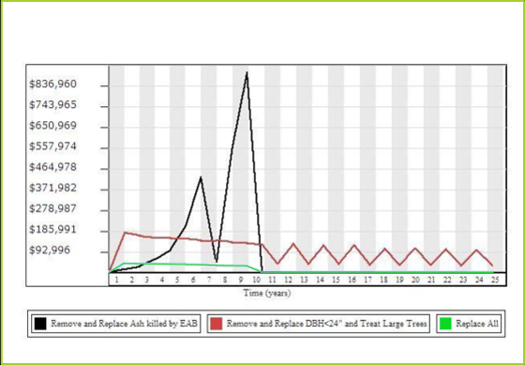
Annual Costs of Management Models

Slide 15
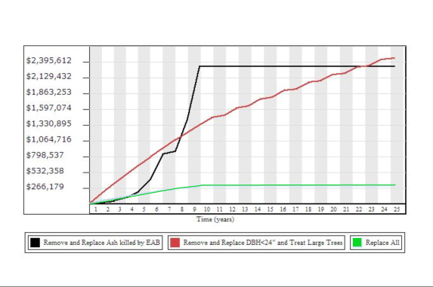
Cumulative costs of Management Models

Slide 16
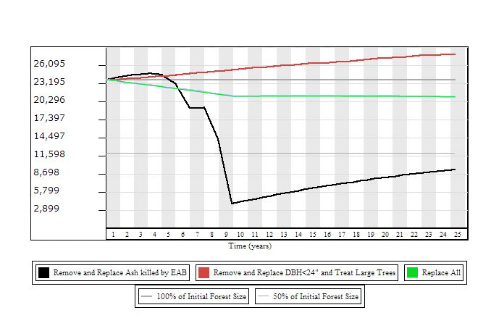
Annual DBH Per Management Plan

Slide 17
Management Options Summary
Each of these management options has separate economic and aesthetic consequences for the city
Costs and benefits extend beyond economic figures presented today when benefits of mature ash trees are considered
Timing of removals has major significance
Proactive measures will help North Saint Paul maximize its resources and minimize damage to the city’s health and character

Slide 18
Potential Resources
Minnesota Pollution Control Agency
Ramsey/ Washington County Watershed District
Soil and Water Conservation District
Izaac Walton League, Minnesota Division
Minnesota State Legislature – State Appropriation
Clubs/Programs
  Garden Clubs
  Environmental Clubs
  Master Gardeners Program

Slide 19
Acknowledgements
Special thanks to:
  Josh Bond, City Forester, City of North Saint Paul
  Jon Fure, Community Development Intern, City of North Saint Paul

Slide 20
Questions?

