Slide 1
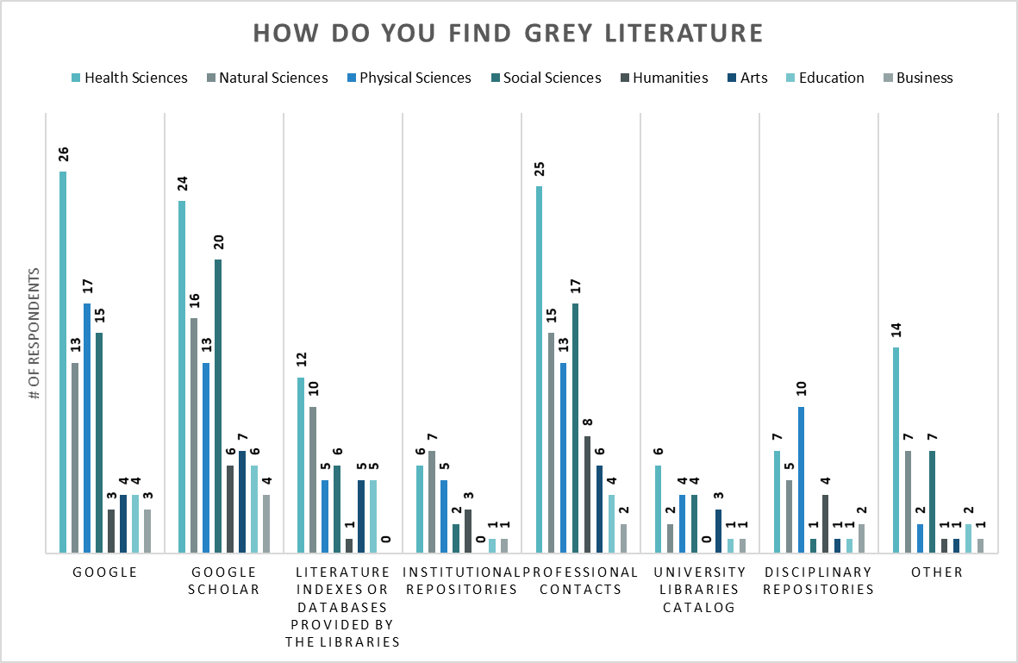
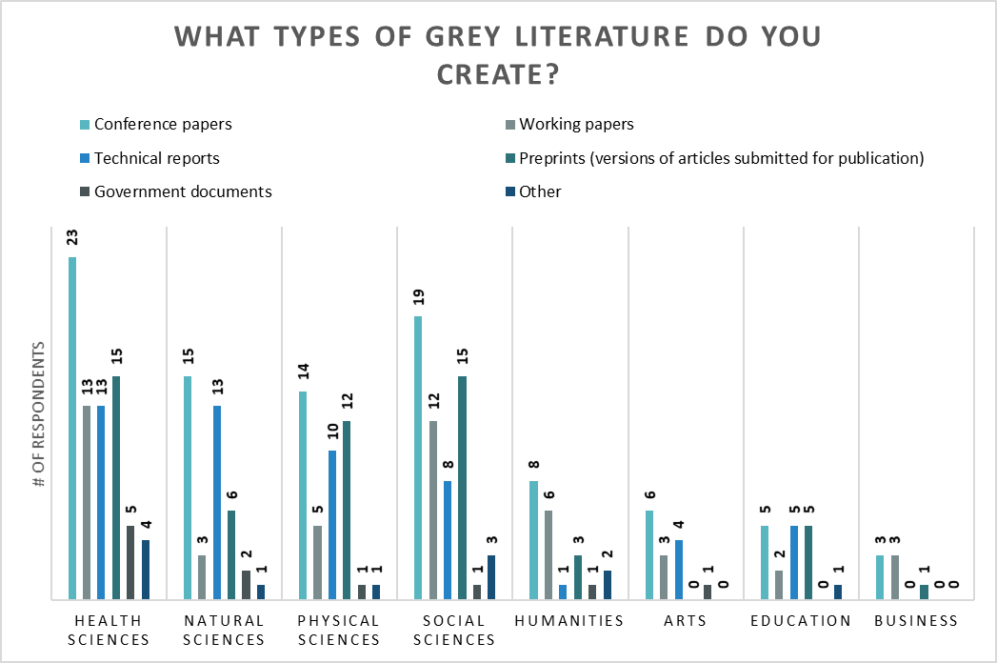
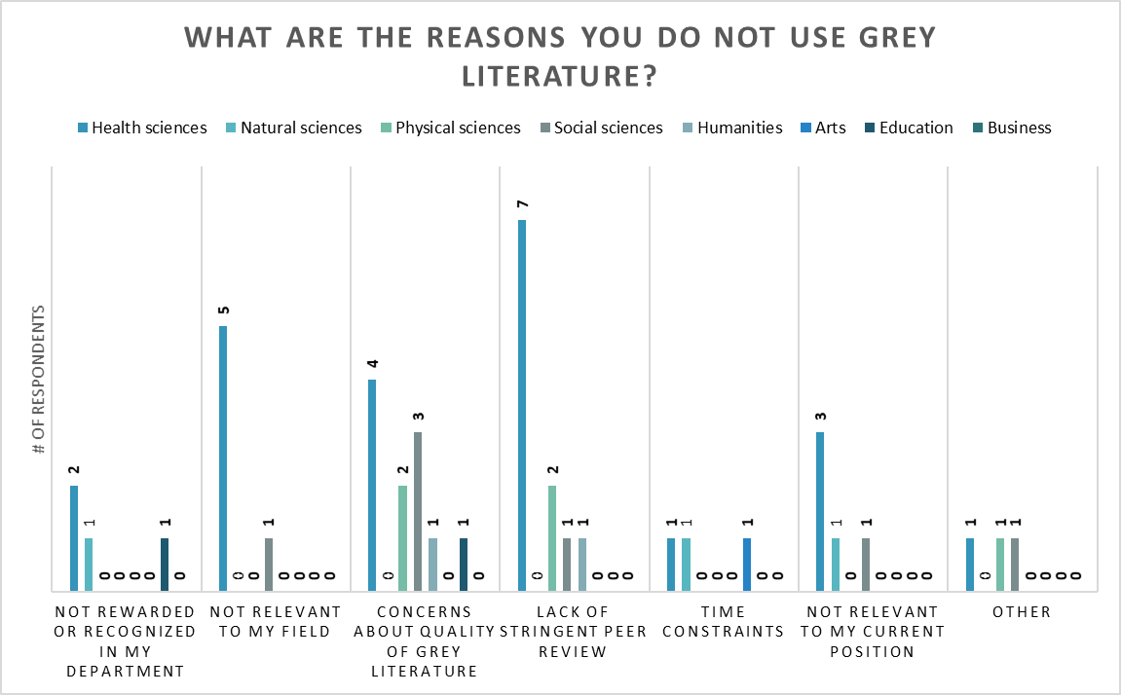
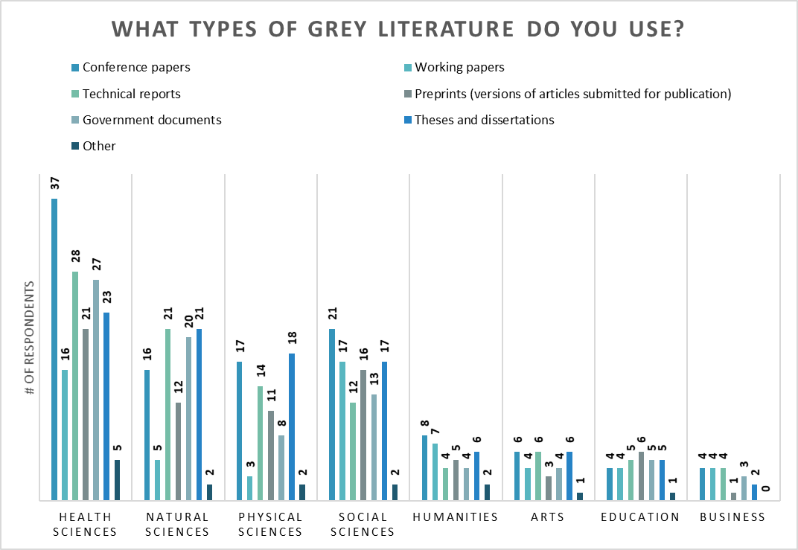
Examining Grey Literature Use, Citation, and Creation Practices of Faculty at a Large Institution
Kristen Cooper, Amy Riegelman, Wanda Marsolek, Shannon Farrell, and Julie Kelly
University of Minnesota Libraries
INTRODUCTION & METHODS
SURVEY RESULTS CONTINUED
SURVEY RESULTS CONTINUED
The study was designed to examine how faculty find, cite, and create grey literature across the disciplines of the University of Minnesota. The University of Minnesota is a large R1 institution with 18 colleges and 2300 faculty
Random sample of 57% of tenure and tenure track faculty (n = 1300).
  172 participated (response rate of 13.2%)
Distributed via Qualtrics
  Multiple choice and open ended survey questions
  Disseminated via email with 1 reminder message
A survey question asked respondents if they would agree to a follow-up interview.
  60 minute in person interviews conducted and recorded
SURVEY RESULTS
INTERVIEW RESULTS & NEXT STEPS
14 interviews were completed with an average length of 48 minutes
Those interviewed feel they are leaders in their fields and need to share information faster than scholarly channels allow
Additional works considered grey literature by interviewees
  Plain language summaries produced for general public
  Documentation of how data is created/analyzed
Transcribe and analyze interviews
Write and submit article for publication
PREVIOUS WORK
Marsolek, W. R., Cooper, K., Farrell, S. L., & Kelly, J. A. (2018). The types, frequencies, and findability of disciplinary grey literature within prominent subject databases and academic institutional repositories. Journal of Librarianship and Scholarly Communication, 6(1). https://doi.org/10.7710/2162-3309.2200

