Slide 1
The Decay Phase of Civilizations: some comparisons between Rome and the current situation
Presented on June 2, 2011 to the 50th anniversary meeting of the International Society for the Comparative Study of Civilizations (ISCSC) at Tulane University in New Orleans
by Michael Andregg, University of St. Thomas in St. Paul, Minnesota, USA
mmandregg@stthomas.edu

Slide 2
In 1961, Carroll Quigley wrote:
.
(in: The Evolution of Civilizations: An Introduction to Historical Analysis, Liberty Press)
“The Stage of Decay is a period of acute economic depression, declining standards of living, civil wars between the various vested interests, and growing illiteracy. The society grows weaker and weaker. Vain efforts are made to stop the wastage by legislation. But the decline continues. The religious, intellectual, social and political levels of the society begin to lose the allegiance of the masses of the people on a large scale. New religious movements begin to sweep over the society. There is a growing reluctance to fight for the society, or even to support it by paying taxes.”

Slide 3
I cited this in 1995, so it’s not a new thought.
…
The decay continues.

Slide 4
In 1999, I ran some early thoughts on this tough topic by the inimitable ISCSC
In, “The Waning Days of Ancient Rome and the Modern Era: Parallels and Echoes”
Presented to the ISCSC in St. Louis, MO, USA on May 22, 1999, but never published.

Slide 5
But what about all those Other Kingdoms and Empires?
K. of Egypt * Roman Mongol
Hittite Byzantine Ottoman
K. of Israel Sassanid European
Assyrian the Caliphate colonialism
Babalonian Seljuk American
Persian Saladin’s hegemony
Macedonian Crusader Kingdoms China?

Slide 6
That’s why we come to ISCSC!
Someone in this audience is guaranteed to know more about each of these historic empires than I ever could in a million years.
So I specifically invite all here to think about whether this alleged “decay phase” truly has parallels across many civilizations. Parallels with Rome are easy; what about the others?

Slide 7
First,
Let’s look at a quick animation …
… Of about 5,000 years of human history with a focus on empires and wars affecting the Middle East, from:
www.mapsofwar.com/images/EMPIRE17.swf
(a tad over 2 minutes for those on deadlines)

Slide 8
Here are 12 possible signs of decay
(from Quigley and others looking at questions of decay among civilizations)
1. Elevation of trivia to high importance.
2. Debasement of the currency and of institutions.
3. Imperial Overreach.
4. Decreasing #’s of citizens on the land producing wealth; increasing #’s of “idle mouths” in cities.
5. Increasing interest in cults, superstition, and in new ideas generally.

Slide 9
Here are 11 possible signs of decay
6. Significant population flows into the empire, and transfers of power to mercenary forces.
7. Significant power struggles with religious entities.
8. Rising authoritarianism with an increasingly isolated (or illegitimate) government.
9. Plague or fears of plague.

Slide 10
Here are 12 possible signs of decay
More generalized but widespread anxiety within the civilization.
Rising income inequalities.
Refusal to pay taxes or fight for the society.

Slide 11
So what does this mean for us?
All the more reason to test the question: Is there really a common ‘decay phase’ in civilizational processes?
And if so, what can we do about that as our common, global civilization faces problems that are truly novel, in scale if not in quality?

Slide 12
The Moral Crisis in U.S.
National Security Today
Michael Andregg
Justice and Peace Studies Program
University of St. Thomas in St. Paul, MN, USA
mmandregg@stthomas.edu
(produced for the Iowa peace caucus in Spirit Lake, IA, June 18, 2011)

Slide 13
Dimensions of the Moral Crisis:
1. We have murdered hundreds of thousands
of innocent people around the world.
2. Torture became official US policy.
3. U.S. Civil liberties have been assaulted.
4. A huge bureaucracy was created that NEEDS
enemies (e.g. 854,000 terrorism scp’s).
5. 9/11 was not as it has been described to be.

Slide 14
Practical Consequences:
Our allies are abandoning us because we have lost the moral high ground. Left it really.
Our enemies are multiplying.
We have squandered about $3 trillion doing it and are on course to bankrupt our children.
The greatest army ever built is being shot up moving back and forth through other people’s civil wars & our aircraft are burning out their engines due to 20 years of continuous warfare.

Slide 15
Meanwhile …
It is an objective, verifiable fact that American citizens today are more likely to be stung to death by bees than killed by a terrorist here. Or to be struck down by lighting or a tornado.
In fact, we are far more likely to kill ourselves with our own toasters, cars or handguns, and far more likely to eat ourselves to death than to be killed by actual terrorists in America.

Slide 16
But …
We are TERRIFIED by terrorists, or at least by
A significant industry that has arisen whose business is keeping Americans terrified by things that are less dangerous in objective, measureable terms than the bees, tornadoes and toasters.

Slide 17
Those Innocent People We Murdered:
The War against Iraq was sold by dramatically fraudulent information & objections within the U.S. intelligence community were suppressed.
There were NO weapons of mass destruction in Iraq.
Iraq had nothing to do with 9/11 or Al Qaeda. In fact Saddam Hussein was an active enemy of Islamic fundamentalists and jihadis.

Slide 18
The Downing Street Memo:
In July, 2002, the head of Britain’s foreign intelligence service (SIS, MI6) Sir Richard Dearlove, was sent to the US to determine the plans of our Administration regarding Iraq. He reported that:
“Military action was now seen as inevitable. Bush wanted to remove Saddam, through military action, justified by the conjunction of terrorism and WMD. But the intelligence and facts were being fixed around the policy.”

Slide 19
Factoid:
On September 15, 2001 (four days after 9/11) Secretary of Defense Donald Rumsfeld and his deputy Paul Wolfowitz advocate an attack on Iraq, noting the scarcity of “good targets in Afghanistan.”
First reported in Bob Woodward’s Bush at War, November, 2002.

Slide 20
Factoid:
Congress and the American people were told repeatedly that Iraq had tried to buy uranium “yellowcake” from Niger in Africa.
They were not told that major parts of the CIA disagreed with that, that the allegations were based on obviously forged documents, and that the former US Ambassador to Niger had been sent to check out the rumors and found them completely unsupportable by evidence.

Slide 21
Factoid:
Congress and the American people were repeatedly told that Iraq had purchased aluminum tubes destined to become centrifuges for uranium enrichment.
They were not told that the Dept. of Energy experts who actually refine uranium disagreed and determined the more obvious use was for basic artillery shells widely used by militaries.

Slide 22
Factoid:
Congress and the American people were repeatedly told that Iraq was building “mobile biological weapons labs.”
We were not told that this conclusion was based on a single source German intelligence warned us was a “drunken fabricator” who would say anything that pleased Western debriefers. We were also not told that Saddam’s son-in-law, who actually ran early biological weapons programs, told us that they had all been ended years ago.

Slide 23
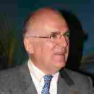
The Director of Britain’s MI6 said:
“The intelligence and facts were
being fixed around the policy.”

Slide 24
Factoid:
Attacking a nation which has not attacked you is a war crime according to the UN Charter, which America wrote and signed long ago.
This means that we have MURDERED many tens of thousands of innocent people.
The facts that Iraq did not have weapons of mass destruction and was an enemy of Islamic fundamentalists is just another aspect of this international war crime.

Slide 25

This 2006 book details many lies told to the U.S. public and the UN prior to the invasion of Iraq:

Slide 26
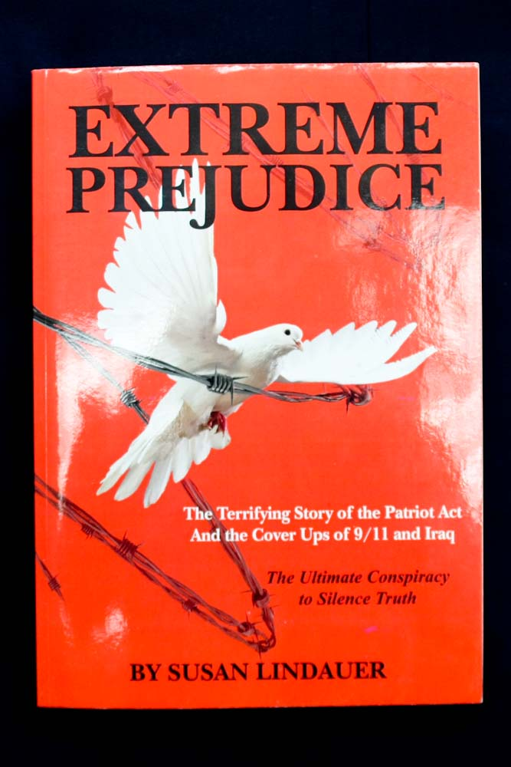
This 2010 book describes Iraq’s desperate efforts to make peace with the USA prior to the invasion:

Slide 27
Torture, some basic Facts:
A) It has been around for many centuries.
B) We decided torture was so bad for our own troops that we joined other civilized nations of the earth to sign a UN Convention on Torture that forbids torture without ANY exceptions.
C) We also wrote a domestic law forbidding it by U.S. troops, law enforcement or others without ANY exceptions whatsoever.
D) Then attorneys rationalized it for the GWOT.

Slide 28
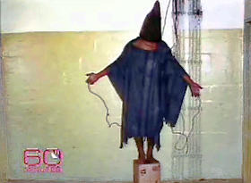
Then came Abu Ghraib
(a US prison in Iraq)

Slide 29
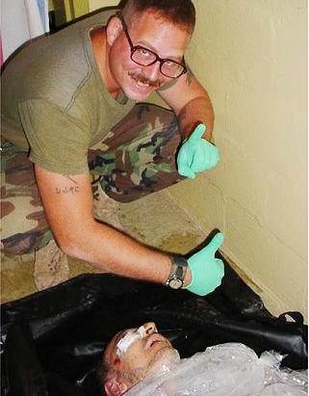
Here is a picture of a man who was beaten to death at Abu Ghraib

Slide 30
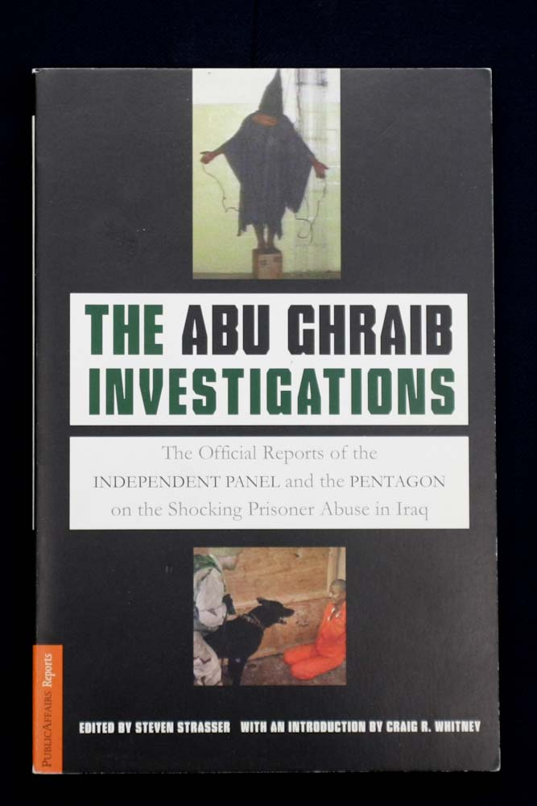
This book describes what happened at Abu Ghraib and at some other U.S. run prisons

Slide 31
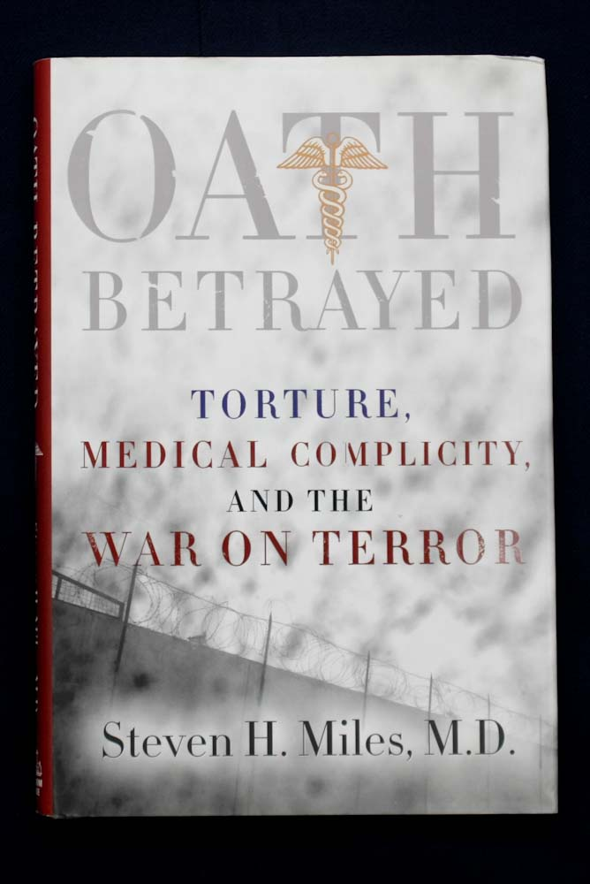
And this book describes the use of medical professionals to experiment on newer, “better” ways to torture people.

Slide 32
A Hundred Deaths in US Custody:
A 2006 report by Human Rights First (an NGO) claimed that almost 100 prisoners had died in US custody as of February of that year (2006).
The U.S. government’s own reporting classified 34 of these deaths as “confirmed or probable homicides.”
One became the subject of the 2007 Academy award winning documentary “Taxi to the Dark Side” about an innocent taxi driver beaten to death by US interrogators in Afghanistan.

Slide 33
This does not count people lost in
CIA “black prisons”
Those reports dealt only with U.S. military prisons subject to review by honorable men like Major General Antonio Taguba, who wrote the seminal report on Abu Ghraib in Iraq.
The CIA was simultaneously running a number of “black prisons” in countries like Poland, Romania and Thailand where other people simply disappeared.

Slide 34
Extraordinary Renditions:
This shameful period brought us new words like “extraordinary renditions” and “waterboarding.”
Extraordinary renditions are where CIA or Army Special Forces or contractors, or thugs hired to do dirty work, kidnap someone in another country, then take them to a “black” prison for torture.
The CIA abducted at least 3 complete innocents* who were citizens of allies that strongly objected (Italy, Germany and Canada).

Slide 35
Want to lose some good Allies?
Italy convicted 23 CIA personnel of abducting citizen “Abu Omar” from the streets of Milan.*
Germany decided not to indict, but condemned the abduction of citizen Khalid al Masri from Macedonia, who was tortured for five months then dumped on a hillside in Albania after the CIA recognized they had grabbed an innocent man.
Canada’s case was of citizen Maher Arar, who was tortured in Syria for 10 months before being returned to Canada and $9 million compensation.

Slide 36
And waterboarding?
“Waterboarding” is an ancient form of torture going back at least to the Spanish Inquisition.
But it was refined by US interrogators doing “SERE” training for our own troops and then applied to terrorism suspects as an “enhanced interrogation method.”
What matters is not method, it is what happens to a country when language, laws and moral standards are tortured to rationalize immorality.

Slide 37
The Yoo, Bybee and other “memos”
Aware they intended to commit war crimes, Vice President Dick Cheney got the Office of Legal Council to the U.S. President (George W. Bush) to work on rationalizations they could provide to interrogators at the CIA and Army who would actually be doing the beating, waterboarding and ultimately killing of some prisoners. Yoo and Bybee were OLC attorneys.

Slide 38
The Yoo, Bybee and other “memos”
They concocted a witches’ brew of lawyer rationalizations that pretended torture is just “enhanced interrogation” and concluded that U.S. Presidents could ignore ANY law, all U.S. treaties, all international law, and all national laws if s/he was acting as Commander in Chief during wartime.
This doctrine of unlimited Presidential Power is a direct assault on the US Constitution.

Slide 39
Other Changes in US Civil Liberties
The USA “Patriot Act” - loss of 4th amendment protections against undue search and seizure.
The “Military Commissions Act” – and the loss of habeas corpus (a very precious right).
The revisions of “FISA” to allow unlimited warrantless wiretapping of U.S. citizens.
Creation of a vast bureaucracy to spy on you.

Slide 40
The USA Patriot Act
The “Patriot Act” is extremely difficult to read because it is mainly hundreds of changes to preexisting laws. Many of those are perfectly understandable updates for the information age.
However, some provisions are Orwellian, like authorizing thousands of FBI agents to avoid judicial review by writing national security letters to anyone to compel their release of your private information and to require silence from them.

Slide 41
The USA Patriot Act
This feature makes it an ideal tool for cracking down on whistleblowers who try to reveal corruption or other wrongdoing to the public. It has already been used to attack several.
Hard to read and passed in a frantic rush right after 9/11, it is likely that no Congressman read it. But someone had to have written it long before, and put it on a shelf for the day.

Slide 42
The Military Commissions Act
Having tortured many people picked up in war zones the government had to find a way to prosecute them outside of normal legal rules that prohibit evidence obtained by torture.
Furthermore many of those imprisoned had been turned over to U.S. forces by locals seeking cash bounties, which guaranteed that some of those detained were quite innocent.

Slide 43
The Military Commissions Act
(continued)
The ACLU had this to say about that:
“In the final hours before adjourning in 2006, Congress passed and the president signed the Military Commissions Act. In doing so, they cast aside the Constitution and the principle of habeas corpus, which protects against unlawful and indefinite imprisonment. They also gave the president absolute power to designate enemy combatants, and to set his own definitions for torture.”

Slide 44
Revisions to the FISA* law
In 2006 a reporter for the Washington Post revealed that the NSA had been secretly, and illegally, collecting vast amounts of phone and email traffic in the United States among US citizens. Rather than exercising its oversight function to restrain this, Congress legalized it.
*FISA means: Foreign Intelligence Surveillance Act, a law that worked fine until it was ‘fixed.’

Slide 45
The Center for National Security Studies in Washington D.C. had this to say about that:
“The Justice Department’s “Fact Sheet” about its 2007 FISA bill omits the most important effect of its proposed changes:
It would permit the government to acquire millions of Americans’ international phone calls and e-mails without a warrant, so long as it vacuumed up the contents of these communications en masse, rather than targeting for acquisition the calls of a particular individual in the United States. And it would permit the government to then sort and analyze all those communications and listen to and distribute whichever ones it chose, in secret, with no warrant or meaningful oversight whatsoever. This would be a dramatic and drastic change to current law.”

Slide 46
“Top Secret America”
On July 19 2010, the Washington Post published the first results of a two year study of these changes called “Top Secret America.”
Among many facts revealed there, we now have about 854,000 people with top secret clearances many of whose jobs depend on finding terrorists. A secret facility is being built out west to run data through supercomputers that will consume as much electricity as Salt Lake City. And 33 other buildings were constructed in D.C. and near areas to house personnel and programs. People who need enemies will find some to justify budgets.

Slide 47
But what about 9/11?
All these changes, the wars in Afghanistan and Iraq, and the rushed legislation that sacrificed civil liberties won over centuries of conflict with tyrannical governments, were justified by continuous reference to “9/11.”
Yet unknown to many Americans, a formal and objective police inquiry into who did “9/11” and why has never been conducted. Why?

Slide 48
Why no real investigation of 9/11?
The answer to that disturbing question is because evidence available does not support the official story about who did 9/11 or why. Worse, evidence contradicts the official story.
Rather, evidence supports the conclusion that someone or some entity far more powerful than Osama Bin Laden and Al Qaeda had to be involved. Here are 7 factoids about that.

Slide 49
> 1400 Architects and Engineers
Over 1400 licensed architects and engineers have petitioned the government to review the collapse of World Trade Center buildings 1, 2 and 7 because, in their professional opinion, these show diagnostically distinct signs that the towers were brought down by controlled processes, not by fires. They have been ignored along with >11,000 other signers. Their website is: http://www.ae911truth.org/

Slide 50
World Trade Center Building 7
Building 7 is especially important because it was not hit by any aircraft, yet it came down completely symmetrically in less than seven seconds about 7 hours after two aircraft hit buildings 1 and 2. Video imagery looks very much like controlled demolitions, but Bldg. 7’s fall has almost never been shown on national television except on the day of 9/11/2001.
See: http://wtc7.net/

Slide 51
Jesse Ventura’s opinion
Former Governor of Minnesota and Navy Seal Jesse Ventura was convinced the official 9/11 story was a lie by his former SEAL demolitions instructor who concluded early on they had to be controlled demolitions. Ventura went on to produce a television documentary about the mysterious explosion at the Pentagon later that fateful day. You could watch his show on YouTube until it was taken down by someone.

Slide 52
Barbara Honegger’s Opinion
Barbara Honegger is much less famous than Jesse Ventura, but she was also the senior military journalist at the Naval Postgraduate School for many years. While there she pointed that the official story required someone to turn off the normal Pentagon air defenses and many other anomalies in the official story which have never been explained or even addressed by the official story. Her essay is at: www.physics911.net/pdf/honegger.pdf

Slide 53
Col. George Nelson’s Opinion
Col. George Nelson spent 34 years in the U.S. Air Force, partly as an official aircraft disaster reviewer. He says this at “patriots question 9/11” http://patriotsquestion911.com/pilots.html
"In all my years of direct and indirect participation, I never witnessed nor even heard of an aircraft loss, where the wreckage was accessible, that prevented investigators from finding enough hard evidence to positively identify the make, model, and specific registration number of the aircraft -- and in most cases the precise cause of the accident. ...
The government alleges that four wide-body airliners crashed on the morning of September 11 2001, resulting in the deaths of more than 3,000 human beings, yet not one piece of hard aircraft evidence has been produced in an attempt to positively identify any of the four aircraft. On the contrary, it seems only that all potential evidence was deliberately kept hidden from public view.”

Slide 54
Hundreds of other professionals
Have asked hundreds of other ???
Hundreds of other pilots and scientists have raised serious questions about the official story which have gone unanswered except by internet blog “debunkers.”
Hundreds of military officers, firefighters,
Hundreds of professors, and hundreds of other professionals have asked why no serious investigation has ever been done on 9/11.

Slide 55
Steven Jones, and 8 other authors
Emeritus BYU physics professor Steven Jones has been asking about the evidence of thermitic incendiary material (military steel cutting compounds) at the World Trade Centers for years.
In 2009 Jones published, along with 8 coauthors from several countries, a peer reviewed paper that shows pictures of steel-cutting thermate chips and spherical balls of iron in dust from the trade center collapses. Both are evidence that military style steel cutting occurred there.

Slide 56
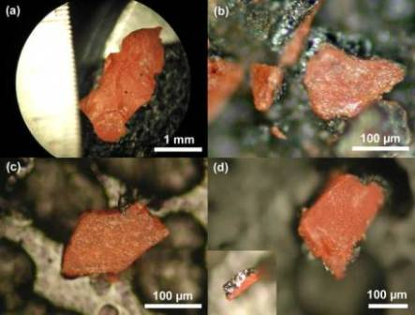
Photos of Thermate Chips in 9/11 dust:
. from the Niels Harrit et al. paper in a peer-reviewed, chemistry physics journal. The original can be seen at:
. http://www.benthamscience.com/open/tocpj/articles/V002/7TOCPJ.pdf

Slide 57
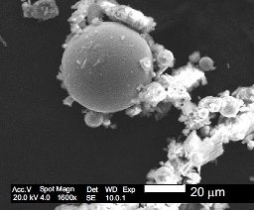
Photo of Microspheres in Dust:
.
Many, iron rich microspheres were also found in that 9/11 dust, which is evidence of steel melting and then solidifying in air. If this finding is valid, it should be confirmable from thousands of other samples of 9/11 dust collected by many New Yorkers during those difficult days.

Slide 58
Why does it matter if 9/11 was a lie?
Why does it matter if we were lured into an unnecessary, illegal and immoral war in Iraq that has killed thousands of Americans and hundreds of thousands of other people?
Why does it matter if our precious civil liberties have been sacrificed in the name of a false security from amped up “terrorists?”
Why does it matter if we are bankrupting our country pursuing phantoms in a perpetual war?

Slide 59
A different hypothesis to consider:
1 – Osama bin Laden’s group thinks up a plan to attack America with hijacked aircraft.
2 – Someone much more powerful learns about that plan and starts to follow them.
3 – Someone much more powerful decides to piggyback on the plan and enhances effects.
4 – One result is an excuse for endless war, huge budgets and reduction of civil liberties.

Slide 60
“Empires have no interest in operating within an international system; they aspire to be the international system. Empires have no need for a balance of power. That is how the United States has conducted its foreign policy in the Americas, and China throughout most of its history in Asia.”
-- Henry A. Kissinger, 1994, in “Diplomacy.”

Slide 61
Produced by
Michael M. Andregg
mmandregg@stthomas.edu
who is responsible for all errors of analysis or alleged fact.
For more info about the author, see
http://en.wikipedia.org/wiki/Michael_Murphy_Andregg

