Slide 1
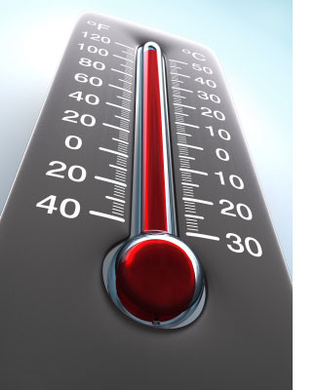
How to Setup a Temporary Booth
Part 6:
Cook Temperatures
Notes:
How to setup a temporary booth, part 6: cook temperatures

Slide 2
Food Cook Temperatures
165°F for 15 seconds
  Poultry
  Poultry stuffing
  Stuffed meat
  Stuffing containing meat
  Leftovers
  Reheating
155° for 15 seconds
  Ground beef
  Hamburgers
  Uncooked brats
  Uncooked polish sausage
Notes:
Poultry, poultry stuffing, stuffed meat and stuffing containing meat, and leftovers/reheated food items should be cooked to 165°F for 15 seconds
Ground beef/hamburger, Uncooked brats or polish sausage to 155°F for 15 seconds

Slide 3
Food Cook Temperatures
145°F for 15 seconds
  Fish
  Raw shelled eggs for immediate service
  Pork chops/ribs
145° for 4 minutes
  Whole pork, beef roasts, and ham
Notes:
Fish, Raw shell eggs prepared for immediate service , pork chops, and ribs to 145°F for 15 seconds

Slide 4
Food Cook Temperatures
135°F for 15 seconds
  Fruits and vegetables cooked for hot holding
Special Considerations:
  Shrimp
  Lobster
  Crabs
  Clams
  Oysters
  Mussels
  Scallops
Notes:
Shrimp, lobster and crabs should be cooked until flesh is pearly and opaque. Clams, oysters, and mussels should be cooked until the shells open during the cooking procedures. Scallops should be cooked until flesh is milky white or opaque and firm

Slide 5
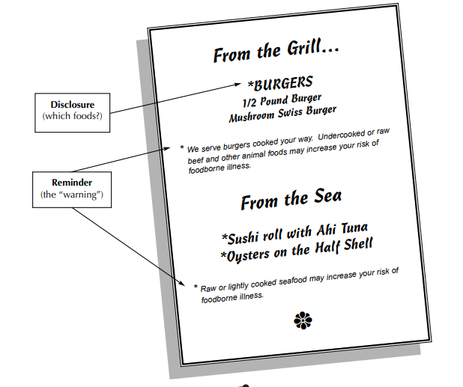
https://www.milwaukee.gov/ImageLibrary/Groups/healthAuthors/CEH/PDFs/consumer_advisories.pdf
Notes:
A printed consumer advisory is required when serving or selling raw or undercooked foods. Some examples of raw or undercooked food items include: medium-rare hamburgers, raw oysters, sushi, or ceviche.
A consumer advisory includes two parts: the DISCLOSURE notes which Animal foods may be ordered raw, rare, or undercooked. These food items are usually marked with an asterisk leading to a footnote that states the foods are being served raw or undercooked. The REMINDER is a written statement identifying the health risks of consuming the raw or undercooked animal food must be provided. The reminder statement may be put on any page of the menu, on a placard, table tent, or by any other written means

Slide 6

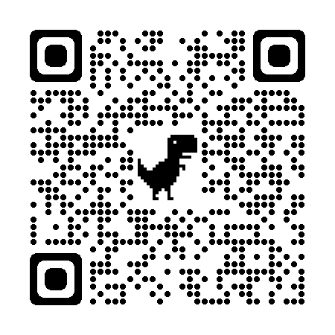
www.milwaukee.gov/health/tempfood
Notes:
Additional information, including printable guidance documents in English and Spanish can be found on the City of Milwaukee Health Department website, or by scanning the QR code located on the screen.

