Slide 1
Food Safety at Temporary Events in Milwaukee, Wisconsin
By Sadie Schuldt
A Capstone Project
submitted in partial fulfillment of the requirements
for the Applied Sciences Leadership Masters of Professional Studies to the
College of Continuing and Professional Studies
of the
University of Minnesota
April 17th , 2022
Notes:
Food Safety at Temporary Events in Milwaukee, Wisconsin. A Capstone Project submitted in partial fulfillment of the requirements for the Applied Sciences Leadership Masters of Professional Studies to the College of Continuing and Professional Studies of the University of Minnesota. April 17th , 2022

Slide 2
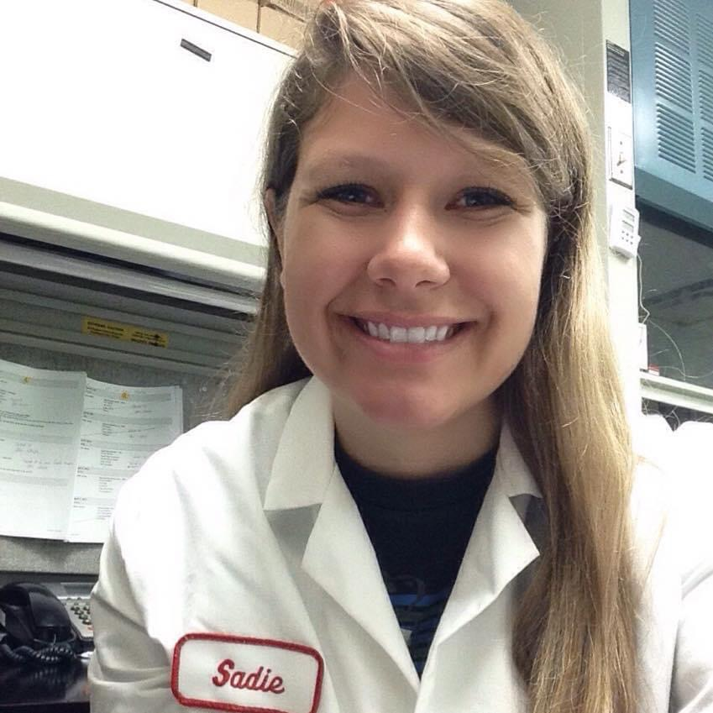
I am an Environmental Health Coordinator; I oversee all temporary event inspections in the City of Milwaukee
Notes:
I’m Sadie Schuldt, I am an environmental health coordinator for the City of Milwaukee Health Department. I oversee all temporary event inspections in the City of Milwaukee.

Slide 3
Capstone Overview
Provide operator training and educational outreach
Reduce violations related to food safety
Series of 8 training videos
  Includes slide show presentations
Notes:
Operator outreach is something I dedicate a large amount of time and energy to. Many operators are unfamiliar with the food safety requirements for selling food to the general public. For larger festivals and events, I will provide an in-person training session. This is a very large time commitment. Many times, operators do not retain the information because they are overwhelmed. This is why I decided to create a series of eight short training videos that operators can watch, pause, and rewatch as needed. With these videos, I have accomplished two objectives: Provide educational outreach and reduce violations.
related to food safety. I will briefly touch on each of the videos in the following slides:

Slide 4
Licensing
Is a license needed for your event?
How to submit application and payment
What to do once you get your license
Notes:
Video 1: Licensing. Not every type of vendor will require a temporary food dealer license. this presentation, helps determine if you need a temporary event license to sell food in the City of Milwaukee; how to submit an application and payment for the license, and how to obtain your license.

Slide 5
Temporary Event Booth Construction
Roof and wall construction
Lighting and electrical power
Flooring,
Dry storage
Special considerations for grill areas
Potable water
Waste water and grease
Garbage
Portable toilet facilities
Pest control,
Petting zoos
Notes:
Video 2 explores the requirements for the construction of a temporary event booth including: roof and wall requirements, lighting, flooring, dry storage, special considerations for grill areas, potable water, waste water and grease, garbage, electrical power, portable toilet facilities, pest control, petting zoos.

Slide 6
Hand Hygiene
How to properly wash hands
Areas that are most often missed when washing hands
When to wash
How to setup a temporary handwash station when water under pressure is not available.
Notes:
Video 3 explains how to properly wash hands and identifies the areas that are most often missed when washing hands. A brief explanation of when to wash is also discussed. The segment is concluded by visually showing and verbally explaining how to setup a temporary handwash station when water under pressure is not available.

Slide 7
Employee Health & Hygiene
Overview of personal health and hygiene requirements
Management’s requirements for excluding or restricting ill employees
Notes:
Video 4 provides an overview of personal health and hygiene requirements for staff working at a temporary event food booth along with Management’s role for excluding or restricting ill employees.

Slide 8
Cleaning & Sanitation
How to heat water at your event
Proper warewashing procedures
Common sanitizers
Sanitizer concentrations
Alternatives to warewashing.
Notes:
Video 5 focuses on cleaning and sanitation. Topics covered in this segment include: how to heat water at your event, proper warewashing procedures, common sanitizers and their concentrations, and alternatives to warewashing at your event.

Slide 9
Food Safety
Temperature control
Thermometers
Cold holding
Cooling
Using ice
Hot holding
Reheating
Notes:
Video 6 discusses temperature control, thermometers, cold holding, cooling, using ice, hot holding, and reheating.

Slide 10
Cook Temperatures
Cooking temperatures
When and how to use a consumer advisory
Notes:
Video 7 the final food safety informational presentation. Cooking temperatures of various food items are discussed in detail along with when and how to use a consumer advisory when uncooked or undercooked food items are served.

Slide 11
Food Safety Data
Overview of the mini-series
Overview of national foodborne illness data
Pathogens
Norovirus
The CDC’s 5 foodborne illness contributing factors
Temporary event inspections conducted in Milwaukee, Wisconsin in 2018, 2019, and 2021
The CDC’s five intervention strategies to avoid foodborne illness
Notes:
Video 8 concludes the mini-series. The presentation explores: an overview of national foodborne illness data; pathogens; norovirus; The CDC’s 5 foodborne illness contributing factors; the number of temporary event inspections conducted in Milwaukee, Wisconsin in 2018, 2019, and 2021; a review of CDC’s 5 risk factors and temporary event data; and the CDC’s five intervention strategies to avoid foodborne illness

Slide 12
Capstone Process Overview
Create script, explore and decide on video software
Create PowerPoint presentations for training videos. Interpret temporary event data
February 2022
March 2022
March 2022
April 2022
Adapt Project due to project scope being too large for anticipated time frame. Obtain temporary event data
Record training videos, create transcript of videos for final paper, work on final paper and polishing the presentations
Notes:
In February 2022 I started to create the script for the training videos. I also explored several different types of video software and presentation designs. I ultimately decided to use Microsoft PowerPoint for the presentation as I had more control over the length, graphics, and design. In March, I had to pivot from my original proposed capstone plan, which included creating the training videos, showing them to operators, and solicitating feedback on the effectiveness. After meeting with my advisor, Dr. van de Ligt, and Carrie Rigdon at the Department of Agriculture for the State of Minnesota, I decided to remove the effectiveness feedback for this project. This is something that I will analyze post graduate studies. March also included creating the powerpoint presentations for the 8 videos and obtaining and analyzing the temporary event data from 2018, 2019, and 2021 temporary event inspections. In April 2022 I recorded all of the video presentations, created a transcript of the videos for the final paper, worked on polishing the final product.

Slide 13
Key Concepts Learned:
Technology take a long time to understand
Resources exist, you just need to ask
Go with the flow
Notes:
Throughout the course of this capstone project, three themes became apparent to me which allowed me to grow as an individual and as an emerging leader. The first key concept was that Understanding technology takes a long time. In order to have things the way you want them on a powerpoint takes a lot of trail and error. Same with using excel spreadsheets to compile data. I still do not understand how some of my data turned out the way it did after indepth exploring! Or even just how to set-up two monitors for easier presentations with notes! Technology takes a long time to understand, but it is one of the most important tools we have.
The second key concept was learning how to ask for help, guidance, or feedback. All of my classmates, professors, advisors, coworkers, peer reviewers, and family were all instrumental in this project. I learned that utliziing key resources is a great tool and skill to have. Not being shy of constructive critisms or feedback is incredibly important. There are resources everywhere, you just need to ask.
The final key concept I learned was to go with the flow. I am a structured individual and I like to have set dates and timeframes. When I discovered how long it took me to understand some of the technology aspects, I found myself stressing out. Having regular meetings with my advisor helped. She helped me to look at things differently. I changed my powerpoint theme and colors to be as friendly to individuals who cannot see certain colors.people, I did not think that using blue and green could cause some individuals to not be able to see my presentations! Going with the flow when hiccups did happen was crucial for this project along with using all of the skills learned throughout this two year program.

Slide 14

Thank you!
Any questions?
You can find me at:
schul864@umn.edu or
sschuldt@milwaukee.gov
Notes:
I would like to thank you for watching my Capstone presentation. If you have any questions, I can be reached at my university email or my health department email both shown on this slide.

