Slide 1
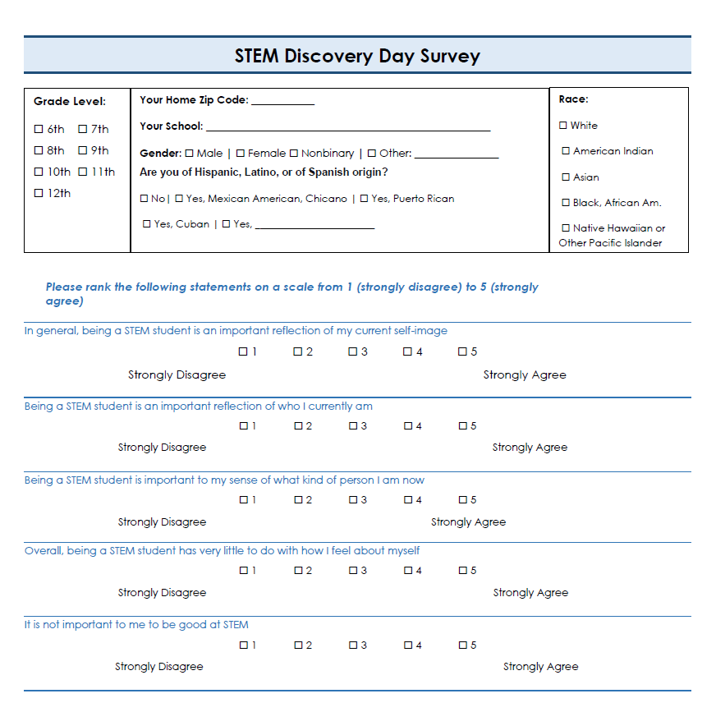
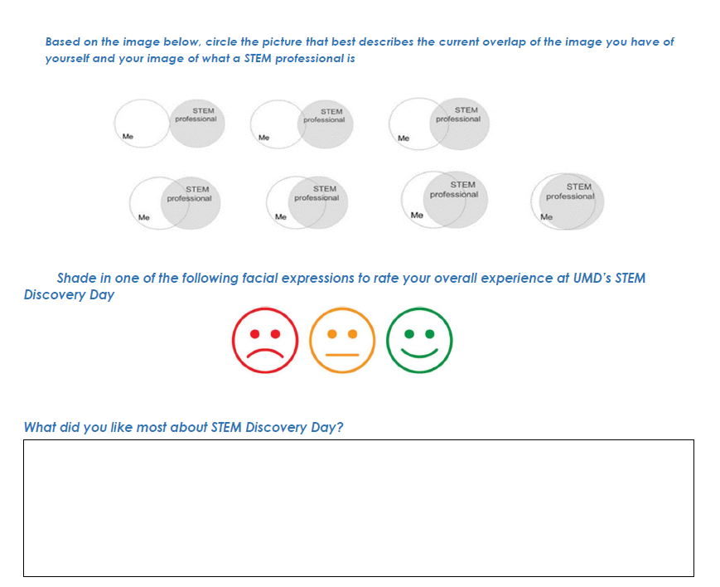
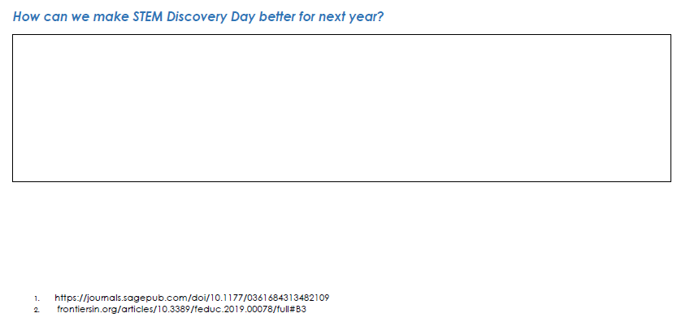
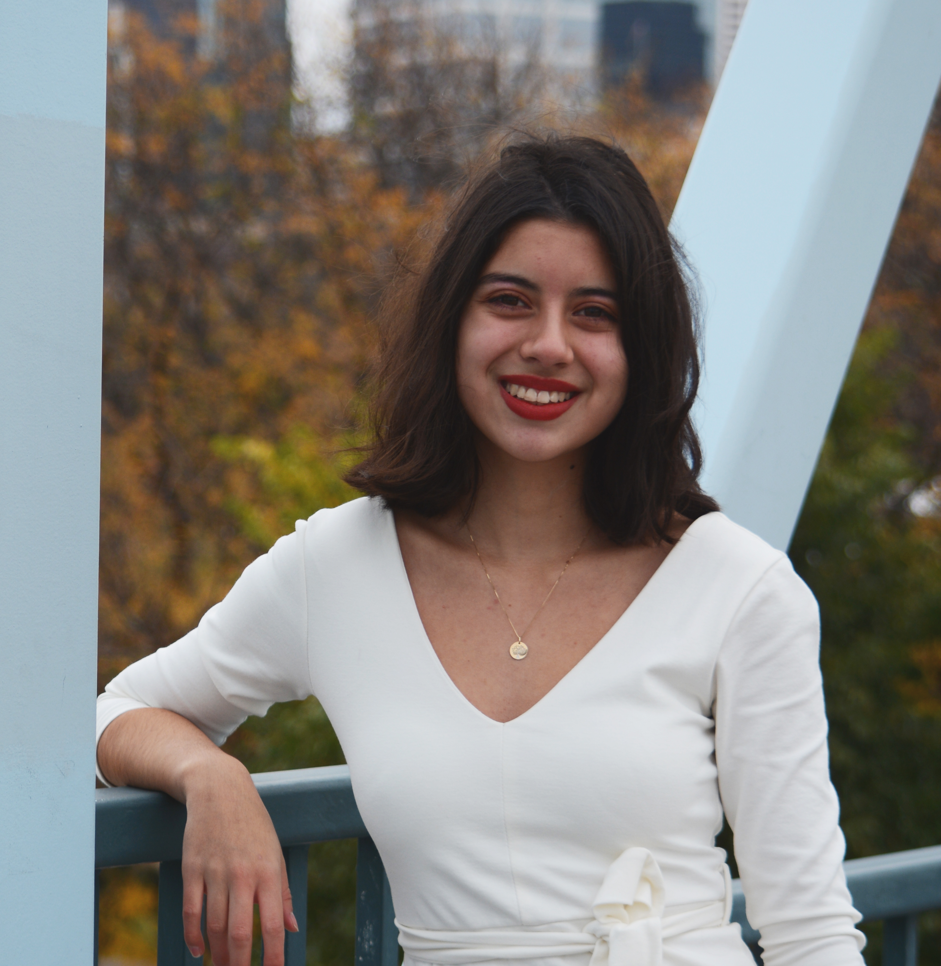
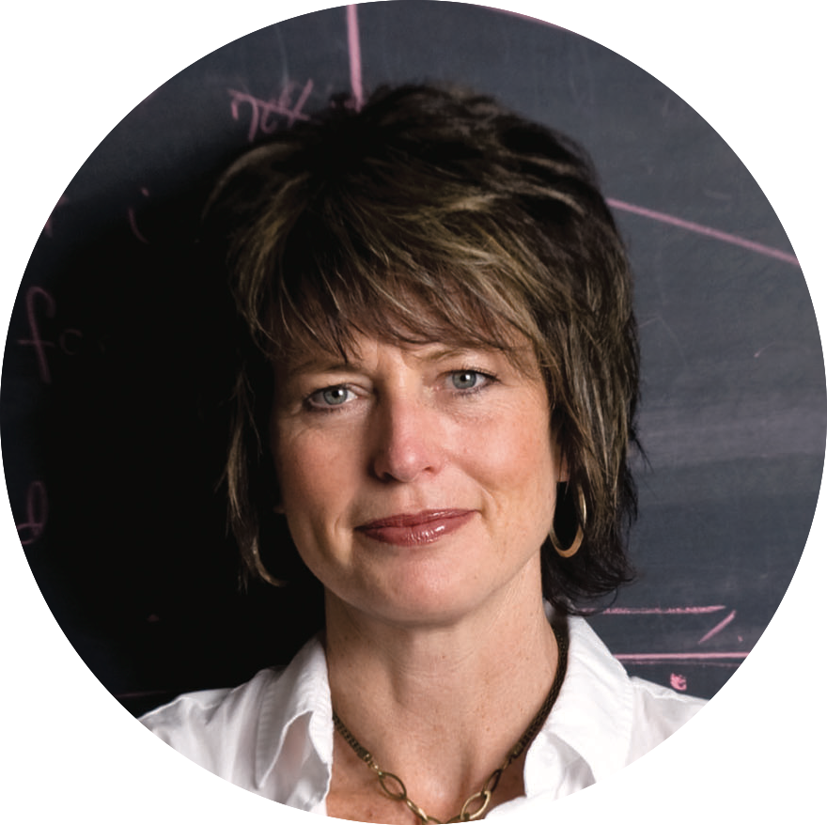

Developing an Assessment Instrument for Outreach Events to Measure Impact on STEM Identity of Middle and High School Students
Student Researcher: Helena Parranto
Faculty Advisor and Investigator: Dr. Tracy Bibelnieks
University of Minnesota Duluth, Department of Mathematics & Statistics
o
Thank you to Dr. Tracy Bibelnieks from the Mathematics & Statistics department for working with me on creating this UROP.
Thank you to Dr. Amy Kireta, the Director Coordinator for SCSE Outreach, for proposing this idea to the Outreach committee and recommending me to the Outreach committee to be the student researcher for this UROP.
Abstract
Evaluation Instrument Overview
Using the Survey in the Future
There is a large body of research literature that uses quantitative and qualitative methods to identify factors affecting attitudes, interest and motivation of k-12 students to engage in and pursue STEM related activities, academic programs and careers [Potvin, 2014]. Furthermore, impact of stand-alone events directed at middle and high school students [Badri, 2016] has been studied for impact on development (or reconsideration) of a students’ STEM identity in the context of their community, school and further STEM career goals. The STEM outreach events such as UMD’s Swenson College of Science and Engineering STEM Discovery Day have the potential to positively influence the STEM identity of middle and high school participants that could potentially lead to those students selecting a STEM degree in college. Through this research, baseline data from STEM Discovery Day can be used to research and create an evaluation instrument that will measure STEM Identity in future SCSE Outreach events.
Due to COVID-19, we were unable to use and test the Evaluation Instrument due to STEM Discovery Day being cancelled. SCSE Outreach is planning on using this survey once big events are safe and able to resume.
By using this survey, the Outreach will be able to make STEM Discovery Day and any other events, such as the Iron Range showcase, more appealing and engaging to middle and high school students.
Once we can use the survey, we will be able to collect the data and create a structural equation model to determine how attending STEM Discovery Day impacts a students STEM identity and their decision to select a STEM related degree at the college or university level.
Project Significance
This research has created an evaluation instrument to measure the STEM Identity in Middle and High School students. This tool can now be used in future SCSE Outreach events to measure how students see themselves in STEM related fields and how the Outreach events impact the way these students see themselves in STEM.
It can also be used to improve and increase STEM identity in students in future SCSE Outreach events.
References
Approach
1. Badri, Masood, et. al. 2016. “My science class and expected career choices—a structural equation model of determinants involving Abu Dhabi high school students.” International Journal of STEM Education, 3, Article no. 12. https://stemeducationjournal.springeropen.com/articles/10.1186/s40594-016-0045-0#Sec1
2. Carlone. 2007. “Understanding the Science Experiences of Successful Women of Color: Science Identity as an Analytic Lens.” Journal of Research in Science Teaching . Wiley Online Library.https://onlinelibrary.wiley.com/doi/10.1002/tea.20237.
3. Kang, Hosun, Barton, Angela, Tan, Edna, Rhee, Hyang-yon, Turner, Chandler, and Simpkins, Sandra D. 2018. “How do middle school girls of color develop STEM identities? Middle school girls’ participation in science activities and identification with STEM careers.” Wiley online library. https://doi.org/10.1002/sce.21492
4. McDonald, Melissa M., Virgil Zeigler-Hill, Jennifer K. Vrabel, and Martha Escobar. 2019. “A Single-Item Measure for Assessing STEM Identity.” Frontiers in Education 4. https://doi.org/10.3389/feduc.2019.00078.
5. Potvin, Patrice, Hasni, Abdelkrim (2014) “Interest, motivation and attitude towards science and technology at K-12 levels: a systematic review of 12 years of educational research, Studies in Science Education.”Vol 50:1, 85-129, DOI: 10.1080/03057267.2014.881626
6. Waters, Sarah, Schroeder, Brandon, and D’Augustino, Tracy. 2018. “Place-Based Education: Connecting to STEM Learning Experiences.” Connected Science Learning, no. 7. Up http://csl.nsta.org/2018/09/place-based-education/.
7. Young, Danielle M., et al. “The Influence of Female Role Models on Women’s Implicit Science Cognitions.” Psychology of Women Quarterly, vol. 37, no. 3, Sept. 2013, pp. 283–292, doi:10.1177/0361684313482109
Ideation:
Creating the evaluation tool in time for the STEM Discovery Day event March 2020. Collecting information on what impacts a student’s STEM identity was the key to identifying what questions to ask students and will give us the best feedback. Once data from the survey is collected, the data will be analyzed by the structured equation modeling (SEM).
Research Collection:
  Research Usage:
    All research used contributed to creating the Stem Discovery Day survey. The survey would have been distributed at the end of the STEM Discovery Day event in March 2020. Due to COVID-19, STEM Discovery day was canceled, and the evaluation tool was never used. The survey was approved for use by the IRB and will be used by the Outreach for future events.
  The STEM outreach events such as UMD’s Swenson College of Science and Engineering STEM Discovery Day have the potential to positively influence the STEM identity of middle and high school participants that could potentially lead to those students selecting a STEM degree in college. Measuring impact requires gathering baseline data and then, along with researched based methods [McDonald, 2019][Young, 2013]
  Currently, there is a decline in students wanting to learn and peruse STEM related fields and careers [Badri, 2016].
  “Numerous research pointed out that the science class and what goes on there and how it is presented play a significant role in building students’ interest toward science [Badri, 2016]”. Being able to create an event—like STEM Discovery Day—that will spark curiosity and interest in students will encourage students to consider STEM degrees.
  Students are more interested in STEM related fields in the primary schooling age rather than in secondary schooling age. “The level of interest among some students, which at the primary school had been high, appeared to have dropped considerably so that those students who had the greatest primary science experience now gave the lowest response to questions about interest in future school science topics [Badri, 2016]”. Contributing factors to negative attitudes and decreased interests in STEM fields are…
    Lack relevance to curriculum to make students interested
    Traditional approach to teaching STEM material/teaching practices
    Using stereotypes on what “looks” like a scientist. Accidentally or not.
    Classroom environment
Acknowledgements
This survey first collects basic demographic data of each individual student. This data was collected so that we could see the impacts of STEM identity based on gender, school, race, residential area (by zip code), and grade level.
There are five statements that are meant to measure each students STEM attitudes and STEM identity. The survey asks students to rank each question from 1 (strongly disagree) to 5 (strongly agree). These questions were based on the study “The Influence of Female Role Models on Women’s Implicit Science Cognitions” written by Danielle Young , Laurie Rudman, Helen Buettner, and Meghan McLean where science identities—rather than STEM as a whole—was being measured.
On this survey, students are shown different overlapping images that overlap STEM professional and “Me” (the individual student taking the survey) to see how the student see themselves and what their image of a STEM professional is. A student’s idea of what a STEM professional is dependent on their experiences and what STEM professionals and figures look like to them. This part of the survey was adapted from the research “A Single-Item Measure for Assessing STEM Identity”.
Helena Parranto
BAS Teaching Mathematics
Dr. Tracy Bibelnieks
Associate Professor
Mathematics & Statistics

