Slide 1
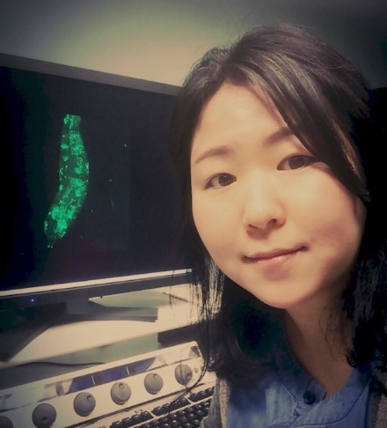
“Dissemination of Ras^{V12}-transformed cells requires the mechanosensitive channel Piezo”
Department of Biology Seminar
Jiae Lee, Senior Fellow, Kwon Lab, University of Washington
Friday, September 11, 2020
On Zoom at https://z.umn.edu/scsefriday at 3:00 p.m.
Host: Dr. Nam Chul Kim
Dissemination of transformed cells is a key process in metastasis. Despite its importance, how transformed cells disseminate from an intact tissue and enter the circulation is poorly understood. Here, we use a fully developed tissue, Drosophila midgut, and describe the morphologically distinct steps and the cellular events occurring over the course of Ras^{V12}- transformed cell dissemination. Notably, Ras^{V12}-transformed cells formed the Actin- and Cortactin-rich invasive protrusions that were important for breaching the extracellular matrix (ECM) and visceral muscle. Furthermore, we uncovered the essential roles of the mechanosensory channel Piezo in orchestrating dissemination of Ras^{V12}-transformed cells. Collectively, our study establishes an in vivo model for studying how transformed cells migrate out from a complex tissue and provides unique insights into the roles of Piezo in invasive cell behavior.

