Slide 1

Environmental Education
Southwood Nature Preserve
By: Hannah Carney, Phitz Nantharath, Colleen Sauber
Notes:
[As you know] There’s a tremendous amount of messaging from pharmaceutical companies and health professionals bombarding consumers on a day to day basis. Standing out in this environment is challenging, but not impossible. The key is setting your brand apart from the rest and building a personal, relevant relationship with the health-minded consumer. We want to talk to you today about an opportunity that does just that by leveraging CBS’s assets.

Slide 2
EXECUTIVE SUMMARY
North St. Paul has many unique, natural features and amenities including several nature reserves and wetland complexes that offer opportunities to educate residents about environmental and natural resource issues. The primary goal of this project is to provide North St. Paul with recommendations for educational opportunities related to Southwood Nature Preserve, a 29-acre nature reserve that currently has minimal programming.
This project is a collaboration between North St. Paul, the Resilient Communities Project (RCP), and three University of Minnesota graduate students enrolled in OLPD 5204, Designing the Adult Education Program, for Spring 2014.
Recommendation includes offering four educational sessions this summer.
Notes:
[As you know] There’s a tremendous amount of messaging from pharmaceutical companies and health professionals bombarding consumers on a day to day basis. Standing out in this environment is challenging, but not impossible. The key is setting your brand apart from the rest and building a personal, relevant relationship with the health-minded consumer. We want to talk to you today about an opportunity that does just that by leveraging CBS’s assets.

Slide 3
PROGRAM GOALS
To provide North St. Paul with recommendations for opportunities in environmental education related to Southwood Nature Preserve.
To increase knowledge and appreciation of the preserve’s attributes
To enhance the preserve’s use by the public
To encourage and support stewardship of SNP
Notes:
[As you know] There’s a tremendous amount of messaging from pharmaceutical companies and health professionals bombarding consumers on a day to day basis. Standing out in this environment is challenging, but not impossible. The key is setting your brand apart from the rest and building a personal, relevant relationship with the health-minded consumer. We want to talk to you today about an opportunity that does just that by leveraging CBS’s assets.

Slide 4
STAKEHOLDERS
North St. Paul residents
Environmental Advisory Commission
Parks & Recreation Commission
Southwood Task Force
ISD-622 Community Education
North St. Paul Master Naturalists
Notes:
[As you know] There’s a tremendous amount of messaging from pharmaceutical companies and health professionals bombarding consumers on a day to day basis. Standing out in this environment is challenging, but not impossible. The key is setting your brand apart from the rest and building a personal, relevant relationship with the health-minded consumer. We want to talk to you today about an opportunity that does just that by leveraging CBS’s assets.

Slide 5
STAKEHOLDER SURVEY
Please check all educational topics that interest you:
  Habitat needs of turtles & frogs
  Bird identification
  Ecological services provided by trees and how to care for them
  Managing native and invasive species to maximize biodiversity
  Ecological services provided by bats
  Ecological services provided by wetlands
  Managing water quantity and quality
  Managing plant communities to attract pollinators
  Other ________________________________
Notes:
[As you know] There’s a tremendous amount of messaging from pharmaceutical companies and health professionals bombarding consumers on a day to day basis. Standing out in this environment is challenging, but not impossible. The key is setting your brand apart from the rest and building a personal, relevant relationship with the health-minded consumer. We want to talk to you today about an opportunity that does just that by leveraging CBS’s assets.

Slide 6
STAKEHOLDER INPUT
Free or low cost
Easy to coordinate
Notes:
[As you know] There’s a tremendous amount of messaging from pharmaceutical companies and health professionals bombarding consumers on a day to day basis. Standing out in this environment is challenging, but not impossible. The key is setting your brand apart from the rest and building a personal, relevant relationship with the health-minded consumer. We want to talk to you today about an opportunity that does just that by leveraging CBS’s assets.

Slide 7
RECOMMENDATION
Four Environmental Education Sessions this Summer
Birding
Trees
Turtles & Frogs
Invasive & Native Species
Notes:
[As you know] There’s a tremendous amount of messaging from pharmaceutical companies and health professionals bombarding consumers on a day to day basis. Standing out in this environment is challenging, but not impossible. The key is setting your brand apart from the rest and building a personal, relevant relationship with the health-minded consumer. We want to talk to you today about an opportunity that does just that by leveraging CBS’s assets.

Slide 8
DELIVERABLES
Final Report
Directory of Experts
Program Coordinator Checklist
Powerpoint Presentation
Poster Presentation
Notes:
[As you know] There’s a tremendous amount of messaging from pharmaceutical companies and health professionals bombarding consumers on a day to day basis. Standing out in this environment is challenging, but not impossible. The key is setting your brand apart from the rest and building a personal, relevant relationship with the health-minded consumer. We want to talk to you today about an opportunity that does just that by leveraging CBS’s assets.

Slide 9
PLANNING TIMELINE
Week 1
Week 2
Week 3
Week 4
Week 5
Week 6
Identify
Topic,
Date of event,
& Expert
Develop
Marketing
Plan
Identify & Train
Coordinator
Discuss
Logistics
Host
Session
Evaluate
Notes:
[As you know] There’s a tremendous amount of messaging from pharmaceutical companies and health professionals bombarding consumers on a day to day basis. Standing out in this environment is challenging, but not impossible. The key is setting your brand apart from the rest and building a personal, relevant relationship with the health-minded consumer. We want to talk to you today about an opportunity that does just that by leveraging CBS’s assets.

Slide 10
Websites
rcp.umn.edu
www.ci.north-saint-paul.mn.us/
en.wikipedia.org/wiki/Nature_reserve
Notes:
[As you know] There’s a tremendous amount of messaging from pharmaceutical companies and health professionals bombarding consumers on a day to day basis. Standing out in this environment is challenging, but not impossible. The key is setting your brand apart from the rest and building a personal, relevant relationship with the health-minded consumer. We want to talk to you today about an opportunity that does just that by leveraging CBS’s assets.

Slide 11
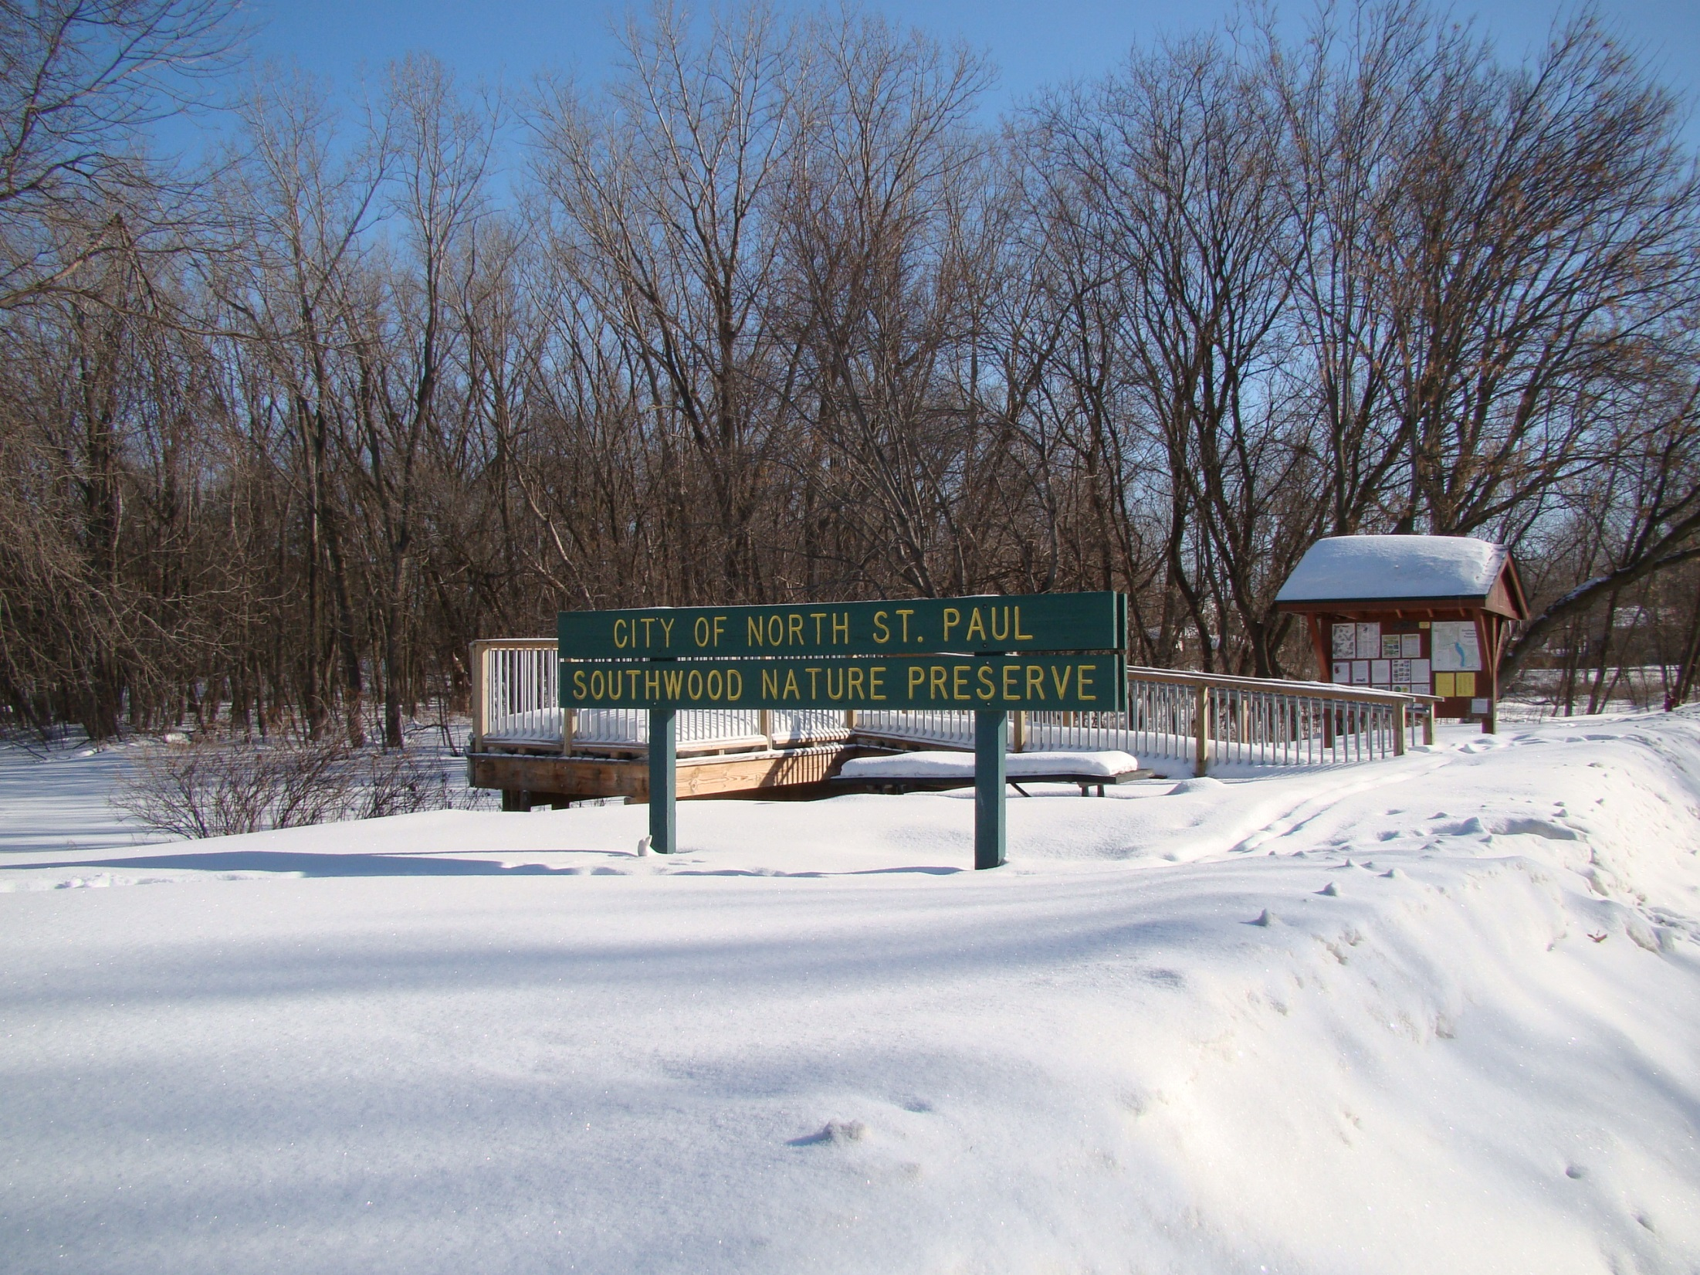
Matching Game!
Photo taken by Colleen Sauber
Notes:
[As you know] There’s a tremendous amount of messaging from pharmaceutical companies and health professionals bombarding consumers on a day to day basis. Standing out in this environment is challenging, but not impossible. The key is setting your brand apart from the rest and building a personal, relevant relationship with the health-minded consumer. We want to talk to you today about an opportunity that does just that by leveraging CBS’s assets.

