Slide 1
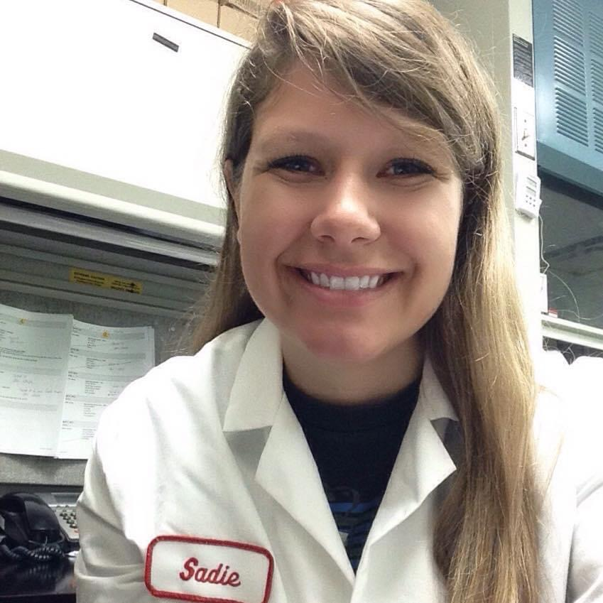
Hello!
I am Sadie Schuldt
Consumer Environmental Health Coordinator for the City of Milwaukee Health Department
Notes:
Hello, I am Sadie Schuldt, Consumer environmental health coordinator for the City of Milwaukee health Department. I oversee the temporary food inspections within the City. This is part 1 of an 7 part mini series where I will explain to you how to properly set-up your temporary event booth. If at anytime you need to pause the videos, or rewatch portions, please do so!

Slide 2
Roadmap of your event
Apply for your Temporary Event License
Determine which events you will participate in
Properly set up booth
1
3
5
2
4
6
Obtain your Temporary Event License
Notifiy Health Department of your participation
Health Department will conduct inspection
Notes:
The roadmap of your event includes applying and obtaining your temporary event license. Determining what events you will participate in and notifying the health department. At your event, you will properly setup your booth and finally, a health department inspection will be conducted.

Slide 3
A successful event requires cooperation
Event Coordinator
Vendors
Regulatory
Notes:
A successful event requires cooperation from all parties involved. This includes the person who organizes the event or festival, you the operator, and regulatory inspectors. Remember, we all want a safe and successful event.

Slide 4
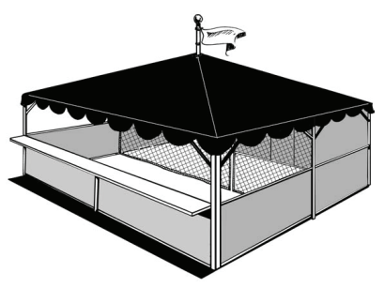
How to Setup a Temporary Booth
Part 1: Construction
Notes:
How to setup a temporary booth, Part 1: construction and employee hygiene

Slide 5
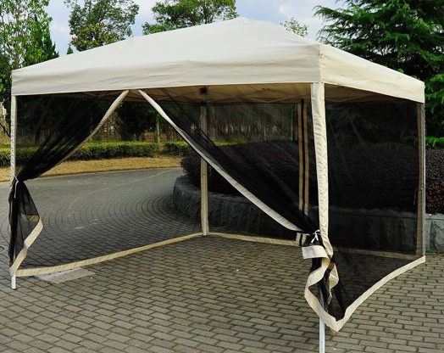
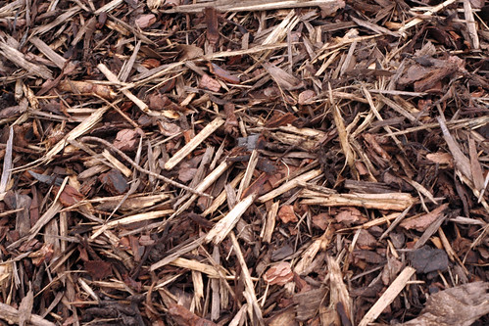
Construction Basics
Stands must have:
A roof and sidewalls to protect from rain wind and dust
Lighting
Adequate lighting by natural or artificial means must be provided
Floors
Sealed wood racks, plywood or shredded bark can be used to control mud, dust, and water
This Photo by Unknown Author is licensed under CC BY
Notes:
Construction basics. Your stand must have a roof and sidewalls to product from rain, wind, and dust. The sidewalls can be built of wood, canvas, nylon, or plastic.
Adequate lighting by natural or artificial means must be provided. Light bulbs shall be shielded, coated, or otherwise shatter-resistant . LED bulbs are a smart choice! For booths set up on grass or other non-hard surfaces, sealed wood racks, plywood or shredded bark should be used to control mud, dust, and water.
Extensive food preparation should occur in an screened in area.

Slide 6
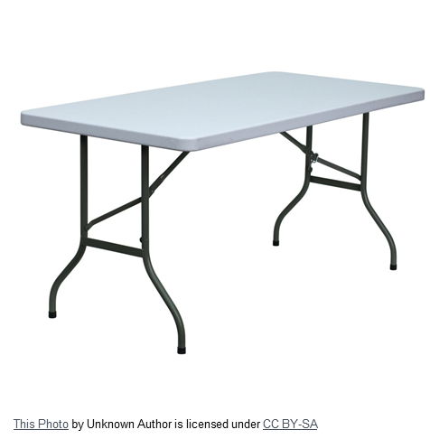
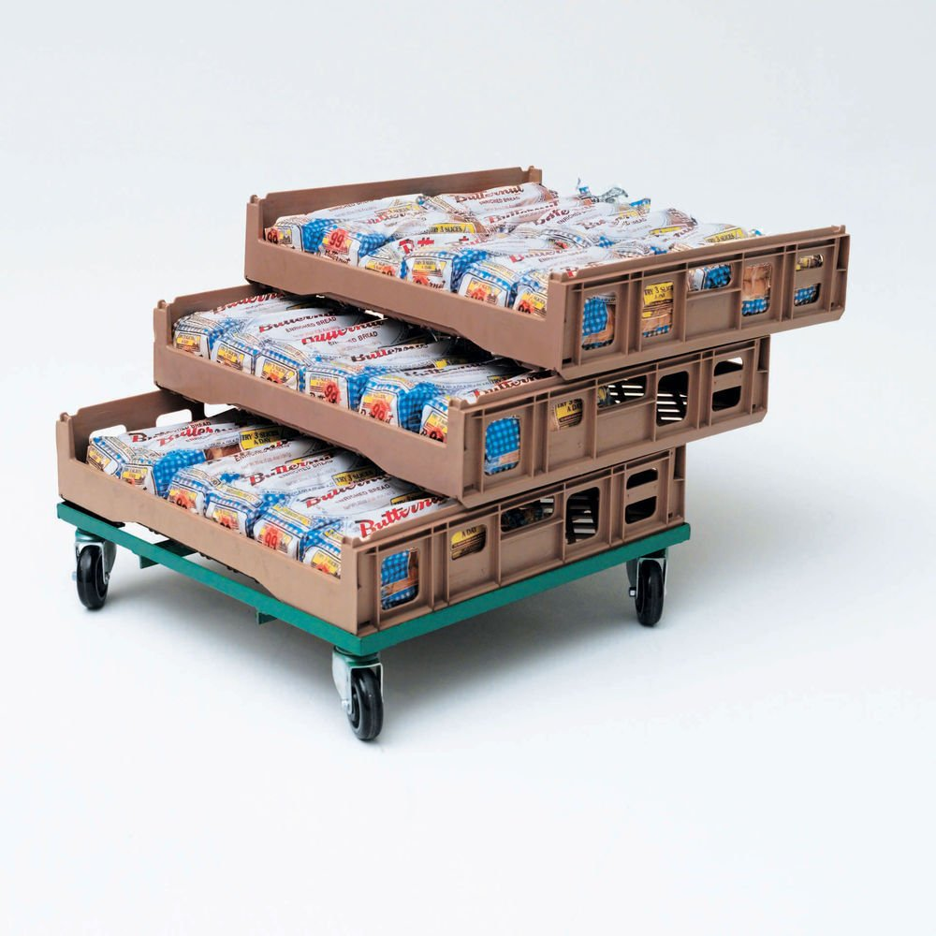
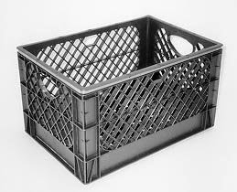
Dry Storage
All items must be at least 6” off the ground
This Photo by Unknown Author is licensed under CC BY-NC-ND
This Photo by Unknown Author is licensed under CC BY-NC-ND
Notes:
The requirements for dry storage is that all items must be at least 6 inches off of the ground. This can be achieved by using pallets, crates, racks, or tables, to keep all food and single-service items at least 6 inches off the ground.

Slide 7
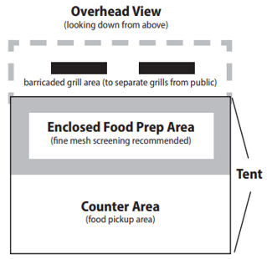
Grill Areas
All grill areas must be separated from
the public by at least 4 feet by using fences ropes, or other means
Notes:
Grills need to be outside of the food tent area. Grills must also be separated by at least 4 feet from the public by using fences, ropes, or other effective means. Remember, always provide a secure and level area for all propane tanks and dispose of hot coals in the hot coal station.

Slide 8
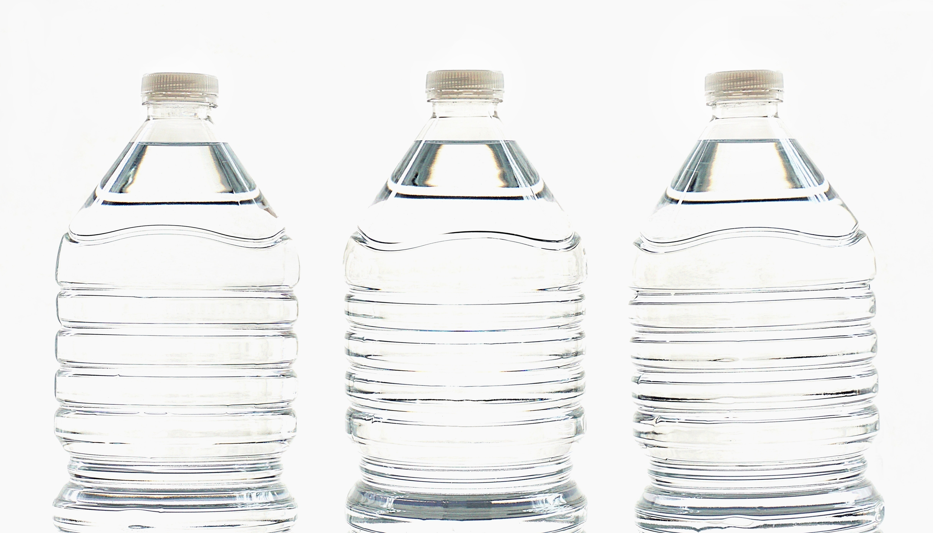

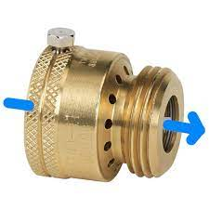
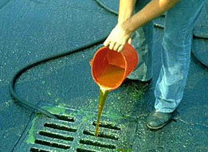
Water & Wastewater
Potable Water
Sufficient supply
Use backflow prevention
Hoses must be food grade
Liquid Waste
Do not empty grease or liquid wastes on the ground or into the street
Never dump into storm sewers
Notes:
Water and wastewater: You must always have a sufficient supply of approved drinking water, also called potable water. Any connections to city water must be made using approved backflow prevention device, as seen in the center photo. Any hoses used for food preparation, handwashing or utensil washing must be food grade ANSI/NSF certified. If city water is not available, potable water may be brought to the site using food grade water containers. . Do not empty grease and liquid wastes on the ground or street. Never dump into the storm sewers.

Slide 9
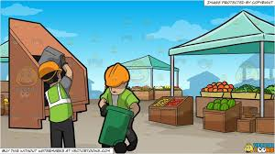

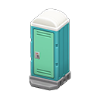
Garbage & Utilities
Electrical Power
Sufficient power must be available for electrical equipment
Trash
Arrange adequate trash containers and service in and around the food stand
Toilet Facilities
Public toilet facilities for each sex must be provided with handwash facilities
Notes:
For larger events, the event organizer may supply some or all of the garbage and utilities. Sufficient power must be available for all electrical equipment. If there is not a source of electricity nearby, generators may be needed. It is require to have sanitary services for adequate trash, grease and wastewater in and around the food stand. Containers must be kept covered and emptied often to prevent flies, odors and other nuisances. Many companies that offer portable toilet facilities often offer a waste water or grease containment holder.

Slide 10

Controlling Vermin
Only approved pesticides
Sticky fly paper is allowed, but may not be located over:
    Food preparation & service areas
    Food displays
    Utensils, equipment, and washing sinks
Fans can discourage flies
Notes:
Controlling Vermin: Only use pesticides that are approved for use in food establishments. Use according to the manufacturer’s label and store away from equipment, utensils and food to prevent contamination. Sticky fly paper is allowed, but do not locate over food preparation and serving areas, over displayed food, or over utensil washing sinks. The use of fans in food stands can discourage flies from congregating.

Slide 11
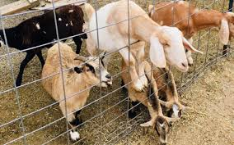
Petting Zoos
A temporary food stand must be located at least 100 feet away from petting zoos or any other type of live animal display, source of odor or other nuisance
Notes:
Petting Zoos: If there is a petting zoo at your event, please remember, any food stands must be located at least 100 feet away from the animal display. Handwash facilities must be located next to petting zoos

Slide 12

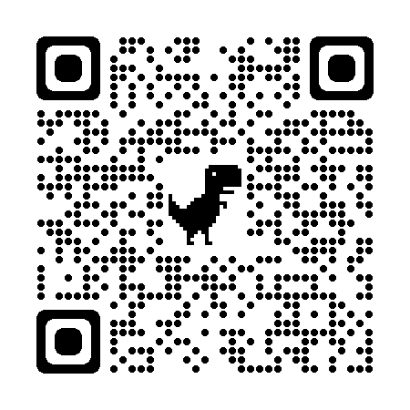
www.milwaukee.gov/health/tempfood
Notes:
Additional information, including printable guidance documents in English and Spanish can be found on the City of Milwaukee Health Department website, or by scanning the QR code located on the screen.

