Slide 1
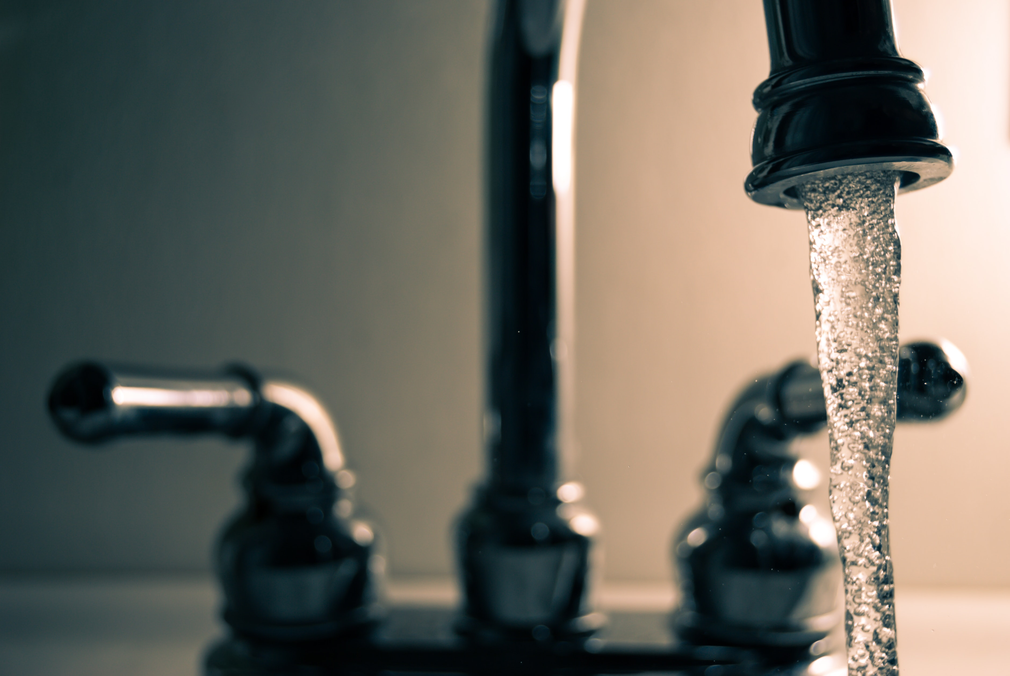
How to Setup a Temporary Booth
Part 2:
Hand Hygiene
Notes:
How to setup a temporary booth: Part 2: Employee health & hygiene

Slide 2
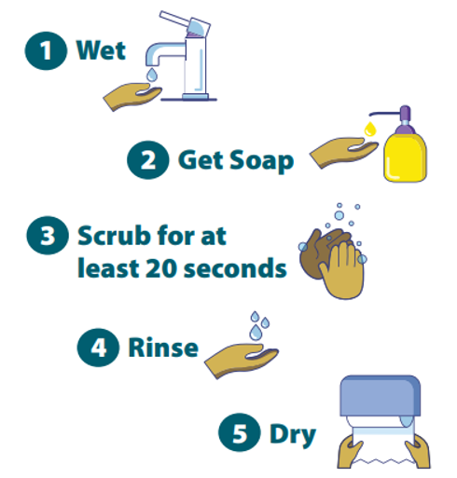
https://www.wchd.org/images/COVID19/Handwashing-poster-adults.pdf
Notes:
Handwashing is our main defense against foodborne illness at temporary events. First wet your hands In warm water, second use soap (liquid or bar soap are both acceptable), scrub your hands for at least 20 seconds, rinse your hands in water , then dry hands using a single use paper towel.

Slide 3
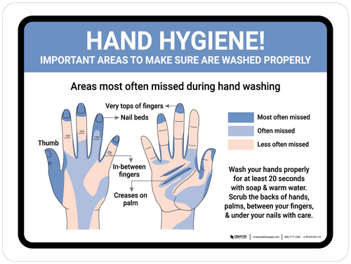
https://www.creativesafetysupply.com/wall-sign/hand-hygiene-important-areas-to-wash-properly-landscape-wall-sign
Notes:
As we can see in this diagram, the areas most often missed during handwashing include the top of the thumb, tops of fingers and nail beds, in between fingers, and the creases on the palm.

Slide 4
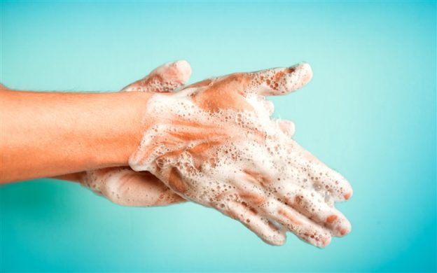
When to Wash Hands:
Before:
  Handling food
  Putting on gloves
After:
  Using the bathroom
  Smoking
  Coughing or sneezing into hands
  Touching hair or face
  Touching raw meats or poultry
  Changing tasks
This Photo by Unknown Author is licensed under CC BY-SA-NC
Notes:
Hands should always be washed before handling food, especially ready-to-eat foods like sandwiches and salads. Before putting on gloves, Make sure you wash your hands. Also wash your hands after using the bathroom. Smoking, coughing or sneezing into hands, touching hair or face , touching raw meats and poultry, or changing tasks like taking out the trash then preparing food.
Gloves and hand sanitizers are not a substitute for handwashing and may only be applied to hands that have been thoroughly washed.

Slide 5
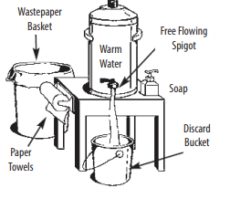
Handwash Setup
5 gallon container with spigot
Warm water
Soap
Single service paper towels
Discard bucket
Wastepaper basket
Notes:
Handwash facilities must be located in all stands where open food is handled or prepared. Handwash facilities must be conveniently accessible to all employees. Grill areas that are separate from other food handling areas should have a separate handwash facility. • When water under pressure is available, use a single compartment sink or prewash sink along with soap and single service towels. • When water under pressure is not available, a temporary handwash setup, as seen in the photo, should be utilized. The handwash facility shall consist of soap, paper towels, wastepaper basket, discard bucket and a minimum 5-gallon insulated container with a free flowing spigot that is filled with warm water.

Slide 6
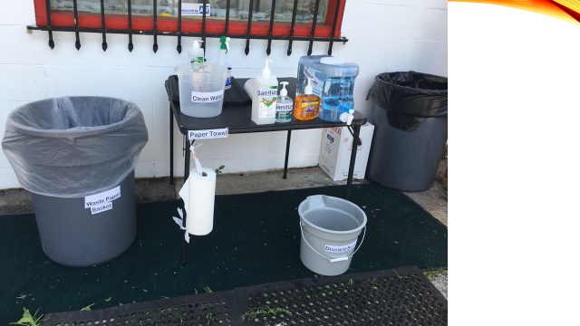
Notes:
This is an example from a temporary. As we can see, they have The handwash facility shall consist of soap, paper towels, wastepaper basket, discard bucket and a minimum 5-gallon insulated container with a free flowing spigot that is filled with warm water.

Slide 7
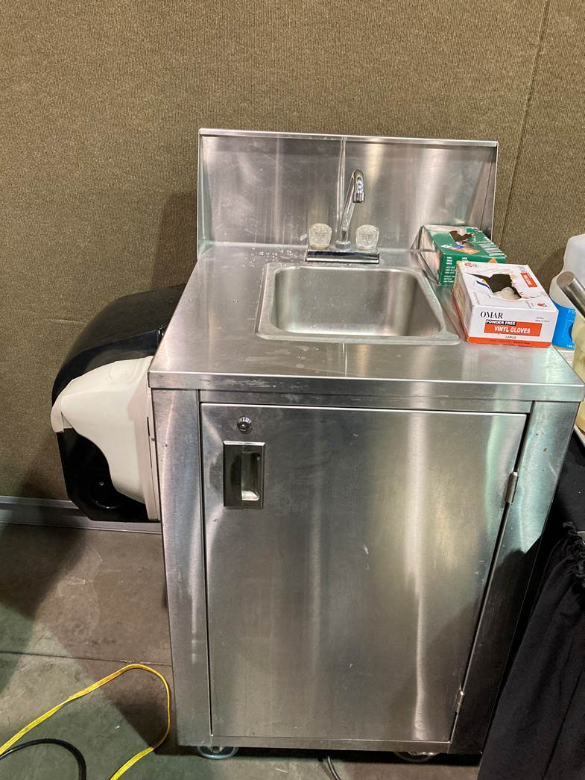
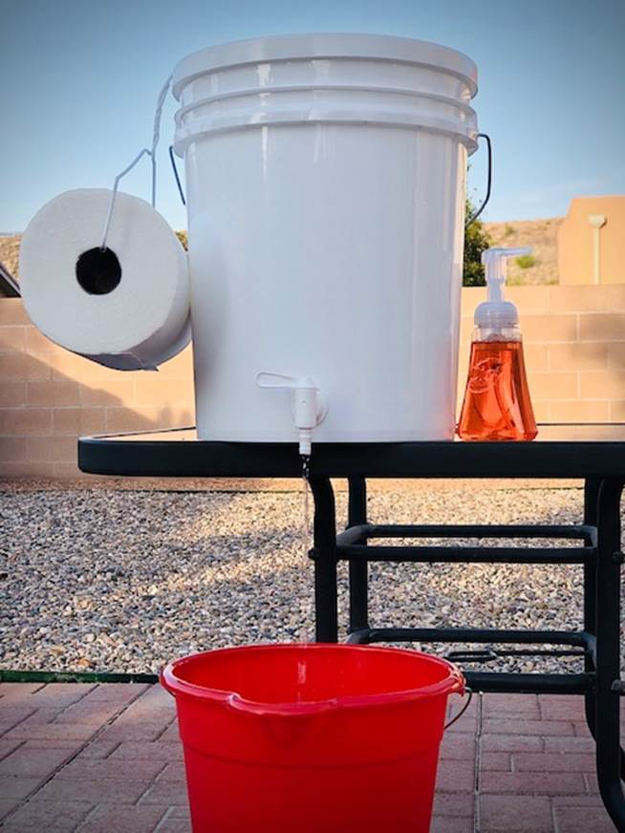
Examples of Handwash Stations
Notes:
Other common temporary handwash stations include a portable handwash station with small electrical heater, a fresh water reservoir and a waste water reservoir. In the second photo we see a simple 5 gallon bucket transformed into a handwash station.

Slide 8

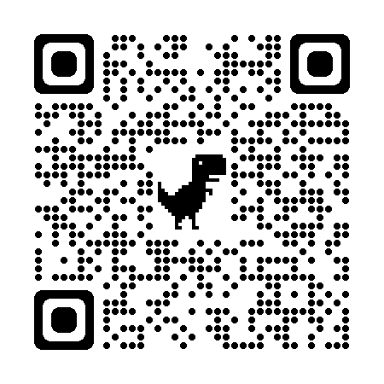
www.milwaukee.gov/health/tempfood
Notes:
Additional information, including printable guidance documents in English and Spanish can be found on the City of Milwaukee Health Department website, or by scanning the QR code located on the screen.

