Slide 1
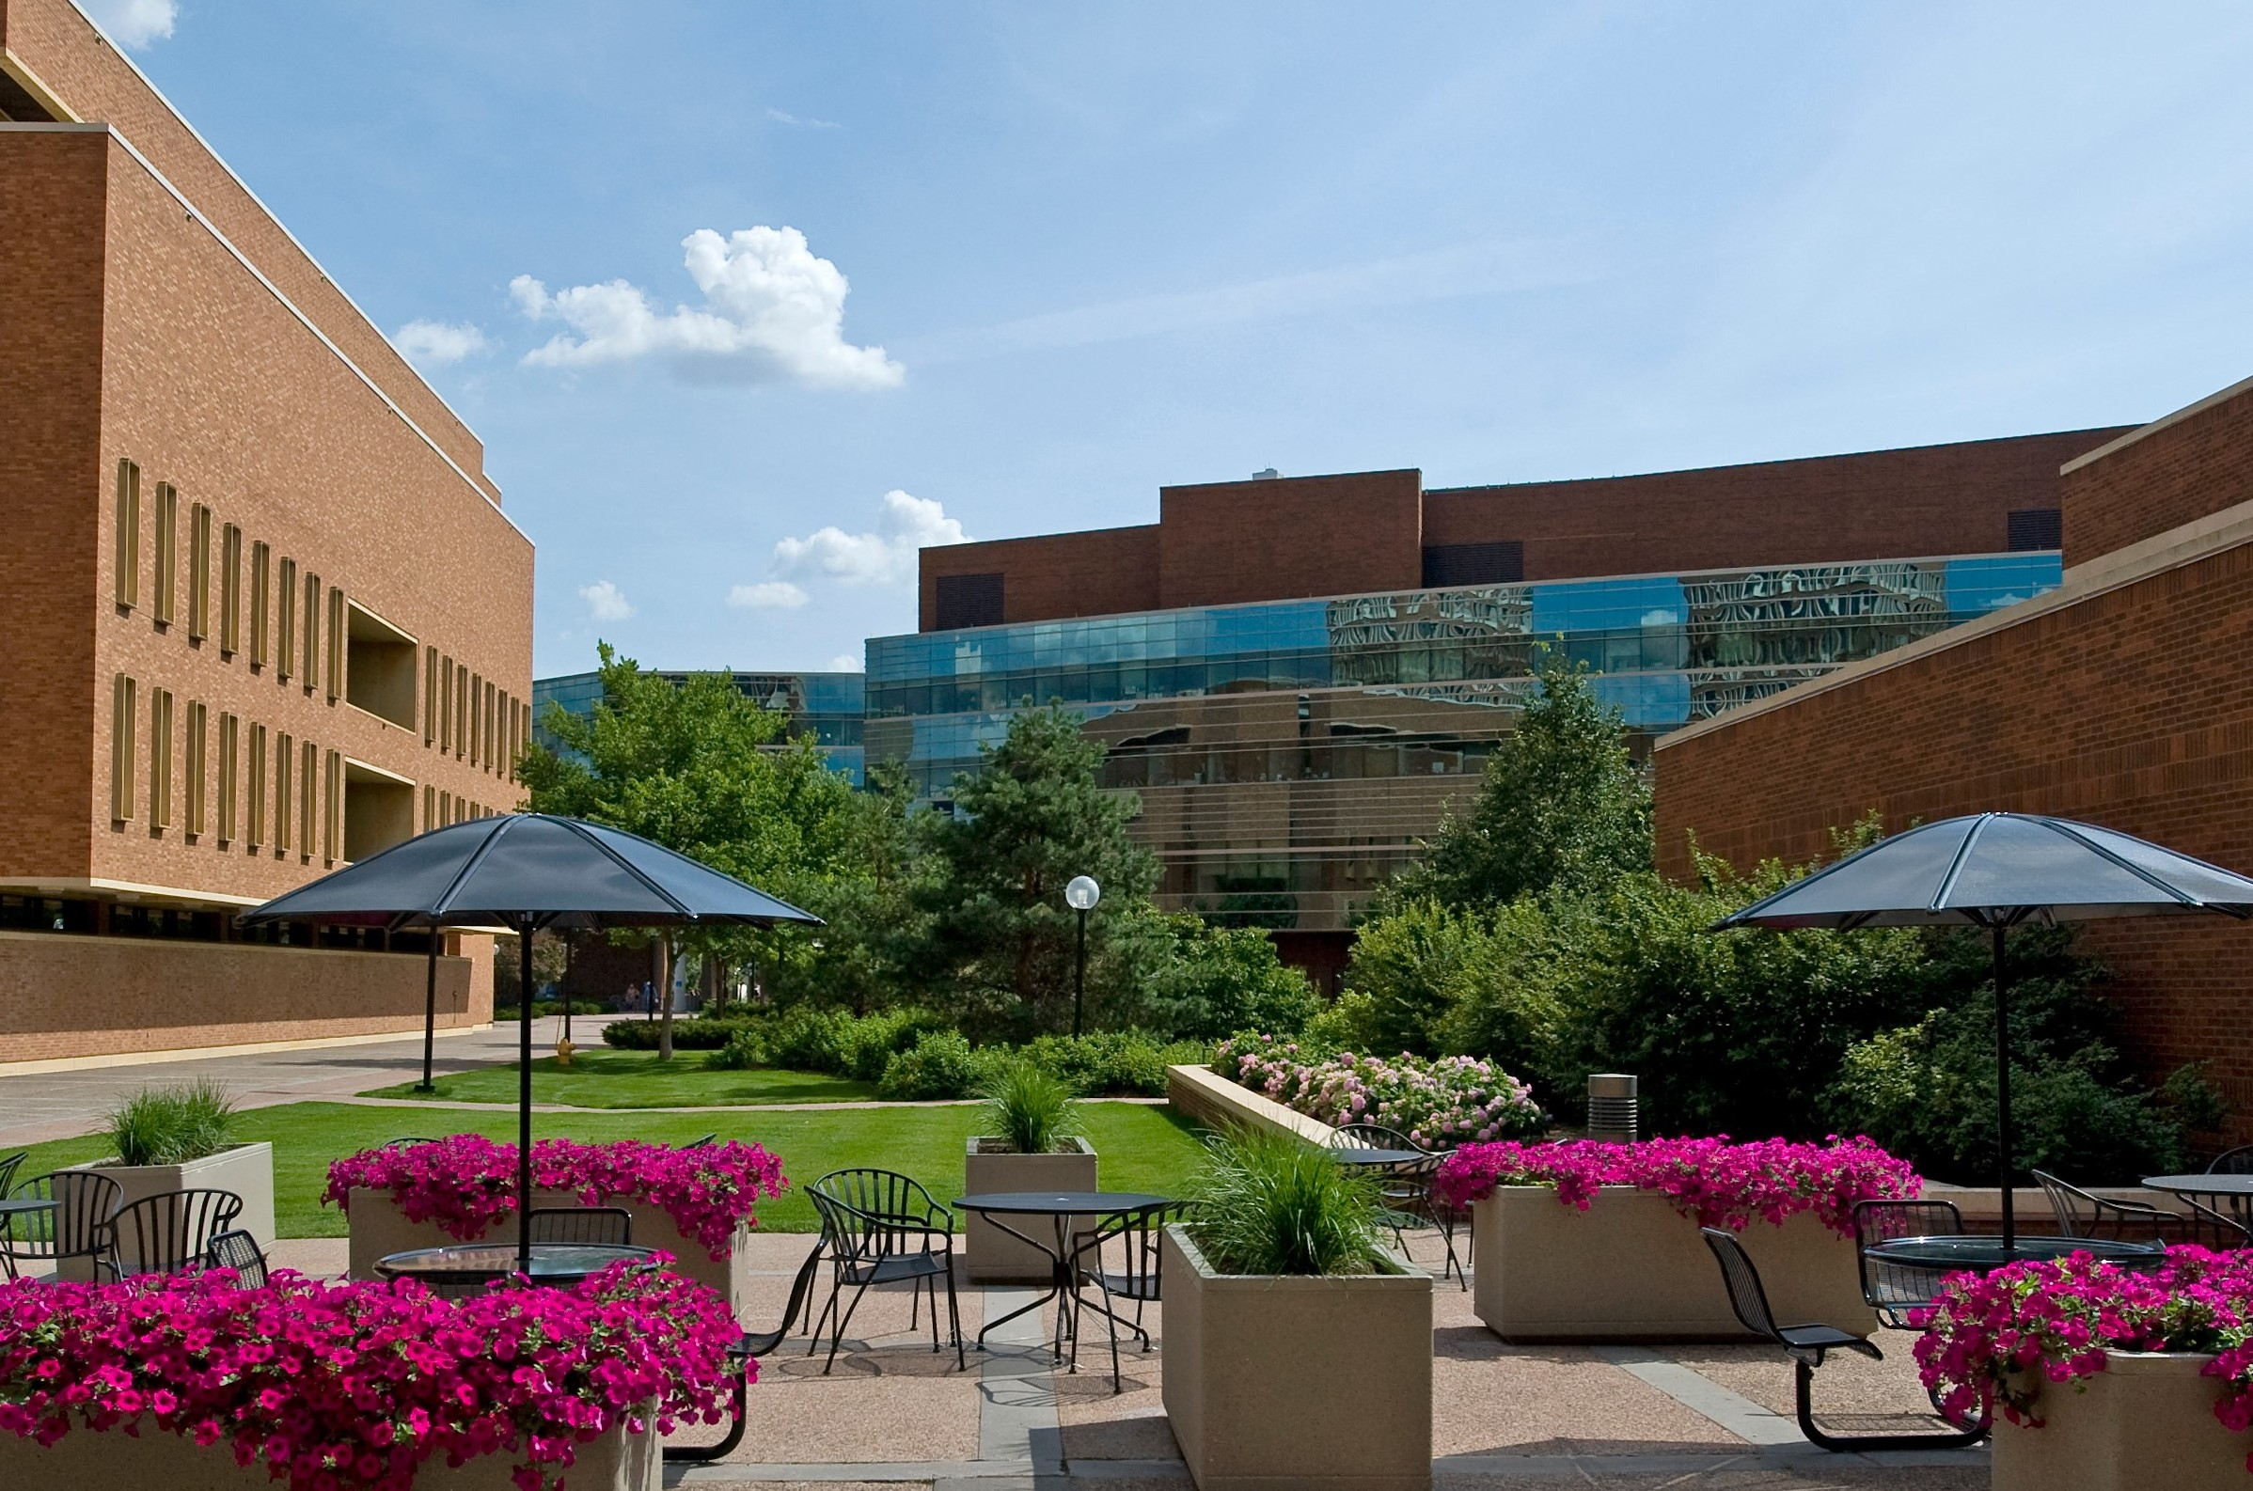

Research Sprints:
A Model for Collaboration
Sarah Jane Brown, Mariya Gyendina,
Shanda Hunt, & Jenny McBurney

Slide 2
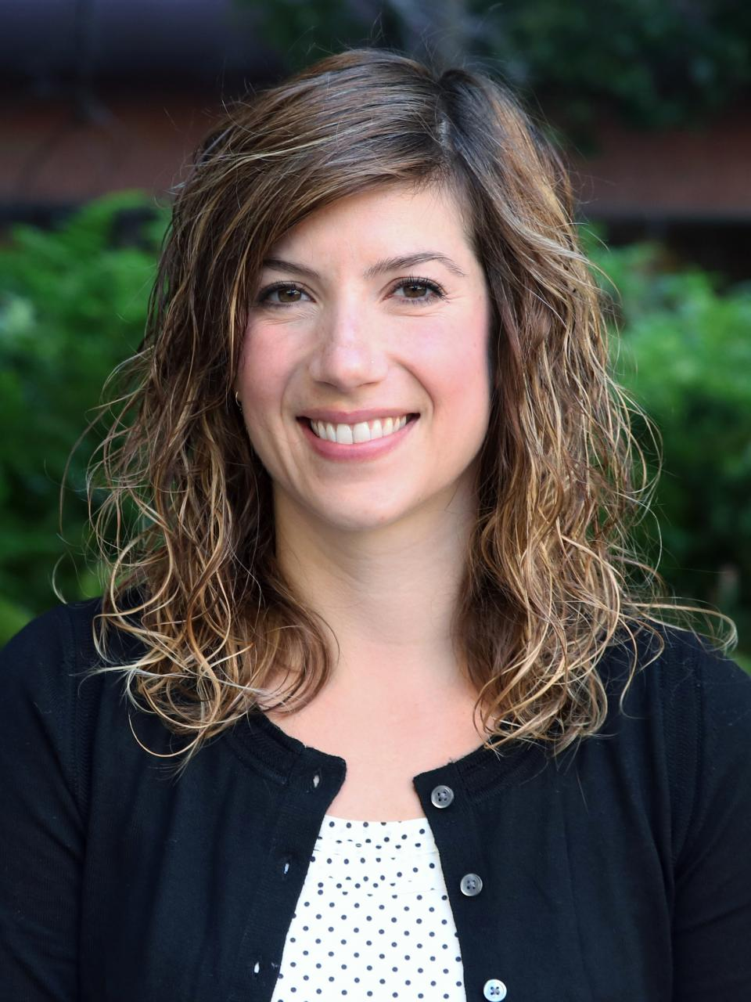
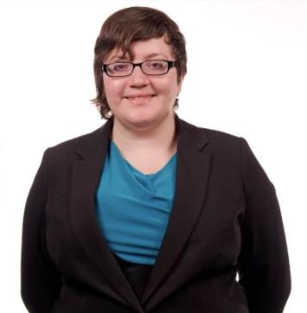
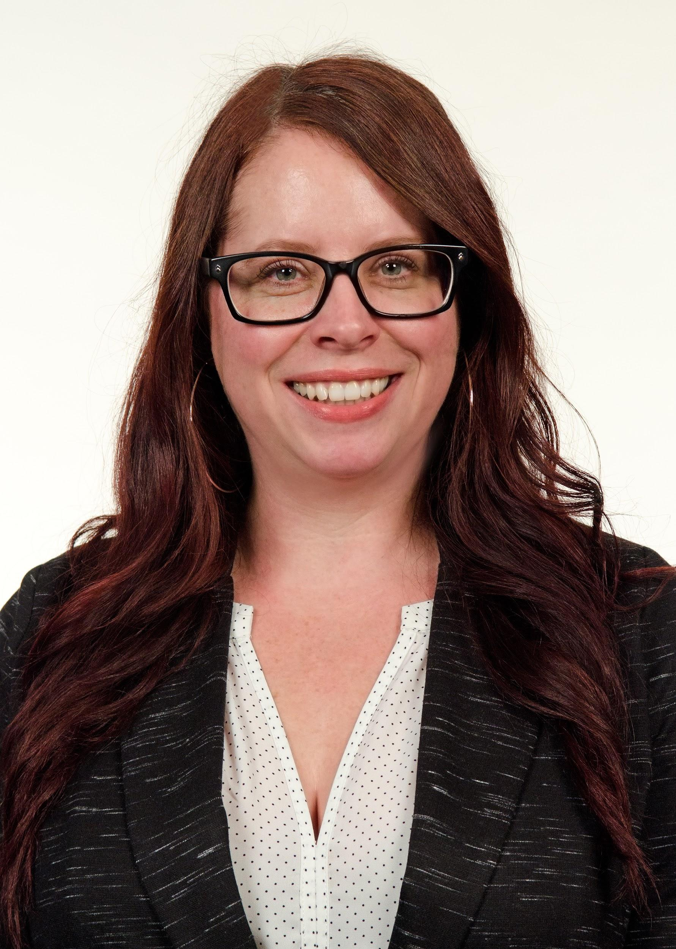
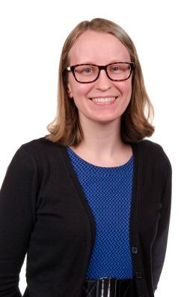
University of Minnesota - Twin Cities Libraries
SARAH JANE BROWN
Pharmacy Librarian
sjbrown@umn.edu
MARIYA GYENDINA
Learning & Inclusion Strategist mgyendin@umn.edu
SHANDA HUNT
Public Health Librarian
hunt0081@umn.edu
JENNY MCBURNEY
Social Sciences Librarian
jmcburne@umn.edu

Slide 3
Today We’ll Cover
What are Research Sprints?
Example Projects
Challenges and Opportunities
Small Group Discussion
Sharing Out & Questions

Slide 4
What are Research Sprints?
Background Info

Slide 5
Faculty Research Sprints offer faculty the opportunity to partner with a team of expert librarians on a specific project, or component of a broader project.
Sprints differ from one-time consultations in their timing and depth of interaction.
The intent is for the entire team—faculty and librarians—to work without distractions to produce a tangible product or outcome.

Slide 6

University of Kansas
KU first iteration 2016
UMN began consulting with KU shortly after
UMN first iteration May 2017
KU’s Research Sprint website
Model builds on previous projects like One Week, One Tool
Notes:
The model builds on previous projects like One Week, One tool, developed at the Center for History and New Media at George Mason University.

Slide 7
UMN Research Sprint Goals
Engage with faculty
Elevate librarians to collaborator status
Advance Libraries’ strategic goals
Advance University Priorities for Research, Enable Grand Challenges Research & Support Field-Shaping Researchers
Partner in Teaching and Learning, Reinforce Grand Challenges Curriculum & Engage Field-Shaping Teachers
Support Reciprocal Engagement With External Communities & Leverage the Distinctive Urban Location of the University
Embrace Excellence & Reject Complacency in Developing Programs in Support of University Goals
Notes:
The Faculty Research Sprints directly relate to Libraries Strategic Goals 1 & 2:
Advance University Priorities for Research, Enable Grand Challenges Research & Support Field-Shaping Researchers
Faculty Research Sprints allow faculty to propel their research forward by offering them a team of information experts coupled with vast resources that include hundreds of electronic databases and unique archives. In the Sprints evaluations, faculty have remarked that the Research Sprints are the perfect kick-off to their summer research endeavors. As a result of the Research Sprints, the Libraries were invited to participate in the 2018 Grand Challenges events.
Partner in Teaching and Learning, Reinforce Grand Challenges Curriculum & Engage Field-Shaping Teachers
Faculty Research Sprints do not only serve researchers, but educators as well. The proposals that we receive and accept often have a pedagogical component or focus. The tangible products that have resulted from the Research Sprints are currently being used in classrooms to disseminate knowledge. One of the original Sprints was a “Choose Your Own Adventure”-style website for a course taught in the Carlson School of Management. Another Sprint developed a map of underlying waters around the Twin Cities that is used in the College of Design to teach about sustainable building and architecture. The latter was also shared in an open platform so that this knowledge was freely available to anyone who might need it.
The Faculty Research Sprints also indirectly relate to Libraries Strategic Goals 3 & 4:
Support Reciprocal Engagement With External Communities & Leverage the Distinctive Urban Location of the University
An unexpected result of the Faculty Research Sprints has been a connection with communities outside of the University. Several past Sprints recipients have had community collaborators who were able to engage in the Spints activities. One community partner even requested that the University Libraries offer them a Sprint at their county-level organization.
Embrace Excellence & Reject Complacency in Developing Programs in Support of University Goals
The Libraries’ values around resource allocation and agility are exemplified in the Faculty Research Sprints. The Sprints are an innovative approach to connecting with campus stakeholders, and was embraced by the Libraries wholeheartedly after a successful pilot launch. While the time and resource commitments that go into the Research Sprints can be a strain at times, the Libraries continue to dig deep to provide exemplary partnerships with University faculty.

Slide 8
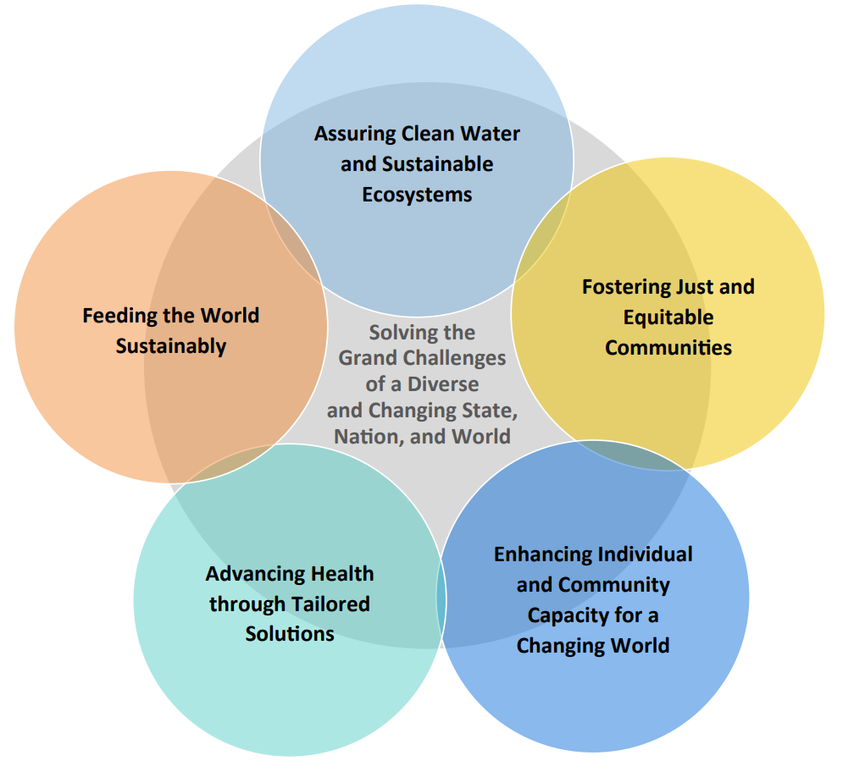
Side Note: What are Grand Challenges?
Provost's Grand Challenges Research Initiative
Campuswide effort to advance the research goals of the Twin Cities campus Strategic Plan
Five interrelated Grand Challenges
3 Phases so far

Slide 9
How Sprints Work at MN
 | May Iterations | Grand Challenges Iterations
Length | 4 Full Days | 1-3 Days
Timing | 2 weeks after the end of the Spring Semester | 2018: January break 2019: Spring break (mid-March) Based on request from Provost’s Office
Applica-tion Process | Tenured, tenure-track, and clinical faculty from any department submit an application Planning committee selects among them based on feasibility, impact, and fit with the Libraries | Selected by the Provost’s Office All GC teams are offered a Sprint; each phase so far has had about 6 teams
Notes:
Application process - also looking for multidisciplinary representation, and creating new and bolster existing relationships between University departments and the Libraries

Slide 10
How Sprints Work at MN
Building the Teams:
Planning committee works with department directors to identify library staff
Project Manager (PM) assigned to each team
Pre-Sprint planning:
PMs organize planning meetings and communications with faculty members

Slide 11
Pre-Sprint Planning
Meetings with faculty to clarify, broaden, or narrow scope of project
Help them realize the kinds of support the Libraries can offer
Identify technological and training needs
Notes:
Example
Redesign entire course, what is feasible within the 4-day timeframe?
Can’t do all 20 topics, can focus on the 5 most important ones

Slide 12

The Sprint Week
1-4 full days together
One large room for cross collaboration
Breakout rooms
Meals and snacks
Organized breaks and optional activities
End-of-Sprint celebration
Notes:
Most recently: 9am-4:30pm, provided lunch and coffee/snacks all day

Slide 13
Example Projects
4 Instruction-Focused Sprints

Slide 14
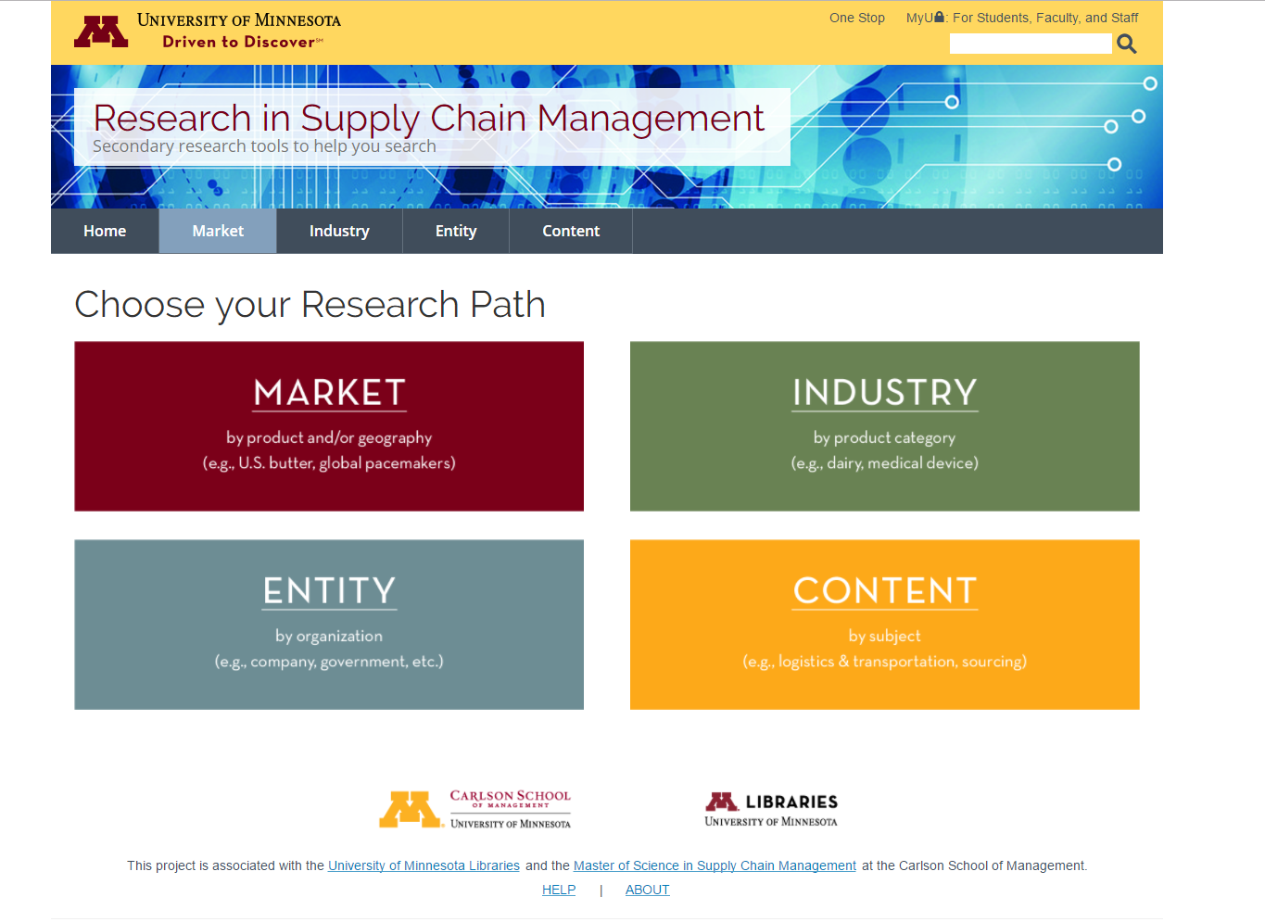
Karen Donohue, Carlson School of Management
Goal: Create a secondary research tool for the Masters in Supply Chain Management program’s capstone class
End Product: Designed a “choose your own adventure”-style website with Drupal Lite, currently being used for the summer course

Slide 15
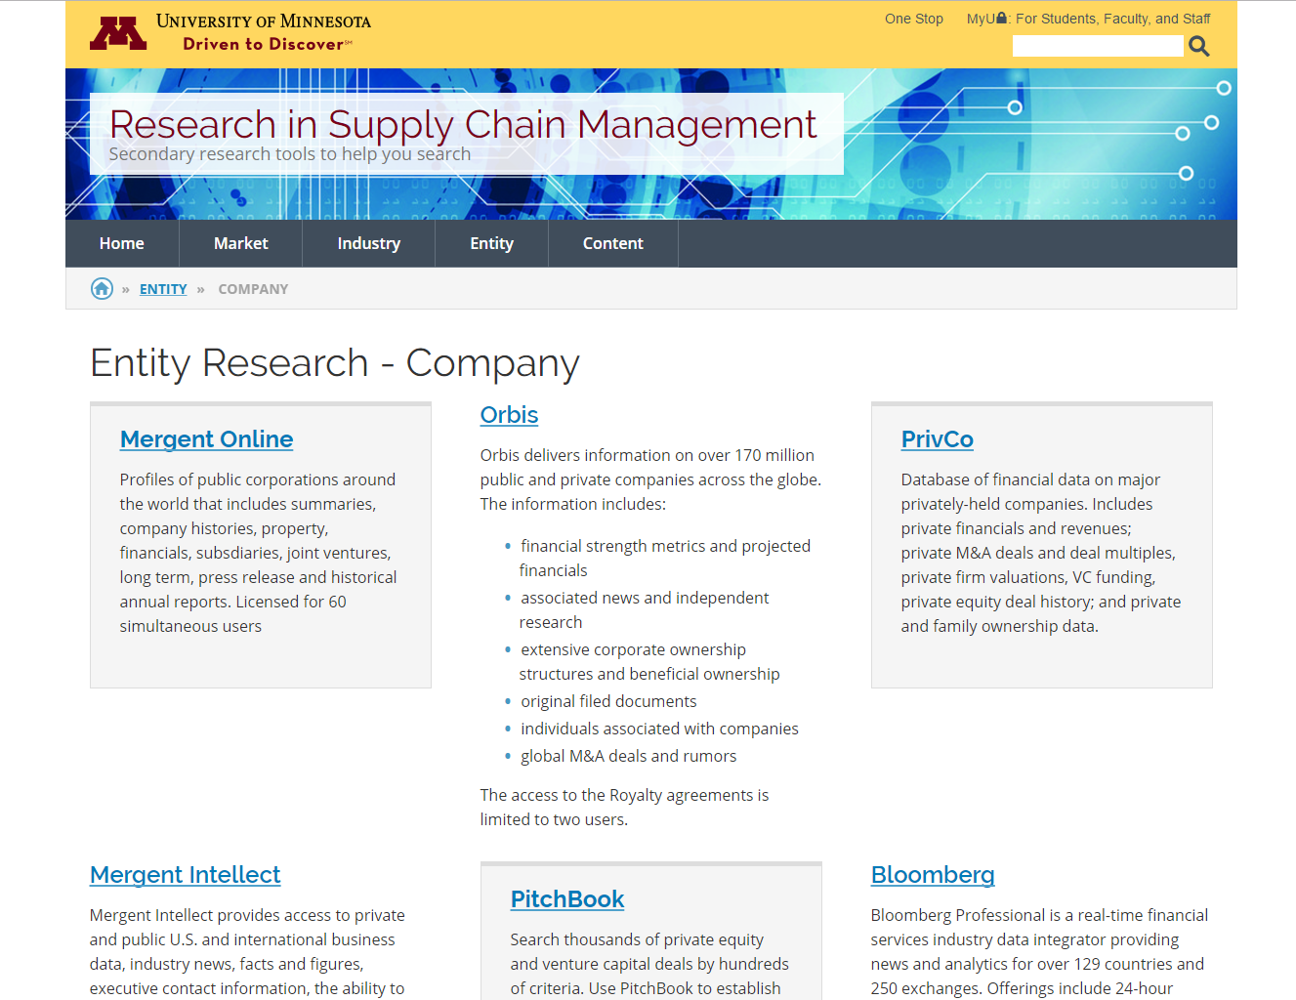
Teaching Support
Identify relevant business, government, and marketing resources for the course
Create a “choose your own adventure”-style website with Drupal Lite
Develop a plan for embedding business librarians in class group projects

Slide 16
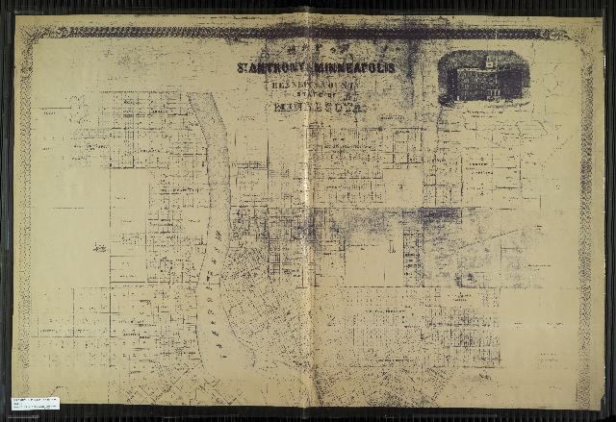
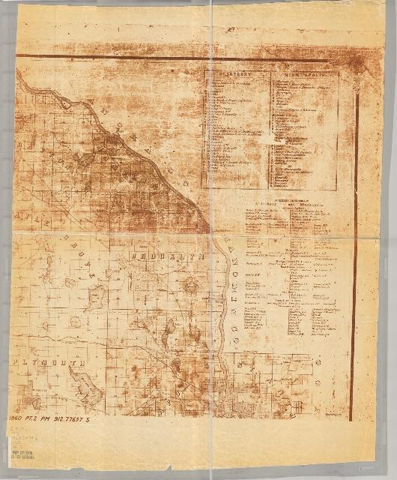
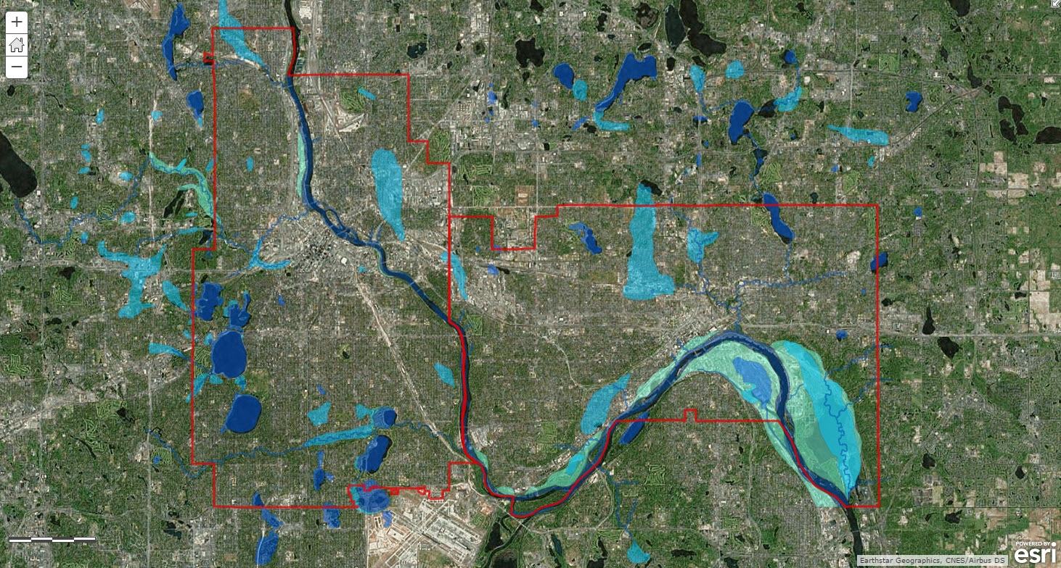
Richard Graves, Architecture
Goal: Create a map of the hidden & lost waters that lie below the Twin Cities
End Product: Literature search and map of the rivers, lakes, streams, and wetlands based on land surveys that date back to pre-1900
Notes:
Richard Graves is a professor in the School of Architecture who is also the director of the Center for Sustainable Building Research and an associate professor in the College of Design. He and Senior Research Fellow, Richard Strong, had had a vision for years that they could not bring to fruition on their own - they wanted to identify and map the rivers, lakes, and streams that were once surface waters, but are now buried below ground. Much of the Minneapolis and St. Paul area had been covered by water, but was “filled in” to create more land for building. These buried waters can have an impact on current urban design and city planning.

Slide 17
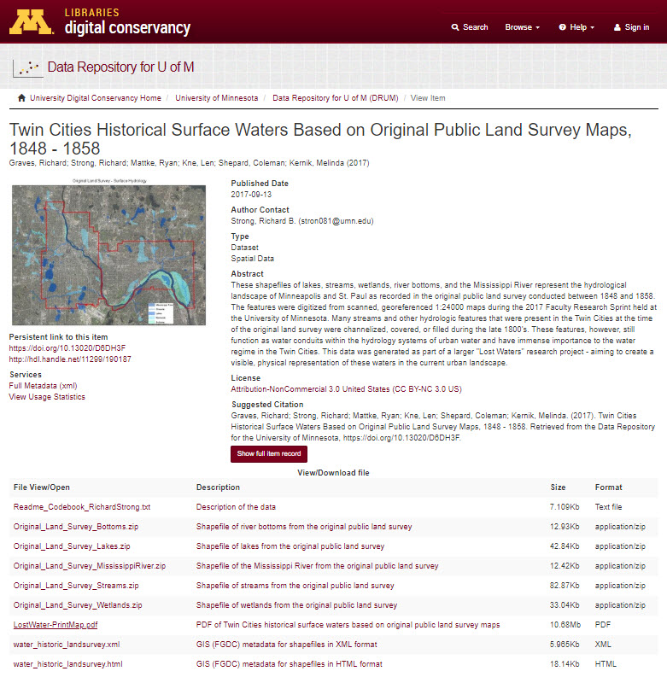
Teaching Support
Map made available to the public via the Data Repository for the University of Minnesota (DRUM) and ArcGIS Online
Site planning guidelines
Art project to build ecoliteracy (working with environmental artist)
Community organizing
Use in academics - course content
Training for local design firms
Design guidelines for things that get state-funded
https://conservancy.umn.edu/handle/11299/190187
Notes:
The map was made publicly available via DRUM and ArcGIS Online so that it could be used in many different educational realms and disciplines, including guidelines, public ecoliteracy, community organizing, professional training, and academic course content. Since this project, the Center for Sustainable Building Research has begun using the University Digital Conservancy (DRUM’s parent, so to speak) to house collections and disseminate their findings to the public.

Slide 18
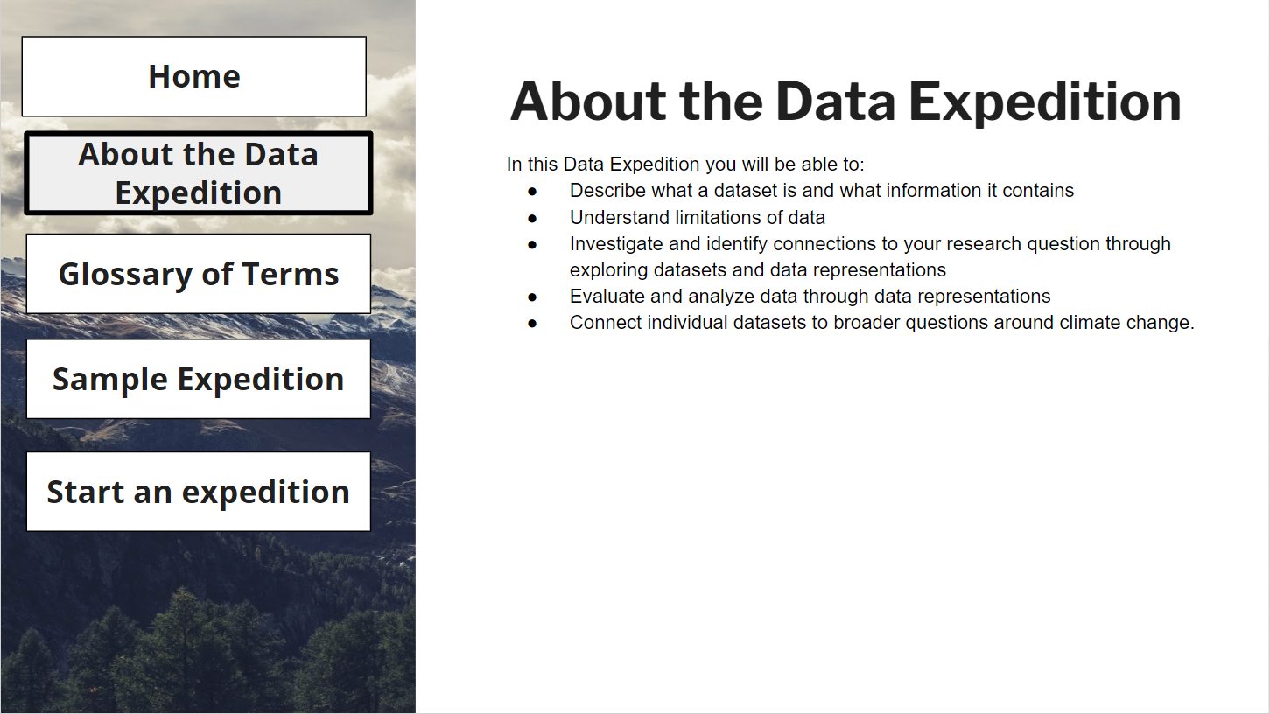
Bodong Chen, Curriculum and Instruction
Goal: Curate open science datasets for a high school unit on climate
End products: Clean datasets, website for students, mock-up of instructional approach, how-to guides for locating and cleaning datasets

Slide 19
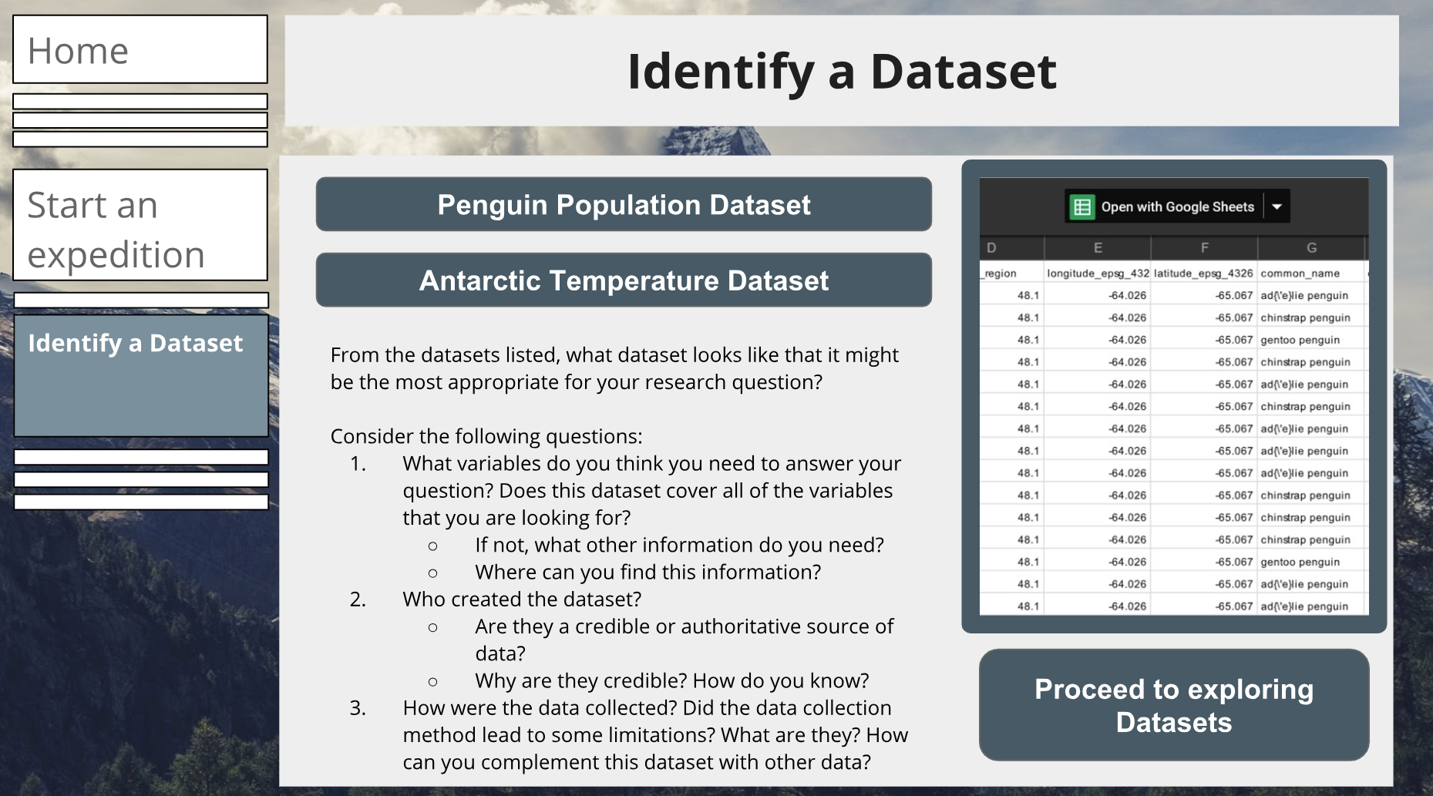
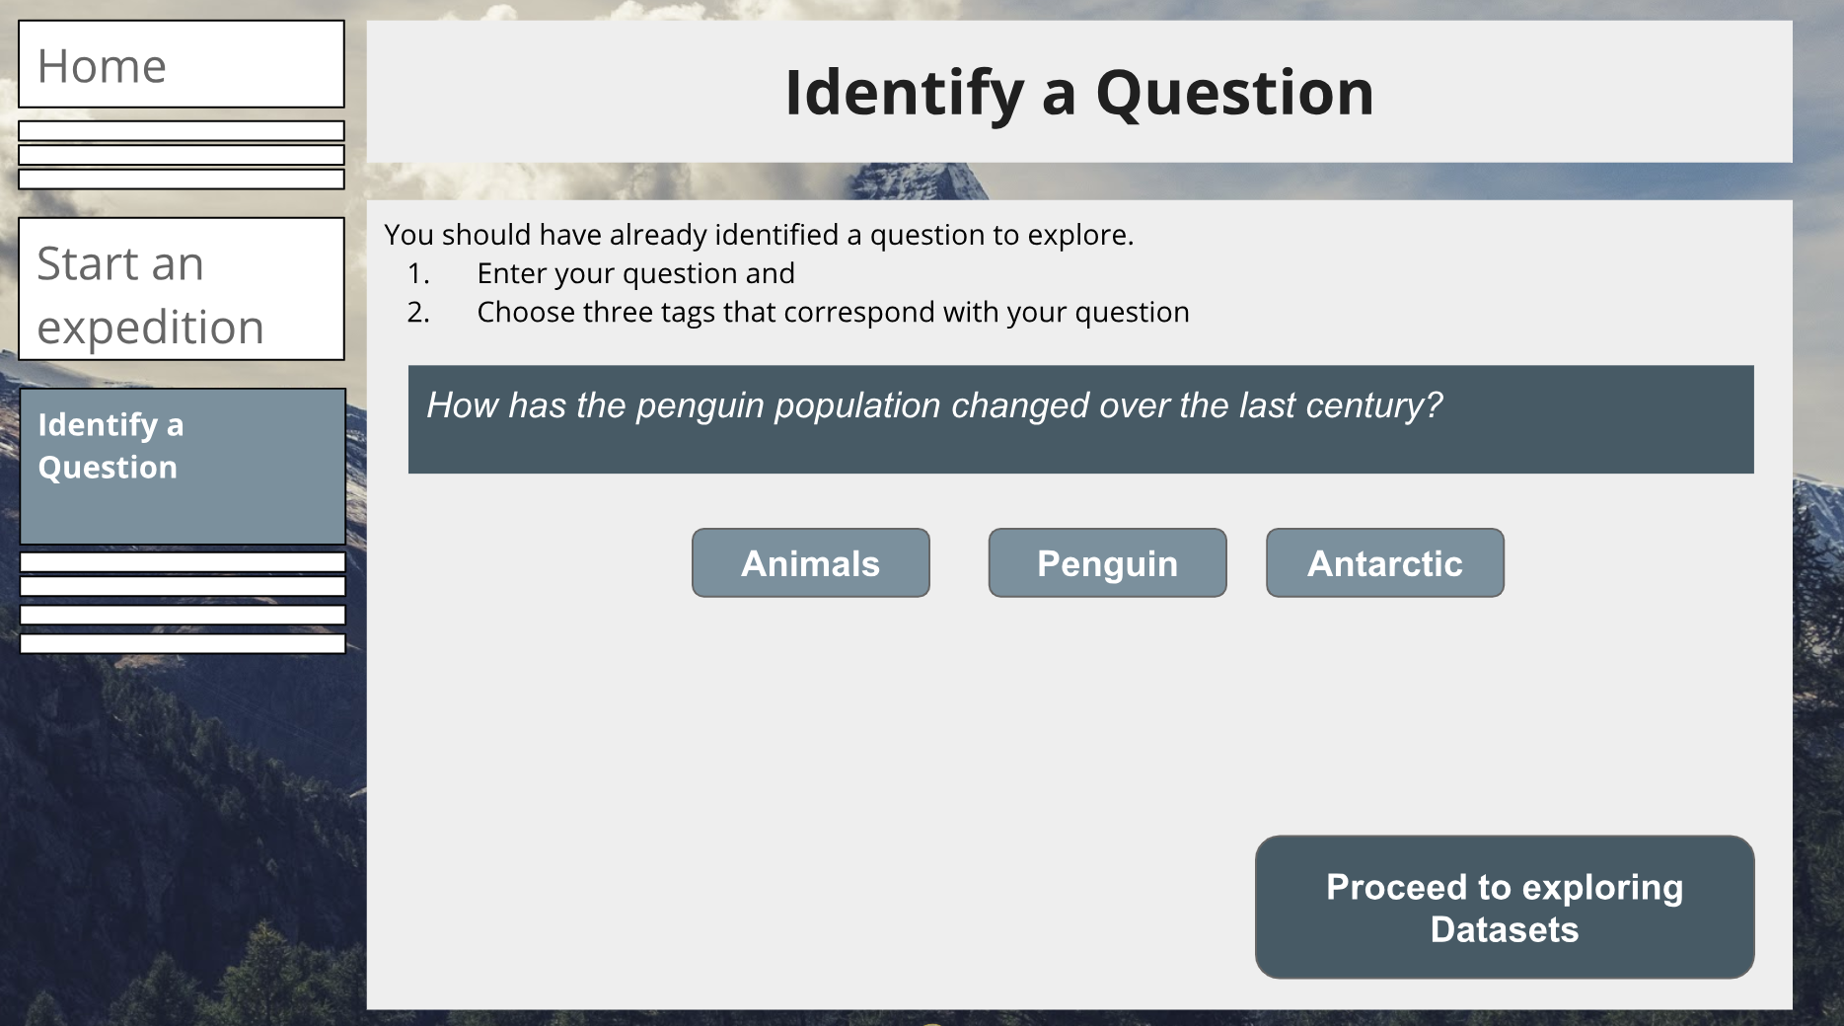
Teaching Support
Curate a set of open science datasets focused on information from the Arctic/Antarctic
Record metadata for each dataset and tag its location and category
Create an accompanying Google doc for each dataset with data transformation description and potential inquiry questions

Slide 20
Teaching Support
Design an instructional approach
Create a prototype of a website that would guide the students through a flexible “choose your own adventure” data expedition
Create a set of accompanying documents, including instructions for processing datasets and tutorials on creating data representations and transforming data

Slide 21
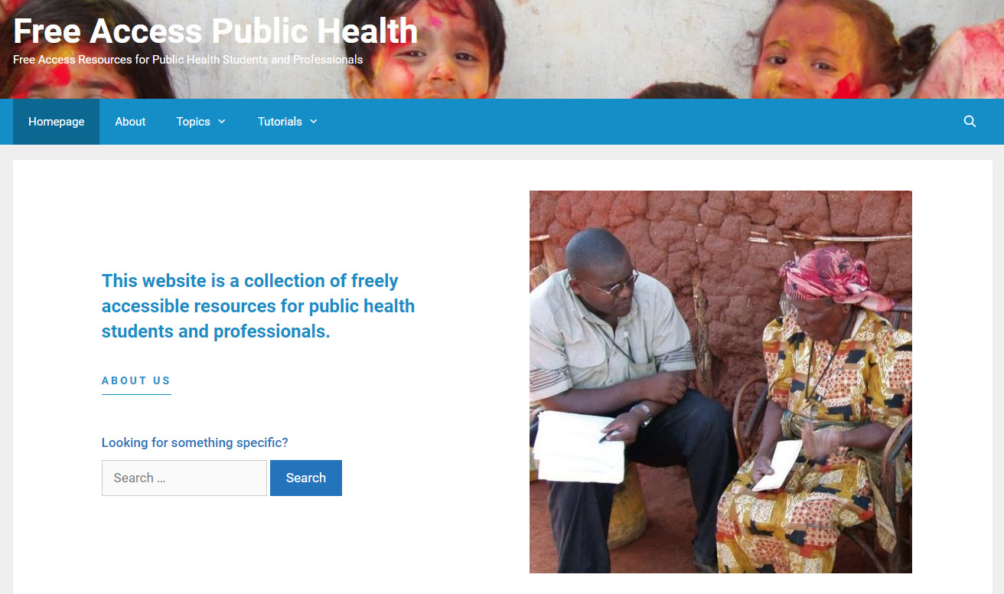
Betsy Wattenburg, School of Public Health
Goal: Create a website to support the MPH faculty and students at Hanoi University (Vietnam)
End products: Curated set of teaching support tools (open textbooks, lectures, lesson plans, and toolkits) for 8 different public health topics and tutorials about professional development
Goal: Create a website to centralize information on freely available resources for international Masters of Public Health students (and faculty) at Hanoi Medical University in Vietnam.
End Product: Website housing instructional materials for 8 public health topics and a number of professional development tutorials.
http://publichealthaccess.org/
Notes:
The Master of Public Health degree at Hanoi University in Vietnam is geared toward medical doctors who practice in resource poor areas. A USAID grant was awarded to faculty from multiple institutions to support Hanoi’s MPH faculty and students, one of whom was Betsy Wattenburg. The Libraries assisted Betsy in curating dozens of teaching support tools such as open textbooks, lectures, lesson plans, and toolkits for 8 different public health topics. Betsy was also concerned that the students at Hanoi do not have access to an abundance of professional skill development resources, so the Libraries curated and created tutorials on professional development for the website.

Slide 22
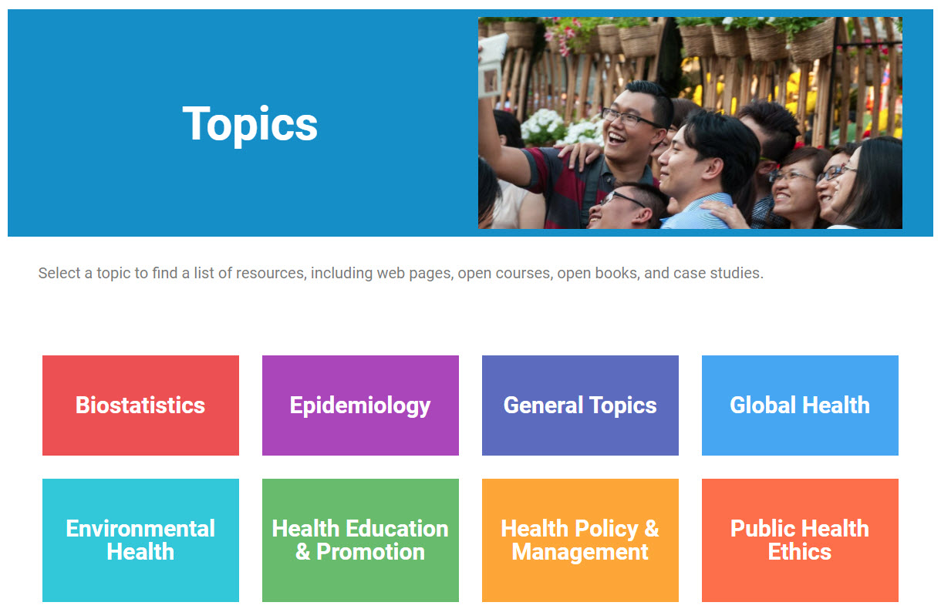
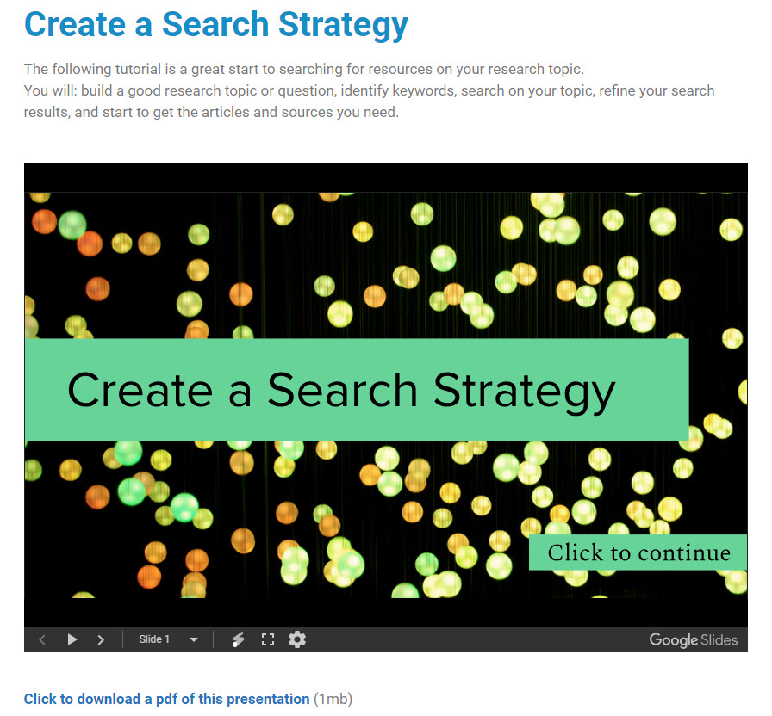
Teaching Support
Open source, global access to the website
Integration of the website into Hanoi University curriculum
Use by future MDs in resource-poor areas
Notes:
Betsy has built in Google analytics and continues to collect usage data on the website. She is looking into a large-scale evaluation of this work, and has invited the Librarians to complete that work with her.

Slide 23
Challenges & Opportunities
Extending the model at UMN

Slide 24
Challenges
Project planning and management
Engagement
Team dynamics
Notes:
Project management and planning:
Key to the success of Sprints projects
Allow Sprint teams to negotiate project scope
Collect input from librarians doing work
Determine what is achievable in the allotted time
Identify necessary pre-work or technology training needs
Determine
Delegate initial tasks in advance of the Sprint
Communication by project manager is key during the Sprint to maximize productivity and flexibility
Clear plan for each day, but build in flexibility to allow for changing circumstances
Frequent check-ins to have librarians report back
Engagement:
Goal of faculty engagement largely achieved with the vast majority of faculty reporting that they were highly satisfied with the expertise of their team and the partnerships that resulted
Perception among a small number of librarians that it was not a good use of their time or skillset
Potential to impact faculty perception
Team dynamics:
No tool or template can help project managing librarians prepare for poor team dynamics
Negative attitudes, defensiveness when asked to provide documentation
Negativity may arise from the projects and tasks themselves or the environment
Environmental factors can be mitigated with frequent breaks, quiet work areas, snacks, etc, but need to recognize these and encourage team to take advantage
Stressors heighten the emotional labor involved in the Sprints, potentially breeding resentment at participation
Communicating appreciation from faculty and organizing committee may help librarians feel better recognized and garner positive feelings toward sprints

Slide 25
Ways to Extend the Model
Offer more focused sprints (for example, teaching)
Use as professional development to advance own research
Pilot in classes
KU: Research hurdles
Notes:
KU research hurdles - “longer research consultations held during shorter sessions”

Slide 26
Teaching Sprints
Partnership across four central units:
University Libraries
Center for Educational Innovation
Disability Resources Center
Academic Technology Support Services

Slide 27
Teaching Sprints
Teaching Sprints are a unique opportunity for faculty and instructors to (re)design a course or portions of a courses for improved learning outcomes and student experience in an intensive and supported 4-day program, June 10-13, 2019. Participating instructors will have the opportunity to make significant progress on course design with the support they need to make their ideas a reality.

Slide 28
Teaching Sprints
Instructors could use the Sprint to:
(re)design their syllabus
identify new or additional course content or readings
develop or revise assignments or lesson plans
create learning modules, videos or other digital assets
(re)design a course website

Slide 29
Pilot Set-up
18 applications from 5 system campuses
10 selected: 5 higher, 5 lower intensity
Project managers identify needs and scope of the project
Each instructor will consult with each unit
Partnering beyond 4 main units

Slide 30
Small Group Discussion
Implementing Sprints at your Institution

Slide 31
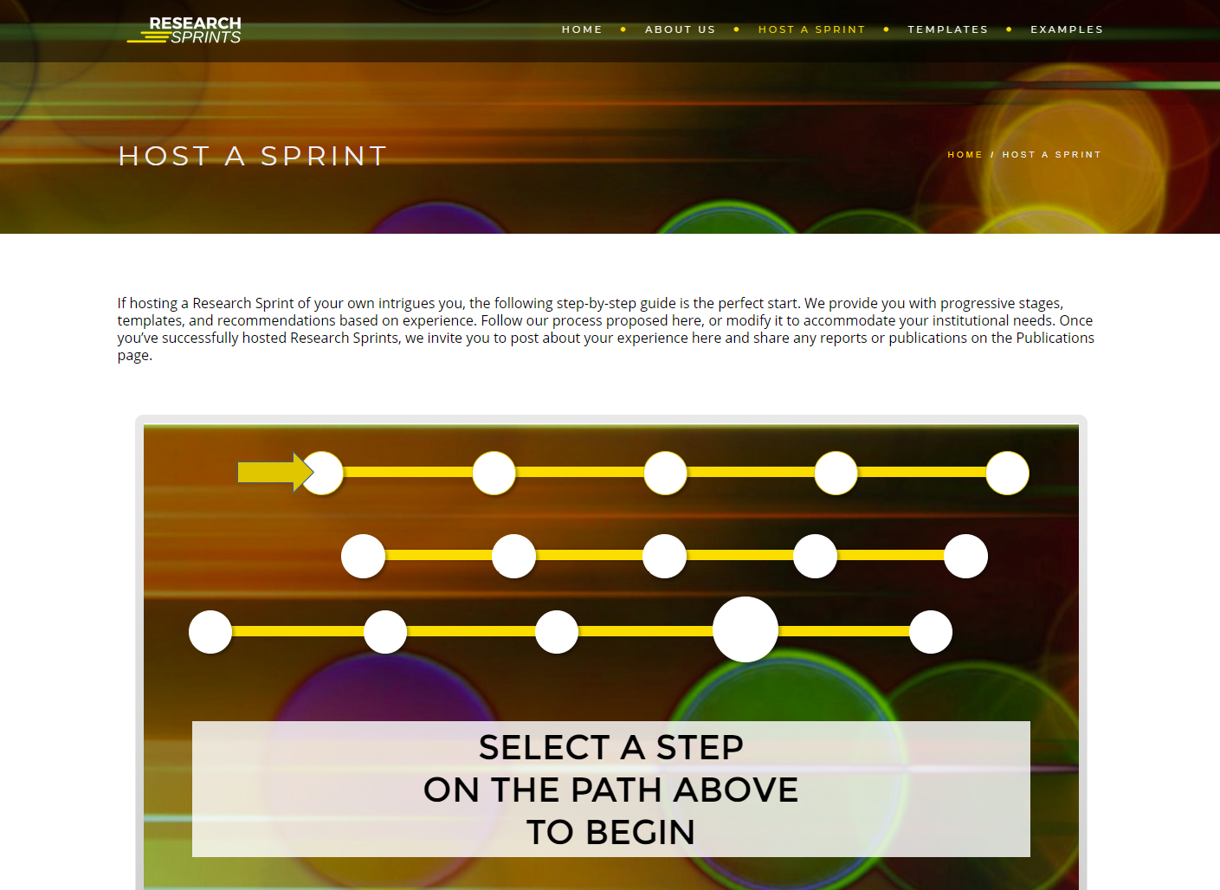
Small Groups
Researchsprints.org
Collaboration with KU and UMN
Toolkit for other institutions
Templates, instructions, etc.

Slide 32
Small Groups
What are benefits and drawback of this model?
Come up with at least 2
How might you implement Sprints at your institution?
What changes would you make?

Slide 33
Share With the Larger Group
What did your small group discuss?

Slide 34
Questions?
ResearchSprints.org
Link to these slides: z.umn.edu/LOEXsprint

Slide 35
References
Presentation template: SlidesCarnival
Slides image: West Bank Plaza by Hubert Humphrey Center & Wilson Library - Copyright © 2009, Regents of the University of Minnesota
Sprints photograph

