Slide 1
Health Reference:
The Basics in Less Than 60 Minutes
Katherine Chew
Research/Outreach Services Librarian
Health Sciences Libraries
University of Minnesota
Notes:
Good morning and welcome to “Health Reference The Basics in Less than 60 minutes.” I hope you all have your favorite morning beverage in hand. A couple of things first – I am coming to you from the wilds of rural Wisconsin, and occasionally Zoom will tell me that my internet is unstable. If I get dropped, I will reconnect as soon as possible and Sarah [Hawkins 763-2218-4475] will be keeping track of where I left off and let me know.

Slide 2
Agenda
Health information needs of patrons
Challenges of providing consumer health services
The Reference Interview – health information
Consumer health on the internet
Notes:
In less than 60 minutes I will attempt to cover the following about providing health reference …

Slide 3
Consumer Health
Health information written for the layperson that is non-technical in nature.
Notes:
For our purposes, consumer health information includes materials that are written for the layperson and which are non-technical in nature.
This is an important topic for libraries because we provide health information to users that help people make important and informed decisions concerning their personal health care.
As we all know, the internet revolutionized the way individual’s access and consume information. This was just as true with health information as it was with other types of information. The internet had a democratizing impact on information – making health information that was traditionally available only to health professionals (or if it was available, warehoused in specialized medical libraries or otherwise difficult to access), readily available to the general public. Health professionals no longer had a monopoly on health information. This change in access not only increased the ability of health consumers to research and learn about health topics on their own, it also impacted how patients and doctors interacted and ultimately changed the role of the patient in their healthcare experience. Patients now increasingly feel like co-creators of their healthcare decisions rather than simply recipients.

Slide 4
Healthier Communities
Have higher rates of education
Stronger local economy
Recover after a disaster more quickly and with less negative health issues
Fewer chronic diseases including obesity
Lower rates of chronic stress and mental fatigue
Lower early death rates from cancer and diabetes
Notes:
Communities that have good health resources in place and healthy community members can often recover after a disaster more quickly and with less negative health issues. Individuals who are have access to health information can better recover from a disaster and are more likely to be able to contribute to a community’s recovery efforts. Healthy communities commonly have high vaccination rates to protect citizens from diseases and easy access to medical care and healthy food; are designed for healthy living at home, work, and school; and provide good mental health resources.

Slide 5
The Search For Health Information
Health is the second most popular subject of an online search
8 of 10 online health inquires start at a search engine
Less than a quarter verify the date of the source
More than 25% hit a paywall
Notes:
I won’t poll you, but how many of you have googled you or a loved one’s own health symptoms within the last few months? Even though we're librarians and we know there is better information out there, this is very common – it’s just so easy to google symptoms, look for advice on how to lower your blood pressure or if there are any “natural” (I put natural in quotes) alternatives to traditional medicine to treat a health issue.
While this is understandable (google is so easy to use and most people are used to it), the problem is the Google algorithm – or Dr. Google -- does not necessarily bring back the best or even reliable information. As people who work in libraries, this is nothing new – the same is the case with other information inquiries. But with health information, the implications and consequences of sub-par results can be much more severe.
Data from a 2013 Pew Research Survey on US internet use shows that health is the second most popular subject of an online search.
The Pew study shows that less than a quarter of those who research health online check the publication date or verify the credibility of the source.
On top of that, 25% reported hitting a paywall and being unable to access the information they were seeking.
The bad news for us is that when Americans begin to look for health information, they tend to look online, despite having access to a great information resource – libraries and librarians! Sound familiar? According to Pew, 59% of Americans look online for health information each year. When we do information literacy instruction with our patrons, there’s a real chance that they might apply those skills to a health information search. Meanwhile, Pew’s research indicates that 8 out of 10 searches for health information begins on a search engine – so, there’s a second way for us to improve health literacy – by promoting reliable health resources

Slide 6
Health Information-Seeking Behavior
Health information-seeking behavior varies depending on individual needs. Learning about a recent diagnosis is different than researching for a class.
People may be searching for information on a illness or they may be looking for wellness information
People may be shy, or not.
Notes:
Most Health Information Seeking Behaviors, about 41%, involve seeking a combination of illness and wellness information, with illness-only searches at 29% and wellness-only at 31%.
The types of information seekers look for fall into two general categories – information about an illness or disease or wellness information and there are generally three types of health information seekers – the patient, the person with the illness, caregivers of patients and researchers, which can range from high school science projects to people who had heard about something and are just curious to serious clinical research.
It is important to know who is asking the question. Find out the relationship of the person asking the question to the question, which will tell you why they need the information and how it will be used.
Is the person:
●A student who needs the information for a school assignment?
●A family member or friend of someone who is gathering information on another person's behalf?
●A family member or friend who is a caregiver?
●Someone who has been recently diagnosed with a serious illness?
●A person who wants more information about something they heard or read?
Finding this out can be tricky - we value our patrons’ privacy, we don’t typically ask point blank. Some tips for eliciting this information include:
●Asking “is this for a school project?” even with an adult, this is appropriate - many adults are returning students, or doing their kid’s assignment. Often, this question is enough to get the patron to say what they want the info for. “No, no, my mom’s friend’s son’s girlfriend has a child with this condition and now my mom’s worried…”
Sometimes this doesn’t work, and you’ll need to be a bit more direct. We all know not to just blurt out “Why do you need to know that?” A more gentle way to say it could be:
●"Can you tell me a little more about why you need this information, or how you will use the information so I can provide the best resources for your needs?"
Remember, often the original question is not the real question, but the user either doesn't know a more direct way to describe the question or is shy about asking. Asking what research the person has done so far can be helpful too.

Slide 7
Factors Impacting Health
Information-Seeking Behavior
Factors:
  Emotions - patients and caregivers may be fearful, angry, overwhelmed, disillusioned, or depressed.
  age, gender, literacy level, socioeconomic background, culture/ethnicity, language
  level of computer searching skill set
Notes:
Emotions can play a role in how they approach the library staff – people may be fearful, confused, anxious.
Socio-economic or literacy levels can influence a person’s information seeking behavior
As well as their level of computer literacy

Slide 8
Regular Reference vs.
Health Reference
Similarities
  Reference interview guidelines apply to both
  Questions range from simple to complex
Differences
  Questions can be more serious in nature
  Privacy concerns
  Complicated topics
  Limited resources for consumers
Notes:
.
Health questions can range from simple term definitions to complex queries requiring specialized resources and searching skills.
Another thing about health reference is that health information falls into many categories, and each one has its own complicated resources: diseases, conditions, therapies/treatments (surgery, medications), prevention, causes, insurance, and health statistics. Just knowing that there are many possible topics that comprise the patron’s real question, is enough to make any question complicated.
Library users often ask complicated health questions, but they need non-complicated answers. Major differences include the potential serious nature of the question and privacy issues.

Slide 9
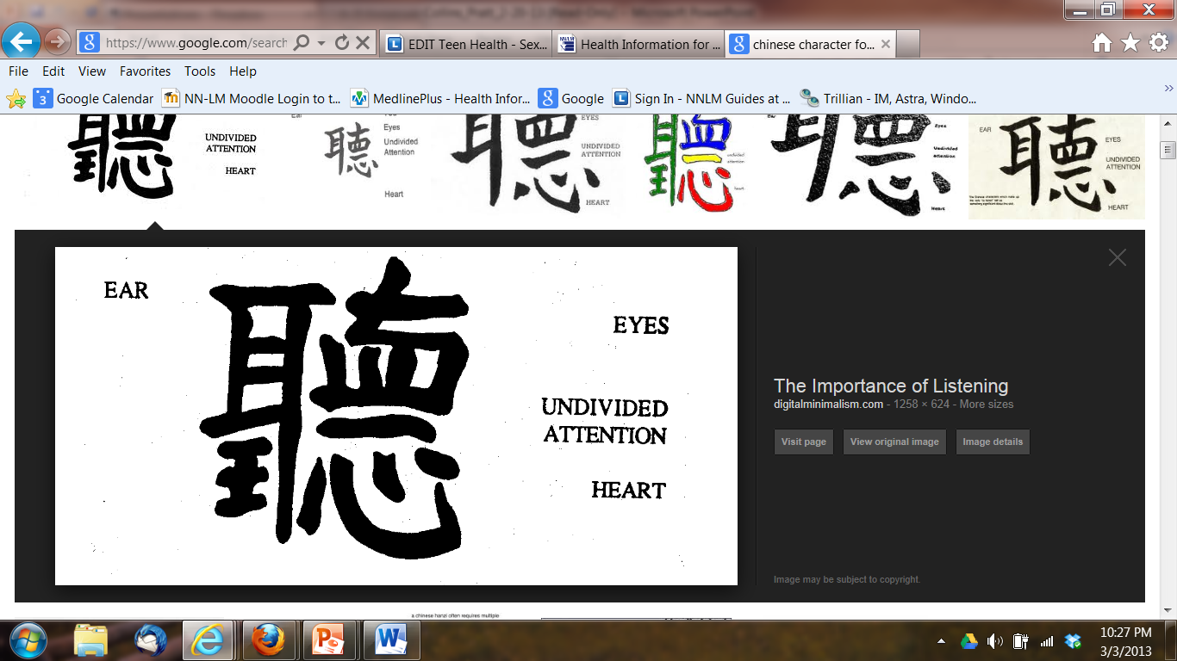
Health Reference Interview
Notes:
Let’s start with the reference interview-- a part of working in a library and assisting library users with health questions involves the reference interview. It’s no use knowing wonderful resources to send people to, if you fail to communicate effectively with them. It’s necessary to think of yourself and the person asking you a health question as partners, meaning each of you has a piece of the puzzle, they the question and you the answer.
The reference interview incorporates several components. The library staff member being open about engaging in conversation with the patron, like fitting the pieces of a puzzle together. They’ve a question and you hopefully are approachable enough to have the opportunity to provide them with an answer.
The Chinese character shown represents listening. As you conduct health reference interviews, it’s going to be important for you to hone in on your listening skills -- we must listen to what our library user is telling us, make sure you pay attention to the body language of the person your assisting, be thoughtful in your responses to the individual, undivided attention, meaning make sure you’re not distracted especially when assisting with sensitive health issues and be empathetic and kind.

Slide 10
Triangle Connection
Health Consumer
Health
Information
Need
Health
Care Professional
Librarian
Notes:
When someone has a health information need, the library/librarian becomes part of the “Triangle Connection”.
There is the patron asking questions, who may be a patient, caregiver, family member or friend, teachers to use in the classroom, students, health professionals looking for patients or for themselves -
The library professionals finding information- their role is to provide information but not interpret- respect confidentiality and privacy, listen carefully to patron; ask if researched before; identify purpose and specific information needed (who, what, when, where, why, how); avoid interpreting information (no diagnose or recommendation; practice compassionate neutrality;
And the health professions who are medical experts- including primary physician/nurse practitioner, supportive professionals such as nurses, x-ray technologist, etc. that the patron may take the information back to.

Slide 11
The Reference Interview … in the context of health information:
Librarian Challenges
Not being familiar with the resources
Knowing the limits of your collection/currency
Medical terminology
Knowing how much to ask
Language and cultural barriers pose special problems
Avoiding interpreting medical information
Notes:
As with any reference interview there can be challenges to the health reference interview. So, what are some challenges when handling a health reference interview that may or may not occur with non-health-related reference interviews?
One issue may be a lack of familiarity with medical terminology for both the library staff member and the person asking the question. Your patron may not have the vocabulary or language skills to ask a question, and you may not have the vocabulary to clarify the question, perform a reference interview, search a resource, or evaluate search results.
Knowing what open ended questions to use and recognizing when you’ve asked enough questions. Remember, health issues can sometimes be sensitive topics and you don’t want an individual to feel they are being interrogated but you want to be able to ask enough questions to get them the answers they need. Finding that balance can be tricky, so be sure to pay attention to the cues they give you based on their body language.
Consider saying, "It will help me to find the information you need if you can tell me more about what you want to know." You can save a great deal of time by determining what the person already knows about the subject. What sources has he or she already consulted? Were these sources too detailed, not detailed enough, too technical, or too general?
Certain types of questions can catch library staff off-guard. Watch for questions that ask about the "best" this or that. "What is the best treatment for...? Who is the best surgeon? Will this medication cure...? Should I...?"
If a library user approaches the information desk with these kinds of questions, it's best to redirect the conversation to help the user give you information about what they need to know. You can rephrase the information: "It sounds like you want to find out about different therapies for X, is that right?" Tell the user what you can do, such as providing information about the therapies to help them understand all the options.
In some cases, the user will become more insistent, but library staff must always avoid giving any medical advice or recommendations. Conversation is to be encouraged as a way to make your patron feel comfortable in a reference interview.
And, finally, a print collection is difficult and expensive to keep current

Slide 12
The Reference Interview … in the context of health information:
Librarian Challenges
Complex question, but no time for a thorough answer
Not offering personal experiences
Knowing where you can refer your patrons
Patron literacy levels
Patron attitude or state of mind
Privacy
Notes:
Health questions usually take more time than other types of questions, so an issue can be the user who is in a rush and is not willing or able to spend the time it takes for a thorough answer. The librarian or staff person should always try to provide a complete answer—with sources—to the question, but sometimes the user isn't able to wait. Always offer to provide information via an email, to hold at the desk for pickup, or to call them back, whichever the patron prefers.
In addition to being difficult, the questions themselves may also be sort of uncomfortable. Most of us are not comfortable discussing bodily functions.
Your patron may have recently received a confusing or possibly life-altering diagnosis, either for themselves or a loved one.
As human beings, librarians often have personal knowledge of medical conditions, treatments, or a variety of other health-related topics. It may be tempting to share stories or personal experiences with library users. It can be easy to find ourselves drawn in to offering an opinion, especially when the patron asking the question also knows something about us personally.
Because every health situation is unique to the individual, it is never appropriate to relate stories of an effective treatment, medication, or any other story. What works for one person may be harmful or inappropriate for another. It is advised that we resist the temptation and focus on providing reliable health information.
Remember to refer the user to a qualified medical professional for questions you cannot or should not answer.
Privacy is a concern both in the reference interview and in many online resources.

Slide 13
The Reference Interview … in the context of health information:
Librarian Challenges
Library staff viewed as knowledgeable on all topics
  Unrealistic expectations, confusion about the librarian's role
More comfortable with library staff than healthcare provider
Library staff are human too
Notes:
. Another set of challenges are related to the position of libraries and librarians in our communities.
Because library staff tend to be trusted and well-informed figures, users often feel comfortable asking for advice, second opinions, or interpretations of lab reports. There may be situations in which users become frustrated or even angry when the staff person won't provide the advice requested. In these cases, we must tell the user that we haven't received medical training, and we don't have the knowledge or skill to give medical advice. We are skilled at finding the best information about the topic, and with that the user can discuss the information with their health professional. It is also the case that many users won't discuss the information with a health professional for any number of reasons, so it is crucial to provide appropriate, understandable information that will enable the user to take action or make decisions.

Slide 14
Frequently Asked Questions
Descriptions of particular procedures
Latest treatment for …
“Everything” about …
The best doctor or hospital
Drug information
Herbal information/alternative treatments

Slide 15
Health Reference Interview Components
Approachability
Interest
Listening/Inquiring
Searching
Follow up.
Notes:
The components of a health reference interview are not that much different from regular reference interviews – with a couple of twists.

Slide 16
Health Reference Interview: Approachability
Keep in mind
  patrons and their family members/caregivers may be emotional, nervous, upset, or in shock
  patrons may be dealing with a sensitive health issue. What one person may feel comfortable talking about, others may feel uncomfortable or fear they are being judged because of their condition.
Notes:
Patrons and their family members may be emotional, nervous, upset, or in shock
Keep in mind patrons may be dealing with a sensitive health issue. What one person may feel comfortable talking about others may feel uncomfortable or fear they are being judged because of their condition.
Make patrons feel more at ease: smile, greet them. Being approachable is the first step in a health reference interview. Body language is not a universal language. Try your best to be aware of different cultures and customs among your patron community.

Slide 17
Health Reference Interview: Interest
Patrons may be unaware of his/her emotional state. Sometimes patrons just want someone to listen to their stories.
Ways to show interest in what the patron is saying: nod head, ask questions, listen, be patient, be non-judgmental, be empathetic.
Notes:
Use active listening skills. Without agreeing/disagreeing with the patron, use phrases to show you are listening: “I see”, “I’m sorry to hear that”, “Tell me a little more about…”

Slide 18
Health Reference Interview: Listening
Make the patron feel at ease. Let them know that you are asking a lot of questions so you can find the best information to meet their needs.
Health literacy concerns and reading level: patrons may be ashamed if they are unable to read. Don’t make assumptions about patrons’ reading ability.
Notes:
Get as much information as possible. Ask-open-ended, neutral questions: ask what patrons already know about the condition, ask the patron what they would like to learn, ask which format they prefer whether it is print or audio-visual).
Look for visual cues. Offer easier to read materials. Offer to read print material to patrons.

Slide 19
Health Reference Interview: Listening
Do not assume the information is for the person asking the question and do not assume that the person asking the question has the illness.
The most appropriate response to a question depends on the role of the person asking the question and their purpose.
Notes:
The person may be asking a question about a medical topic because he/she or a child may have a homework assignment about the condition. Determine the age (adult vs. child) and the gender of the person with the medical condition. Sample Scenario: The person asking the question might be an adult but the person with the condition may be a child. Medical conditions sometimes affect adults and children differently or treatment options may differ, and gender can play a part in treatment or diagnosis. Determine the age (adult vs. child) of the person to whom the information will be given. For example: information about cancer to help a child understand any family member’s cancer.

Slide 20
The Reference Interview … in the context of health information
What are these patrons really looking for?
  Sick lick vomiting
    Cyclic vomiting
  Dropped Bladder
    Cystocele
  Fireballs in the Eucharist
    Fibroids in the uterus
  Smiling Mighty Jesus
    Spinal Meningitis
  Bavarian Enemy
    Barium enema
  Corroded arteries
    Carotid Artery
Notes:
Problems with medical terminology -- What are these people looking for??? [click]

Slide 21
Health Reference Interview: Listening
Patrons may be unfamiliar with medical terms and may not know or remember the correct name of the condition, drug, etc.
Notes:
Verify the name of the condition and the proper spelling (use a medical dictionary if needed). Don’t try to guess the name of the condition/procedure/medication, etc. If unsure, ask that patrons check with his/her medical provider for the correct name of the condition.
Patron may have heard it incorrectly, written it down incorrectly, or the doctor’s writing may be difficult to read
Suggest the person get the correct terminology and spelling from his doctor or nurse – only a cell phone call away
Repeat the question back to patrons to make sure you understand what they are asking.

Slide 22
Medical Jargon
Tylenol vs. Tylenol PM
Hypothermia vs. Hyperthermia
prednisolone vs. prednisone
Holistic vs homeopathic
a.c.: Before meals.
b.i.d.: Twice daily.
Vertebrae?
Cervical
Lumbar
Thoracic
Dysphasia vs. dysphagia
Cerebrum vs. cerebellum vs cerebral cortex
Notes:
The reason why – medical jargon is a problem for both patrons and librarians.
Healthcare personnel use many acronyms; many medical terms are spelled very similarly, but mean different things and there are also medical terms that sound the same or nearly the same, but are spelled differently and mean different things.
For example:
Hypothermia = abnormally low body temperature (caused when body loses eat faster than it produces it_
Hyperthermia = high body temperature (may be caused by heat stroke; central nervous system diseases; thyroid storm; and infections)

Slide 23
Health Reference Interview: Searching
Use reputable sources only. Become familiar with reputable online consumer health sites such as MedlinePlus.
  Evaluate websites critically for credibility.
  Provide complete information.
  Provide impartial provision of information.
Notes:
It sometimes is tempting to do so, but do not censor health information. Often patrons will want to know the prognosis, the likely course of a disease or ailment, of the medical condition. Even if you know the prognosis is grim, you must provide the patron with complete information.

Slide 24
Health Reference Interview:
Follow-up
Ask if the patron would like
  additional information.
  information in another format.
Welcome the patron to ask more questions now or later after he/she has finished reading the information.
Notes:
I am now going to go over some additional cautions

Slide 25
Health Reference Interview:
Additional Cautions
We are information professionals NOT health professionals.
Notes:
Remember, patrons may not understand the role of the librarian as an information professional and not health professional. This bears repeating -- Some patrons may expect the librarian to provide them with a diagnosis- they may come in with a list of symptoms expecting the librarian to diagnose them. Explain politely what you are able to do for them and suggest they consult a health care professional regarding a diagnosis. Let them know that once they have a diagnosis you will be happy to help them find additional information about it. Sometimes patrons may want your opinion regarding what they should do. Never provide your opinion. Always suggest they talk with a health care professional.

Slide 26
Health Reference Interview:
Additional Cautions
Do not talk about personal health experiences (even if you or a loved one has the same condition).
Notes:
Do not interpret medical information or provide medical advice, though you will find many patrons will push you to do so. Resist the temptation to share personal health experiences. Instead offer to find additional information or use a medical dictionary to define unfamiliar terms.. Be empathetic but do not give the patrons false hope.

Slide 27
Caution With Certain Questions
Cancer: Often patrons are uncertain of their type or stage of cancer. Patrons may simply say, “I have lung cancer.” Ask what type of cancer and what stage patrons are interested in.
Diabetes: Here are some things to keep in mind when working with patrons who ask questions about diabetes. There are different types of diabetes – type 1, type 2, gestational. Ask what type of diabetes patrons are interested in. Don’t try to guess the type.
Notes:
Note: Some cancers like blood cancers, lymphoma, and brain cancers have different staging systems.

Slide 28
Caution With Certain Questions
Drugs: Different drug names may sound alike – do not try to guess the name of the drug. Be cautious when providing information about dosages of drugs. Suggest patrons talk to their doctor or pharmacist. Use the NLM Drug Info portal https://druginfo.nlm.nih.gov/drugportal/ or DailyMed https://dailymed.nlm.nih.gov/dailymed/
Notes:
Verify medical terminology in a medical dictionary or encyclopedia. A patron might not know the correct medical terminology to describe their health condition. Always verify unfamiliar terms in a dictionary or encyclopedia (both available in MedlinePlus). Be vigilant with medication names - some drugs have similar names but very different uses.
Give complete information about the drug when reading to the patron. Be cautious when reading drug information over the phone – send printed information as a follow-up if you can.

Slide 29
Caution With Certain Questions
Over the phone: Realize it may be difficult to hear (on both ends). Be thorough – read complete information
Chat: You may lose/drop a patron before the question is answered
Follow-up by mailing or emailing printed information.
Notes:
Over the phone: Realize it may be difficult to hear (on both ends). Be thorough – read complete information
Chat: You may lose/drop a patron before the question is answered
Follow-up by mailing or emailing printed information.

Slide 30
Caution With Certain Questions
Patron speaks a language other than languages you speak fluently: Do not use the patrons’ children as a translator. Be familiar with resources that provide reliable health information in other languages such as MedlinePlus http://www.nlm.nih.gov/medlineplus/languages/languages.html
Notes:
Patron speaks a language other than languages you speak fluently: Patience is key as you want to make sure that both you and the patron understand each other. Articulating and speaking slowly helps a lot. Check frequently if they understand what you say. Repeat their questions, and don’t talk when the patrons are behind you. If the patron still can’t comprehend what you say after you have been trying so hard talking so slowly and clearly, don’t get frustrated! Try writing and using gestures. Sometimes the patron’s reading and writing level are better than listening and speaking level. Be familiar with resources that provide reliable health information in other languages such as MedlinePlus.

Slide 31
Caution With Certain Questions
Referrals vs. Recommendations: Do not make recommendations (treatments, doctors, hospitals, etc.). Provide referrals (to other organizations, etc.). Use organizational directories such as AMA Docfinder.
https://doctorfinder.ama-assn.org/doctorfinder/home.jsp?
Notes:
Provide referrals. Because library staff cannot provide medical advice, it is always good practice to refer the patron back to his or her health care professional to discuss the information they just received. It is also appropriate to provide access to directories or listings of health professionals and other organizations as needed. Use MedlinePlus to access Directories and Organizations to find a local, state, or national organization dedicated to a specific health condition or concern. A referral as described is not the same as a recommendation. Do not provide recommendations to any healthcare service providers or organizations.

Slide 32
Virtual Reference
Reference interviews rely on the soft skills of approachability, comfort, interest, and listening. The necessity of these skills is even more pronounced in chat reference, where non-verbal cues are lost. Soft skills can be summed up as “being human.”

Slide 33
Virtual Reference
Approachability
  In a chat environment, this means responding quickly to chats and avoiding multitasking.
Interest
  You don’t have to be interested in every question, but you should express interest to the patron
  In chat, non-verbal cues such as nodding are lost. Express interest and listening by asking explicit questions and maintaining contact with the patron.
Notes:
Responding to a chat immediately is your first step. Introduce yourself, offer to help, and give your full focus, just as you would with a patron at the desk.
It is up to you to break the ice. A warm and sincere “Thanks for contacting your library! How can I help you today?” sets the tone for the entire chat. It reduces patron anxiety and frustration so you can work together to find answers.
Patrons often come to us anxious or frustrated and sometimes the words “I’m sorry” help diffuse patron frustration. Some useful phrases include
“Looking for health information can be frustrating sometimes. I’m happy to help see what I can find from this end”;
“I’m sorry, I’m not sure I fully understand your question. I want to be sure I get it so I can help you find the best answer. It sounds like you’re looking for [XYZ]. Do I have that right?”

Slide 34
Virtual Reference
Searching
  In chat this involves sharing links and soliciting feedback on resources.
Follow-up
  Encourage the patron to contact the library again if they have further questions. Close with a statement such as “If you need additional information just let me know.”

Slide 35
The Reference Interview … in the context of health information: Tips
Be an empathetic active listener
Use open ended questions
Respect privacy / confidentiality
Be prepared for emotions
Be aware of body language
Do not be afraid to tell the person “I don’t know” or “I can’t get that information for you”
Do not be afraid to refer the patron back to his/her health care provider
Notes:
Let’s finish the discussion of what is different about health information reference, and what the challenges are, by summarizing what we’ve learned so far.
A good reference interview is key to successfully answering health questions. Do this the way you do any reference interview:
Be an empathetic active listener
Use open ended questions
But health reference is different from other reference transactions, so let’s consider those as well:
It’s important to respect your patron’s privacy and confidentiality. I’ll talk more about this in a minute
Be prepared for emotions --your patron may have recently received some life-changing news. Do not take the person’s attitude/frustration personally.
Be prepared with reassuring language, “I can understand why this is frustrating for you…" “Let’s work together to find some information you can discuss with your care team.”
Know your limits, and the limits of your collection - have a plan in place for getting your patron in contact with a medical librarian at a health sciences library = know who to contact and how to contact them.
And remember, it is always appropriate to refer the patron back to their health care provider or health organizations (use Medline Plus to find info).

Slide 36
Privacy, Diversity, Legal And Ethical Issues
Notes:
The privacy of the library user should always be protected and respected. Busy information desks are not the ideal place for a user to ask a sensitive question; if this situation arises, walk the user to the stacks or to a less busy area of the library. If that is not going to be possible, try to shift around to give the feeling of a little more private conversation, keeping your voice low. Discreet and respectful handling of questions is not only appreciated by the user but a professional necessity.
The interaction between the patron and library staff is to be treated with confidentiality; it is never appropriate to discuss patrons' health issues or to reveal information about particular users that could identify them to other staff or library users. If it is necessary to discuss the question with other staff for help with answering the question, only provide the necessary facts about the topic unless the user has given permission to share the information. If a return phone call is necessary, ask whether a message can be left if the user is not at the number when you call.

Slide 37
Diversity
The Challenge:
  Respect for diversity
  Willing to provide services to users where they are
  Provide culturally relevant health information
  Importance of knowing the community the library serves
Notes:
Diversity may mean different things to different people, but it is helpful to think about your community members and how this might impact reference services the library provides.
In order to provide relevant services, learning about the cultural beliefs and preferences of an ethnic group is essential. The same is true when it comes to gender diversity. Some important concepts should be embraced by staff:
Respect for diversity
Understanding and acceptance of differences
Willingness to provide services to all users where they are comfortable
But having the intent to be respectful is not enough to provide health information. We need to know who is likely to need our services and be prepared to provide relevant health information and to provide materials to address the health needs of particular and diverse populations.
The ways that individuals think about medical care and treatment differ greatly among different cultures and populations. If your library serves immigrant populations there are sites that provide information about cultural beliefs, medical issues, and health-related topics of interest to immigrants and refugees.
Be prepared to provide welcoming environment as well as culturally sensitive health information resources for Sexual and Gender Minorities (SGM) populations
If your library serves racial or ethnic minorities, make yourself familiar with the tools available from your local or state office of minority health as well as the office of minority health in the US department of health and human services.

Slide 38
Legal Risk and Ethics
What is the legal liability?
What about the right to read and intellectual freedom?
Notes:
Whether there is a legal risk to libraries or library staff members for providing health information that turns out to be incorrect or harmful is unknown. Librarians providing health information do not seem to be especially susceptible to malpractice but it is nonetheless important to be aware of the dangers.
Adhering to good professional practices and avoiding dispensing advice or interpreting health information for patients will help to minimize liability. Another protection is to remind patrons to check all health information provided by the library with their health provider or clinical team. It is never appropriate to offer any type of medical advice, direction, or interpretation.
Ethical issues related to health information center around privacy and intellectual freedom. It is important to remember that the user ultimately has the right to read—or not to read—information provided by the library. While library staff might not agree with the content of certain books or resources, it is not appropriate to make judgment calls.
Provide the most complete information to answer the information request. Providing the best, most accurate information is the goal of every reference interaction. This includes providing the most current and complete information possible and citing the source. However, some situations pose practical or ethical concerns. For example, some questions are far too broad to answer completely. A patron may ask for "everything you have about diabetes" or some other topic, in which the library staff will need to help the patron narrow down the question. For complex questions, the librarian can work with the patron to break it into manageable "chunks," providing information that can be digested a bit at a time. Offer to take the search to a higher level if the patron desires. Another challenge is that some library staff may feel uncomfortable or unwilling to provide an answer that is perceived to be bad news, such as a diagnosis that is debilitating or even fatal. However, such information should not be withheld; the role of the librarian is to provide the complete answer, not to censor out parts of the answer or to guess that the patron does not want the full answer. It is always appropriate to encourage the individual to discuss the issue with his or her health care provider instead of interpreting the information on their own, since every situation is unique.
This can sometimes be challenging with regards to your collection. Most public libraries are at least somewhat driven in their material selection by patron demand, and often patrons are demanding material of dubious medical value.
Books by say, Gwyneth Paltrow, may be in demand but are not reliable sources for medical advice.
This may be in apparent conflict with the commitment to provide quality, authoritative information, so use the opportunity to educate the library user about evaluating health information and about the other material you have as well.

Slide 39
Ethical Guidelines
Privacy/Confidentiality
Know the limits of your collection
Do not interpret medical information
Refer back to healthcare provider
Use a disclaimer or caution statement
Notes:
In looking at ethical guidelines, there’s really nothing new here. This is where we focus on privacy and confidentiality. Be sure to keep voices lowered, move to a private area if possible when answering sensitive health questions. Familiarize yourself with your collection and know when you’ve reached your limits. Every collection does not have everything you need, so you may need to refer an individual to a different location or use an online resource as opposed to something in print.
I cannot emphasize enough that it is critical that you do not attempt to interpret medical information, provide a diagnosis, or recommend a therapy or intervention. Emphasize to your patron that you are an information professional, not a health professional. Avoid agreeing or disagreeing with what the consumer expresses. Do not offer your own experiences or hearsay about similar medical conditions. When discussing consumer health issues in person, on the telephone, or via e-mail, state the limitations of your role as an information professional and the limitations of your collection. It is always good practice to refer the patron back to his or her health care professional for interpretation or explanation of the information they have received.

Slide 40
Evaluating Online Health Information
Notes:
For reference purposes most of our information sources will be online. Why? The most recent information is not found in books. Additionally, medical books usually cost a lot of money, and are difficult for the layperson to understand. There are some titles which you will select for your patrons to check out, but for answering questions and for getting patrons started on research, you will be turning to websites a lot.
So it becomes imperative that we know how to locate good sources. I will walk you through some techniques for evaluating those resources you and your patrons might find via Google.
I mentioned that one of the challenges of providing health information is the complexity and unfamiliarity of medical information to most non healthcare librarians. So, how can we look at a website and determine if the information it contains is true or false when we don’t really understand the content?
There are several methods to use for evaluating health information. You may be familiar with at least one technique for evaluating websites. There is quite a bit of overlap among them, so let’s take a quick look at some.

Slide 41
“Can This Website Be Trusted”? Guidance Questions to Ask:
Who runs the site? Can they be contacted?
Does the site have advertisements? Are they labeled?
Where does the information on the site come from? Is the information reviewed by experts? Is it up-to-date? Does it make unbelievable claims?
  “breakthrough”
  “Miracle cure”

Slide 42
“Can This Website Be Trusted”? Guidance Questions to Ask
Maintaining privacy is important. Do they ask for personal information?
Do they want to sell something?
How is the site designed? Is it easy to find your way around?

Slide 43
Consumer Health on the Internet
The ABC’s of evaluation
  Accuracy
  Authority
  Bias
  Currency
  Coverage
  And, user friendliness
https://nnlm.gov/initiatives/topics/health-websites
Notes:
As we know people are using the Internet more and we as library staff rely on the Internet to refer our users to. The National Library of Medicine provides the majority of their resources online in order to have the most current information available and provide access to a greater range of persons. So, it becomes important to evaluate the information and teach our library users to do the same. These are the things that you want to look for in a web site.
One method we’ll look at is the ABC’s. Here the ABCs are Accuracy and Authority; Bias; Currency and Coverage. Are you starting to see how these methods have quite a bit in common?
Accuracy
●Is the information based on sound medical research? Can the information on the web page be verified by another source?
●Are the sources cited reliable?
●Are there grammatical and spelling errors?
●Are there footnotes, bibliographies, or references so that you can verify the information? Are these reliable? (a citation to Parade magazine does not have the same weight as an article from JAMA )
Authority
●Who published the page? What are the person's credentials? What do you know about them?
●Is the person backed by a known organization? (the American Association for Cancer Therapy may be a made-up name for something operating out of someone's basement.)
●Is the person affiliated with a university? If so, is the person a student or a faculty member?
●Can you easily find contact information on the web page? Check the about us link, usually found at the beginning or the end of a webpage. What does the About Us section tell you about the purpose of the organization? Can you find a physical location for the organization? Or is the only way to contact the organization through a webform?
●What is the domain name? (.edu, .gov ) Is it a personal page or supported by the organization? The tilde (~) means that the site is a personal page (compare an address like med.harvard.edu/~jsmith/headache to med.harvard.edu/neurology/headache)
Bias/Objectivity
●Is the information showing just one point of view?
●What kind of institution sponsored the webpage? A pharmaceutical company? A non-profit organization?
●Is advertising clearly marked?
●Can you tell if the information you are reading is advertisement?
●Do the graphics, fonts, and verbiage play to the emotions? Beware of CAPITAL LETTERS, EXCLAMATION POINTS!!!!! Or words like MIRACLE CURE!!! Breakthrough!
●Is the author using data improperly to promote a position or a product?
Currency/Timeliness
●Is there a date on the page?
●When was the page last updated?
●Do the links work?
●Has there been more recent research on the subject? Many medical treatments change with the publication of new studies. What was published a year ago may be outdated now.
Coverage
●Is the information complete?
●Are there sources given for additional information?

Slide 44
CRAAP Test
Currency
Relevancy
Authority
Accuracy
Purpose
Source:
https://www.emaze.com/@AIFFRRWC/C.R.A.A.P.-Test-for-Evaluating-Websites
https://library.csuchico.edu/sites/default/files/craap-test.pdf
Notes:
Another variation is the CRAAP Test - the acronym Currency, Relevancy, Authority, Accuracy, and Purpose
Currency: The timeliness of the information.
●When was the information published or posted?
●Has the information been revised or updated?
●Does your topic require current information, or will older sources work as well?
●Are the links functional?
Relevance: The importance of the information for your needs.
●Does the information relate to your topic or answer your question?
●Who is the intended audience? Medical professionals, the general public, children, teens ...
●Is the information at an appropriate level (i.e. not too elementary or advanced for your needs)?
●Have you looked at a variety of sources before determining this is one you will use?
●Would you be comfortable citing this source in your research paper?
Authority: The source of the information.
●Who is the author/publisher/source/sponsor?
●What are the author's credentials or organizational affiliations? And is the author qualified to write on the topic?
●Is there contact information, such as a publisher or email address?
●Does the URL reveal anything about the author or source? examples: .com .edu .gov .org .net
Accuracy: The reliability, truthfulness and correctness of the content.
●Where does the information come from? Is the information supported by evidence?
●Has the information been reviewed or refereed?
●Can you verify any of the information in another source or from personal knowledge?
●Does the language or tone seem unbiased and free of emotion?
●Are there spelling, grammar or typographical errors?
Purpose: The reason the information exists.
●Is it to inform, teach, sell, entertain or persuade?
●Do the authors/sponsors make their intentions or purpose clear?
●Is the information fact, opinion or propaganda?
●Does the point of view appear objective and impartial?
●Are there political, ideological, or other biases?

Slide 45
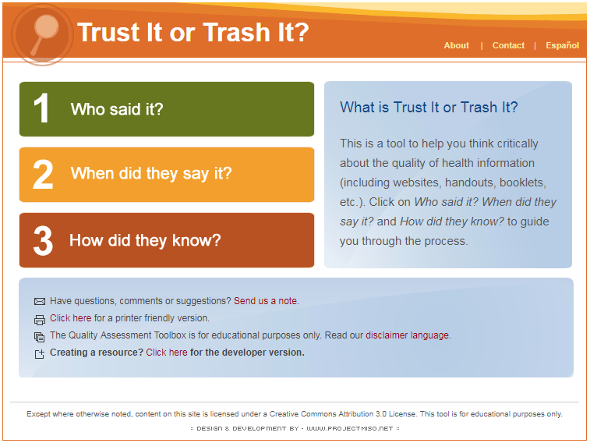
Trust it or Trash It?
http://trustortrash.org/
Notes:
The final method I will mention is Trust it or Trash it.
It was developed by The Access To Credible Genetics (ATCG) Resource Network which is a cooperative agreement with the National Center on Birth Defects and Developmental Disabilities AND the Centers for Disease Control and Prevention. This method uses plain language – no fancy librarian jargon like “authority” or “relevancy” -- just straight forward terms.
Our patrons are less likely to be intimidated by the use of ordinary words and perhaps a bit more receptive to being shown how to apply these principles to their search results.
This site encourages you to ask those three questions - who said it; when did they say it; and how did they know - and then decide whether to Trust it or Trash it.
Who said it, when did they say it, and how did they know cover all the aspects in the more complicated CRAAP test or the ABCs - we get currency by “when did they say it” and we get our authority/bias/relevancy/coverage, etc. in the much more patron-friendly phrases of who said it and how did they know.
So, those are three slightly different techniques you should be using to evaluate websites. But don’t use them just for yourself -- we know our patrons are doing a LOT of their own searching -- share these techniques with patrons when you can.
During the course of the day, library staff encounter many situations in which they can teach a snippet of good search skills or evaluation techniques. Whenever the opportunity arises, take advantage of teachable moments with users. For example, you might perform a Google search on the computer, and you can show the user the results list. Point out the advertisements on the search results page, then the URLs with the .gov and .edu domains. Explain that these are generally the authoritative and reliable sites. Dot com sites are typically in business to make money from advertising and selling products, so the user will be able to navigate sites better if they can recognize advertising and its purpose, which is using their interest in a site to draw them away from the content they seek to click on an ad.
And, always remind your patrons to check back with you -- it never hurts to reinforce that we are there to help.

Slide 46
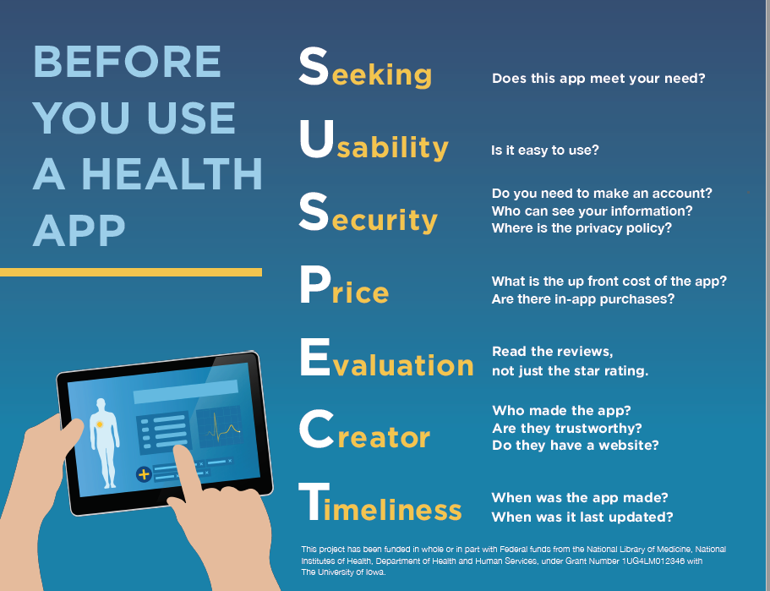
Health Apps
https://news.nnlm.gov/gmr/2018/07/suspect-before-you-download-that-health-or-wellness-app/
Notes:
When Bobby Newman of the National Network of Libraries of Medicine Region 6 (Minnesota is part of Region 6) was developing content for their public library course Stand Up for Health: Health and Wellness Services for Your Community on health and wellness related apps she decided she need a clever evaluation tool similar to CRAAP for websites. Using the following criteria she came up with SUSPECT. I hope you find it helpful for all app evaluations!
Seeking – Why are you searching for an app? Does this app do something you want or need?
Usability – How is the app designed? Is it easy to use? Do the menus or icons make sense?
Security – Do you need to make an account? Does the app share your data with friends? Does the developer share your data or sell it to other third-parties? What is the security policy? Is it easy to find? Is it written in plain language?
Price – What is the upfront cost of the app? Are there in-app purchases?
Evaluation – Read the reviews for the application, don’t just look at the stars, what are other people saying about the application in their reviews.
Creator – Who developed the application? Is the developer reputable? Do they have a website?
Timeliness – When was the application developed? When it was last updated?

Slide 47
Health Information
Tools & Resources
Notes:
[Time check] The following are some consumer health resources that you can use and point your patrons to

Slide 48
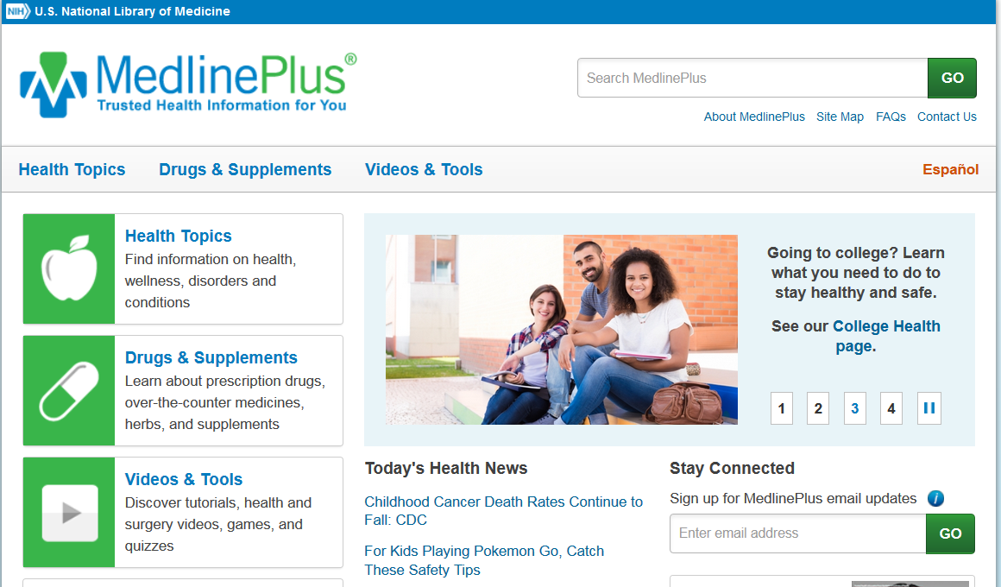

https://medlineplus.gov/
MedlinePlus.gov – free, trusted, family-friendly
Hosted by reputable government agency: The National Library of Medicine
No sales
Can search for many health conditions: 900+ Health Topics: including Diseases, Illnesses, Health Conditions and Wellness
Available in multiple languages
Easy-to-Read materials/how to write easy-to-read materials
  http://www.nlm.nih.gov/medlineplus/etr.html
Interactive tutorials/videos and health check tools
Drugs and Supplements
Medical tests
Notes:
Any one who has answer health information questions should be familiar with MedlinePlus. MedlinePlus is produced by the National Library of Medicine .

Slide 49
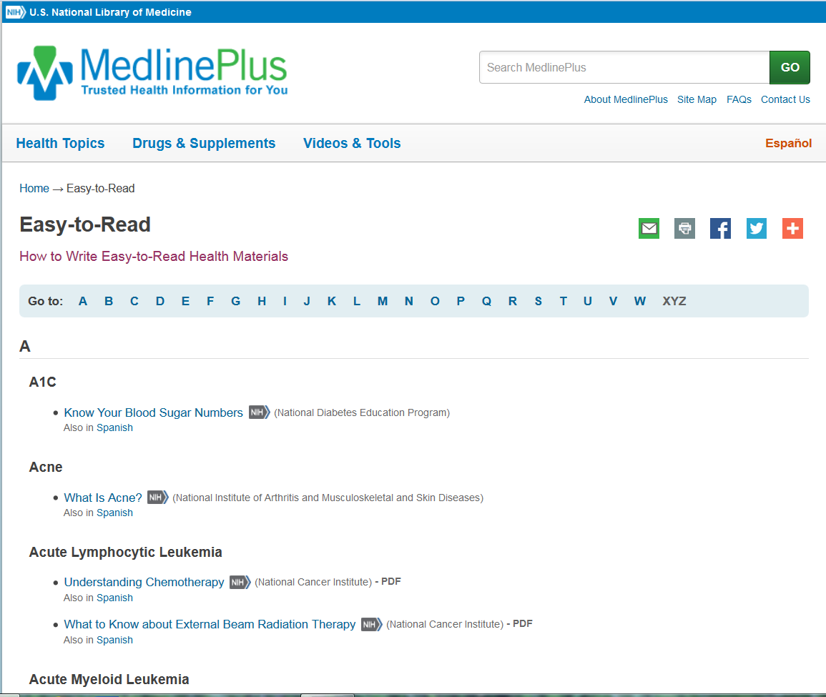
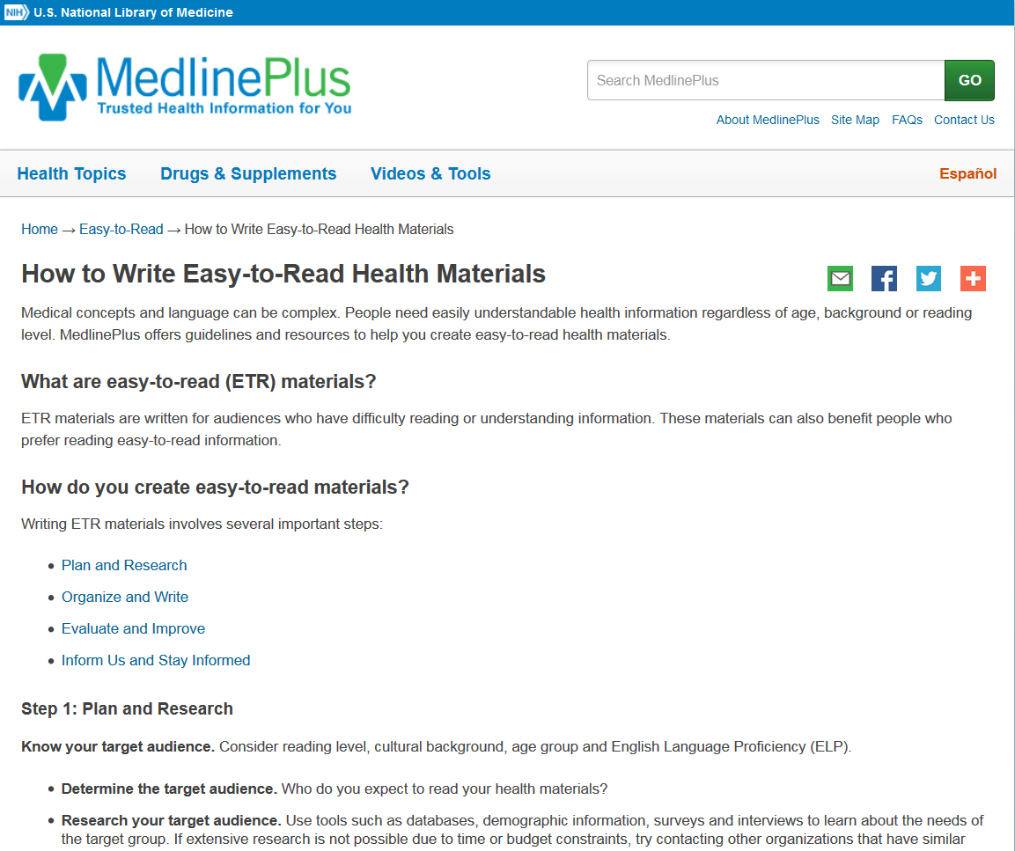
MedlinePlus: Easy to Read Materials
In general, easy to read materials found on MedlinePlus are usually written at a 5th to 8th grade reading level. The summaries on their health topic pages aim for a 5th to 8th grade reading level.
Notes:
Easy to read materials

Slide 50
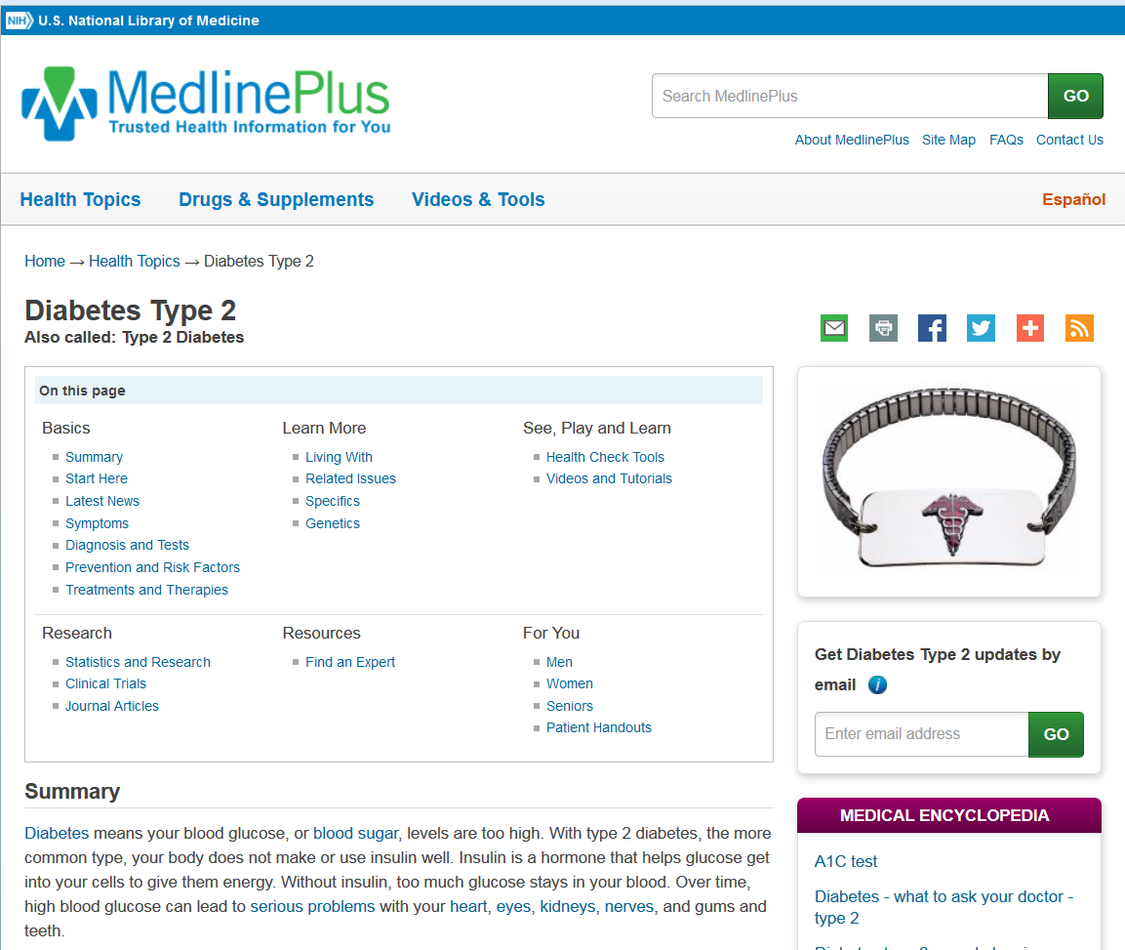
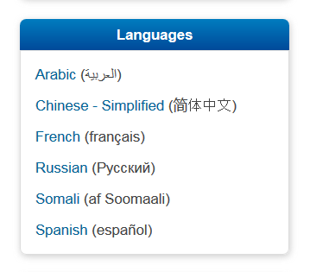
MedlinePlus: Multiple Languages
Notes:
Materials in other languages

Slide 51
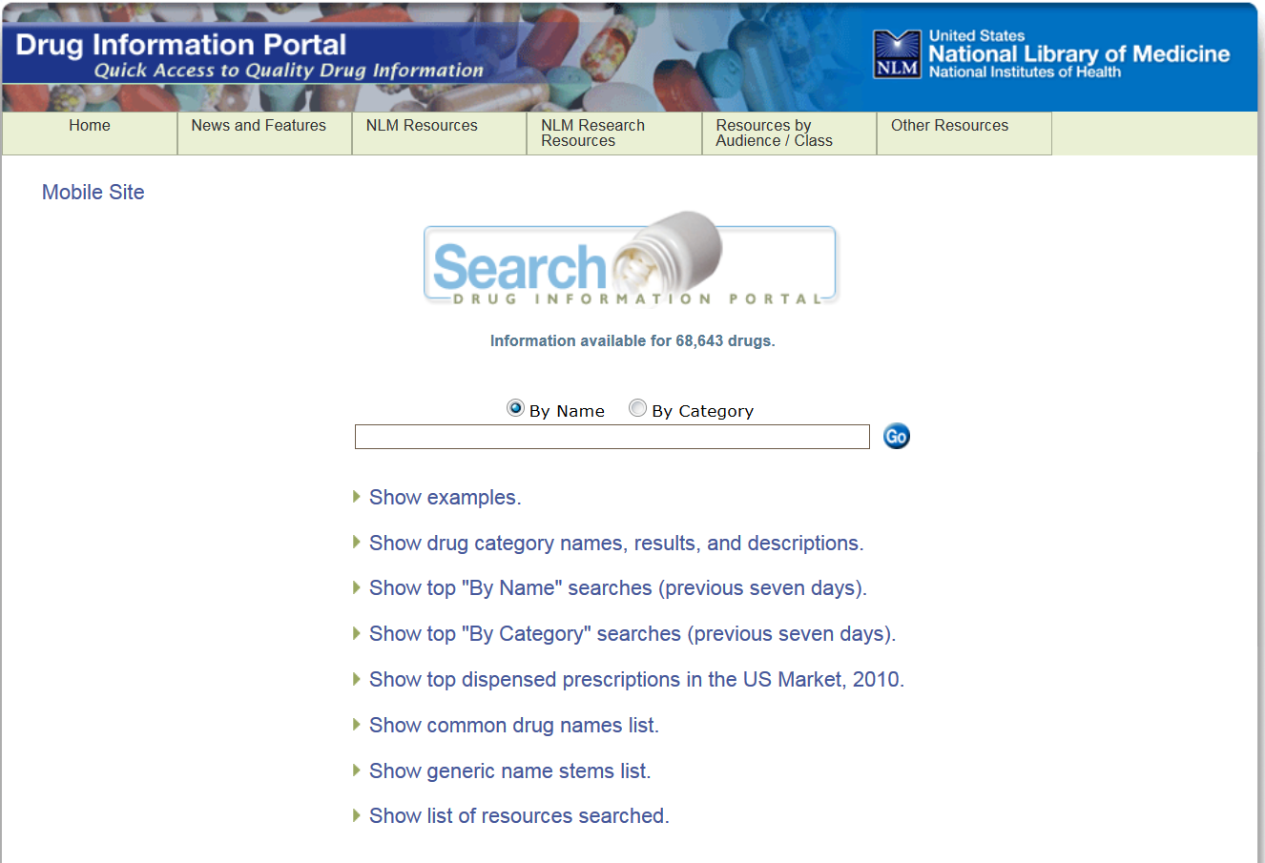
Drug Information Portal
https://druginfo.nlm.nih.gov/drugportal/drugportal.jsp
Notes:
The Drug Information Portal is a free web resource from the National Library of Medicine (NLM) that provides an informative, user–friendly portal to current drug information for over 50,000 drugs. Links to sources span the breadth of NLM, the National Institutes of Health (NIH) and other government agencies. A varied selection of focused topics in medicine and drug–related information is also available from displayed subject headings.

Slide 52
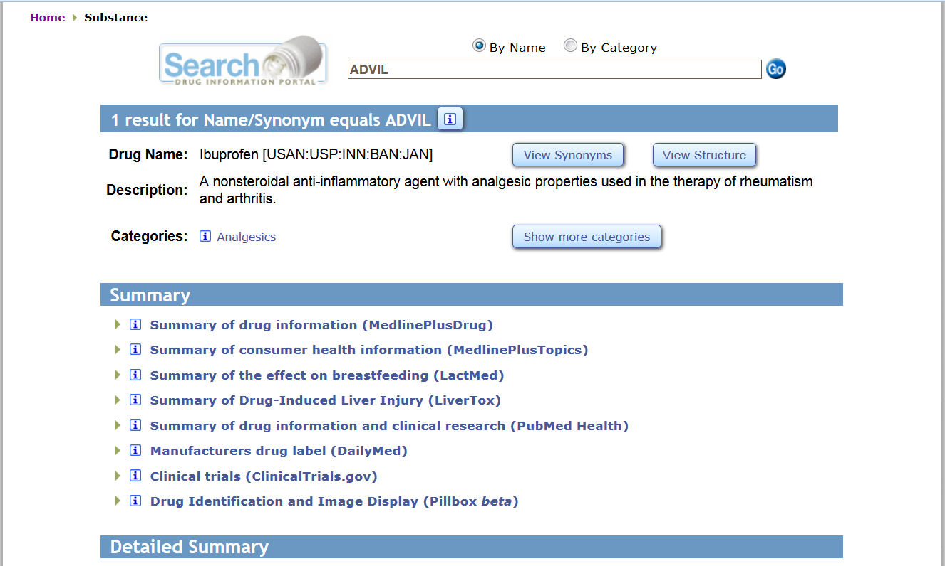
Drug Information Portal
Notes:
Users can search by a drug’s brand/trade name (e.g., Valium) or generic/common name (e.g., Diazepam). The search will display a unique drug profile created from links to online resources listed in the table below. More inclusive searches can be performed by using the asterisk (*) to truncate a drug's name at the beginning or at the end of the term. Searching is also available for drug name fragments by enclosing the search term within asterisks.

Slide 53
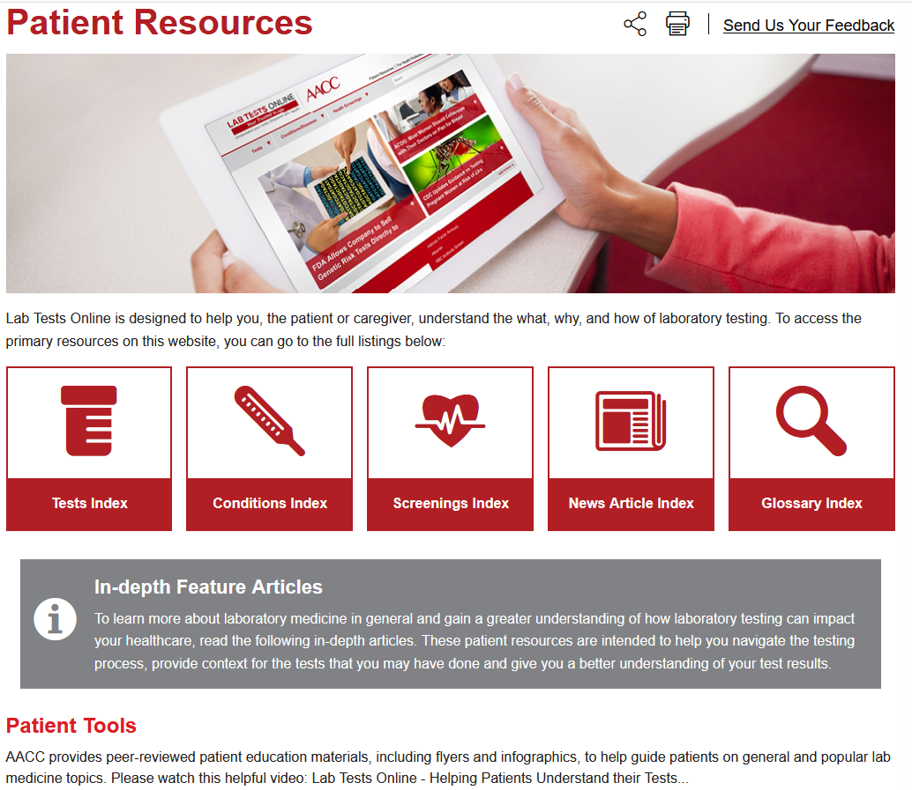
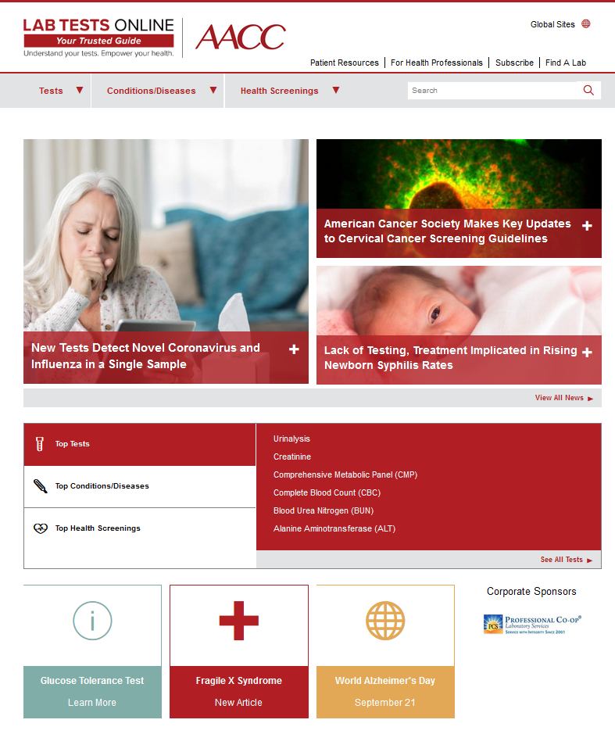
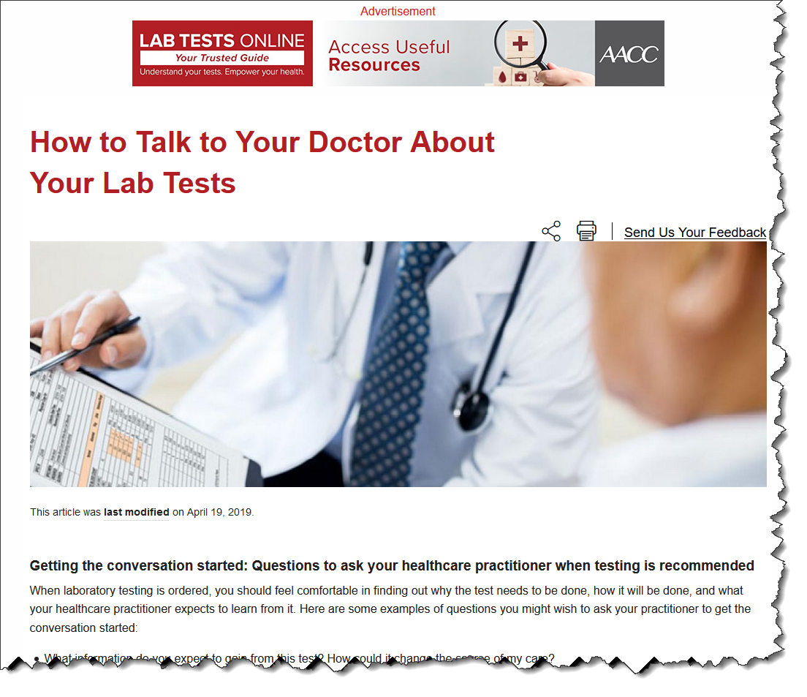
Lab Tests Online
https://labtestsonline.org/
Notes:
Lab Tests Online is an health information web resource designed to help patients and caregivers understand the many lab tests that are a vital part of medical care. Laboratory and medical professionals, who are experts in the field, develop and review all content, including articles on lab tests, conditions/diseases, screening, patient resources, and lab test news. The site is produced by AACC, a global scientific and medical professional organization dedicated to clinical laboratory science and its application to healthcare.
.
The site includes a library of conditions and diseases that are briefly described and linked to the tests that are typically used to screen for, diagnose, and monitor them.

Slide 54
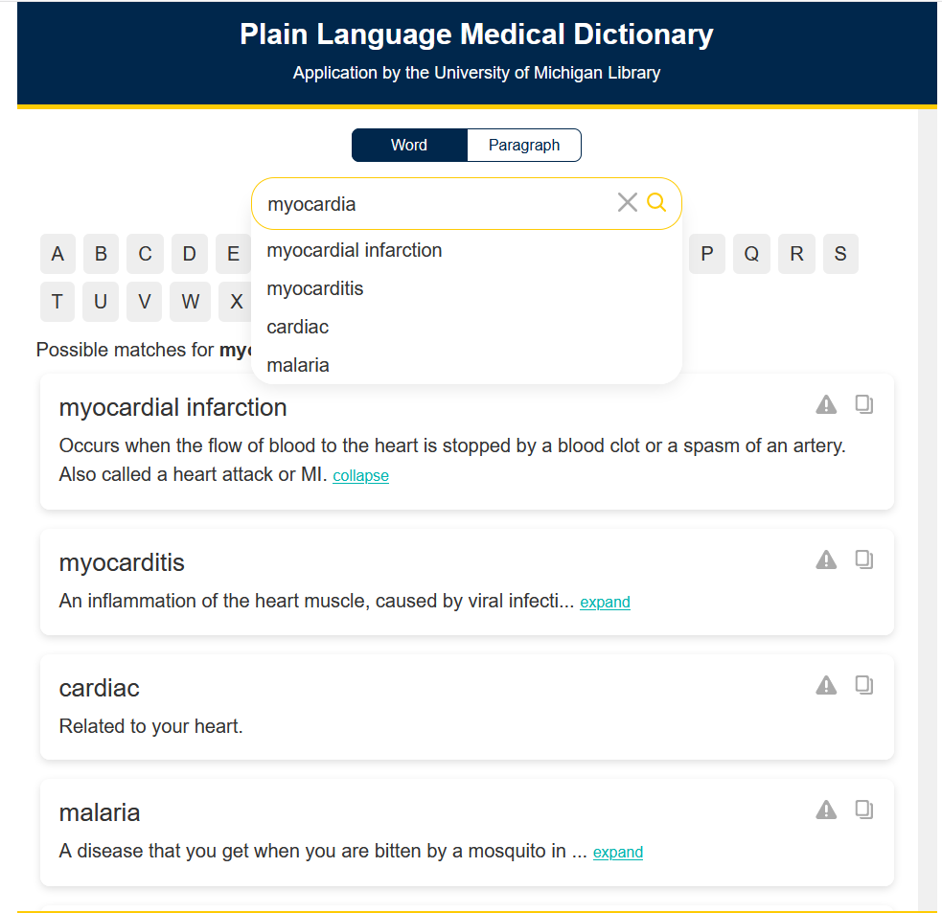
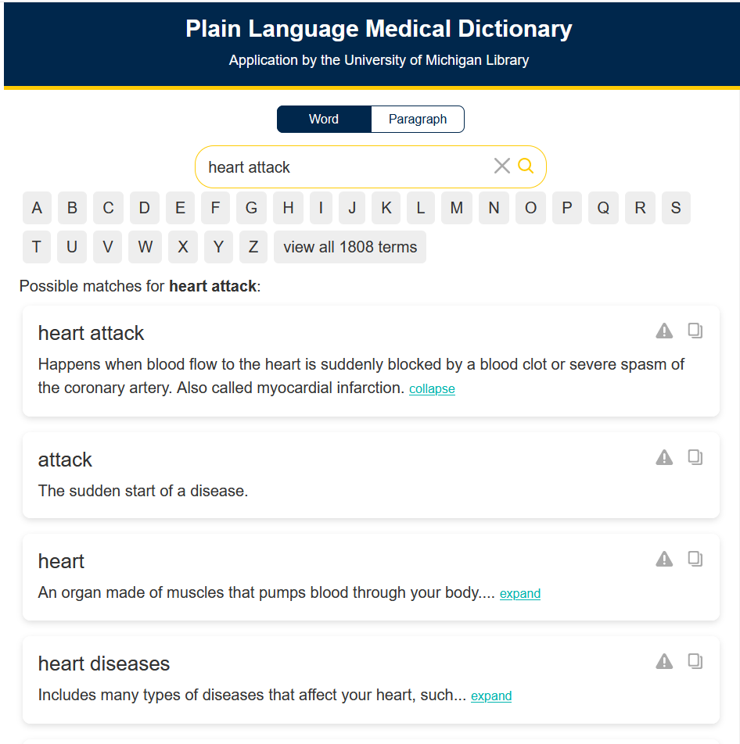
Plain Language Medical Dictionary
http://www.lib.umich.edu/taubman-health-sciences-library/plain-language-medical-dictionary
Notes:
is a project of the University of Michigan Taubman Health Sciences Library as part of the Michigan Health Literacy Awareness project. You can type in either a plain language term or its equivalent medical term.

Slide 55
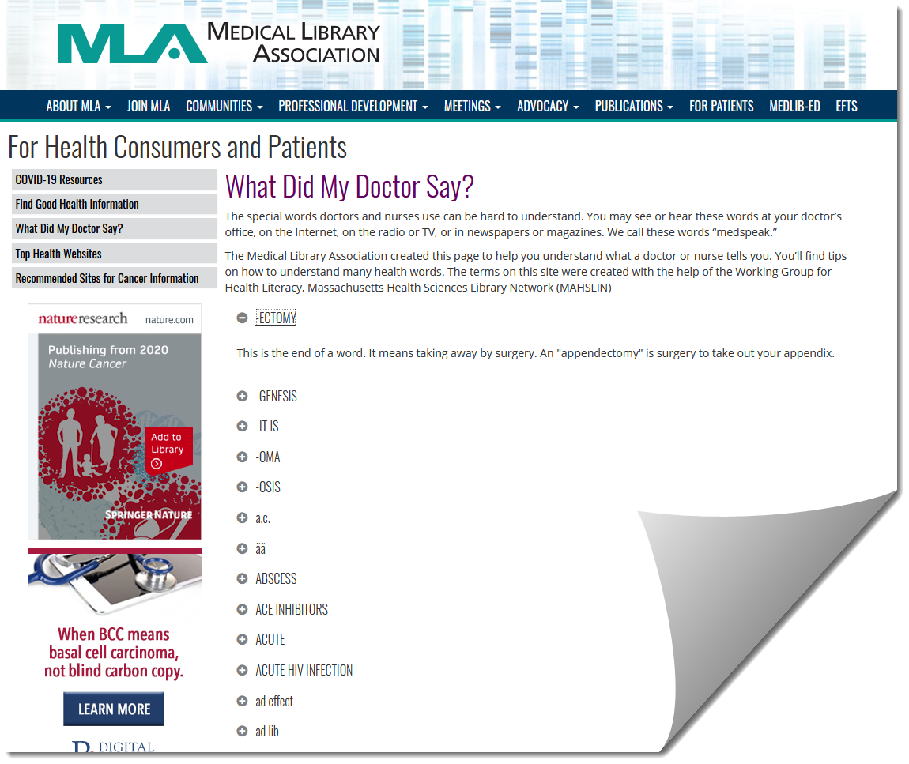
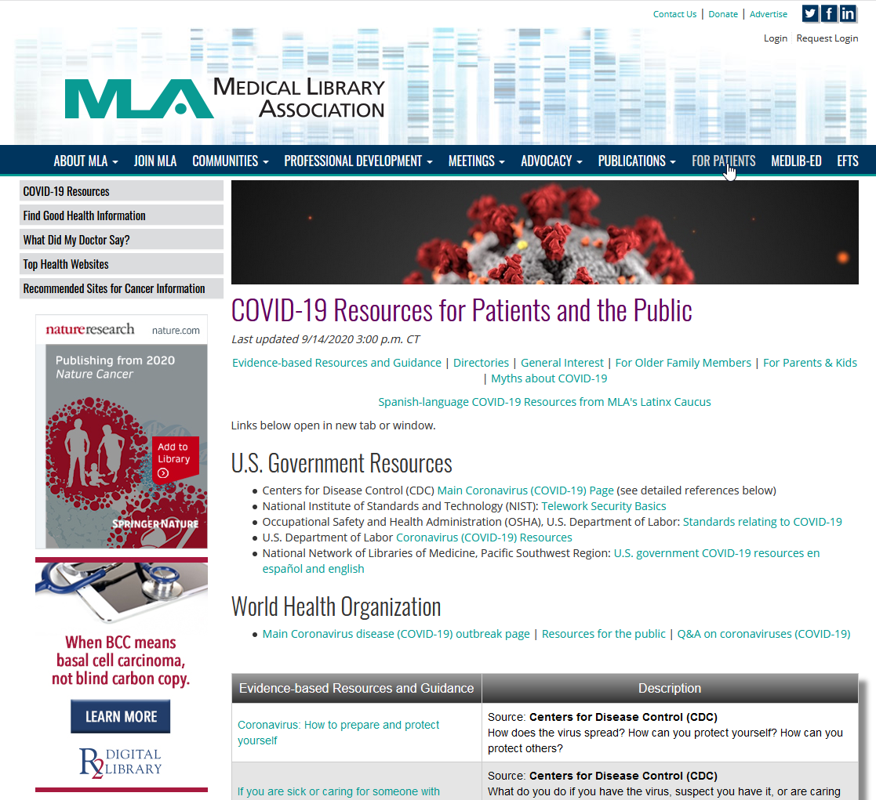
For Patients:
Medical Library Association
https://www.mlanet.org/p/cm/ld/fid=1717
Notes:
The Medical Library Association has a “for patients” page that includes a page on acronyms

Slide 56
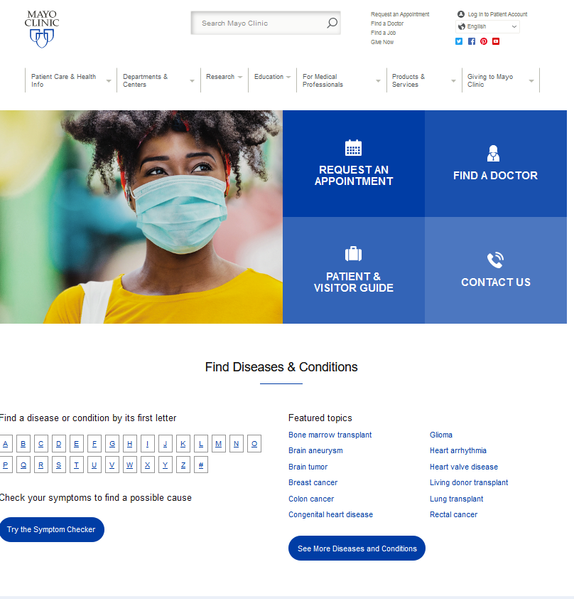
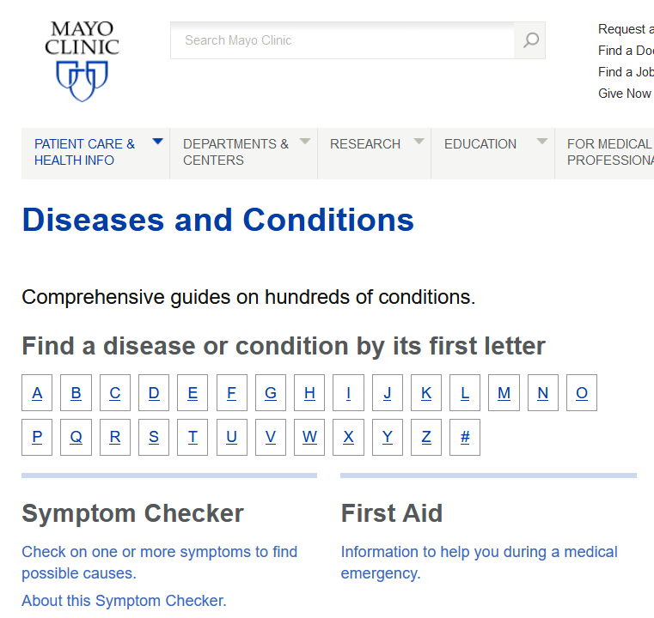
MayoClinic.org
https://www.mayoclinic.org/

Slide 57
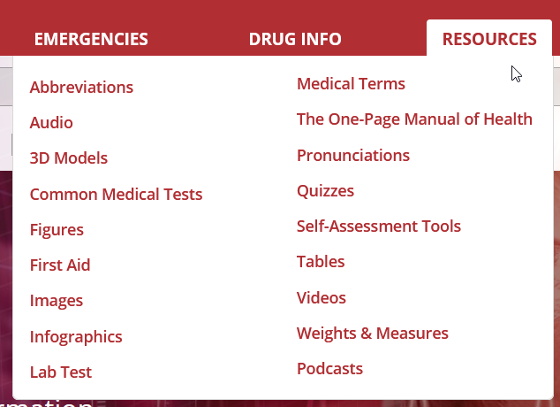
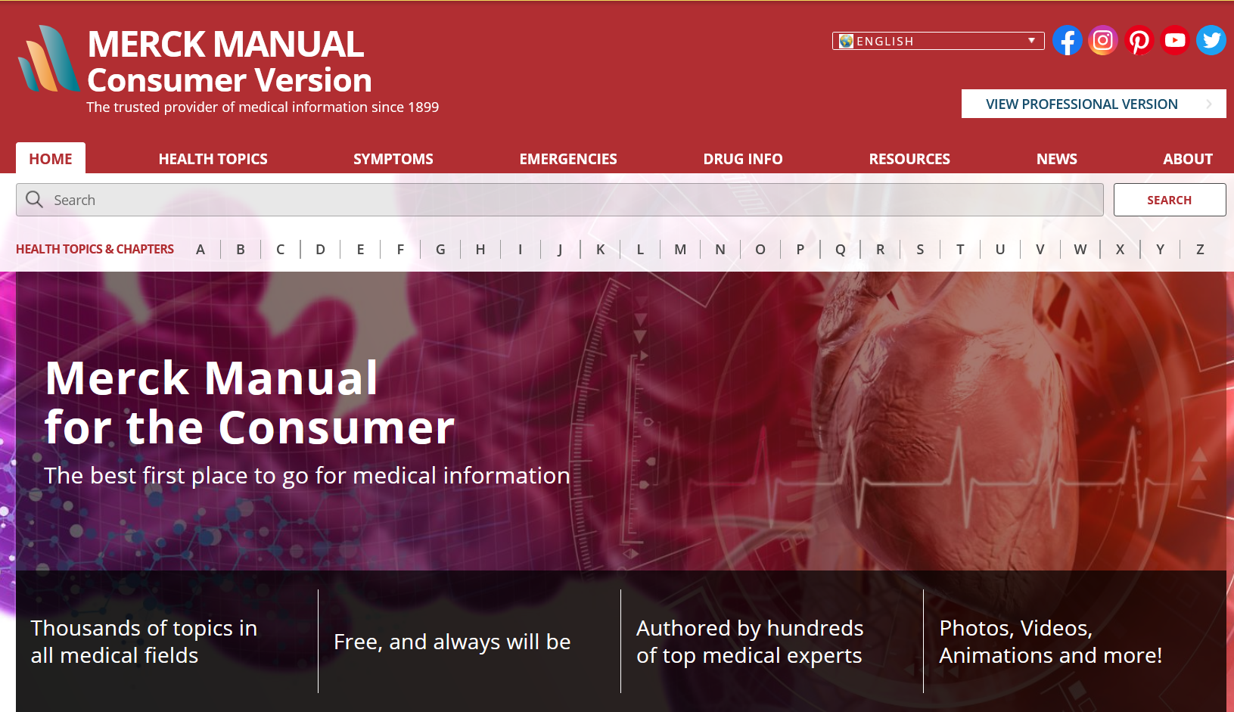
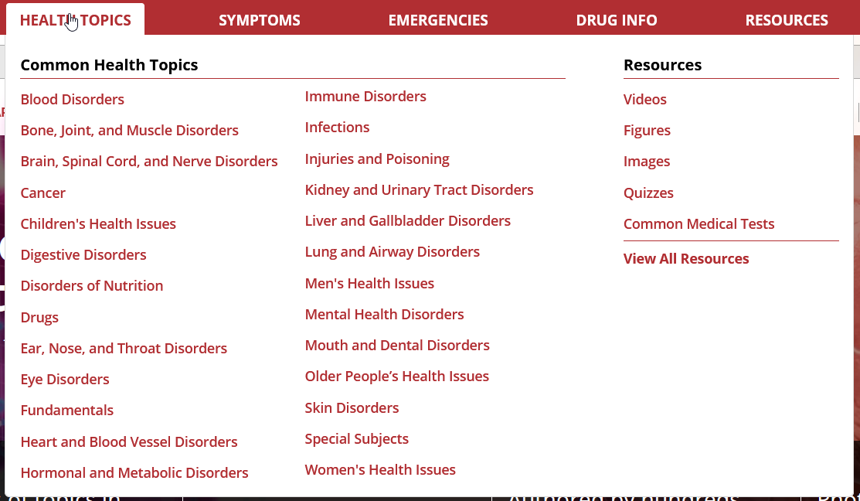
Merck Manual Consumer Version
https://www.merckmanuals.com/home
Notes:
The Manual contains general medical information about thousands of diseases and symptoms in all fields of medicine. The Consumer Version also contains Quick Facts, which are shorter, easier to read versions of selected consumer topics.

Slide 58
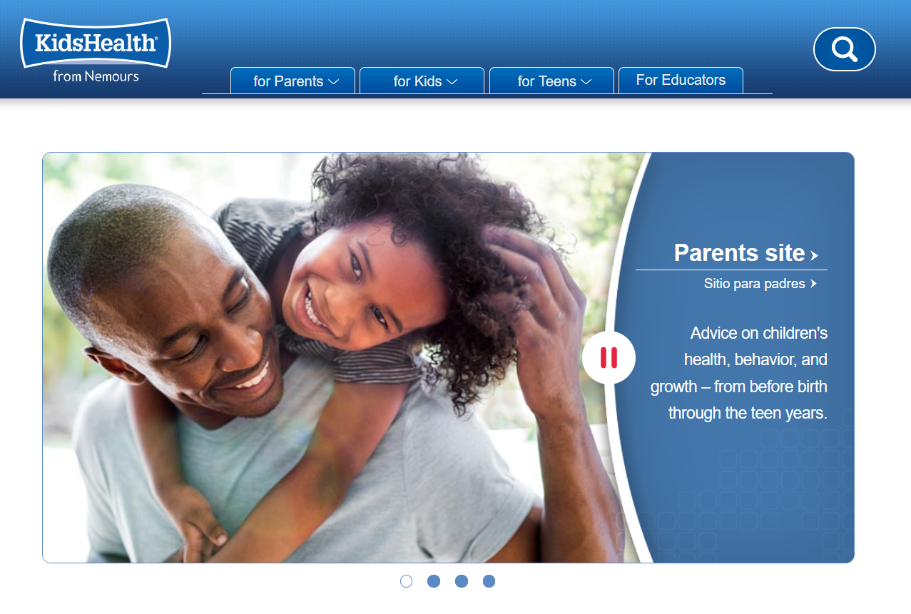
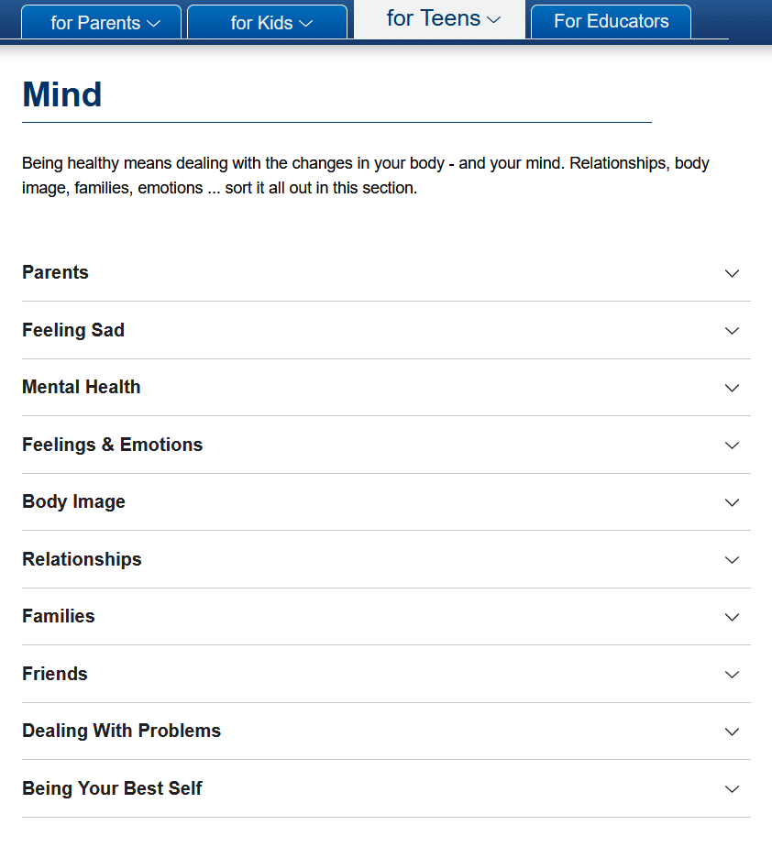
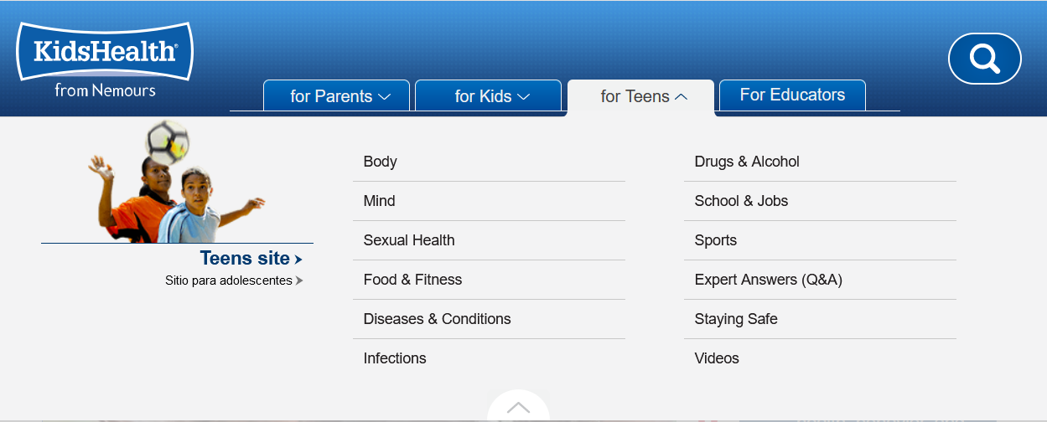
KidsHealth.org
https://kidshealth.org/
Notes:
Doctor-reviewed advice on hundreds of physical, emotional, and behavioral topics — from before birth through the teen years.
Separate sections for parents, kids, and teens
Easy-to-follow articles, slideshows, videos, and health tools designed to help families learn, grow, and be their best.
Free lesson plans and programs for teachers and early childhood educators

Slide 59
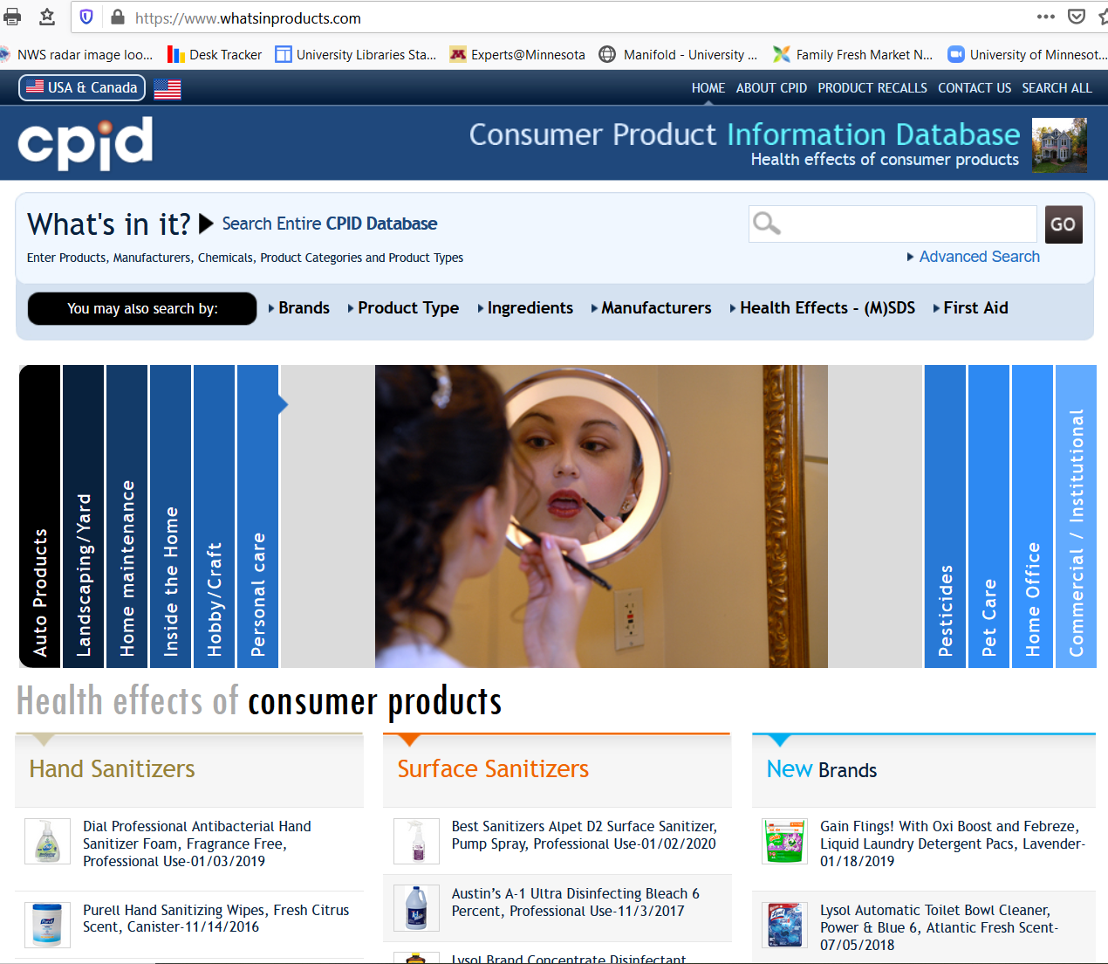
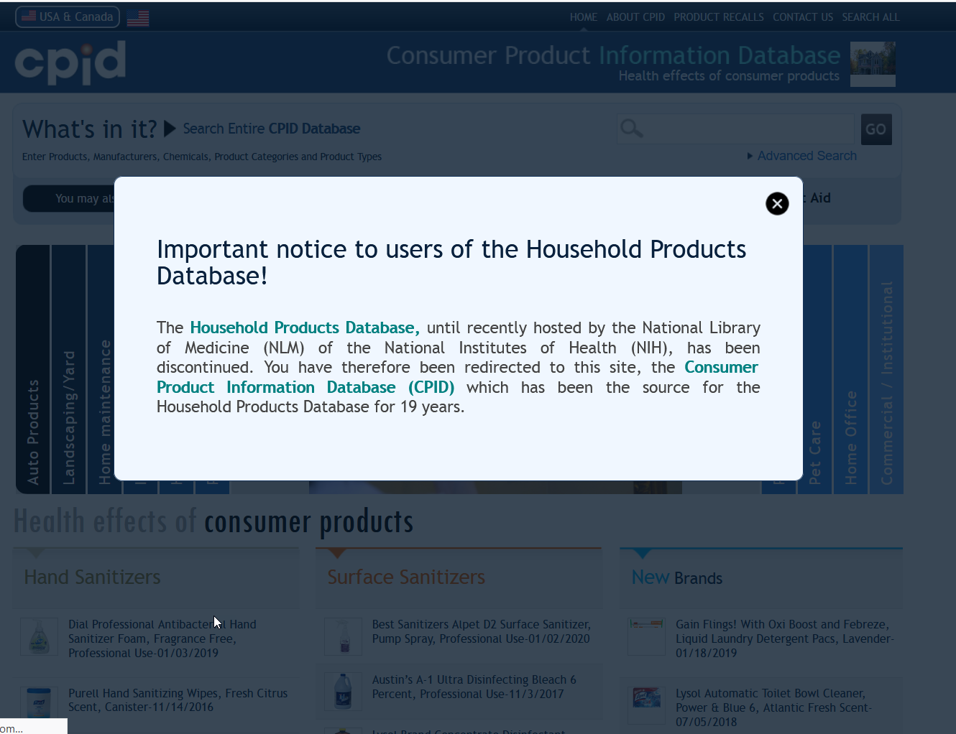
Consumer Product Information Database

Slide 60
R.I.P.
Pillbox
HealthReach
NIHSeniorHealth
Genetics Home Reference
Household Products Database
American Indian and Alaska Native Health
SIS (Specialized Information Service)
Notes:
Consumer health resources that have disappeared in the last two-three years.
If you are interested in additional workshops or training in consumer health, check out the National Networks of Libraries of Medicine training – they offer multiple freely available classes on all different topics related to consumer health.
NNLM – training – classes by category – consumer health.
Health and Wellness @ the Library: The Essentials of Providing Consumer Health Services 4 week interactive course. Listed in handout. Free
Check out NNLM for other free online courses on consumer health.
https://nnlm.gov/training/classes-by-category?combine=&field_class_category_tid%5B%5D=480

Slide 61


Thank You!
Katherine Chew
chewx002@umn.edu
612-626-3017
Notes:
Questions

