Slide 1
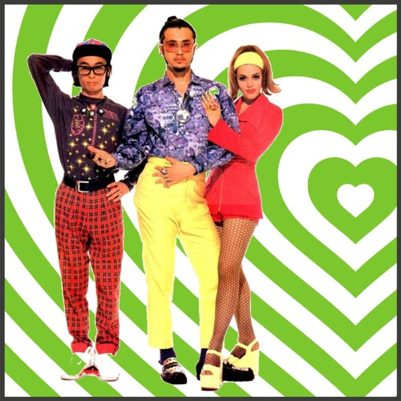
Groove is in the heart 💗
Trust and vulnerability in collaboration
🎷Mara Blake, she/her, North Carolina State University
🎸Wanda Marsolek, they/them, University of Minnesota
🎺 Mikala Narlock, she/her, University of Minnesota
Notes:
Mikala: Welcome, introduce speakers
On the saxophone, we’ve got Mara Blake, sher her, formerly of Johns Hopkins University, presently of North Carolina State University
On the guitar, we’ve got Wanda Marsolek, they them, of the University of Minnesota
And I am Mikala Narlock, also of the University of Minnesota

Slide 2
Agenda
Context
  What is the Data Curation Network
  Retrospective report
Structures that enable Radical Interdependence
Trust and Vulnerability
(if time allows) Q&A
Notes:
We have a very short time together today, so we will move at a brisk pace through these topics. Our contact information will be on the last slide, but we also whole-heartedly invite you to chat with us after the presentation!

Slide 3
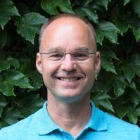
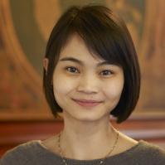
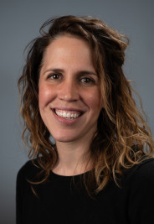
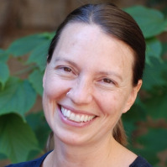
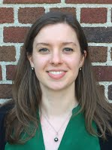
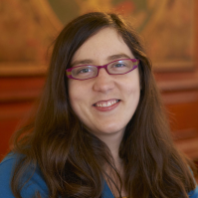
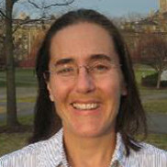
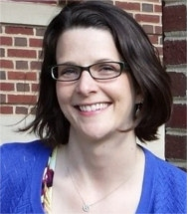
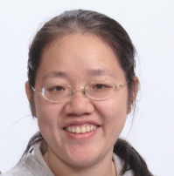
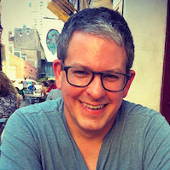
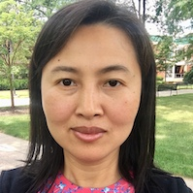
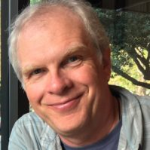
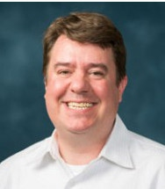
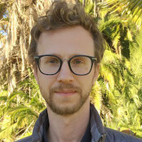
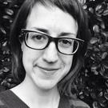
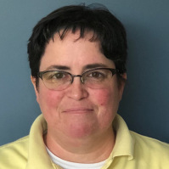
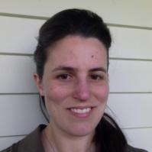
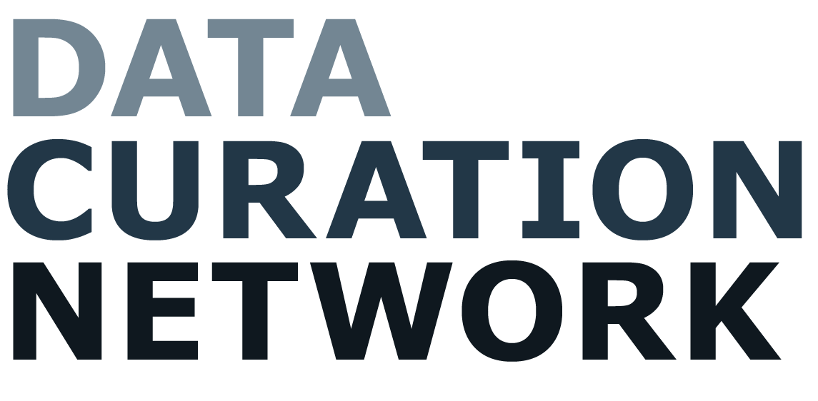
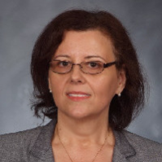
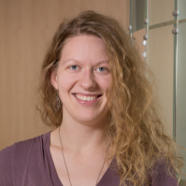
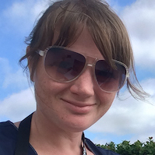
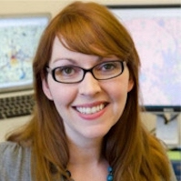
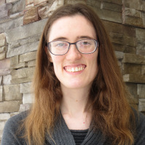
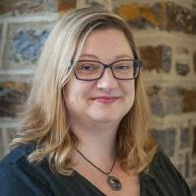
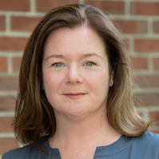
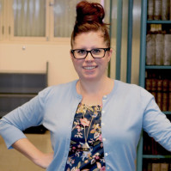

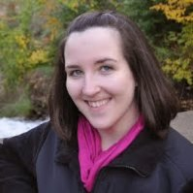
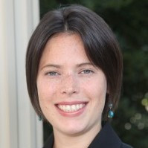
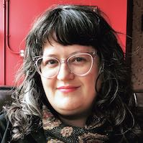
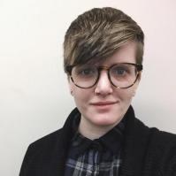
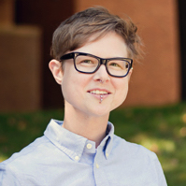
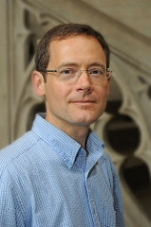
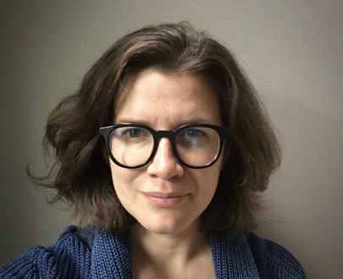
Notes:
Today we’re going to talk about collaboration and vulnerability
While the three of us have the pleasure of speaking here today, what what we are presenting is the result of many folks’ efforts. Every member of the Data Curation Network, past present and future, has contributed to the work we’re going to discuss today. We are incredibly grateful for their energy and support.

Slide 4
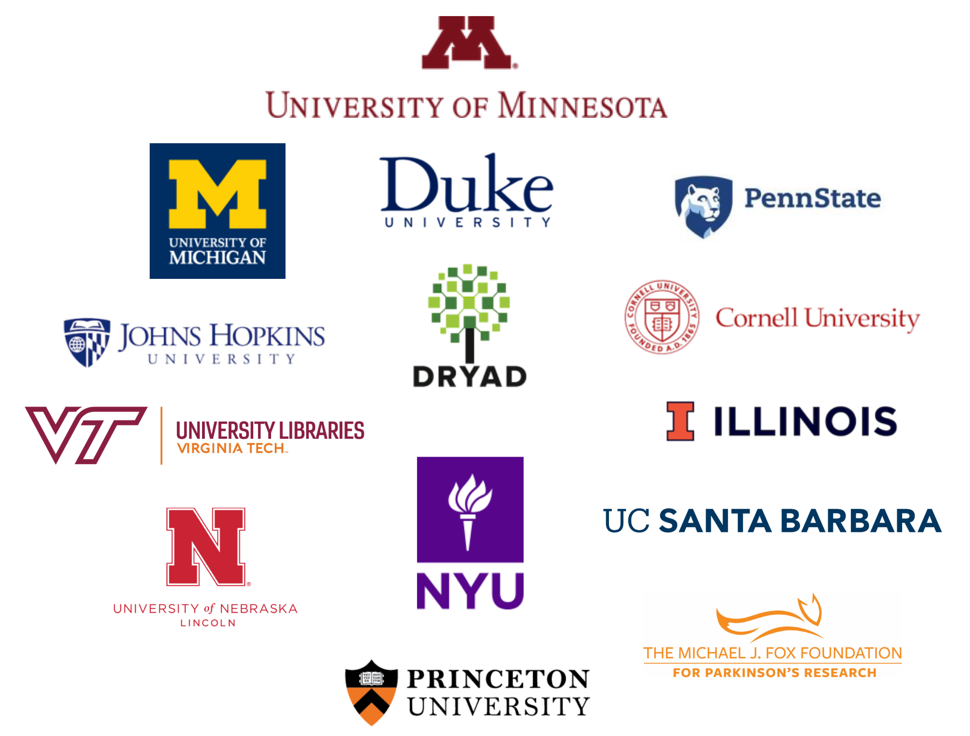
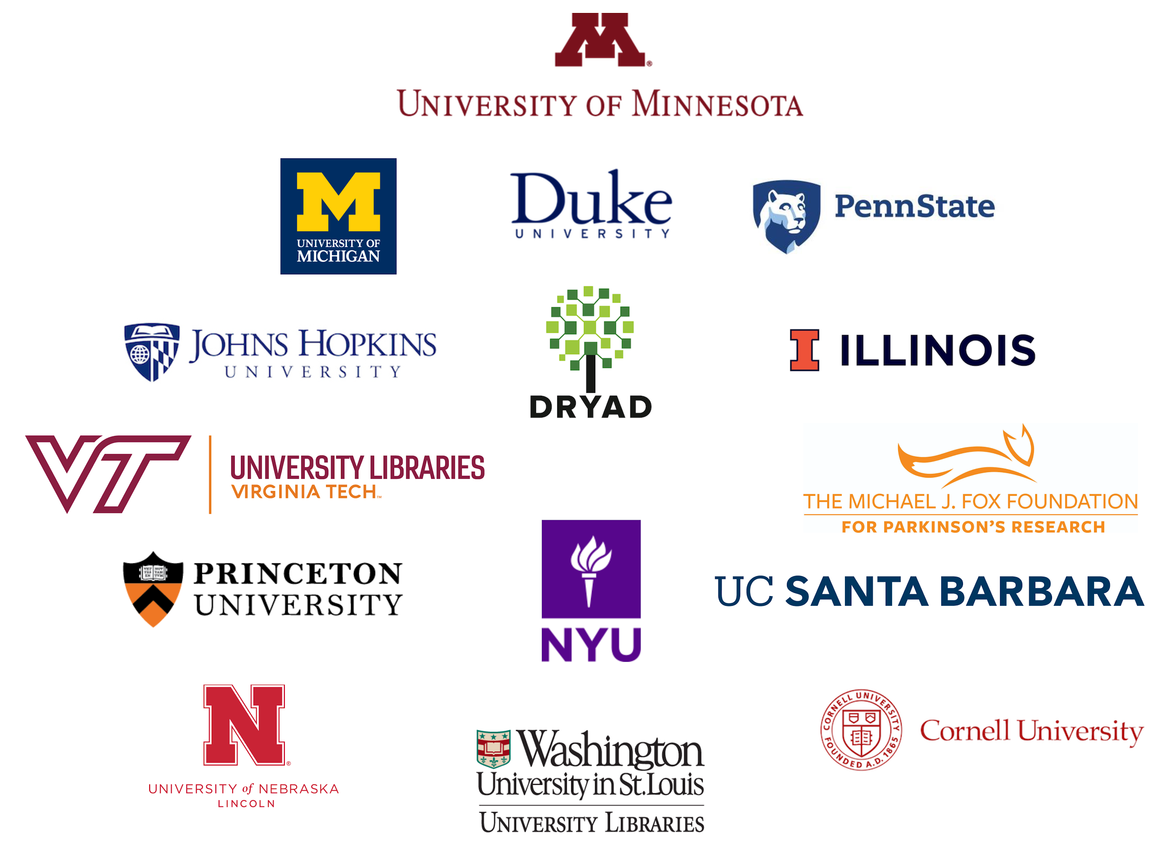
Mission
Trusted, community-led network of curators advancing open research by making data
Ethical. Reusable. Better.
Notes:
The Data Curation Network, or DCN, is a community-led network of curators advancing open research by making data more ethical, reusable, and understandable. We are an active community of data stewards and curation practitioners who share knowledge and time to collaboratively curate research outputs and advance the data curation profession. The DCN has been active since 2016, and officially launched as a member-funded organization in July 2021, and the initial phase was generously funded by the Alfred P. Sloan Foundation.
In particular, the DCN collaborates to curate datasets, shares expertise and resources, offers education and professional development opportunities to the wider research community, and advocates for the role of data curators and information professionals. In this way, we help ensure that data shared by researchers at our institutions is more findable, accessible, and reusable.
Lastly, the DCN is actively involved in and working towards how to improve the ethics of not just the datasets we curate and help share, but also our own work. We examine how we can make our community more inviting and inclusive, how our curation practices can be more equitable;

Slide 5

Toward Sustainability
Towards Sustainability
Planning Phase Grant
Implementation Phase Grant
Sustaining the DCN
Shared curation
6 partners
8 partners
10 partners
12 partners
Steady growth
2016
2017
2018
2019
2020
2021
Research and planning
Model published
Launching the Network
Data Curation Network goes live Jan 1, 2019 with 10 partner institutions!
Assess and Adjust
Transition to membership model
Researcher focus groups “Most important curation activities”
Pilots
Comparison of curation workflows
Fiscal models
(2017) A cross-institutional staffing model for curating research data. IJDC 13(1)
Hired 1FTE coordinator
Trained first curator cohort
Put technology/ workflows into place.
Special interest groups
Research value of curation
Sustainability planning
Establish membership model
Launch Governance Board
Notes:
The DCN was initially conceived of in 2016 with funding from the Alfred P. Sloan Foundation. After this one year planning grant, the project team launched into a three year implementation grant again from the Alfred P. Sloan Foundation. After a one year no cost extension, the DCN concluded the grant phase is May 2022 and officially transitioned to be exclusively member funded. As we neared the end of the grant funded, we brought team members together for a project retrospective to better understand the structures that enabled the successes of the DCN as well as the challenges the team either overcame or is still grappling with.

Slide 6
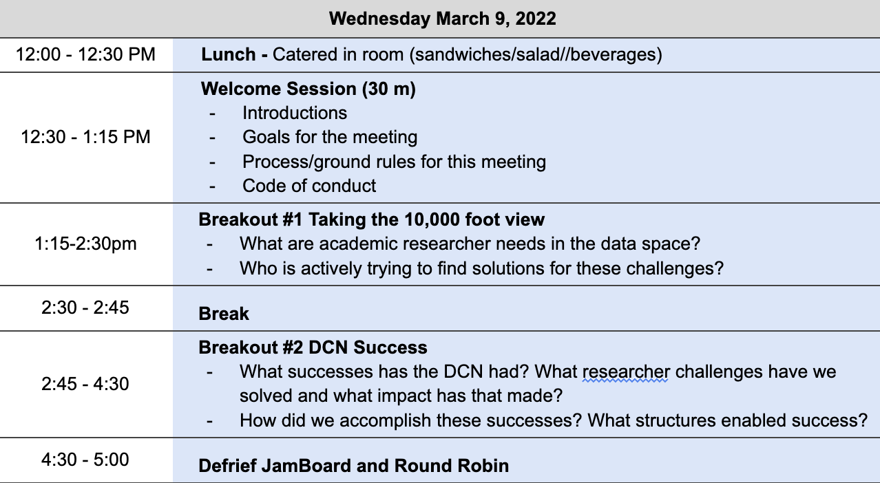
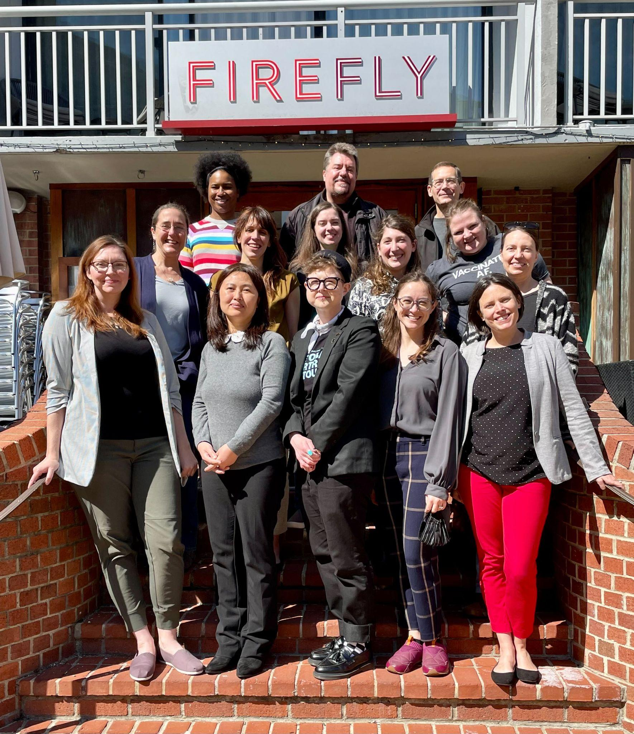
Notes:
This retrospective was held in March 2022 in Washington D.C. Over the course of 2.5 days, team members engaged in discussions and activities to really unpack the work of the network. We are incredibly excited to share that the result of this retrospective will be a report published with the University of Michigan Press

Slide 7
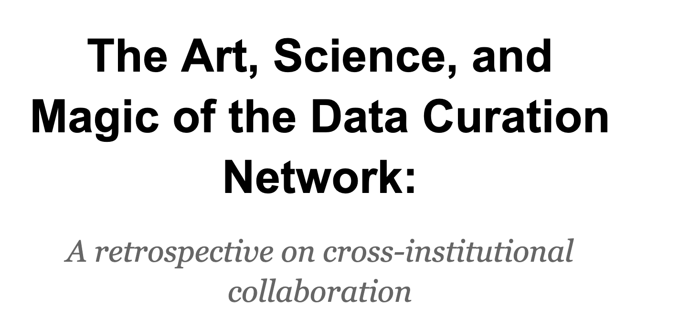
Notes:
Titled: The Art, Science, and Magic of the Data Curation Network, a retrospective on cross institutional collaboration.

Slide 8
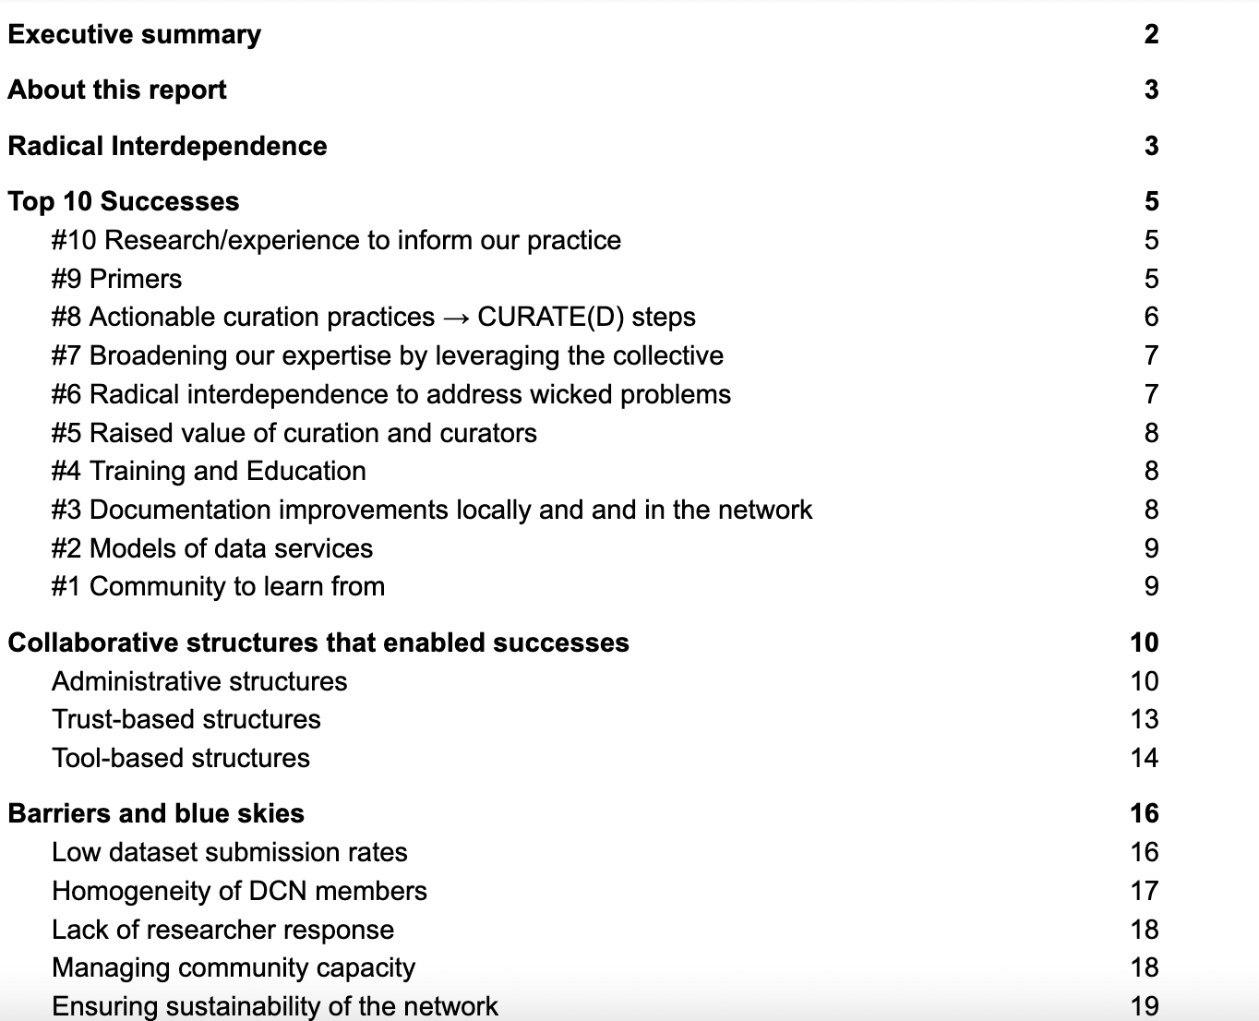
Notes:
I know it’s hard to see, but we wanted to give a sense of what this report will include – we start with an executive summary, then describe what the DCN is, our successes, barriers, and potential future directions. Throughout the report, and throughout the retrospective meeting, one thing we kept coming back to was radical interdependence.

Slide 9
Radical interdependence is more than cooperation – it is relying on others outside of your organization to complete work for our individual institutions... . It is about collaboration, trust, vulnerability, and accountability, not from a punitive perspective, but from an intrinsic desire to show up for and serve one another based on clear expectations, commitments, and the shared goal of advancing the field. It is about pooling our resources, our knowledge, and our interests, to better accomplish our work and advocate for the role of data curators. It is about recognizing the interconnectedness of the work we are all doing.
Notes:
Here’s the definition of radical interdependence that we set forth in our retrospective. (pull out some of the text)
And with that, I’ll turn it over to Mara to discuss Radical interdependence/Structures enabling DCN success

Slide 10
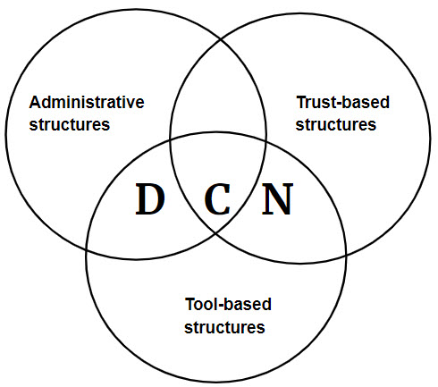
DCN Collaborative Successes

Slide 11
Administrative Structures

Slide 12


Grant Funding
Alfred P. Sloan Foundation
Planning Grant
Implementation Grant
Institute of Museum and Library Services (IMLS)
Workshop grants

Slide 13
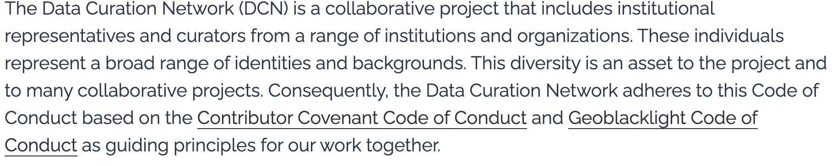
Community Code of Conduct
See the full code at https://datacurationnetwork.org/about/code-of-conduct/. SeS

Slide 14
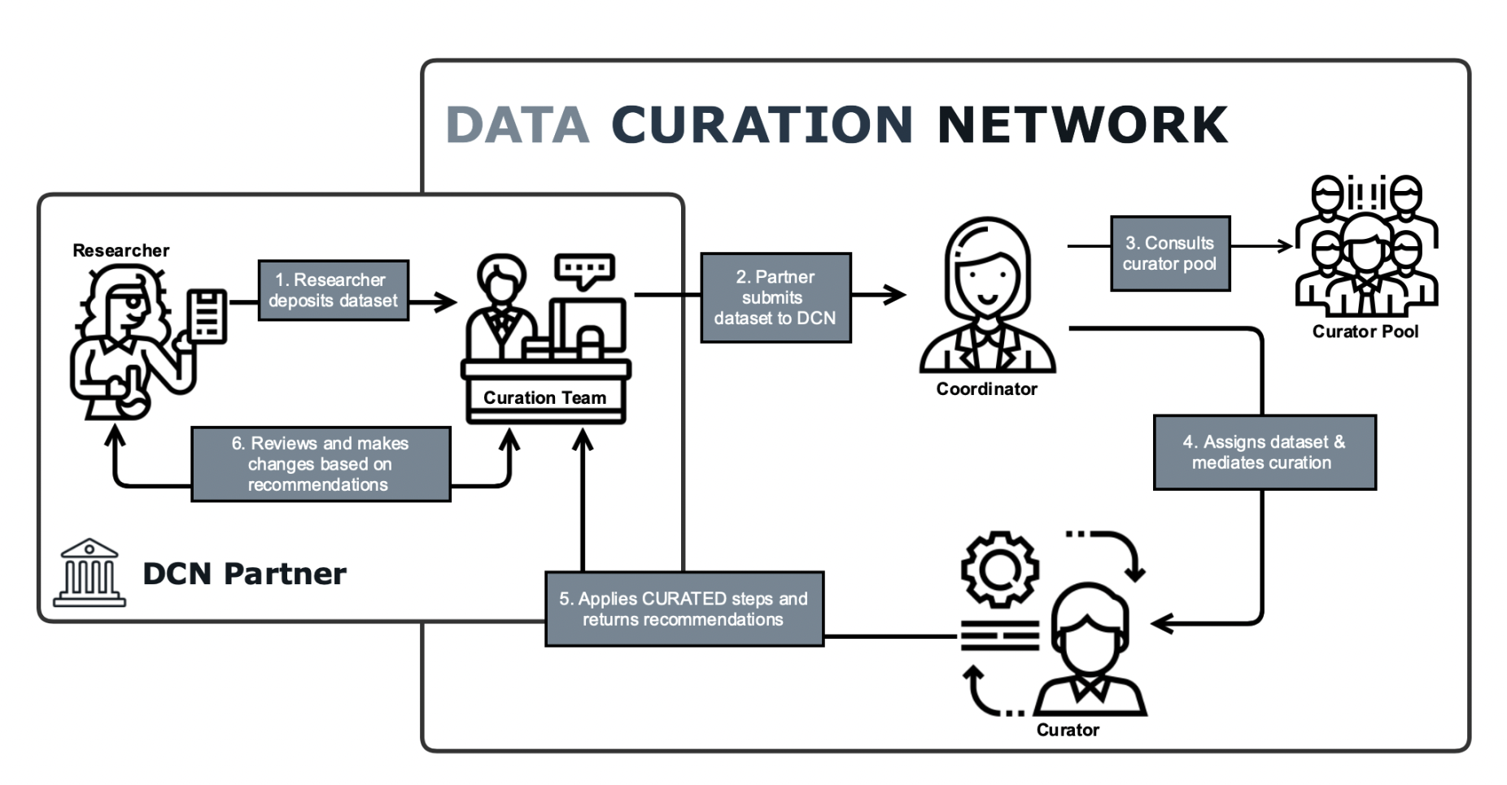
Full-time Coordinator

Slide 15
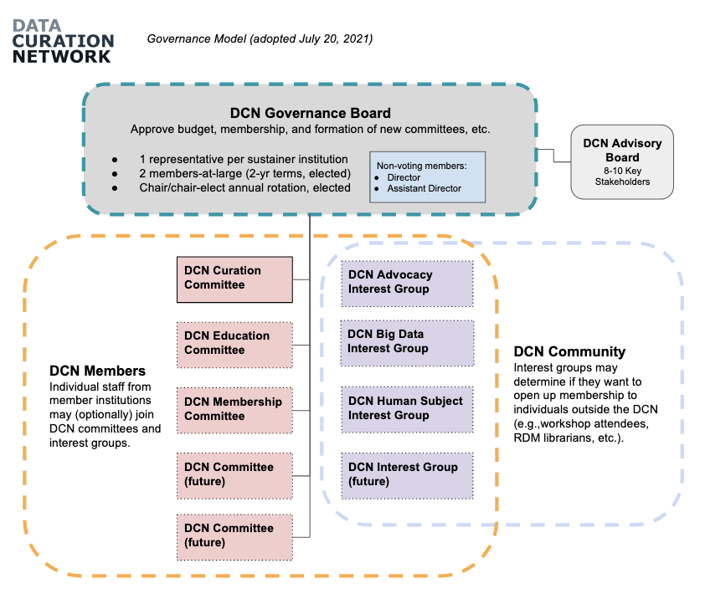
Sustainable Governance Model
Lead institution and DCN home (University of Minnesota)
Designated roles for member institutions

Slide 16
Tool Based Structures

Slide 17
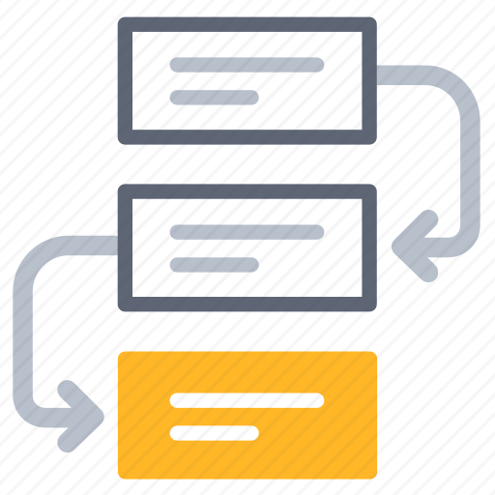
CURATE(D) Workflow
Check files
Understand documentation
Request missing information
Augment the submission
Transform the format
Evaluate for FAIRness
Document throughout

Slide 18
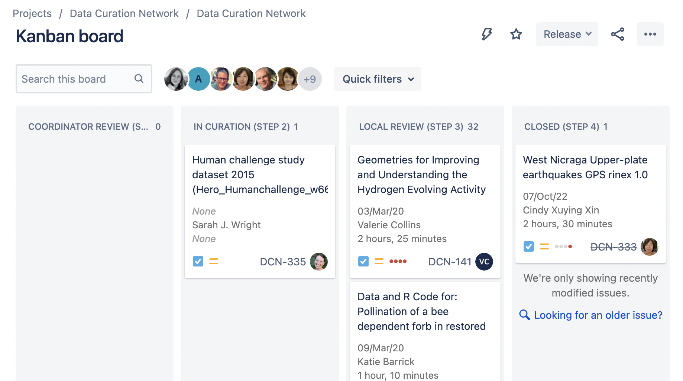
JIRA Implementation

Slide 19
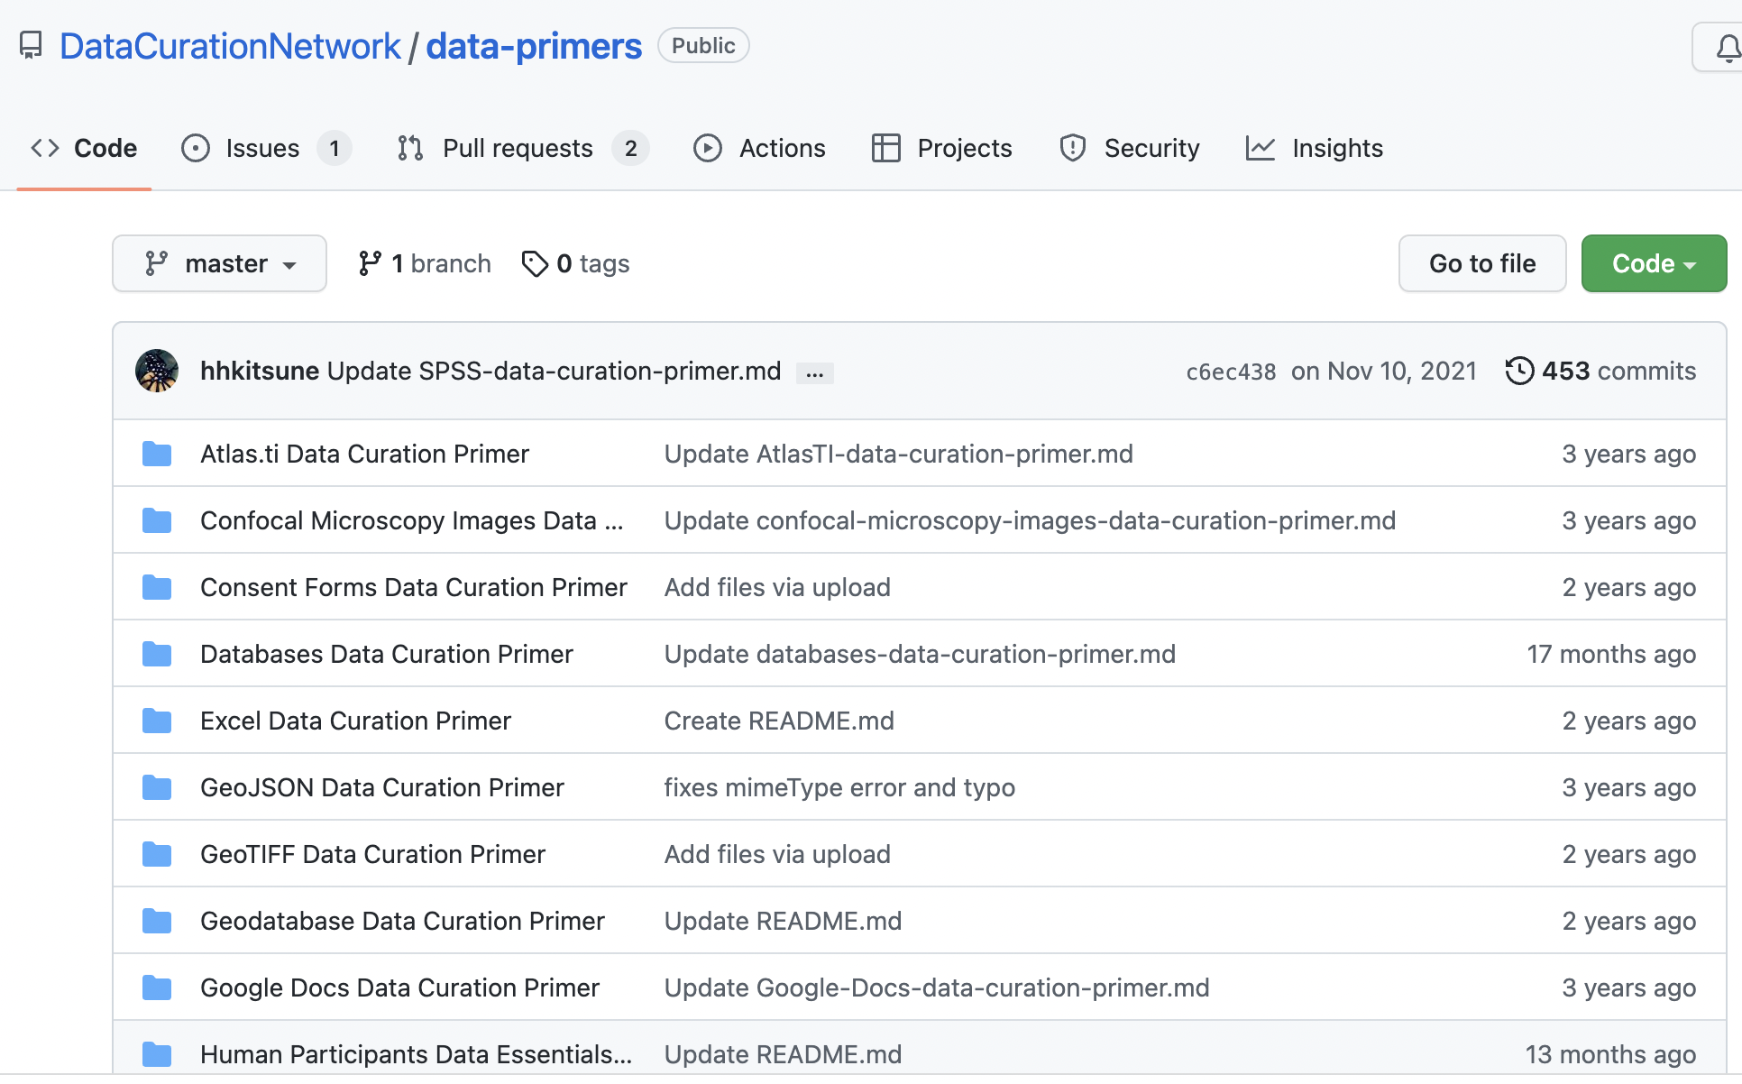
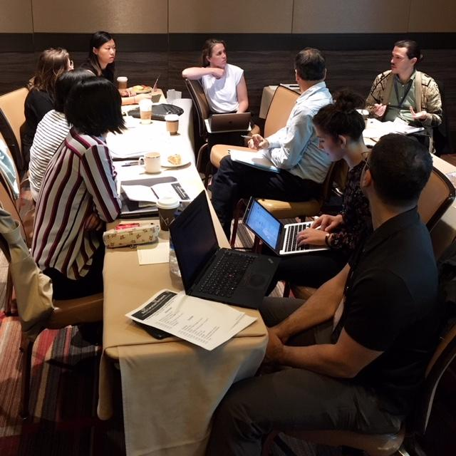
Primers and Workshops

Slide 20
Trust & Vulnerability
for Community Building
Notes:
Wanda
Folks at all levels of an organization experience vulnerability - most we don’t hear about. It takes trust to be vulnerable.
Being vulnerable/ showing vulnerability takes courage. Helps individuals of an organization see one another’s differences AND ALSO similarities.
Vulnerability and trust are cyclical

Slide 21
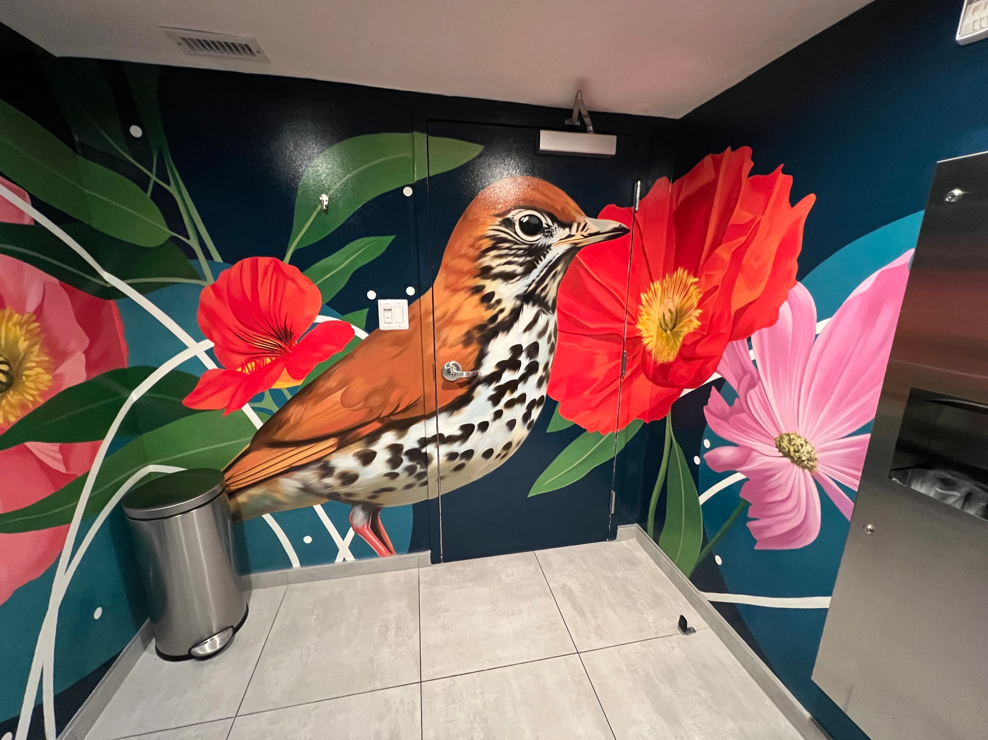
Notes:
Wanda
This slide is a brightly colored mural of a bird and flowers. The bird is about 7 feet tall.
The mural takes up 3 walls of the room which is a single use all gender restroom
Mikala mentioned earlier that several folks met in person in a location new to all attendees to work on the DCN retrospective.
Throughout the first day, one by one as folks used the restroom in the building each of us came back with similar comments “what is up with that bird?” Did you see that bird?
Oddly that bird helped us build trust with one another even more and allow ourselves to be a bit more vulnerable, honest and ourselves
What is your organization’s bird?

Slide 22


How to Build Trust & Vulnerability
Notes:
Wanda
**I’m not a trust and vulnerability expert - you can look to Brene Brown for that, but I am talking about my experience with trust and vulnerability in the DCN and my work in generalas a white, queer, gender non conforming person.
Building community with trust and vulnerability is not accidental - very rarely does it just happen.
It takes work and intentionality. It needs to be nurtured - like an orchid
Internal and external trust–
–Curators trust in one another - ok to say I don’t know how to do this, can you help me (i.e. can you curate this dataset, help me make recommendations that won’t make me look like I’m not an expert)
–Trust in the process - releasing the dataset from my hands to a curator at another institution that I have no idea what their schedule or calendar looks like and meet my deadline
–Researchers trust US to do our job - to make their data more FAIR - Researchers are repeat customers, encouraging their colleagues to submit data. and we see recommendations given to one researcher in a department then that rec turns up in another researcher in that same department. depositors have to feel confident in the process to submit their data and repeat
–Our external collaborators trust us - DCN gets many requests to collaborate (research, surveys, mentorship, advisory members)
The whole model relies on trust –
Accidental image
CC BY-SA 3.0
Attribution: Alpha Stock Images - http://alphastockimages.com/
Original Author: Nick Youngson - link to - http://www.nyphotographic.com/
Original Image: https://www.thebluediamondgallery.com/tablet-dictionary/a/accidental.html
Orchid image
CC0 Public Domain
https://www.publicdomainpictures.net/en/view-image.php?image=162228&picture=orchid-flower

Slide 23
How to Nurture Trust and Vulnerability
Internal to the DCN
Bi weekly check ins
Repository tours
Committee work
Primers
All Hands Meeting
Governance
External to the DCN
Peer compare sessions
Mentorship
Co- sponsor/support internships
Workshops
Notes:
Wanda
As with many things, nurturing is iterative. Things don’t always work or if they do work, they may not work forever.
DCN was born out of a distributed network - we were born and raised online, the pandemic didn’t phase us in that manner, but what we never saw coming was what the pandemic to work in general - all online all the time, burn out, work/home separation - and that we may have noticed (i.e. everyone is over burdened with work that should be done by 2-4 people) AND WE GET IT
People show up when they can
Internal
External

Slide 24
Why trust and vulnerability?
“Perfectionism doesn’t advance anything”
- Virgil Abloh
Notes:
Wanda
Its ok not to know everything.
We are standing on the shoulders of those who came before us and will be here for others so they can stand on our shoulders
When everything is neat, clean, easy nothing new is learned, those mistakes or moments of vulnerability can be incredible moments of growth
Virgil Abloh who created the designer/streetwear fashion line Off-White and who was the Louis Vuitton Men’s collection creative designer, artist, dj, and on and on said “Perfectionism doesn’t advance anything” and I agree. He was trained as an architect, but excelled at clothing design that people wait for, line up for willing to buy at huge markup on the resale market. He learned as he went, he made mistakes, he learned, he had incredible mentors and he was a mentor. He also said that he creates for his 14 year old self. I think we are all doing work, sharing our work, striving to do better - that we wish we would have had for our earlier career selves.
A lot of us doing curation work are learning as we go, we may not be formally trained, but we have the opportunity to and potential to excel at what we do if we let others help us and we also help others.

Slide 25
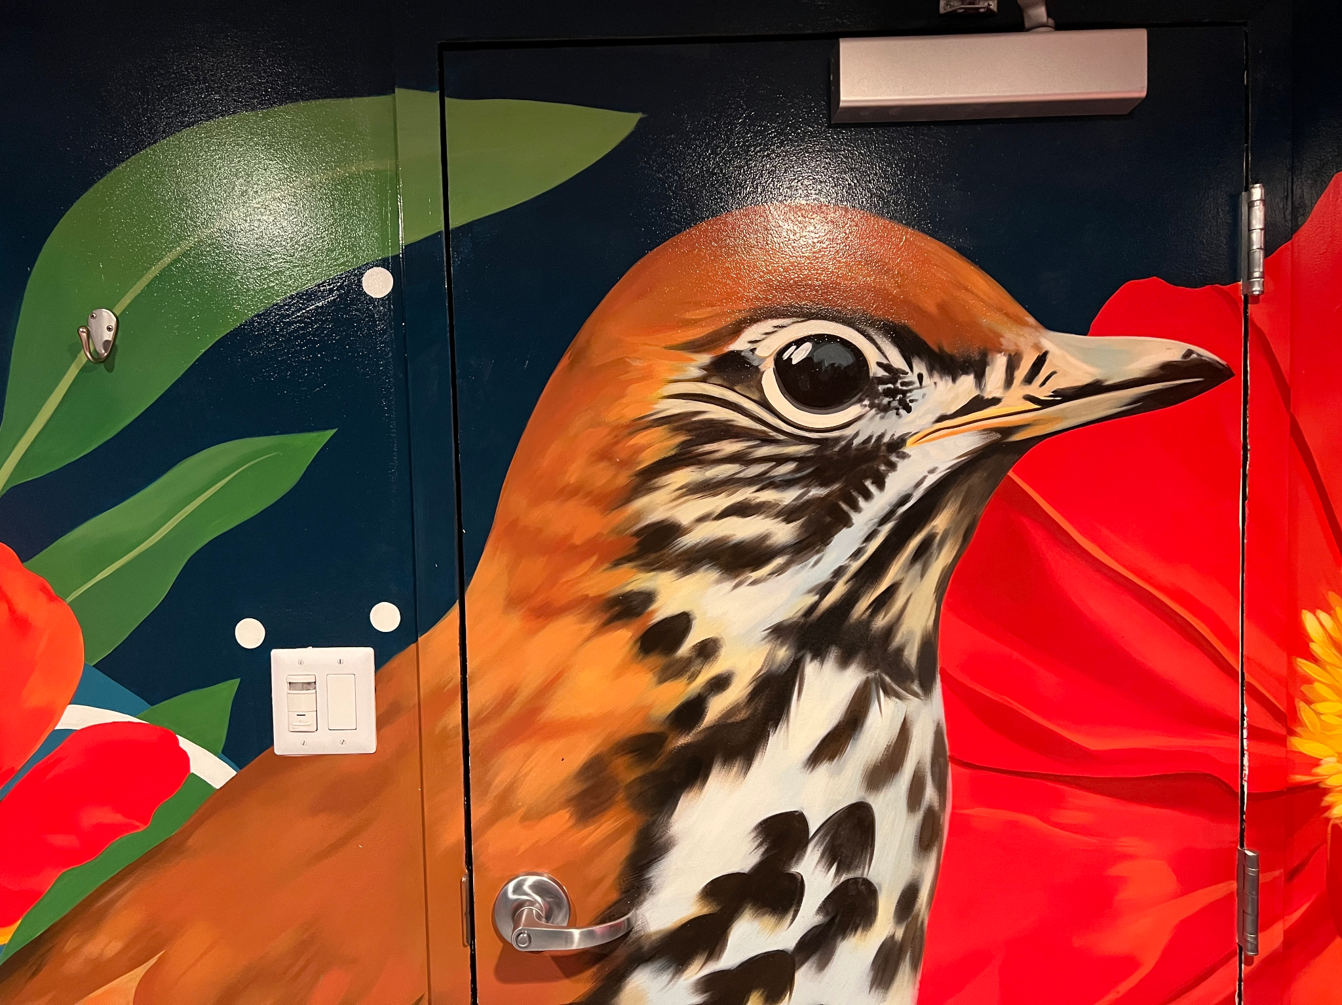
Questions?
Mara:
mrblake2@ncsu.edu
Wanda:
mars0215@umn.edu
Mikala:
mnarlock@umn.edu

