Slide 1
Using Engineering tools with insights from Social Science to analyze
Carbon Tax, Market Diffusion of Combined Heat and Power and Economic Viability of Vehicle-to-Grid
Vivek Bhandari
University of Minnesota
Notes:
Slide 1 – Say the story and set the stage/expectations
The STEP area focuses on public issues arising at the intersection of science, technology, environment, and society that shape economic development, environmental sustainability, human health, and well-being. This dissertation combines engineering tools with insights from social science to study three examples of energy policies that are at the intersection of science, technology, environment and the society. Two of the essays are published in peer reviewed journals, one is ready to be sent.
Transition to next slide.

Slide 2

Key Messages
The essay on a carbon taxª reveals that carbon tax would interact with Production Tax Credits and power system operating conditions and it may not adequately reduce emissions.
The essay on the market diffusion of Combined Heat and Power^{b} reveals that subjective impressions could overrule rational economic behavior.
The essay on the Vehicle to Grid (V2G)^{c} reveals that V2G may not be appealing to the Electric Vehicle owners.
Photo : http://www.connectyourmeetings.com/blogs/takeaways-from-great-ideas-conference/
ª Published in The Electricity Journal, Elsevier
^{b} Ready to be submitted to The Electricity Journal, Elsevier
^{c} Published in Energy, Elsevier
Notes:
Carbon tax
This example analyzes carbon tax from an engineering perspective by simulating an example electricity market with a carbon tax. It runs Optimal Power Flow and yields….(see results above)
CHP
CHP is cost positive, but still, it has not gained enough traction in the US. This example uses expert elicitation to find …. (see above)
EV
V2G services from Evs are well discussed in academia. But in reality, V2G has not gathered a lot of commercial interest. This essay analyzes the profitability of V2G to EV owners by running a detailed model using Dynamic Programming and Unit Commitment. It finds…(see above)
All of these essays combine engineering tools with insights from social science and draws proper conclusions that can be used to inform public policy to advance the common good in a complex and diverse world. The methods used are well-proven methods, but the application and the insights are noble.

Slide 3
Table of Contents
Background and Intro
Essay 1 – Power Engineering Aspect Of A Carbon Taxª
  Rationale
  Literature Review
  Methods
  Results
  Conclusions and Policy Implications
    Essay 2 – Non Financial Barriers To Market Diffusion Of Combined Heat And Power^{b}
    Essay 3 – Profitability Of Electric Vehicles In Electricity Reliability Council Of Texas Market^{c}
    Conclusions
ª Published in The Electricity Journal, Elsevier
^{b} Ready to be submitted to The Electricity Journal, Elsevier
^{c} Published in Energy, Elsevier
Notes:
Explain the table of contents.

Slide 4
Background
AND INTRODUCTION

Slide 5
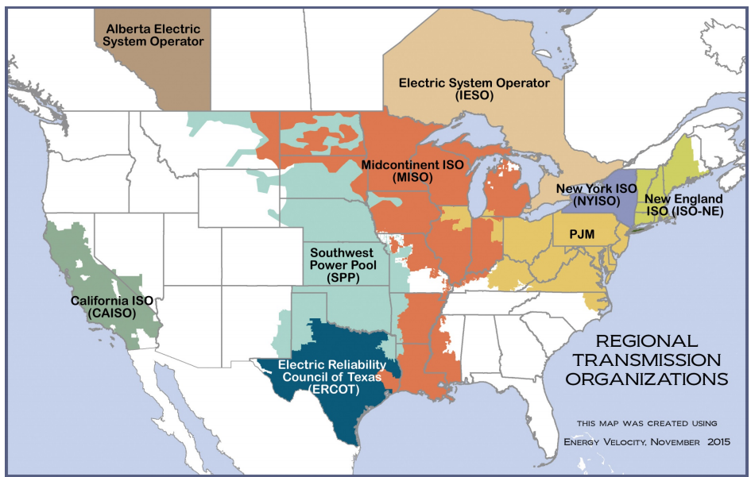
Over 66% of US electricity sector is served by Regional Transmission Organizations (RTOs)
Electricity Systems
Photo : http://www.ferc.gov/industries/electric/indus-act/rto/elec-ovr-rto-map.pdf
Notes:
Society’s grand challenges—rapid urbanization, climate change, sustainable energy transitions, governance of emerging and/or disruptive technologies—require interdisciplinary holistic insights and systems thinking rooted in real-world projects. An example of such a complicated system is the electricity system whose working is governed by several energy policies. Holistic insights are needed in every step of the policy process.
The electricity systems are important and …are on stake.

Slide 6
Holistic Insights
Energy Policy
Engineering
EconomicMarket
Socio-Political
Notes:
If one or more of the building blocks necessary for providing holistic insights are missed, the energy policy would become ineffective. It will be hard to bind and analyze it.

Slide 7
Examples
Combined Heat and Power
Non-financial barriers (sociopolitical)
….
Vehicle to Grid
Profitability to Electric Vehicle owners (economic/market)
Carbon Tax
Effect of Power Systems operation (engineering)
Notes:
This dissertation combines engineering tools with insights from social science to study three examples of energy policies. The studies are focused on the understudied building blocks (or aspects) and reveal ideas that have prominent policy implications.

Slide 8
Essay 1
Power ENGINEERING
Aspect of a CARBON TAX

Slide 9
Rationale
Carbon tax is a well studied economic policy.
Existing academic literature talks a very little about its interaction with power system operating conditions like
  market operations
  transmission congestions
Notes:
Explain transmission congestion and interactions with other policies

Slide 10
Literature Review
Calculating/predicting emission savings from carbon tax (Agostini et al., 1992; Metcalf and Weisbach, 2009)
Broader economic impacts and migrating negative consequences (Mathur and Morris, 2014, Fishcer and Fox, 2009)
Economic model of transmission congestion on Carbon tax (Contreras et al., 2015; Downward, 2010)
Notes:
Some example literature review

Slide 11
Research Questions
How is the effectiveness of a carbon tax impacted by
the short-term impacts of transmission congestion and
price spreads due to other energy policies to promote renewables like Production Tax Credits.
Notes:
Explain short term in power system is decades. And, all of these results are applicable for that period (at max)

Slide 12
Take Aways
Due to power engineering aspect (transmission congestion and large price spreads) of a carbon tax
  Tax and congestion rents need to be recycled
3
  Renewable generators may become the beneficiaries
2
  Emissions may not be reduced
1
Notes:
Effectiveness of a carbon tax is measured in terms of emission savings and revenue streams (double dividend of a tax)
Answer to first question ➔ Transmission congestion could boost or plummet the effectiveness of a carbon tax. It depends which transmission lines are congested.
Large price spreads would ➔ result in no emission reduction and make renewables the beneficiaries of a carbon tax.

Slide 13
Methods
Data (Modified IEEE Reliability Test System)
Create transmission congestion and large price spread
Apply a carbon tax on four scenarios
Run Optimal Power Flow
Note the results
Change carbon tax and congestion to illustrate the sensitivities
1
No tax no congestion (base case)
2
Tax and no congestion
3
No tax and congestion
4
Tax and congestion
1
Emission savings
2
Net benefits
Change in net benefits
3
Notes:
Describe this diagram. Explain that it is a linearized way of representing what was done. Actual process is cyclic not linear.

Slide 14
Methods
Data Collection - IEEE Reliability Test System
Operationalizing a carbon tax
Optimal Power Flow

Slide 15
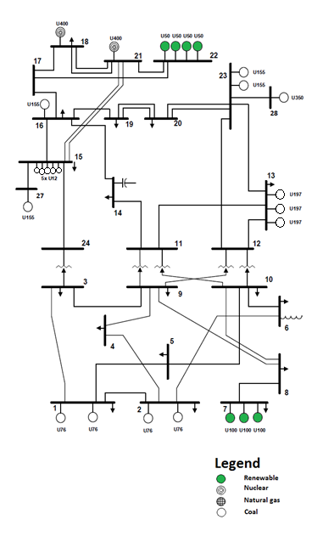
Data Collection - IEEE Reliability Test System (Modified)
Methods
Notes:
Explain this model and explain the modifications

Slide 16




Operationalizing a carbon tax
Methods
Marginal Social Cost = $Marginal Private Cost$+ $δ$
$$δ= emission_{tax}\left(\frac{\$}{tonCO_{2e}}\right)∗ marginal emission factor \left(\frac{tonCO_{2e}}{MWhr}\right)$$
Price per unit ($/MWhr)
S. No | Power plant | Emission factor | Tax ($/tonCO2e) | Tax ($/MWhr)
1 | Coal | 2000
2 | Natural gas | 1200
3 | Renewable | N/A
4 | Hydro | N/A
5 | Nuclear | N/A
Marginal social cost
[0, 5, 10, 15, 20 ] ➔ coal
[0, 3, 6, 9, 12 ] ➔ natural gas
22
20 ➔ coal
12 ➔ natural gas
tax, $δ$
[0, 5, 11, 16, 22 ]
$∆$C(P1*)
$∆$C(P*)
Marginal private cost
P1*
P*
No. of units (MW)
EPA’s estimate @ 5% discount rate from 2015 to 2045 ranges from $11/tonCo_{2e} to $23/tonCo_{2e}
Notes:
Explain the concept of a carbon tax. And, say why these values are used.
The results presented only show the results for 22$/tonCo2e. Sensitivity against other tax rates are presented in the thesis chapter. The conclusions don’t change.

Slide 17

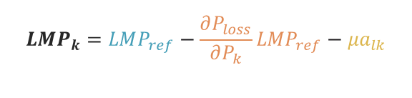
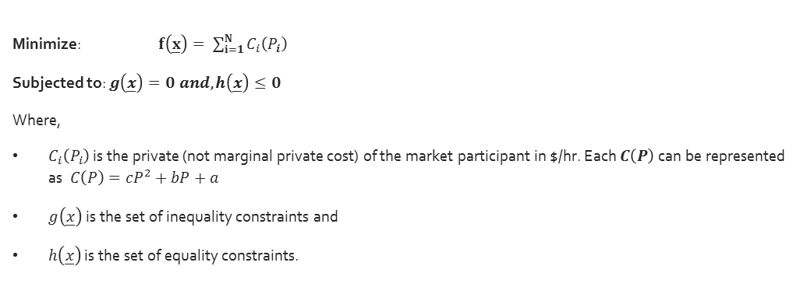
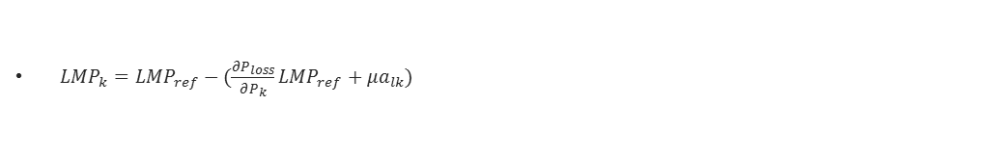
Optimal Power Flow
(Wood et al., 2014; Bhandari et al., 2017)
Methods
Minimize: $f\left(\underline{x}\right)= \sum_{i=1}^{N}{C_{i}\left(P_{i}\right)}$
Subjected to: $g\left(\underline{x}\right)=0 and, h\left(\underline{x}\right)≤0$
Where,
$C_{i}\left(P_{i}\right)$ is the private (not marginal private cost) of the market participant in $/hr. Each $C\left(P\right)$ can be represented as$C\left(P\right)=cP^{2}+bP+a$
$g\left(\underline{x}\right)$ is the set of inequality constraints and
$h\left(\underline{x}\right)$ is the set of equality constraints.
Marginal Cost of losses from the reference bus to bus k (MLC)
The Lagarangian for this optimization problem is
$L \left(x, λ,µ\right)=f\left(x\right)+ λ^{T} h_{i}\left(x\right)+µ^{T} g_{i}\left(x\right)$
An optimality condition requires that $∆L=0$ , i.e.
$∆L_{x}\left(x, λ,µ\right)$ = 0➔ $∆f_{x}\left(x\right)+ ∆h_{x}\left(x\right)λ+∆g_{x}\left(x\right)µ=0$
$∆L_{λ}\left(x, λ,µ\right)=0$➔$h\left(x\right)=0$
$∆L_{µ}\left(x, λ,µ\right)=0$ ➔$g\left(x\right)≤ 0$
$µ^{T} g_{i}\left(x\right)$ =0 and $µ^{T}≥0$
Solution gives LMP which can be represented as
Marginal Cost of transmission congestion from the reference bus to bus k (MCC)
Marginal cost at reference bus
$$LMP_{k}=LMP_{ref}−\frac{∂P_{loss}}{∂P_{k}}{LMP}_{ref}−{μa}_{lk}$$
${{LMP}_{k}=LMP}_{ref}−(\frac{∂P_{loss}}{∂P_{k}}{LMP}_{ref}+{μa}_{lk})$
Photo : https://www.misoenergy.org/LMPContourMap/MISO_All.html
Notes:
Don’t bore the audience. Just skim the slide and make a transition to the concept of LMP

Slide 18
 |  | Scenario 1 – Base case | Scenario 2 (uncongested with ~22$/tonCo_{2e} tax) |  | Scenario 3 (congested without tax) |  |  |  | Scenario 4 (congested with 22$/tonCO_{2e} tax)
 |  |  |  |  | 40 % transmission congestion |  | 50 % transmission congestion |  | 40% transmission derating |  | 50% transmission derating
 |  |  | Actual | %change from base | Actual | %change from base | Actual | %change from base | Actual | %change from base | Actual | %change from base
Total output (MW) | Coal | 1274 | 1274 | 0 | 1153 | -9 | 1173 | -8 | 1152 | -10 | 1173 | -8
 | Natural gas | 461 | 461 | 0 | 582 | 26 | 651 | 41 | 583 | 26 | 651 | 41
 | Nuclear | 800 | 800 | 0 | 800 | 0 | 681 | -15 | 800 | 0 | 681 | -15
 | Renewables | 600 | 600 | 0 | 600 | 0 | 600 | 0 | 600 | 0 | 600 | 0
 | Total | 3135 | 3135 | 0 | 3135 | 0 | 3105 | -0.95 | 3135 | 0 | 3105 | -1
Total emissions (tons of CO2e) | Coal | 1156 | 1156 | 0 | 1046 | -9 | 1064 | -8 | 1045 | -10 | 1064 | -8
 | Natural gas | 251 | 251 | 0 | 317 | 26 | 354 | 41 | 317 | 26 | 354 | 41
 | Total emissions | 1407 | 1407 | 0 | 1363 | -3 | 1418 | ~1 | 1362 | -3 | 1418 | 1
Net benefits for generators ($) | Coal | 15292 | 5100 | -67 | 8996 | -41 | 1329205 | 8592 | 4010 | -74 | 1282273 | 8285
 | Natural gas | 4391 | 4392 | 0 | 5975 | 36 | 1259586 | 28588 | 6458 | 47 | 1243962 | 28232
 | Nuclear | 18699 | 28299 | 51 | 6871 | -63 | 7430 | -60 | 22827 | 22 | 7430 | -60
 | Renewables | 10722 | 17922 | 67 | 8109 | -24 | 667374 | 6124 | 17613 | 64 | 667374 | 6124
Revenues for other participants ($) | Load | -90507 | -128127 | -42 | -88907 | 2 | -4678337 | -5069 | -133824 | -48 | -4678337 | -5069
 | Government + FTR holders | 0 | 31017 | N/A | 15460 | N/A | 1369200 | N/A | 39412 | N/A | 1400478 | N/A

Slide 19
Unless there is reduction in demand, a carbon tax will not reduce emissions.
 |  | Scenario 1 – Base case | Scenario 2 (uncongested with ~22$/tonCo_{2e} tax) |  | Scenario 3 (congested without tax) |  |  |  | Scenario 4 (congested with 22$/tonCO_{2e} tax)
 |  |  |  |  | 40 % transmission congestion |  | 50 % transmission congestion |  | 40% transmission derating |  | 50% transmission derating
 |  |  | Actual | %change from base | Actual | %change from base | Actual | %change from base | Actual | %change from base | Actual | %change from base
Total output (MW) | Coal | 1274 | 1274 | 0 | 1153 | -9 | 1173 | -8 | 1152 | -10 | 1173 | -8
 | Natural gas | 461 | 461 | 0 | 582 | 26 | 651 | 41 | 583 | 26 | 651 | 41
 | Nuclear | 800 | 800 | 0 | 800 | 0 | 681 | -15 | 800 | 0 | 681 | -15
 | Renewables | 600 | 600 | 0 | 600 | 0 | 600 | 0 | 600 | 0 | 600 | 0
 | Total | 3135 | 3135 | 0 | 3135 | 0 | 3105 | -0.95 | 3135 | 0 | 3105 | ~-1
Total emissions (tons of CO2e) | Coal | 1156 | 1156 | 0 | 1046 | -9 | 1064 | -8 | 1045 | -10 | 1064 | -8
 | Natural gas | 251 | 251 | 0 | 317 | 26 | 354 | 41 | 317 | 26 | 354 | 41
 | Total emissions | 1407 | 1407 | 0 | 1363 | -3 | 1418 | 1 | 1362 | -3 | 1418 | 1
Net benefits for generators ($) | Coal | 15292 | 5100 | -67 | 8996 | -41 | 1329205 | 8592 | 4010 | -74 | 1282273 | 8285
 | Natural gas | 4391 | 4392 | 0 | 5975 | 36 | 1259586 | 28588 | 6458 | 47 | 1243962 | 28232
 | Nuclear | 18699 | 28299 | 51 | 6871 | -63 | 7430 | -60 | 22827 | 22 | 7430 | -60
 | Renewables | 10722 | 17922 | 67 | 8109 | -24 | 667374 | 6124 | 17613 | 64 | 667374 | 6124
Revenues for other participants ($) | Load | -90507 | 128127 | 42 | 88907 | -2 | 4678337 | 5069 | 133824 | 48 | 4678337 | 5069
 | Government | 0 | 31017 | N/A | 15460 | N/A | 1369200 | N/A | 39412 | N/A | 1400478 | N/A
A carbon tax will normally reduce or levelize income of the coal and natural gas generators
Renewables could become the beneficiaries of a carbon tax.
If the revenues are not recycled appropriately, the load pays it all.

Slide 20
 |  | Scenario 1 – Base case | Scenario 2 (uncongested with ~22$/tonCo_{2e} tax) |  | Scenario 3 (congested without tax) |  |  |  | Scenario 4 (congested with 22$/tonCO_{2e} tax)
 |  |  |  |  | 40 % transmission congestion |  | 50 % transmission congestion |  | 40% transmission derating |  | 50% transmission derating
 |  |  | Actual | %change from base | Actual | %change from base | Actual | %change from base | Actual | %change from base | Actual | %change from base
Total output (MW) | Coal | 1274 | 1274 | 0 | 1153 | -9 | 1173 | -8 | 1152 | -10 | 1173 | -8
 | Natural gas | 461 | 461 | 0 | 582 | 26 | 651 | 41 | 583 | 26 | 651 | 41
 | Nuclear | 800 | 800 | 0 | 800 | 0 | 681 | -15 | 800 | 0 | 681 | -15
 | Renewables | 600 | 600 | 0 | 600 | 0 | 600 | 0 | 600 | 0 | 600 | 0
 | Total | 3135 | 3135 | 0 | 3135 | 0 | 3105 | -0.95 | 3135 | 0 | 3105 | ~-1
Total emissions (tons of CO2e) | Coal | 1156 | 1156 | 0 | 1046 | -9 | 1064 | -8 | 1045 | -10 | 1064 | -8
 | Natural gas | 251 | 251 | 0 | 317 | 26 | 354 | 41 | 317 | 26 | 354 | 41
 | Total emissions | 1407 | 1407 | 0 | 1363 | -3 | 1418 | 0.78 | 1362 | -3 | 1418 | ~1
Net benefits for generators ($) | Coal | 15292 | 5100 | -67 | 8996 | -41 | 1329205 | 8592 | 4010 | -74 | 1282273 | 8285
 | Natural gas | 4391 | 4392 | 0 | 5975 | 36 | 1259586 | 28588 | 6458 | 47 | 1243962 | 28232
 | Nuclear | 18699 | 28299 | 51 | 6871 | -63 | 7430 | -60 | 22827 | 22 | 7430 | -60
 | Renewables | 10722 | 17922 | 67 | 8109 | -24 | 667374 | 6124 | 17613 | 64 | 667374 | 6124
Revenues for other participants ($) | Load | -90507 | 128127 | 42 | 88907 | -2 | 4678337 | 5069 | 133824 | 48 | 4678337 | 5069
 | Government + FTR holders | 0 | 31017 | N/A | 15460 | N/A | 1369200 | N/A | 39412 | N/A | 1400478 | N/A
If the revenues are not recycled appropriately, the load pays it all.

Slide 21
Conclusions
In a short-term, due to power engineering aspect of a carbon tax
  Emissions may not be reduced
  Renewable generators may become the beneficiaries
  Not only tax but also congestion rents need to be recycled
Photo : http://www.connectyourmeetings.com/blogs/takeaways-from-great-ideas-conference/
Notes:
Effectiveness of a carbon tax is measured in terms of emission savings and revenue streams (double dividend of a tax)
Answer to first question ➔ Transmission congestion could boost or plummet the effectiveness of a carbon tax. It depends which transmission lines are congested.
Large price spreads would ➔ result in no emission reduction and make renewables the beneficiaries of a carbon tax.

Slide 22

Policy Implications
Any new energy policy involving dispatch, transmission, and distribution should be evaluated in context of
  Power system operations
  Existing policy environment
  Power system operations and existing policies could undermine the implementation of a carbon tax. Therefore, states like Washington and Vermont that are exploring carbon tax should conduct a thorough analysis and look for mitigation measures.
Photo : http://www.connectyourmeetings.com/blogshttps://online.pointpark.edu/public-administration/policy-making-cycle//takeaways-from-great-ideas-conference/

Slide 23
References
Vivek Bhandari, Anthony M Giacomoni, Bruce F Wollenberg, Elizabeth J Wilson, Interacting policies in power systems: Renewable subsidies and a carbon tax. The Electricity Journal Vol 30-6, pp. 80-84 2017.
Paola Agostini, Michele Botteon, Carlo Carraro, A Carbon Tax to Reduce Co2 Emissions in Europe. Energy Economics Vol 14, pp. 279-290, 1992.
Gillbert E Metcalf, David Weisbach, The Design of a Carbon Tax. Harv. Envtl. L. Rev. Vol 33, p. 499, 2009.
A. Mathur, A. C. Morris, Distributional Effects of a Carbon Tax in Broader Us Fiscal Reform. Energy Policy Vol 66, pp. 326-334, 2014.
Carolyn Fischer, Alan K. Fox, Comparing Policies to Combat Emissions Leakage: Border Tax Adjustments Versus Rebates. RFF Discussion Papers Vol, pp. 09-02, 2009.
J Contreras, JB Krawczyk, J Zuccollo, Economics of Collective Monitoring: A Study of Environmentally Constrained Electricity Generators. Computational Management Science Vol, pp. 1-21, 2015.
Anthony Downward, Carbon Charges in Electricity Markets with Strategic Behavior and Transmission. The Energy Journal Vol, pp. 159-166, 2010.
Allen J Wood, Bruce F Wollenberg, Gerald B Sheble, Power Generation, Operation, and Control. 3rd ed. John Wiley & Sons Inc, 2014.

Slide 24
Grants
Innovating for sustainable electricity systems: Integrating renewables, reallocating transmission and driving demand, Initiative on Renewable Energy and the Environment – IREE (Awarded November 2012)
“Sustainable Energy Systems: Control Systems and Sensors to Link Rural Renewables and Demand for Sustainable Industrial Energy in Food Processing Systems” MN-Drive (Awarded June, 2014)

Slide 25
Essay 2-
Non-Financial Barriers to
Market Diffusion of
Combined Heat And Power

Slide 26
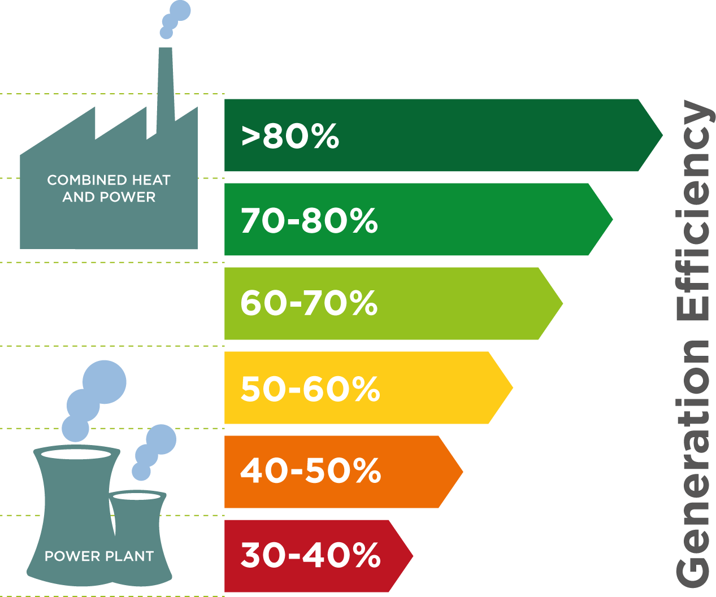
Combined Heat and Power - Concept
Co-generate heat and power to a) reduce line losses and b) utilize waste heat for fulfilling heating and cooling needs
Picture: http://northernutilities.co.uk/combined-heat-and-power/

Slide 27
Rationale
Combined Heat and Power (CHP) is a matured technology. However, the market diffusion of CHP in the United States remains problematic.
Existing academic literature does not talk about such non-financial barriers.
Notes:
Reiterate why??
Though many CHP projects are cash positive (aka economically viable), their market diffusion still remains problematic. (see slide…)

Slide 28
Literature Review
“Energy-gap” for energy efficiency and other techs (Jaffe and Stavins, 1994; Shama, 1983)
Financial barriers of Combined Heat and Power (Kaufman, 2011; Several reports from Environment Protection Agency and Department Of Energy)
Non-financial barriers in Europe (Vietor et al., 2015; Van Der Veen and Kasmire, 2015)
Notes:
Some example literature review

Slide 29
Research Questions
What kinds of non-financial obstacles are faced during the Combined Heat and Power (CHP) installation process?
How can an individual agency; opinion leadership and larger policies affect the decision to construct the CHP plant/facility?

Slide 30
TakeAways
The non-financial barriers facing market diffusion of Combined Heat and Power
  Complexity in allocating risks and benefits
3
  Negative subject impressions
2
  The business model of the utility
1
Notes:
Explain the slide – this answers the first question
For second question see notes below
an individual agency like opinion leadership and internal champions, Example University of Minnesota CHP
larger policies example – the motivation to go green by DATE …. affect the decision to construct the CHP plant/facility

Slide 31
Methods
Literature review and document analysis
Semi structured interviews with experts
Qualitative Analysis
Results
1
Interview guide
2
Interview transcription
1
Coding
2
Reconciliation and triangulation of codes
Notes:
Say this is a linearized representation. But in reality, it is not as linear as it is portrayed.

Slide 32
Methods
Interview protocol
Data analysis
  Coding/triangulation/themes

Slide 33
Methods
Interview Protocol
Introduction
Icebreaker questions
Policy problem
Problem perception, viable solutions, desired outcome
Existing system
Structure, power and authority, culture
Actual implementation
Integration challenge, design challenge
Post evaluation
Evaluations? Then vs now description
Conclusion
Opportunities/barriers, innovation at each stage

Slide 34
Methods
Data analysis
Transcribe/code
Code 10-random interviews using themes from the literature review and document analysis
Newer codes emerge
Code another 10 interviews
Repeat until all interviews are coded
02
Reconcile and triangulate
Look into literature and documents Look for codes that can be grouped
Derive themes
01

Slide 35
Results
Results (Final Themes) | Codes from Transcripts | Codes from Document Analysis
Business model of the utility | Utility rate, energy regulation, environmental regulation, tariff, interconnection, net-metering, revenue-erosion | Utility contracts, standby rates, utility business model
Negative subjective impressions | Not-alluring, education, training, knowledge, business priority, organization culture | Education, lack of knowledge, organizational culture
Allocation of risks and benefits | Complicated, multiple output, benefit sharing, price, risk, hedging
Notes:
Business model – Explain Cops/munis vs IOUs.
Negative subjective impressions – groups that actively advocate against CHP
Allocation of risks and benefits – complicated because it straddles several policy boxes

Slide 36
Results
Combined Heat and Power (CHP) is a “revenue erosion:”
Investors Owned Utilities track public utility commissions as if “sunflowers track the sun”
“It is not a flashy, sexy thing.
It is not solar. It is not wind.”
Somebody has to ”champion these”
CHP is a “never ending process”
It is frankly “pretty boring”
“Who pays and where do the benefits occur”
“holy grail of CHP…”
“Instead of going full in on the marriage…smaller projects”

Slide 37
Results
Notes:
%tages in qualitative analysis are contested issue. However, it still gives some indication. Therefore, should not be neglected. Example …..

Slide 38
Results
33%
Utilities consider their business model as a barrier
>70%
Other interviewees consider the business model of the utility as a major barrier

Slide 39
Results
29%
Government agencies don’t perceive negative impressions to be a barrier. However, they are the only ones who could effectively mitigate it by running educational campaigns.

Slide 40
Conclusions
The non-financial barriers facing market diffusion of Combined Heat and Power are
  The business model of the utility
  Negative subject impressions, and
  Complexity in allocating risks and benefits
Photo : http://www.connectyourmeetings.com/blogs/takeaways-from-great-ideas-conference/
Notes:
Explain the slide – this answers the first question
For second question see notes below
an individual agency like opinion leadership and internal champions, Example University of Minnesota CHP
larger policies example – the motivation to go green by DATE …. affect the decision to construct the CHP plant/facility

Slide 41
Policy Implications
Expand existing programs
  Combined Heat and Power (CHP) –Technical Assistance Programs by directly contacting potential users
  Policies that encourage energy efficiency should help CHP
Seek/encourage “flexibility-services” from the newer fleet
Photo : http://www.connectyourmeetings.com/blogshttps://online.pointpark.edu/public-administration/policy-making-cycle//takeaways-from-great-ideas-conference/

Slide 42
References
Vivek Bhandari, Stephen Rose, Elizabeth J Wilson, Non-Financial Barriers to Combined Heat and Power in the United States- A Qualitative Study, The Electricity Journal Vol 32, pp. 49-56 2019.
Adam B Jaffe, Robert N Stavins, The Energy-Efficiency Gap What Does It Mean? Energy Policy Vol 22, pp. 804-810, 1994.
Avraham Shama, Energy Conservation in Us Buildings: Solving the High Potential/Low Adoption Paradox from a Behavioural Perspective. Energy Policy Vol 11, pp. 148-167, 1983.
Anna Chittum and Nate Kaufman, Challenges Facing Combined Heat and Power Today: A State-by-State Assessment. American Council for an Energy-Efficient Economy,, 2011.
Birte Viétor, Thomas Hoppe, Joy Clancy, Decentralised Combined Heat and Power in the German Ruhr Valley; Assessment of Factors Blocking Uptake and Integration. Energy, sustainability and society Vol 5, p. 5, 2015.
Reinier AC Van Der Veen, Julia Kasmire, Combined Heat and Power in Dutch Greenhouses: A Case Study of Technology Diffusion. Energy Policy Vol 87, pp. 8-16, 2015.

Slide 43
Grants
“Sustainable Energy Systems: Control Systems and Sensors to Link Rural Renewables and Demand for Sustainable Industrial Energy in Food Processing Systems” MN-Drive (Awarded June, 2014)
“Doctoral Dissertation Fellowship” University of Minnesota (Awarded April, 2016)

Slide 44
Essay 3
Profitability of
Vehicle to Grid for
Electric Vehicle owners
Notes:
Explain the rationale of this research

Slide 45
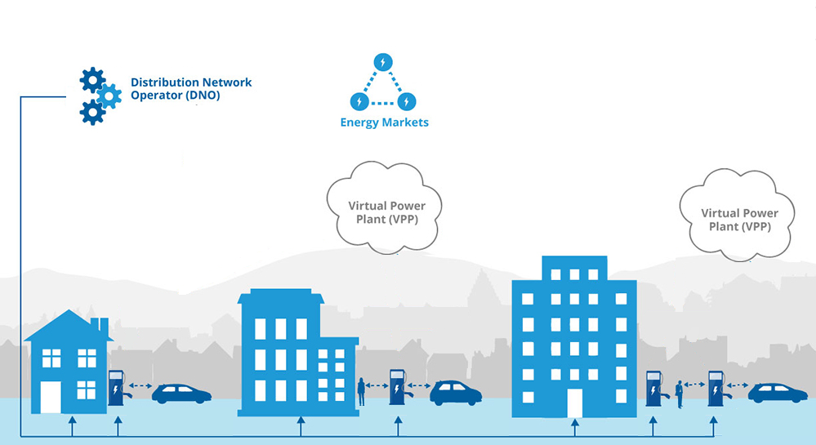
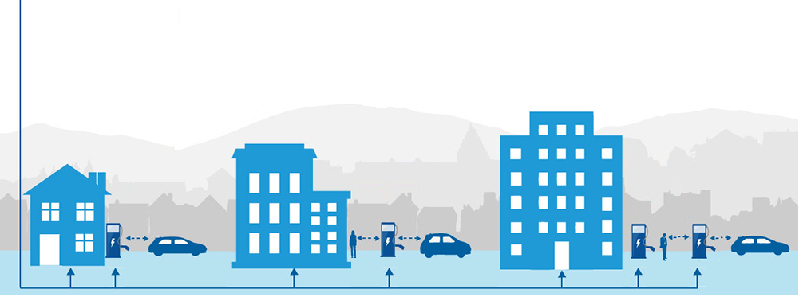
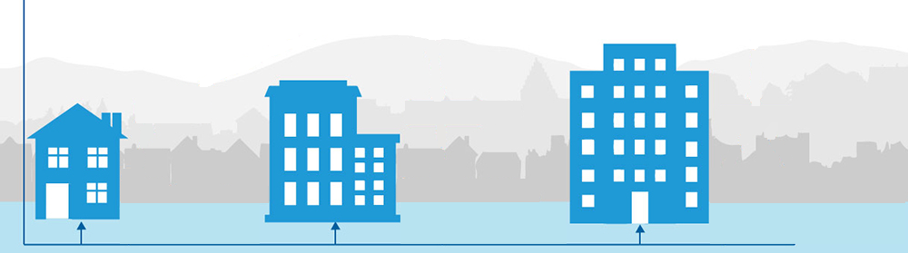
Vehicle to Grid - Concept
Photo : https://www.cenex.co.uk/energy/vehicle-to-grid/efes/

Slide 46
Rationale
Through Vehicle to Grid (V2G) system, Electric Vehicles (EVs) have an immense technical potential to provide energy and ancillary services to the grid. However, other than a few pilots, V2G has not gained commercial traction.
Technical aspects of V2G are thoroughly studied. But economic/market aspects (esp w.r.t. profitability and market rules) remain unstudied.
Notes:
There are several technical studies and on the surface V2G looks promising. But what will it take to make it commercially attractive?

Slide 47
Literature Review
Technical aspects like control algorithms and data exchange (Lopes et. al., 2009; Sortomme et al., 2011; Caramanis and Foster, 2010; Uddin et al., 2017; Ansari et al., 2015)
Market rules and pumped hydro (Paine et al., 2014)
Notes:
Sample literature review

Slide 48
Research Questions
How does the economics of a Vehicle to Grid (V2G) system look?
Is the current set of market rules enough to make V2G profitable to all the participants?

Slide 49
TakeAways
While Vehicle to Grid (V2G) is always beneficial to the Virtual Power Plant and the market operator
  Newer market rules (or investment in battery costs reduction) needs to be introduced to compensate the EV owners.
3
  Cheaper EVs could lose more because of the extensive use of battery and insufficient rewards.
2
  V2G would not be profitable to the Electric Vehicles (EVs).
1

Slide 50
Methods
Get price data, EV and grid parameters
Create Dynamic Programming and Unit Commitment Model
Run the model
Note the results
Create Sensitivity Cases
1
Business As Usual
2
Fixed retail price
3
Dynamic retail price
4
50% profit sharing
1
Battery cost reduction
2
Extra reward case
Participation based on a threshold
3
4
Virtual Power Plants profit capped
Notes:
This is a simplified linear model. The actual method is non-linear.

Slide 51
Methods
Data Collection
Dynamic Programming
Unit Commitment

Slide 52
Methods
Data Collection
Electric Vehicle (EV) Cost Functions
C(PW)=b*PW + a
Electricity Prices
2015 Locational Marginal Prices and Responsive Reserve Prices
Other Parameters
Max 8 charge/discharge cycles per day
Minimum SOC randomly distribution
Three sets of EVs arrive and leave.
Location
Electricity Reliability Council of Texas
Houston Hub

Slide 53
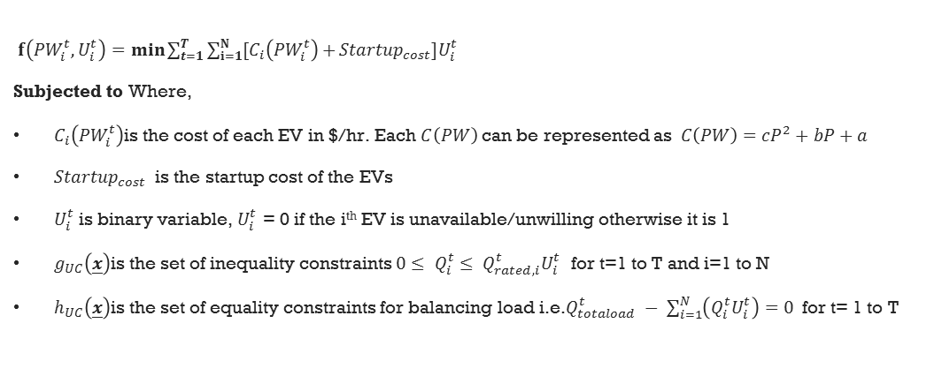
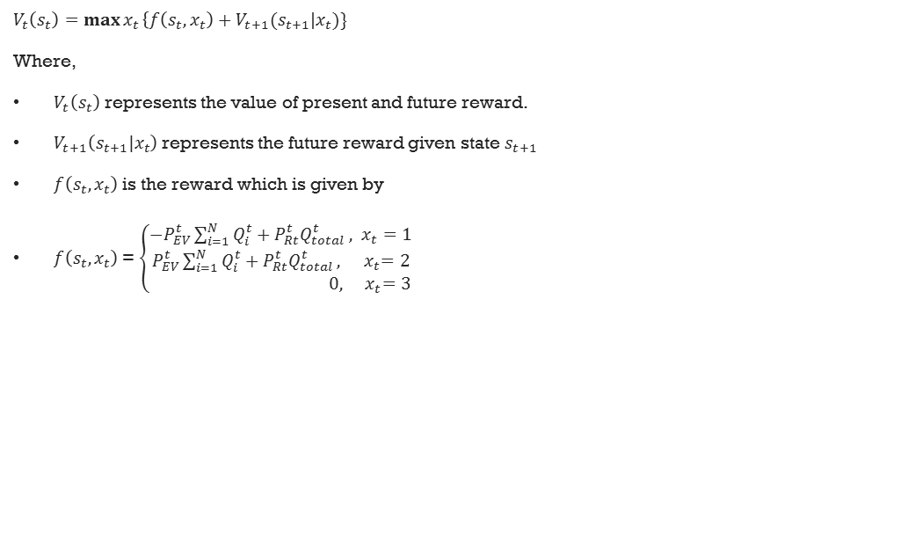
Dynamic Programming
Methods
$V_{t}\left(s_{t}\right)=\max{x_{t}}\left\{f\left(s_{t},x_{t}\right)+V_{t+1}{(s}_{t+1}\right|x_{t})\}$
Where,
$V_{t}\left(s_{t}\right)$ represents the value of present and future reward.
$V_{t+1}\left(s_{t+1}|x_{t}\right)$ represents the future reward given state $s_{t+1}$
$f\left(s_{t},x_{t}\right)$ is the reward which is given by
$f\left(s_{t},x_{t}\right)$ = $\left\{\begin{aligned}{−P}_{EV}^{t}\sum_{i=1}^{N}{Q_{i}^{t}+P_{Rt}^{t}Q_{total}^{t}}, x_{t}=1 \\ P_{EV}^{t}\sum_{i=1}^{N}{Q_{i}^{t}+P_{Rt}^{t}Q_{total}^{t}}, { x}_{t}=2 \\ 0,{ x}_{t}=3\end{aligned}\right.$
$f\left({PW}_{i}^{t},U_{i}^{t}\right)=min\sum_{t=1}^{T}{\sum_{i=1}^{N}{{[C}_{i}\left({PW}_{i}^{t}\right)+}{Startup}_{cost}]U_{i}^{t}}$
Subjected to Where,
$C_{i}\left({PW}_{i}^{t}\right)$is the cost of each EV in $/hr. Each $C\left(PW\right)$ can be represented as$C\left(PW\right)=cP^{2}+bP+a$
${Startup}_{cost}$ is the startup cost of the EVs
$U_{i}^{t}$ is binary variable, $U_{i}^{t}$ = 0 if the i^{th} EV is unavailable/unwilling otherwise it is 1
$g_{UC}\left(\underline{x}\right)$is the set of inequality constraints ${{0≤ Q}_{i}^{t}≤ Q}_{rated,i}^{t}U_{i}^{t}$ for t=1 to T and i=1 to N
$h_{UC}\left(\underline{x}\right)$is the set of equality constraints for balancing load i.e.$Q_{totaload}^{t} − \sum_{i=1}^{N}{\left(Q_{i}^{t}U_{i}^{t}\right)=0 }$ for t= 1 to T
Unit Commitment
Notes:
Don’t bore the audience. Just skim the slide and make a transition to the concept of LMP

Slide 54

Results
Vehicle to Grid (V2G) is always profitable to the Virtual Power Plant (VPP).
V2G becomes profitable (or at least better than Business As Usual) to an Electric Vehicle (EV) if
the battery price is substantially reduced (over 50%)
the EVs chose to participate only if the price exceeds a threshold
Photo : https://www.ndtv.com/jobs/tspsc-group-2-result-revised-results-for-2015-2016-recruitment-tspsc-gov-in-direct-link-here-1954687

Slide 55
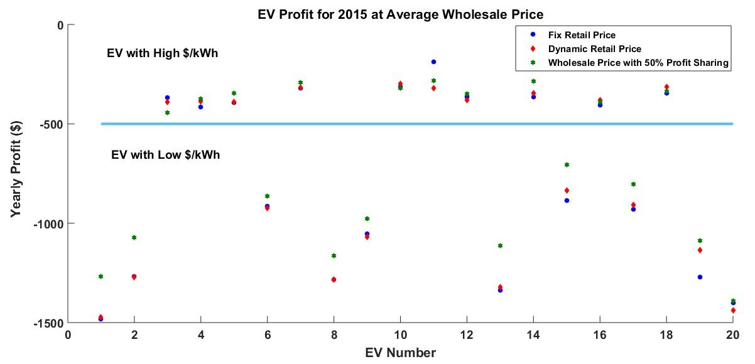
Results
Yearly profit in $ for all the Electric Vehicles (EVs).
EV with lower per-unit cost could get extensively used.
Extensive use + insufficient reward ➔ not-a-profitable business

Slide 56
Conclusion
While Vehicle to Grid (V2G) is always financially viable to the Virtual Power Plant, because of expensive battery costs and insufficient rewards
  V2G would not be profitable to the Electric Vehicles (EVs).
  Cheaper EVs could lose more because of the extensive use of battery and insufficient rewards.
Photo : http://www.connectyourmeetings.com/blogs/takeaways-from-great-ideas-conference/

Slide 57
Policy Implications
Vehicle to Grid (V2G) still lacks commercial drive. One of the reasons being Profitability to Vehicle Owners.
  To make it better. Policymakers should
  Invest in reducing battery costs
  Introduce newer market products like peak-shaver or renewable consuming product
Photo : http://www.connectyourmeetings.com/blogshttps://online.pointpark.edu/public-administration/policy-making-cycle//takeaways-from-great-ideas-conference/

Slide 58
References
Vivek Bhandari, Kaiyang Sun, Frances R Homans, The profitability of vehicle to grid for system participants-A case study from the Electricity Reliability Council of Texas. Energy Vol 153, pp. 278-286, 2018.
João Peças Lopes, Pedro Miguel Rocha Almeida, Antero Miguel Silva, Filipe Joel Soares, Smart Charging Strategies for Electric Vehicles: Enhancing Grid Performance and Maximizing the Use of Variable Renewable Energy Resources. Vol, 2009.
Eric Sortomme, Mohammad M Hindi, SD James MacPherson, SS Venkata, Coordinated Charging of Plug-in Hybrid Electric Vehicles to Minimize Distribution System Losses. IEEE transactions on smart grid Vol 2, pp. 198-205, 2011.
Michael C Caramanis, Justin M Foster, Coupling of Day Ahead and Real-Time Power Markets for Energy and Reserves Incorporating Local Distribution Network Costs and Congestion. Communication, Control, and Computing (Allerton), 2010 48th Annual Allerton Conference on. IEEE, pp. 42-49, 2010.
Muhammad Ansari, Ali T. Al-Awami, Eric Sortomme, MA Abido, Coordinated Bidding of Ancillary Services for Vehicle-to-Grid Using Fuzzy Optimization. IEEE transactions on smart grid Vol 6, pp. 261-270, 2015.
Kotub Uddin, Tim Jackson, Widanalage D Widanage, Gael Chouchelamane, Paul A Jennings, James Marco, On the Possibility of Extending the Lifetime of Lithium-Ion Batteries through Optimal V2g Facilitated by an Integrated Vehicle and Smart-Grid System. Energy Vol 133, pp. 710-722, 2017.
Nathan Paine, Frances R Homans, Melisa Pollak, Jeffrey M Bielicki, Elizabeth J Wilson, Why Market Rules Matter: Optimizing Pumped Hydroelectric Storage When Compensation Rules Differ. Energy Economics Vol 46, pp. 10-19, 2014.

Slide 59
Grants
“Doctoral Dissertation Fellowship” University of Minnesota (Awarded April, 2016)

Slide 60
Insights
Vehicle to Grid – Profitability to Electric Vehicles owners
Analysis of Economic /Market Aspects of V2G reveal that V2G may not be appealing to the EV owners.
Study of understudied aspects of Energy Policy examples reveal……
C
Market Diffusion of Combined Heat and Power (CHP)
Analysis of Socio-Political Aspects of market diffusion of CHP reveal that subjective impressions could overrule rational economic behavior.
B
A
Carbon Tax
Analysis of Engineering Aspects of Carbon Tax reveal that Carbon would interaction with Production Tax Credits and it may not effectively reduce emissions.
Notes:
This dissertation integrates science with public policy by integrating engineering tools with insights from social science . It aims to advance the common good in a complex and diverse world.
The study on carbon tax finds …
The study on CHP finds…
The study on V2G finds …..

Slide 61
Holistic Insights
Energy Policy
Environmental
EconomicMarket
Engineering
Socio-Political
Notes:
Society’s grand challenges—rapid urbanization, climate change, sustainable energy transitions, governance of emerging and/or disruptive technologies—require holistic insights and systems thinking rooted in real-world projects. This is required in every step of the policy process.
Three examples of public issues (carbon tax, market diffusion of CHP, profitability of V2G) arising at the intersection of science, technology, environment, and society that shape economic development, environmental sustainability, human health, and well-being were analyzed in this dissertation. These policies are at different stages in the policy process.
Insights from this dissertation
For a carbon tax can be applied to refine the problem and analyze it thoroughly
For CHP can be used to refine existing policies or creating new policies
For V2G can be used to allocate money for reducing battery costs or creating new market rules
This dissertation integrates science with public policy by integrating engineering tools with insights from social science . It aims to advance the common good in a complex and diverse world.

Slide 62

Policy Process
Insights
Problem Identification
Policy Implementation
Policy Analysis
Strategy and Policy Development
Policy Enactment
Carbon Tax
Effect of Power Systems operation (engineering)
Vehicle to Grid
Profitability to EV owners (economic/market)
Combined Heat and Power
Non-financial barriers (sociopolitical)
Notes:
Society’s grand challenges—rapid urbanization, climate change, sustainable energy transitions, governance of emerging and/or disruptive technologies—require holistic insights and systems thinking rooted in real-world projects. This is required in every step of the policy process.
Three examples of public issues (carbon tax, market diffusion of CHP, profitability of V2G) arising at the intersection of science, technology, environment, and society that shape economic development, environmental sustainability, human health, and well-being were analyzed in this dissertation. These policies are at different stages in the policy process.
Insights from this dissertation
For a carbon tax can be applied to refine the problem and analyze it thoroughly
For CHP can be used to refine existing policies or creating new policies
For V2G can be used to allocate money for reducing battery costs or creating new market rules
This dissertation integrates science with public policy by integrating engineering tools with insights from social science . It aims to advance the common good in a complex and diverse world.

Slide 63
Thank You
Questions
X

Slide 64


Next Steps..
X
During the Ph.D., I have studied several examples using theory and practices related to energy and environment policy especially by combining engineering tools with insights from social science. I shall continue doing that in future, and help to bridge the gap between engineering and public policy.

Slide 65
Published Papers
Vivek Bhandari, Stephen Rose, Elizabeth J Wilson, Non-Financial Barriers to Combined Heat and Power in the United States- A Qualitative Study, The Electricity Journal Vol 32, pp. 49-56 2019.
Vivek Bhandari, Kaiyang Sun, Frances R Homans, The profitability of vehicle to grid for system participants-A case study from the Electricity Reliability Council of Texas. Energy Vol 153, pp. 278-286, 2018.
Vivek Bhandari, Anthony M Giacomoni, Bruce F Wollenberg, Elizabeth J Wilson, Interacting policies in power systems: Renewable subsidies and a carbon tax. The Electricity Journal Vol 30-6, pp. 80-84 2017.

