Slide 1
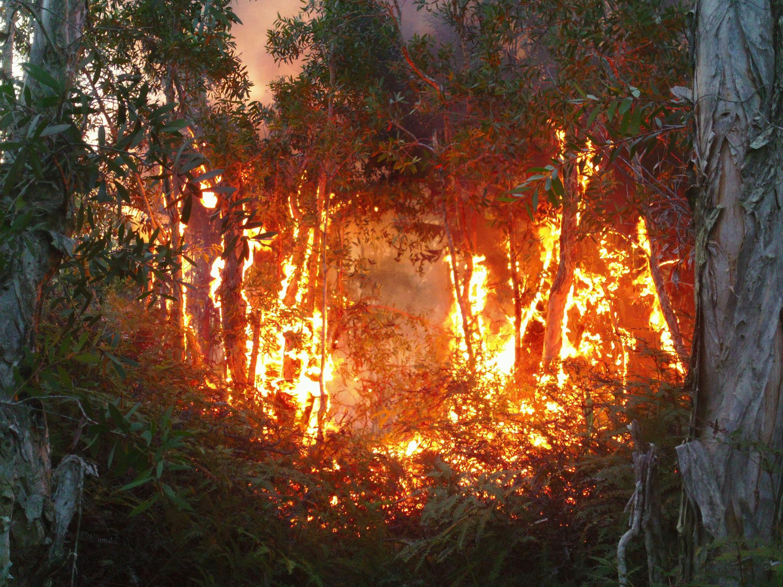
Forest restoration in Eastern Madagascar:
Post-fire survival of select Malagasy tree species
Matt Hill
matt2hill@gmail.com

Slide 2
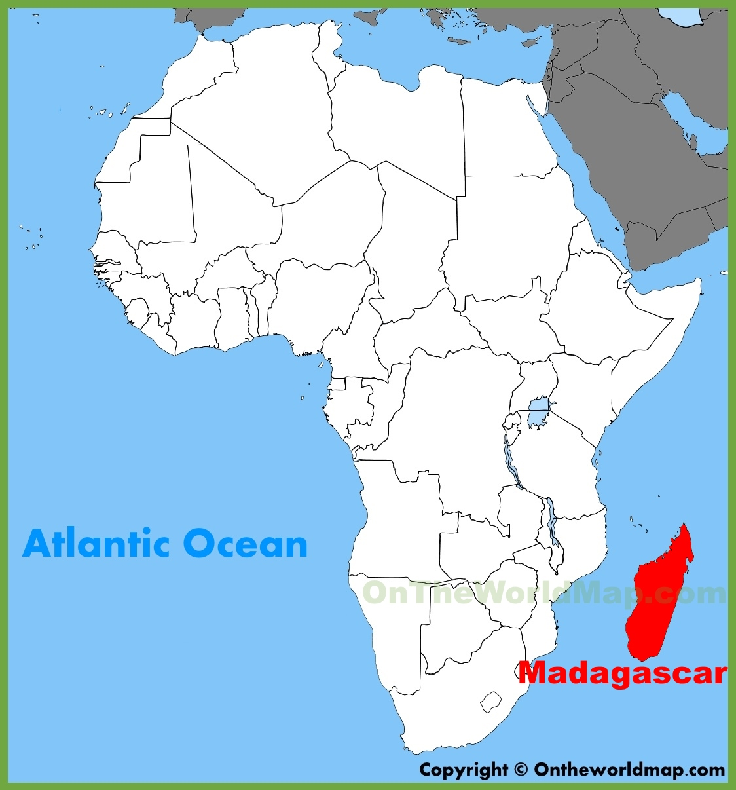

Slide 3
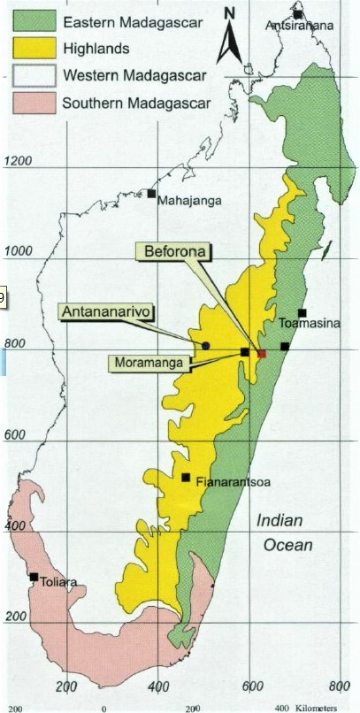

Slide 4
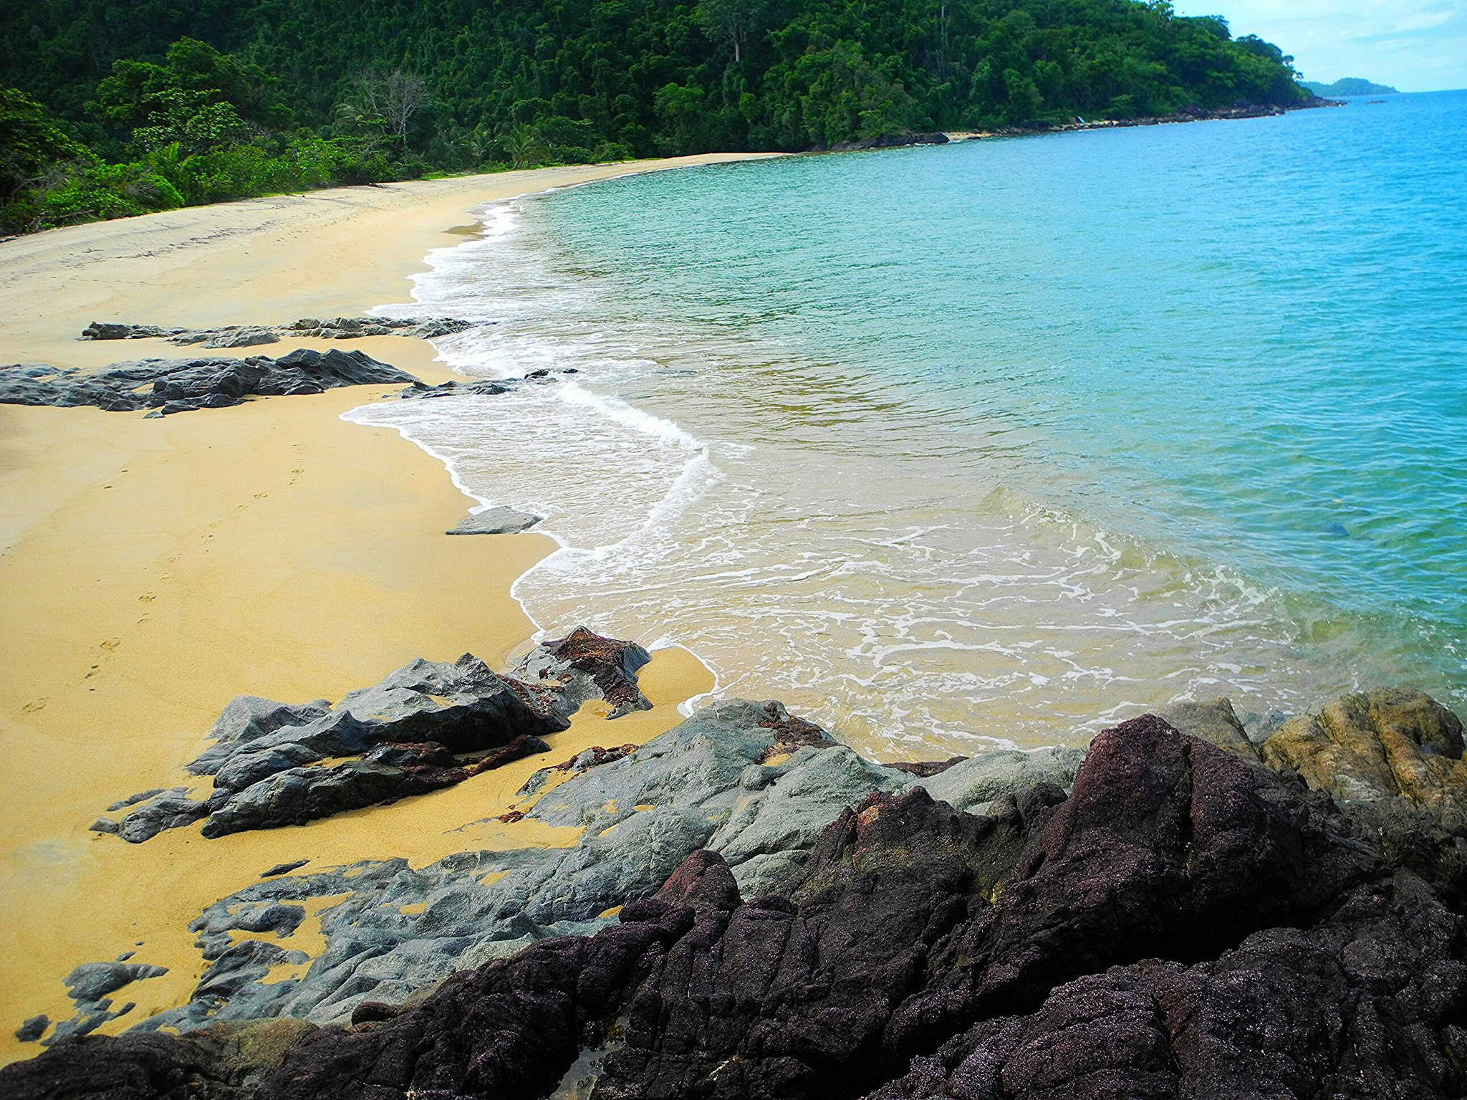
Sava Fishing Village, Antongil Bay

Slide 5
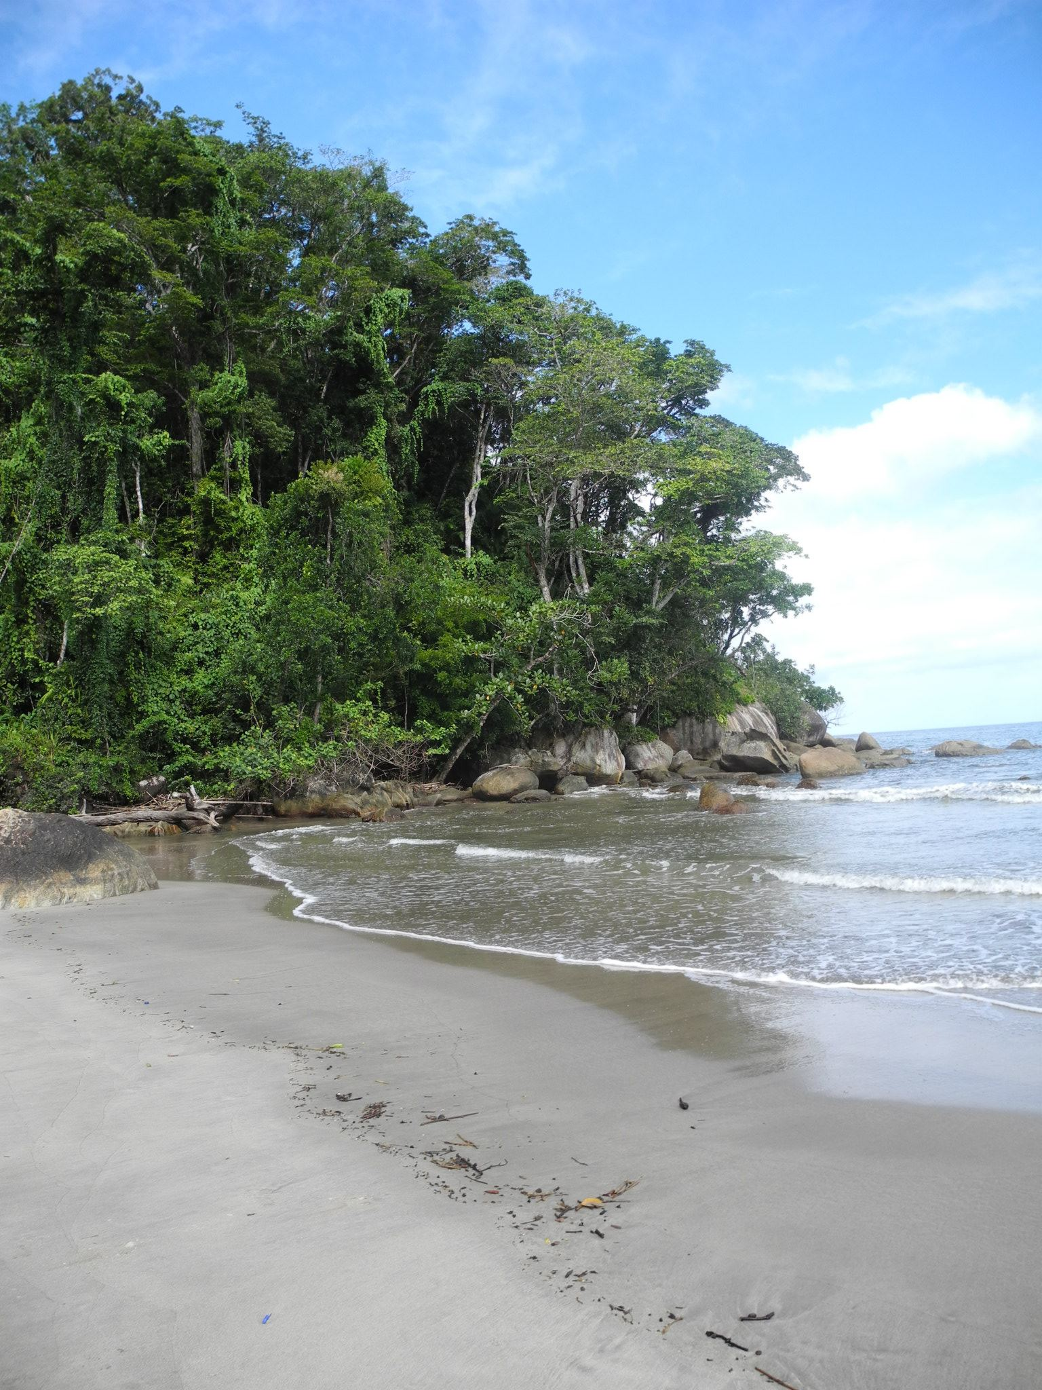
Nosy-Mangabe Park, Maroantsetra Region

Slide 6
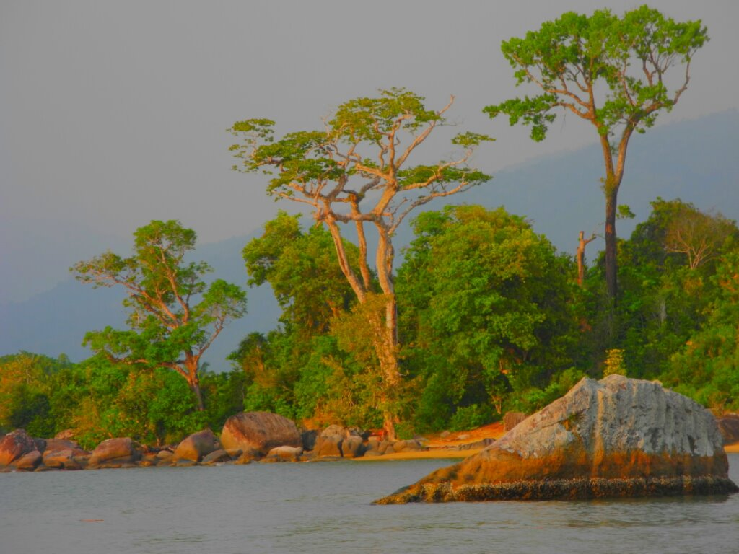
Andranofotsy shoreline

Slide 7
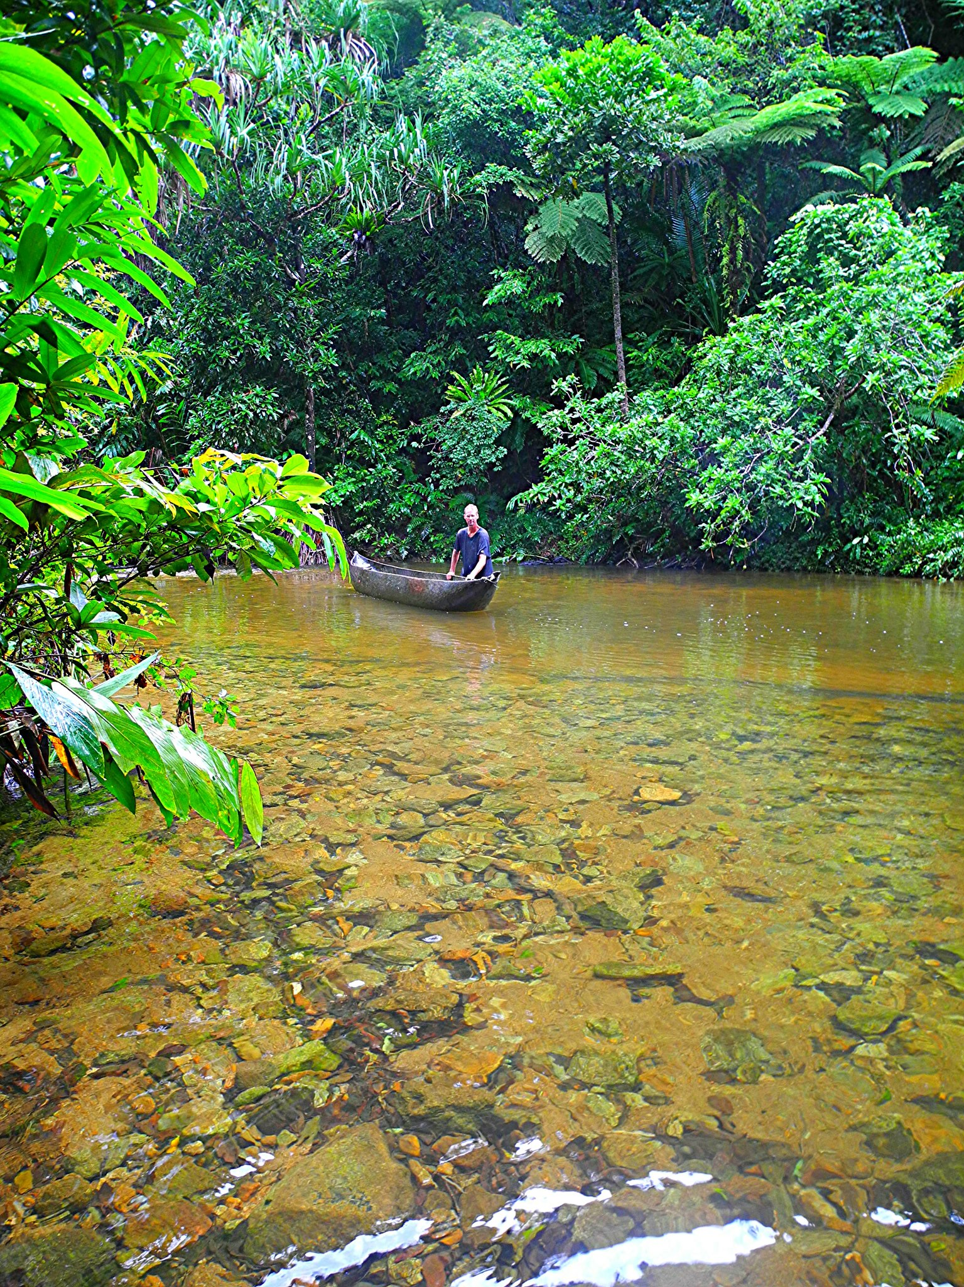
Ambanizana river, Masoala region
>600 species / hectare

Slide 8
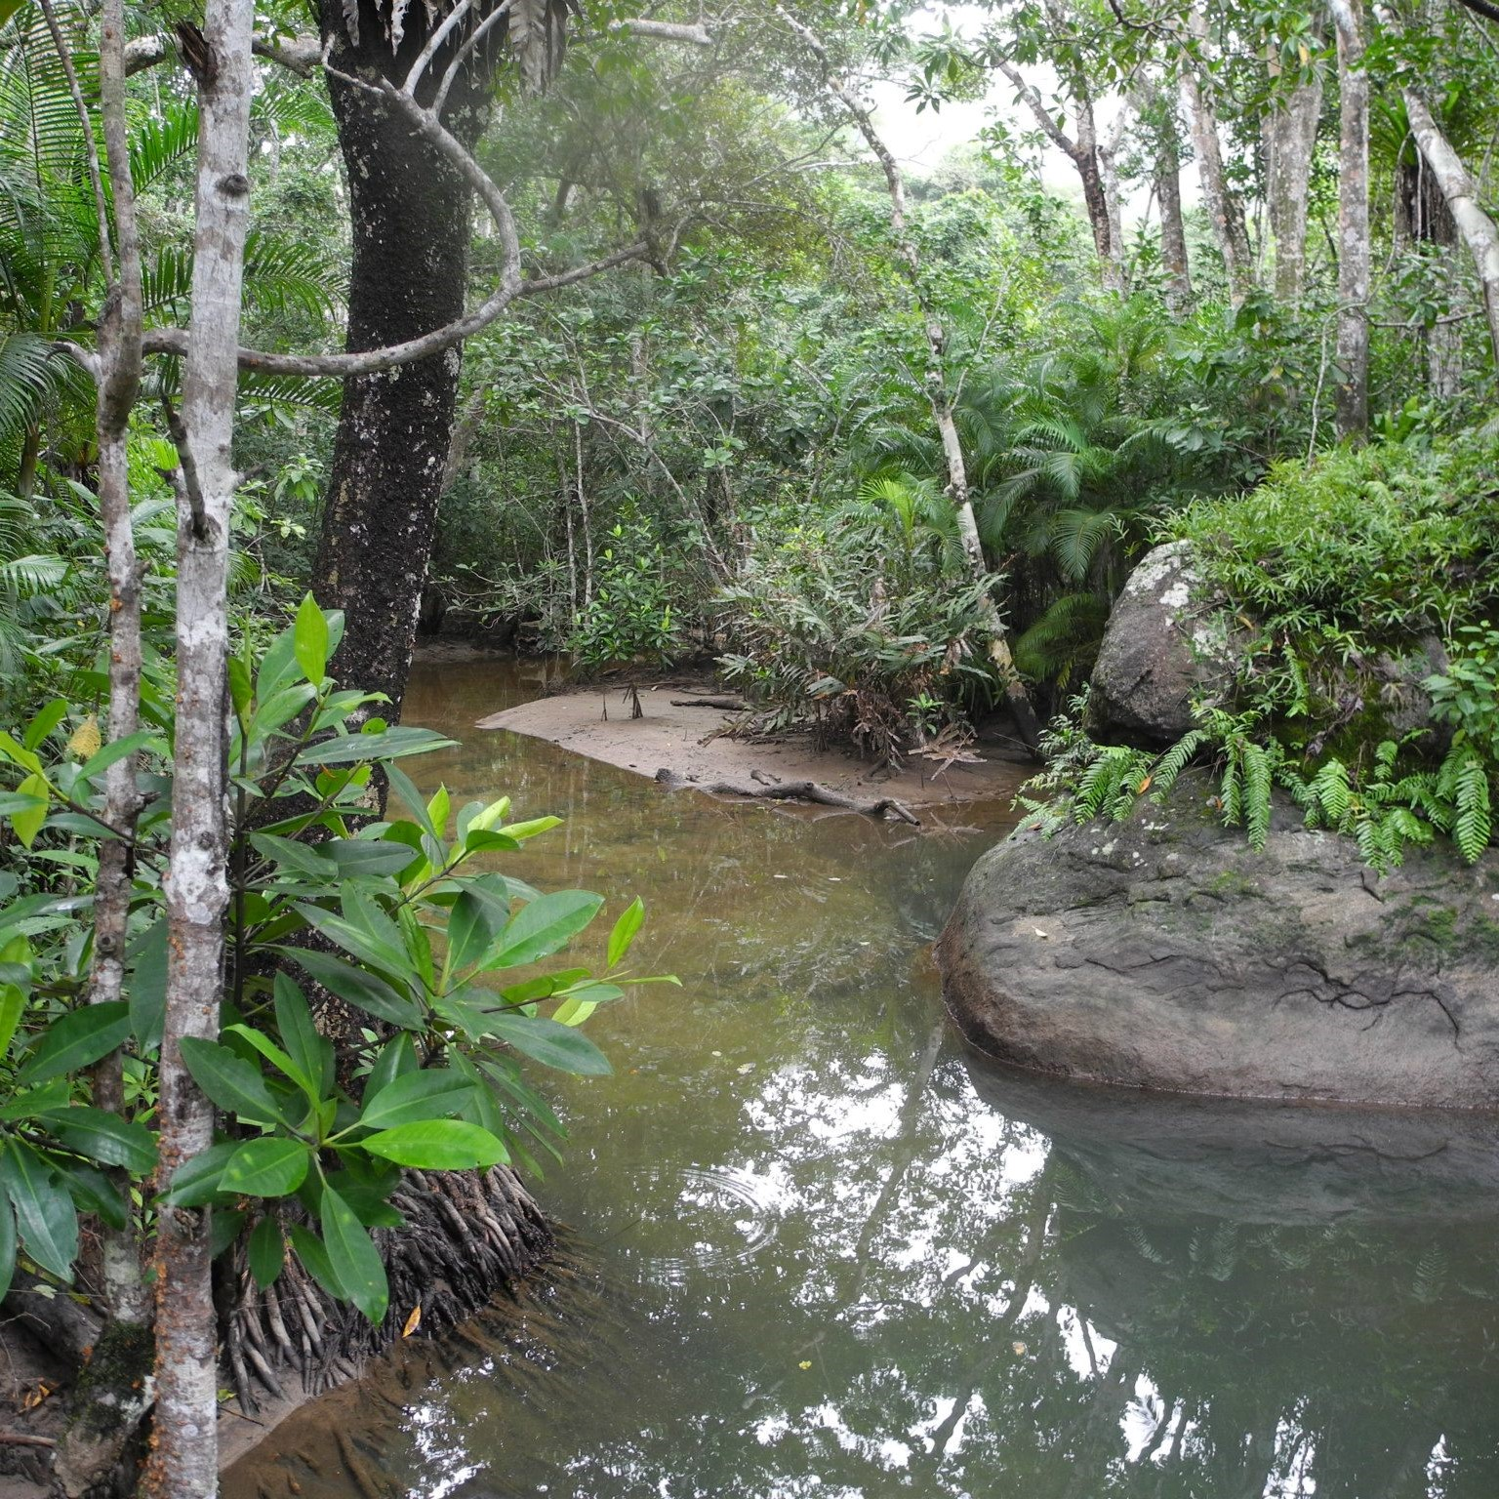
Fanakaraina State Park
10%-20% known to western science

Slide 9
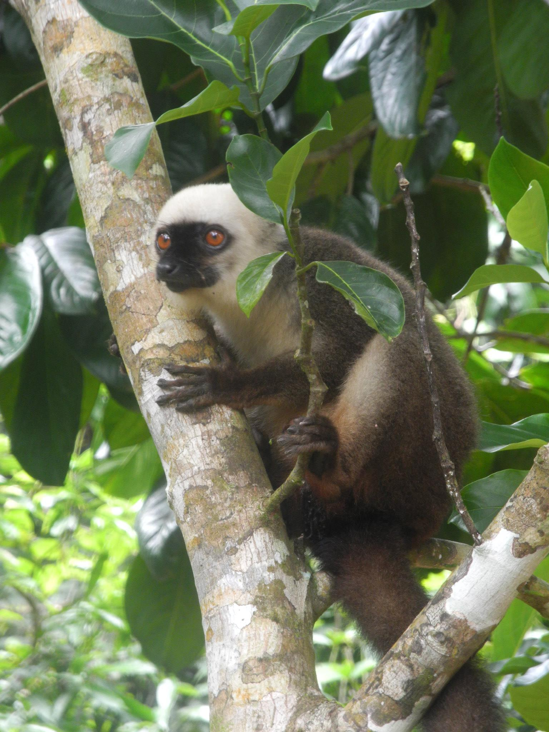
White-ruffed Lemur (adult male)

Slide 10
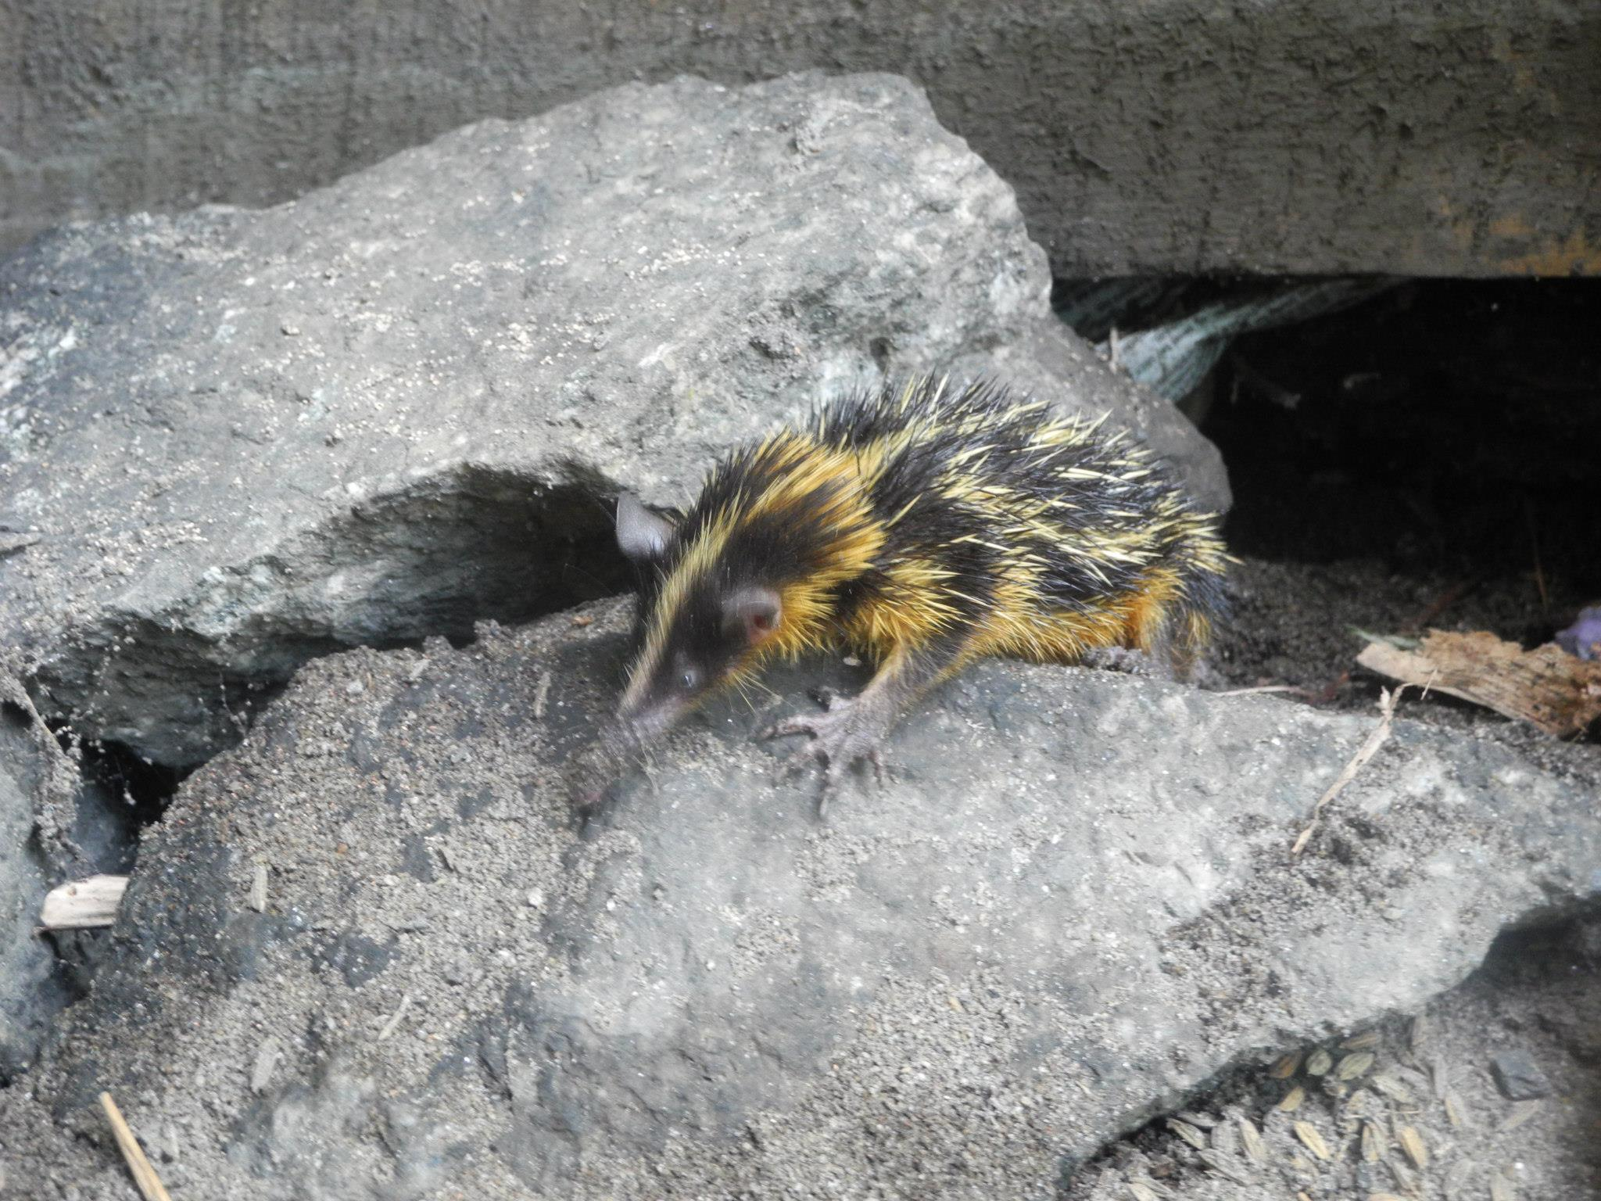
Tenrec (adult female)

Slide 11
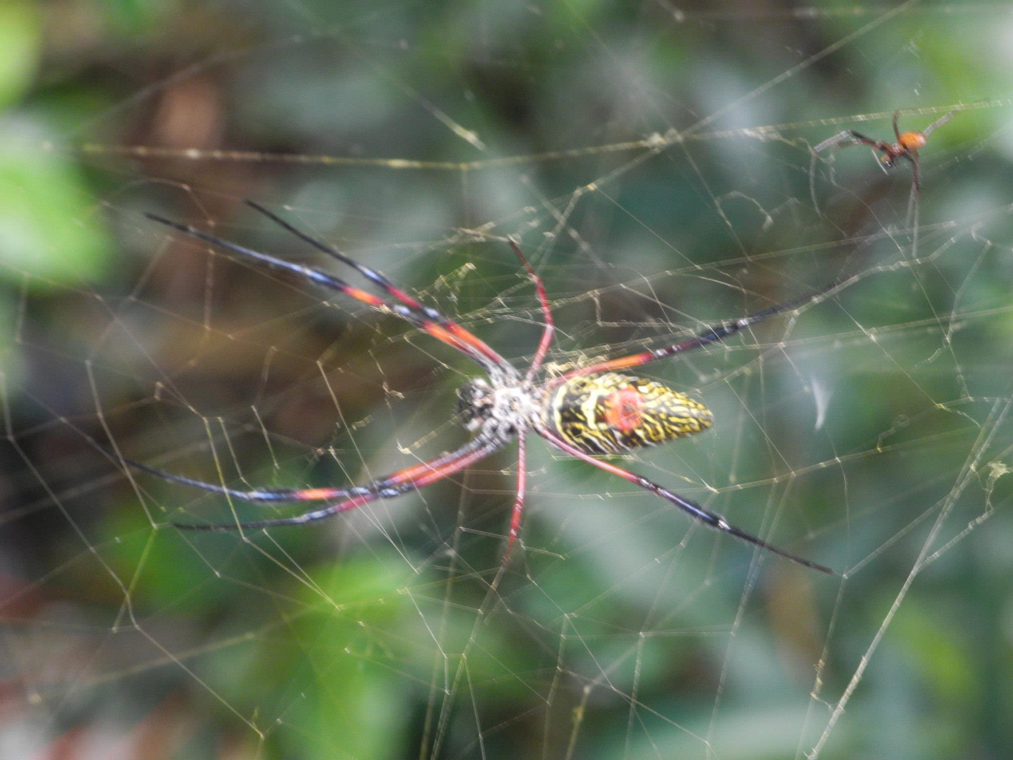
Golden silk orb-weaver spider (adult)

Slide 12
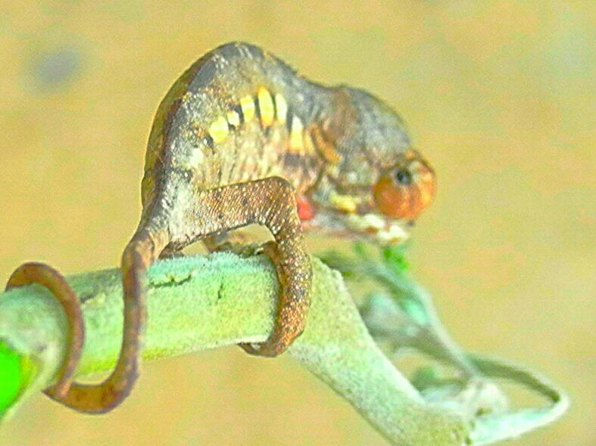
Panther chameleon (juvenile)

Slide 13
Endemic: 95% reptiles, 89% plant life, and 92% mammals
(disappearing fast!)

Slide 14

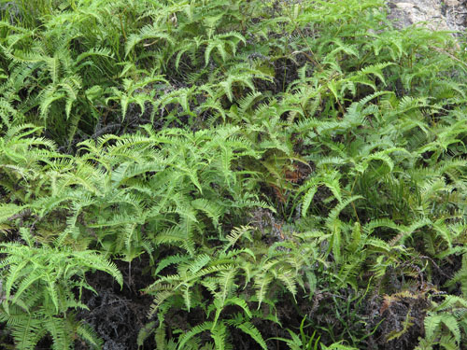
Historically biodiverse rainforest…
…now monoculture invasive fern!

Slide 15
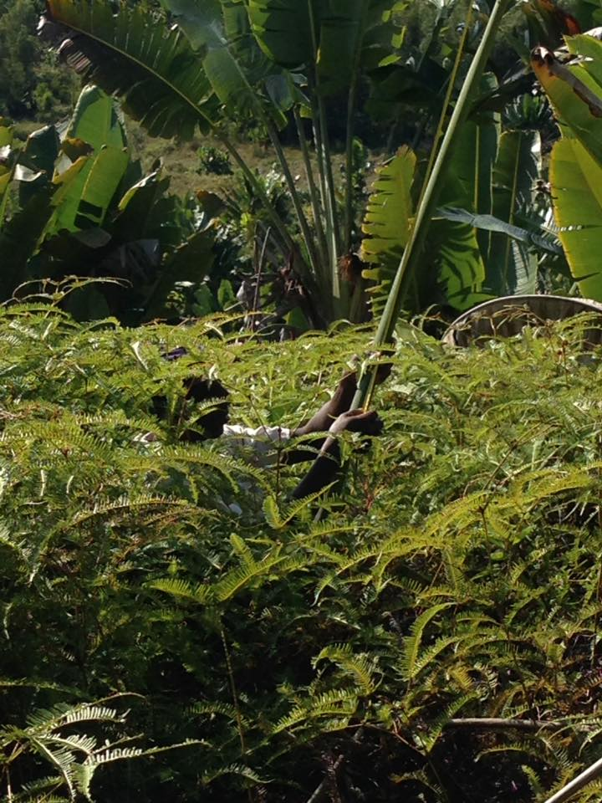
Dicranopteris linearis: 7-10 ft thicket

Slide 16
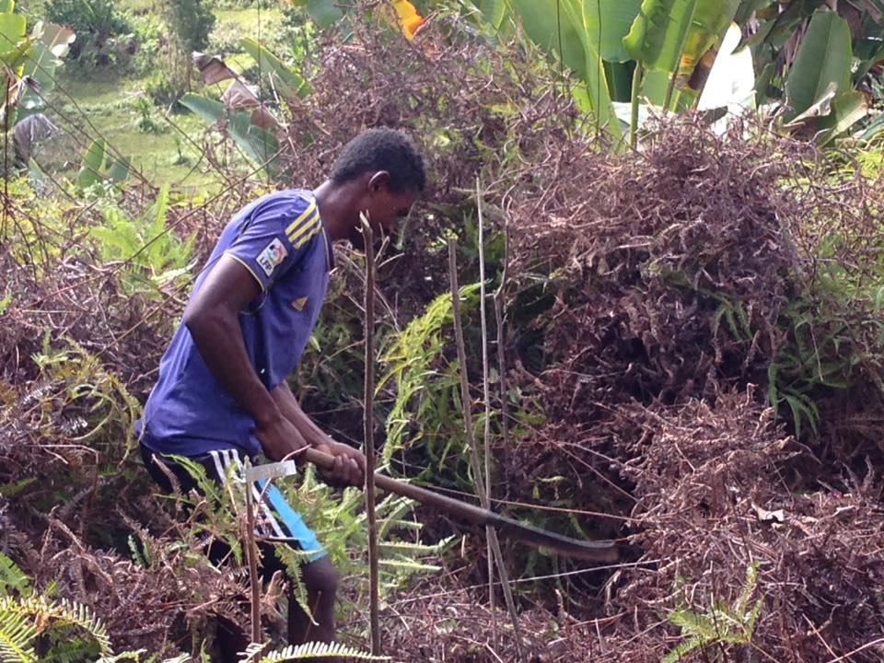
Dicranopteris linearis: 2-9 ft mat

Slide 17
7-10 ft thicket
Landscape Monoculture
Invasive Fern
2-9 ft mat

Slide 18
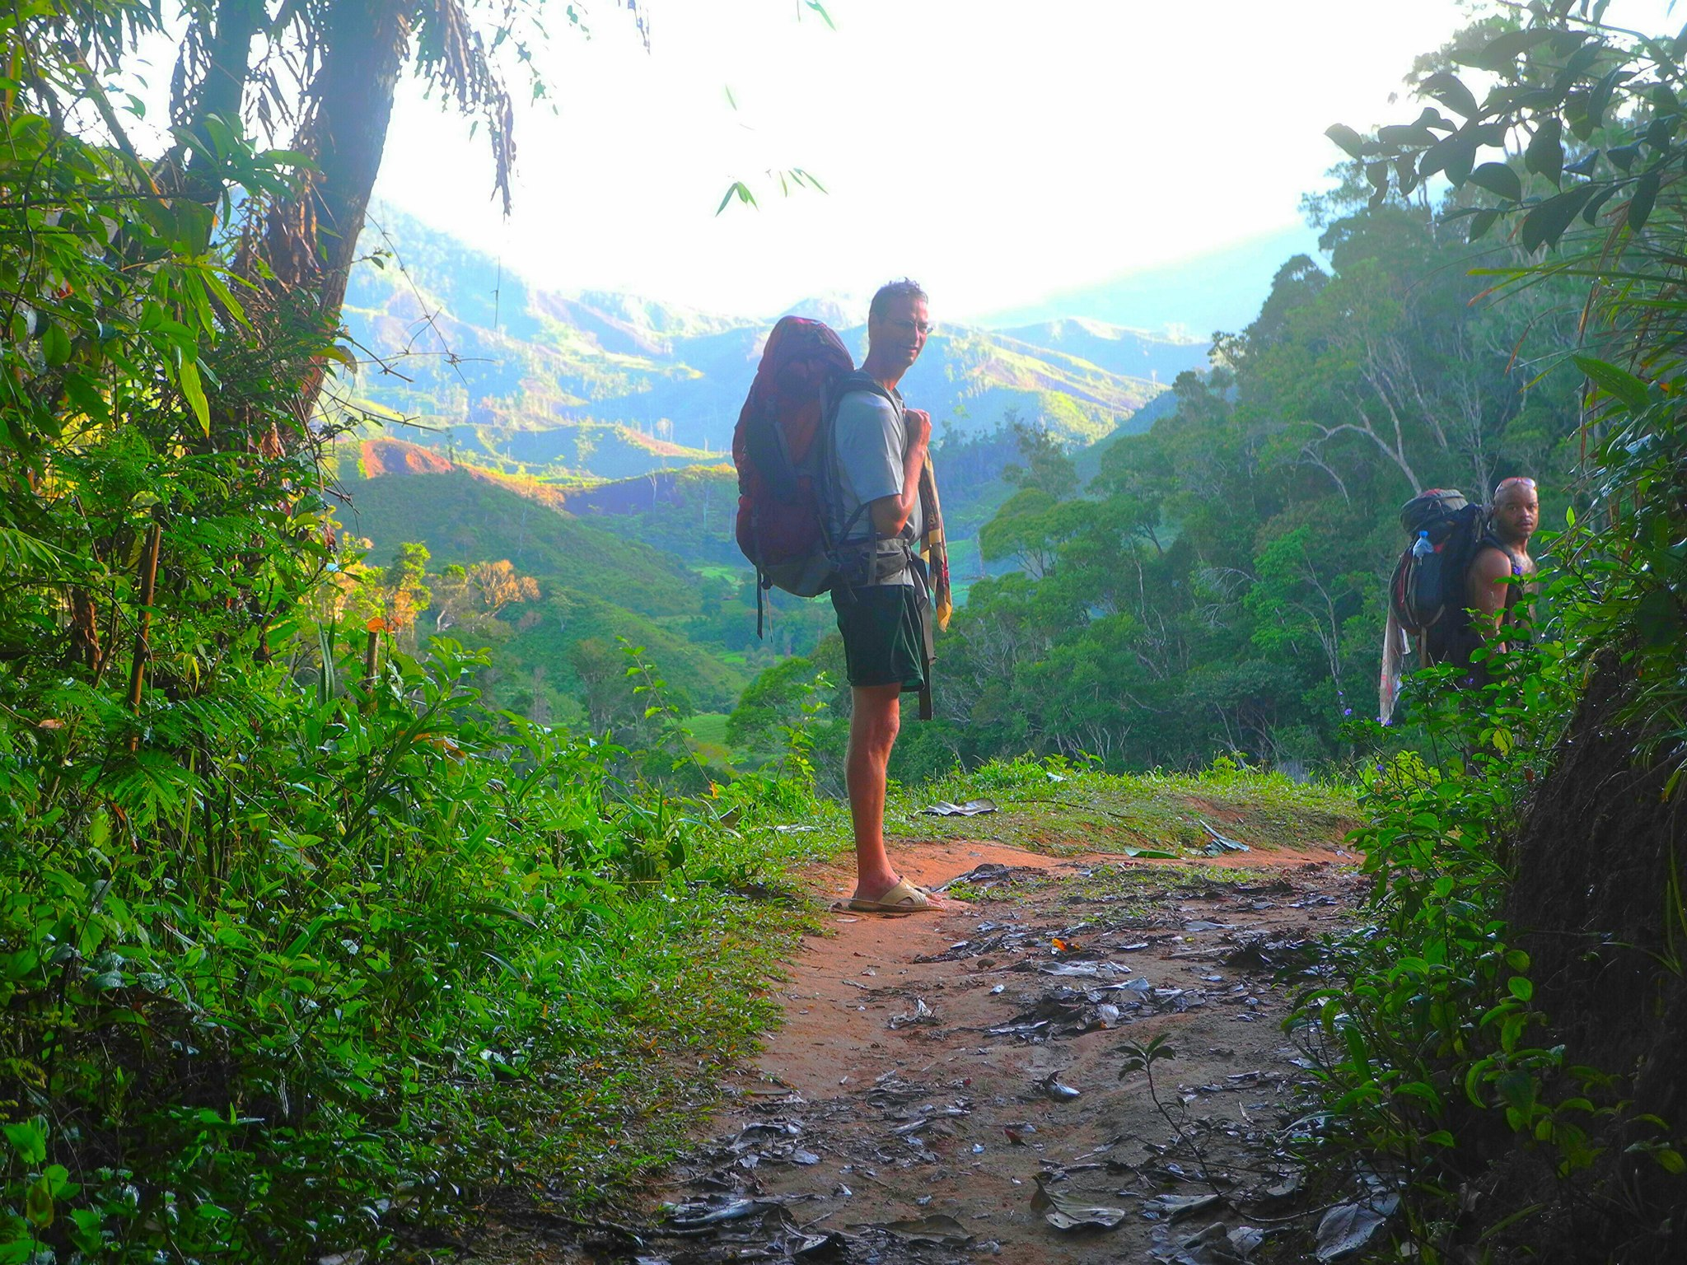
D. linearis: 500km by 40km

Slide 19
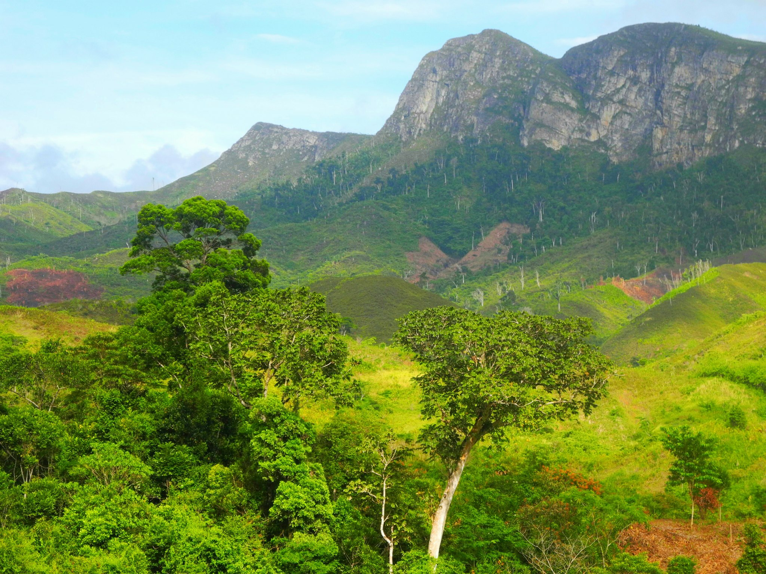
D. linearis: 500km by 40km

Slide 20
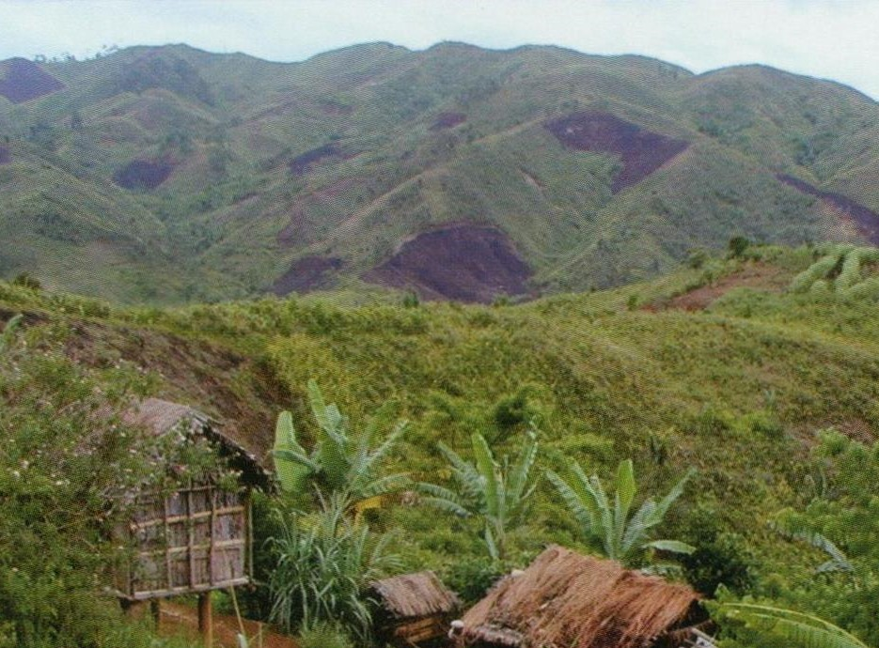
D. linearis: 500km by 40km

Slide 21
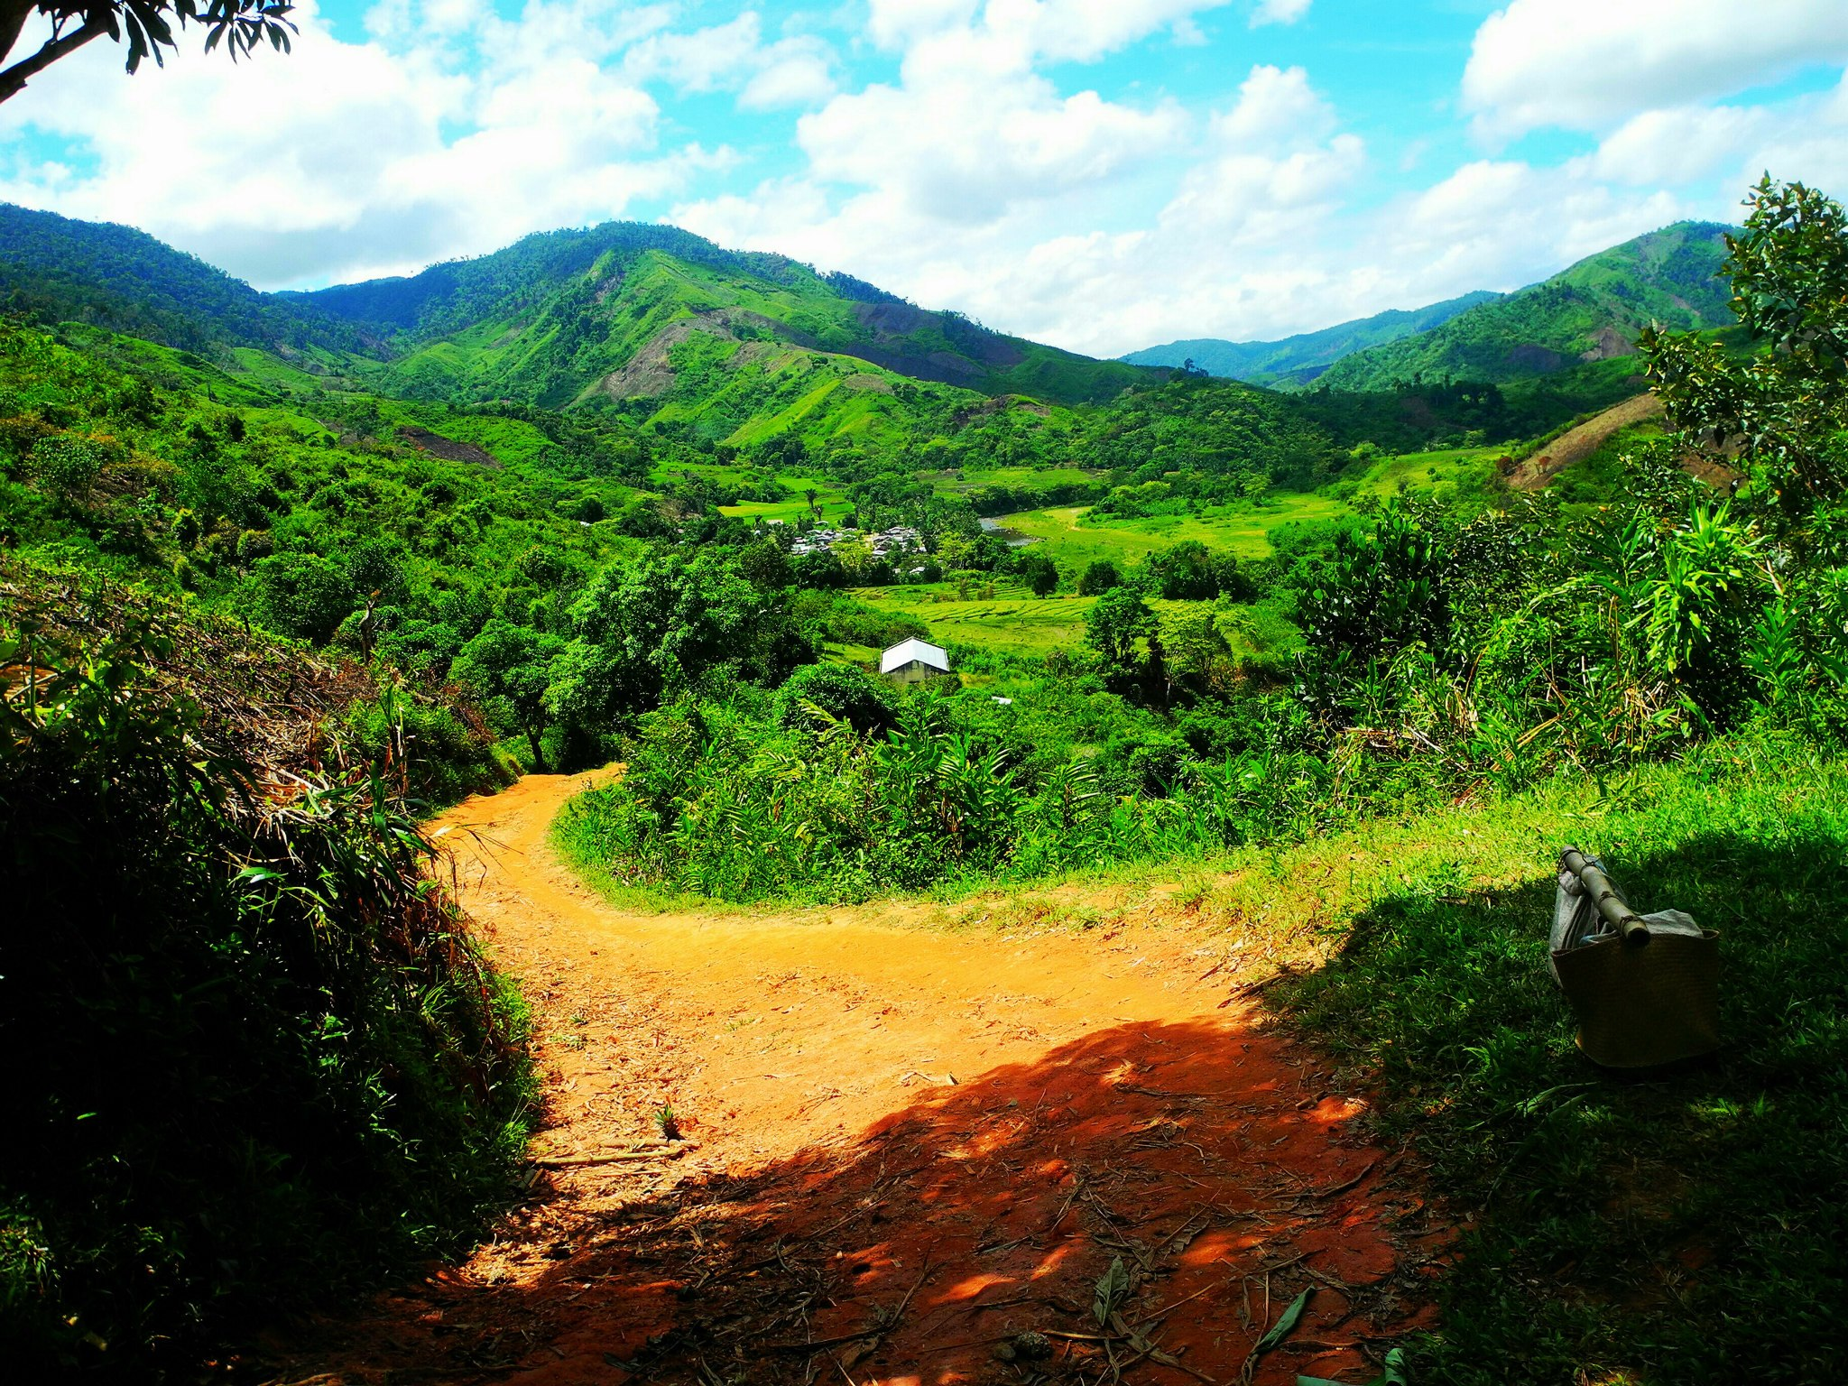
D. linearis: 500km by 40km

Slide 22
7-10 ft thicket
? ? ? ? ?
2-9 ft mat
Notes:
15 min mark

Slide 23
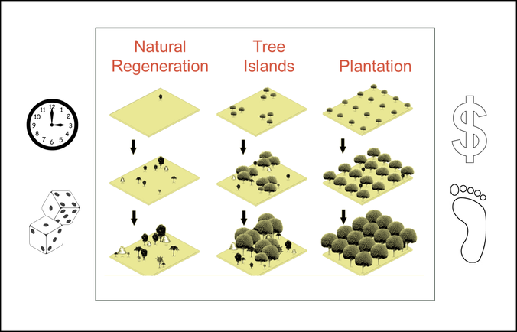
Applied Nucleation

Slide 24
GreenAgain islands: 25-tree monocultures
5 | corner | edge | edge | edge | corner
4 | edge | ring | ring | ring | edge
3 | edge | ring | center | ring | edge
2 | edge | ring | ring | ring | edge
1 | corner | edge | edge | edge | corner
 | 1 | 2 | 3 | 4 | 5

Slide 25
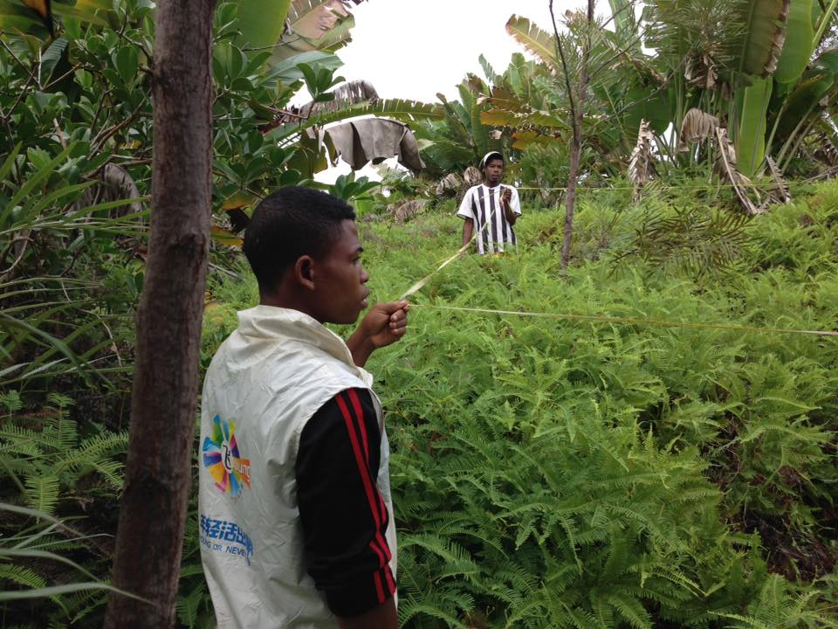

Slide 26
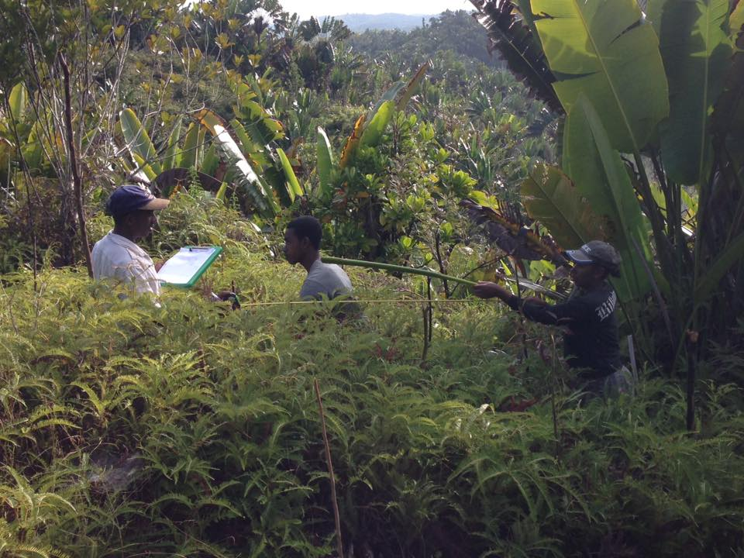

Slide 27
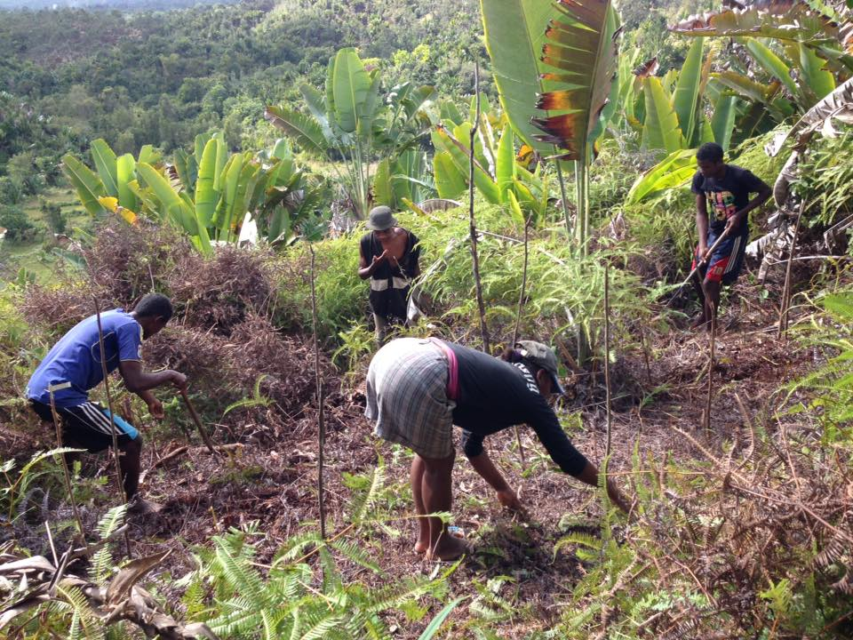

Slide 28
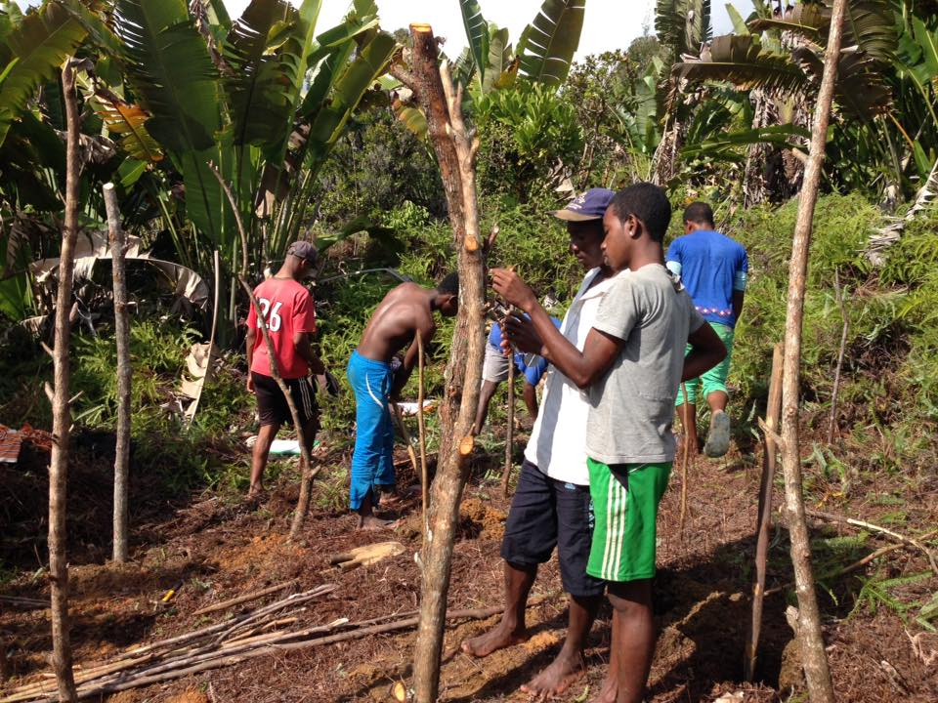

Slide 29
11 Malagasy Tree Species in our experiment
Code | Scientific Name | Family | Malagasy
DL | Dypsis lutescens | Arecaceae | lafaza
HM | Harungana madagascariensis | Hypericaceae | harongana
HV | Hymenaea verrucosa | Fabaceae | mandrorofo
IB | Intsia bijuga | Fabaceae | hintsina
MC | Macaranga spp | Euphorbiaceae | mankarangana
NT | Neotina spp | Sapindaceae | voantsilana
PM | Parkia madagascariensis | Fabaceae | kintsakintsa
PO | Pittosporum crassifolium | Pittosporaceae | maimbovitsika
TE | Terminalia mantaly | Combretaceae | mantaly
TO | Trema orientalis | Cannabaceae | andrarezona
UP | Uapaca spp | Phyllanthaceae | voapaka
> 150 cm height & >100 cm crown (3 years)

Slide 30
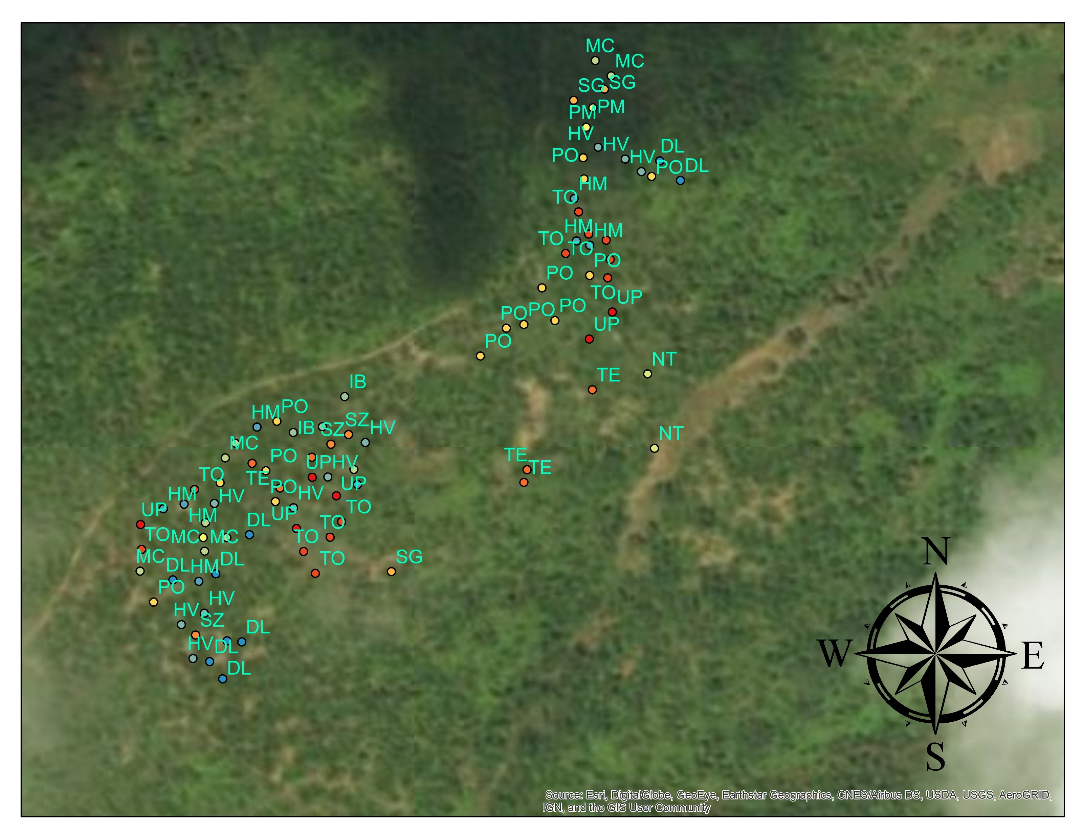
Ambonivato village
Project 2016
160 Monoculture Islands
interspersed to form
Biodiverse Forest Stand

Slide 31
7-10 ft thicket
Ruderal Suppression
2-9 ft mat

Slide 32
Invasive Fern
7-10 ft thicket
2-9 ft mat
Only ½ the Problem
? ? ? ? ?

Slide 33
Tavy
(slash & burn)

Slide 34
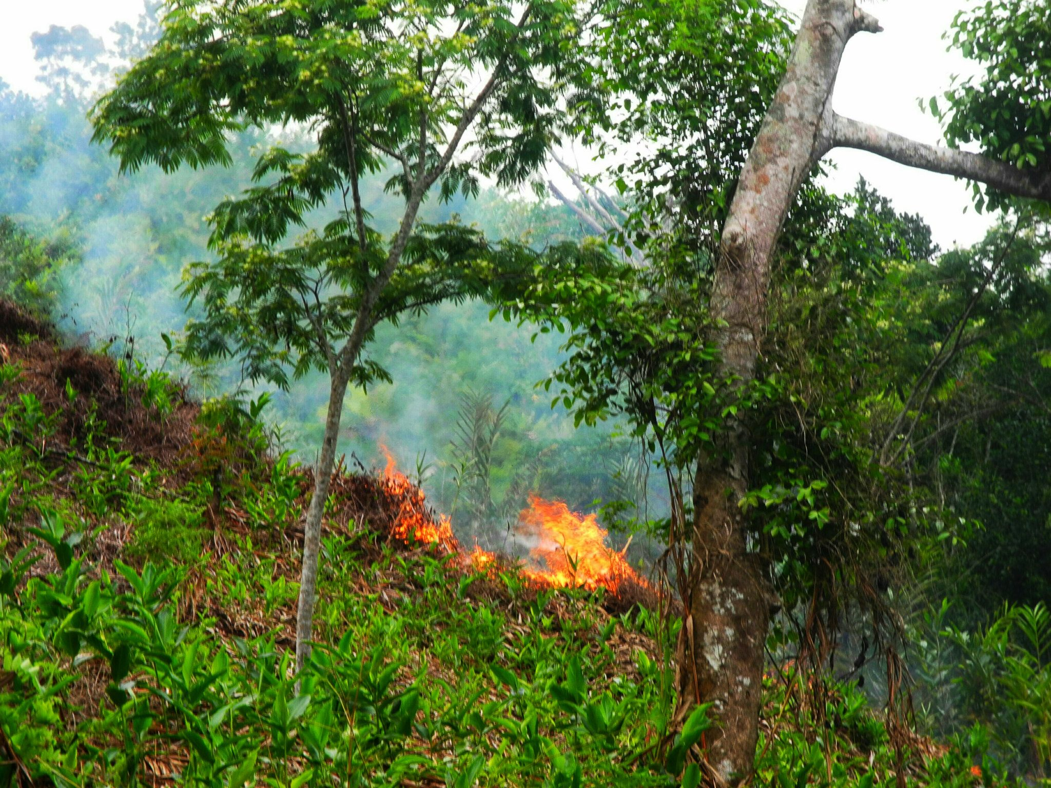
Tavy
(slash & burn)

Slide 35
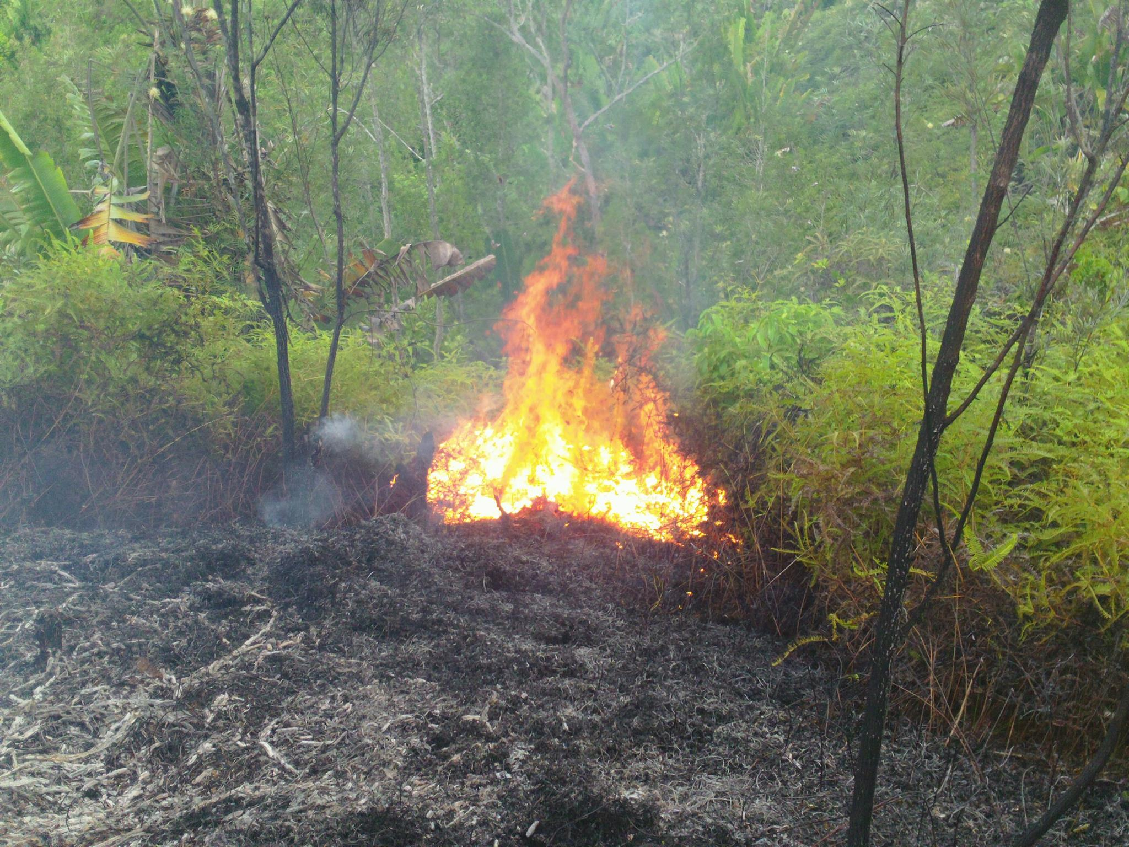

Slide 36
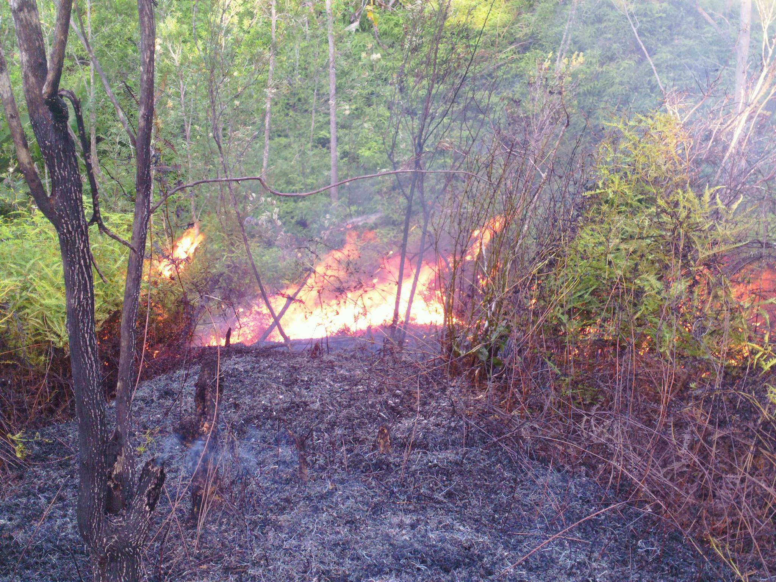

Slide 37
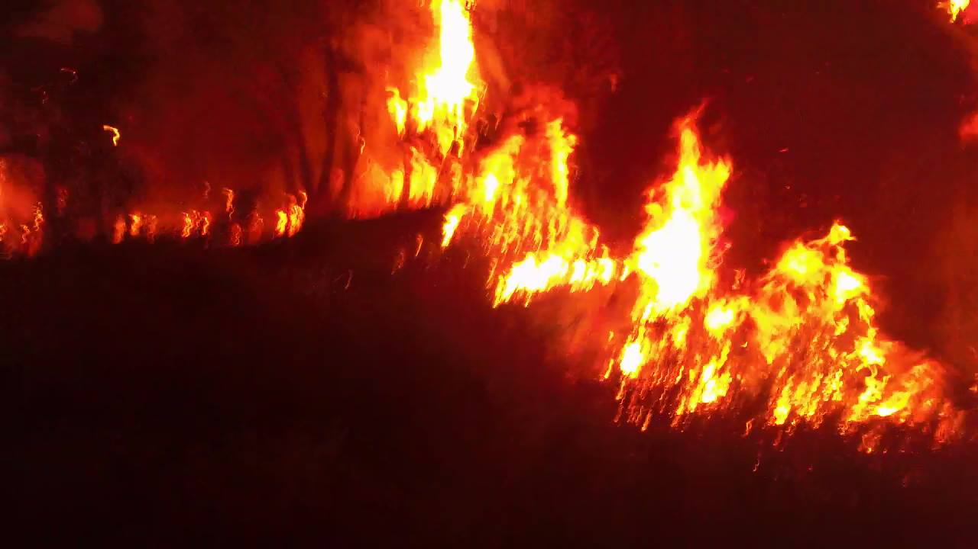

Slide 38
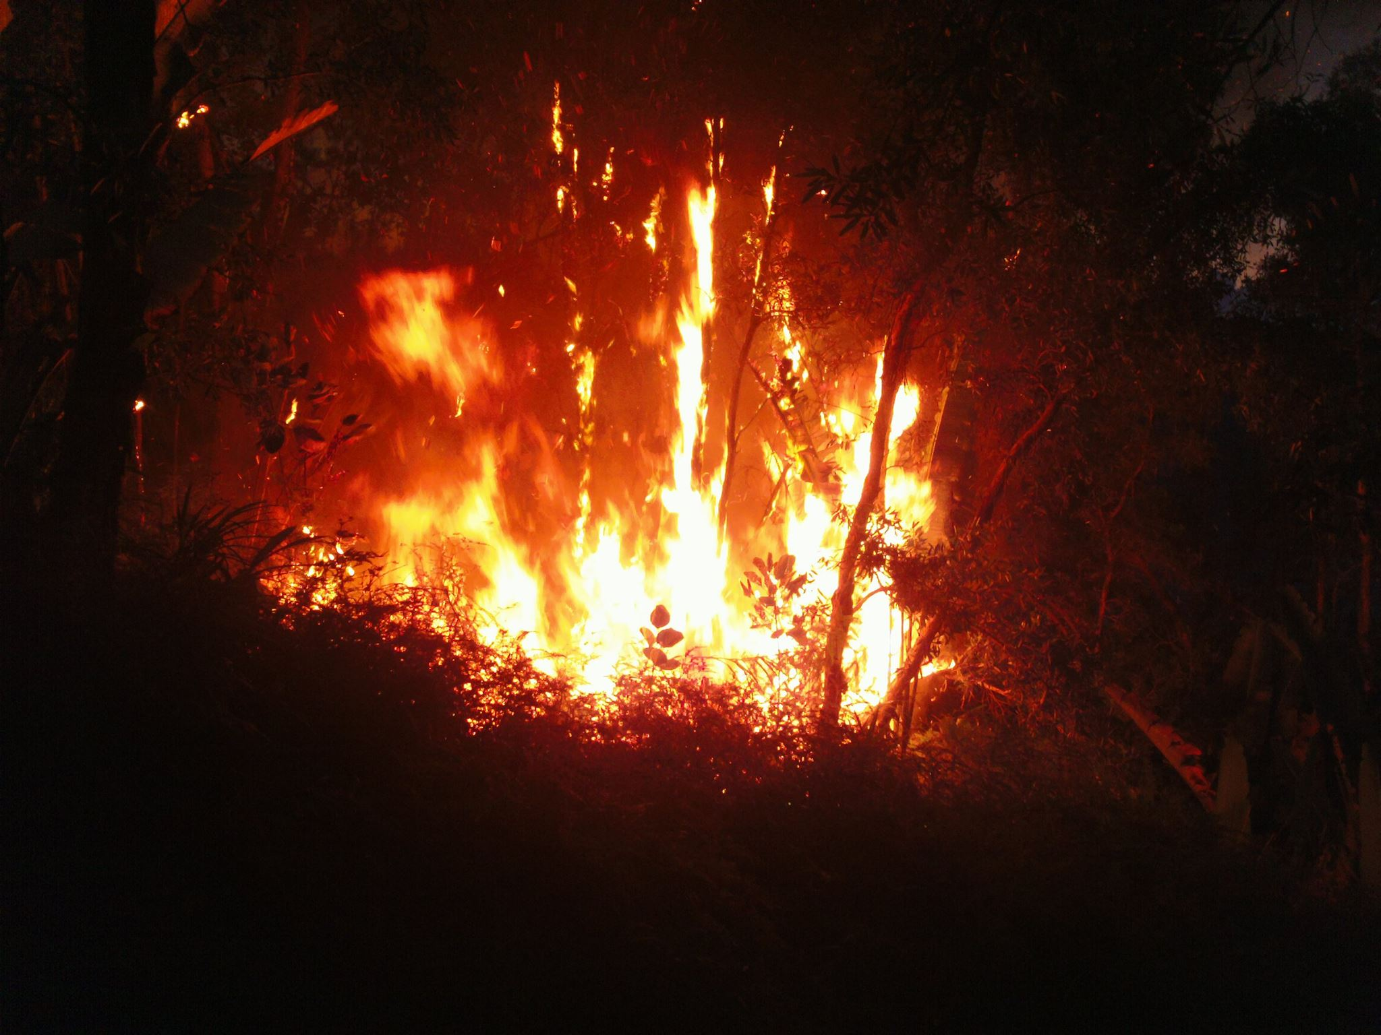

Slide 39
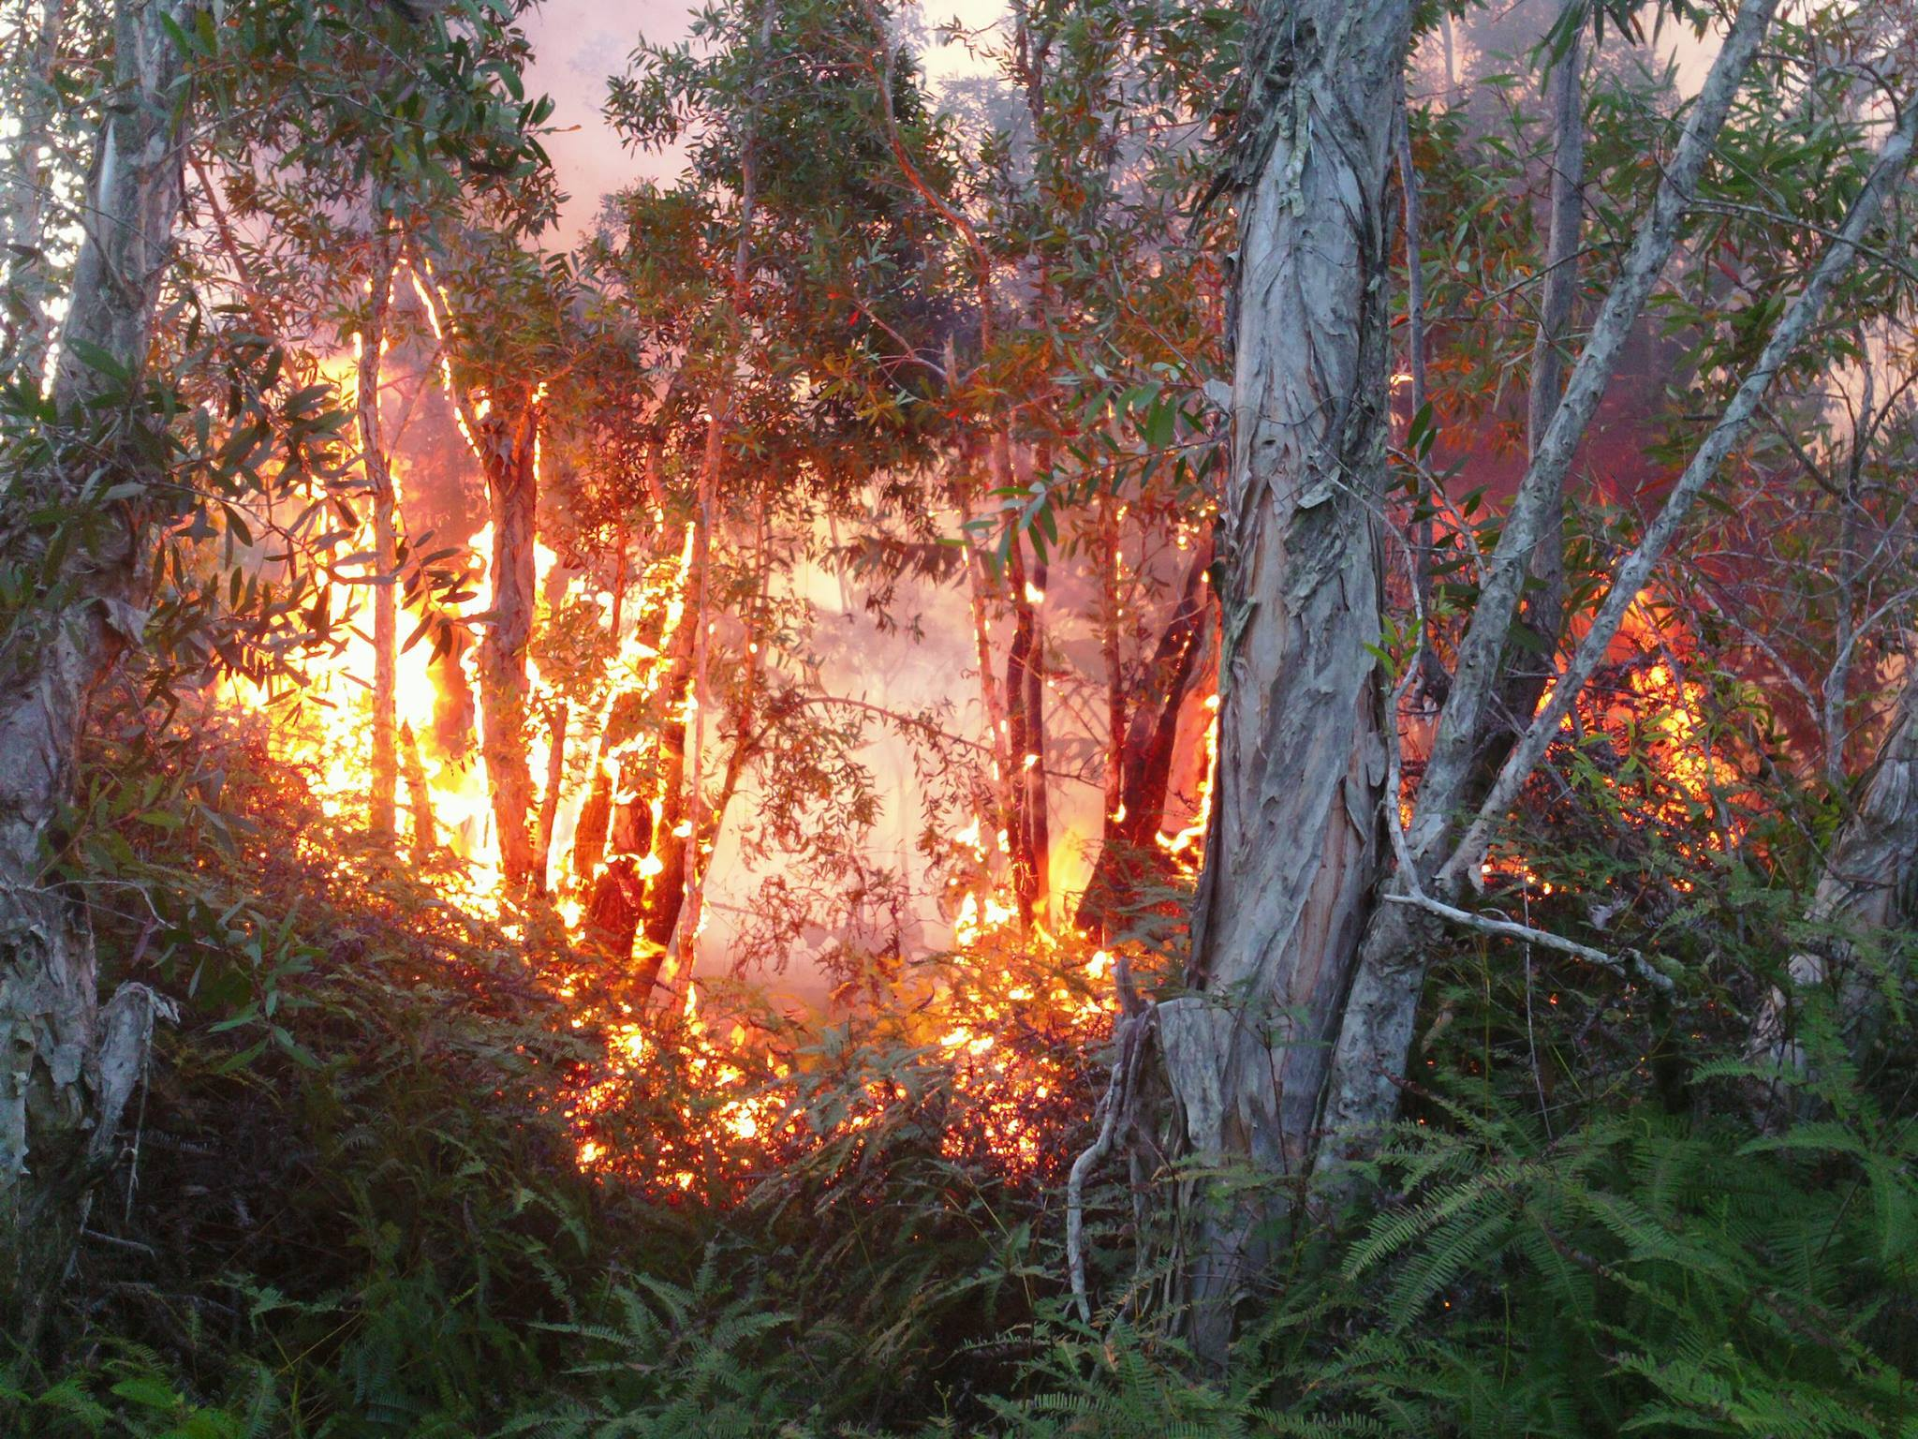

Slide 41
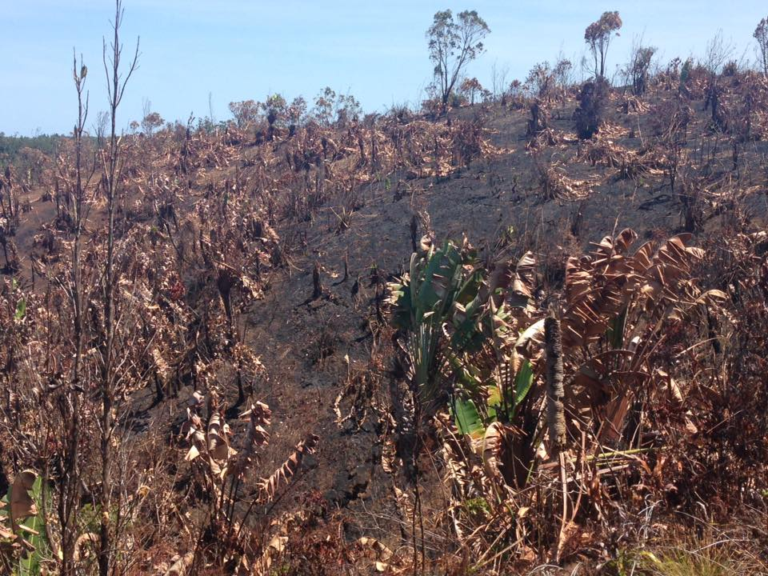

Slide 42
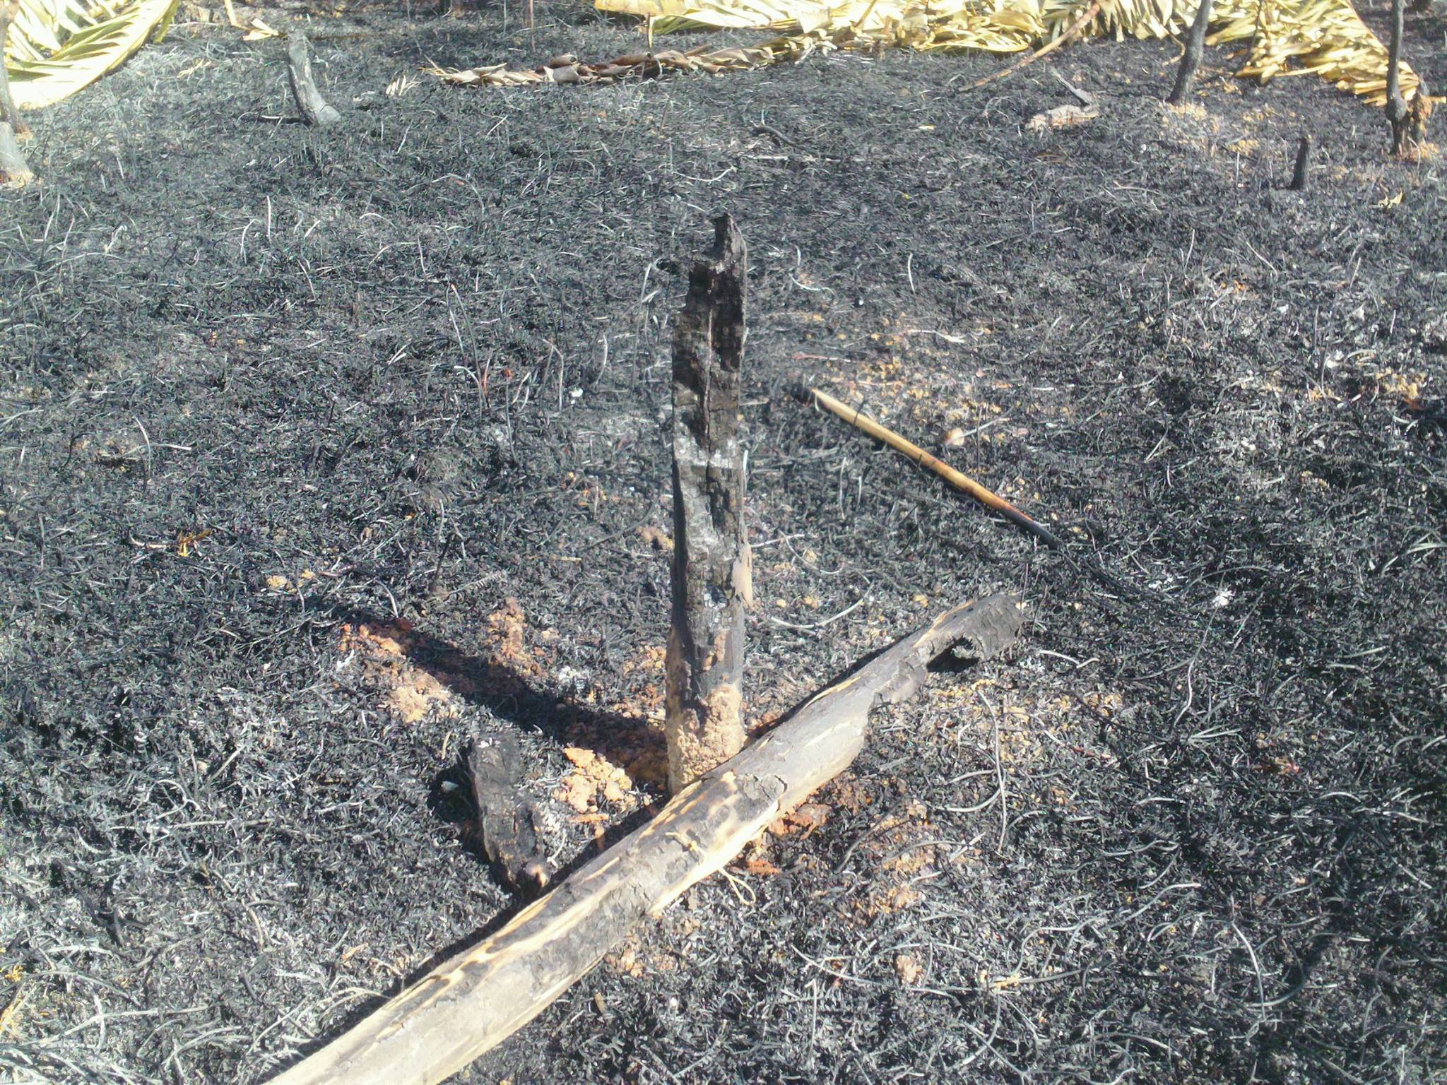

Slide 43
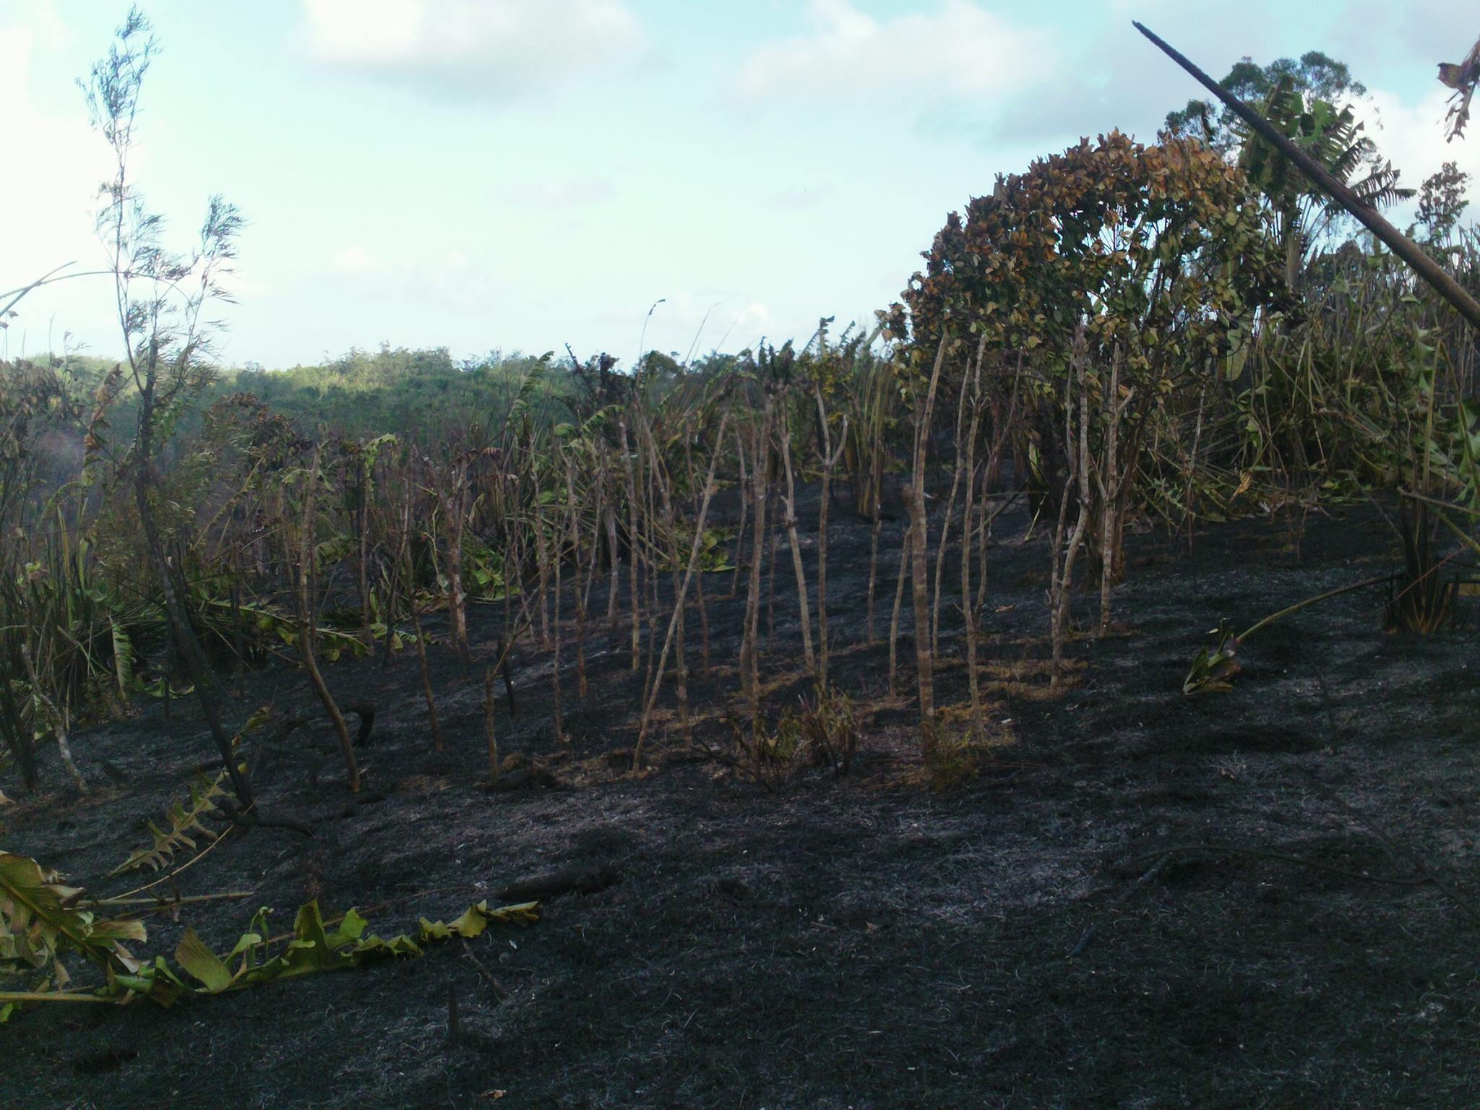

Slide 44
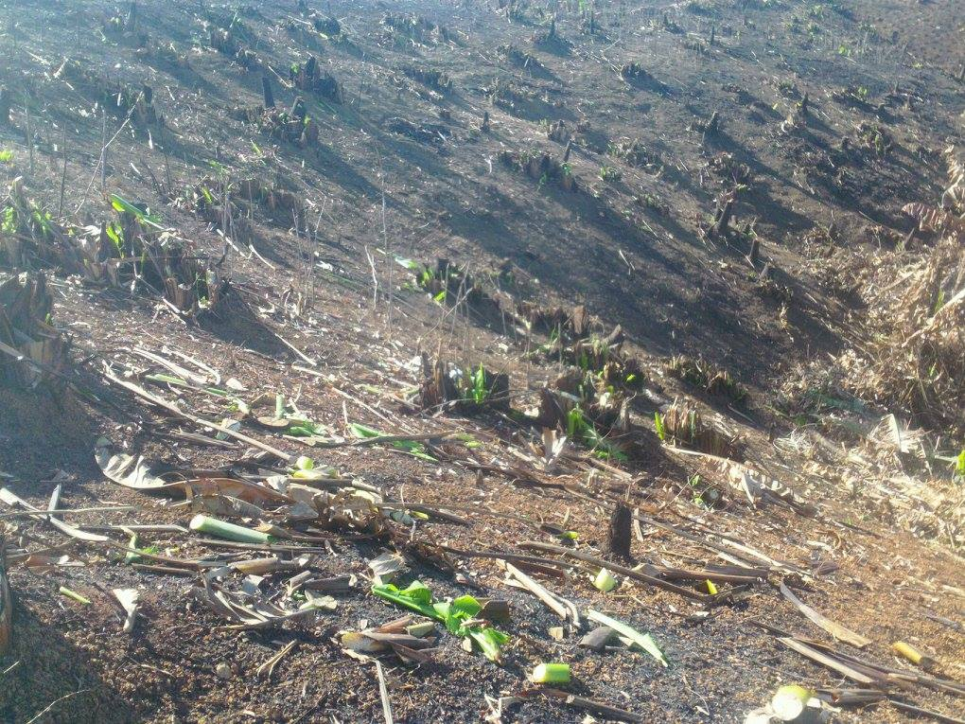
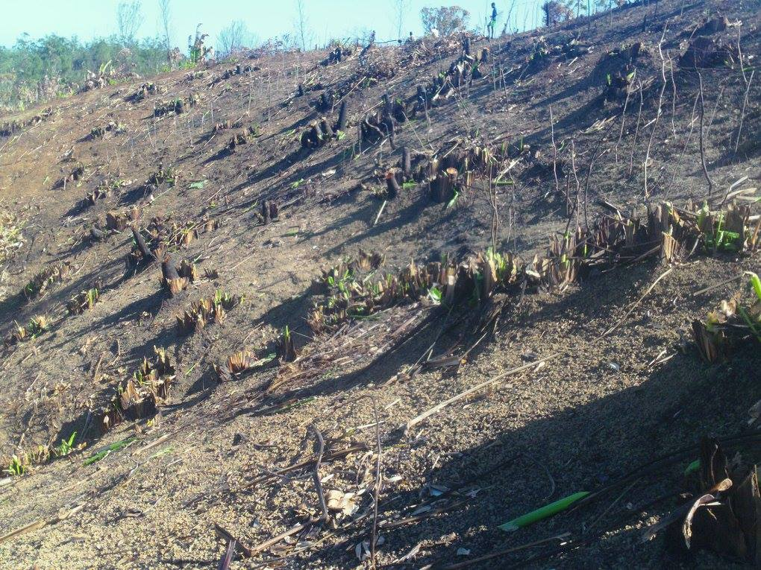

Slide 45
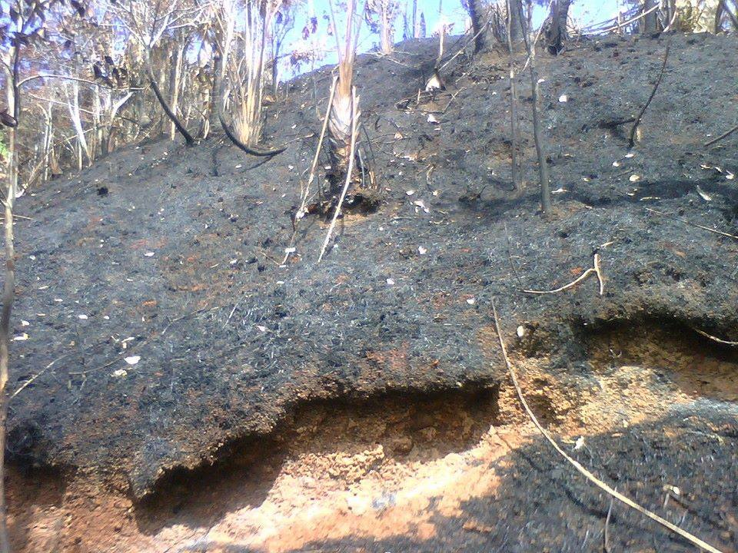

Slide 46
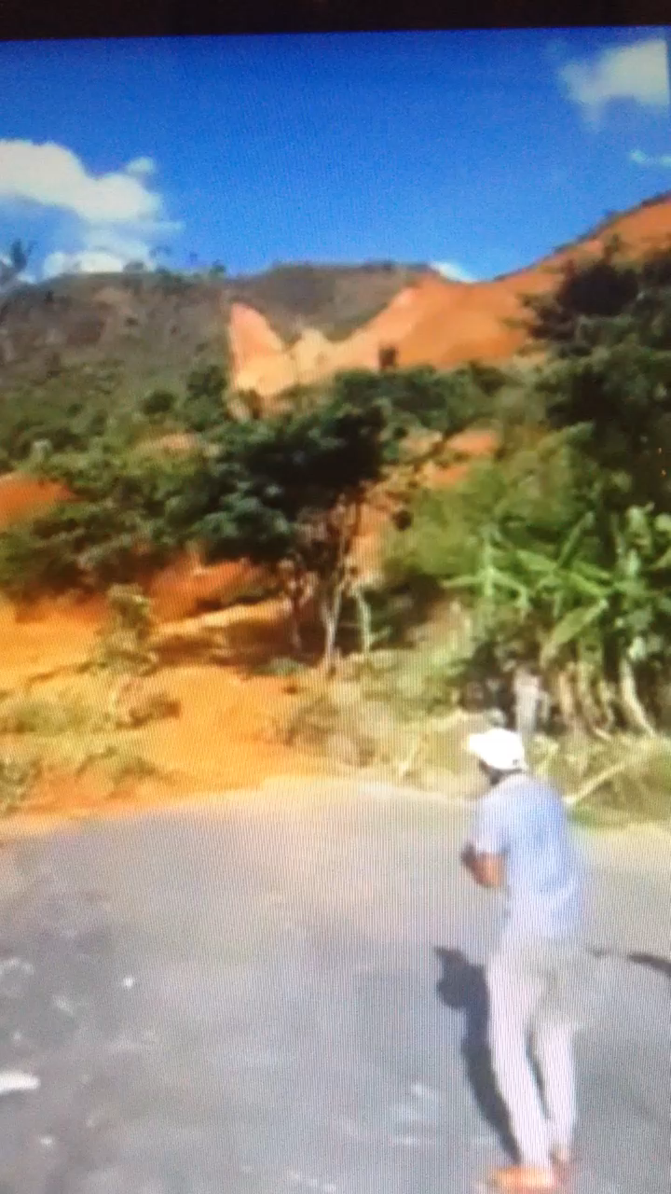

Slide 48
INVASIVE FERN
CATCH-22 !!!
WILDFIRE

Slide 49
INVASIVE FERN
ruderal suppression
+
fire survivors
WILDFIRE

Slide 50
148 collected
Discovering Essential Variables
46 candidates
18 primary
5 pre-fire
regressions
charts
graphs
calculated fields
ordinal logistic models
general linear models
3 post-fire

Slide 51
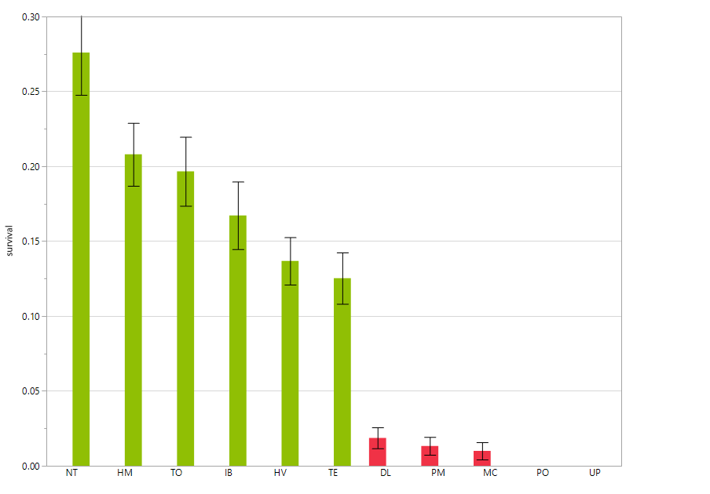
11 Malagasy Species Tested: 6 Survivor Species, 5 Perisher Species
Code | Group | Survival Rate | Lower 95-CI | Upper 95-CI
NT | Survive | 27.6% | 22.0% | 33.2%
HM | Survive | 20.8% | 16.7% | 24.9%
TO | Survive | 19.7% | 15.1% | 24.2%
IB | Survive | 16.7% | 12.3% | 21.2%
HV | Survive | 13.7% | 10.6% | 16.8%
TE | Survive | 12.5% | 9.2% | 15.9%
ALL |  | 9.5% | 8.6% | 10.4%
DL | Perish | 1.9% | 0.5% | 3.2%
PM | Perish | 1.3% | 0.0% | 2.5%
MC | Perish | 1.0% | 0.0% | 2.1%
PO | Perish | 0.0% | 0.0% | 0.0%
UP | Perish | 0.0% | 0.0% | 0.0%

Slide 52
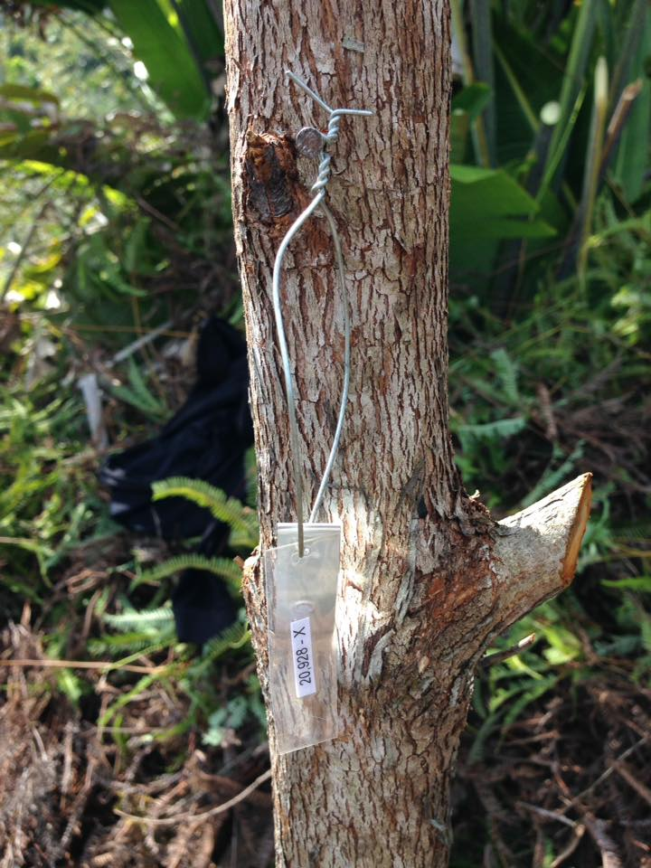
Intensity
Abiotic Factors
{0, 1, . . . , 6, 7}
Slash Charred
Duff Charred
Plastic Ticket Melted
Plastic Ticket Charred
Stake Scorched
Stake Charred
Metal Ticket Ashes
Severity
Biotic Factors
{0, 1, 2, 3, 4}
Leaves Scorched
Leaves Charred
Stem Scorched
Stem Charred
Frelich: FNRM-5203 (Fire Ecology)
Notes:
30 min mark

Slide 53
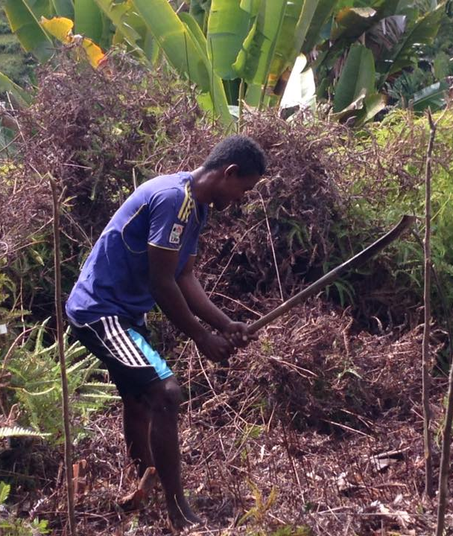
Intensity
Abiotic Factors
{0, 1, . . . , 6, 7}
Slash Charred
Duff Charred
Plastic Ticket Melted
Plastic Ticket Charred
Stake Scorched
Stake Charred
Metal Ticket Ashes
Severity
Biotic Factors
{0, 1, 2, 3, 4}
Leaves Scorched
Leaves Charred
Stem Scorched
Stem Charred

Slide 54
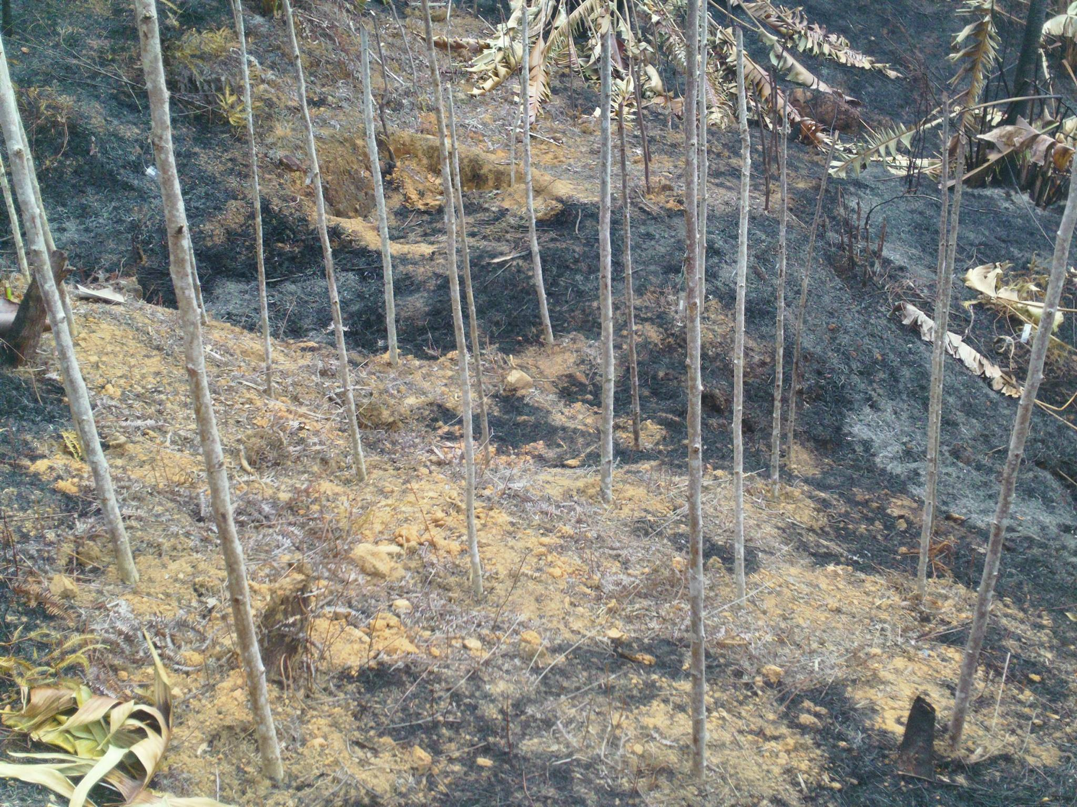
Intensity
Abiotic Factors
{0, 1, . . . , 6, 7}
Slash Charred
Duff Charred
Plastic Ticket Melted
Plastic Ticket Charred
Stake Scorched
Stake Charred
Metal Ticket Ashes
Severity
Biotic Factors
{0, 1, 2, 3, 4}
Leaves Scorched
Leaves Charred
Stem Scorched
Stem Charred

Slide 55
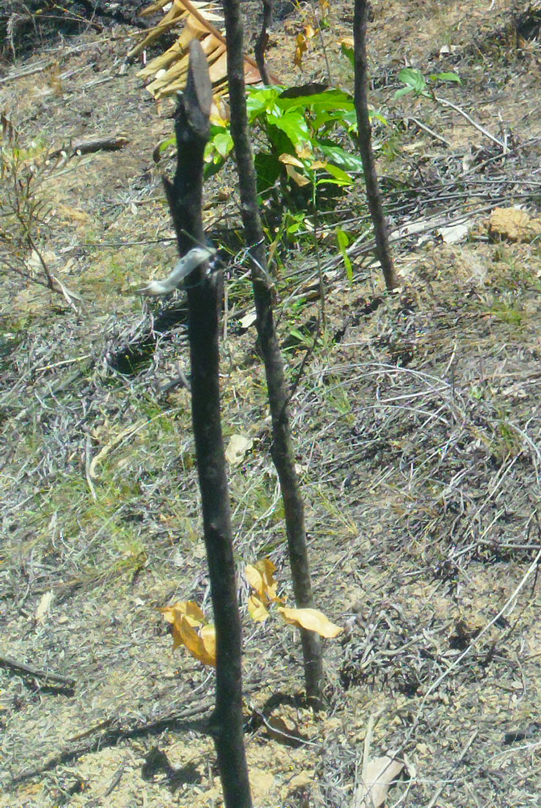
Intensity
Abiotic Factors
{0, 1, . . . , 6, 7}
Slash Charred
Duff Charred
Plastic Ticket Melted
Plastic Ticket Charred
Stake Scorched
Stake Charred
Metal Ticket Ashes
Severity
Biotic Factors
{0, 1, 2, 3, 4}
Leaves Scorched
Leaves Charred
Stem Scorched
Stem Charred

Slide 56
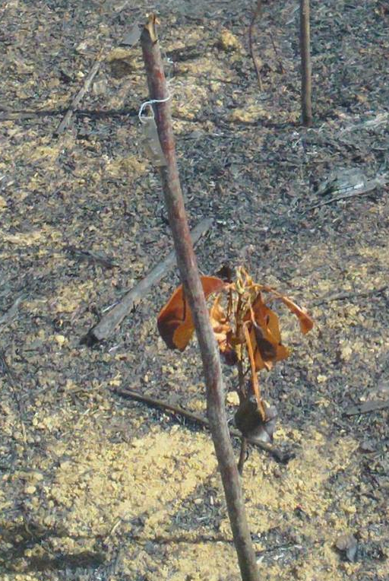
Intensity
Abiotic Factors
{0, 1, . . . , 6, 7}
Slash Charred
Duff Charred
Plastic Ticket Melted
Plastic Ticket Charred
Stake Scorched
Stake Charred
Metal Ticket Ashes
Severity
Biotic Factors
{0, 1, 2, 3, 4}
Leaves Scorched
Leaves Charred
Stem Scorched
Stem Charred

Slide 57
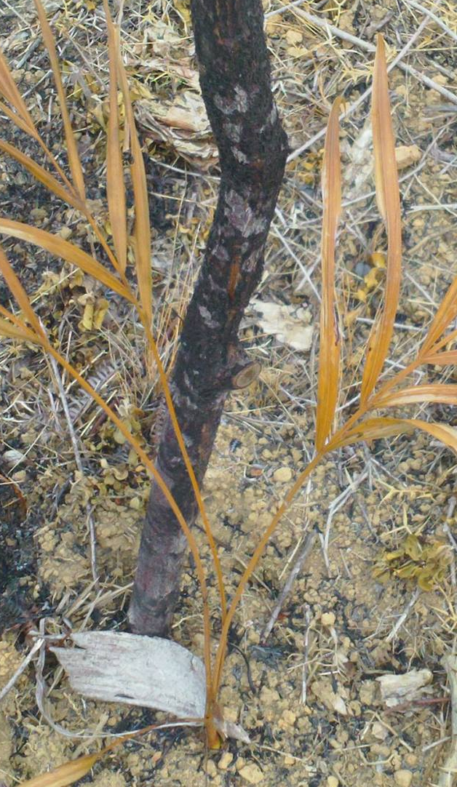
Intensity
Abiotic Factors
{0, 1, . . . , 6, 7}
Slash Charred
Duff Charred
Plastic Ticket Melted
Plastic Ticket Charred
Stake Scorched
Stake Charred
Metal Ticket Ashes
Severity
Biotic Factors
{0, 1, 2, 3, 4}
Leaves Scorched
Leaves Charred
Stem Scorched
Stem Charred

Slide 58
Intensity
Abiotic Factors
{0, 1, . . . , 6, 7}
Slash Charred
Duff Charred
Plastic Ticket Melted
Plastic Ticket Charred
Stake Scorched
Stake Charred
Metal Ticket Ashes
Severity
Biotic Factors
{0, 1, 2, 3, 4}
Leaves Scorched
Leaves Charred
Stem Scorched
Stem Charred

Slide 59
Intensity
Abiotic Factors
{0, 1, . . . , 6, 7}
Slash Charred
Duff Charred
Plastic Ticket Melted
Plastic Ticket Charred
Stake Scorched
Stake Charred
Metal Ticket Ashes
Severity
Biotic Factors
{0, 1, 2, 3, 4}
Leaves Scorched
Leaves Charred
Stem Scorched
Stem Charred

Slide 60
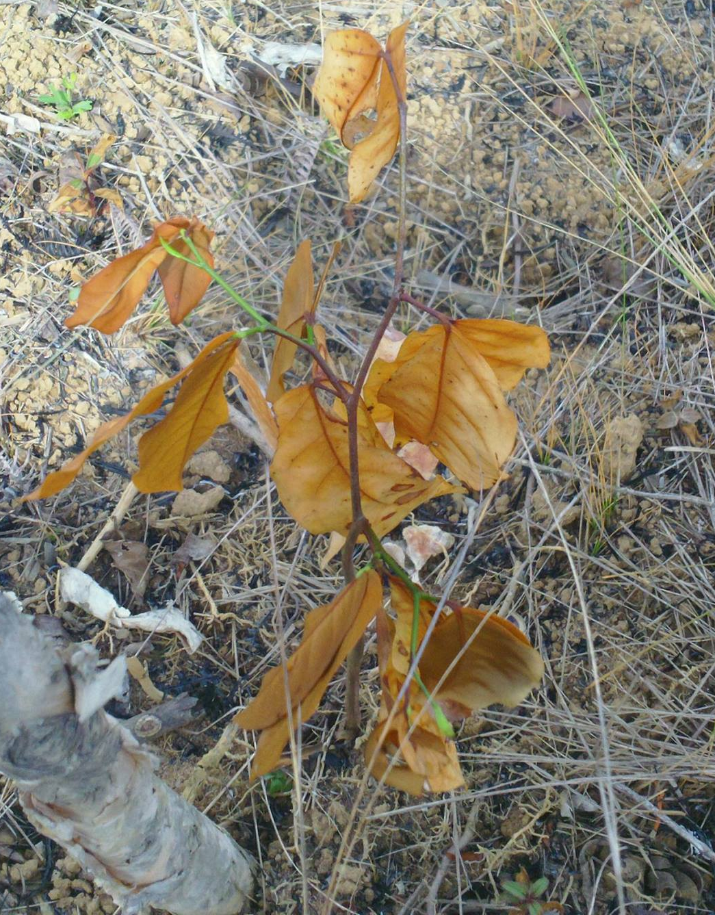
Intensity
Abiotic Factors
{0, 1, . . . , 6, 7}
Slash Charred
Duff Charred
Plastic Ticket Melted
Plastic Ticket Charred
Stake Scorched
Stake Charred
Metal Ticket Ashes
Severity
Biotic Factors
{0, 1, 2, 3, 4}
Leaves Scorched
Leaves Charred
Stem Scorched
Stem Charred

Slide 61
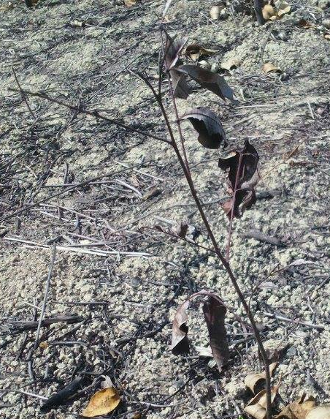
Intensity
Abiotic Factors
{0, 1, . . . , 6, 7}
Slash Charred
Duff Charred
Plastic Ticket Melted
Plastic Ticket Charred
Stake Scorched
Stake Charred
Metal Ticket Ashes
Severity
Biotic Factors
{0, 1, 2, 3, 4}
Leaves Scorched
Leaves Charred
Stem Scorched
Stem Charred

Slide 62
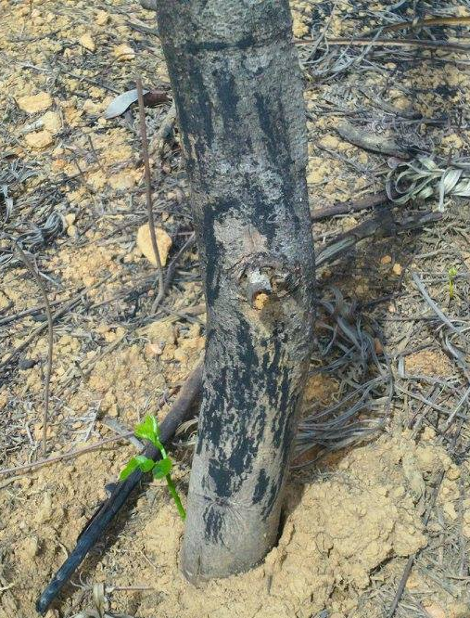
Intensity
Abiotic Factors
{0, 1, . . . , 6, 7}
Slash Charred
Duff Charred
Plastic Ticket Melted
Plastic Ticket Charred
Stake Scorched
Stake Charred
Metal Ticket Ashes
Severity
Biotic Factors
{0, 1, 2, 3, 4}
Leaves Scorched
Leaves Charred
Stem Scorched
Stem Charred

Slide 63
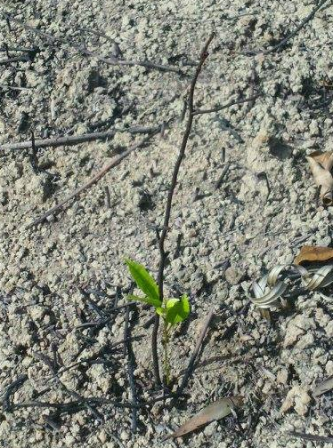
Intensity
Abiotic Factors
{0, 1, . . . , 6, 7}
Slash Charred
Duff Charred
Plastic Ticket Melted
Plastic Ticket Charred
Stake Scorched
Stake Charred
Metal Ticket Ashes
Severity
Biotic Factors
{0, 1, 2, 3, 4}
Leaves Scorched
Leaves Charred
Stem Scorched
Stem Charred

Slide 64
3 Ways to Survive: Retardant Resistant Resilient

Slide 65
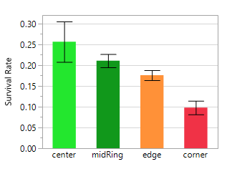
3 Ways to Survive: Retardant Resistant Resilient
5 | corner | edge | edge | edge | corner
4 | edge | ring | ring | ring | edge
3 | edge | ring | center | ring | edge
2 | edge | ring | ring | ring | edge
1 | corner | edge | edge | edge | corner
 | 1 | 2 | 3 | 4 | 5
 |  | intensity
5 | 3.6 | 3.2 | 3.1 | 3.3 | 3.8
4 | 3.4 | 2.7 | 2.6 | 2.8 | 3.5
3 | 3.5 | 2.8 | 2.8 | 2.7 | 3.6
2 | 3.8 | 3.2 | 3.0 | 3.1 | 3.8
1 | 4.3 | 4.0 | 3.8 | 3.9 | 4.4
 | 1 | 2 | 3 | 4 | 5

Slide 66
3 Ways to Survive: Retardant Resistant Resilient
Retardance : “How much does it cool the fire down?”
retardance = 1 – [ center / mean(corners) ]

Slide 67

3 Ways to Survive: Retardant Resistant Resilient
Macaranga spp cooled the fire down 17%
Intsia Bijuga cooled the fire down 34%
Common Name | Mean Time of Individual Combusition (sec) | Mean Loss of Mass (%)
Scots Pine | 127 | 83.1
English Oak | 142 | 76.9
Merbau | 8 | 3.7
“Merbau wood (Intsia sp.) belongs to hardly ignitable and hardly combustible materials on the basis of mean loss of mass and its time of individual combustion, i.e. 3.7% and 8s, respectively.”
Monder et al. 2009 (Faculty of Wood Technology, Warsaw University of Life Sciences)
Notes:
How long does it take to catch on fire in the first place???
“The Shorea was observed to be most flammable, exhibiting ignition at 120 sec while the Southern pine was least flammable, exhibiting ignition at 225 sec. No established flame was developed on the Merbau even with 60 min exposure (3,600 seconds).” (2 min Shorea; 3.5 min Pine)
Qingfeng Xu et al. 2015 Combustion and charring properties of five common constructional wood species from cone calorimeter tests

Slide 68
3 Ways to Survive: Retardant Resistant Resilient
Resist(4) := mean(severity) following 4-intensity heat from the fire
Intensity
Abiotic Factors
{0, 1, . . . , 6, 7}
Slash Charred
Duff Charred
Plastic Ticket Melted
Plastic Ticket Charred
Stake Scorched
Stake Charred
Metal Ticket Ashes
Severity
Biotic Factors
{0, 1, 2, 3, 4}
Leaves Scorched
Leaves Charred
Stem Scorched
Stem Charred

Slide 69


3 Ways to Survive: Retardant Resistant Resilient
Terminalia mantaly suffered 1.89 severity
Parkia madagascariensis suffered 3.33 severity
“Leaf flammability was significantly correlated with all measures of leaf size... …such that larger leaves were faster to ignite.”
Murray et al. 2013 (University of Technology Sydney, Australia)

Slide 70
3 Ways to Survive: Retardant Resistant Resilient
Resilience(2) := survival rates following 2-severity damage from the fire

Slide 71

3 Ways to Survive: Retardant Resistant Resilient
Harungana 13.5% survival rate
severity-2 fire
survival rate of 3.8% across all 11 species
“The secondary afforestation mainly begins with Harungana madagascariensis bushes, which are highly resistant to fire and trampling as well as having high regeneration capacities; their destruction exceeds the graziers’ capacities and would require a special program”
Hurault 1998
(Institut Geographique National Saint-Mande, France)

Slide 72


ruderal suppression
fire survival
www.GreenAgainMadagascar.org

Slide 73
Ambonivato village
Project 2016
Rice
Fields
Rice
Fields

Slide 74
Ambonivato village
Project 2016
Rice
Fields
Rice
Fields
Notes:
retardant green around rice fields
resistant blue hedgerow
resilient yellow along footpath

Slide 75

Acknowledgments
Advisor:
Rebecca Montgomery UMN
Committee:
Lee Frelich UMN
Jennifer Powers UMN
Leighton Reid MOBOT
Green-Again Captains:
Catherine
Marselain
Francia
Berto
Malagasy Land-Owners:
Beravo
Jean-Francois
Special Thanks:
Nirina Gladys Hill
;-)
www.GreenAgainMadagascar.org
Notes:
Change picture to high-res

