Slide 1
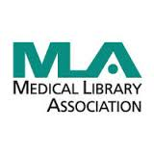
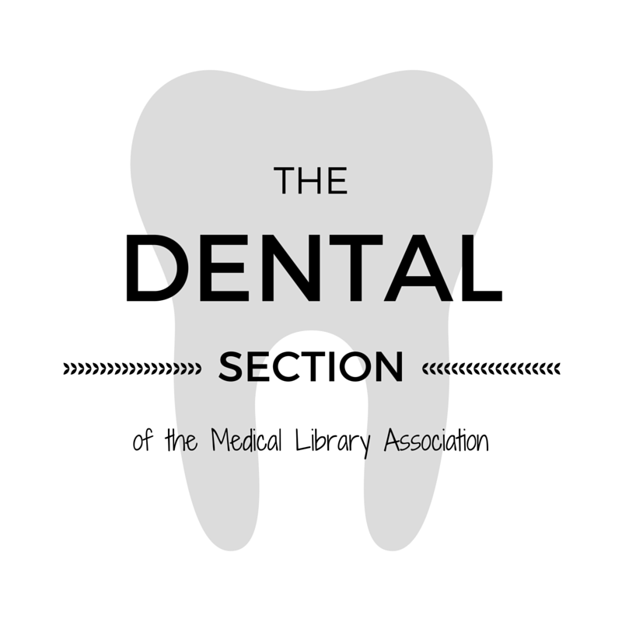
A Comprehensive Summary of Services and Resources Provided by Librarians in Support of CODA Accredited Predoctoral (DDS/DMD) Dental Education Programs in the United States and Canada
Elizabeth Stellrecht, MLS; Richard McGowan, MLS; Irene M. Lubker, MLS, MPH, RD, PhD(C); Nena Schvaneveldt, MSLIS, AHIP; Susan Arnold, MS, MLIS, AHIP, RD;
Elisa Cortez, MILS; Rebecca O. Davis, PhD, MSIS; Michael Kronenfeld, MLS, MBA, AHIP, FMLA; Nicole Theis-Mahon, MLIS
Objective
The objective of this study is to provide a summary of library services and resources that support dental education and research. This summary will demonstrate trends in dental librarianship as well as services and resources that can be adopted to serve the needs of dental related education programs. To date, there has not been a comprehensive summary of these services.
Methods
An environmental scan was carried out to take inventory of services that dental librarians (1) provide. The study population consisted of librarians who work in dental libraries or college / university libraries that serve dental programs. The librarians surveyed were from institutions with a CODA accredited DMD/DDS pre-doctoral program (2). Currently, there are 76 such programs within the United States and Canada, of which 71 responded.
Conclusion
Our data demonstrates that the majority of dental programs have a dedicated librarian or library liaison providing clinical, educational, and research support through a variety of approaches. Increasing awareness and utilization of available services and resources within the dental community can facilitate research and complement dental education. The service models cited here can be adapted in dental related education programs across North America.
Results
93% of the librarians surveyed have a dedicated Dental Librarian or multiple librarians assigned to Departments within the College of Dentistry.
90% of responders offer literature search services to faculty, staff, students, residents and fellows. 90% of those offering literature search services do so for free, the others charge small fees or request article authorship credit for larger, systematic searches.
86% of librarians surveyed actively participate in systematic reviews by creating and conducting searches.
45% feature an official Systematic Review support program, system, or service at the library.
41% of librarians surveyed have coauthored publications with College of Dentistry faculty, students or researchers
92% offer delivery services for books or articles not available from the institution (Interlibrary Loan). Of those with this service, 86% require no fee, the rest charge a small recovery fee or have limits.
70% of libraries have assisted in the accreditation process.
30% support the IRB submission process beyond basic services such as database access and article delivery.
80% provide access to citation management programs such as EndNote, Mendeley, RefWorks, or Papers for free, another 15% provide access with some sort of discount.
95% provide formal workshop/classroom instruction, individual instruction, or both, on the use of those citation management programs.
Results
Other Services Provided by Librarians and Libraries
Inform and assist with scholarly communication and open access initiatives.
Create a personal library for faculty papers in an institutional repository.
Assist with cited reference searching for Promotion and Tenure.
Conduct information sessions about research data management and research best practices.
Literature Searching for annual faculty publications reports.
Develop clinical apps that provide resources in the dental clinic.
Design and create credit-bearing continuing education courses for faculty.
*In-class instruction is defined as a guest appearance in a course. Course instruction is defined as teaching or co-teaching an entire credit-bearing course.
References
Dental Section of the Medical Library Association at http://www.mlanet.org/p/cm/ld/fid=524
CODA-accredited list of United States dental and dental-related education programs and Commission on Dental Accreditation of Canada list of Canadian programs at www.ada.org/en/coda/find-a-program/

