Slide 1

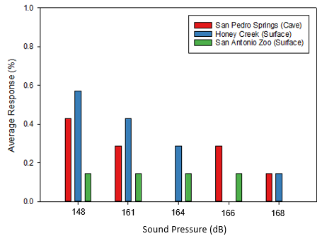
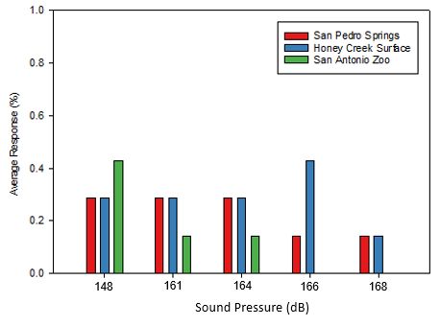
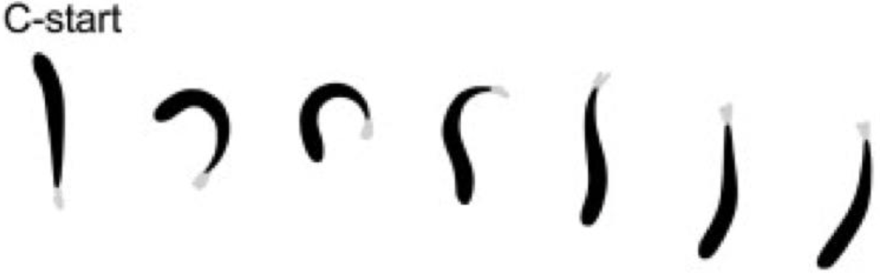
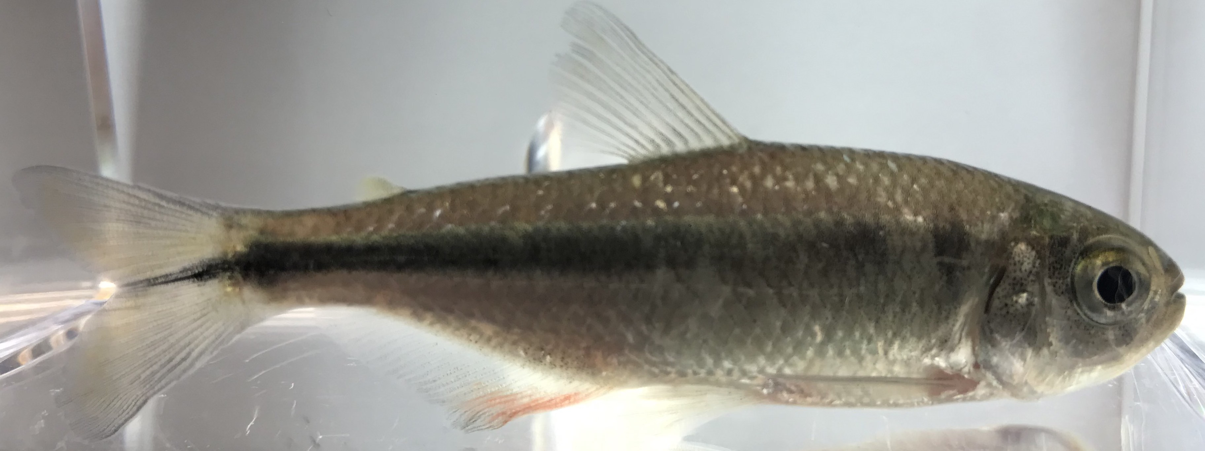
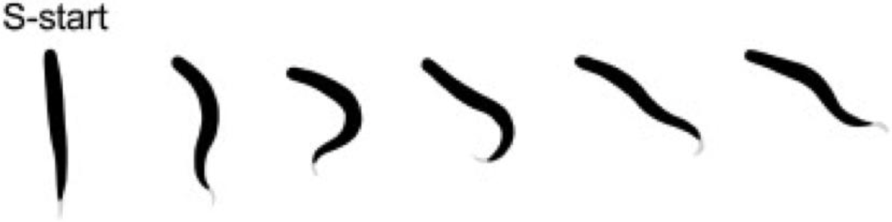

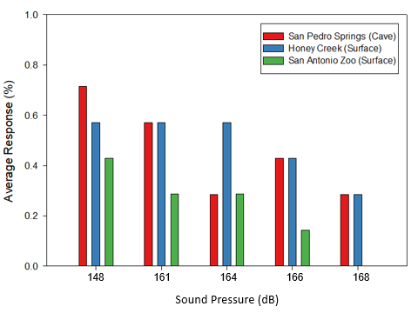
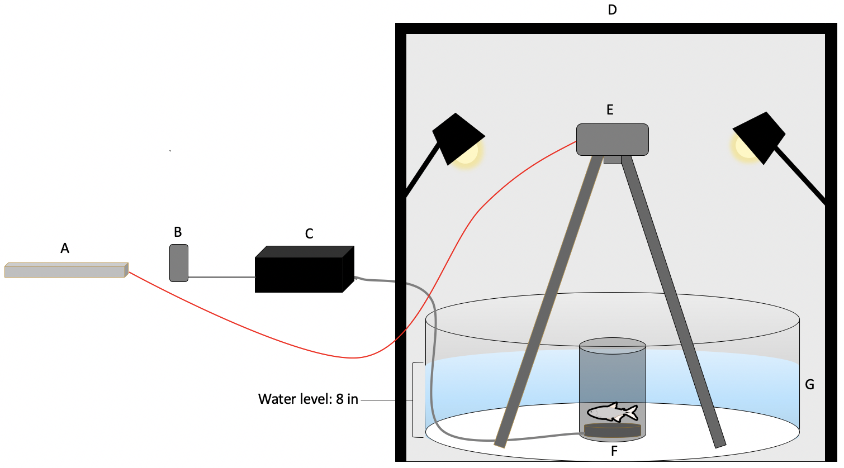
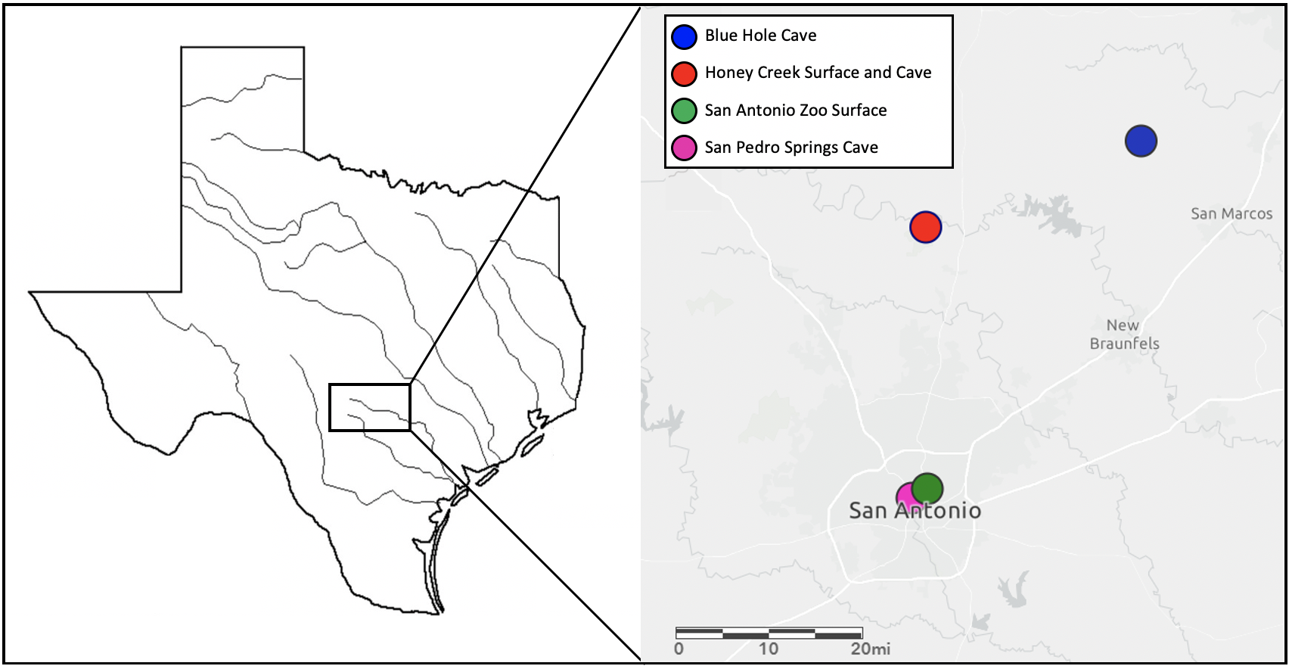
Behavioral differences in sound detection in recently diverged cave and surface forms of Astyanax mexicanus
Amanda R. Kistner, Maya S. Enriquez, Noland O. Michels & Allen F. Mensinger,
Biology Department, University of Minnesota, Duluth
Introduction
Hypothesis
Results
Conclusion
Astyanax mexicanus, commonly called the Mexican tetra, inhabits both surface streams and cave systems. Distinct troglomorphic characteristics, such as the loss of eyes and pigmentation, have developed in populations inhabiting caves over several million years. These environmentally induced changes has resulted in , A. mexicanus has become a powerful model in evolutionary research (Gross, 2012). Approximately 100 years ago, A.mexicanus was introduced to a Texas aquifer, and several populations diverged into caves and surface streams. Recent research shows evidence of rapid evolutionary change in these satellite cave populations in traits such as coloration, feeding, and wall-following that are consistent with the native cave populations (McGaugh et al., 2020).
Previous work examined sensory adaptations between the surface and cave forms of A. mexicanus, and changes in hearing sensitivity as a result of environmental changes is of particular interest (Popper, 1970). Auditory evoked potentials (AEPs) provide quick screening tools to determine auditory sensitivity however because the responses of large population of sensory cells measure the action potential summation, they are insufficient to determine the hearing sensitivity. Assessing escape responses to sound such as the C-start (Kimmel et al., 1974 is a more sensitive measure to determine sound detection thresholds. Previous AEP studies have determined the frequency sensitivity of the fish which provided the foundation to compare auditory sensitivity sensitivities in three recently diverged cave and surface populations using a behavioral audiogram protocol.
Using recently collected AEP data from the Mensinger lab, I hypothesize that the cave and surface forms of A. mexicanus will demonstrate behavioral differences to sound, as exhibited by the C-start and S-start response, similar to the trends in the AEP data, where both cave and surface forms are most sensitive between 0.1 kHz and 0.5 kHz and least sensitive at 1.0 kHz and higher.
No significant differences in C-start, S-start, or combined average percent of responses were found between populations.
All populations exhibited a response at the initial intensity level
The high variability in responses may be due to differences in populations including behavioral differences and/or the environmental soundscape
Some populations seem to be more responsive than others, i.e. San Pedro Springs (cave) and Honey Creek (surface) had more C-starts and S-starts in response to sound stimulus.
The response curves suggest possible habituation to the sound stimulus.
Methods
Fish from San Antonio Zoo (n=7), San Pedro Springs (n=7) and Honey Creek (n=7) were tested individually in a 50 gallon tank filled to a water level of 20 centimeters from the top of the gravel.
Fish were acclimated in the experimental chamber (Figure 4) for 20 minutes prior to the experiment, then presented with a pure tone frequency of 0.5 kHz at five different intensities with 5 minutes in between each stimulus presentation.
C-starts and S-starts (Figure 3) were quantified using an 8 GB RAM HHC X4 Mega Speed camera at 500 fps. C-starts and S-starts were counted when they occurred under 200 ms and assessed via visual inspection.
Sound pressure values were determined using an HTI hydrophone.
One-way ANOVA was used to determined statistical difference in C-start and S-start, and combined occurrence between populations
Future Directions
Figure 5. Average percentage of C-start responses at 5 different volume levels
The populations studied will be retested using an amplifier with a more sensitive volume control in order to determine actual hearing thresholds.
Native surface and cave populations will be assessed in order to compare to satellite populations
A more thorough quantification of startle responses will be used, such as measuring the angle of the fish’s body during a C-start, coupling video with the stimulus to measure latencies, etc.
EthoVision video tracking software may be used to better quantify partial startle responses
References
Figure 3. Diagram of a C-start and S-start (Hale, 2002).
Figure 6. Average percentage of S-start responses at 5 different volume levels.
Gross, J. B. (2012). The complex origin of Astyanax cavefish. BMC Evolutionary Biology, 12(1), 105. https://doi.org/10.1186/1471-2148-12-105
Kimmel, C. B., Patterson, J., & Kimmel, R. O. (1974). The development and behavioral characteristics of the startle response in the zebrafish. Developmental Psychobiology, 7(1), 47-60. https://doi.org/10.1002/dev.420070109
McGaugh, S. E., Weaver, S., Gilbertson, E. N., Garrett, B., Rudeen, M. L., Grieb, S., Roberts, J., Donny, A., Marchetto, P., & Gluesenkamp, A. G. (2020). Evidence for rapid phenotypic and behavioral change in a recently established cavefish population.
Popper, A. N. (1970). Auditory capacities of the Mexican blind cave fish (Astyanax jordani) and its eyed ancestor (Astyanax mexicanus). Animal Behaviour, 18, 552-562. https://doi.org/10.1016/0003-3472(70)90052-7
cm
Figure 1. The Mexican Tetra
Figure 4. Schematic of experimental chamber. From left to right: (A) Laptop with camera control, (B) MP3 player, (C) Speco Tech amplifier, (D) Iron frame (110 cm x 125 cm x 182 cm) fitted with foam insulation surround the op and three sides, (E) high speed camera, (F) underwater speaker, (G) 50 gal tank.
Acknowledgements
Thank you to the Mensinger lab for their support and Dr. Mensinger for his advisement. Thank you to Rosalyn L. Putland and Brooke J. Vetter for advice on acoustics. We would like to acknowledge the University of Minnesota Duluth UROP program for funding.
Figure 2. Map of locations of satellite populations in Texas
Figure 7. Average percentage of both C-start and S-start responses at 5 different volume levels

