Slide 1
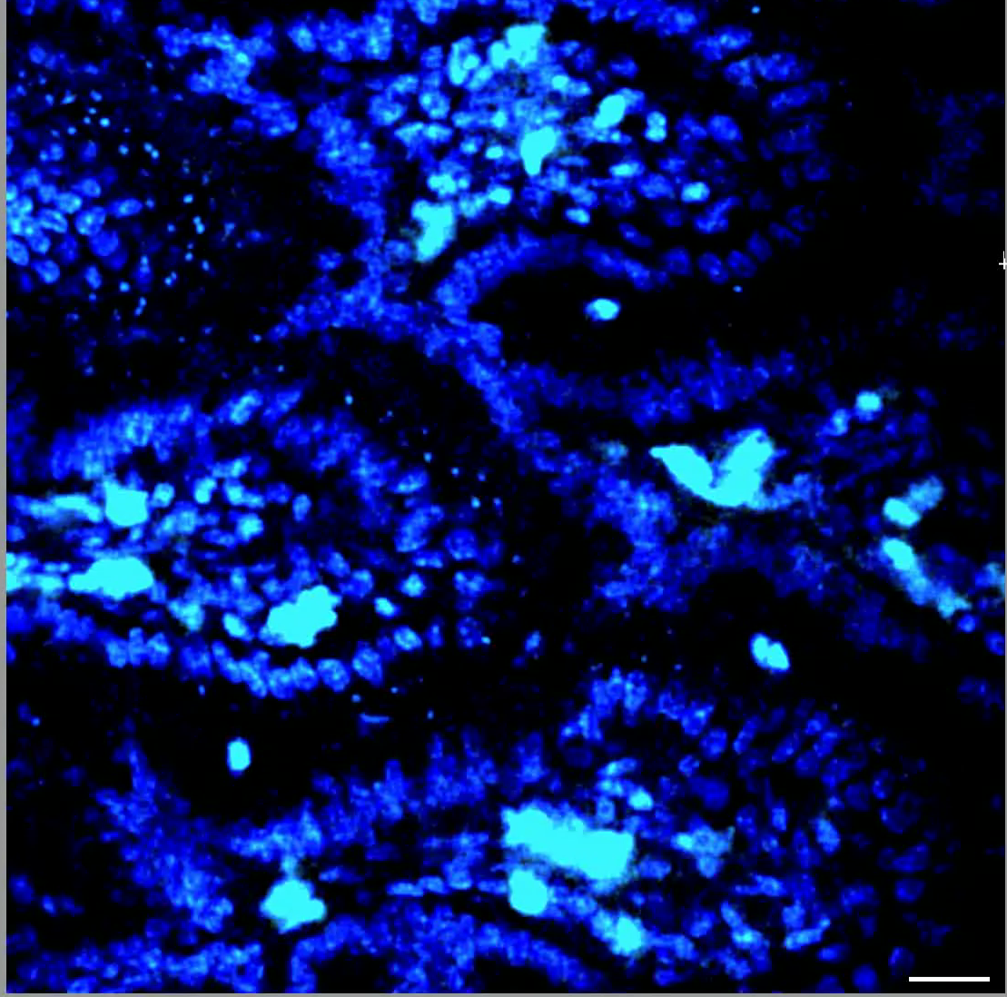
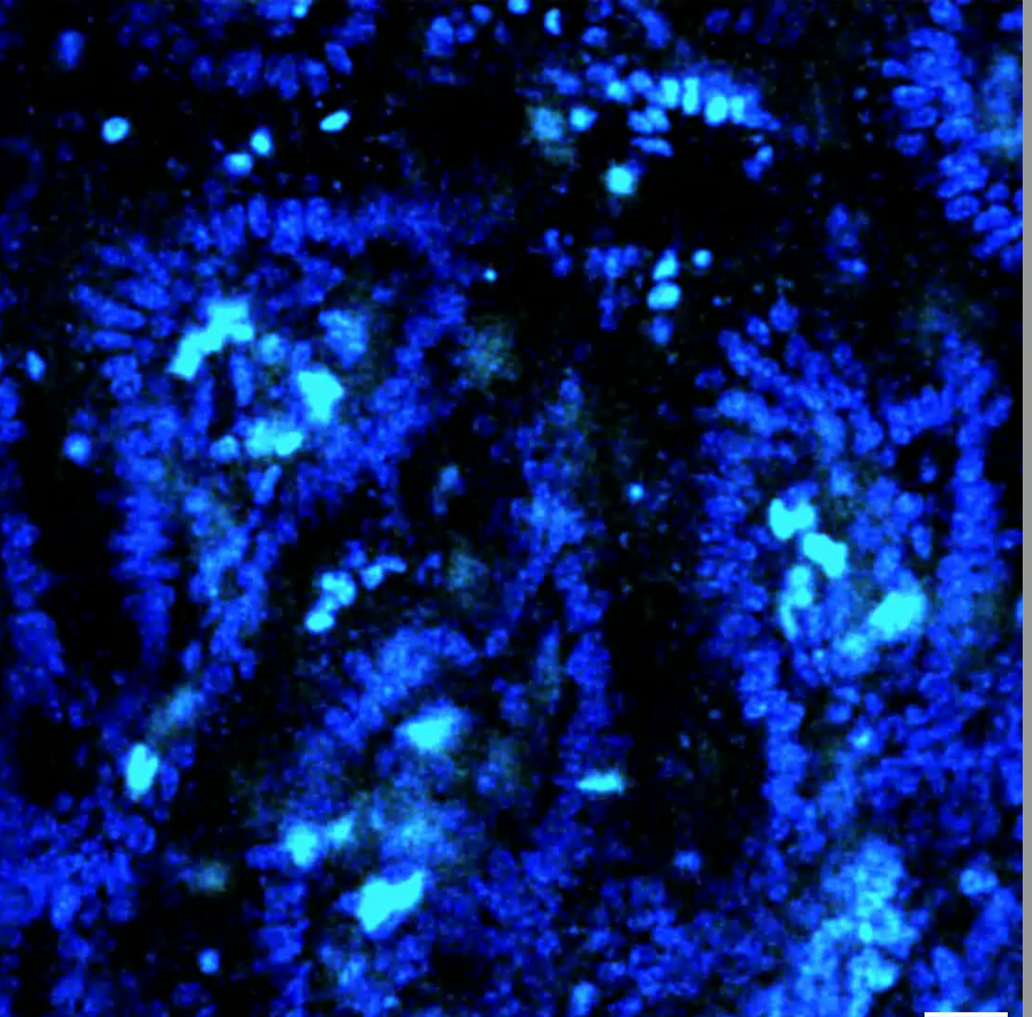
3.1 P14-GFP CD8⁺ T cell motility at days 5 and 8 after LCMV
Day 5
Day 8
P14-GFP Hoescht

Slide 2
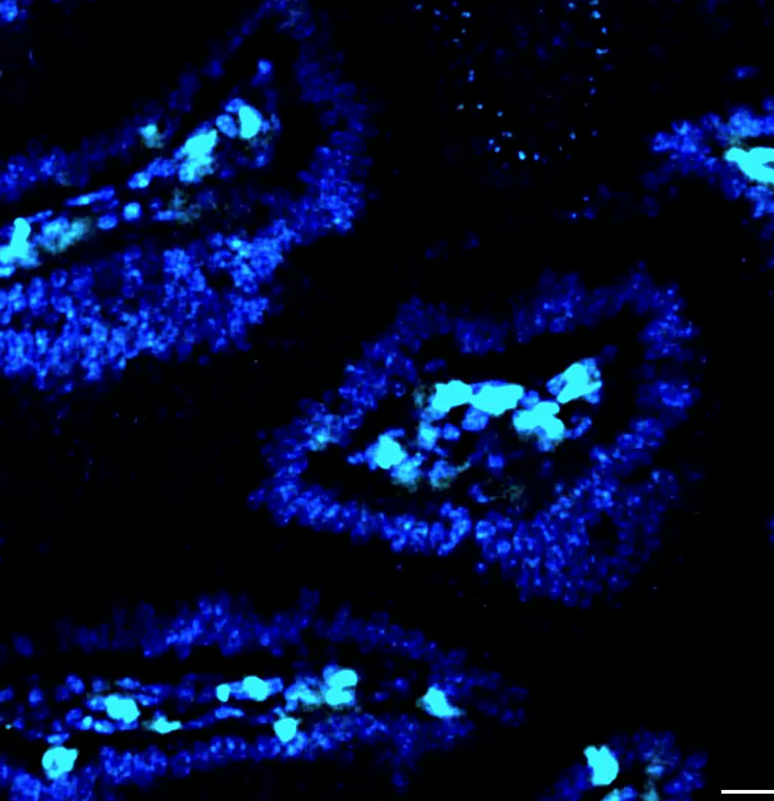
3.2 P14-GFP CD8⁺ T cell motility at day 30 after LCMV
P14-GFP Hoescht

Slide 3
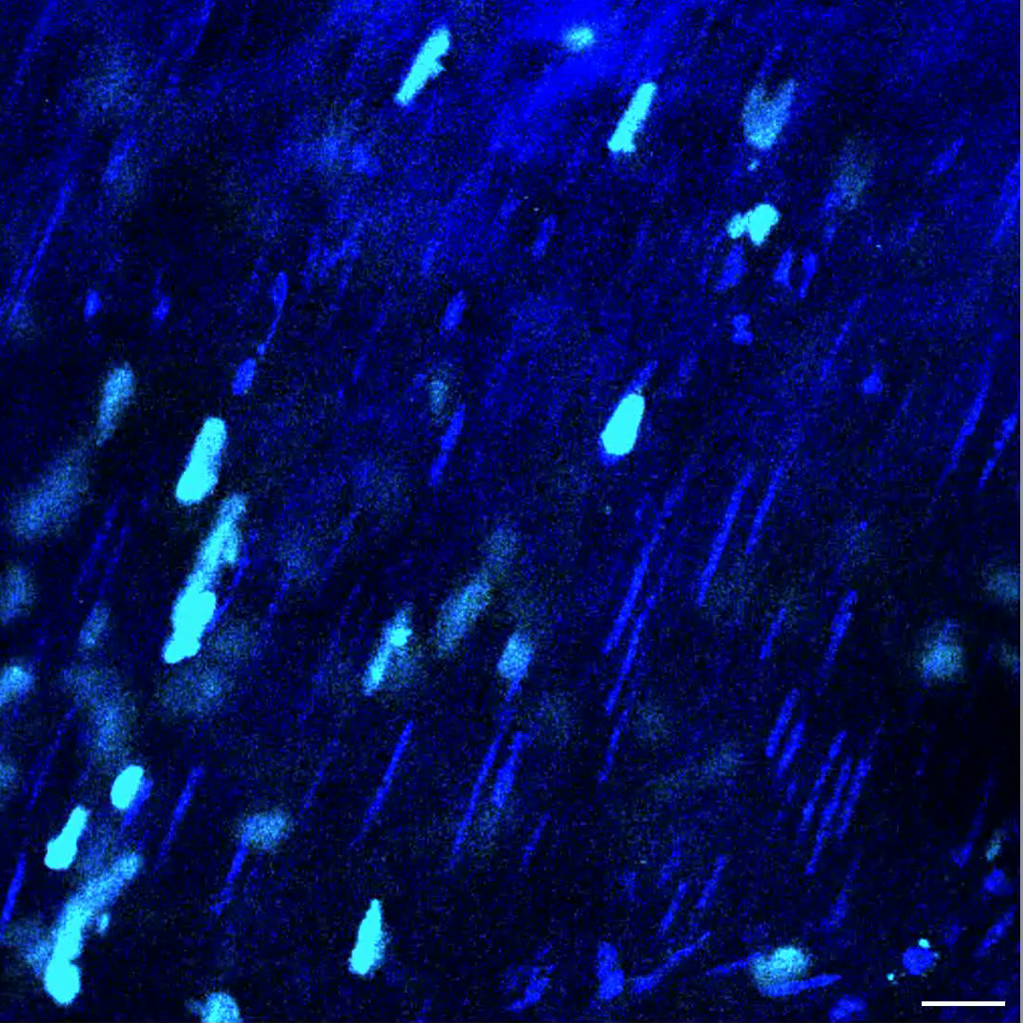
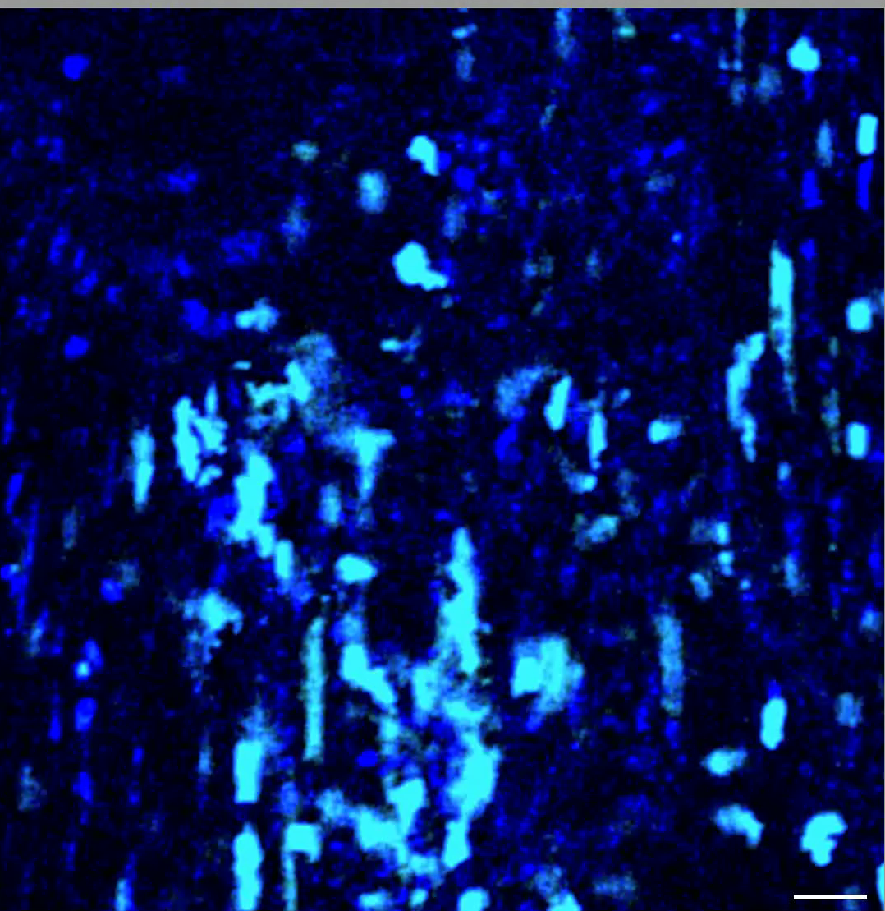
3.3 P14-GFP CD8⁺ T cell motility in small intestine longitudinal muscle
Day 5
Day 8
P14-GFP Hoescht

Slide 4
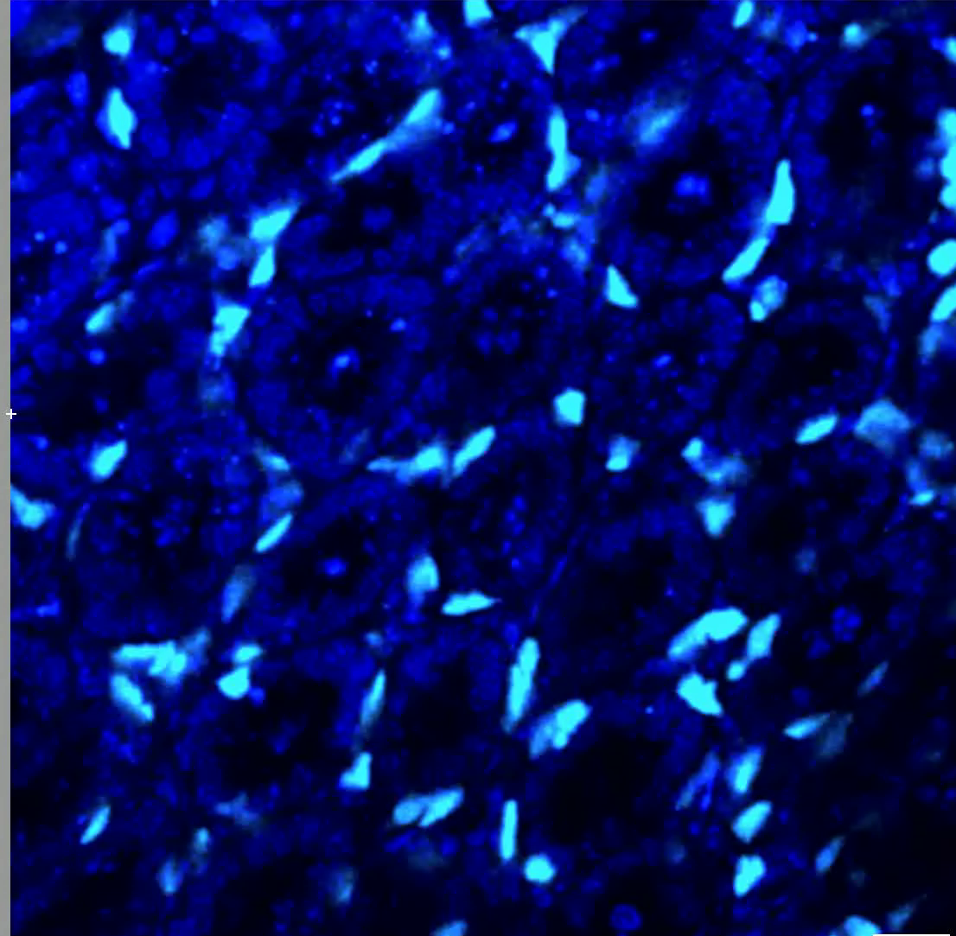
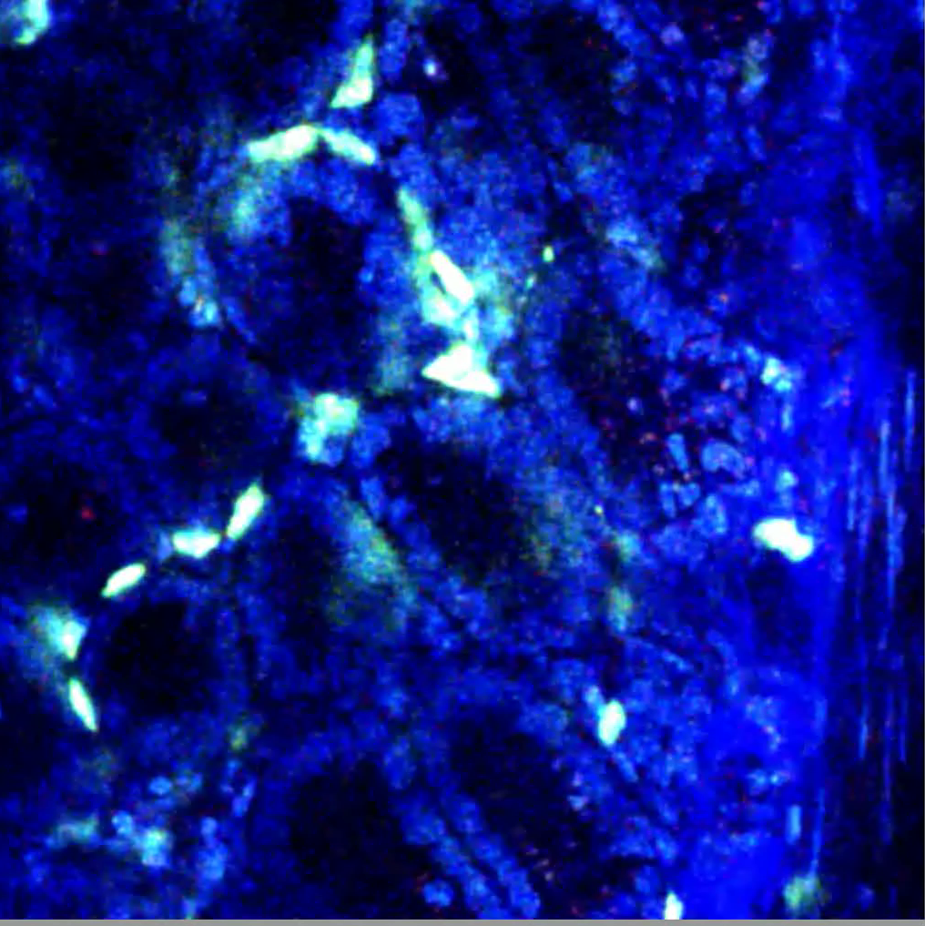
3.4 P14-GFP CD8⁺ T cell motility in the small intestine crypts
Day 5
Day 8
P14-GFP Hoescht
Notes:
3.4 P14-GFP CD8⁺ T cell motility in small intestine crypts. Naïve P14-GFP CD8⁺ T cells (cyan) were transferred to B6 mice and infected with LCMV 1 day later. A piece of jejunum was excised (see methods) and imaged in the crypt at days 5 (left) and 8 (right) after LCMV. Hoescht stain (blue) was injected 1 hour prior to imaging to visualize intestinal architecture. Day 5 scale bar is 30um where day 8 scale bar is 20um.

Slide 5
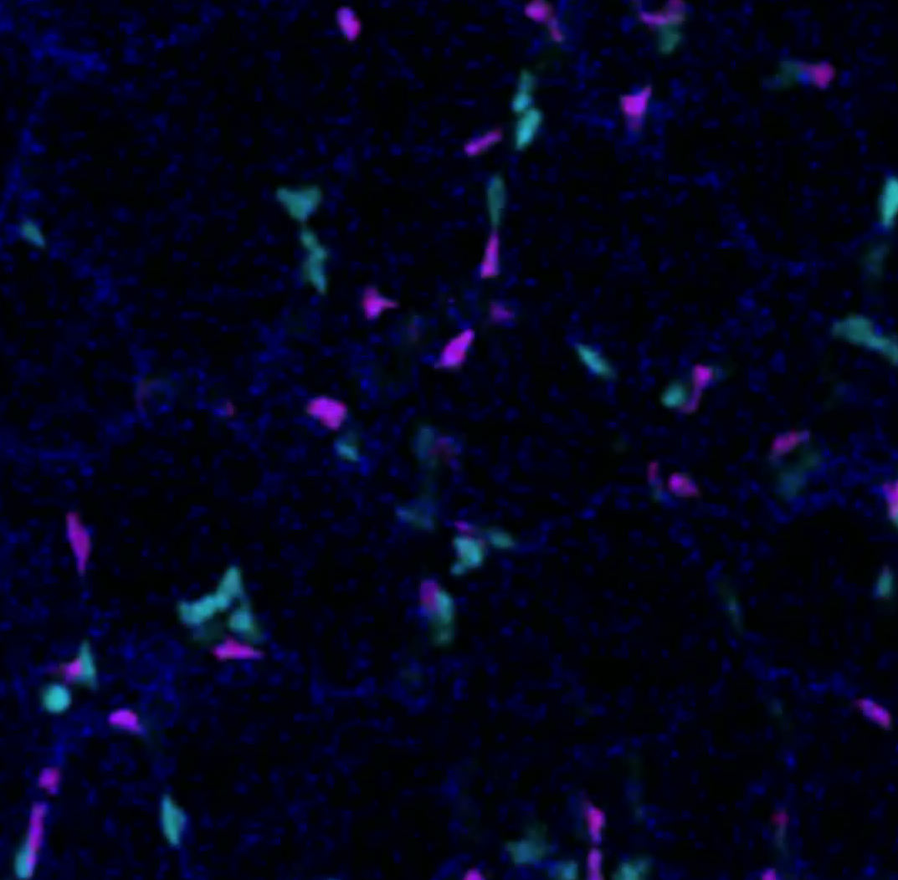
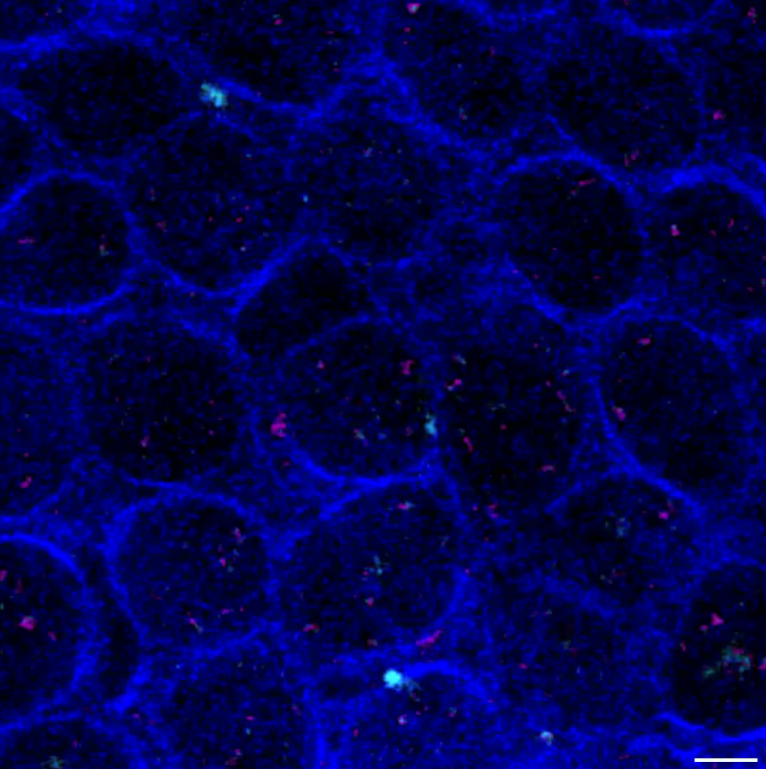
3.5 P14-GFP CD8⁺ T cell motility in the small intestine
crypts is independent of CD103
Day 8
Day 14
P14-GFP CD103^{+/+} P14-CFP CD103^{-/-} Second harmonics
Notes:
3.5 P14-GFP CD8⁺ T cell motility in small intestine crypts is independent of CD103 Naïve P14-GFP CD8⁺ T cells CD103^{+/+} (cyan) and P14-CFP CD103^{-/-} CD8⁺ T cells (magenta) were transferred in equal numbers to B6 mice and infected with LCMV 1 day later. A piece of jejunum was excised (see methods) and imaged in the crypt at days 8 (left) and 14 (right) after LCMV infection. Second harmonics are shown in blue. Scale bars are 30υm.

Slide 6
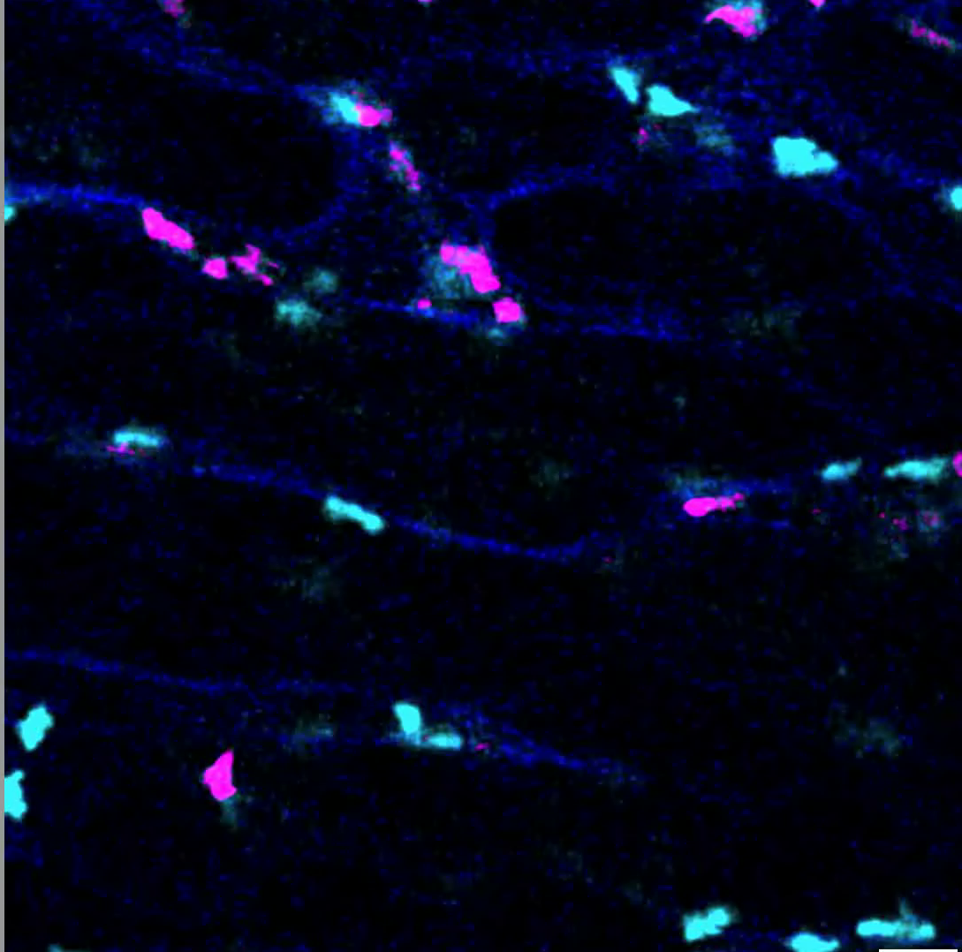
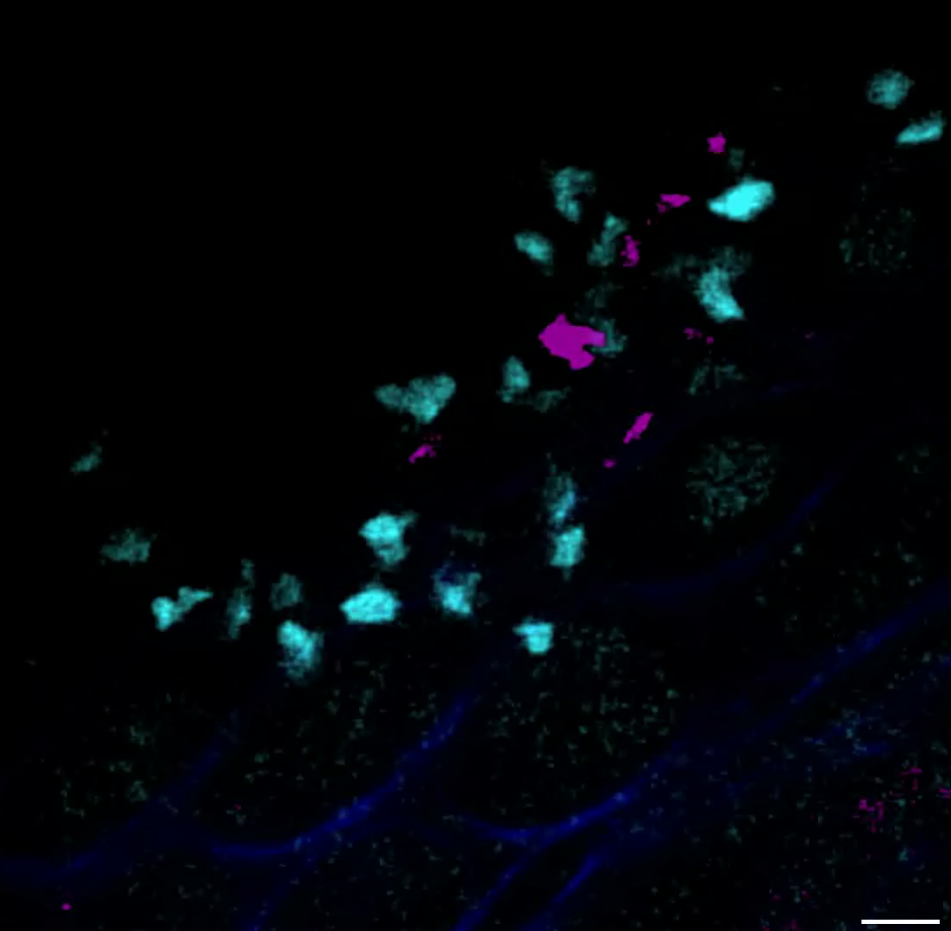
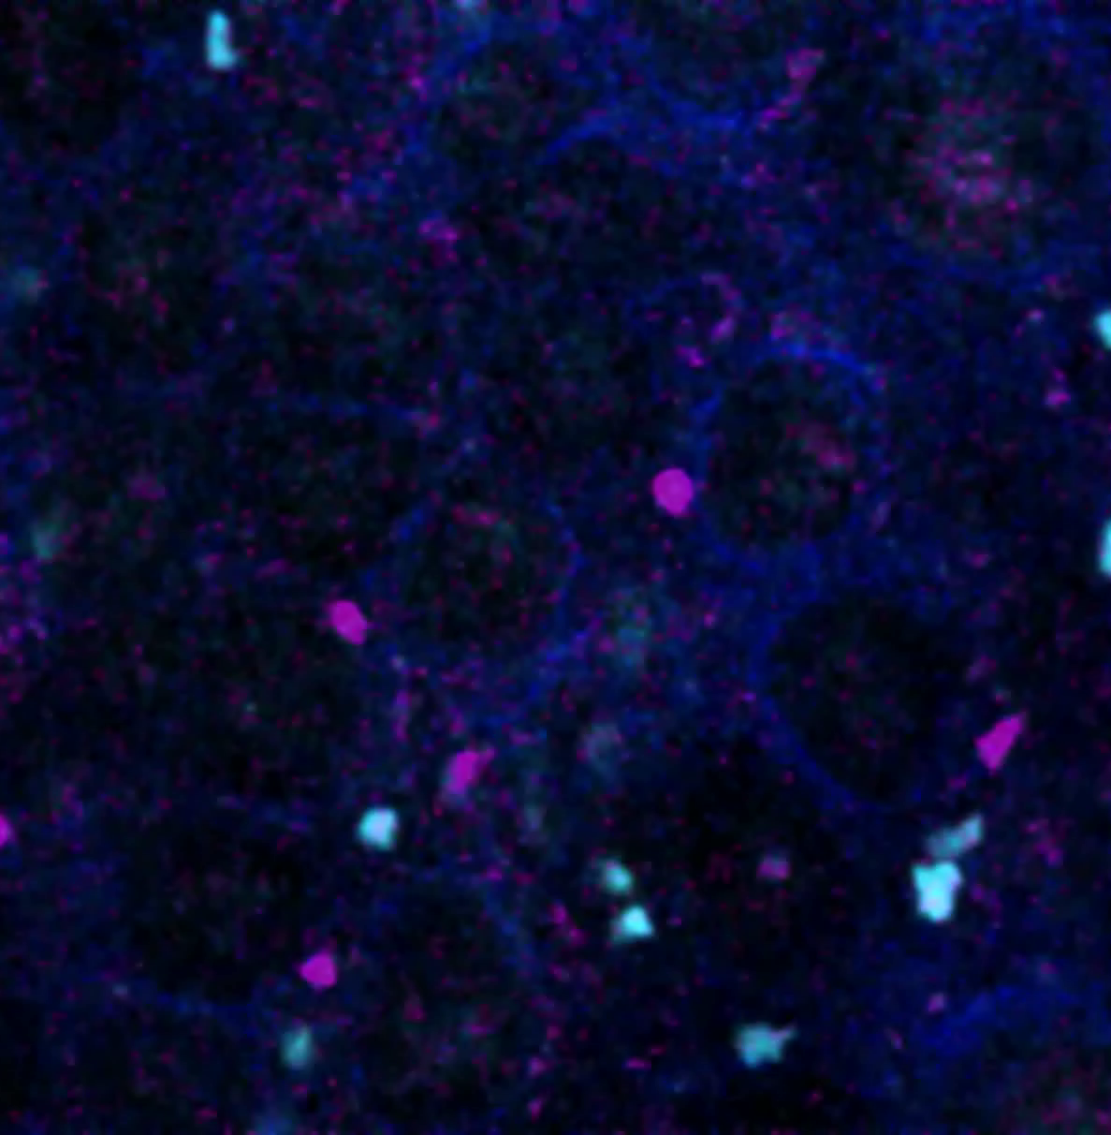
3.6 P14-GFP CD8⁺ T cell motility in the small intestine
villi is independent of CD103
Day 8
Day 14
Day 30
P14-GFP CD103^{+/+} P14-CFP CD103^{-/-} Second harmonics

Slide 7
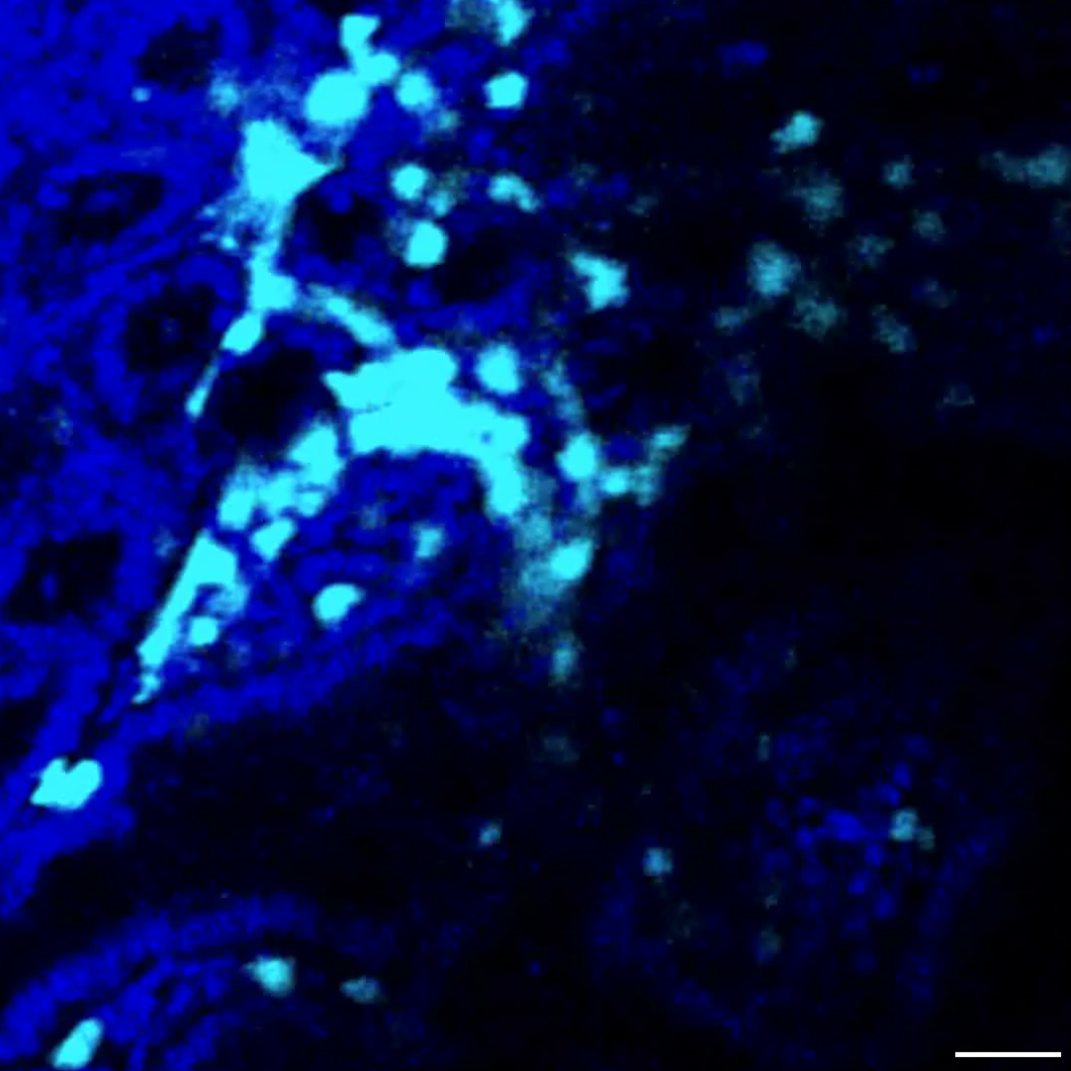
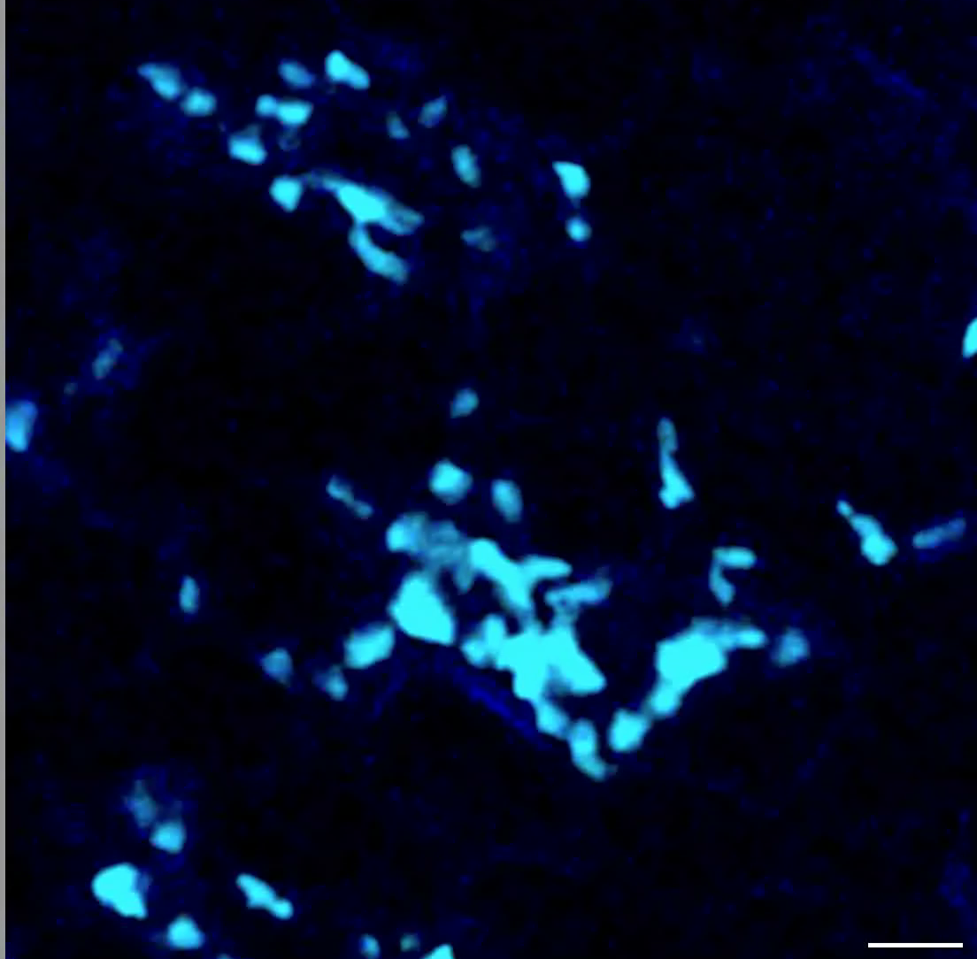
3.7 Self-specific CD8⁺ T cell motility in the small intestine
Day 5
Day 5 + anti-K^{b}-SIINFEKL
OT-I-GFP Hoescht

