Slide 1
"What a long, strange trip it's been": A Retrospective of the Data Curation Network
Jake Carlson, University of Michigan
Lisa Johnston, University of Wisconsin - Madison
Mikala Narlock, University of Minnesota
Notes:
Jake Introduce – note that we’re recording and will share the slides!

Slide 2
Outline
Title slide: welcome, introductions
The early days (Jake)
  Researchers were faced with new requirements to share their data. Early support efforts explored how to understand the data (profiles), bring campus groups together (groups/institute), and make data sharing as impactful/useable as possible (curation)
  Based on the challenges we collectively faced, we formed the Data curation
DCN launch + timeline (lisa)
Retro (Mikala)
  Grown into a successful collaboration across 17 member institutions (and growing!).
  To understand our progress over the last 7 years, we held a “Project Retrospective” in march 2022…Our retrospective process
Results of Retrospective (Lisa)
  Our key findings
Future things we want to do (Mikala)
Conclusion

Slide 3
The early days…
Notes:
Jake

Slide 4
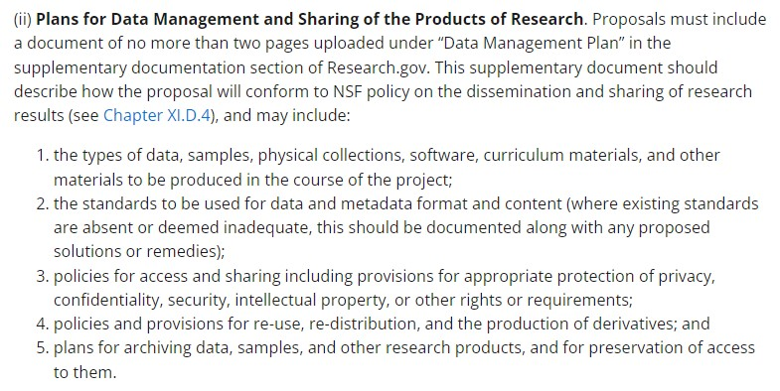
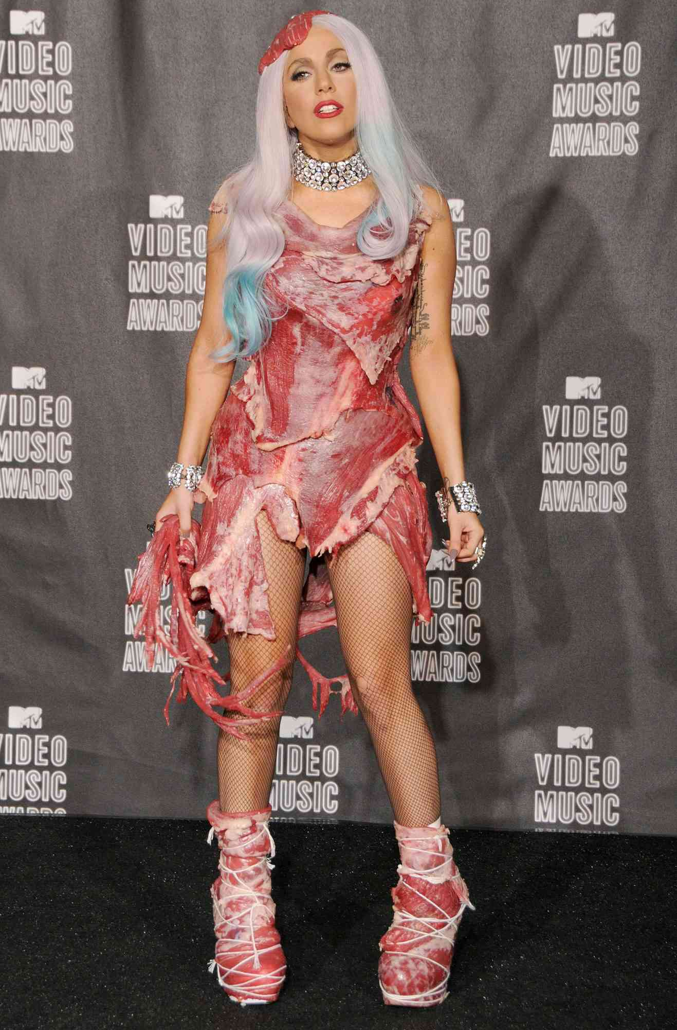



Remember 2010?
Notes:
The twilight series, Lady Gaga’s meat dress at the MTV Music Video Awards, Angry Birds as the game that we were all playing…
And the NSF released their Data Management Plan requirement. Researchers applying for grants from the NSF now had to include a 2 page document (Data Management Plan) describing how they would conform to the NSF’s policy on the dissemination and sharing of research data. In particular, researchers had to describe their data, the standards that would be used in documenting and formatting the data, how people would be able to access the data, what people could do with it once they had the data and how access to the data would be preserved.
This caused a lot of consternation and confusion among researchers as many of them had not had to consider these types of questions before. Libraries saw an opportunity to apply our knowledge, skills and expertise with managing and sharing information towards working with research data to provide services to address researcher concerns.

Slide 5
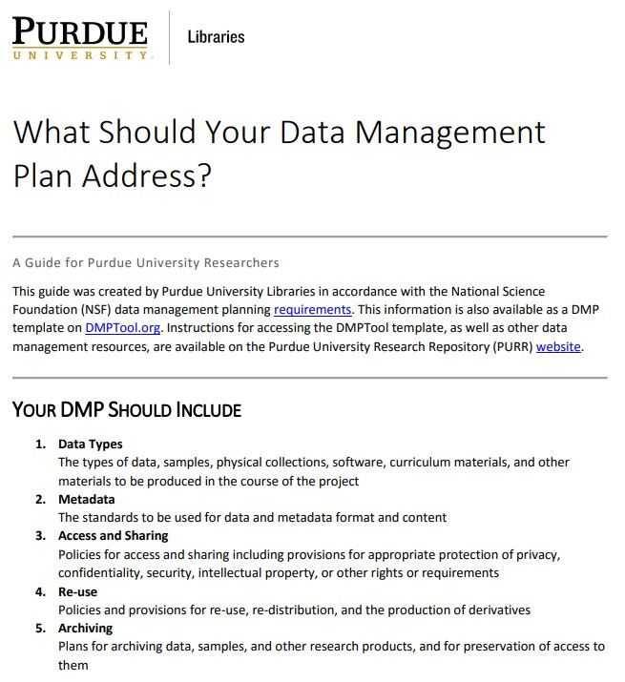
Response from Libraries
A proliferation of guides on how to create a Data Management Plan.
A recognition that we needed to know more about how researchers managed, shared and preserved their data.
Notes:
The NSF announcement was referred to as the announcement that launched 1k LibGuides. This is the guide that I had a hand in creating back when I was at Purdue University. But we quickly recognized that just guiding researchers through creating a DMP was not going to be sufficient. Researchers needed to be able to follow through on the promises that they were making in their DMPs, which would require a greater level of understanding about the data and researcher needs.
Data management itself being ill defined concept at the time, there was not much written about data management as a topic in the literature and so it was difficult to know where or how to start.

Slide 6
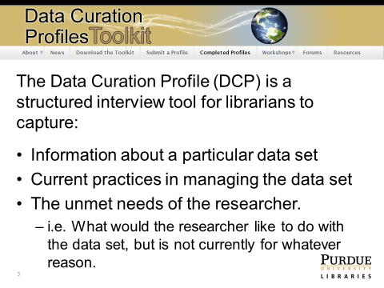
Data Curation Profiles
DCP Toolkit:
https://docs.lib.purdue.edu/dcptoolkit/
DCP Directory: https://docs.lib.purdue.edu/dcp/
Notes:
One of the first things that I worked on at Purdue was something called the Data Curation Profile Toolkit. The DCP Toolkit was designed to be used by librarians as a means to gather the information they might need to really understand a researchers situation in making a data set of theirs more widely available. is essentially a reference interview on steroids.

Slide 7

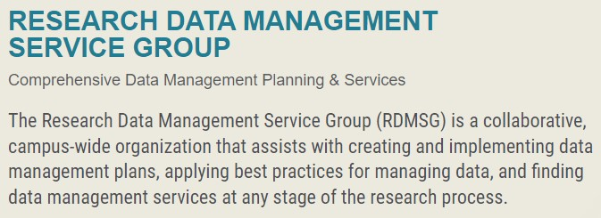
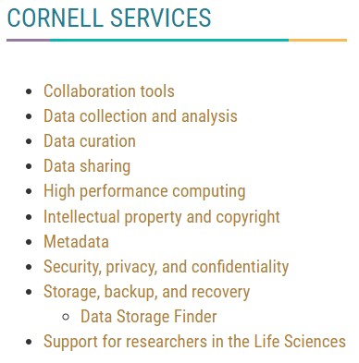
Research Data Management Group at Cornell
Notes:
Another early effort by libraries to address researcher needs around data sharing was the Research Data Management Group at Cornell. Managing, Sharing and working with data requires different types of services and resources, more than any one department could provide on their own. The Cornell Libraries formed working partnerships with the IT units, Office of Research and others to form their university wide Research Data Management Group. They engaged in research early on to better understand how researchers were responding to the DMP requirement, but have continued on and developed an incredibly useful guide to building readme files and created the Data Storage Finder tool to help researchers navigate through the many options they had for storing their data. The Data Storage Tool has been adopted by many other universities, including Michigan.
I’ll also say that Cornell’s Research Data Management Group has served as the model for Michigan’s Research Data Stewardship Initiative and other campus wide communities at other universities.

Slide 8
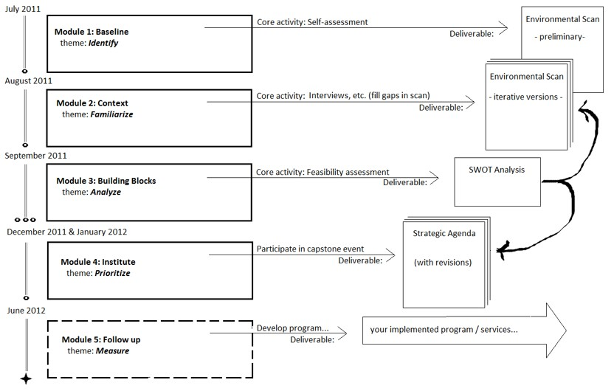
ARL / DLF E-Science Institute
2011-12
Notes:
The ARL-DLF E-Science institute was another initiative designed to help prepare academic libraries to understand and address the emerging needs for data services. Here too, we recognized the need to work collaboratively with our peers given the scope and complexity of research data.
70 institutions went through the 1st iteration of the e-science institute and many more went through the second and third offerings.
Five stages:
Environmental scanning - what services relevant to managing, sharing and preserving research data were offered by the institution and by whom? (The Library and others)
Interviews of researchers - what data were they generating, what were they doing with it and what were their needs for it?
SWOT analysis - analyzing what was learned
Develop a strategic agenda to identify and prioritize areas for investment at an individual institution
Measure the progress made (6 month follow up report out)

Slide 9
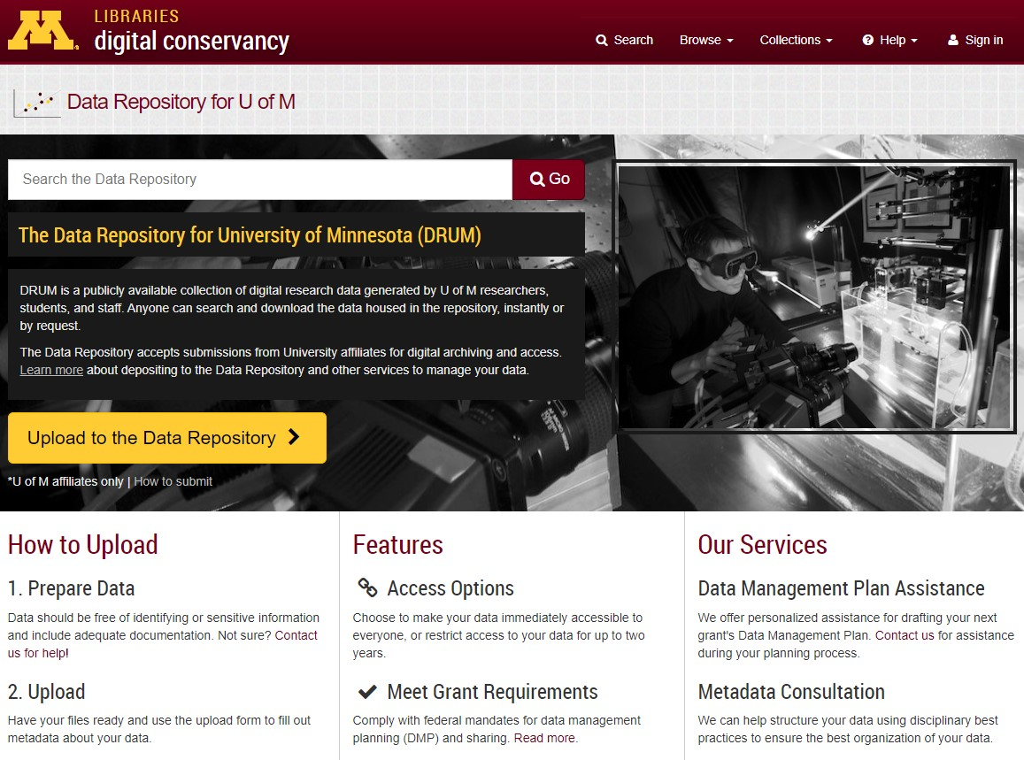
Data Repositories
Notes:
Libraries also saw their institutional repositories being used as a way to share the data in ways that would satisfy federal agency requirements, and in some cases Libraries developed stand alone data repositories such as DRUM at the University of Minnesota.
However, we did not want these repositories to be dumping grounds for poorly organized or described data sets. If we invested into data IRs we wanted them to be useful not just for people producing data who needed to satisfy the data sharing requirement but for consumers of data as well. We want the data that we host to be understandable, trusted and reusable as possible. This requires that we curate the data, that we invest staff time and energy into reviewing the data, the documentation and the connection between files to ensure that the data is as valuable as it could be in our repository.

Slide 10
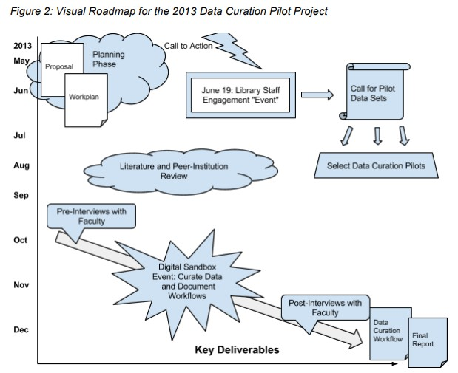
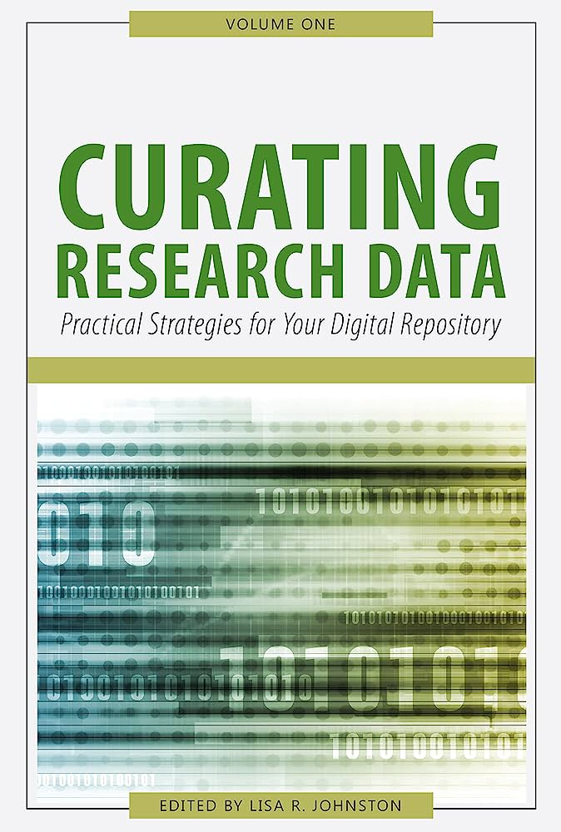
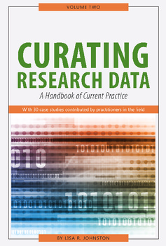
What is Data Curation
Johnston, L.. (2014). A Workflow Model for Curating Research Data in the University of Minnesota Libraries: Report from the 2013 Data Curation Pilot. University of Minnesota Digital Conservancy. http://hdl.handle.net/11299/162338
World Cat listing https://www.worldcat.org/title/969352704
World Cat listing https://www.worldcat.org/title/966989181
Notes:
However, The concept of data management was not well formed back in 2010 let alone data curation. We needed not just to define data curation but to operationalize it and make it something that could be operationalized and actionable by librarians.
Lisa did a masterful job in researching data curation as a concept and in recruiting experts in the field to define the current practice of data curation and to provide practical strategies for how it could be done.
She then took it a step further and tried an experiment with librarians at the University of Minnesota. She give librarians access to several data sets for them to review and then told them to try and curate the data as best they could. This study provided some important insights about our preparedness to do data curation work and the nature of the time and labor involved in doing it.

Slide 11
Sum up the challenges
Librarians have relevant skills and expertise for digital preservation and sharing, but we needed to develop an understanding as to how to translate and apply them to research data
  Leverage library / archival best practices
  Understand specialized research data types and researcher needs for them
  Make curation work actionable (not just conceptual)
Lots of work happening, but in isolation at institutions. Given the scope and the scale of research data, we needed to transcend our institutional boundaries.
  Break down barriers across institutions
  Developing shared common practices and infrastructure

Slide 12
Data Curation Network
Notes:
Lisa start
In light of these challenges, a group of six librarians at six institutions came together and asked, why not try to work together to address these as a collective instead of individuals operating in silos?

Slide 13

Forming the Data Curation Network
Five Key Areas
• build a shared curation workflow between the DCN and the data curators at each member institution;
• define a staffing and governance model for our network;
• craft a 6-year implementation plan to serve as a roadmap in growing curation offerings and membership;
• develop a financial plan focused on the long-term sustainability of the DCN
• assess our networked approach to curating research data
Radical Independence:
“Why not work together to address our common challenges? – And not just to share information, but to actually do the work of curating the data that ingest into our repositories?”
Notes:
This discussion led to the six PIs submitting for and being awarded a one year planning grant from the Alfred P. Sloan Foundation to better investigate what a cross-institutional data curation network would look like. This included understanding what a shared curation workflow would look like, how it would be staffed and governed, what financial sustainability would look like, and developing a roadmap to grow the network and its curation offerings.
This work, from the outset, was rooted in radical interdependence, which is something that we’ve actively worked to maintain in the DCN. Radical interdependence is about relying on one other to work together to common challenges– to go beyond information sharing and to actually do the work of curating research data ingested into repositories. It’s about being able to say I don’t know can you help, and trusting that your colleague will show up for you and complete their work.

Slide 14
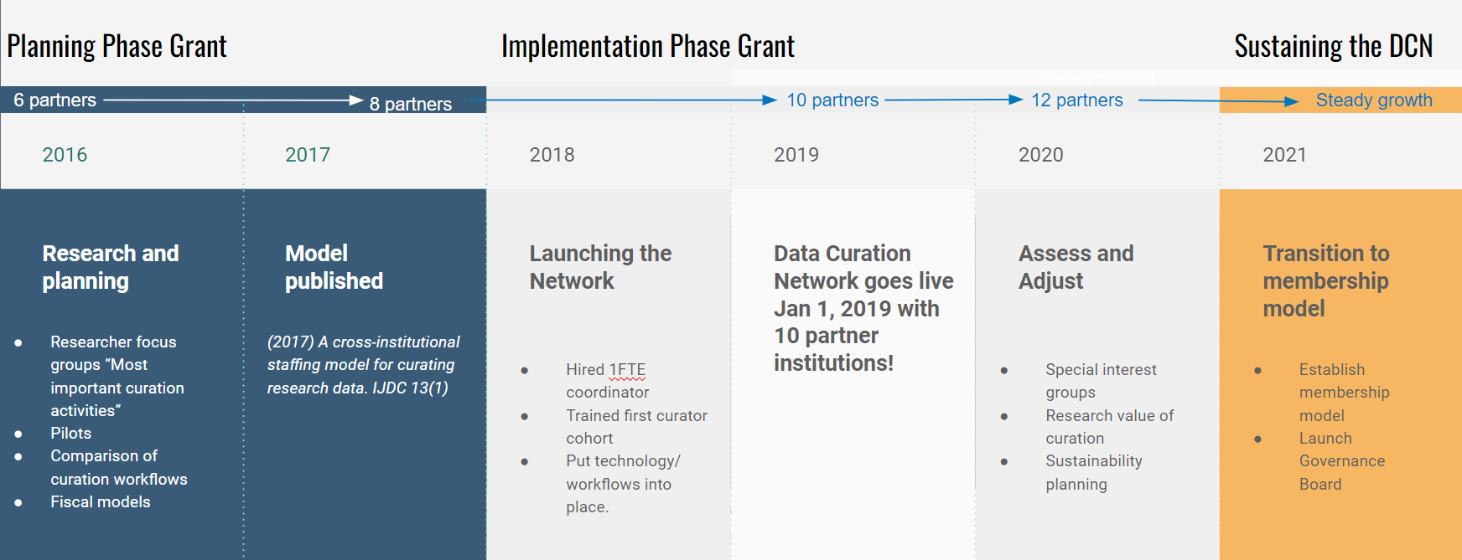
Data Curation Network Timeline
DOI: https://doi.org/10.2218/ijdc.v13i1.616
Notes:
This is just a high-level timeline of the development of the DCN. After the one year planning grant, the Alfred P. Sloan foundation awarded the team a three year implementation grant, which also provided enough funding to hire a full time project coordinator. This full time staff person was essential for developing and launching the shared curation workflow, which officially launched January 2019. During this implementation phase, the team put into practice what was learned during the research and planning phase. In 2021, the DCN transitioned to be a fully member funded project, rolling off the grant funding into our sustainability and growth model.
I wanted to highlight that the community started with six partners and six librarians in 2016, growing to 8 partners in 2017, 10 partners in 2019, 12 partners in 2020, 14 partners in 2021, and 17 partners in 2022. Starting in 2018, the community also grew beyond just the PIs from each institution, as partners started adding curators to the community. This means that we started to grow both in terms of number of participants and in cohesion.

Slide 15
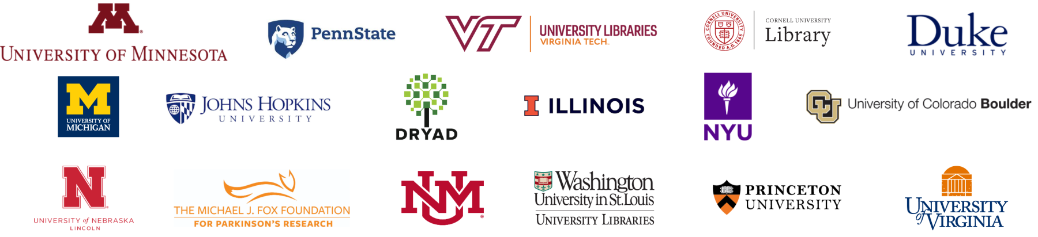
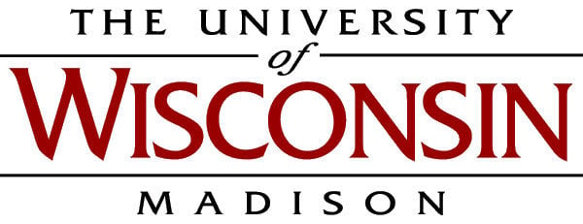

Data Curation Network - 19 members and growing!
New in 2023!
Notes:
Mikala Start
And this has been essential as we’ve continued to grow and onboard both new institutions and new curators into our network – we’re now up to 19 member institutions with the University of wisconsin and university of pennsylvania joining us in FY 23.

Slide 16
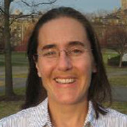
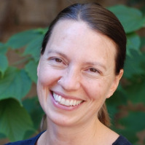
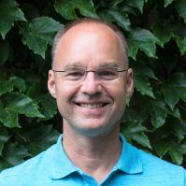
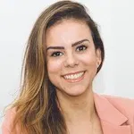
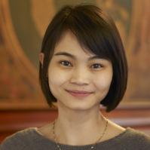
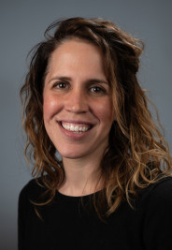
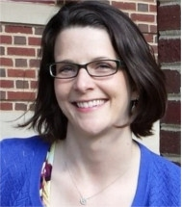

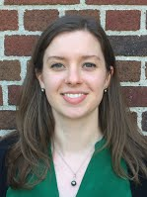
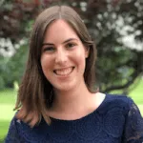
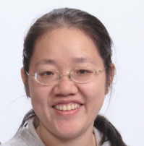
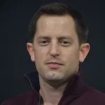
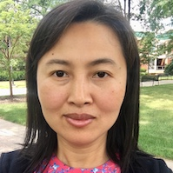
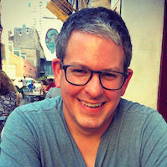


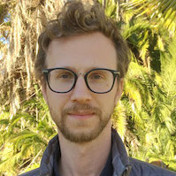
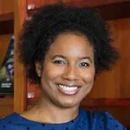
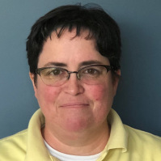
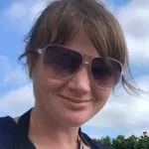
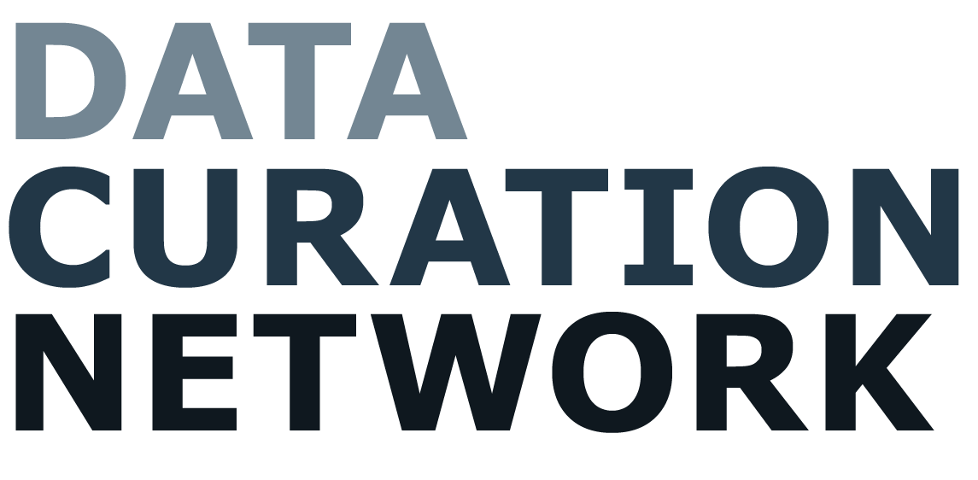
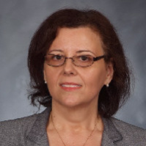
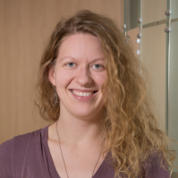

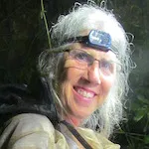
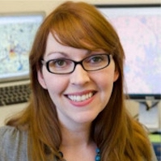
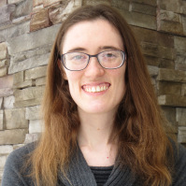
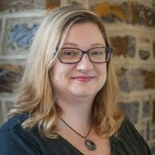
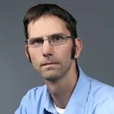
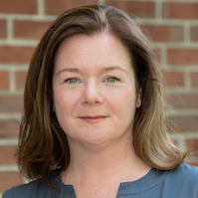
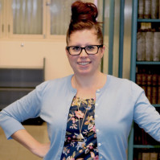
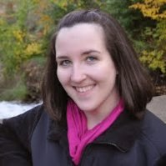


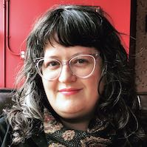
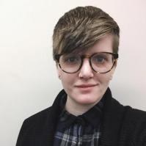
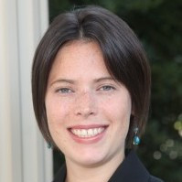
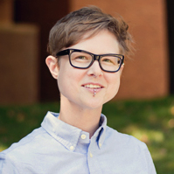
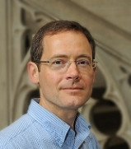
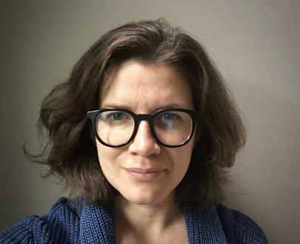
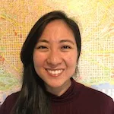

Mission
Trusted community-led network that enables researchers to openly share data in ways that are
Ethical. Reusable. Better.
Notes:
Now that we’ve been in operation for more than 7 years, what is the DCN now? We are a community-led network of curators advancing open research by making data more ethical, reusable, and understandable. We are an active community of data stewards and curation practitioners who share knowledge and time to collaboratively curate research outputs and advance the data curation profession.

Slide 17






Curation
Education
Primers
Research
Community
Access curation expertise across our cross-institutional network
Offer professional development opportunities for an emerging data curator professional community
Contribute to openly shared data curation best practices
Join a DCN special interest group addressing a specific topic: big data, human subjects, racial justice, + more
Be a part of the virtual community for discussion, training, networking events, more
Ethical. Reusable. Better.
Ethical. Reusable. Better.
datacurationnetwork.org
datacurationnetwork.org
Notes:
Some of the things the DCN provides and facilitates are listed here, but this includes Curation: from 17 partner institutions, soon to be 19, we have nearly 50 individual curation experts who are the foundation of our cross-institutional curation network. The DCN also serves as an educational resource for data curators, through workshops and the data curation primers, as well as a community of practice that offers interest groups, professional development opportunities, and networking.

Slide 18
Why a retrospective?
Project debrief
Visioning and future direction
Onboarding / Staff transitions
Notes:
The DCN has been active in these areas, and more, since 2016. In March 2022, we conducted a project retrospective and brought together many project personnel, to better understand the process of planning and implementing the DCN. We were at an interesting point in time: we’d transitioned to be member funded, we had launched our governance model and process, I had recently been hired, and Lisa Johnston, who had served as the PI and leader for the grants, was preparing to transition to a new position outside of the DCN. So, we decided to host this project retrospective to better understand: what were the successes and challenges we faced in building, launching, and sustaining the DCN? Where are we headed for the next phase of our work? And, how can we ensure that this transition in personnel is as smooth as possible?

Slide 19
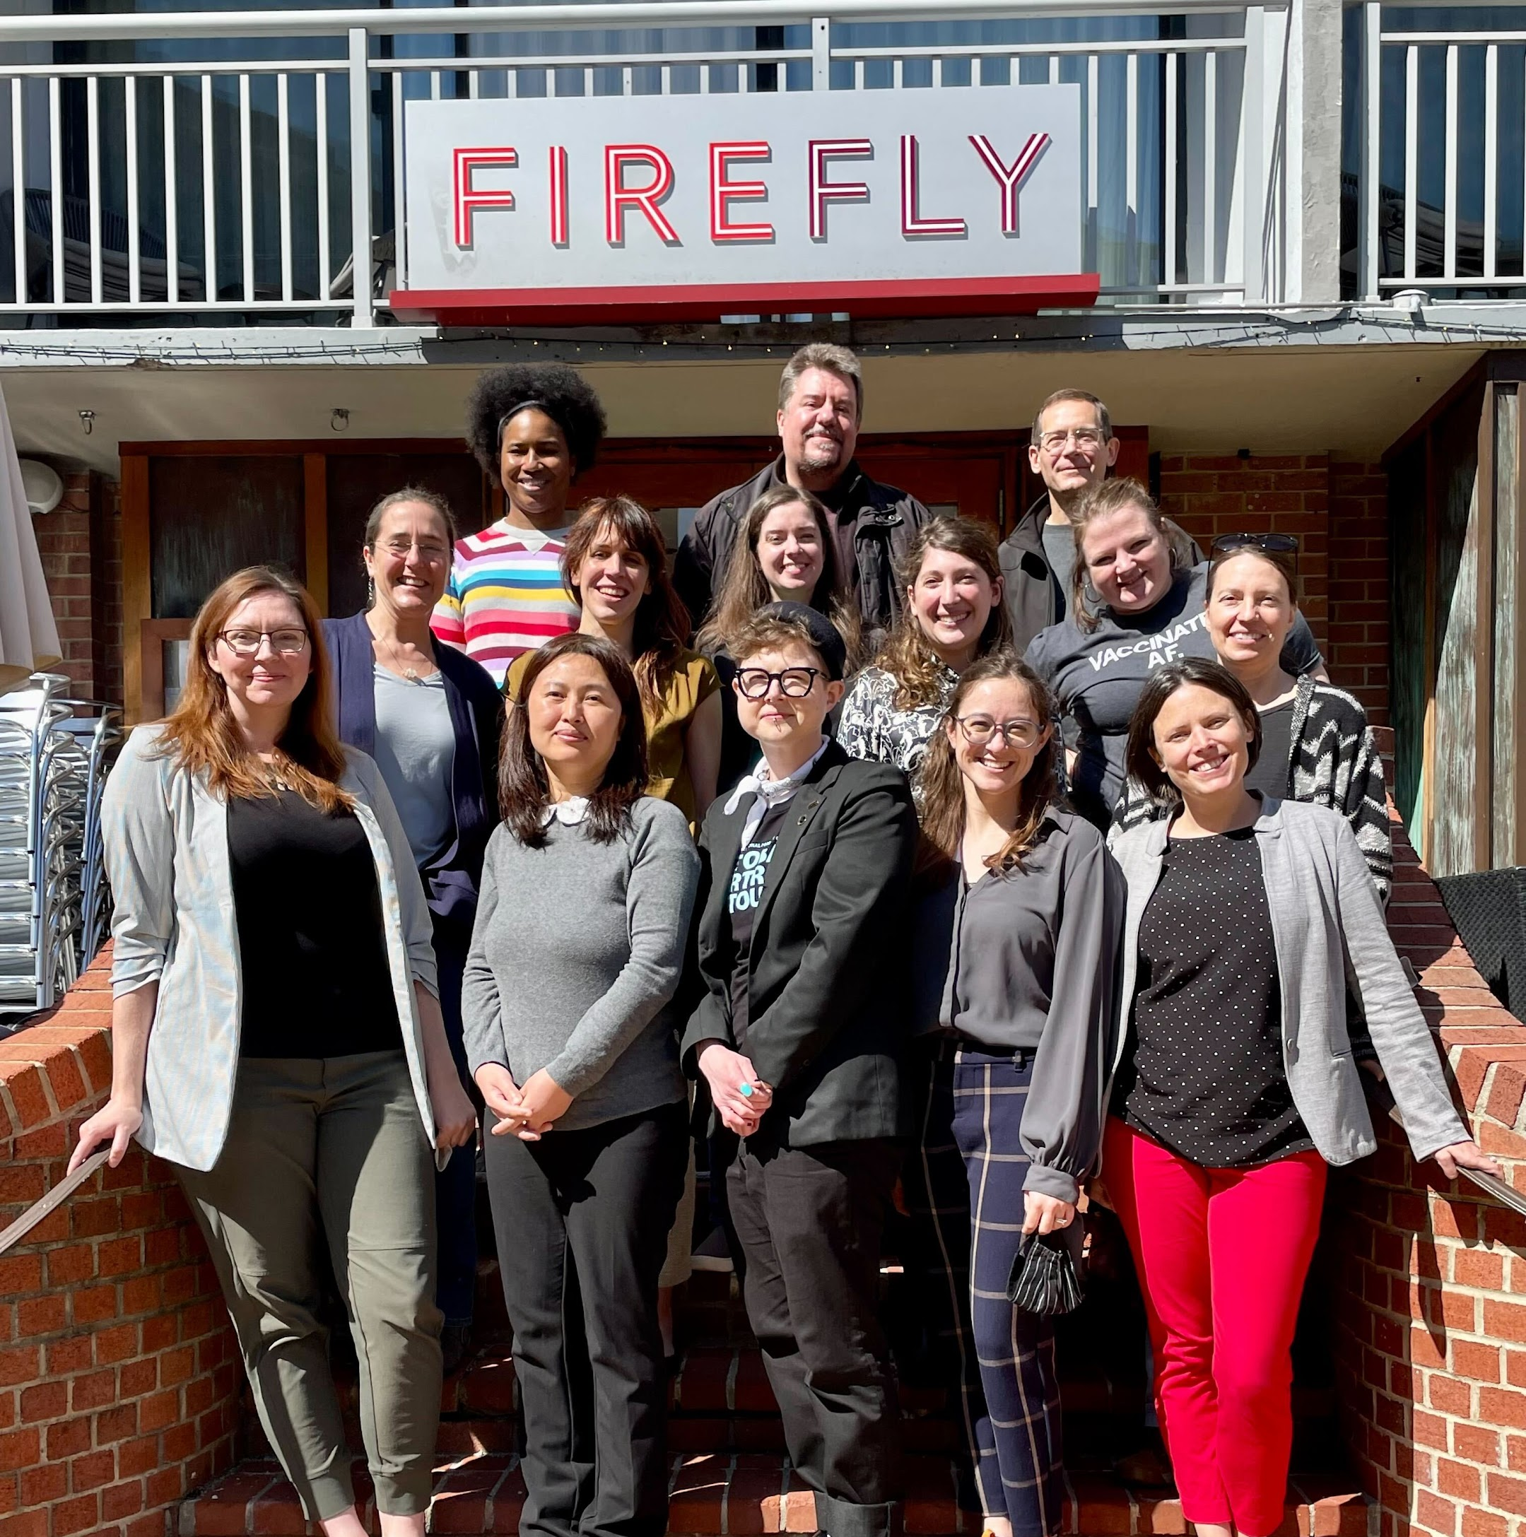
Project Retrospective Process
Structured and unstructured time
Different activities and prompts
Celebrating the good, acknowledging the challenges
Notes:
Lisa and I collaborated on a retrospective meeting agenda that, over the course of 2.5 days, set out to accomplish all of those things. We think this effort was successful, and wanted to quickly share how we organized this meeting. We balanced structured and unstructured time and conversations– sometimes we had very specific questions and conversations, and other times took a broad prompt and had a wide ranging discussion.
We also brought in different activities and prompts to make sure we were engaging folks in mechanisms they were most comfortable with– whether that was free writing time, jamboard activities, or just conversation.
And, we incorporated both celebrating the accomplishments of our community while acknowledging the challenges and shortcomings.

Slide 20

Retrospective Report
doi.org/10.3998/mpub.12782791
Jake Carlson, Mikala Narlock, Mara Blake, Joel Herndon, Heidi Imker, Lisa Johnston, Wendy Kozlowski, Cindy Xuying Xin, Sophia Lafferty-Hess, Hoa Luong, Wanda Marsolek, Jennifer Moore, Dorris Scott, Cynthia Hudson Vitale, Briana Ezray Wham, & Sarah Wright
2023 Michigan Publishing Services
Notes:
We captured our discussions through notes, and as a team, authors a retrospective report published through the University of Michigan Press in March 2023, which you can access at this DOI. And now I’ll turn it over to Lisa!

Slide 21
Some of our findings
Notes:
Lisa Start

Slide 22
Top 10 Successes
Administrative structures
Tool-based structures
Trust-Based structures
#10
#9
#8
#7
#6
Research informed practice
Data Curation Primers
Actionable Workflows
Leveraging the Collective
Radical Interdependence
#5
#4
#3
#2
#1
Engagement beyond Libraries
Training and Education
Documentation Tools
Data Service Models
Community to Learn / Grow

Slide 23




Success: Research informed practice
I have lots of research data curation needs!
It’s challenging to offer data curation services!

Slide 24


Success: Data Curation Service Model

Slide 25





Success: Training and Education
Data Curation Primers
Just in time training for how to curate code and specialized data types
http://z.umn.edu/dcn-primers

Slide 26

Continued Efforts
Source: Educopia, “Community Cultivation Field Guide”
Notes:
Mikala start:
Thanks Lisa! The DCN has accomplished some amazing things over the years, but this is not to suggest that there haven’t been challenges in developing, launching, and sustaining the DCN. In fact, there remains work to be done. We’re are in the ongoing development phase, highlighted in the Community Cultivation Lifecycle here, which requires a continued focus on fostering a healthy community, demonstrating our sustainability, as well as ensuring we are growing to meet the changing needs of our community. But, we are in a fortunate position to not only be financially stable, but also have an active and involved community that will help us address some challenges on the horizon.

Slide 27
Future challenges
Homogeneity of DCN Members
Balance interests and goals with capacity
Maintaining trust and community
Notes:
One future challenge we see is the homogeneity of our members. We are primarily R1s and all well-resourced institutions. We want to be sure that the DCN is welcoming to all institutions, regardless of their type. We are here to support curators looking for a community. In the coming years, we will continue to find ways to serve as a welcoming and inclusive community for curators– and remember that your institution doesn’t have to be a sustaining member to participate in the DCN.
Another challenge will be balancing our interests, our goals, our research projects with our very real and limited capacity. I am the only full time staff member of the DCN– everyone else participates on top of their day jobs. So while there are many exciting opportunities and interests, we have to be sure that we are moving strategically so as not to burn ourselves out.
And lastly, as we grow, we’re reflecting on our radical interdependence at the fabric of the DCN. We know that the trust between members and the community is one of the key benefits of the DCN. As we continue to onboard new members and institutions, we will need to be thoughtful and intentional about building and maintaining trust and community.

Slide 28



On the horizon…
Supporting data communities through data management support
Collaborative metadata application
Data repository characteristics
Notes:
Looking more broadly at the data curation profession, there are exciting new challenges and opportunities on the horizon and happening now
Supporting Data Communities– Recently the DCN collaborated with Ithaka S+R on an NSF funded project to better understand the data management and sharing needs of data communities. Data communities are “formal or informal groups of scholars who share a certain type of data with each other, regardless of disciplinary or institutional boundaries,” and the results of this workshops demonstrate that there is a lot for room for supporting these communities.
Another interesting and challenging opportunity is collaboration across IRs with specific regards to metadata application. Recent work through the NSF funded Realities of Academic Data Sharing Initiative, based at the association of research libraries. They have recently done some research into metadata completeness in participating IRs, and learned that many institutions are applying metadata in slightly different ways, which can make it hard to compare apples and apples. Plus, by the time the metadata gets to an aggregator level, like DataCite, the records are less complete than they are in the host IR.
These are just two challenges that we see on the horizon, but we’re excited about the possibilities of working with others in the RDM community to address these shared opportunities.

Slide 29
Q&A / Discussion
Key Takeaways:
Successful cross-institutional collaboration takes trust, reciprocity, and resource investment (time and money)
Retrospective process helps large, multi-year projects look back, celebrate successes, and prioritize for the future
jakecar@umich.edu
lrjohnston@wisc.edu
mnarlock@umn.edu
Notes:
So, to wrap up this long, strange journey, some of our key takeaways are that successful cross-institutional collaboration requires trust and vulnerability, and especially resources. The retrospective process can provide a structured reflection time to celebrate successes and prioritize for the future. And, many of us are facing similar challenges– and we don’t need to go through thos challenges alone.
And with that, we thank you sincerely for your time and would love to open the floor for questions and comments!

