Slide 1
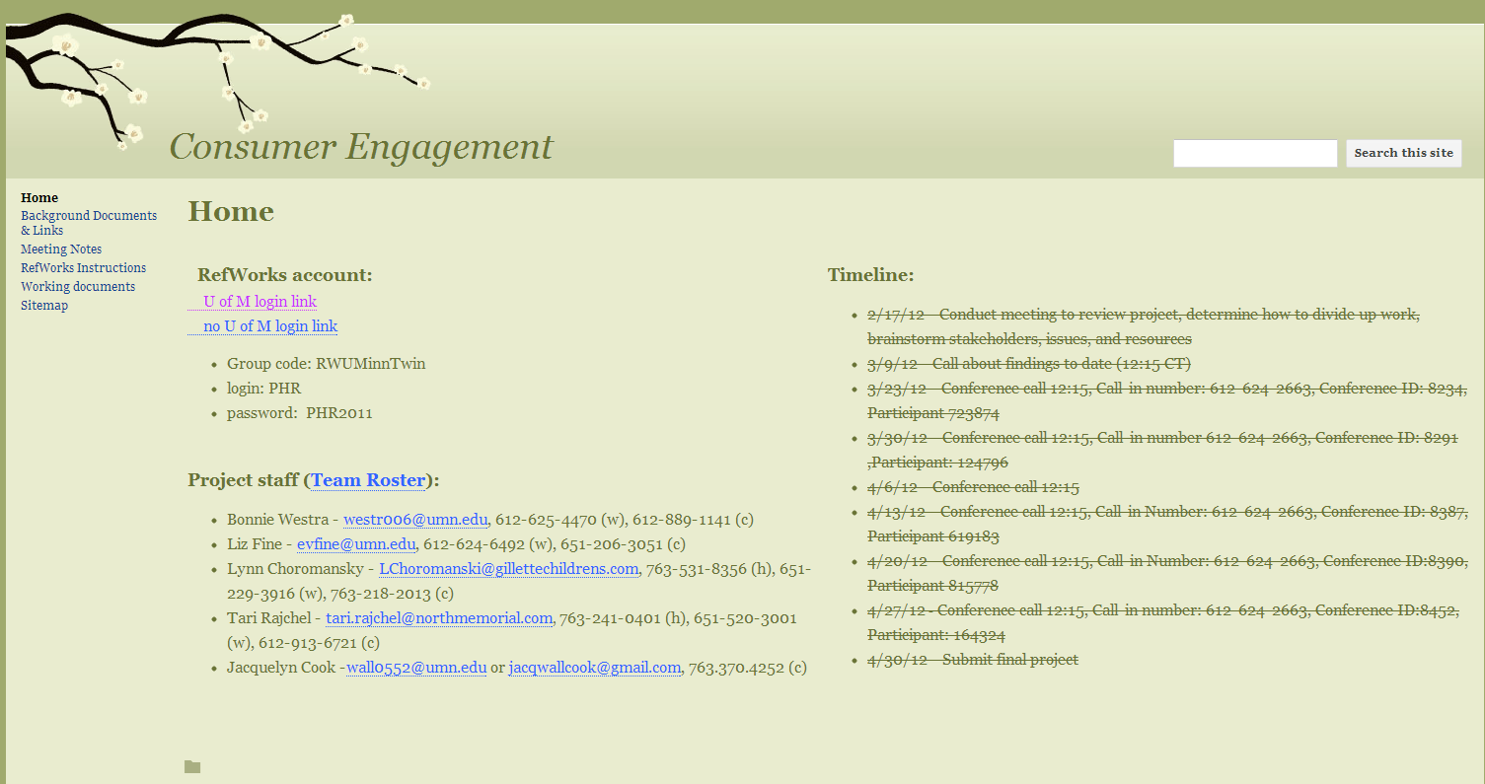

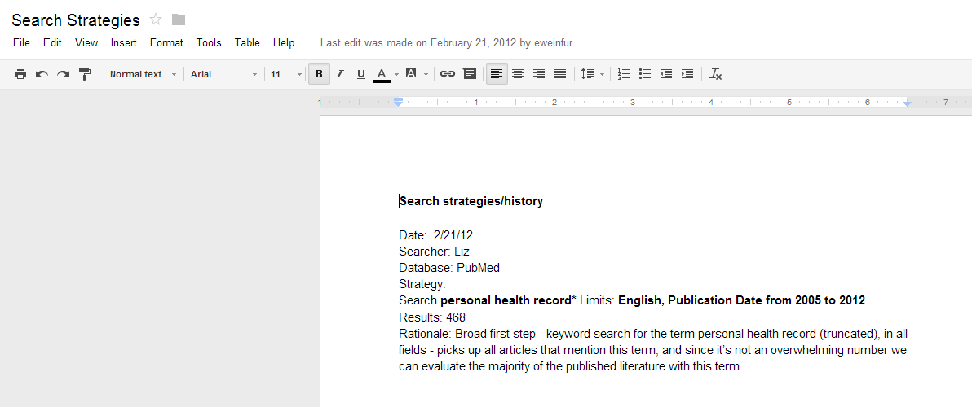
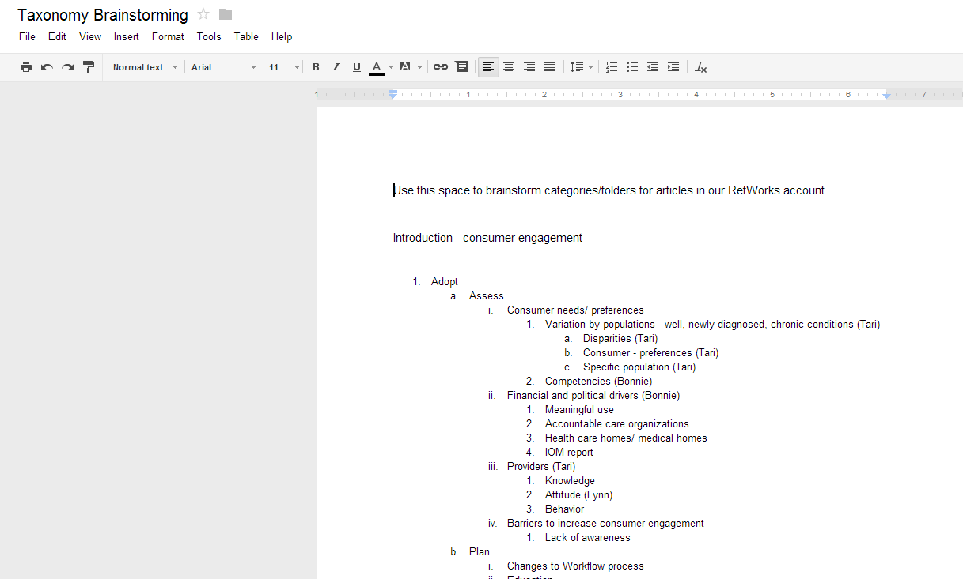

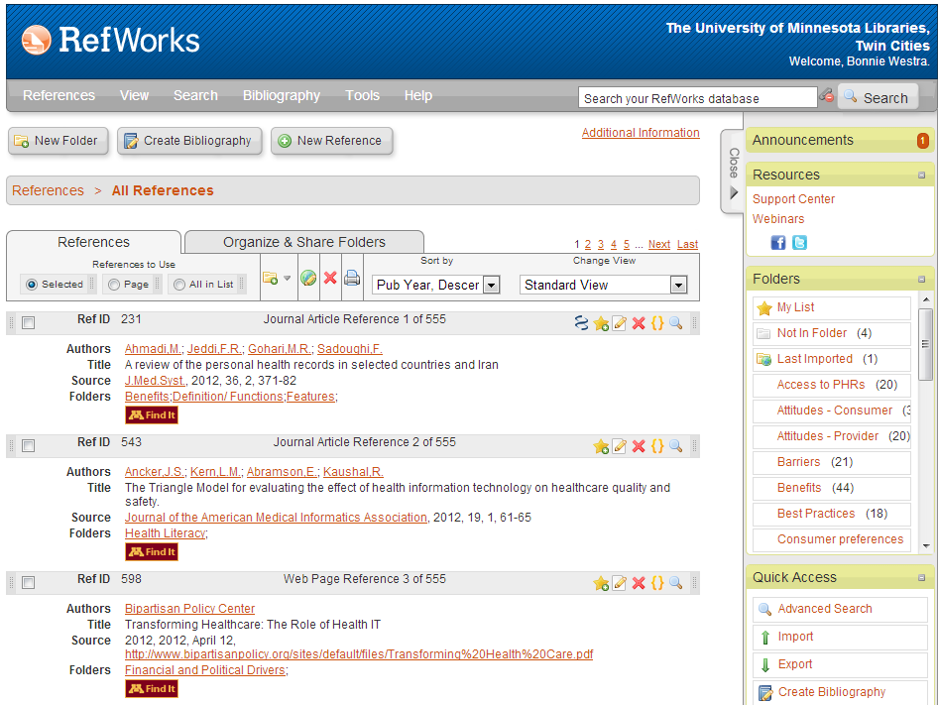


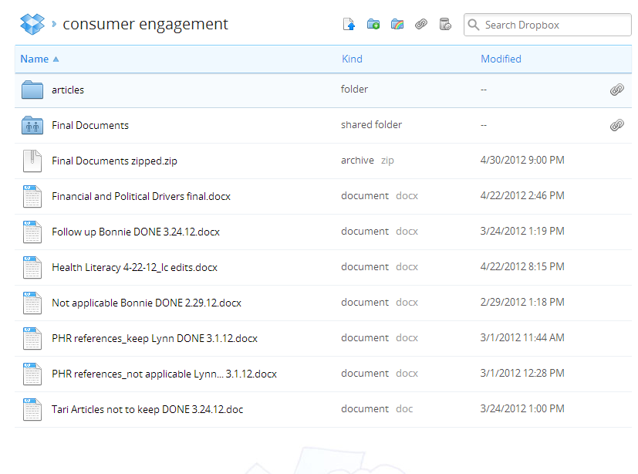
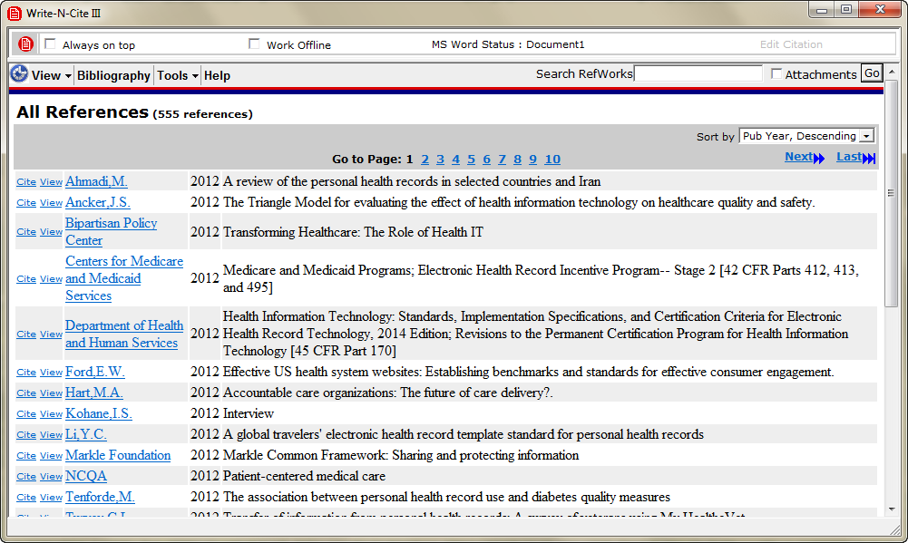



Managing a Literature Review Project with Collaborators at Multiple Institutions:
Tools and Strategies for the Search, Review, and Writing Processes
Elizabeth Fine Weinfurter, MLIS, Liaison Librarian, Health Sciences Libraries, University of Minnesota
Case Example: The Project
Technological Solutions
Tips for Managing Similar Projects
Conference Presentations and Exhibits
The Health Sciences Libraries
Project: Conduct an extensive literature review to develop a tool kit supporting consumer engagement in use of Personal Health Records (PHRs).
Deliverable: Approximately 20 brief (2-3 page) evidence-based documents for providers on the different aspects of consumer engagement with PHRs.
Timeline: Aggressive (2 months).
Team: Four nurse researchers from three different institutions, one librarian.
A suite of (mostly) free tools was employed to manage the elements of the search, review, and writing process, as well as managing the project overall.
Create a homepage for the project with the project scope, timeline, contact information, working documents, etc.
Consider Google Docs for collaborative writing, where format is not important.
Use a reference management tool to organize citations.
Think carefully about how you may need to pull lists of references throughout the project, and create your naming structure with these needs in mind.
Train team members on basic functionality of the tool, but designate one team member to oversee and clean up the data.
When working on manuscripts, consider Dropbox for easy collaborative storage of documents where format is important. Google Docs will not preserve formatting in a Word document.
Designate one team member to edit document(s) for consistency in content and visual layout.
For creating a website to host information about the project
Task Breakdown and Workflow
For collaborative writing and brainstorming documents
.
Task | Owner | Tools
Create project management site with timeline, team info, working documents, etc. | Librarian | Google Sites, Google Docs
Conduct literature search and keep track of strategy | Librarian | PubMed, Google Docs, RefWorks
Triage search results and sort into categories | Team members | RefWorks
Retrieve full text of articles | Librarian and team members | RefWorks
Synthesize evidence for subtopics into 2-3 page documents | Team members | Google Docs
Edit documents for consistency | Team lead | Dropbox
Format bibliographies for each document | Librarian | RefWorks
Create a master annotated bibliography for whole project | Librarian | RefWorks
For management of references
For inserting citations in manuscripts and formatting bibliographies
Contact information
Liz Fine Weinfurter, Liaison Librarian, University of Minnesota. eweinfur@umn.edu, 612-624-6492.
To store documents and files where format is important (such as manuscripts)

