Slide 1

Resilient Communities Project:
An External Review of Post-Development Projects
By: Hanife Cakici, Alejandra Defreitas, Chendong Pi, & Douglass Moon

Slide 2
Goals for this meeting
Discuss the results of data collected by the evaluation team
Shape recommendations for action

Slide 3
Ground Rules
Tell your truth without blame or judgment
Assume everyone has wisdom
Balance the limitations of data with the validity of people’s experiences
Be open and non-attached to the outcome
What people say here remains in the room
Fun matters

Slide 4
A Reminder
The data provided in the report and this presentation are residents’ perceptions, experiences, and realities

Slide 5
Overview of Evaluation
Background
  Resilient Communities Project
  Course: OLPD 8595 Evaluation Problems
Purpose
  Help the City of Minnetonka improve the public review process of future development projects
Methodology
  Fifteen (15) individual phone interviews and two group interviews with a total of 9 participants
Timeline
  December 2012-April 2013
Notes:
Public perceptions of these controversial projects
City of Minnetonka’s public engagement processes during review of development proposals

Slide 6
Findings from interview data
Why did the residents oppose to the project(s)?
How do they feel about the project(s) now?
What do they think of the public review process?
What recommendations do they have?

Slide 7
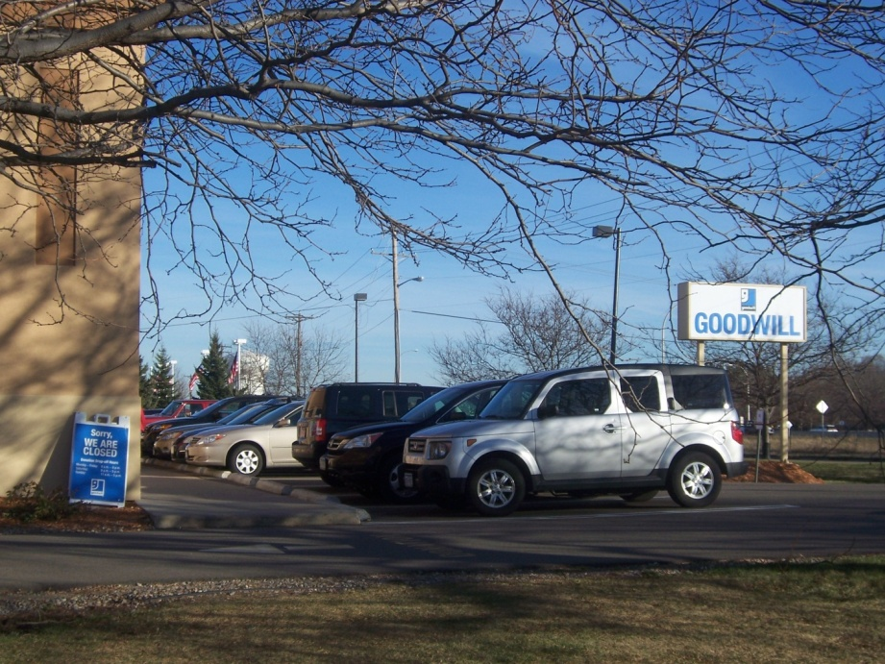
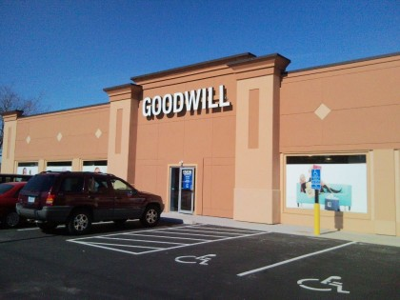
Project 1
Goodwill Industries

Slide 8
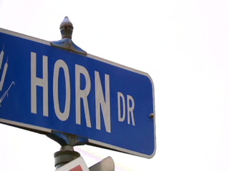
Goodwill Industries
Background
Lingering Concerns for Residents
  Traffic and road safety issues on Horn Drive Wayzata Boulevard
  Parking
  Noise and Light
  Trash
Notes:
Background:
Building near the Knollway neighborhood
Significant vocal opposition to the project

Slide 9

City’s Review Process
  Residents felt that they were “not listened to.”
Recommendations
  Stop signs
  Publicize planning sessions
  More resident feedback
Notes:
City’s Review Process?
City’s outreach
People heard through e-mail, newsletters, and postcards
Meetings held by private developer
Residents’ ability & Methods to raise their concerns
Petitioning, speaking at radio, mailing elected officials and attending planning & city council meetings
City’s willingness to listen and act:
Neither the city nor the developer was really “listening”… not willing to change the plan

Slide 10
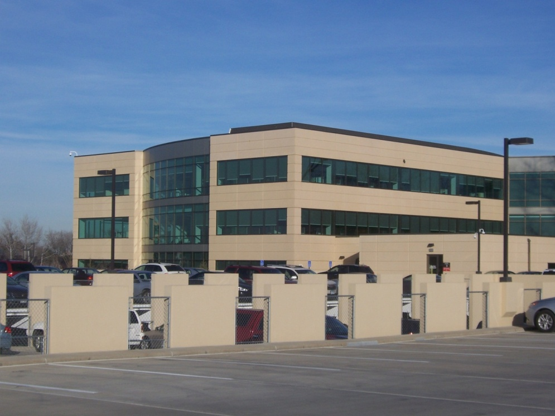
Project 2
Crest Ridge Corporate Center

Slide 11
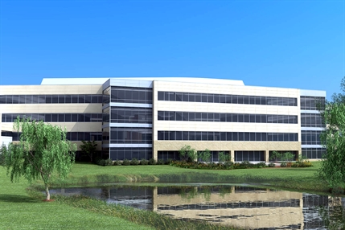
Crest Ridge Corporate Center
Background
Lingering Concerns for Residents
  Location of the project
  Scale of the project
Notes:
Background:
OPUS Northwest LLC plan to redevelop Wilshire, single-family residential neighborhood
14-acre project (two office buildings and parking structures)
Feedback from nearly 120 property owners →There was opposition
Study Participants:
4 (17%) participants through phone interviews
2 males, 2 females
Long-term residents (>8 years)

Slide 12
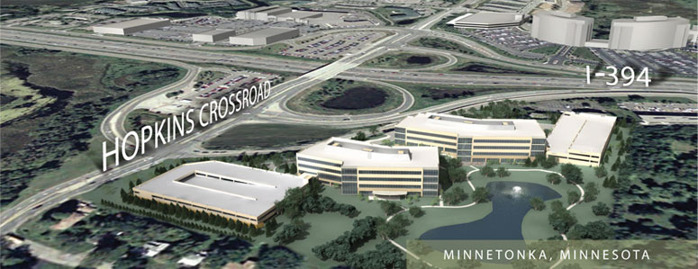
City Review Process
  Residents were listened to only because they fiercely sought what they needed.
Recommendations
  No specific recommendations
Notes:
City Review Process?
Outreach:
People heard through neighborhood meetings & postcards
Residents’ ability & methods to raise concerns:
Emails, telephone conversations, and attending meetings
City’s willingness to listen and act:
City listened to their concerns & adjusted plans
…But only because they effectively and persistently expressed their concerns

Slide 13
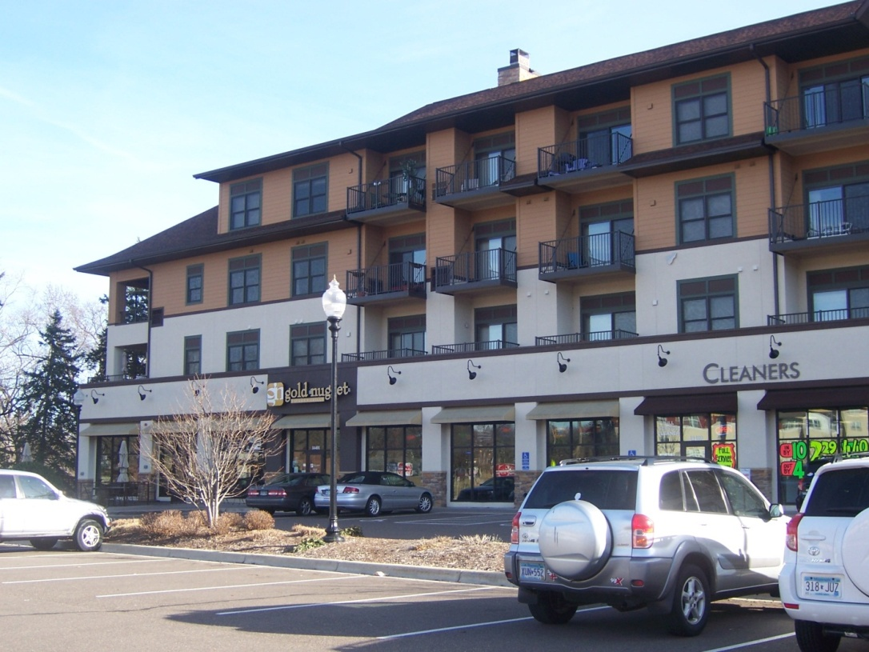
Project 3
Glen Lake Redevelopment

Slide 14
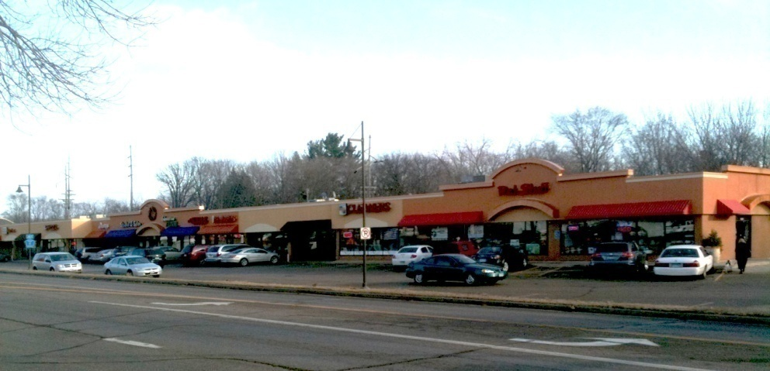
Glen Lake Redevelopment
Background
Lingering Concerns for Residents
  Density and Size
  Landscape
  Change in plans
Notes:
Background:
3 phase redevelopment of several commercial properties →condominiums, retail/service commercial and restaurants
Feedback from nearly 1000 residents
Significant vocal opposition
Study Participants:
11 (46%) people participated in either phone or group interviews
7 female, 4 males
All long-term residents (>8 years)

Slide 15
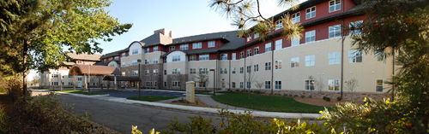
City Review Process
    Residents were listened to, but plan was already set
Recommendations
  Resident input before planning
  Hold public interest over commercial interest
  Use social media to publicize planning sessions
Notes:
City Review Process?
Outreach:
Postcards, audio recordings of meetings, and local newspaper
City Council members talked to residents directly
Residents’ ability & methods to raise concerns:
Planning Commission and City Council meetings, neighborhood meetings, petitioning, letters and emails
City’s willingness to listen & act:
Residents were listened to, but plan was already set
“City asked for residents’ input only because it is required by statute to do so”

Slide 16
Next Steps
How to act on what has been learned?
  More publicity; diverse options
  Clarify intentions
  Inform early; act early
  Clarify changes based on resident input

Slide 17
Questions?

Slide 18

Contact
140B Wulling Hall
86 Pleasant Street SE
Minneapolis, MN 55455
Email: mesi.umn@gmail.com

