Slide 1

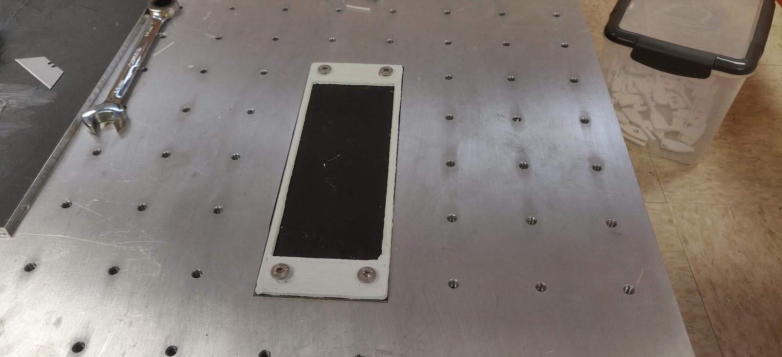
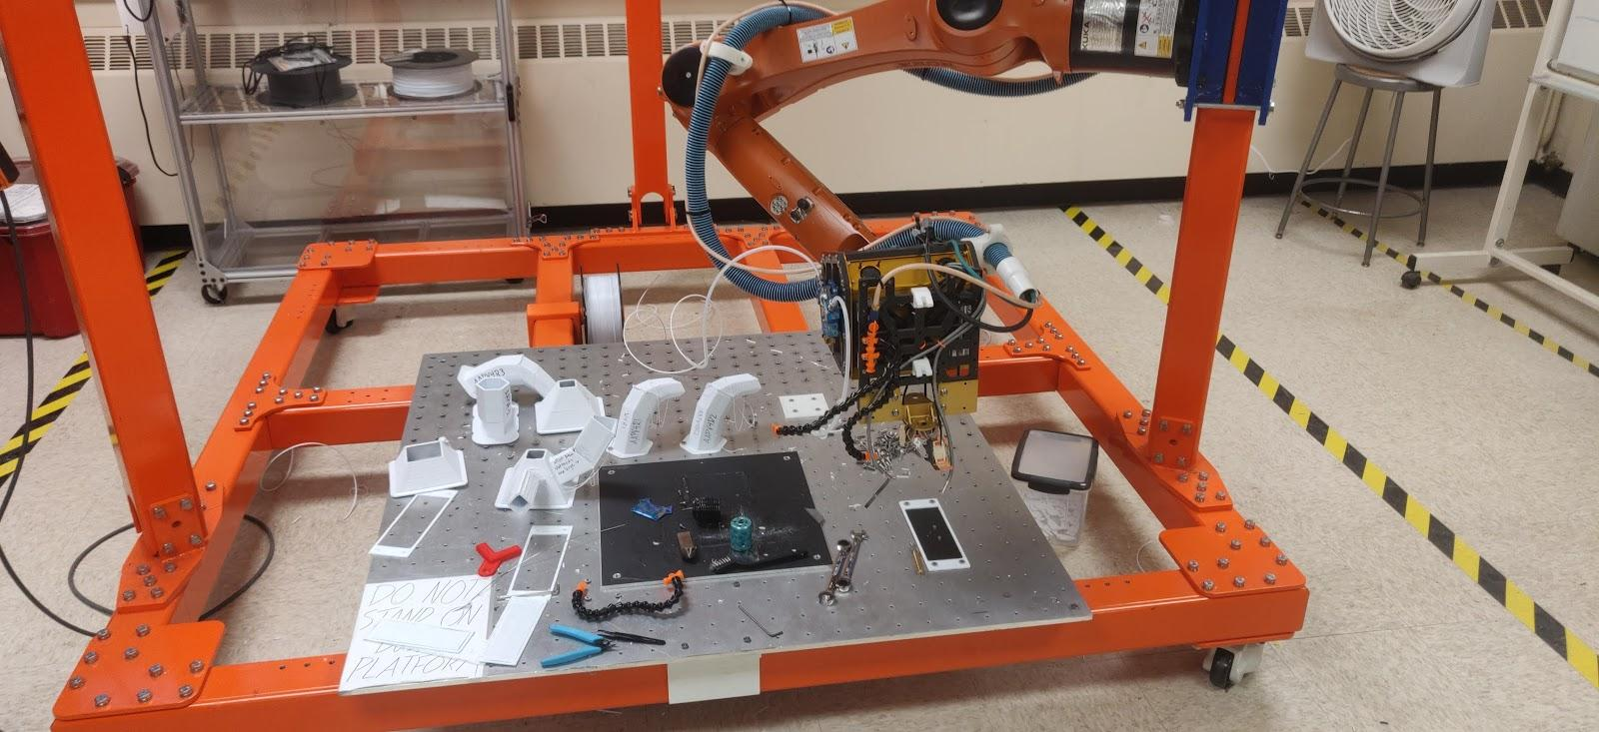
Strength Test Methodology for Testing large format
Robotic Arm 3D Printing
Derek Olesen, Ty Lindley, Gireesh Menta
Objectives: This study aims to observe fused deposition modeling 3D printing with the S1 robotic arm 3D printer. First, the goal is to learn and develop a method for producing consistent prints, then create and follow a methodology for testing the strength and adhesion between roads for different possible print settings from the robot.
Methodology:
The methodology for printing using the robotic arm printer follows a five-step process.
Create a solid model in Solidworks
Intro: What combination of print temperature, extrusion rate, printhead speed, and layer height produces the best parts using the Orbital S1 robotic arm 3D Printer?
Slice model for 3D printing in Simplify3D
Anchor print to hold specimens
Background:
The robotic arm 3D printer used for this research is a kuka 6-axis robotic arm using software from Orbital Composites. This 3D printer is designed to enable large format, variable axis printing. Variable axis printing enables the printhead to rotate during the print, which allows for faster printing without the use of support material. The printer is still in the early stages of development and as such the methodology for producing quality prints still requires research.
Results:
The testing methodology produced allows for specimen printing with minimal warping or bending in the parts. This is achieved by first printing an anchor piece which bolts to the build plate. The test specimen is then printed on the anchor, allowing its warping forces to be absorbed and producing a flat print. The method for locating the prints was also developed during the research. This method involves using the robot arm as a probe, which gives the approximate coordinates for the desired location of the part. These coordinates can then be used in Octopuz to ensure the part prints in the correct place.
Import Slice to Octopuz and create point cloud
Import code to linux computer
Conclusion:
This research conducted allowed for the development of a process for printing parts in very specific locations on the build plate, as well as a methodology for creating and testing specimens using the robotic arm printer.
Use linux to control print
Future Work:
In the future, ideally this methodology can be built upon and used in order to obtain meaningful observations regarding various strength properties of robotic arm printing.
Orbital S1 Printer

