Slide 1
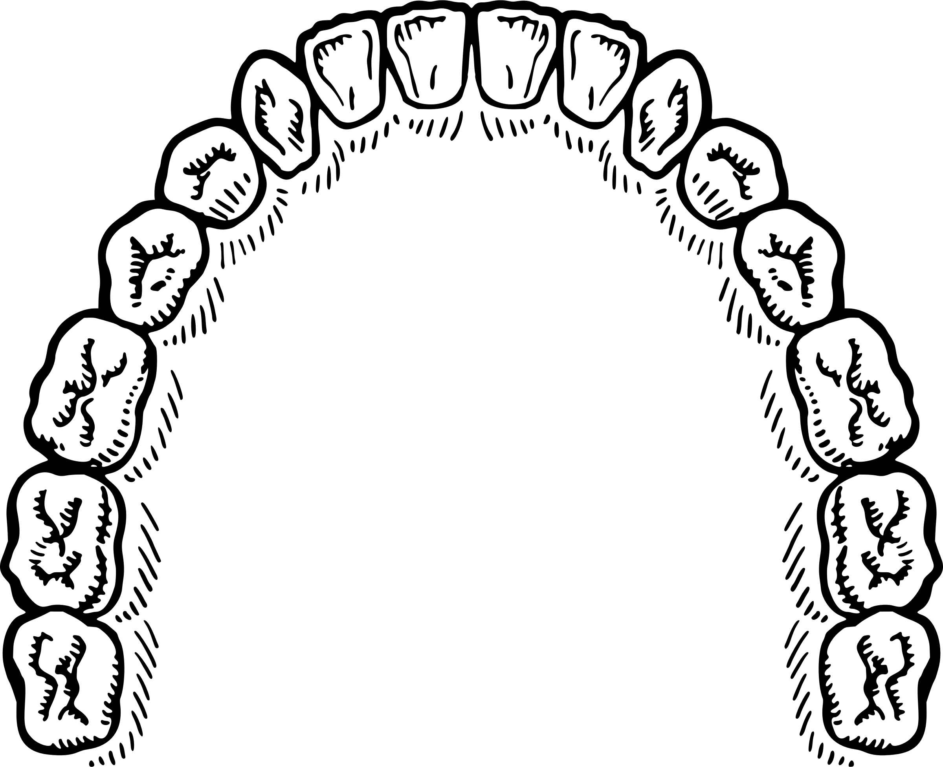

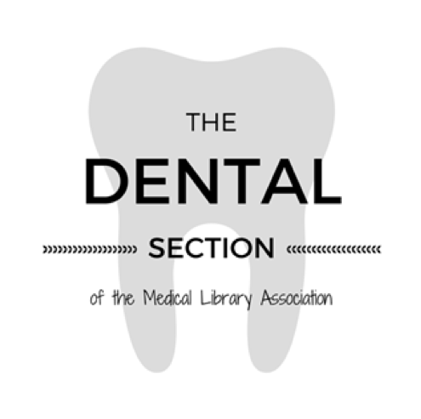

Non-Cognitive Predictors of Student Success:
A Predictive Validity Comparison Between Domestic and International Students
Non-Cognitive Predictors of Student Success:
A Predictive Validity Comparison Between Domestic and International Students
Looking Back to Move Forward:
A Reflection of the Dental Section’s History
Poster #106
SECTION HISTORY
Nicole Theis-Mahon, MLIS, AHIP
Amanda Nevius, MLIS
Nena Schvaneveldt, MSLIS, AHIP
1924 – First paper presented on a dental topic at Medical Library Association (MLA) Annual Meeting, Chicago, IL, by George B. Denton, Ph.D., Northwestern University Dental School, “Making a dental library active.”
1933 – Fourteen people invited to attend the MLA meeting with the intention of holding a round table on dental libraries. The leader prevailed upon those present to join MLA so a committee might be appointed to prepare programs for future dental round tables.[4]
These events correlate to significant advances in the dental field in the first half of the 20th Century.[5]
INTRODUCTION
“It is very
important that
dental librarians understand how
oral health is truly
connected to
overall health.”
Dental Section Member Interview
The history of the Dental Section illuminates our own history as communities of librarians with the Medical Library Association (MLA).
Knowledge and awareness of a community’s past can be used to guide members through change.
DESCRIPTION
Examined historical documents from the Dental Section
Conducted interviews with community members.
Established context via review and description of history of dentistry and its relationship to medicine
SECTION INTERVIEWS
When asked about their experience with the section, specifically regarding benefits and significant changes, interviewees highlighted:
Community
“It’s great being able to be a part of a niche community of librarians genuinely interested in seeing each other succeed.”
Knowledge Sharing
“It’s become really important to not only be able to help our constituents find the literature, but we also really need to be knowledgeable about scholarly communications in the dental world.”
Passion for Dentistry
“People in the section who truly care about the field.”
HISTORY OF DENTISTRY & MEDICINE
2660 BC Egypt - The oldest recorded dentist in the world recognized as both “chief of dentists”[1] and “chief of physicians.”[1]
Interim time period when dental care was primarily performed by tooth pullers who were sometimes licensed surgeons but other times not.
1728 - Pierre Fauchard of France again introduced the idea of dentistry as a branch of surgery. This time the idea stuck and spread around the world.[2]
1840 - The renewed separation of dentistry and medicine in the United States (US) occurred with the establishment of the first dental college in the US – Baltimore College of Dental Surgery. The founders originally intended it to be a specialty within Baltimore Medical College, but this did not occur, although the exact reason remains unknown.[3]
The history of a community of librarians informed by the history of the practitioners they serve is important to directing MLA’s future.
REFERENCES
1. Forshaw RJ. The practice of dentistry in ancient Egypt. Br Dent J. 2009 May;206(9):481–6.
2. Barnett R. The Smile Stealers: The Fine and Foul Art of Dentistry. 1 edition. London: Thames & Hudson; 2017. 256 p.
3. Otto M. Teeth: The Story of Beauty, Inequality, and the Struggle for Oral Health in
America. 1 edition. New York: The New Press; 2017. 288 p.
4.Dental Library Roundtable, Bulletin of the Medical Library Association. V, 22(2); v.22(2); 1933 Nov. p.74-77
5. American Dental Association. History of Dentistry Timeline. Access April 2, 2019. http://www.ada.org/en/about-the-ada/ada-history-and-presidents-of-the-ada/ada-history-of-dentistry-timeline

